Slide 1
Monday, February 10th, 2025
Week: 22
Period: 64
UNIT 8 :SPORTS AND GAMES
LESSON 3: A CLOSER LOOK 2
Grammar: THE SIMPLE PAST TENSE

Slide 2
Grammar
The past simple
Imperatives
Choose the correct answer A, B, or C.
Look at each picture and choose the correct answer.
Write the correct form of the verbs to complete the conversation.
Tell your friends what to do and what not to do at the gym.
Work in groups. Ask and answer questions about your last weekend.

Slide 3
Grammar
The past simple (Thì quá khứ đơn)
We use the past simple to talk about something that happened in the past.
Example:
I played badminton with Phong yesterday.
I was at the beach 2 days ago.
* Use: Dùng để diễn tả hành động xảy ra và đã kết thúc vào một thời điểm xác định trong quá khứ.
Trang tu thuong gap: yesterday: hôm qua, ………ago: cách đây, last +…......: qua, rồi, trước

Slide 4
Grammar: The past simple: Thì quá khứ đơn
* Form:
To be: (+)
I/ He/ She/ It was......
You/ We/ They were .......….
(-) S + wasn’t/weren’t + …
(?) Was/Were + S + …?
Ex: We .............at the festival last night.
He ..............late for school yesterday.
Yesterday............. a rainy day. (not)
Where ..............you two days ago?
were
was
wasn’t
were

Slide 5
Ordinery vebs: Động từ thường
( + )
S + V-ed/ V2 (cột 2).........
( - )
S + did not (didn’t) V.....
( ? )
Did + S + V................... ?
Short answer: Yes, S+did/ No, S+didn’t
watched
Ex: - He (watch) ............... TV yesterday.
went
- They (go)............ to school yesterday.
didn’t do
- Nga (not do) ................ last night.
- you (see) our teacher two hours ago?
Did see
Yes, I did./ No, I didn’t.

Slide 6
Choose the correct answer A, B, or C.
1.
There _______ an interesting match on TV last night.
A.
is
B.
were
C.
was
2.
My dad _______ a lot of tennis some years ago.
A.
plays
B.
played
C.
is playing
3.
I was at the gym last Sunday, but I _______ you there.
A.
B.
don’t see
C.
didn’t see
not saw
4.
The teacher _______ us about our homework this morning.
A.
B.
not asking
C.
doesn’t ask
didn’t ask
5.
_______ sleep well last night?
A.
B.
Did you
C.
Were you
Do you

Slide 7
2. Write the correct form of the verbs to complete the conversations
Nick: Hi, there.
Sonny: Hello, Nick. Did you have a nice weekend?
Nick: Yeah, it was OK. On Sunday, I (1. go) _______ fishing with my dad. How about you?
Sonny: Oh, I (2. have) _______ a good weekend, too.
Nick: Really? What _______ you (3. do) _______?
Sonny: I (4. visit) _______ the museum with my family, then we (5. eat) _______ at my favourite restaurant.
Nick: Did you watch football last Sunday
Sonny: Oh, yeah! My favourite team (6. score) _______ a fantastic goal!
went
had
did
do
visited
ate
scored

Slide 8
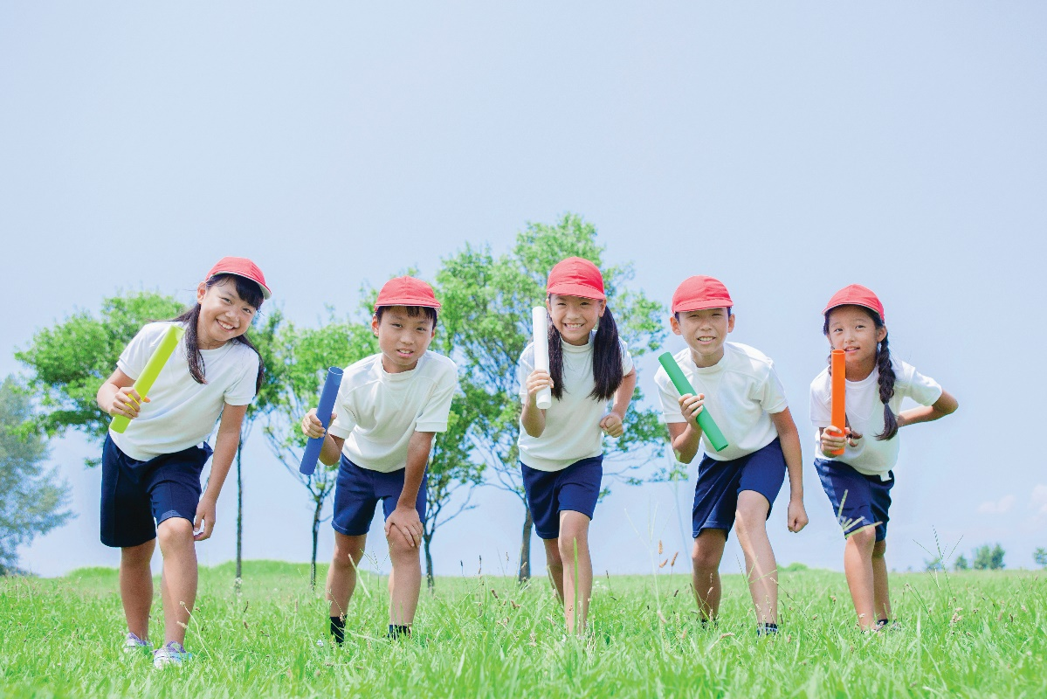
3. Work in groups. Ask and answer questions about last weekend.
A: Did you do any sport last weekend?
B: Oh yes, and I was exhausted.
C: Really? What did you do?
B: ........................
I played some games with my friends

Slide 9
Grammar:
Imperatives: (câu mệnh lệnh)
* Câu mệnh lệnh dùng đề ra lệnh, yêu cầu ai đó làm gì hoặc hướng dẫn làm gì đó.
* Form:
(+) V.
(-) Don’t+ V.
- It's chewing gum.
Eg: - Chew it.
- Don't swallow it.

Slide 10
* Vocabulary:
score (v) /skɔ:[r]/ : ghi bàn, ghi điểm
fantastic (adj.) /fæn'tæstik/ : tuyệt
chew (v) /t∫u:/ : nhai
swallow (v) /'swɒləʊ/: nuốt
tidy up (v) /'taidi ʌp/: dọn dẹp, làm cho ngăn nắp
lift (n) /lift/ : thang máy
V1 | V2
be | → was/were
go | → went
have | → had
do | → did
V1 | V2
eat | → ate (ăn)
see | → saw (thấy)
take | → took (cầm, lấy)
write | → wrote (viết)

Slide 11
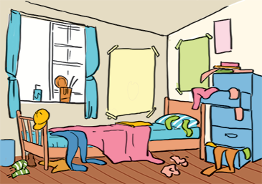
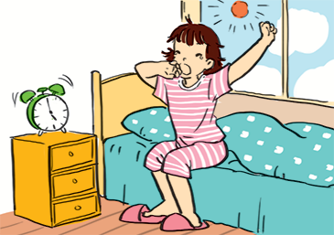
Look at each picture and choose the correct answer.
1. (Park / Don't park) here.
2. (Close / Open) the window. It's windy outside.
3. (Tidy up/Don't tidy up) your room.
4. Use / Don't use) the lift when there is fire.
5. Try / Don't try to get up early to do some exercise.

Slide 12
5. Tell your friends what to do and what not to do at the gym.
GYM RULES
Example:
- Change your clothes.
- Don’t speak loudly.
- Pay your fee first.
- Put on your trainers/ sports shoes.
- Listen to the instructor carefully.
- Don’t litter.
- Don’t eat or drink at the gym.

Slide 13
- Learn by heart the grammar notes.
- Do exercises in part B in the workbook.
- Prepare the new lesson: Communication

