Slide 1
Welcome to our class
CLASS 6A

Slide 2
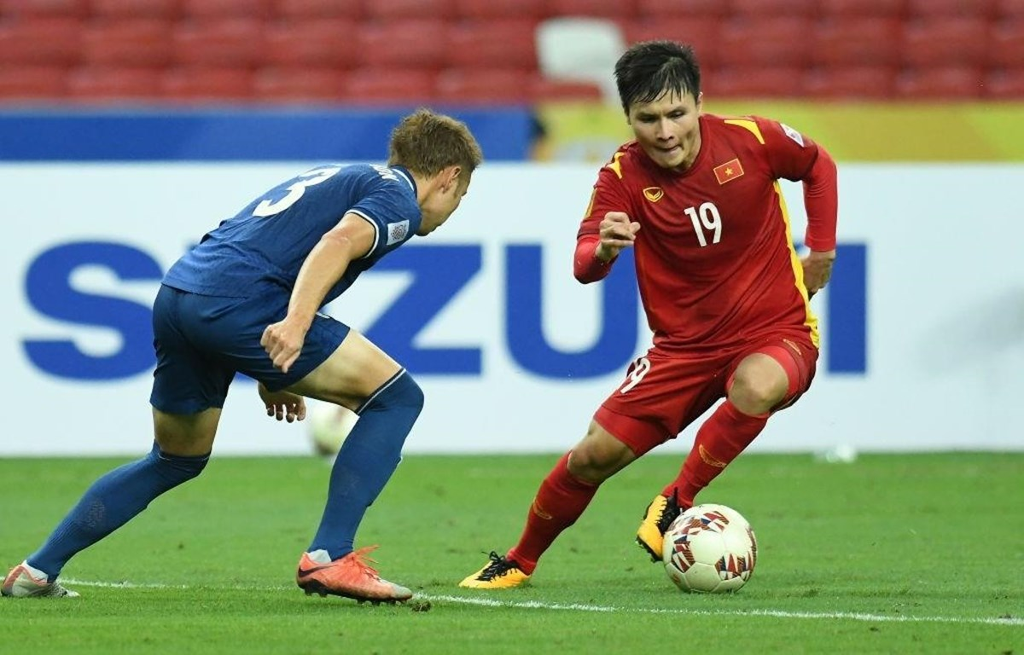
Football
Video games

Slide 3
football
table tennis
volleyball
Names of sports and games
chess
tennis
marbles
swimming
skipping

Slide 4
AT THE GYM
- Who are they in the picture ?
They are Duong and Mai.
- Where are they?
They are at the gym.
- What are they talking about?
Duong
Mai
NVL
NVL

Slide 5
Thursday, February 6th 2025
Week: 21
Period: 62
UNIT 8. SPORTS AND GAMES
Lesson 1: Getting started
NVL

Slide 6
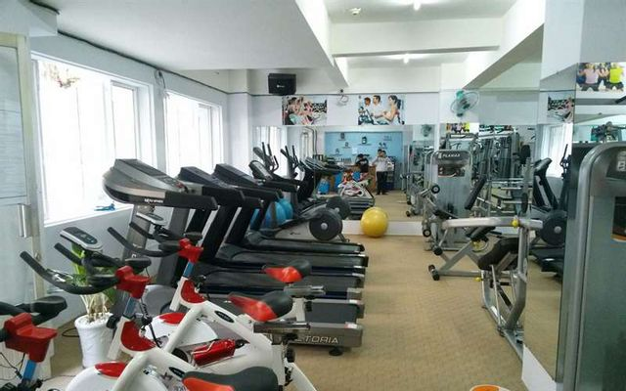
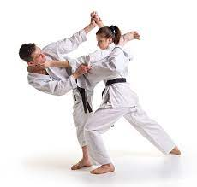
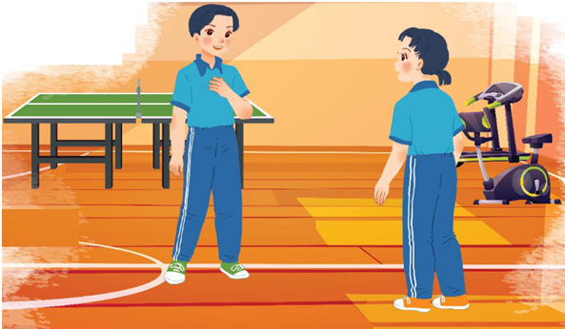
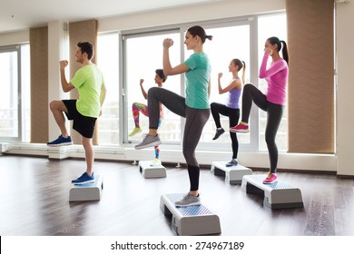
* Vocabulary
- gym (n)
: phòng tập thể dục
- Equipment (n)
:dụng cụ, thiết bị
- karate (n)
: môn võ karate
- fit (adj)
:khoẻ mạnh, cân đối
- aerobics (n)
: thể dục nhịp điệu

Slide 7
* Matching
1.gym
2.aerobics
3.equipment
4.fit
5.karate
a
b
c
d

Slide 8
Mai: Where's the club?
Duong: It's Superfit Club, in Pham Hung Road. You can cycle there.
At the gym
Duong: Wow! This gym is big!
Mai: OK. See you then.
Mai: Yeah. The equipment is great. What sports do you do, Duong?
TRUE/ FALSE CORRECTION
Duong: Well, I do karate, and I play table tennis. Yesterday I played with Duy, and I won!
STATEMENTS | T | F
1.The gym is small.
2.Duong does karate and plays table tennis.
3. Mai is not good at sports.
4.Duong will meet Mai on Wednesday.
Mai: Congratulations! You look fit! I'm not good at sports.
√
Duong: I have an idea – you can go to the karate club with me.
√
Mai: No, I can't do karate.
Duong: But you can learn! You'll love it.
√
Mai: Well... OK
√
Duong: Great! I'll meet you there at 10 a.m. on Sunday.
Note: nhấn vào từng câu để phát ra tiếng.
NVL

Slide 9
At the gym
Duong: Wow! This gym is big!
Mai: Yeah. The equipment is great. What sports do you do, Duong?
Duong: Well, I do karate, and I play table tennis. Yesterday I played with Duy, and I won!
Mai: Congratulations! You look fit! I’m not good at sports.
Duong: I have an idea – you can go to the karate club with me.
Mai: No, I can’t do karate.
Duong: But you can learn! You’ll love it.
Mai: Well ... OK.
Duong: Great! I’ll meet you there at 10 a.m. on Sunday.
Mai: Where’s the club?
Duong: It’s Superfit Club, in Pham Hung Road. You can cycle there.
Mai: OK. See you then.
NVL

Slide 10
Put ONE word from the conversation in each gap.
fit
1. Duong looks ................ He often does karate.
2. Mai likes going to the............... The equipment there is great.
3. Duong played .................... with Duy yesterday,
and he won.
4. Mai and Duong are going to meet at Superfit ............... on Sunday.
5. Mai will…………to Superfit Club.
gym
table tennis
club
cycle

Slide 11
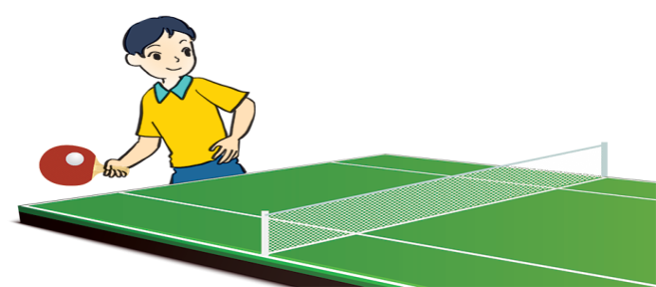
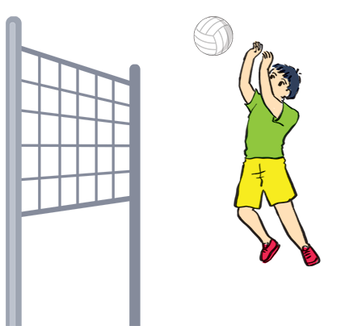
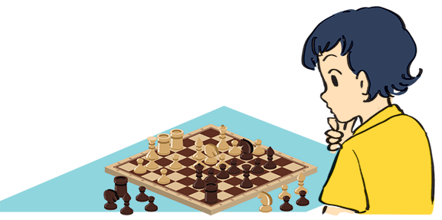
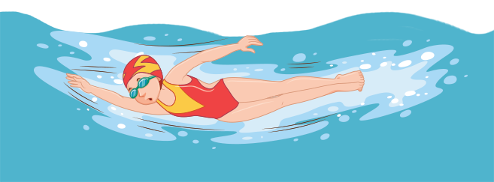
Name these sports and games, using the words from the box.
chess
cycling
aerobics
swimming
table tennis
volleyball
1.
2.
3.
4.
5.
6.

Slide 12
3
4
Lucky apple?
2
5
6
1
7
8

Slide 13
aerobics

Slide 14
chess

Slide 15
cycling

Slide 16
table tennis

Slide 17
volleyball

Slide 18
swimming

Slide 19
LUCKY apple!
YOU GET A GIFT

Slide 20
LUCKY apple!
YOU GET A GIFT

Slide 21
Name these sports and games, using the words from the box.
chess
cycling
aerobics
swimming
table tennis
volleyball
cycling
aerobics
table tennis
1.
2.
3.
4.
swimming
5.
chess
6.
volleyball

Slide 22
What is the difference between
a sport and a game ?

Slide 23
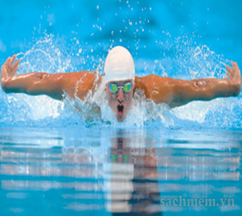
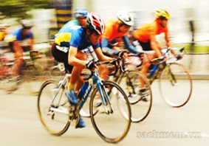
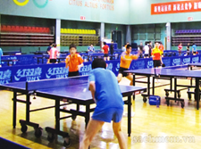
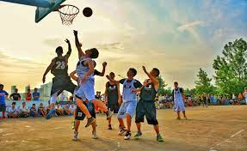
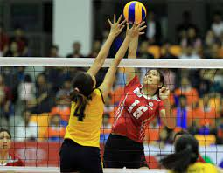
* Notes:
A sport: an activity that you do for pleasure and that needs physical exercise.
swimming
cycling
table tennis
basketball
volleyball

Slide 24
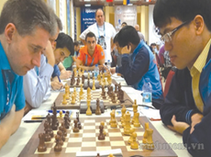
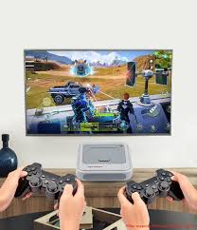
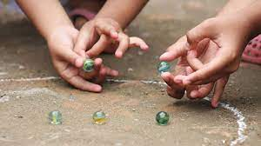
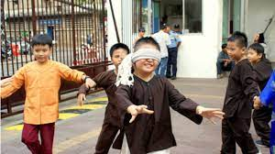
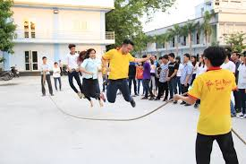
* Notes:
A game: an activity or a sport with rules in which people or teams compete against each other.
chess
marbles
computer games
blind man's bluff
skipping

Slide 25
Work in pairs. Ask your partner these questions to find out how sporty they are.
1.
Can you swim?
If your answers to the questions are mostly “A”, you are sporty. If they are mostly “B”, do more sport and try to be more active.
A.
Yes.
B.
No.
2.
Do you play outdoors every day?
A.
Yes.
B.
No.
3.
Do you usually do morning exercise?
A.
Yes.
B.
No.
4.
What do you usually do at break time at school?
A.
Play in the school yard.
B.
Sit in the classroom.
5.
What do you think of sports and games?
A.
Very good.
B.
Not useful.

Slide 26
Homework
Learn new words by heart.
Practise the dialogue again .
Prepare : Lesson 2 : A closer look 1
Good bye !

Slide 27
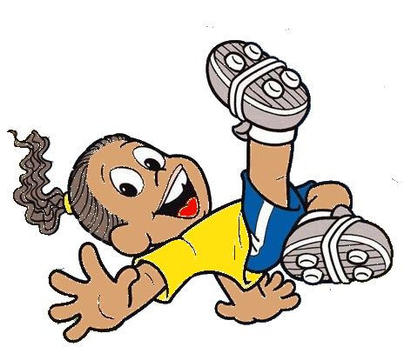

Slide 28
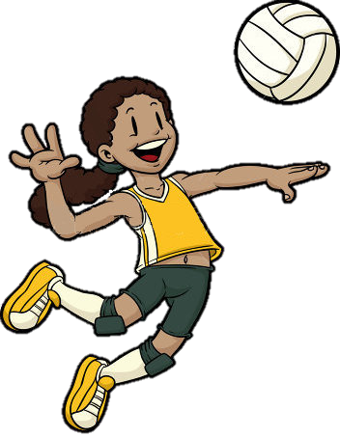
What sport is this?
She plays
volleyball
play
go
do

Slide 29
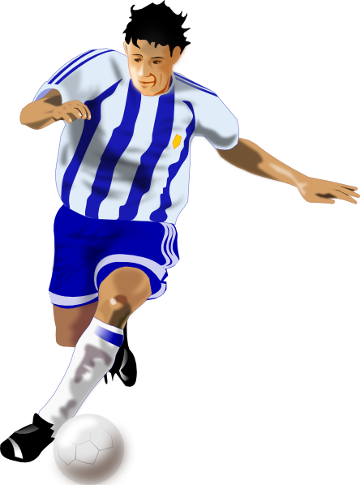
What sport is this?
He plays
football
play
go
do

Slide 30
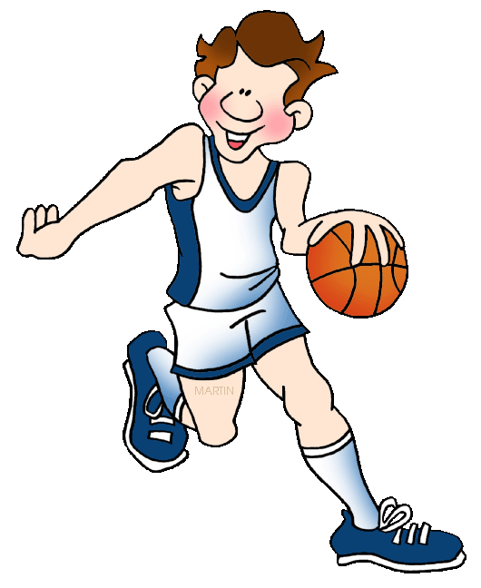
What sport is this?
He plays
basketball
play
go
do

Slide 31
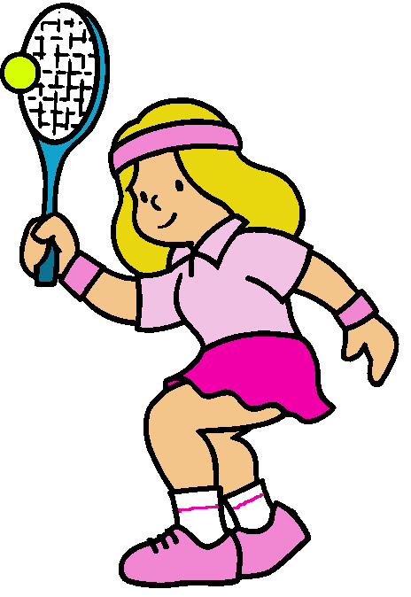
What sport is this?
She plays
tennis
play
go
do

Slide 32
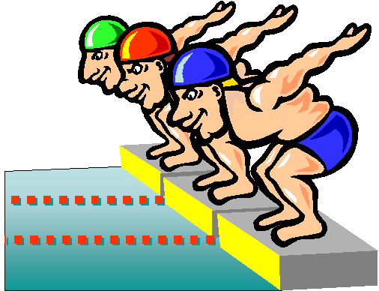
What sport is this?
They go
swimming
play
go
do

