Slide 1
ENGLISH 6

Slide 2
documentary
Kim’s Game
Year - end meeting
The voice kids
Rap Viet
cartoon
sports
News
comedy

Slide 3
Thursday, January 23rd, 2025
Week: 20
Period: 60
UNIT 7: TELEVISION
LESSON 6: SKILLS 2

Slide 4
+ What programme did you watch last night?
+ What was it about?
+ What did you like about it?
+ What didn’t you like about it?
+ Why did you like/dislike it?

Slide 5
I. Listening
II. Writing

Slide 6
I. Listening
Listen and tick () the correct channel for each programme.
PROGRAMMES | CHANNEL 1 | CHANNEL 2 | CHANNEL 3
Green Summer
My Childhood
Harry Potter
English and Fun




Audio script

Slide 7
Listen again and tick () T (True) or F (False).
 | T | F
1. Green Summer is a music programme.
2. My Childhood is the story of a girl and her dog.
3. Children love Harry Potter.
4. English and Fun is at five o’clock.


( a boy and his dog)


9 o'clock
Audio script

Slide 8
AUDIO SCRIPT
Here are some interesting TV programmes for you. Green Summer, a music programme, is on channel 1. It starts at eight o’clock. My Childhood is on Channel 2. It’s the story of a country boy and his dog Billy. On channel 3, you will watch Harry Potter at 8.30. Children all over the world love this film. If you like to learn English, you can go to English and Fun on channel 1. It’s at nine o’clock. We hope you can choose a programme for yourself. Enjoy and have a great time.
AUDIO SCRIPT

Slide 9
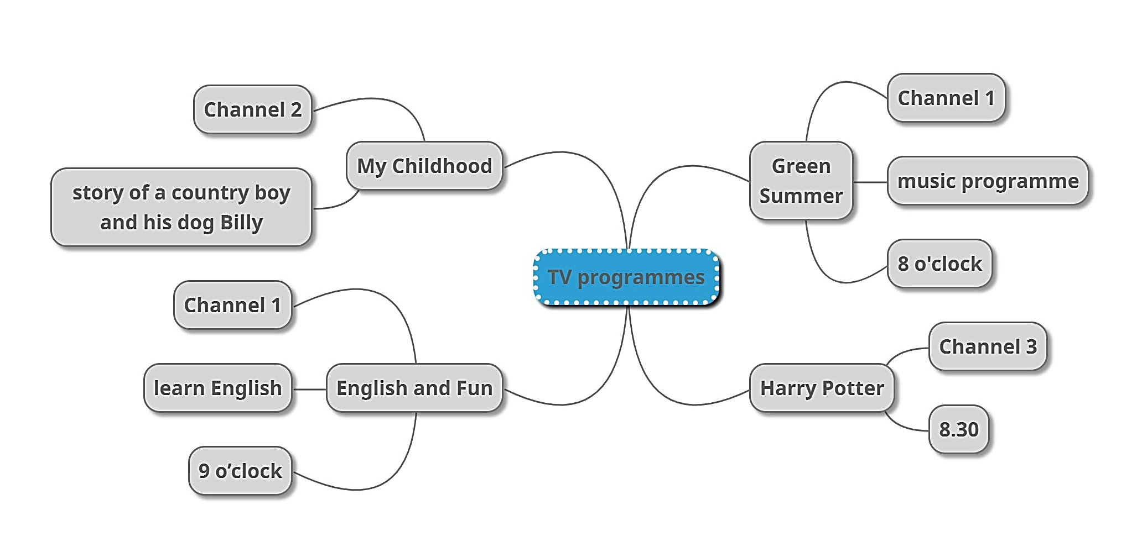
* Summarize the information of the listening part.

Slide 10
II. Writing
Read the questions and circle the right answers for yourself.
1.
How much do you like watching TV?
A.
A lot.
B.
So so.
C.
Not much.
2.
How many hours a day do you watch TV?
A.
1 hour.
B.
2 -3 hours.
C.
Less than one hour.
3.
When do you watch TV the most?
B.
C.
In the evening
A.
In the morning
In the afternoon
4.
Do you watch TV when you are eating?
A.
Always.
B.
Sometimes.
C.
Never.
5.
What TV programme do you watch the most?
A.
Cartoons.
B.
Sports.
C.
Science.

Slide 11
Write a paragraph of about 50 words about your TV-viewing habits. Use your answers in 3.

Slide 12
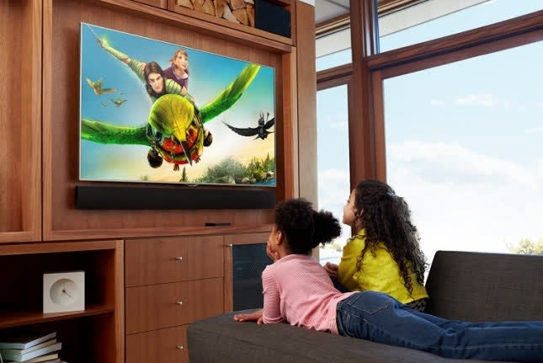
Model writing 1
+ I like watching TV a lot. I usually spend 2-3 hours on watching TV. I often watch TV in the evening. I somtimes watch TV when I'm eating. I like watching Cartoon the most because it’s funny and interesting.

Slide 13
Model writing 2
I like watching TV, about one hour a day. I only watch TV in the evening. During the day, I go to school. On Saturday and Sunday, I watch more. Sometimes I watch TV when I’m eating, but I never watch TV when I’m studying. I like watching sport programme the most because I love playing football and I want tobe a good footballer.

Slide 14
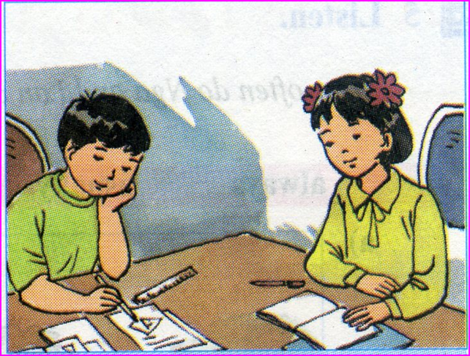
Homework:
Rewrite the paragraph in the notebooks.
Do exercises in part E in WB.
- Prepare Looking back and project.

Slide 15
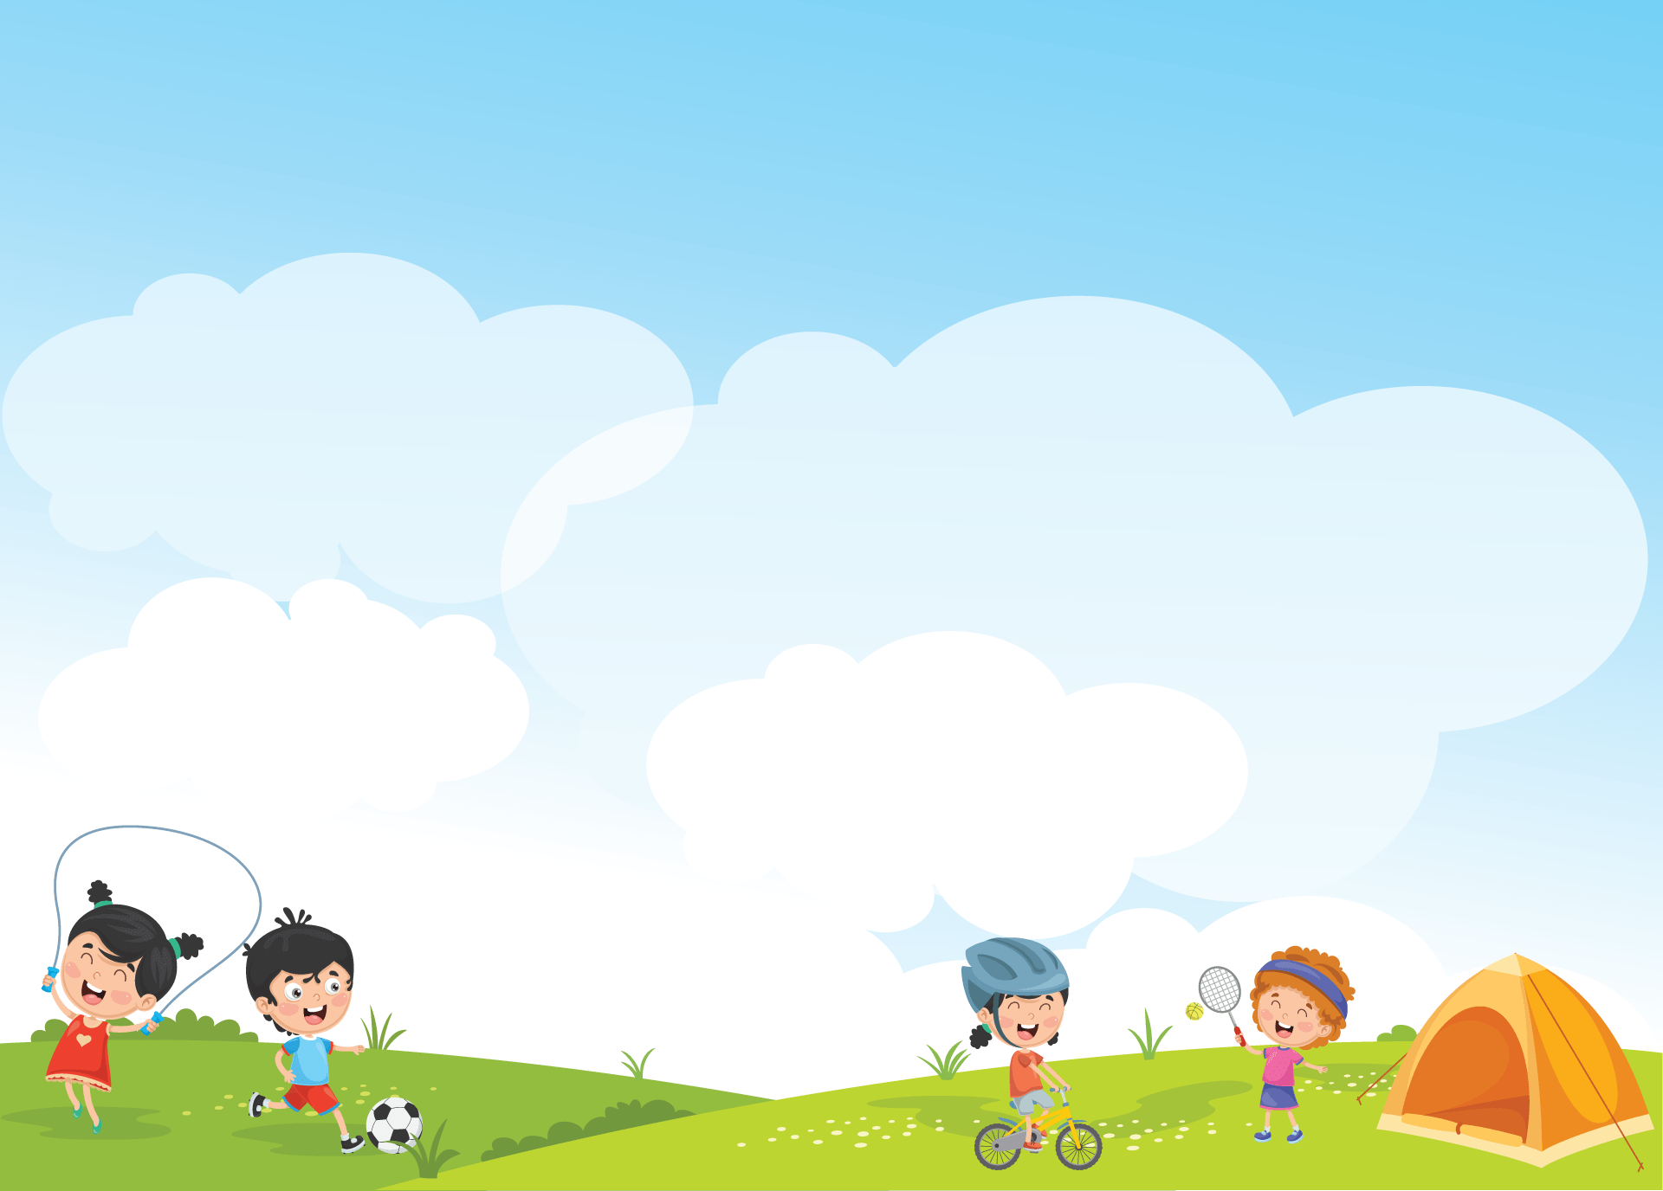
Liên hệ Côi Nguyễn nhé.

