Slide 1
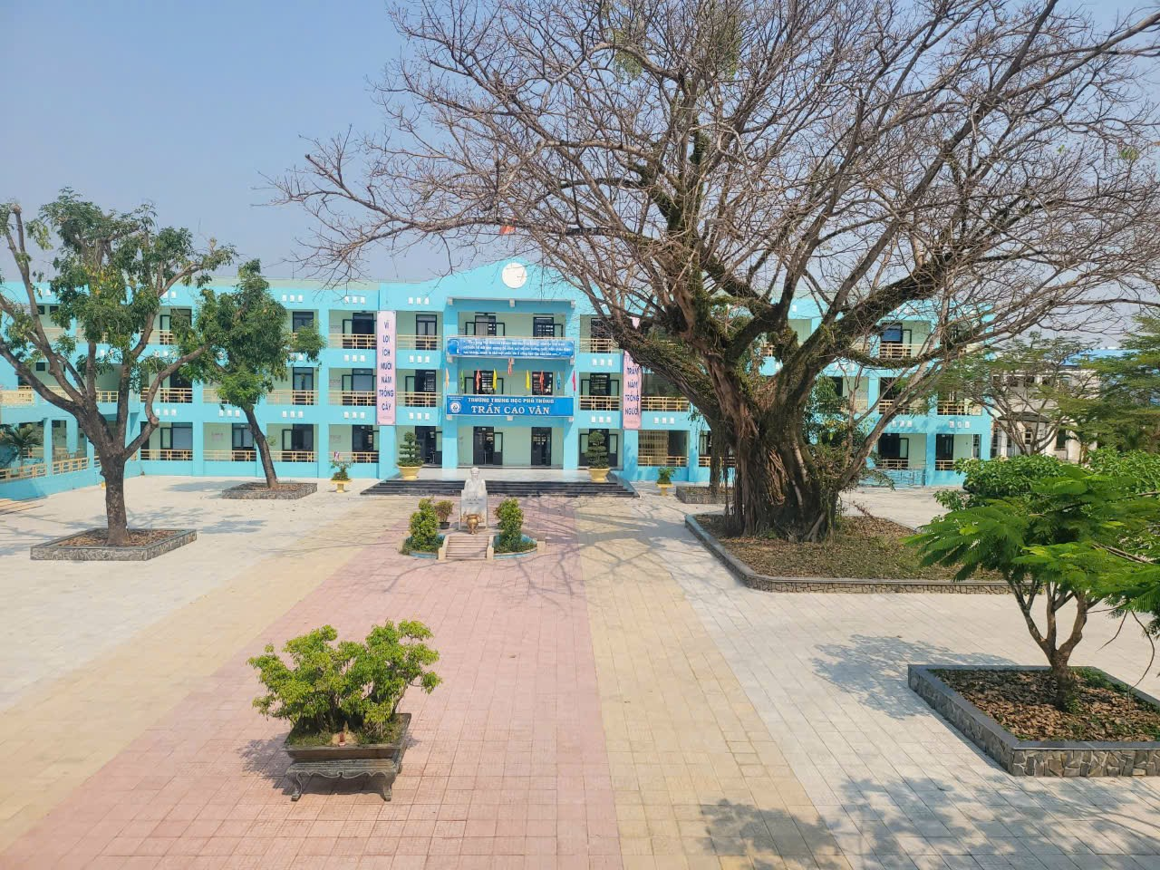
WELCOME TO OUR CLASS!
Saturday, February 22nd, 2025

Slide 2




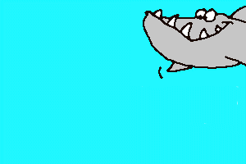


SHARK ATTACK
Let’s play the game:
L | A | N | G | U | A | G | E

Slide 3
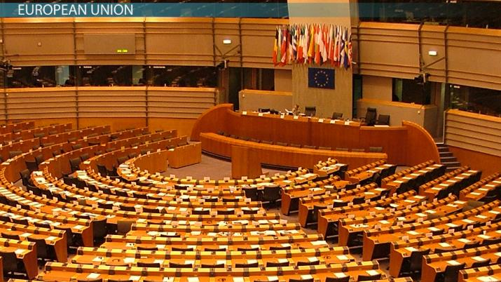

UNIT 7: VIET NAM AND INTERNATIONAL ORGANISATIONS
LESSON 2: LANGUAGE

Slide 4

I. PRONUNCIATION
Stress in words with more than three syllables
WATCH THE VIDEO

Slide 5

PRONUNCIATION: Stress in words with more than three syllables
Read the Tips box and watch the tutorial video.
Notes:
https://www.youtube.com/watch?v=ieeJhVM4C6c&list=PL8_ETpRL2xNa6yKTFH47dDogixNFdQlRk&index=7

Slide 6

PRONUNCIATION: Stress in words with more than three syllables
1
Listen and repeat. Pay attention to the syllable with the primary stress.
More than three syllables words
ˌappliˈcation | ˌpopuˈlation
comˌmuniˈcation | ˌindeˈpendent
ˌecoˈnomic | ˌpossiˈbility
ˌexplaˈnation | parˌticiˈpation

Slide 7
PRONUNCIATION: Stress in words with more than three syllables
Listen and mark the primary stress in the words in bold. Then practise saying the sentences.
2
1. Viet Nam is a member of different international organisations.
2. Our responsibility is to help the most disadvantaged children.
3. This organisation aims to promote environmental protection.
4. UNICEF aims to create educational opportunities for all children.
1. Viet Nam is a member of different ,inter'national ,organi'sations.
2. Our re,sponsi'bility is to help the most ,disad'vantaged children.
3. This ,organi'sation aims to promote en,viron'mental protection.
4. UNICEF aims to create ,edu'cational ,oppor'tunities for all children.

Slide 8
VOCABULARY: Joining international organisations
1
Match the words with their meanings.
WORDS
1. enter
2. promote
3. aims
4. committed
5. welcomes
MEANINGS
A. intends
B. is pleased to accept
C. go into
D. encourage
E. promised
VIETNAMESE MEANINGS
Đặt ra mục tiêu
Chào đón, hoan nghênh
Thâm nhập, đi vào
Quảng bá, khuếch trương
Cam kết

Slide 9
II. VOCABULARY
2
Complete the following sentences, using the words in bold in 1.
1. Joining the WTO has helped Viet Nam _________ its economic growth.
2. Viet Nam __________ foreign investors in various parts of the economy.
3. We _________ to use the donations effectively. We have signed an agreement on this.
4. This environmental organisation __________ to protect local forests. It has a detailed plan to achieve this.
5. We need to improve the quality of goods and services so that they can _________ new markets.
promote
welcomes
committed
aims
enter

Slide 10


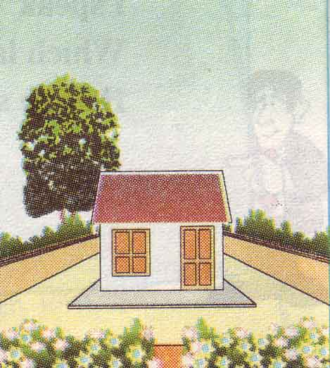
a small house
a smaller house
the smallest house
comparative
superlative

Slide 11
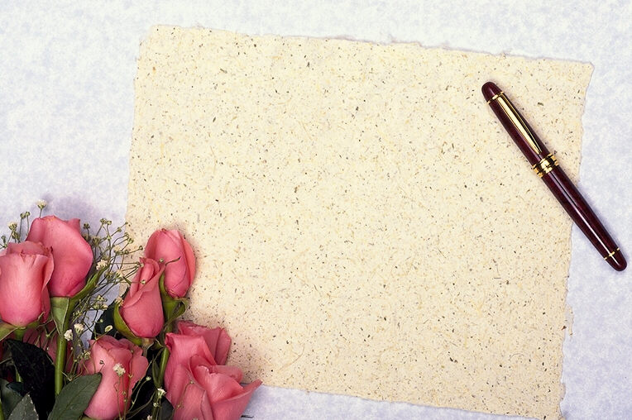
III. Grammar
Comparative and superlative adjectives

Slide 12
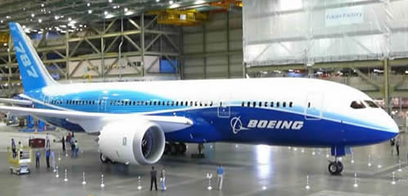
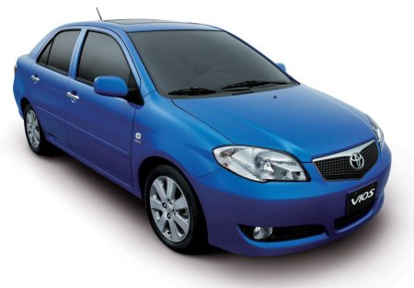
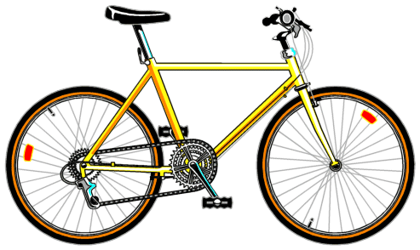
Make sentences based on the prompts below, using comparison:
1. The bicycle / is / cheap / the car.
The bicycle is cheaper than the car.
2. The airplane / is / expensive / the car.
The airplane is more expensive than the car.
3. The bicycle / is / cheap.
The bicycle is the cheapest.
4. The airplane / is / expensive.
The airplane is the most expensive.
$120,000,000
$100
$10,000

Slide 13
GRAMMAR: Comparative and superlative adjectives
Remember!
 | Comparative adjectives | Superlative adjectives
Form | - Short adjectives: S + V + Adj-er + than + Noun/ Pronoun. - Long adjectives: S + V + more/less + Adj + than + Noun/Pronoun. | - Short adjectives: S + V + the + Adj- est + in /of …. - Long adjectives: S + V + the most/least + Adj + in/of …
Use | - To compare a person or thing with another person or thing. - To show changes | To compare a person or thing with the whole group of which that person or thing is a member
Example | - The European markets are usually more competitive than the Asian markets. - The Asian markets are less competitive than the European markets. - Since then, our country has become more active. | - This trade organisation includes two of the largest economies in the world: the United States and China. - UNICEF supports the most disadvantaged children all over the world.

Slide 14
GRAMMAR: Comparative and superlative adjectives
Some irregular adjectives
Adj | Comparative | Superlative
good bad little many/ much far old | better worse less more farther further older/elder | the best the worst the least the most the farthest the furthest the oldest/ the eldest
Notes: farther: distance
further: information

Slide 15
GRAMMAR: Comparative and superlative adjectives
1
Choose the correct answers.
1. WTO rules make trade the easiest / easier for smaller member countries.
2. This job offer is more attractive / the most attractive than the previous one.
3. Because of poorly designed packaging, our products are less competitive / the least competitive than foreign products.
4. Over the past few years, Viet Nam has become one of more popular /
the most popular destinations for foreign visitors in Southeast Asia.

Slide 16
GRAMMAR: Comparative and superlative adjectives
2
Write another sentence using the word(s) in brackets. Make sure it has the same meaning as the previous one.
1. No place is more popular with foreign visitors than this city. (the most popular)
This city is the most popular place for foreign visitors.
2. In many supermarkets, imported goods are not as expensive as locally produced goods. (cheaper)
In many supermarkets, imported goods are cheaper than locally produced goods.
3. No international organisation is larger than the United Nations. (the largest)
The United Nations is the largest international organisation.
4. In the past, our country wasn’t as active on the international stage as it is today. (more active)
Our country is more active on the international stage today than it was in the past.

Slide 17
GRAMMAR: Comparative and superlative adjectives
3
Choose the letter A, B, C, or D to indicate the sentence that is closest in meaning to each of the following questions.
1. No student in my class can run as fast as Jack.
A. Jack is faster than no student in my class. B. Jack is the fastest runner in my class.
C. All students in my class don’t run faster than Jack. D. No student in my class runs fast as Jack.
2. Nothing is more precious than happiness and health.
A. Happiness and health are the most precious things. B. Happiness is more precious than health.
C. Health is more precious than happiness. D. Happiness and health are more and more precious.
3. I can’t cook as well as my mother does.
A. I can cook better than my mother can. B. My mother can’t cook better than I can.
C. My mother can cook well than I can. D. My mother can cook better than I can.
4. Murder is the most serious of all crimes.
A. Murder is very serious. B. No crime is more serious than murder.
C. Everyone is very afraid of murder. D. Murder is the dangerous crime.
5. I’ve never seen such a nice bouquet of wedding flowers.
A. This bouquet of wedding flowers is the nicest that I’ve ever made.
B. This is the nicest bouquet of wedding flowers that I’ve ever seen.
C. I’ve never seen the nicest bouquet of wedding flowers so far.
D. Nothing I’ve seen is nicer than this bouquet of wedding flowers.
6. Tet holiday is the most interesting Vietnamese traditional festival that he’s ever attended.
A. Tet holiday is more interesting than the Vietnamese traditional festival that he’s ever attended.
B. He has attended many interesting Vietnamese traditional festival including Tet holiday.
C. He has never attended a more interesting Vietnamese traditional festival than Tet holiday.
D. Tet holiday is one of the most interesting Vietnamese traditional festival he’s ever attended.

Slide 18
CONSOLIDATION
1
Wrap-up
What have you learnt today?
Lexical items related to the topic “international organisations”
Pronunciation: stress in words with more than three syllables
Grammar: Comparative and superlative adjectives

Slide 19
CONSOLIDATION
2
Homework
Do exercises in the workbook.
Prepare: Unit 7 - Lesson 3-Reading.

Slide 20







Thank you for your attention!
.
Goodbye!

