Slide 1
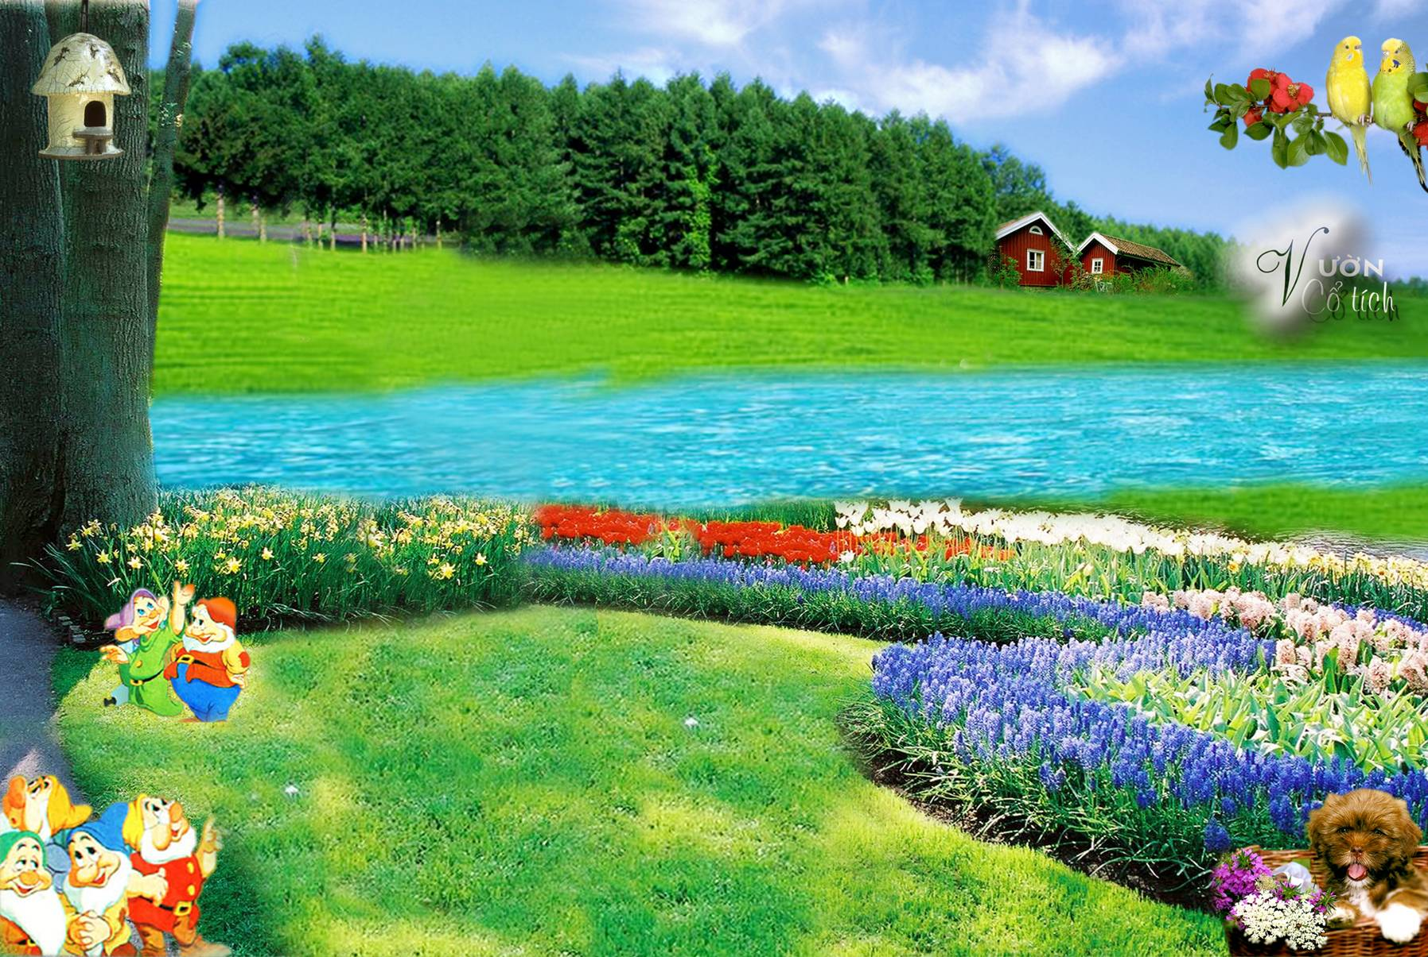
warmly welcome teachers
attending our lesson
Teacher : Trần Thị Mỹ Linh
Class : 10 /1
Welcome to our english class

Slide 2
Unit
3
1
Unit
FAMILY LIFE
MUSIC
LESSON 8
LOOKING BACK AND PROJECT

Slide 3
Unit
1
1
FAMILY LIFE
Family Life
Unit
OBJECTIVES
Revise stress in two-syllable words
Revise vocabulary items learnt in the unit
Revise compound sentences
Revise verbs followed by to-infinitives and bare-infinitives
Develop students’ research and collaboration skills, and
practise giving an oral presentation

Slide 4
LESSON 8
LOOKING BACK AND PROJECT
Unit
GETTING STARTED
WARM-UP
Game: Guess the form of the traditional music
Pronunciation: Listen and mark the stressed syllables in words. Then read them out.
Vocabulary: Complete the text.
Grammar:
1. Match the two parts to make complete sentences.
2. Find the mistake in each sentence and correct it.
Looking back through game: lucky flowers
LOOKING BACK
PROJECT
Research on a form of traditional music
CONSOLIDATION
Wrap-up
Home work

Slide 5
WARM-UP
Guess the types of the songs
SONG 1
Bai Choi singing
SONG 2
Xam singing
SONG 3
Don ca tai tu
SONG 4
Hue Royal Court Music

Slide 6
LOOKING BACK
1
PRONUNCATION
Listen and mark the stressed syllables in the following words. Then read them out.
perform singer
concert famous
final enjoy

Slide 7
LOOKING BACK
2
VOCABULARY
Complete the text using the words and phrases in the box.
artists music concerts instrument fans
Our class survey revealed some surprising results about the students' (1) _______ habits. Most of them did not hesitate to say that they love music because they find it relaxing. Their favourite music is K-pop and British or American pop music as they are big (2) _______ of Korean and American (3) _______. Fourteen out of twenty students play a musical (4) _________ and most of them practise between one and three hours a week. Going to (5) _______ is usually popular among teenagers, but only eight people said that they like going to such music events.
music
fans
artists
instrument
concerts

Slide 8
LOOKING BACK
3
GRAMMAR
1. Match the two parts to make complete sentences.
1. She writes her own songs,
a. or we can stay at home to watch the final night of Vietnam Idol.
2. He participated in many
talent competitions,
b. so we decided to walk to the stadium.
3. We can go to a live concert at City Theatre,
c. and they always have deep meanings.
4. The traffic was really bad,
d. but the judges never liked his songs.

Slide 9
LOOKING BACK
3
Choose the letter A, B, C or D to indicate the underlined
part that needs correction.
GRAMMAR
1. She asked him attend the school performance.
A B C D
2. Don’t let her to go to the music festival!
A B C D
3. Their parents will never agree buy that expensive piano.
A B C D
4. To develop her musical talent, her father made her to sing at family
A B C D
gatherings.
To attend
B
go
C
To buy
C
D
sing

Slide 10
Game: lucky flowers
You are divided into two teams. There are 10 flowers: 7 ones with 7 questions, 3 ones with 3 lucky flowers. Team choosing a lucky flower will get 10 marks without answering the question. You will get 10 marks if you have a correct answer. Otherwise, the rest team have the right to answer. At the end of the game, the winner is the team with the higher marks.

Slide 11
Team A
Team B
50
40
30
20
50
40
30
20
10
0
50
40
30
20
10
0
1
2
3
4
5
6
7
8
9
10

Slide 12
Question 1: She has joined the panel of _____________ the popular TV talent show.
A. audience B. judges C. viewers D. watchers
B. judges
6

Slide 13
Question 2: Van Cao’s “Tien Quan Ca” was made into the national _______ of the Socialist Republic of Viet Nam.
A. song B. music C. melody D. anthem
D. anthem
1

Slide 14
Question 3: Minh had his teeth decayed, ____ he refused to see the dentist.
A. and B. so C. or D. but
D. but
8

Slide 15
Question 4: John made me _________ a lot with his hilarious jokes.
Laughing B. to laugh
C. laugh D. laughed
C. laugh
10

Slide 16
Question 5: Choose the word whose main stress pattern is not the same as that of the others.
A. paper B. enjoy C. lecture D. story
B. enjoy
3

Slide 17
Question 6. Choose the word whose main stress pattern is not the same as that of the others.
A. common B. Music C. final D. perform
D. perform
4

Slide 18
Question 7. Choose the word whose main stress pattern is not the same as that of the others.
A. compose B. Careful C. concert D. album
A. compose
9

Slide 19
may mắn
1
3
4
5
6
7
8
9
10

Slide 20
may mắn
1
2
3
4
6
7
8
9
10

Slide 21
1
2
3
4
5
may mắn
6
8
9
10

Slide 22
LESSON 8
LOOKING BACK AND PROJECT
Unit
GETTING STARTED
WARM-UP
Game:
Pronunciation: Listen and mark the stressed syllables in words. Then read them out.
Vocabulary: Complete the text.
Grammar:
1. Match the two parts to make complete sentences.
2. Find the mistake in each sentence and correct it.
Looking back through game: lucky flowers
LOOKING BACK
PROJECT
Research on a form of traditional music
CONSOLIDATION
Wrap-up
Home work

Slide 23
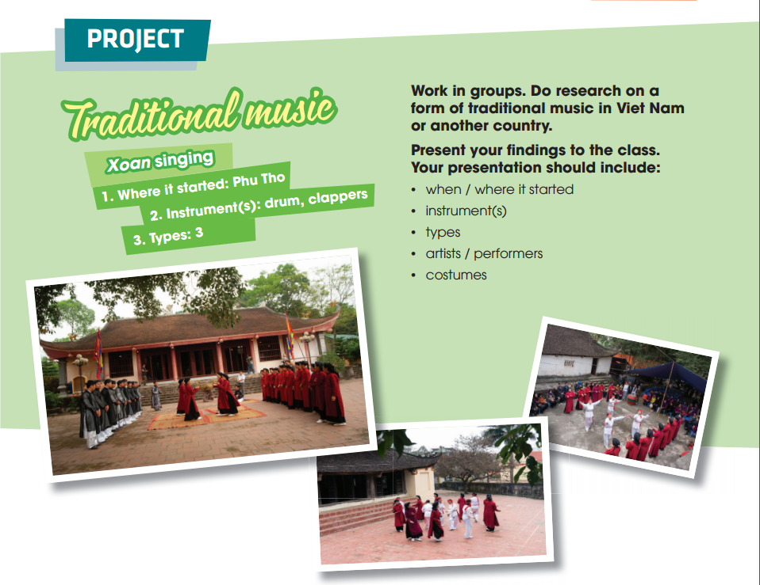
PROJECT

Slide 24
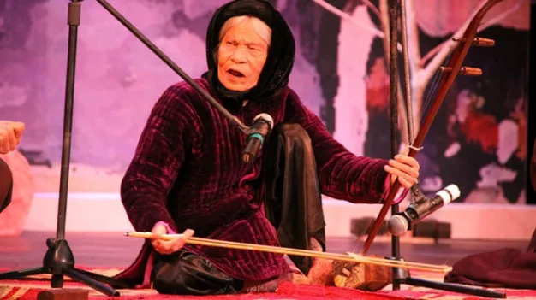
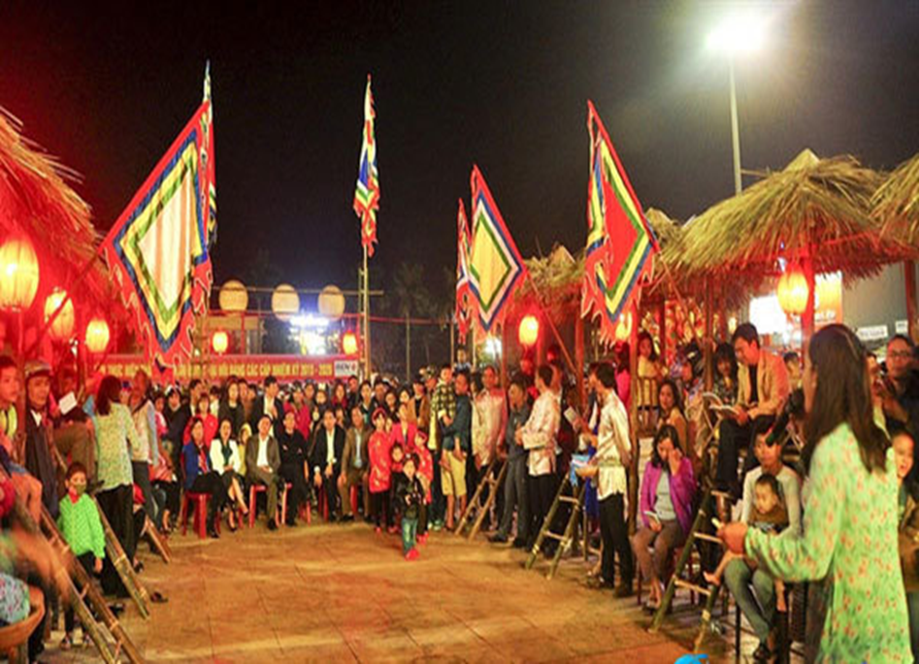
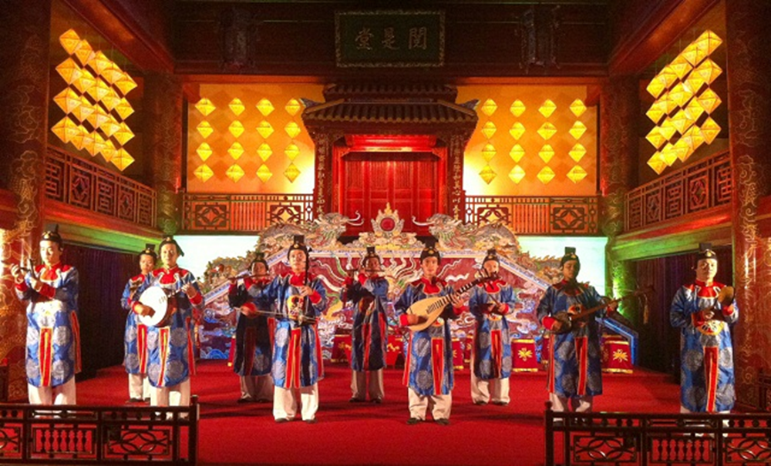
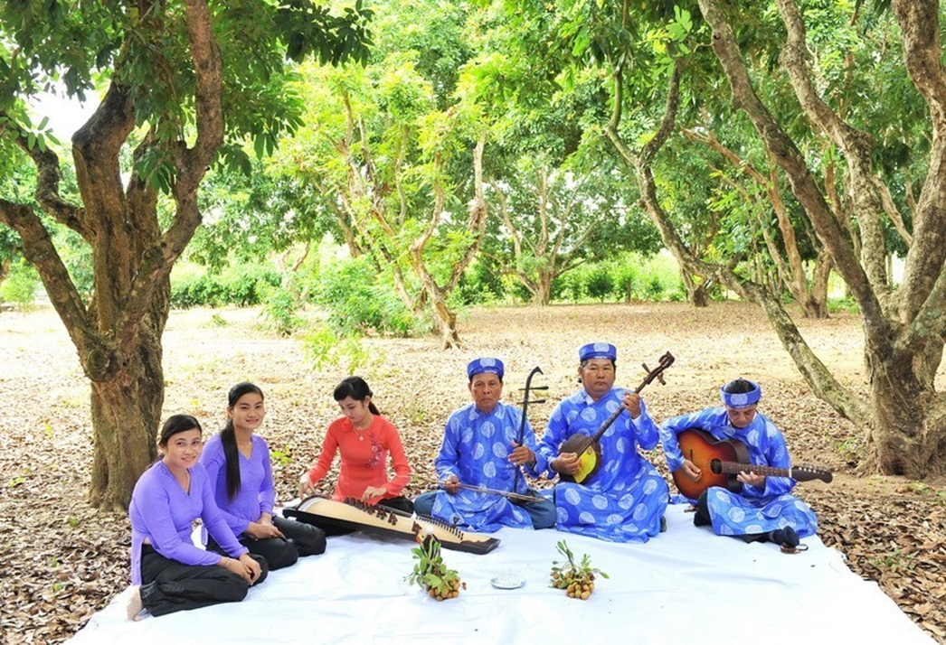
Xam singing
1
Bai Choi singing
2
Hue Royal Court Music
Don ca tai tu
3
4

Slide 25
PROJECT
 | Tick where appropriate | Comments (in English or Vietnamese)
DELIVERY
- The presenters greeted the audience.
- The presenters spoke clearly and naturally.
- The presenters cooperated when delivering their talk.
- The presenters interacted with the audience.
- The presenters used some photos /pictures to illustrate their ideas.
- The presenters concluded their talk appropriately.
CONTENT: The presentation includes the following information about a form of traditional music:
- when/where it started
- instruments
- types
- artists/performers
- costumes
Checklist for peer assessment

Slide 26
PROJECT
 | Tick where appropriate | Comments (in English or Vietnamese)
DELIVERY
- I greeted the audience.
- I spoke clearly and naturally.
- I cooperated with my group members when delivering the talk.
- I interacted with the audience.
- I used some photos / pictures to illustrate my ideas.
- I concluded my part of the talk appropriately.
CONTENT: Our presentation includes the following information about a form of traditional music
- when/where it started
- instruments
- types
- artists/performers
- costumes
Checklist for self-assessment

Slide 27
LESSON 8
LOOKING BACK AND PROJECT
Unit
GETTING STARTED
WARM-UP
Game: The last man standing
Pronunciation: Listen and mark the stressed syllables in words. Then read them out.
Vocabulary: Complete the text.
Grammar:
1. Match the two parts to make complete sentences.
2. Find the mistake in each sentence and correct it.
LOOKING BACK
PROJECT
Research on a form of traditional music
CONSOLIDATION
Wrap-up
Home work

Slide 28
CONSOLIDATION
1
Wrap-up
Revise how to pronounce stress in two-syllable words correctly;
Revise the use of words/ phrases related to the topic Music;
Revise how to use conjunctions to make compound sentences correctly;
Revise some verbs followed by to-infinitives and bare-infinitives.
Do research on traditional music in Viet Nam or another country and give a group presentation about it.

Slide 29
CONSOLIDATION
2
Homework
Do exercises in the workbook
Prepare for Unit 4 - Lesson1

Slide 30
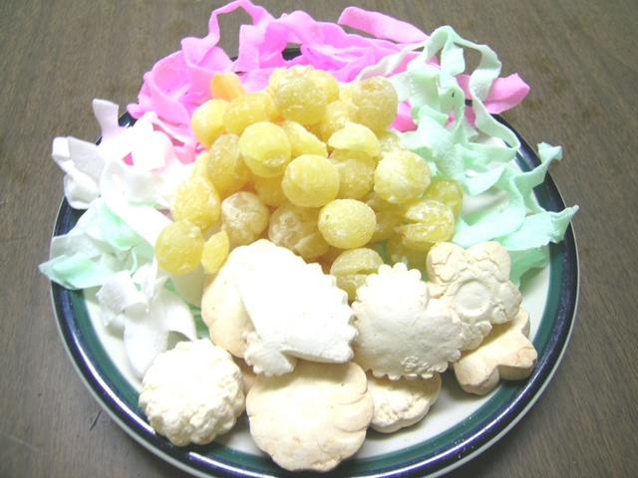
Thank you for attending

