Slide 1
Unit 7:
Reading
Unit 7:
Reading
-
by Tra My, Truong Thinh

Slide 2
Trà My : Lesson 3 - Reading
Trường Thịnh : Games
INTRODUCING
MEMBERS
Contents

Slide 3
Vocabulary
Vocabulary
-
We will give you several essential vocabulary words that help you complete the following activities and exercises more easily.

Slide 4
I. Vocabulary
ˈekspɜːt

Slide 5
I. Vocabulary
Expert (n)
a person with special knowledge, skill or training in something

Slide 6
I. Vocabulary
ˈfɔːml

Slide 7
I. Vocabulary
Formal (adj)
(of a style of dress, speech, writing, behaviour, etc.) very correct and suitable for official or important occasions

Slide 8
I. Vocabulary
ˈmænɪdʒ

Slide 9
I. Vocabulary
Manage (v)
to control or be in charge of a business, a team, an organization, land, etc.

Slide 10
I. Vocabulary
treɪd

Slide 11
I. Vocabulary
Trade (n)
a job, especially one that involves working with your hands and that requires special training and skills

Slide 12
I. Vocabulary
əˈprentɪʃɪp

Slide 13
I. Vocabulary
Apprenticeship (n)
a period of time working as an apprentice; a job as an apprentice

Slide 14
I. Vocabulary
ˌɪnstɪˈtjuːʃn

Slide 15
I. Vocabulary
Institution (n)
a large important organization that has a particular purpose, for example a university or bank

Slide 16
Activities
Activities
-

Slide 17
Activity 1:
-

Slide 18
Work in pairs. Which of the two options for school-leavers is more common in your town? Can you think of other options?

Slide 19
Activity 2:
-

Slide 20
a. a job that requires special training and skills
1. Formal
b. a period of time working for and learning from a skilled person
2. Manage
c. to succeed in doing something difficult
3. Trade
d. important organizations that have a particular purpose
4. Apprenticeship
e. received in a school, college, or university, with lessons, exams, ect
5. Institutions

Slide 21
Activity 3:
-

Slide 22
-

Slide 23
Read the article again. Match the headings (1-3) with the paragraphs (A- B). There is ONE extra heading
Getting vocational training
2. Earning a salary while studying
3. Going to college or university

Slide 24
Read the article again. Match the headings (1-3) with the paragraphs (A- B). There is ONE extra heading
Getting vocational training
B
2. Earning a salary while studying
3. Going to college or university
A

Slide 25
Activity 4:
-

Slide 27
formal
trade
degree
apprenticeship
Training

Slide 28
Activity 5:
-

Slide 29
Which of the two options will be appropriate for you after leaving school? Why?

Slide 30
GAMES
GAMES
4 Parts

Slide 31
GAME LIST
Each section has 5-10 questions
Vocabulary
Correct wrong sentences
Rewrite the sentence
01

Slide 32
GAME RULES
Raise your hand if there are any questions you can answer
If no one raises their hand, we will randomly select one person to answer
After 3 random people cannot answer correctly, we will show the answer
01

Slide 33
Part 1
Vocab
03

Slide 34
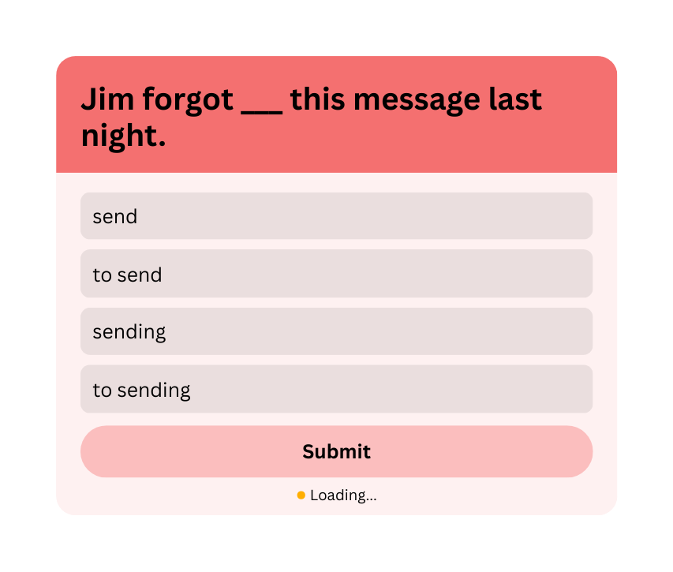
QUESTION 1
03

Slide 35
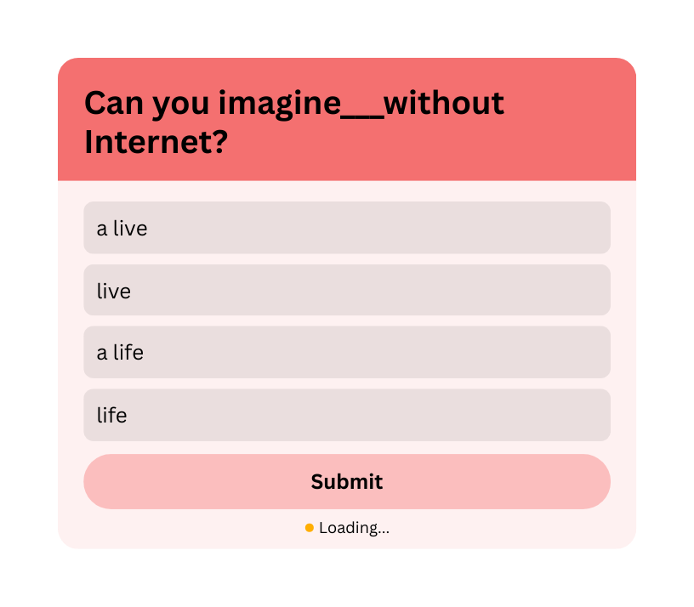
QUESTION 2
03

Slide 36
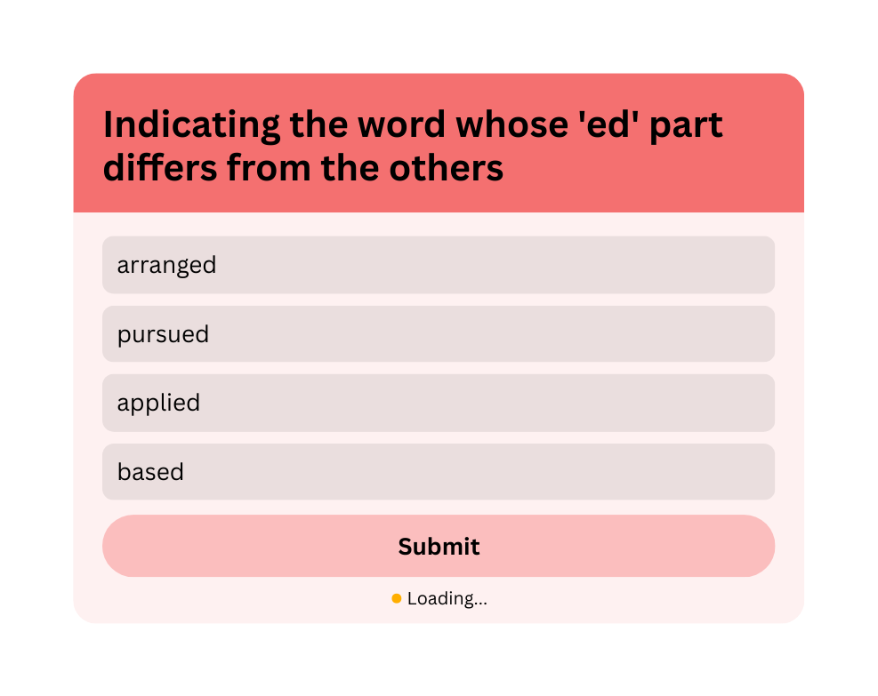
QUESTION 3
03

Slide 37
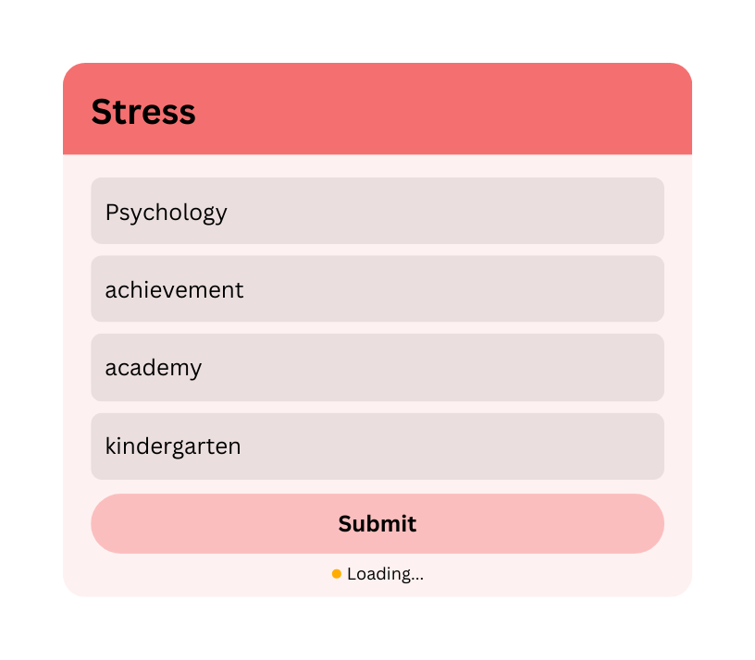
QUESTION 4
03

Slide 38
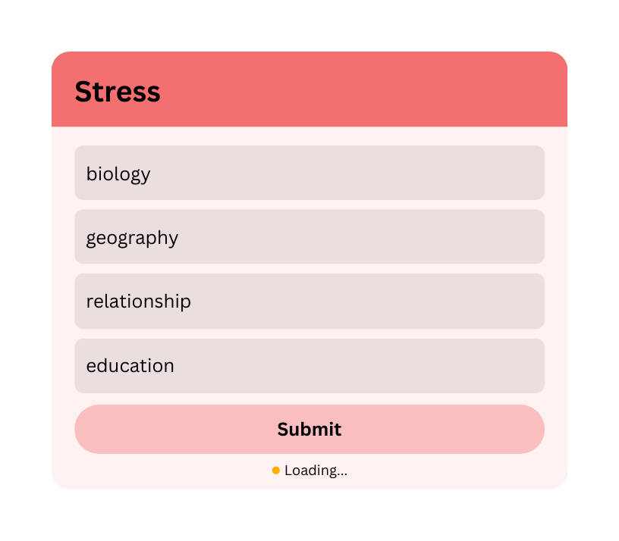
QUESTION 5
03

Slide 39
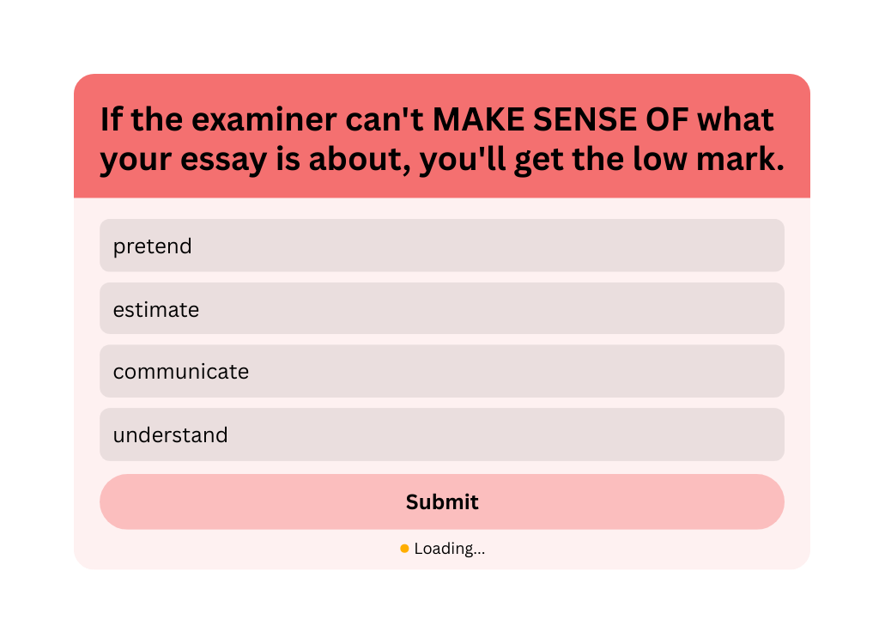
QUESTION 6 : SYNONYM
03

Slide 40
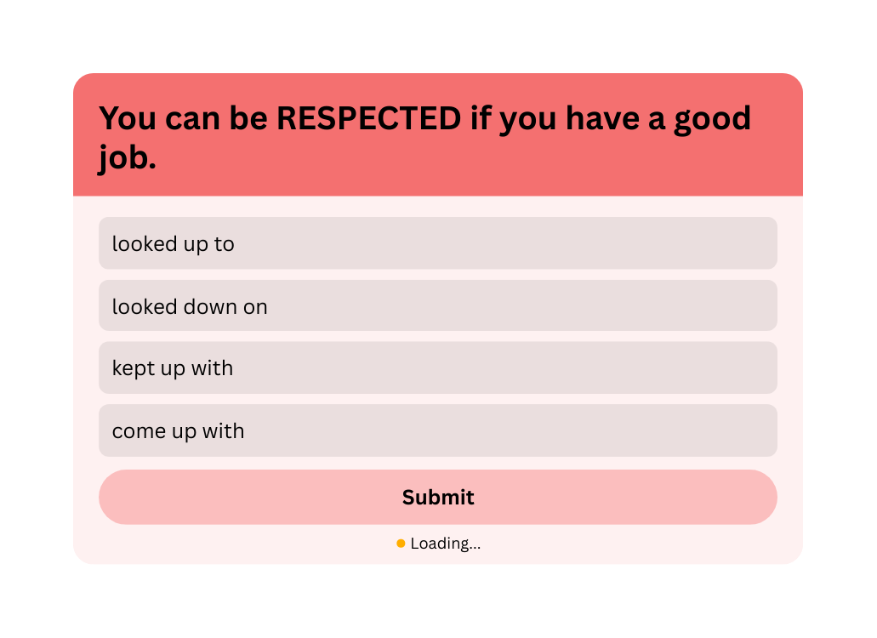
QUESTION 7 : SYNONYM
03

Slide 41
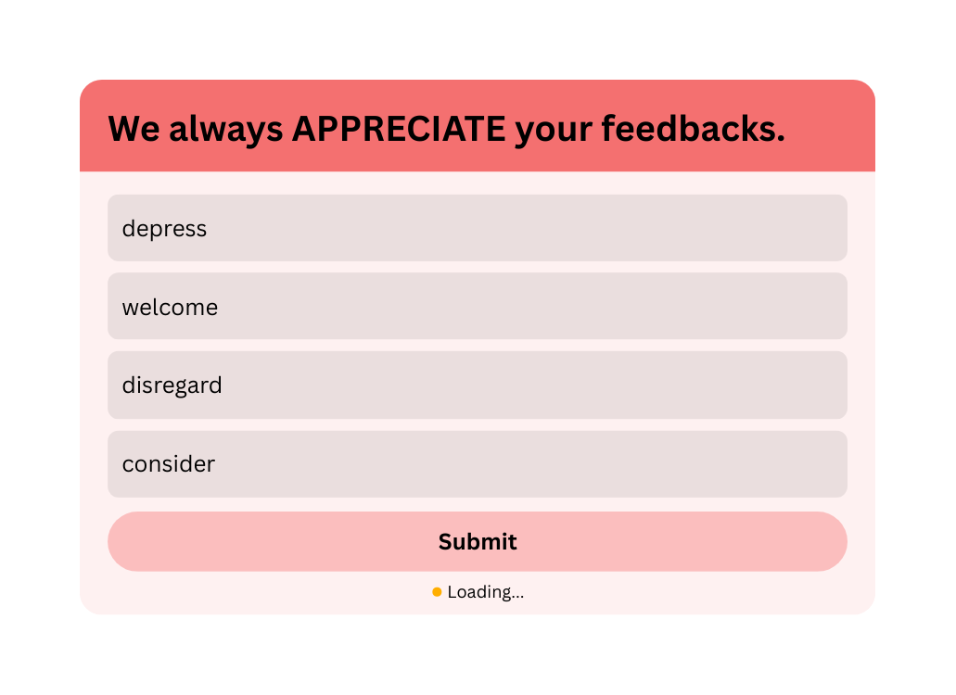
QUESTION 8 : ANTONYM
03

Slide 42
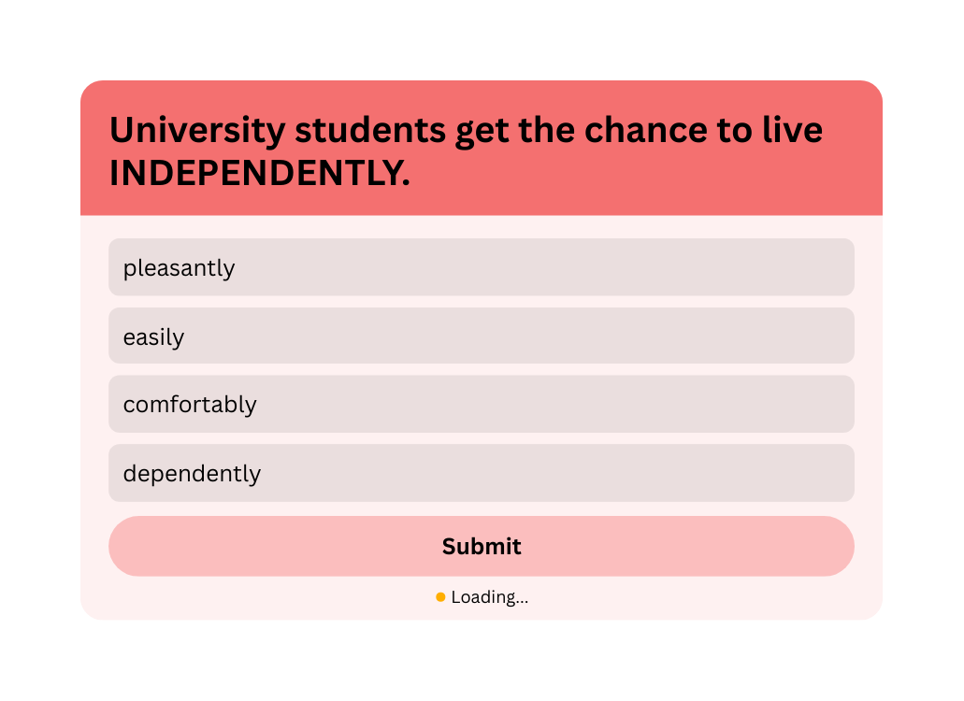
QUESTION 9 : ANTONYM
03

Slide 43
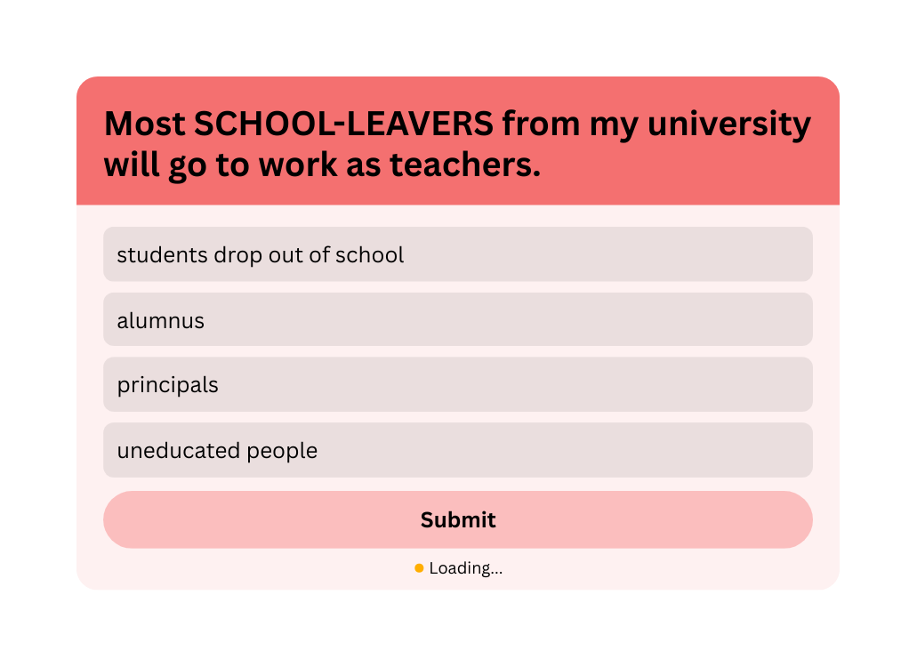
QUESTION 10 : SYNONYM
03

Slide 44
Part 2
Fixing
02

Slide 45
QUESTION 1
I forgot have discussed this topic with you last week. Can I buy you something as an apology?
A. forgot
B. have discussed
C. last week
D. an apology
Sau “forgot” cần dùng “having + V3/ed” để nhấn mạnh hành động đã hoàn thành.
02

Slide 46
QUESTION 2
Had won many maths competitions helped me win a place at university.
A. Had
B. helped
C. win
D. at
Đầu câu cần dùng “Having won” (danh động từ hoàn thành) để chỉ hành động đã xảy ra trước mệnh đề chính.
02

Slide 47
QUESTION 3
Nam regretted not having choose a more interesting course at university.
A. regretted
B. choose
C. interesting
D. at
“choose” sai thì; cần dùng “chosen” (quá khứ phân từ)
02

Slide 48
QUESTION 4
He was proud of had won the first place at the biology competition.
A. was proud of
B. had won
C. at
D. the biology competition
Sau “proud of” cần sử dụng “having won” để diễn đạt hành động đã hoàn thành trong quá khứ.
02

Slide 49
QUESTION 5
Not have spent enough time on studying, he couldn’t answer the questions.
A. have
B. spent
C. studying
D. couldn’t
Sử dụng “Not having spent” để diễn đạt nguyên nhân (hành động chưa được thực hiện đủ) dẫn đến kết quả.
02

Slide 50
Part 3
Writing
10

Slide 51
QUESTIONS
1/ After I finished my homework, I went to bed.
2/ Completing the marathon left him exhausted.
-> His having ...
3/ Because she did not attend the meeting, she missed important announcements.
-> Not having ...
4/ After he had saved enough money and planned his itinerary, he booked a flight to Europe.
-> Having ...
5/ The man lost his keys, so he was late for the meeting.
-> The man, ...
-> Having finished my homework, I went to bed.
07

Slide 52
ANSWERS
1/ After I finished my homework, I went to bed.
2/ Completing the marathon left him exhausted.
3/ Because she did not attend the meeting, she missed important announcements.
4/ After he had saved enough money and planned his itinerary, he booked a flight to Europe.
5/ The man lost his keys, so he was late for the meeting.
-> Having finished my homework, I went to bed.
-> His having completed the marathon left him exhausted.
-> Not having attended the meeting, she missed important announcements.
-> Having saved enough money and planned his itinerary, he booked a flight to Europe.
07
-> The man, having lost his keys, was late for the meeting.

Slide 53
THANK YOU
THANK YOU

