Slide 1
Unit
4
1
Unit
FAMILY LIFE
FOR A BETTER COMMUNITY
warmly welcome teachers
attending our lesson
Teacher : Tran Thi My Linh
Class : 10 /5
LESSON 3
READING
Teenagers and voluntary work
Welcome to our english class

Slide 2
Unit
4
1
Unit
FAMILY LIFE
FOR A BETTER COMMUNITY
LESSON 3
READING
Teenagers and voluntary work

Slide 3
Unit
1
1
FAMILY LIFE
Family Life
Unit
OBJECTIVES
Develop reading skill for specific information about teenagers and voluntary work.

Slide 4
LESSON 3
READING
Unit
GETTING STARTED
WARM-UP
Warm up: questions
* Vocabulary
PRE-READING
Task 1: Read the text and choose the main idea.
Task 2: Match the highlighted words in the text with their meanings.
Task 3: Decide whether the following statements are true (T) or false (F).
WHILE-READING
POST-READING
Task 4: Discuss the question.
CONSOLIDATION
Wrap-up: Game
Homework

Slide 5
QUESTION 1
Which of the following activities is volunteering activity for teenagers?
A. Playing video games for fun
C. Raising money for charity
B. Watching a documentary about the environment
D. Attending a school club meeting

Slide 6
QUESTION 2
List some popular volunteering activities for teenagers (use the pictures on page 45 Textbook)
Work in group (2ms)

Slide 7
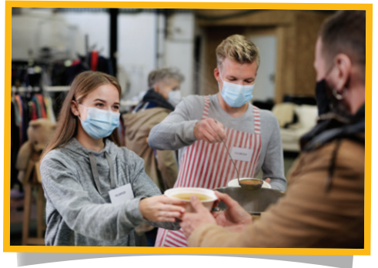
PRE-READING
Some popular volunteering activities for teenagers.
helping at a food bank
selling handmade items
raising money for charity
Volunteering activities
Clean up the beaches
…

Slide 8
VOCABULARY
donation (n)
/dəʊˈneɪʃn/
something that is given to a person or an organization such as a charity, in order to help them; the act of giving something in this way

Slide 9
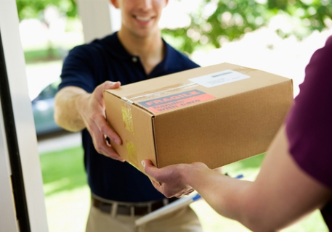
VOCABULARY
deliver (v)
/dɪˈlɪvə(r)/
to take goods, letters, etc. to the person or people they have been sent to

Slide 10
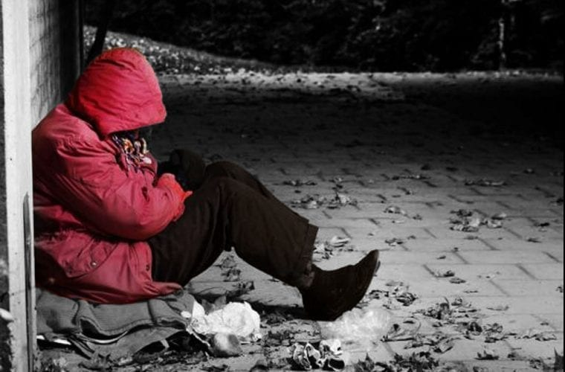
VOCABULARY
hardship (n)
/ˈhɑːdʃɪp/
a situation that is difficult and unpleasant because you do not have enough money, food, clothes, etc.

Slide 11
VOCABULARY
Form | Pronunciation | Meaning
donation (n) | /dəʊˈneɪʃn/ | something that is given to a person or an organization such as a charity, in order to help them; the act of giving something in this way
deliver (v) | /dɪˈlɪvə(r)/ | to take goods, letters, etc. to the person or people they have been sent to
hardship (n) | /ˈhɑːdʃɪp/ | a situation that is difficult and unpleasant because you do not have enough money, food, clothes, etc.

Slide 12
WHILE-READING
1
Read the text and choose the main idea.
A. The writer’s secondary school has a long and interesting history.
B. The Volunteer Club was set up 15 years ago to help teens gain work experience.
C. The club organises many volunteering activities that benefit both community and the students.

Slide 13
WHILE-READING
1
Read the text and choose the main idea.
I joined the Volunteer Club when I started secondary school. The club formed fifteen years ago, shortly after the school was set up. Since then, it has organised various volunteering activities for all students to participate.
One of the most popular activities of our club is selling handmade items to raise money for the local orphanage and homeless old people. Last year, we also raised over one hundred million VND to help people in flooded areas. The money was used to buy warm clothes, blankets, food and clean water.
Our club welcomes different types of donations: clothes, picture books, unused notebooks, and other unwanted items. At the end of each month, we take the donations to the community centre. Our club also organises afterschool games for orphanage and concerts for the old people at the centre. In addition, it offers other volunteering activities, such as helping at a food bank or delivering free meals to poor families.
Volunteering has helped my gain life experiences and find my sense of purpose in life. When I see suffering and hardships, I feel thankful for what I have. What is more, these activities provide opportunities for me to meet other teenagers with similar interests and help me build essential life skills.

Slide 14
WHILE-READING
1
Read the text and choose the main idea.
A. The writer’s secondary school has a long and interesting history.
B. The Volunteer Club was set up 15 years ago to help teens gain work experience.
C. The club organises many volunteering activities that benefit both community and the students.

Slide 15
WHILE-READING
PRACTICE
2
Match the highlighted words in the text with their meanings
1. various
a. objects or things
2. participate
b. taking things to someone
3. items
c. several different
4. raised
d. to take part in an activity
5. delivering
e. collected money

Slide 16
WHILE-READING
PRACTICE
3
Decide whether the following statements are true (T) or false (F)
 | T | F
1. The Volunteer Club was set up long after the school was opened.
2. All students can join different volunteering activities.
3. The money collected from selling handmade items is used to build a local centre for orphans and homeless old people.
4. Students can volunteer at the orphanage or the community centre.
5. Club members can also help cook free meals for poor families.
short
✓
✓
✓
to raise money for the local
orphanage and homeless old people.
✓
deliver
✓

Slide 17
POST-READING
4
Work in pairs. Discuss the following question.
If you were a member of the Volunteer Club, what could you do to help?

Slide 18
POST-READING
Suggested answers:
Clean up the beaches
Help the old and the homeless
Direct traffic
Donate blood
Raise money for the poor
Provide education for the people in remote and mountainous areas

Slide 19
CONSOLIDATION
1
Wrap-up
Gift box secret game

Slide 20
TRÒ CHƠI HỘP QUÀ BÍ MẬT
Gift box secret game

Slide 22
Question 1: When was the volunteer club formed?
A. Fifteen years ago
B. Twenty years ago
C. Ten years ago
D. Five years ago
You are given 2 candies
GO HOME

Slide 23
Question 2: What was one of the most popular activities of the Volunteer Club mentioned in the text?
A. Organizing sports events
B. Hosting movie nights
C. Selling handmade items
D. Conducting workshops
You are given 4 candies
GO HOME

Slide 24
Question 3: How much money did the club raise last year to help people in flooded areas?
A. Over fifty million VND
B. Over two hundred million VND
C. Over seventy-five million VND
D. Over one hundred million VND
You are given 5 candies
GO HOME

Slide 25
Question 4: Where are the donations taken at the end of each month? ?
A. To the school
B. To the local market
C. To the orphanage
D. To the community centre
You are given 2 candies
GO HOME
GO HOME

Slide 26
Question 5: How does the author feel when witnessing suffering and hardships??
A. Indifferent
B. Thankful for what they have
C. Sad and hopeless
D. Excited for more opportunities
You are given 2 candies
GO HOME

Slide 27
Question 6: What is one of the benefits the author gained from volunteering according to the text??
A. Earning money
B. Meeting famous people
C. Gaining life experiences
D. Traveling to different countries
You are given 6 candies
GO HOME

Slide 28
CONSOLIDATION
2
Homework
Prepare for the next lesson: Unit 4: Speaking
2. Do exercises in the workbook

Slide 29
Thank you for attending

