Slide 1


Slide 2



Unit
5
OUR CUSTOMS AND TRADITIONS
Unit
ETHNIC GROUPS OF VIET NAM
LESSON 6: SKILLS 2
LESSON 3: A CLOSER LOOK 2
Unit
HOBBIES
LISTENING
WRITING

Slide 3
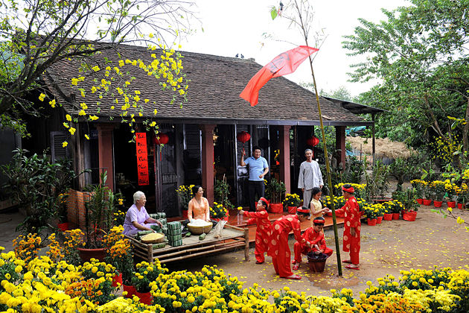
WARM-UP
LUNAR NEW YEAR / TET HOLIDAY

Slide 4
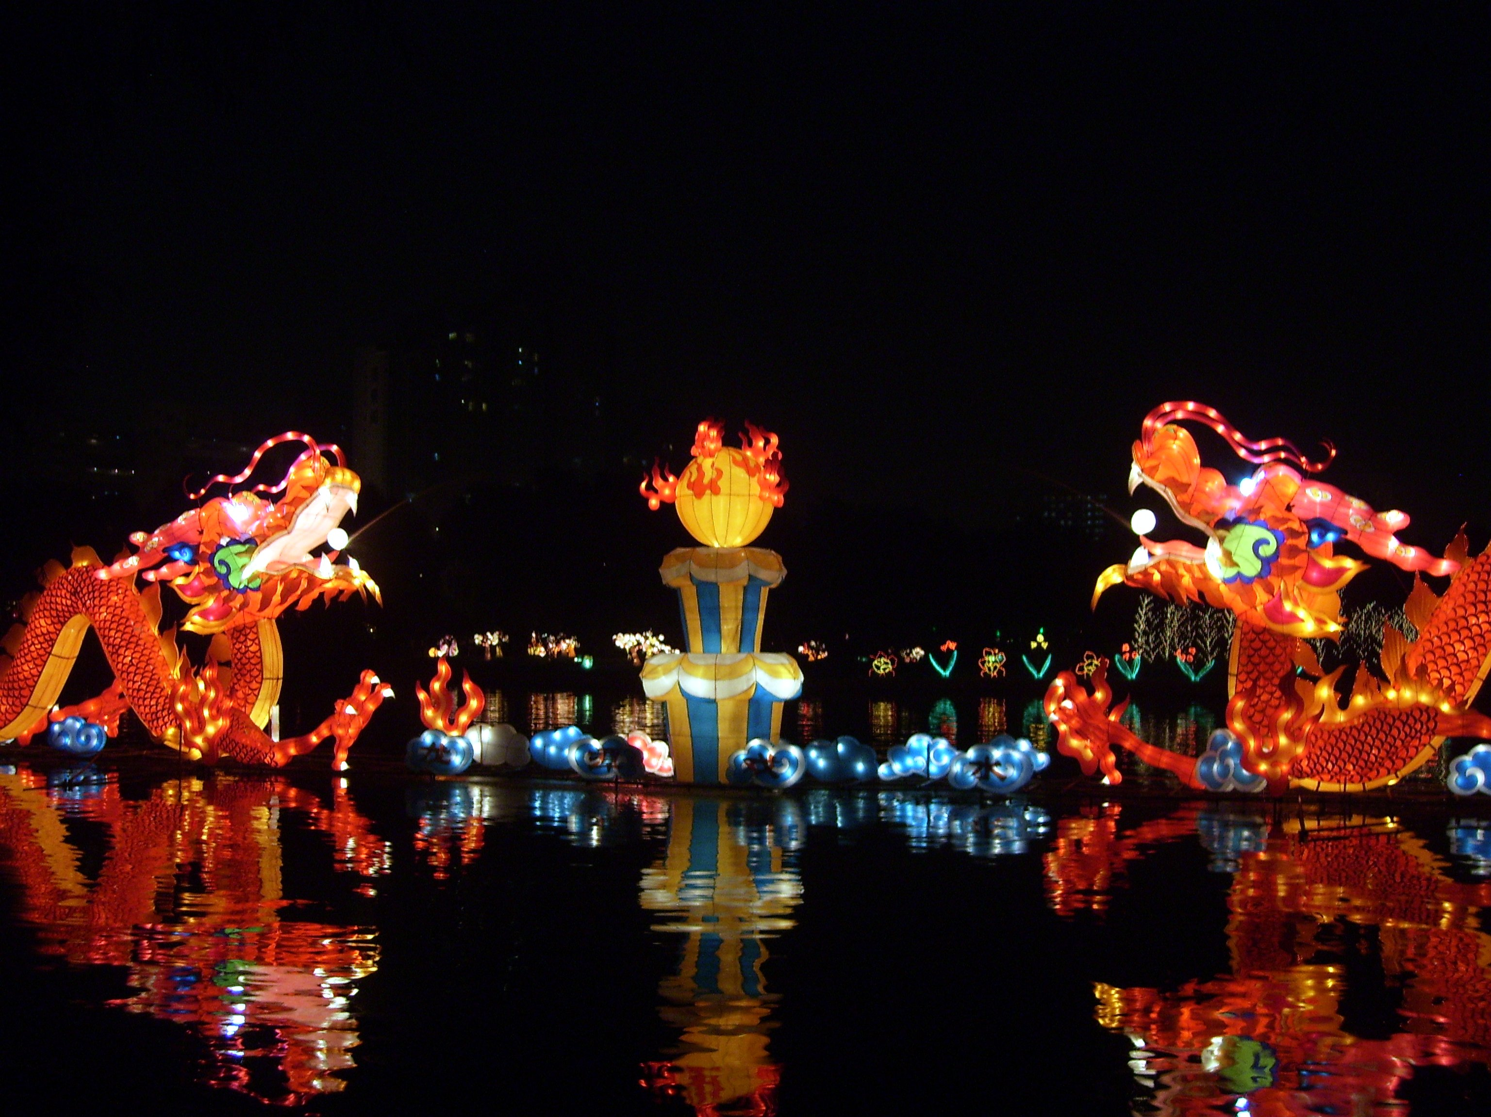
WARM-UP
FULL MOON FESTIVAL / MID-AUTUMN FESTIVAL

Slide 5
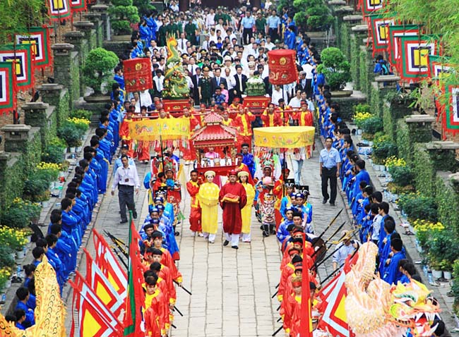
WARM-UP
HUNG KING TEMPLE FESTIVAL

Slide 6
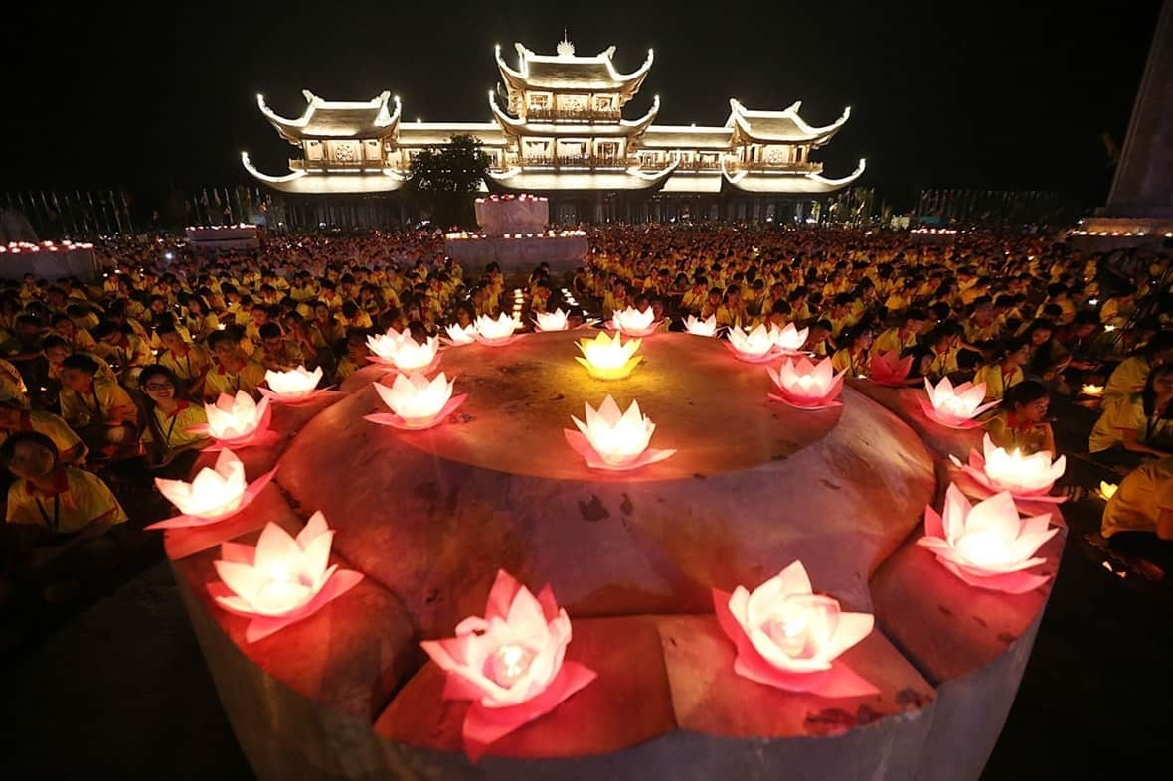
WARM-UP
BUDDHA’S BIRTHDAY

Slide 7
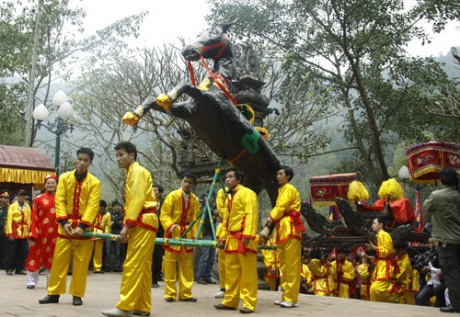
WARM-UP
GIONG FESTIVAL

Slide 8
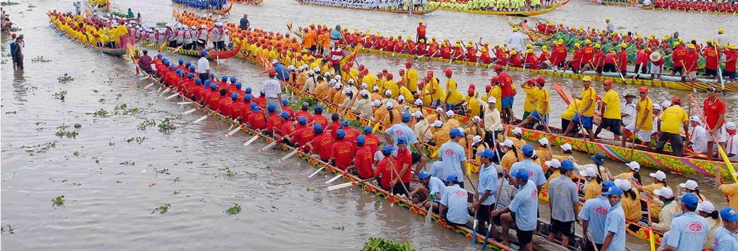
WARM-UP
OK OM BOK FESTIVAL

Slide 9

LISTENING
1
Work in pairs. Look at the picture and answer the following questions.
1. What can you see in the photos?
2. In which part of Viet Nam might the festival occur?

Slide 10

LISTENING
2
Listen to part of the programme “Charming Viet Nam”. Fill in each blank with no more than TWO words.
Ok Om Bok Festival
Purposes | - to thank the Moon God - to mark the (1) ______ of the Khmer year
Time | mid-October (lunar calendar)
Offerings | (2) ___________ and fruits
Activities | - singing and dancing - games and traditional (3) ______________ - Ngo Boat (4) ______
end
young rice
fashion shows
Race

Slide 11

LISTENING
3
Listen again and tick T (True) or F (False).
 | T | F
1. Ok Om Bok is the Moon Worshipping Festival.
2. On the night of the festival, the elders talk about their wishes.
3. There are lantern contests at the festival.
4. Tourists should wear informal clothes when attending the worshipping ceremony.

Slide 12
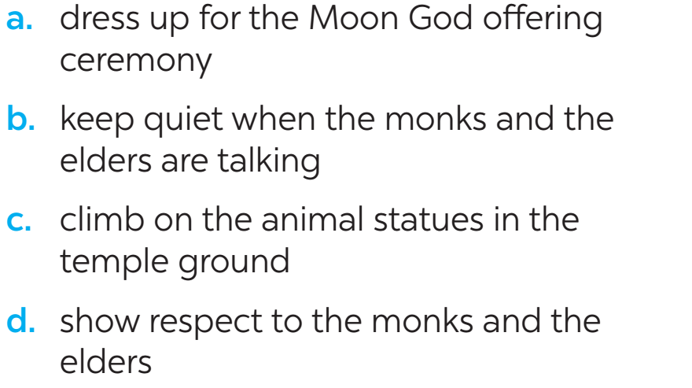
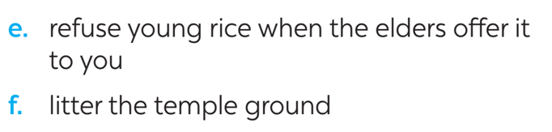
WRITING
4
Work in groups. Read the following pieces of advice for tourists at the Ok Om Bok Festival. Put them in the correct column.
Dos | Don’ts
a | f
b
c
d
e

Slide 13
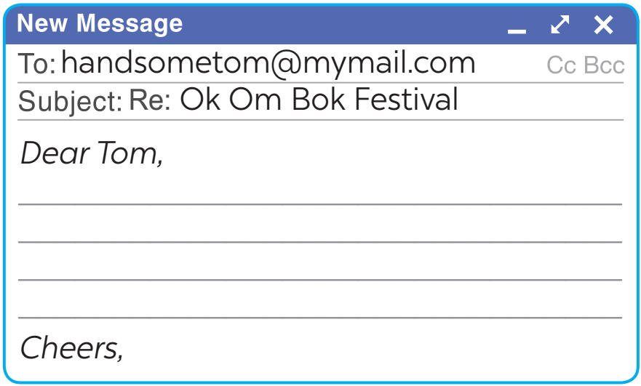
WRITING
5
Tom sent you an email. Read part of his email below.
“… Guess what! My dad is taking me with him to Soc Trang Province. We will be there during the Ok Om Bok Festival. What are some dos and don’ts at this festival? ...”
Write an email (80 - 100 words) to advise Tom about participating in the Ok Om Bok Festival.

Slide 14

CONSOLIDATION
1
Wrap-up
In this lesson, we have learnt to:
listen about a festival;
write an email to give advice on participating in a traditional festival.

Slide 15

CONSOLIDATION
2
Homework
Rewrite the passage on the notebook.
Do exercises: E1,2,3/43 in the workbook.
Prepare for Lesson 7 – Looking back & project.

Slide 16

Website: hoclieu.vn
Fanpage: facebook.com/www.tienganhglobalsuccess.vn/

