Slide 1
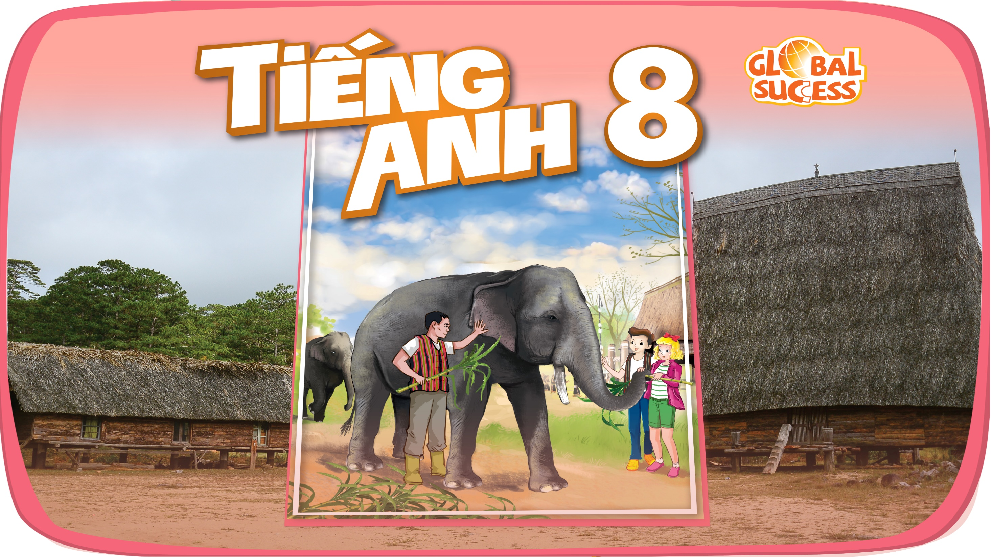

Slide 2

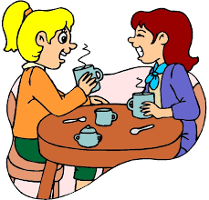
Unit
5
OUR CUSTOMS AND TRADITIONS
ETHNIC GROUPS OF VIET NAM
Unit
MUSIC AND ARTS
Unit
LESSON 4: COMMUNICATION
Unit
HOBBIES

Slide 3
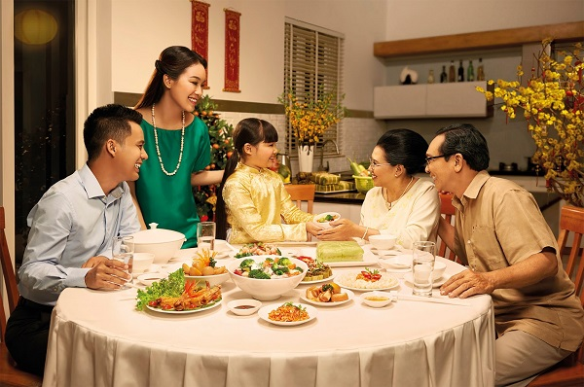
WARM-UP
- What the child is doing?
- Is she behaving well at the table?
Can you give me some examples of table manners?
- Wait for the the table arrangement before sitting down.
- Wait for the oldest people to start first.
...

Slide 4

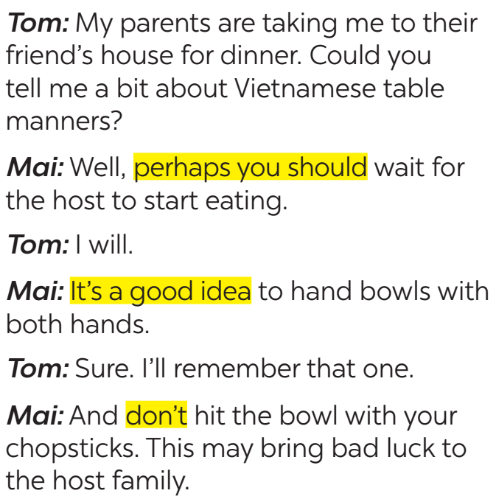



EVERYDAY ENGLISH
1
Listen and read the conversations. Pay attention to the highlighted sentences.
should do
should NOT do

Slide 5
EVERYDAY ENGLISH
Perhaps you should + V₀
It’s a good idea to + V₀
Don’t + V₀
- Perhaps you should wait for the host to start eating.
- It’s a good idea to hand bowls with both hands.
- Don’t hit the bowl with your chopsticks.

Slide 6
EVERYDAY ENGLISH
2
Work in pairs. Make similar conversations with the following situations.
Student A is travelling to Sa Pa in winter. He / She doesn’t know what to wear. Student B gives advice.

Slide 7
EVERYDAY ENGLISH
2
Work in pairs. Make similar conversations with the following situations.
Student A is going to a birthday party. He / She doesn’t know what kind of gift to bring. Student B gives advice.

Slide 8
THE JAPANESE LION DANCE & VIETNAMESE UNICORN DANCE
3
Read the passage and choose the correct title for it.
JAPANESE LION DANCE
Japanese name | (1) __________________
Occasions | – (2) _______________________ – other important occasions
Number of performers | one or more
Skills | (3) ____________
Dance partner | no dance partner
Musical instruments | (4) _______ and drums
Purposes | – to chase away (5) ____________ – to bring good luck
shishi-mai
New Year celebrations
acrobatics
flutes
bad spirits

Slide 9
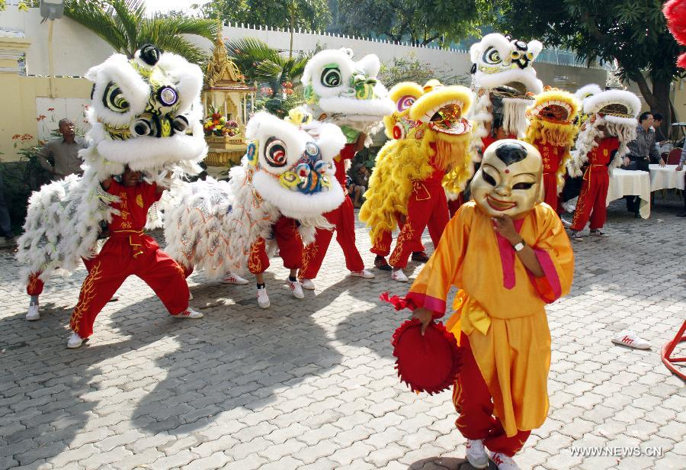
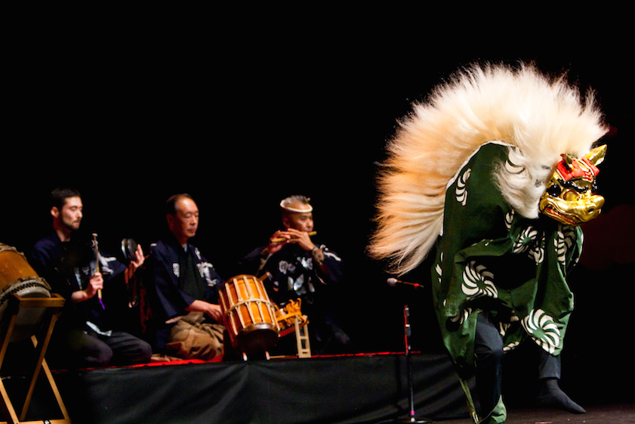
THE JAPANESE LION DANCE & VIETNAMESE UNICORN DANCE
4
Work in groups. Read Mai’s notes on the Vietnamese unicorn dance. Compare the Vietnamese unicorn dance with the Japanese lion dance.
What are the similarities and differences between two pictures?

Slide 10
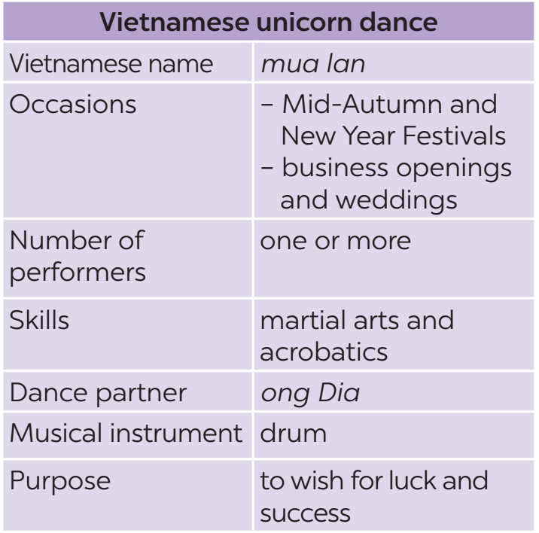
THE JAPANESE LION DANCE & VIETNAMESE UNICORN DANCE
4
Work in groups. Read Mai’s notes on the Vietnamese unicorn dance. Compare the Vietnamese unicorn dance with the Japanese lion dance.
Example:
The Vietnamese unicorn dance and the Japanese lion dance are both popular on New Year Festivals.

Slide 11

CONSOLIDATION
1
Wrap-up
In this lesson, we have learn to:
learn how to give advice
practise using some grammar points and vocabulary related to the topic.

Slide 12

CONSOLIDATION
2
Homework
Do exercises C1,2,3/39,40 in the workbook.
Compare Vietnamese Tet Holiday and Chinese Tet Holiday.
Prepare Unit 5: Skills 1.

Slide 13
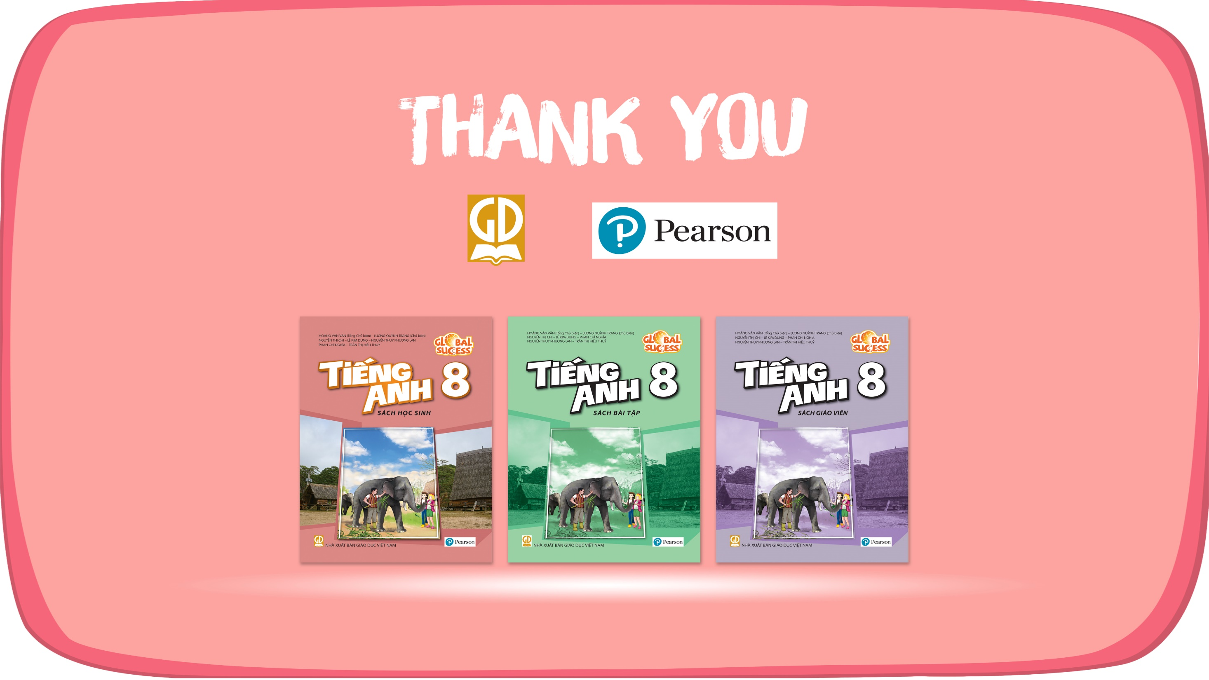
Website: hoclieu.vn
Fanpage: facebook.com/www.tienganhglobalsuccess.vn/

