Slide 1
Tran Phu secondary school
Good morning class !!!

Slide 2
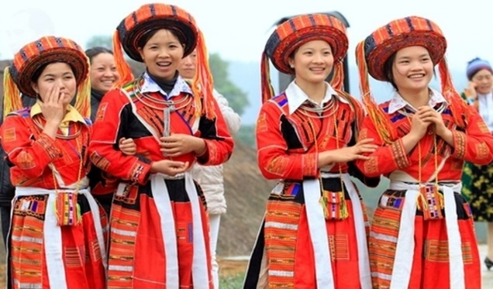
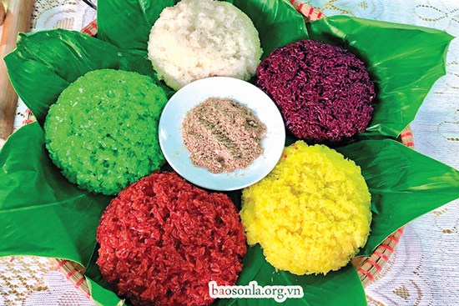
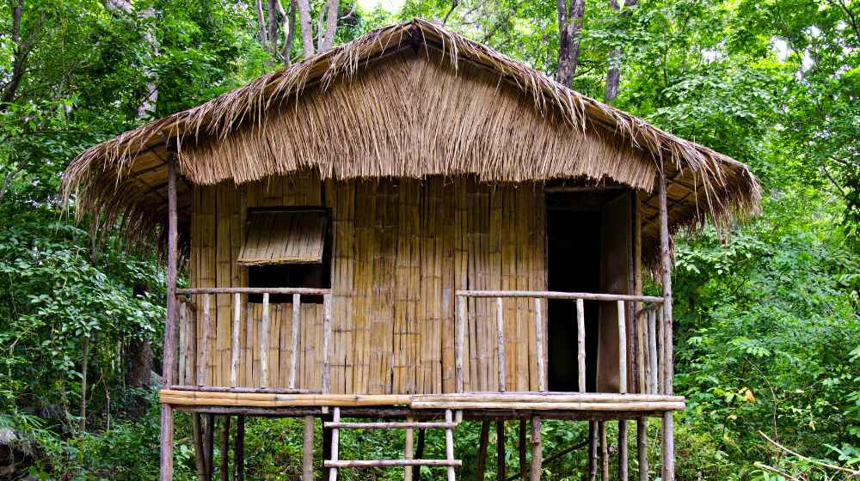
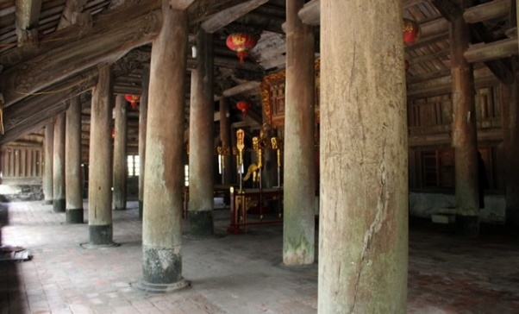
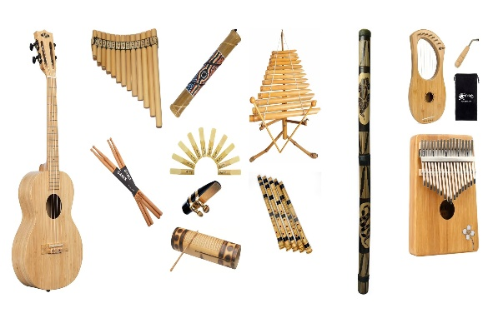
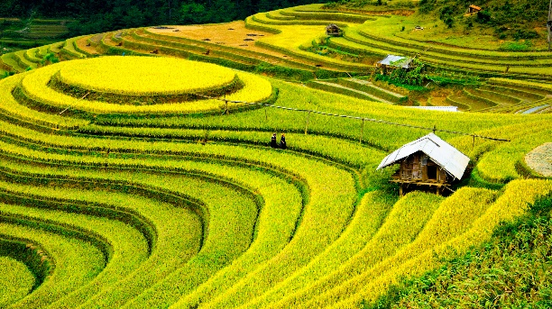
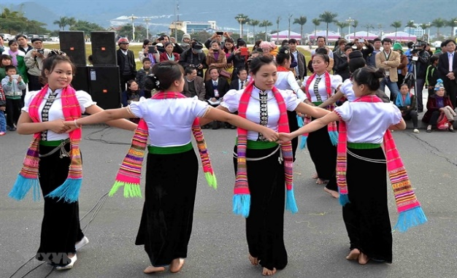
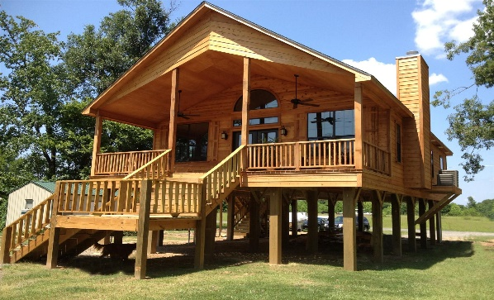
* WARM-UP
2 minutes to start
Kim’s Game

Slide 3
* WARM-UP
bamboo house
costume
five-color sticky rice
post
folk dance
musical instrument
stilt house
terraced field

Slide 4
Unit
4
ETHNIC GROUPS OF VIET NAM
LESSON 2: A CLOSER LOOK 1
VOCABULARY
PRONUNCIATION

Slide 5
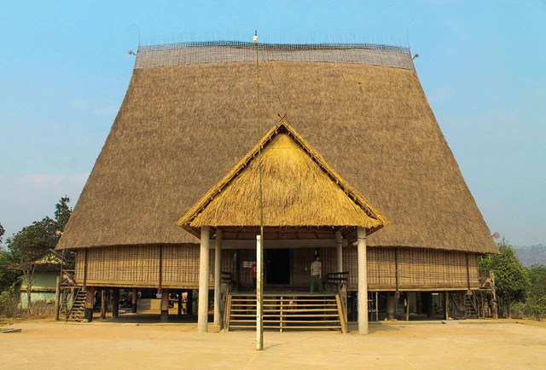
* VOCABULARY
communal house (n):
nhà rông, nhà sinh hoạt cộng đồng.
/kəˈmjuːnəl haʊs/

Slide 6
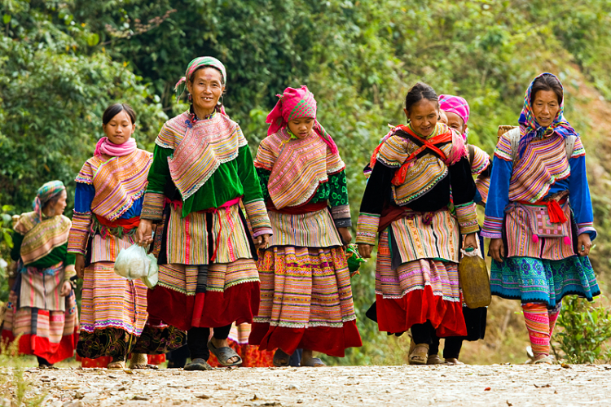
* VOCABULARY
- minority group (n):
dân tộc thiểu số
/maɪˈnɔːrəti gru:p/

Slide 7
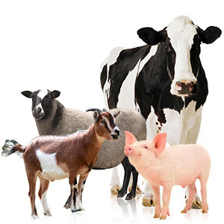
* VOCABULARY
- livestock (n):
gia súc
/ˈlaɪvstɒk/

Slide 8
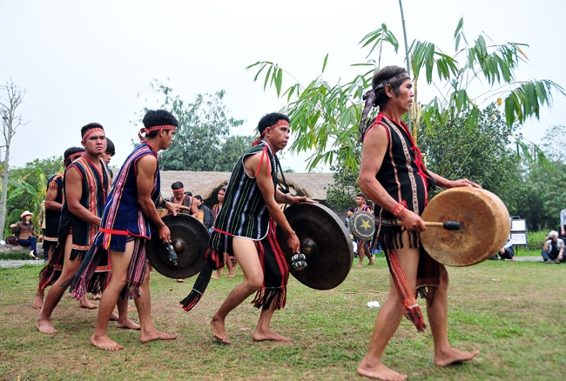
* VOCABULARY
- gong (n):
cái cồng,cái chiêng
/ɡɒŋ/

Slide 9
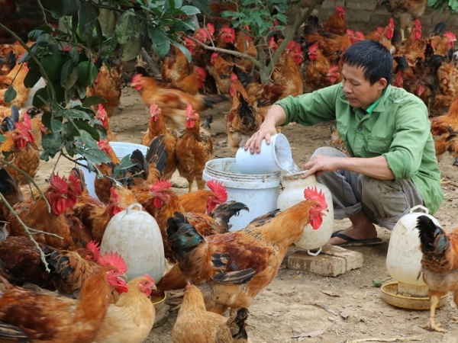
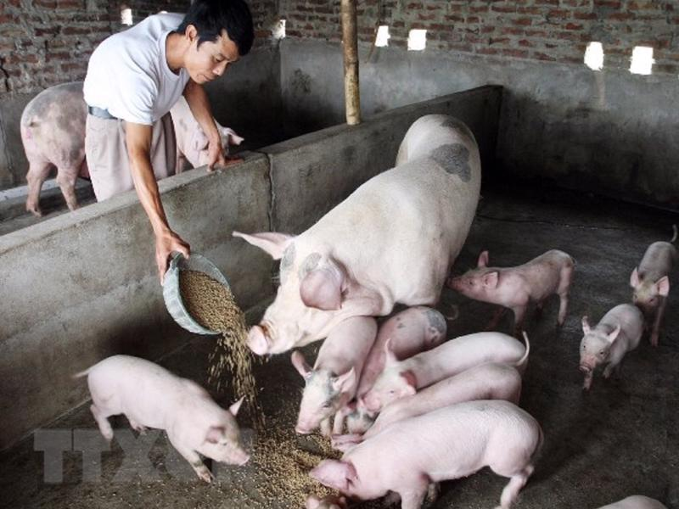
* VOCABULARY
- raise (v):
chăn nuôi
/reiz/

Slide 10
* VOCABULARY
New words | Pronunciation | Meaning
1. communal house (n) | /kəˈmjuːnəl haʊs/ | nhà rông, nhà sinh hoạt cộng đồng.
2. minority group (n) | /maɪˈnɔːrəti gru:p/ | dân tộc thiểu số
3. livestock (n) | /ˈlaɪvstɒk/ | gia súc
4. raise (v) | /reiz/ | chăn nuôi
5. gong (n) | /ɡɒŋ/ | cái cồng, cái chiêng

Slide 11
* Checking vocab
What and Where
raise
communal
house
minority
group
gong
livestock

Slide 12
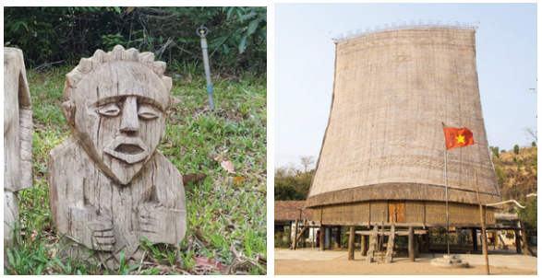
* VOCABULARY
1
Write a word or phrase from the box under each picture.
Rong house weaving terraced fields
gong bamboo flute wooden statue
wooden statue
Rong house
1._________________
2.________________

Slide 13
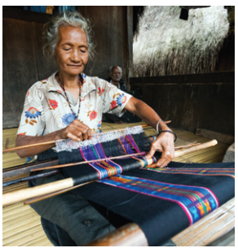
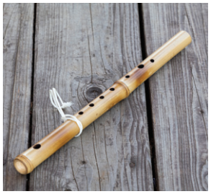
* VOCABULARY
1
Write a word or phrase from the box under each picture.
Rong house weaving terraced fields
gong bamboo flute wooden statue
weaving
bamboo flute
3._______________
4._________________

Slide 14
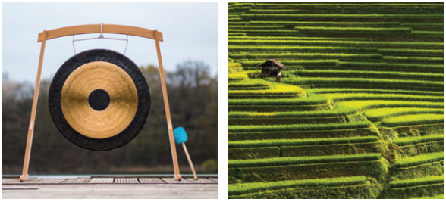
*VOCABULARY
1
Write a word or phrase from the box under each picture.
Rong house weaving terraced fields
gong bamboo flute wooden statue
gong
terraced fields
5.___________________
6.___________________

Slide 15
* VOCABULARY
2
Match the words and phrases with their meanings.
A |  | B
 |  | a. the animals we keep on a farm like cows and sheep
 |  | b. a large room for community activities
 |  | c. a group smaller in size than other groups in the same country
 |  | d. a traditional musical instrument
 |  | e. work like growing, watering, weeding, and harvesting
1. minority group
2. livestock
3. gardening
4. gong
5.communal house

Slide 16
3
Complete the sentences with the words and phrases from the box.
communal house unique features minority group
raise weave livestock
unique features
1. It’s interesting to learn about the _______________ of an ethnic group’s traditional culture.
2. Most mountain girls know how to ______ clothing.
3. The Cham in Ninh Thuan _____ sheep and cows.
weave
raise

Slide 17
VOCABULARY
3
Complete the sentences with the words and phrases from the box.
communal house unique features minority group
raise weave livestock
4. A _______________ is for community meetings and events.
5. There are fewer Nung than Kinh, so they are an ethnic ______________.
6. Children in both the lowlands and highlands help raise their family’s _________.
communal house
minority group
livestock

Slide 18
* PRONUNCIATION
How to pronounce the sounds /k/ and /g/.

Slide 19
* PRONUNCIATION
4
Listen and repeat the words. Pay attention to the sounds /k/ and /g/.
/k/ | /g/
cultural communal musical folk overlook | gong garden gathering tiger pig

Slide 20
5
Listen and repeat the sentences. Pay attention to the underlined words.
1. The kitchen is for family gatherings.
2. Tigers and monkeys live in the forest.
3. I love the five-colour sticky rice.
4. Yesterday, we harvested cucumbers from our garden.
5. Most girls know how to cook.
/k/ and /g/

Slide 21
* CONSOLIDATION
VOCABULARY
PRONUNCIATION

Slide 22
* Homework
- Learn by heart all the words that they have just learnt.
- Do exercises in the workbook.
- Prepare for Lesson 3 - A closer look 2.

Slide 23
Goodbye.
See you again.

