Slide 1
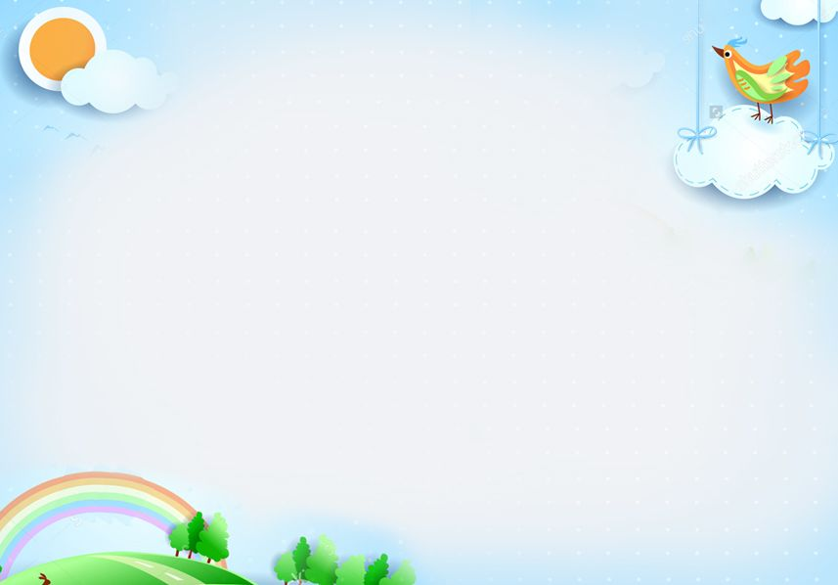
Good morning class !!!

Slide 2

Find 6 meaningful words in the puzzle.
* WARM-UP
A | N | C | H | E | C | K | E
P | P | O | S | T | O | S | E
I | E | N | A | C | U | U | B
C | O | N | M | U | A | T | E
T | W | E | B | S | I | T | E
U | A | C | L | I | P | D | I
R | S | T | D | Y | F | K | L
E | R | P | Q | E | A | O | V
- The team with the more correct answers wins.

Slide 3

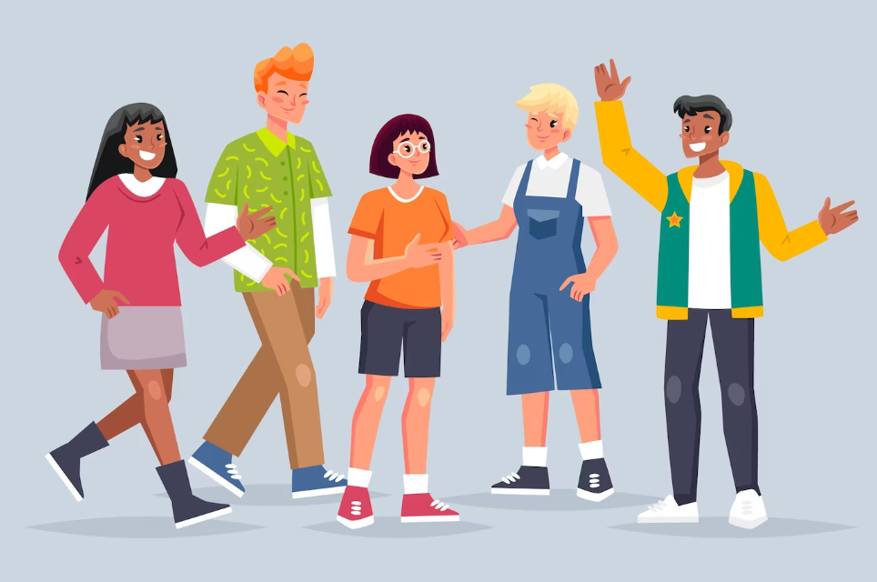
Unit
3
TEENAGERS
LESSON 2: A CLOSER LOOK 1

Slide 4
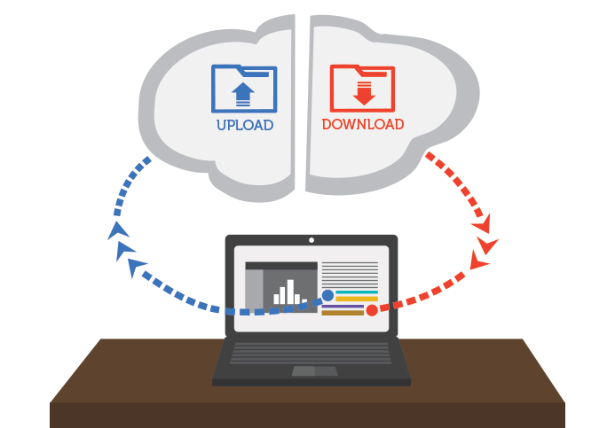

* VOCABULARY
upload (v):
tải lên
/ˌʌpˈləʊd/

Slide 5
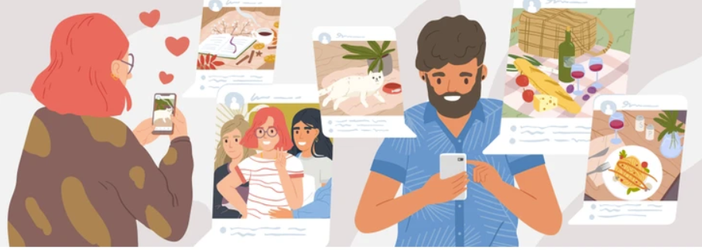
* VOCABULARY
browse (v):
đọc lướt, tìm (trên mạng)
/braʊz/

Slide 6
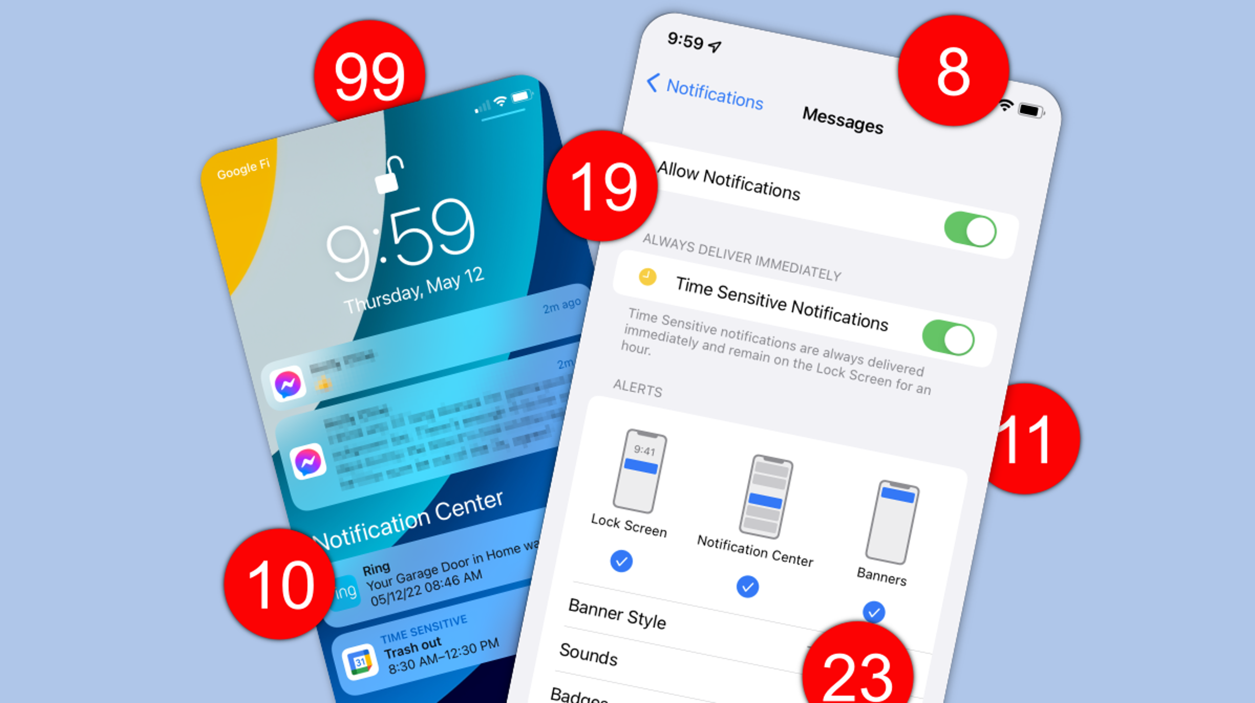
* VOCABULARY
notification (n):
thông báo
/ˌnəʊtɪfɪˈkeɪʃn/

Slide 7
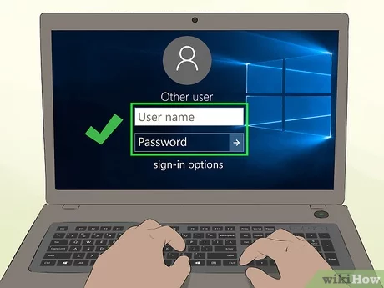
* VOCABULARY
log on to (v):
đăng nhập
/lɒɡ ɒn tə/

Slide 8
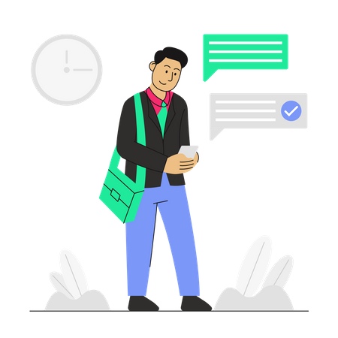
* VOCABULARY
check (v):
kiểm tra
/tʃek/

Slide 9
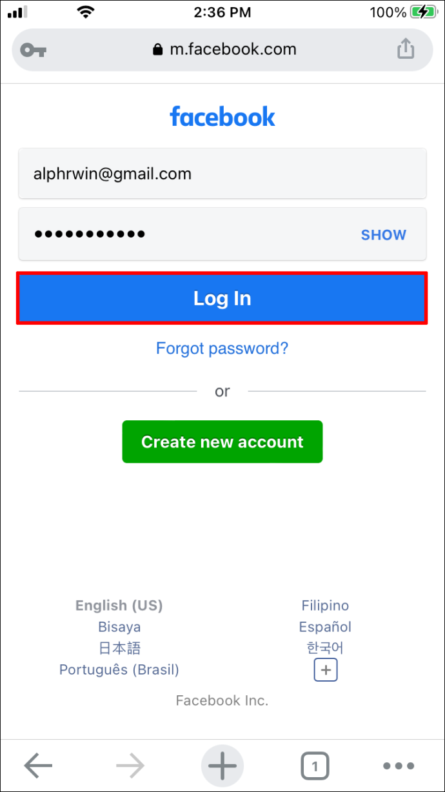
* VOCABULARY
account (n):
tài khoản
/əˈkaʊnt/

Slide 10
* VOCABULARY
New words | Pronunciation | Meaning
1. upload (v) | /ˌʌpˈləʊd/ | tải lên
2. browse (v) | /braʊz/ | đọc lướt, tìm (trên mạng)
3. notification (n) | /ˌnəʊtɪfɪˈkeɪʃn/ | thông báo
4. log on to (v) | /lɒɡ ɒn tə/ | đăng nhập
5. check (v) | /tʃek/ | kiểm tra
6. account (n) | /əˈkaʊnt/ | tài khoản

Slide 11
* VOCABULARY
New words | Pronunciation | Meaning
1. | /ˌʌpˈləʊd/ | tải lên
2. | /braʊz/ | đọc lướt, tìm (trên mạng)
3. | /ˌnəʊtɪfɪˈkeɪʃn/ | thông báo
4. | /lɒɡ ɒn tə/ | đăng nhập
5. | /tʃek/ | kiểm tra
6. | /əˈkaʊnt/ | tài khoản
upload (v)
browse (v)
notification (n)
log on to (v)
check (v)
account (n)

Slide 12


* VOCABULARY
1
Circle the correct options to complete the phrases.

Slide 13

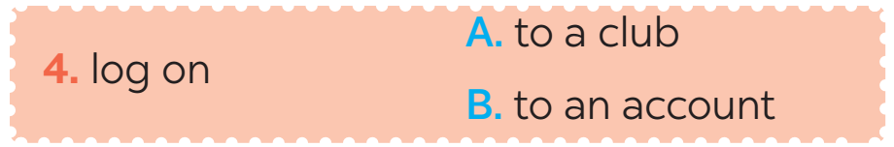

* VOCABULARY

Slide 14
2
Use the correct forms of the verbs in 1 to complete the sentences.
1. I________ the school website and found pictures of school activities.
2. Our teacher ________ a video of our last meeting in our forum for everyone to see.
3. She ________ with some old friends at the English club.
4. Tom ________ the notifications and saw some new posts.
5. Mi often ________ to her Instagram account to chat with her friends.
browsed
uploaded
connects
checked
logs on

Slide 15
3
Choose the correct answer A, B, or C.
1. Our class has a(n)______, and we often post questions there to discuss.
A. office B. forum C. club
2. We try to meet our parents’ ______, but it is hard.
A. dreams B. interests C. expectations
3. He is a big ______ and scares his weaker classmates.
A. bully B. forum C. pressure
4. She was chatting with her friends, so she couldn’t ______ on the lesson.
A. concentrate B. coach C. advise
5. We have ______ from our exams, peers, and parents. This makes us feel very stressed.
A. interests B. pressure C. friends

Slide 16

Choose the best answer

Slide 17


1
5
4
1
1. Our class has a(n)______, and we often post questions there to discuss.
3
2
A. office
B. forum
C. club

Slide 18
5
4
1
2. We try to meet our parents’ ______ but it is hard.
3
2
a. dreams
b. interests
c. expectations

Slide 19
3. He is a big ______ and scares his weaker classmates.
A. bully B. forum C. pressure
4. She was chatting with her friends, so she couldn’t ______ on the lesson.
A. concentrate B. coach C. advise
5. We have ______ from our exams, peers, and parents. This makes us feel very stressed.
A. interests B. pressure C. friends

Slide 20
4
Listen and repeat the words. Pay attention to the sound /ʊə/ and /ɔɪ/.
Then put the words into the correct columns
boy tourist toy ensure
avoid choice sure tournament
/ʊə/ | /ɔɪ/
tourist
boy
ensure
toy
sure
avoid
tournament
choice

Slide 21
5
Listen and practice the sentences. Underline the words with /ʊə/ and circle the words /ɔɪ/.
She is a noisy and curious girl.
They joined a full-day city tour.
I found it enjoyable to watch the tournament.
She’ll record our voices during the interview.
He is not acting very mature and is starting to annoy me.

Slide 22
RULE:
Work in 2 teams.
T reads out word by word, one student will run to the board and slap on the correct word with the correct sound.
The team with more correct answers will be the winner.

Slide 23
FURTHER PRACTICE
toy
noisy
annoy
sure
boy
voice
soil
tour
tourist
enjoy
ensure
tournament
choice
mature
avoid
Notes:
* Teacher should prepare these words to stick on the board.

Slide 24

Homework:
- Do the exercises again.
- Be ready for A closer Look 2

Slide 25

Thanks for your atendance!
Goodbye. See you again
Notes:
25

Slide 26
5
4
1
1. I want ______ cup of tea.
3
2
a. a
b. an
c. the

Slide 27
3
5
4
1
1. I want ______ cup of tea.
3
2
a. a
b. an
c. the

Slide 28
5
4
1
5. ______ films often make us cry.
3
2
a. Amusing
b. Moving
c. Funny

