Slide 1
Song Ve secondary school
Good morning class !!!

Slide 2
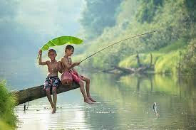
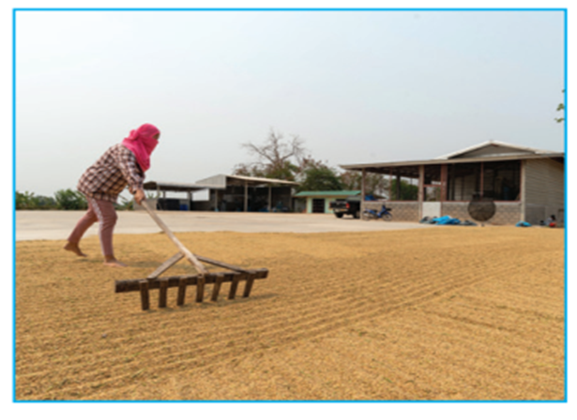
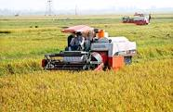
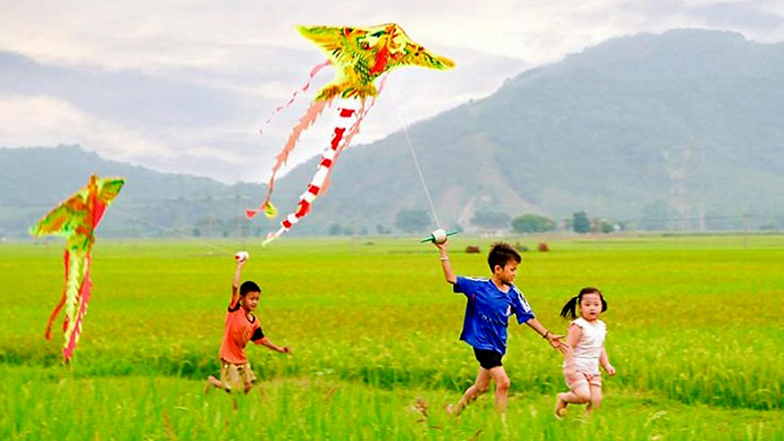
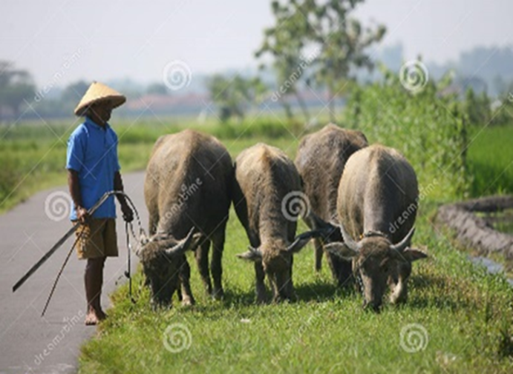
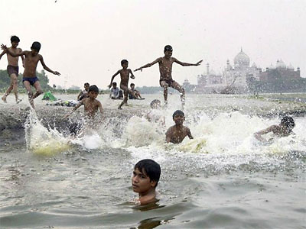
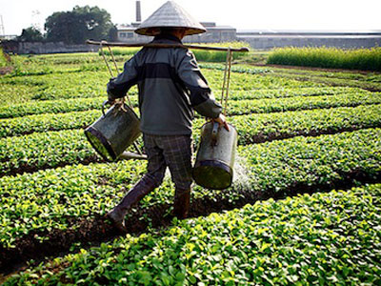
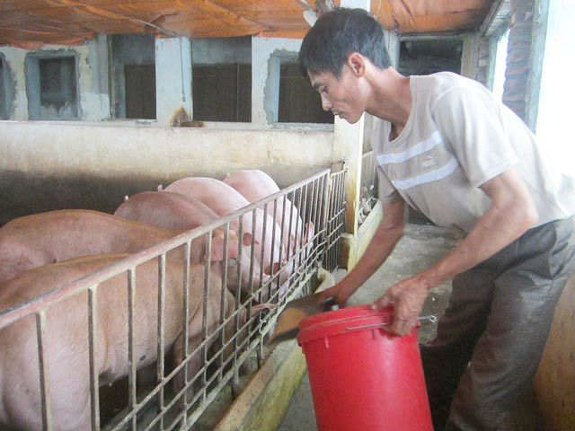
Going fishing
harvesting rice
drying rice
Kim’s Game
flying kites
herding buffaloes
Swimming in the river
feeding pigs
watering vegetables

Slide 3
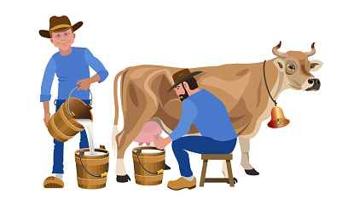
Unit
2
LIFE IN THE COUNTRYSIDE
LESSON 7: LOOKING BACK & PROJECT

Slide 4
What have we learnt in Unit 2?
- words about life in the countryside
- the sounds /ə/ and /ɪ/ in words and sentences
- comparative forms of adverbs
REVISION
- giving and responding to compliments
- reading about different aspects of a Vietnamese village
- talking about the village or town where someone lives
- listening to someone’s opinion about life in the countryside
- writing a paragraph about what someone likes or dislikes about life in the countryside

Slide 5
VOCABULARY
1
Write a phrase from the box under the correct picture.
unloading rice milking cows catching fish ploughing fields feeding pigs drying rice
ploughing fields
catching fish
1. _________________
2. _________________

Slide 6
VOCABULARY
1
Write a phrase from the box under the correct picture.
unloading rice milking cows catching fish ploughing fields feeding pigs drying rice
drying rice
unloading rice
3. _________________
4. _________________

Slide 7
VOCABULARY
1
Write a phrase from the box under the correct picture.
unloading rice milking cows catching fish ploughing fields feeding pigs drying rice
feeding pigs
milking cows
5. _________________
6. _________________

Slide 8
VOCABULARY
2
Choose the correct answer A, B, or C.
1. There is a huge cloud ______ as far as the eye can see. A. surrounded B. stretching C. vast
2. People in my village are really ______; they are always generous and friendly to visitors. A. well-trained B. funny C. hospitable

Slide 9
VOCABULARY
2
Choose the correct answer A, B, or C.
3. The development of cities destroys ______ areas of countryside. A. vast B. much C. stretching
4. The workers in our factory are very ______ because they took a lot of good training courses. A. hospitable B. kind C. well-trained
5. The area around the village is famous for its ______ landscape. A. picturesque B. boring C. dull

Slide 10
GRAMMAR
3
Complete the sentences with suitable comparative forms of the adverbs from the box.
1. Every morning nick gets up ten minutes (early) ______ than his sister.
2. I speak French (fluently) ____________ now than I did last year.
3. You’ll find your way around the village (easily) __________ if you have a good map.
4. It rained (heavily) ____________ today than it did yesterday.
5. If you work (hard) _________, you will do (well) ________ in your exam.
Game

Slide 11
LUCKY NUMBERS
1
2
3
4
5
6
7
8
GA
2
4
6
8
10
12
14
GB
2
4
6
8
10
12
14

Slide 12
3
Complete the sentences with suitable comparative forms of the adverbs from the box.
earlier
1. Every morning nick gets up ten minutes (early) ______ than his sister.

Slide 13
3
Complete the sentences with suitable comparative forms of the adverbs from the box.
more fluently
2. I speak French (fluently) ______________ now than I did last year.

Slide 14
3
Complete the sentences with suitable comparative forms of the adverbs from the box.
3. You’ll find your way around the village (easily) ______________ if you have a good map.
more easily

Slide 15
3
Complete the sentences with suitable comparative forms of the adverbs from the box.
more heavily
4. It rained (heavily) _______________ today than it did yesterday.

Slide 16
3
Complete the sentences with suitable comparative forms of the adverbs from the box.
harder
better
5. If you work (hard) _________, you will do (well) ________ in your exam.

Slide 20
3
Complete the sentences with suitable comparative forms of the adverbs from the box.
earlier
1. Every morning nick gets up ten minutes (early) ______ than his sister.
2. I speak French (fluently) ______________ now than I did last year.
3. You’ll find your way around the village (easily) _____________ if you have a good map.
4. It rained (heavily) ________________ today than it did yesterday.
5. If you work (hard) _________, you will do (well) ________ in your exam.
more fluently
more easily
more heavily
harder
better

Slide 21
GRAMMAR
4
Underline the mistakes in the sentences and correct them.
1. I run faster as my brother does.
2. People in the city seem to react quicklier to changes than those in the country.
→ than
→ more quickly

Slide 22
GRAMMAR
4
Underline the mistakes in the sentences and correct them.
3. We need to work more hardly, especially at exam time.
4. You must finish harvesting the rice the earlier this year than you did last year.
5. As they climbed more highly up the mountain, the air became cooler.
→ harder
→ earlier
→ higher

Slide 23
* PROJECT
- Show your group’s poster about a village that you would like to visit.
- Present your poster to the class.

Slide 24
* CONSOLIDATION
Vocabulary review
Grammar review
Project: My favourite village

Slide 25
* Homework
Do exercises in the workbook.
Prepare Unit 3 : Getting started

