Slide 1
Hello everyone !!!

Slide 2
WARM-UP
1. Thank you. Yours’ re, too.
2. Happy birthday. Wow you’re wearing such a beautiful dress
3. Here is your present. I hope you like it.
JUMBLED
CONVERSATION
4. I’m glad you like it.
5. This is the best gift I have ever had. I love it.

Slide 3
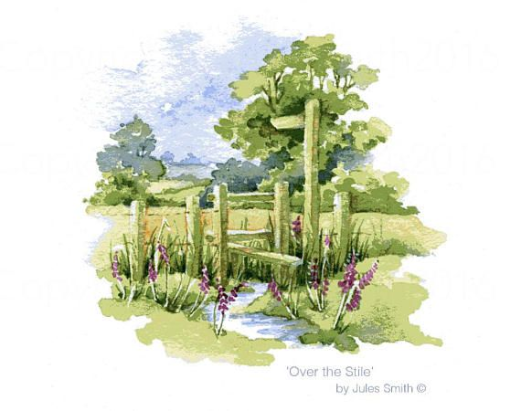
Unit
2
LIFE IN THE COUNTRYSIDE
LESSON 4: COMMUNICATION

Slide 4
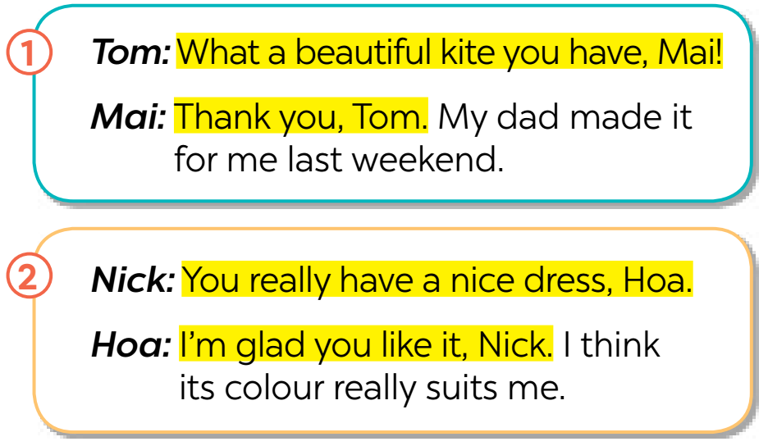
EVERYDAY ENGLISH
1
Listen and read the conversations. Pay attention to the highlighted sentences.
Giving compliments | Responding to compliments
- What a beautiful kite you have! - You really have a nice dress. | - Thank you. - I’m glad you like it.

Slide 5
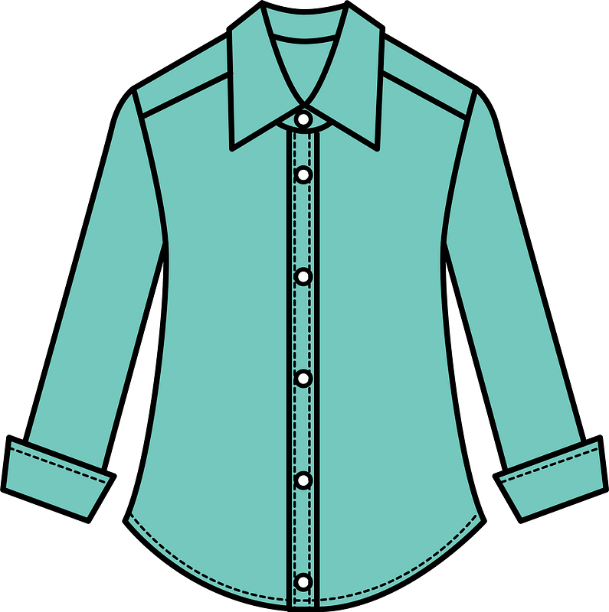
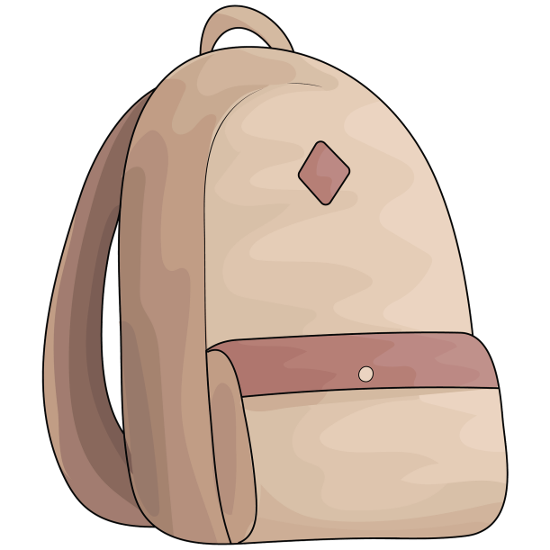
EVERYDAY ENGLISH
2
Work in pairs. Make similar conversations to practise giving and responding to compliments, using the cues below.
– a shirt – a bicycle – a school bag

Slide 6
EVERYDAY ENGLISH
2
Work in pairs. Make similar conversations to practise giving and responding to compliments, using the cues below.
A: What a nice shirt you have!
B: Thank you. My mom bought it for me last week.
– a shirt

Slide 7
EVERYDAY ENGLISH
2
Work in pairs. Make similar conversations to practise giving and responding to compliments, using the cues below.
– a bicycle
A: You really have a nice bicycle!
B: I'm glad you like it.

Slide 8
EVERYDAY ENGLISH
2
Work in pairs. Make similar conversations to practise giving and responding to compliments, using the cues below.
– a school bag
A: What a nice school bag you have!
B: Thank you. My sister gave it to me yesterday.

Slide 9
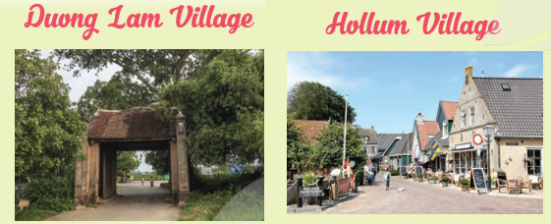
ADVERTS FOR BEAUTIFUL VILLAGES
3
Read the adverts for the two beautiful villages. tick the boxes to show which village the statements describe. Sometimes both boxes need to be ticked.
Duong Lam, one of the most ancient villages in Ha Noi, is situated in Son Tay. Visitors can get there from the centre of Ha Noi by car, bus or even by bicycle. It is famous for its ancient pagoda, traditional houses, and temples. Besides these, visitors can observe the locals making specialities, such as keo doi, che lam, etc. and then try them.
Hollum is one of the ancient villages on the island of Ameland, the Netherlands. Many visitors come to the village because of its historical and cultural values. It is full of fascinating sights, such as traditional houses, a museum, a church, a lighthouse, etc. Besides sightseeing, visitors can also take part in sports like kite-flying, surfing, etc. Visitors can reach the village by air or ferry.

Slide 10
3
Read the adverts for the two beautiful villages. tick the boxes to show which village the statements describe. Sometimes both boxes need to be ticked.
Statements | Duong Lam | Hollum
1. It’s an ancient village.
2. We can visit an ancient pagoda, traditional houses, and temples in this village.
3. We can get there by plane or ferry.
4. We can go there by car, bus, or bike.
5. It has a lighthouse.

Slide 11
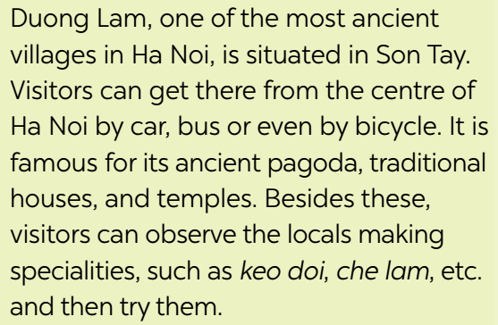
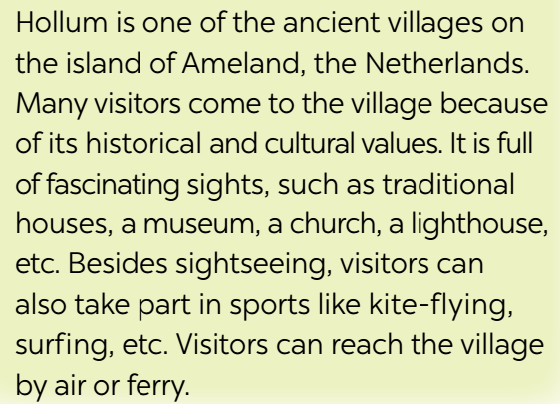
4
Work in groups. take turns to talk about the similarities and differences between Duong Lam and Hollum
Duong Lam and Hollum are both ancient villages, …
Duong Lam | Hollum
-situated in Son Tay, Ha Noi | - located on the island of Ameland, New Zealand.
-get there by car, bus or even by bicycle | - get there by plane or ferry
-places to visit: traditional houses, and temples | - places to visit: traditional houses, a museum, a church, a lighthouse
-observe the locals making specialities, such as keo doi, che lam, etc. and then try them. | - take part in sports like kite-flying, surfing, etc.

Slide 12
5
Work in pairs. Which village in 3 would you like to visit for a holiday? Explain your choice to your partner.
Example:
A: Which village would you like to visit for a holiday?
B: Duong Lam, of course!
A: Why?
B: Because I love watching the locals making specialities and …
A: Which village would you like to visit for a holiday?
B: Duong Lam, of course!
A: Why?
B: Because I love watching the locals making specialities and …

Slide 13
5
Work in pairs. Which village in 3 would you like to visit for a holiday? Explain your choice to your partner.
A: Which village would you like to visit for a holiday?
B: Duong Lam, of course!
A: Why?
B: Because I love watching fascinating sights, such as traditional houses, a museum, a church, a lighthouse,... and taking part in sports like kite-flying, surfing, etc.

Slide 14
* CONSOLIDATION
What have we learnt in this lesson?
How to give and respond to compliments

Slide 15
* Homework
Do exercises in the workbook.
Prepare lesson 5 : Skills 1

Slide 16
Thanks for your atendance!
Goodbye. See you again
Notes:
16

