Slide 1
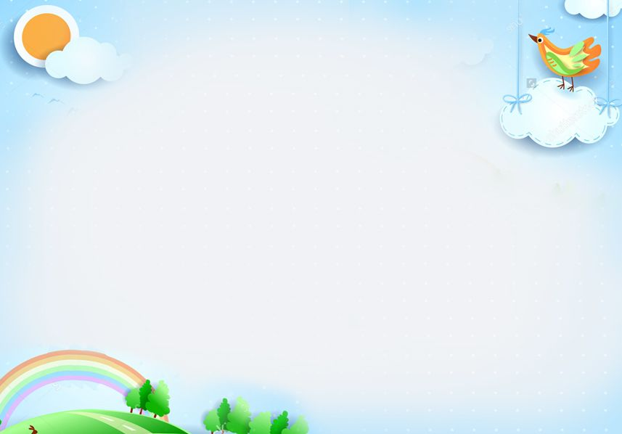


Slide 2


2 minutes to start
Work in 2 groups
Write down some verbs or phrases of liking and disliking
Suggested answers
Group A | Group B
………………… | …………………………….
love
like
detest
fancy
dislike
enjoy
hate
prefer
don’t like
1. be interested in
2. be fond of
3. be keen on
4. be crazy about
5. be into
The group with more words and faster wins the game

Slide 3

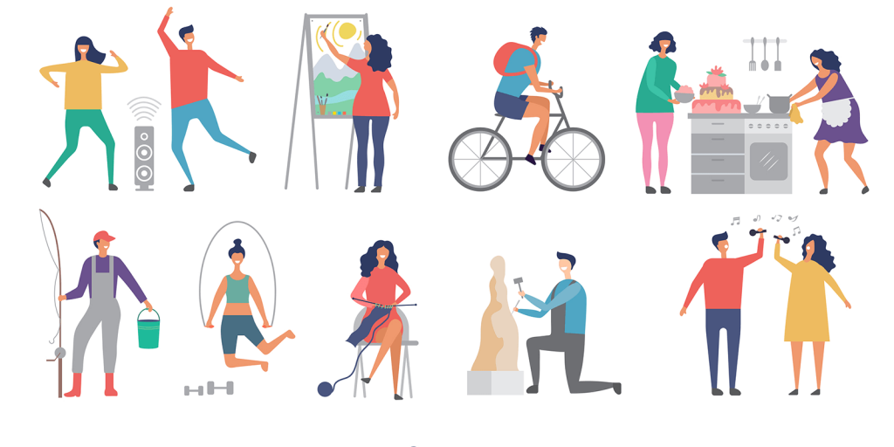
Unit
1
LEISURE TIME
LESSON 7: LOOKING BACK & PROJECT
1

Slide 4
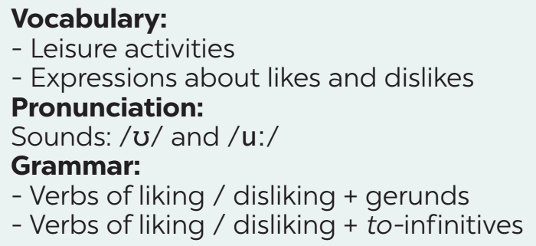
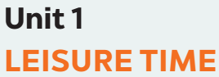
What we have learnt in this unit:
REVISION

Slide 5
* VOCABULARY
1
Complete the sentences with appropriate leisure activities.
1. Mai loves ________ online for about 30 minutes a day. She thinks puzzles are good for the brain.
2. My favourite leisure activity is _______. I can make many things myself, such as paper flowers and bracelets.
3. _______________ is a popular way for teens to spend their free time. Many of them send messages to each other every day.
4. My brother is fond of ___________ with his friends. On Sundays, he usually plays football, goes swimming, or plays badminton with them.
5. Tom spends one hour on the Internet almost every day. He is keen on _________.
Game

Slide 6


Tom
Jerry
40
Lucky Numbers
10
20
30
60
70
80
50
70
30
20
10
40
60
50
1
2
3
4
5
6
7

Slide 7
* VOCABULARY
1
Complete the sentences with appropriate leisure activities.
1. Mai loves ___________ online for about 30 minutes a day. She thinks puzzles are good for the brain.
doing puzzles

Slide 8
* VOCABULARY
1
Complete the sentences with appropriate leisure activities.
2. My favourite leisure activity is ________. I can make many things myself, such as paper flowers and bracelets.
doing DIY

Slide 9
* VOCABULARY
1
Complete the sentences with appropriate leisure activities.
Messaging friends
3. _______________ is a popular way for teens to spend their free time. Many of them send messages to each other every day.

Slide 10
* VOCABULARY
1
Complete the sentences with appropriate leisure activities.
4. My brother is fond of ___________ with his friends. On Sundays, he usually plays football, goes swimming, or plays badminton with them.
playing sport

Slide 11
* VOCABULARY
1
Complete the sentences with appropriate leisure activities.
5. Tom spends one hour on the Internet almost every day. He is keen on ____________.
surfing the net

Slide 12


LUCKY NUMBER!
you get 2 plus points

Slide 13
LUCKY NUMBER!
you get 2 plus points

Slide 14
* VOCABULARY
1
Complete the sentences with appropriate leisure activities.
doing puzzles
1. Mai loves ___________ online for about 30 minutes a day. She thinks puzzles are good for the brain.
2. My favourite leisure activity is ________. I can make many things myself, such as paper flowers and bracelets.
3. _______________ is a popular way for teens to spend their free time. Many of them send messages to each other every day.
4. My brother is fond of ___________ with his friends. On Sundays, he usually plays football, goes swimming, or plays badminton with them.
5. Tom spends one hour on the Internet almost every day. He is keen on ____________.
doing DIY
Messaging friends
playing sport
surfing the net

Slide 15
2
Write complete sentences from the given cues.
1. my cousin / crazy about / play / computer / games.
________________________________________________
2. they / interested / play / badminton / after school?
________________________________________________
3. I / not fond / make models / because / I / not patient.
________________________________________________
My cousin is crazy about playing computer games.
Are they interested in playing badminton after school?
I’m not fond of making models because I’m not patient.

Slide 16
2
Write complete sentences from the given cues.
4. - why / you / not into / cook?
_____________________________
- because / often / burn / myself.
_____________________________
5. my friends / keen / do judo / and / they / go / judo club /
every Sunday.
_________________________________________________________________
Why are you not into cooking?
Because I often burn myself.
My friends are keen on doing judo, so they go to the judo club every Sunday.

Slide 17
*GRAMMAR
3
Fill in each blank with the correct form(s) of the verb in brackets.
1. Does Tom enjoy (cycle) _________ in the park with his friends?
2. Some teenagers don’t like (read) ______________ comic books.
3. Mai detests (play) _________ sport because it’s tiring.
4. Trang and Ann love (chat) ______________ with each other in their free time.
5. What do Nam and Mark prefer (do) ___________ at the weekend?
cycling
reading / to read
playing
chatting / to chat
doing / to do

Slide 18
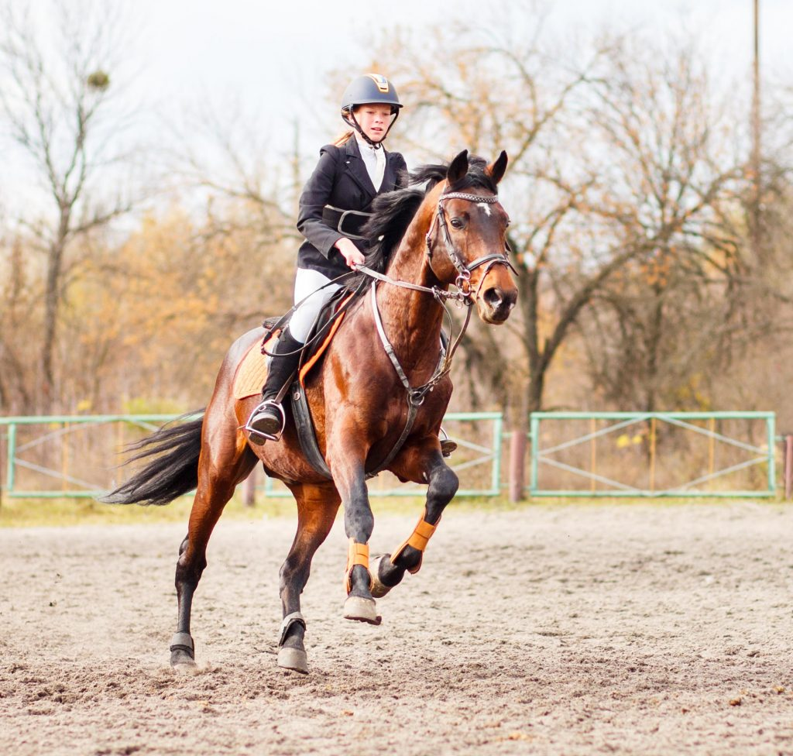
4
Complete the passage. Use the correct form(s) of the verbs in brackets and the pictures. Add more words if necessary.
Ann is my best friend. She usually has free time at the weekend. She adores
(1. ride) riding a horse at the riding club.

Slide 19

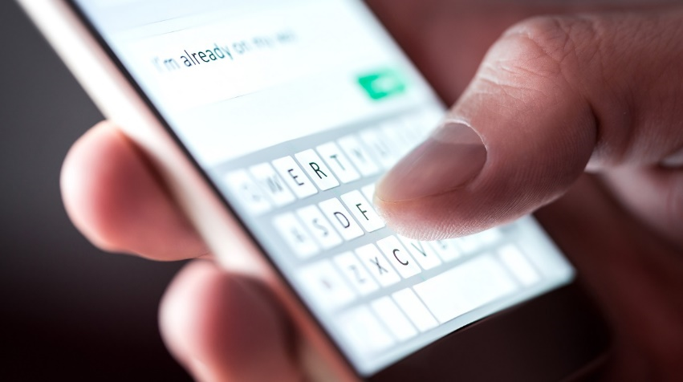
4
Complete the passage. Use the correct form(s) of the verbs in brackets and the pictures. add more words if necessary.
Sometimes, she likes (2. read) ___________________
or (3. message) _____________________________.
reading / to read books
messaging / to message her friends

Slide 20
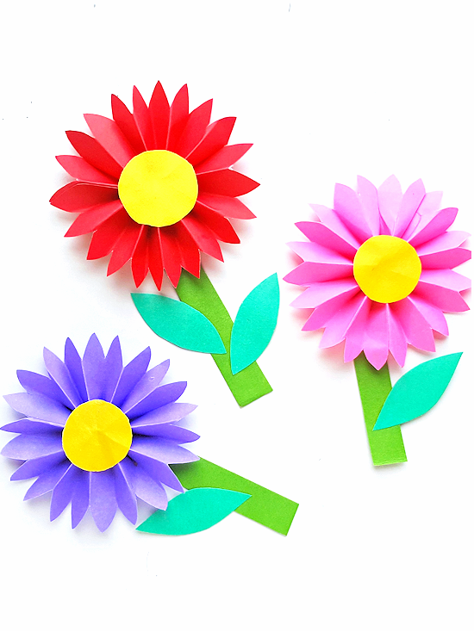
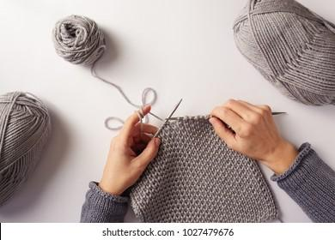
4
Complete the passage. Use the correct form(s) of the verbs in brackets and the pictures. add more words if necessary.
She also loves (4. make) __________________________ and (5. knit) ______________.
making / to make paper flowers
knitting / to knit

Slide 21
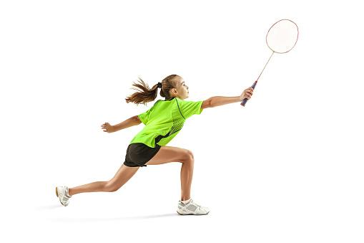
4
Complete the passage. Use the correct form(s) of the verbs in brackets and the pictures. add more words if necessary.
There is one thing she doesn’t like doing in her free time. She dislikes
(6. play) _______________.
playing badminton

Slide 22

* PROJECT
LEISURE TIME SURVEY
Interview some students from your class or from other classes.
Collect the answers.
Report your group’s findings to your class based on the following guiding questions

Slide 23

* PROJECT
LEISURE TIME SURVEY
1. Interview some students from your class or from other classes. Use the questions below.
1. When do you have free time?
2. What do you like doing with your family in your free time?
3. What do you like doing with your friends in your free time?
4. What leisure activities do you like doing on your own?
5. What leisure activities would you like to try in the future?

Slide 24
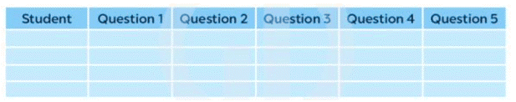
* PROJECT
LEISURE TIME SURVEY
2. Collect the answers. Use the table below.

Slide 25
* PROJECT
LEISURE TIME SURVEY
3. Report your group’s findings to your class based on the following guiding questions:
1. How many students did you interview?
2. When do the students have free time?
3. What are the most popular activities they do with their family?
4. What are the most popular activities they do with their friends?
5. What are the most popular activities they do on their own?
6. What leisure activities would they like to try in the future?

Slide 26
* PROJECT
LEISURE TIME SURVEY
3. Report your group’s findings to your class based on the following guiding questions:
1. We interviewed four students.
2. The students have free time at the weekend, finish all their homework, on holiday, ...
3. The most popular activities they do with their family: cooking, watch TV shows, go for a walk, go for a bike ride, ...
4. The most popular they do with their friends: play video games, play sport, go swimming, ...
5. The most popular activities they do on their own: surf the net, message friends, do DIY, ...
6. Leisure activites they would like to try in the future are: go skateboarding, go to the cinema, join volunteer project, ...

Slide 27
* CONSOLIDATION
What have we learned in this lesson?
Review vocabulary related to leisure activities and expressions about likes and dislikes
Review verbs of liking / disliking followed by gerunds and / or to-infinitives to talk about likes and dislikes

Slide 28

homework
Redo all the exercises.
Prepare UNIT 2 ( Getting started)

Slide 29
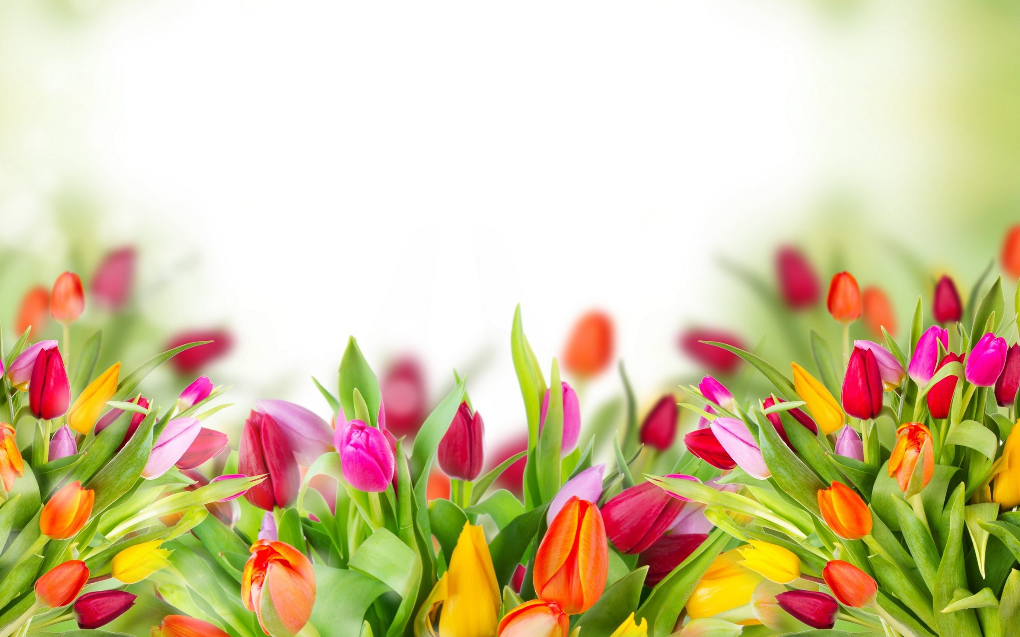
Thank you!
Have a nice day!

