Slide 1
Tran Phu secondary school.
Good morning class!!!

Slide 2
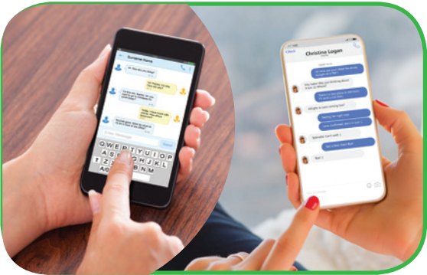
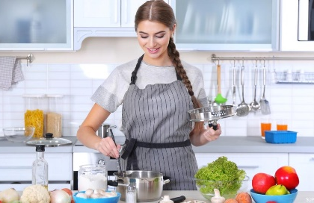
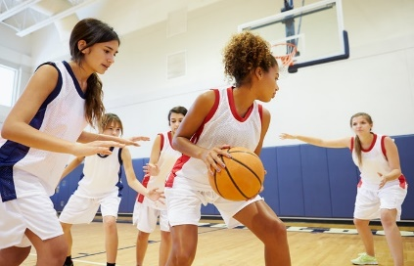
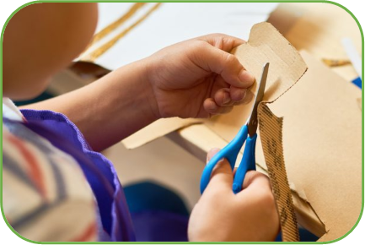
WARM-UP
PELMANISM
1
2
3
4
5
6
7
8
9
10
11
12
cooking
doing DIY
surfing the net
going shopping
playing sport
messaging friends

Slide 3
WARM-UP
PELMANISM
messaging friends
cooking
playing sport
doing DIY
going shopping
surfing the net
I like cooking.
How about you? Do you like cooking?

Slide 4
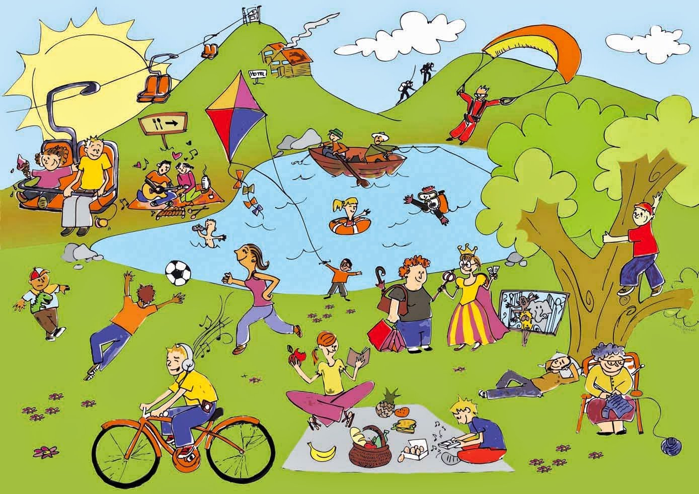
Unit
1
LEISURE TIME
LESSON 3: A CLOSER LOOK 2
1

Slide 5
* Grammar:
Verbs of liking
love
prefer
like
enjoy
fancy
Verbs of liking are used to express positive attitudes towards people or things.

Slide 6
Verbs of disliking
detest
hate
dislike
Verbs of disliking are used to express negative attitudes towards people or things.

Slide 7
Some verbs of liking and disliking can be followed by gerunds only.
Example: They dislike surfing the net.
Some are followed by both gerunds and
to-infinitives.
Example: I love going / to go to the cinema.

Slide 8
* Verbs of liking
Adore ( yêu thích)
Love
Like, enjoy, fancy ( thích)
Don’t mind ( không phiền)
Hate (ghét)
Detest ( căm ghét)
Degree
+ Gerund
(V- ing)

Slide 9
Love
Prefer(thích hơn) + V- ing / to Verb
Like
Hate

Slide 10
* PRACTICE
1
Work in pairs. Put the verbs in the appropriate column.
love like detest fancy
dislike enjoy hate prefer
Verbs followed by gerunds only | Verbs followed by both gerunds and to-infinitives
detest
love
fancy
like
dislike
hate
enjoy
prefer

Slide 11
2
Choose the correct answer A, B, or C.
1. I love ______, so in my leisure time, I go to some villages near Ha Noi to relax and enjoy the outdoors.
A. travelling B. travelled C. to travel
2. Tom enjoys ______ puzzles, especially Sudoku. A. doing B. do C. to do

Slide 12
2
Choose the correct answer(s).
3. When do you like ______ TV? A. watched B. watch C. to watch
4. Do you fancy ______ to the cinema this weekend?
A. go B. going C. to go
5. I detest ______. I think it’s cruel to harm animals. A. hunting B. to hunt C. hunt

Slide 13
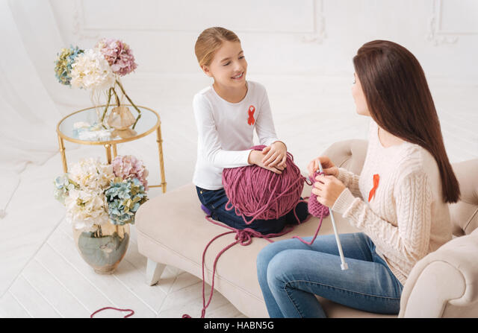
3
Look at the pictures and complete the sentences, using the verbs in brackets in their suitable form.
likes surfing / to surf the Internet
1. Mark ___________________________. (like)
2. The girls ____________. (enjoy)
enjoy knitting

Slide 14
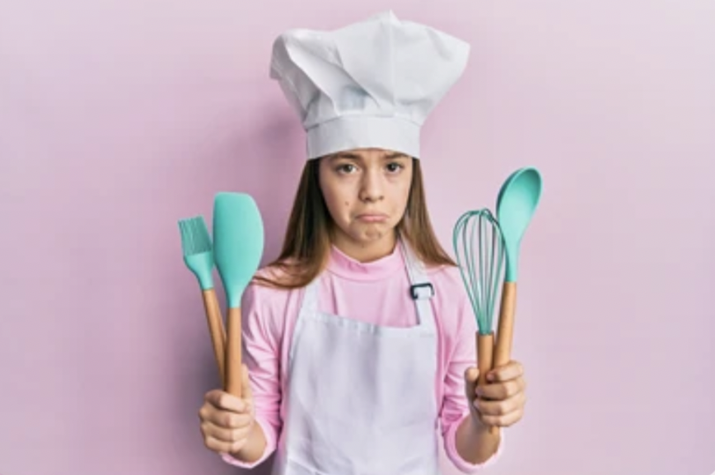
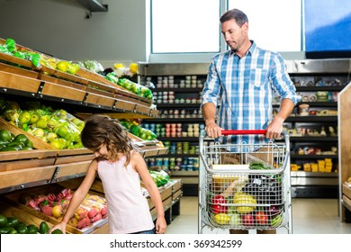
3
Look at the pictures and complete the sentences, using the verbs in brackets in their suitable form.
3. My cousin ______________. (dislike)
dislikes cooking
hates going / to go shopping
4. My father________________________. (hate)

Slide 15
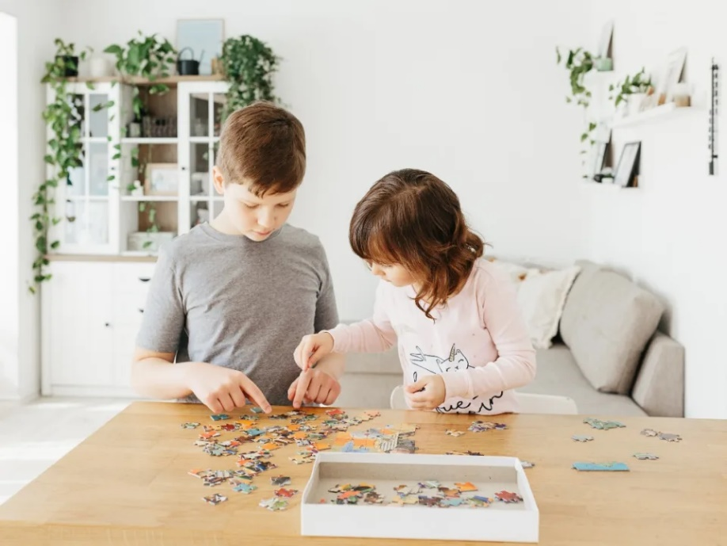
3
Look at the pictures and complete the sentences, using the verbs in brackets in their suitable form.
5. Tom and his sister ______________________. (prefer)
prefer doing / to do puzzles

Slide 16
4
Complete the sentences about yourself.
All about me
I like ______. I prefer ______. I love ______. | I dislike ______. I hate ______. I detest ______.

Slide 17
4
Complete the sentences about yourself.
I like messaging friends. | I dislike doing puzzles.
I prefer cooking. | I hate knitting.
I love singing. | I detest cleaning the floor.

Slide 18
* PRODUCTION
5
Likes and dislikes mimes
Work in groups. One mimes a leisure activity he / she likes or dislikes.
The others guess the activity by asking yes / no questions using the verbs they have learnt.
Example:
A: Do you like surfing the net? B: No, I don’t. C: Do you love messaging your friends?
B: Yes, I do.

Slide 19
* PRODUCTION
Find someone who…
Go around the classroom and find:
Find someone who… | Name
likes playing computer games.
enjoys knitting.
detests cooking.
fancies going shopping.
loves doing puzzles.
hates hunting.
dislikes watching TV.
prefers going to the cinema.

Slide 20
* Complete the sentences:
I like ___________ oranges.
My sister enjoys __________ meals.
They prefer _________ English.
Hoa dislikes _________ books.
We hate _________up early.
My sister is fond of _________ to English music.
Game

Slide 21
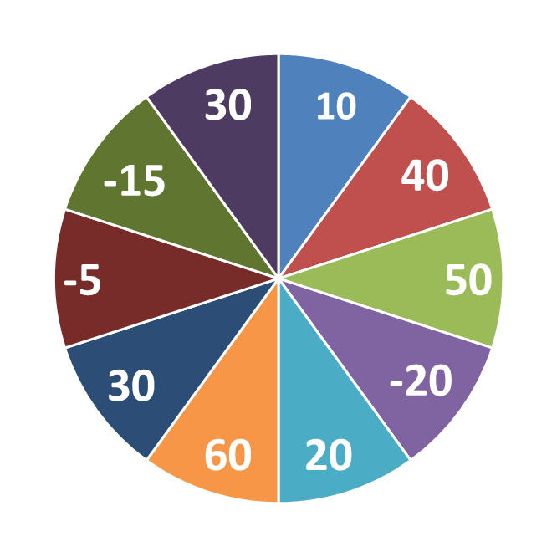
THE BIG WHEEL GAME
QUESTIONS
1
4
2
5
3
6

Slide 22
* Complete the sentences:
I like ___________ oranges.
eating

Slide 23
* Complete the sentences:
2. My sister enjoys __________ meals.
cooking

Slide 24
* Complete the sentences:
3. They prefer _________ English.
learning

Slide 25
* Complete the sentences:
4. Hoa dislikes _________ books.
reading

Slide 26
* Complete the sentences:
5. We hate _________up early.
to get

Slide 27
* Complete the sentences:
I like ___________ oranges.
My sister enjoys __________ meals.
They prefer _________ English.
Hoa dislikes _________ books.
We hate _________up early.
My sister is fond of _________ to English music.
eating
cooking
learning
reading
to get
listening

Slide 28
CONSOLIDATION
What have we learnt in this lesson?
How to use verbs of liking and disliking

Slide 29
CONSOLIDATION
2
Homework
- Do exercises in the workbook.
- Prepare lesson 4: COMMUNICATION

Slide 30
Thanks for your atendance!
Goodbye. See you again
Notes:
30

