Slide 1
Nguyen Huu Tho secondary school.
Good afternoon class!!!

Slide 2
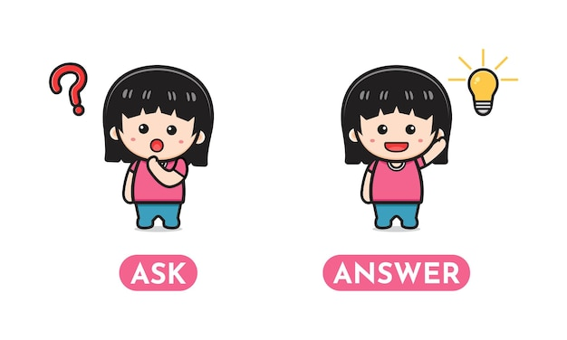
WARM-UP
Guess What the hobby is?
The team with the most points is the winner.
Example:
A: Water, grow, flowers, vegetables.
B: Is it gardening?
A: Yes, it is.

Slide 3
Unit 1:
HOBBIES
LESSON 3: A CLOSER LOOK 2
GRAMMAR

Slide 4
* Grammar:
The present simple

Slide 6
* Practice
1
Match the sentences (1 – 5) to the correct uses (a – c).
b
a
c
a
b

Slide 7
* Practice
2
Complete the sentences. Use the present simple form of the verbs.
1. My brother and I (make) ________ a new model every month. 2. What _________ Lan (do) ________ in her free time? 3. I (have) _________ a drawing lesson every tuesday. 4. Mark (not like) ____________ doing judo. 5. _________ your English lesson (start) _________ at 6 p.m.?
make
does
do
have
doesn’t like
Does
start

Slide 8
* Practice
3
Fill in each blank with the correct form of the verb in brackets.
My family members have different hobbies. My dad (1. enjoy) _________ gardening. He (2. spend) __________ two hours in our garden every day. My mum and sister (3. not like) __________ gardening, but they love cooking. They (4. go) _______ to a cooking class every Sunday. Their lesson (5. begin) ________ at 9 a.m. I (6. not enjoy) _______________ cooking, and I cannot cook very well.
enjoys
spends
don’t like
go
begins
don’t enjoy

Slide 9
* Practice
4
Write complete sentences, using the given words and phrases. You may have to change the words or add some.
1. sun / set / in / west / every evening. __________________________________________________________ 2. Trang and Minh / play / basketball / every day / after school? __________________________________________________________ 3. flight / from / Ho Chi minh City / not arrive / 10:30. __________________________________________________________ 4. our science teacher / start / our lessons / 1 p.m. / on Fridays. __________________________________________________________ 5. you / make / model / at / weekend? __________________________________________________________
The sun sets in the west every evening.
Do Trang and Minh play basketball every day after school?
The flight from Ho Chi Minh City doesn’t arrive at 10:30.
Our science teacher starts our lessons at 1 p.m. on Fridays.
Do you make models at the weekend?

Slide 10
* Production
5
Game: Sentence Race

Slide 11
* Game: Sentence Race
Example:
go
I go to school at 7 a.m every day.
watch
My brother watches TV at the weekend.
listen
My father usually listens to music.
play
We play football every Sunday morning.

Slide 12
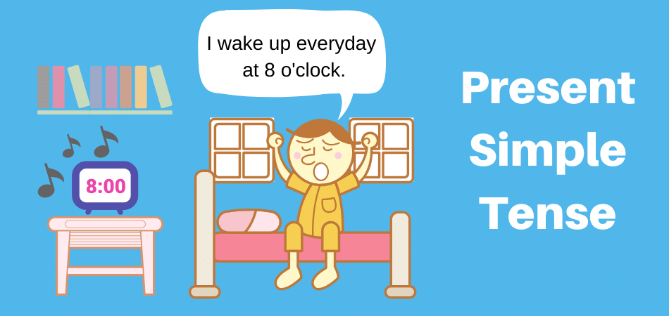
* CONSOLIDATION
1
WRAP-UP

Slide 13
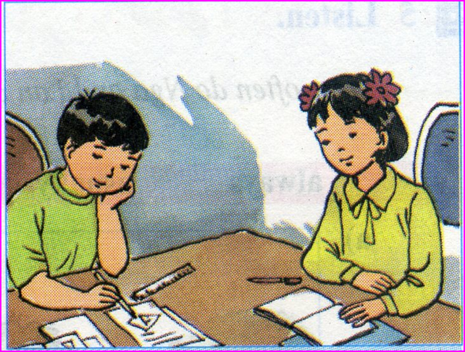
Homework:
- Practise the exercises again.
- Do exercises in workbook.
- Prepare communication.

Slide 14
Goodbye.
See you again.

