Slide 2

Our school rooms
Lesson 2 - Period 4

Slide 3


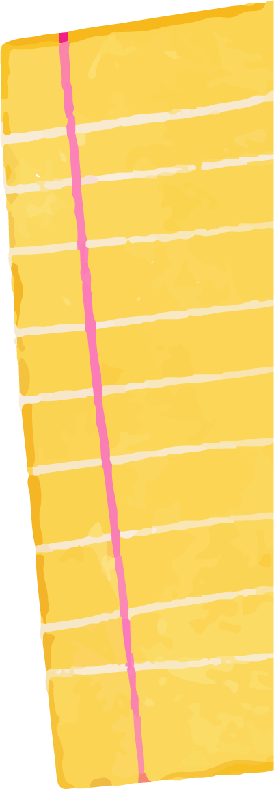

Table of contents
01
02
03
04
Let's play.
Warm-up & Review
05
Listen and tick.
Fun corner & Wrap-up
Read and complete.

Slide 4


01
Warm-up & Review

Slide 5





Bad
Luck
Billy
Notes:
This template is for educational, non-commercial purposes only. For more free game templates like this one, visit https://www.taysteachingtoolkit.com

Slide 6




This is Billy.
He has bad luck.

Slide 7


Dark clouds like to follow him…

Slide 8


…and strike him with lightning!
Notes:
Skeleton image designed by creazilla.com

Slide 9
Don’t worry,
Billy is okay…

Slide 10
…but, don’t have
bad luck like Billy.

Slide 11
How to Play
Everyone stands up.
One person reads the word or sentence on the screen.
Then, the next person goes.
If Billy is struck by lightning when you’re reading, you’re out (sit down).
The last person standing is the winner!
Notes:
TEACHER NOTES:
When I say ”Then, the next person goes.” I mean the next person reads the same word/sentence on the screen. The order of students reading is up to you and what makes the most sense for your class.
Feel free to adjust the instructions as needed for your class.
Skeleton image designed by creazilla.com

Slide 12

go
Ready?
Notes:
TEACHER NOTES:
Replace the text in the box with your key vocabulary/sentences.
OR if you want to make it into a speaking activity, delete the text and put an image in the box.
When playing the game, click/press the spacebar to send in the dark clouds.
Students start reading the text in the box after the dark cloud music stops.
Lightning will strike automatically after the dark clouds appear, no need to click again. The time when it strikes is different on each slide (view the animation pane to view or change the timing).
After the lightning strikes Billy and the student reading sits down, click/press the spacebar to go to the next slide.
Currently, there are 30 game slides in total (meant for 31 students). However, feel free to add or delete slides as needed for the number of students in your class.
If you want to adjust the time of when the lightning strikes, go to the “Animations” tab and open the ”Animation Pane.” Then, click on the “Lightning Strike” animation and adjust the delay time in the timing window.
If using the game more than once with the same class and are worried students will remember the lightning strike timing on each slide, no need to adjust the times of each lightning strike animation, just reorder the slides to save time and make the game feel fresh.
Skeleton image designed by creazilla.com

Slide 13
go ⬆stairs
Ready?
Notes:
TEACHER NOTES:
Replace the text in the box with your key vocabulary/sentences.
OR if you want to make it into a speaking activity, delete the text and put an image in the box.
When playing the game, click/press the spacebar to send in the dark clouds.
Students start reading the text in the box after the dark cloud music stops.
Lightning will strike automatically after the dark clouds appear, no need to click again. The time when it strikes is different on each slide (view the animation pane to view or change the timing).
After the lightning strikes Billy and the student reading sits down, click/press the spacebar to go to the next slide.
Currently, there are 30 game slides in total (meant for 31 students). However, feel free to add or delete slides as needed for the number of students in your class.
If you want to adjust the time of when the lightning strikes, go to the “Animations” tab and open the ”Animation Pane.” Then, click on the “Lightning Strike” animation and adjust the delay time in the timing window.
If using the game more than once with the same class and are worried students will remember the lightning strike timing on each slide, no need to adjust the times of each lightning strike animation, just reorder the slides to save time and make the game feel fresh.
Skeleton image designed by creazilla.com

Slide 14
turn →
Ready?
Notes:
TEACHER NOTES:
Replace the text in the box with your key vocabulary/sentences.
OR if you want to make it into a speaking activity, delete the text and put an image in the box.
When playing the game, click/press the spacebar to send in the dark clouds.
Students start reading the text in the box after the dark cloud music stops.
Lightning will strike automatically after the dark clouds appear, no need to click again. The time when it strikes is different on each slide (view the animation pane to view or change the timing).
After the lightning strikes Billy and the student reading sits down, click/press the spacebar to go to the next slide.
Currently, there are 30 game slides in total (meant for 31 students). However, feel free to add or delete slides as needed for the number of students in your class.
If you want to adjust the time of when the lightning strikes, go to the “Animations” tab and open the ”Animation Pane.” Then, click on the “Lightning Strike” animation and adjust the delay time in the timing window.
If using the game more than once with the same class and are worried students will remember the lightning strike timing on each slide, no need to adjust the times of each lightning strike animation, just reorder the slides to save time and make the game feel fresh.
Skeleton image designed by creazilla.com

Slide 15

go along the corridor
Ready?
Notes:
TEACHER NOTES:
Replace the text in the box with your key vocabulary/sentences.
OR if you want to make it into a speaking activity, delete the text and put an image in the box.
When playing the game, click/press the spacebar to send in the dark clouds.
Students start reading the text in the box after the dark cloud music stops.
Lightning will strike automatically after the dark clouds appear, no need to click again. The time when it strikes is different on each slide (view the animation pane to view or change the timing).
After the lightning strikes Billy and the student reading sits down, click/press the spacebar to go to the next slide.
Currently, there are 30 game slides in total (meant for 31 students). However, feel free to add or delete slides as needed for the number of students in your class.
If you want to adjust the time of when the lightning strikes, go to the “Animations” tab and open the ”Animation Pane.” Then, click on the “Lightning Strike” animation and adjust the delay time in the timing window.
If using the game more than once with the same class and are worried students will remember the lightning strike timing on each slide, no need to adjust the times of each lightning strike animation, just reorder the slides to save time and make the game feel fresh.
Skeleton image designed by creazilla.com

Slide 16
go past the library and turn ⬅
Ready?
Notes:
TEACHER NOTES:
Replace the text in the box with your key vocabulary/sentences.
OR if you want to make it into a speaking activity, delete the text and put an image in the box.
When playing the game, click/press the spacebar to send in the dark clouds.
Students start reading the text in the box after the dark cloud music stops.
Lightning will strike automatically after the dark clouds appear, no need to click again. The time when it strikes is different on each slide (view the animation pane to view or change the timing).
After the lightning strikes Billy and the student reading sits down, click/press the spacebar to go to the next slide.
Currently, there are 30 game slides in total (meant for 31 students). However, feel free to add or delete slides as needed for the number of students in your class.
If you want to adjust the time of when the lightning strikes, go to the “Animations” tab and open the ”Animation Pane.” Then, click on the “Lightning Strike” animation and adjust the delay time in the timing window.
If using the game more than once with the same class and are worried students will remember the lightning strike timing on each slide, no need to adjust the times of each lightning strike animation, just reorder the slides to save time and make the game feel fresh.
Skeleton image designed by creazilla.com

Slide 17
It's on the 1st floor.
Ready?
Notes:
TEACHER NOTES:
Replace the text in the box with your key vocabulary/sentences.
OR if you want to make it into a speaking activity, delete the text and put an image in the box.
When playing the game, click/press the spacebar to send in the dark clouds.
Students start reading the text in the box after the dark cloud music stops.
Lightning will strike automatically after the dark clouds appear, no need to click again. The time when it strikes is different on each slide (view the animation pane to view or change the timing).
After the lightning strikes Billy and the student reading sits down, click/press the spacebar to go to the next slide.
Currently, there are 30 game slides in total (meant for 31 students). However, feel free to add or delete slides as needed for the number of students in your class.
If you want to adjust the time of when the lightning strikes, go to the “Animations” tab and open the ”Animation Pane.” Then, click on the “Lightning Strike” animation and adjust the delay time in the timing window.
If using the game more than once with the same class and are worried students will remember the lightning strike timing on each slide, no need to adjust the times of each lightning strike animation, just reorder the slides to save time and make the game feel fresh.
Skeleton image designed by creazilla.com

Slide 18



02
Listen and tick.

Slide 19
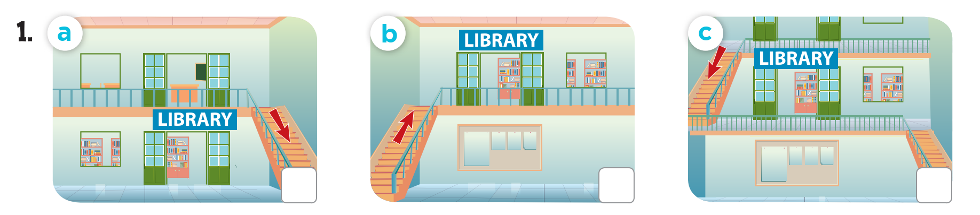
How do you get to the library in picture a/b/c?

Slide 20
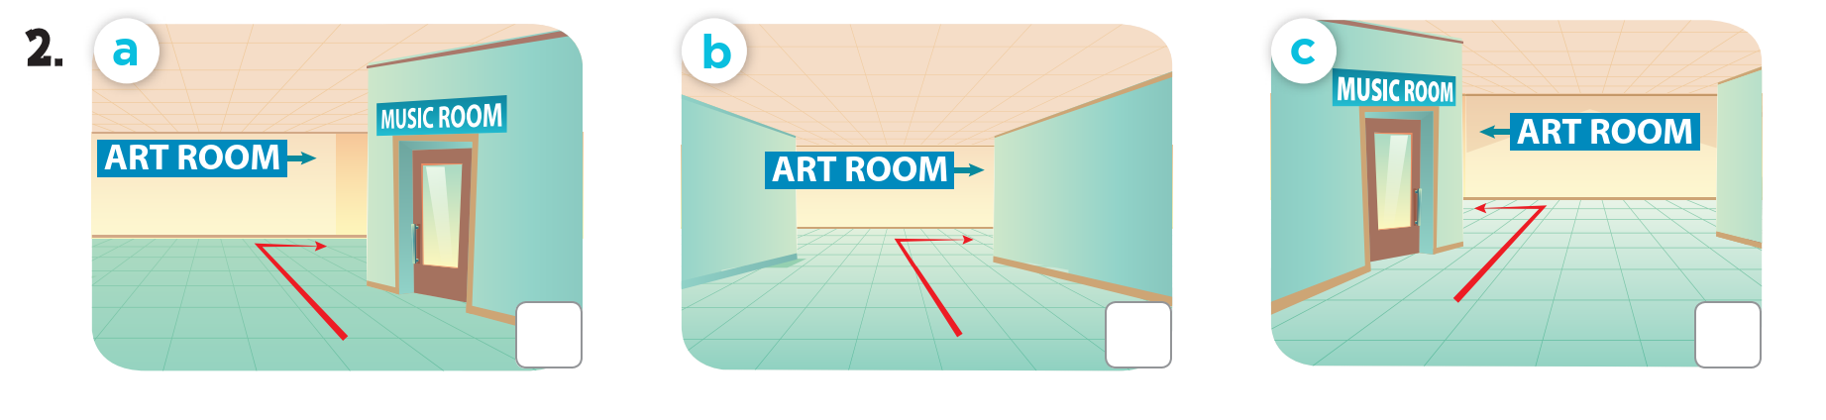
How do you get to the art room in picture a/b/c?

Slide 21

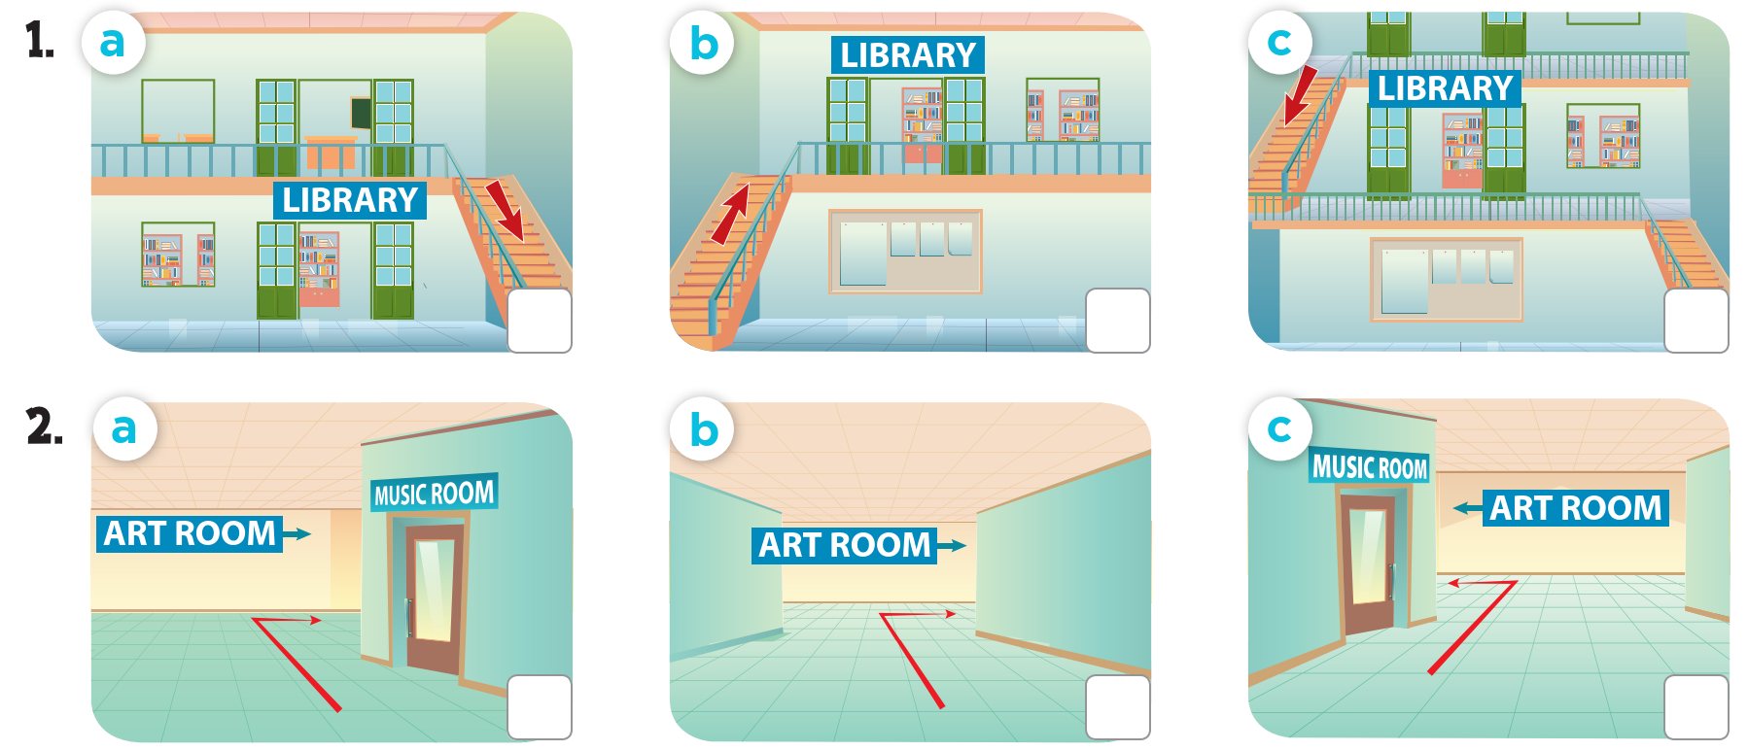
Listen and tick.
Click for answer



Slide 22
03
Read and complete.

Slide 23
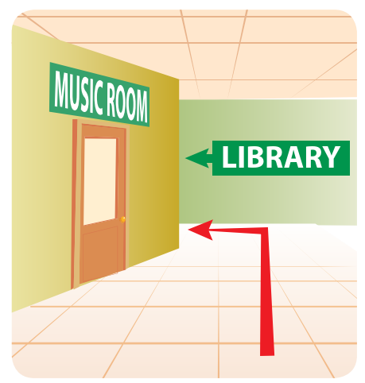
Read and complete.
1. A: Hello, Mr Long.
B: Hello, Lucy.
A: Could you tell me the _____ to the library, please?
B: Go ______ the music room and turn left.
A: Thanks a lot, Mr Long.
way
past

Slide 24
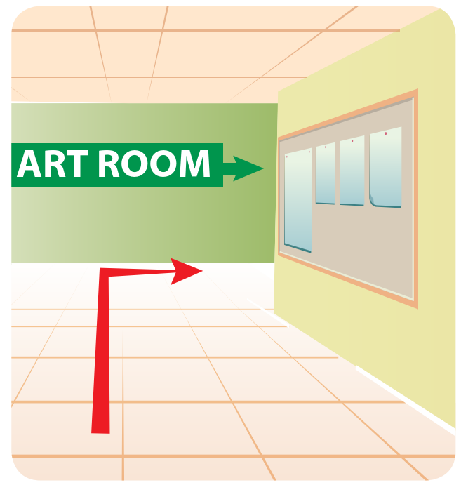
Read and complete.
2. A: Excuse me.
B: Yes?
A: _______ you tell me the way to
the art room, please?
B: Go _______ the corridor and
turn ______.
A: Thank you.
B: You’re welcome.
Could
along
right

Slide 25
04
Let’s play.

Slide 26
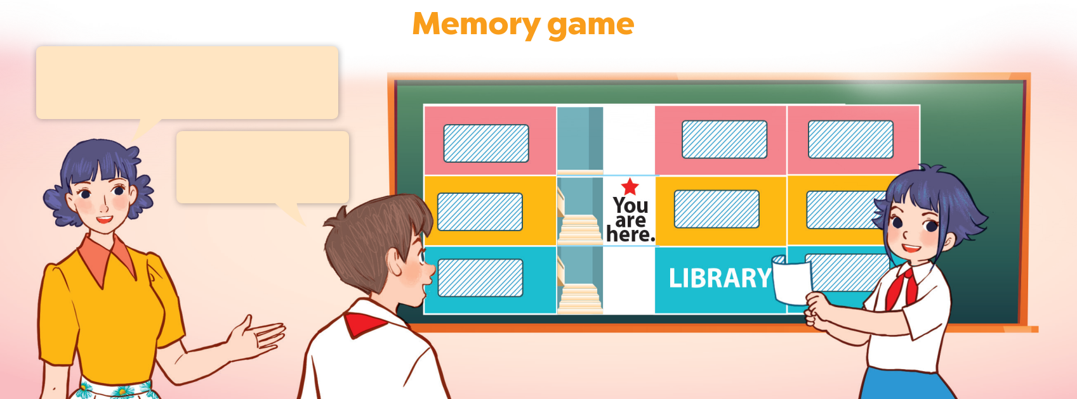
Could you tell me the way to the library, please?
Go downstairs and turn left.

Slide 27
05
Fun corner & Wrap-up
Notes:
- Each team takes turn to ask and answer, using the structures learned.
- If students successfully make the conversation, that team can choose a box and get the points.

Slide 28
Lucky number
Notes:
- Each team takes turn to ask and answer, using the structures learned.
- If students successfully make the conversation, that team can choose a box and get the points.

Slide 29

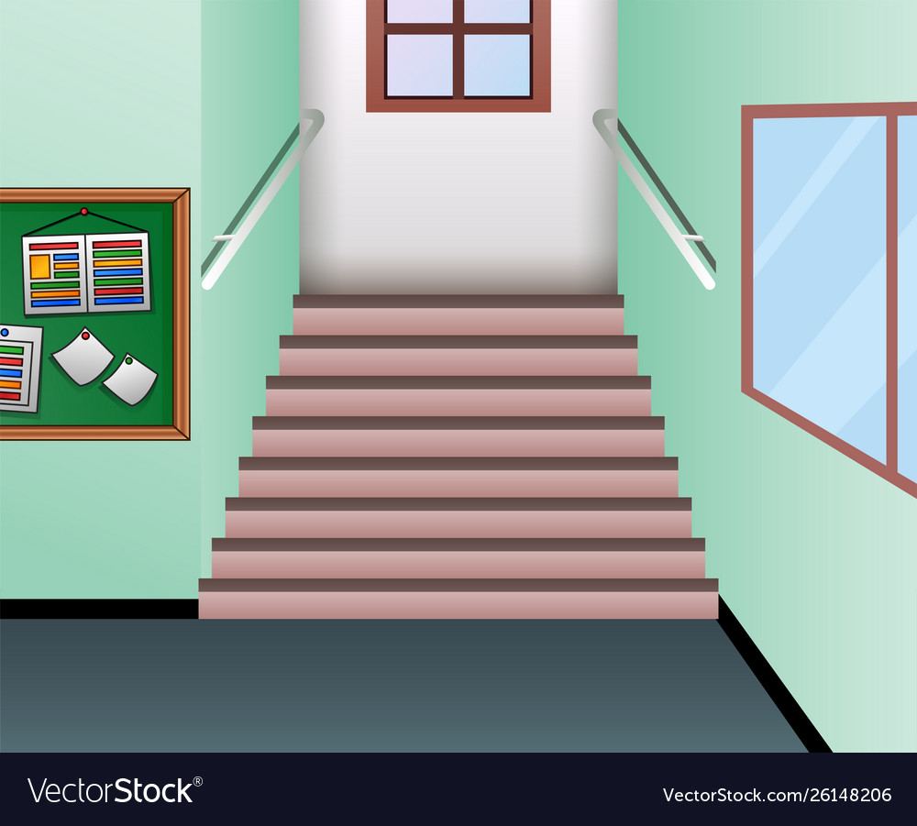

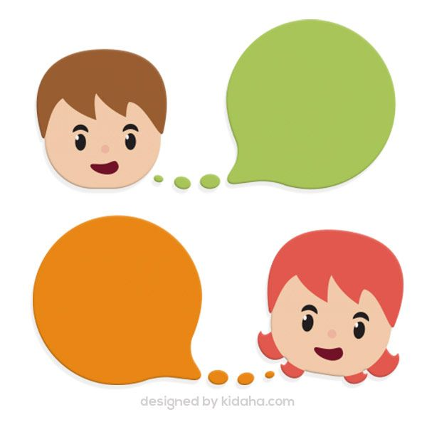

LIBRARY
LIBRARY
CLASS 5A
CLASS 5A
CLASS 5B
CLASS 5B
Go to the art room.
CLASS 4A
ART ROOM
CLASS 4A
CLASS 4B
CLASS 4B
ART ROOM
?
COMPUTER ROOM
MUSIC ROOM
COMPUTER ROOM
?
MUSIC ROOM
CLASS 3B
You're here
Notes:
2 presentatives ask and answer:
A: Could you tell me the way to ......, please?
B: ............... .

Slide 30

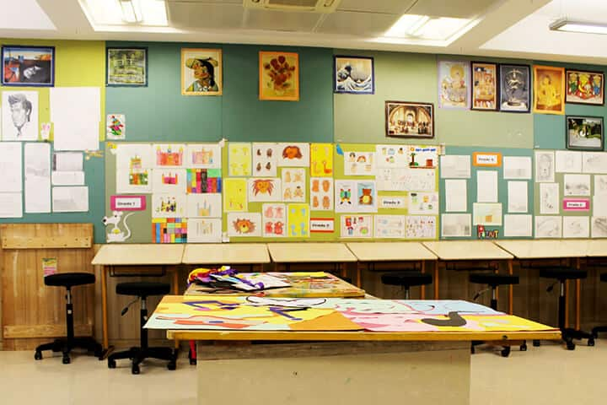













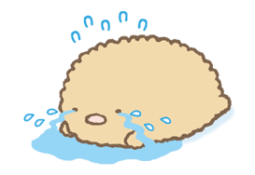
Sound file is in me!
1.
2.
Change points
+6
3.
4.
-3
+6
Notes:
Choice slide. Click on the character in the bottom right hand corner to go to the points counter.

Slide 31
_____
LIBRARY
LIBRARY
CLASS 5A
CLASS 5A
CLASS 5B
CLASS 5B
Go to
Class 5B.
CLASS 4A
CLASS 4A
CLASS 4B
CLASS 4B
ART ROOM
?
You're here
CLASS 3B
COMPUTER ROOM
MUSIC ROOM
COMPUTER ROOM
?
MUSIC ROOM
Notes:
2 presentatives ask and answer:
A: Could you tell me the way to ......, please?
B: ............... .

Slide 32
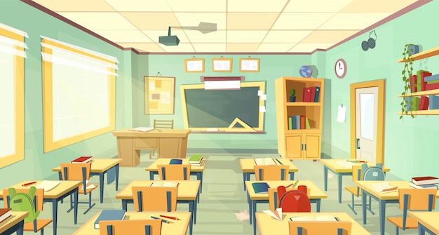
Sound file is in me!
1.
-3
2.
Change points
3.
4.
+6
+3
Notes:
Choice slide. Click on the character in the bottom right hand corner to go to the points counter slide.

Slide 33
LIBRARY
LIBRARY
CLASS 5A
CLASS 5A
CLASS 5B
Go to
Class 4A.
You're here
CLASS 4A
CLASS 4A
CLASS 4B
CLASS 4B
ART ROOM
?
COMPUTER ROOM
MUSIC ROOM
COMPUTER ROOM
MUSIC ROOM
CLASS 3B
?
Notes:
2 presentatives ask and answer:
A: Could you tell me the way to ......, please?
B: ............... .

Slide 34
Sound file is in me!
1.
2.
-1
+2
3.
4.
-3
+6
Notes:
Choice slide. Click on the character in the bottom right hand corner to go to the points counter slide.

Slide 35
LIBRARY
LIBRARY
CLASS 5A
CLASS 5A
CLASS 5B
Go to the computer room.
CLASS 4A
CLASS 4B
CLASS 4B
ART ROOM
?
You're here
COMPUTER ROOM
MUSIC ROOM
COMPUTER ROOM
MUSIC ROOM
CLASS 3B
?
Notes:
2 presentatives ask and answer:
A: Could you tell me the way to ......, please?
B: ............... .

Slide 36
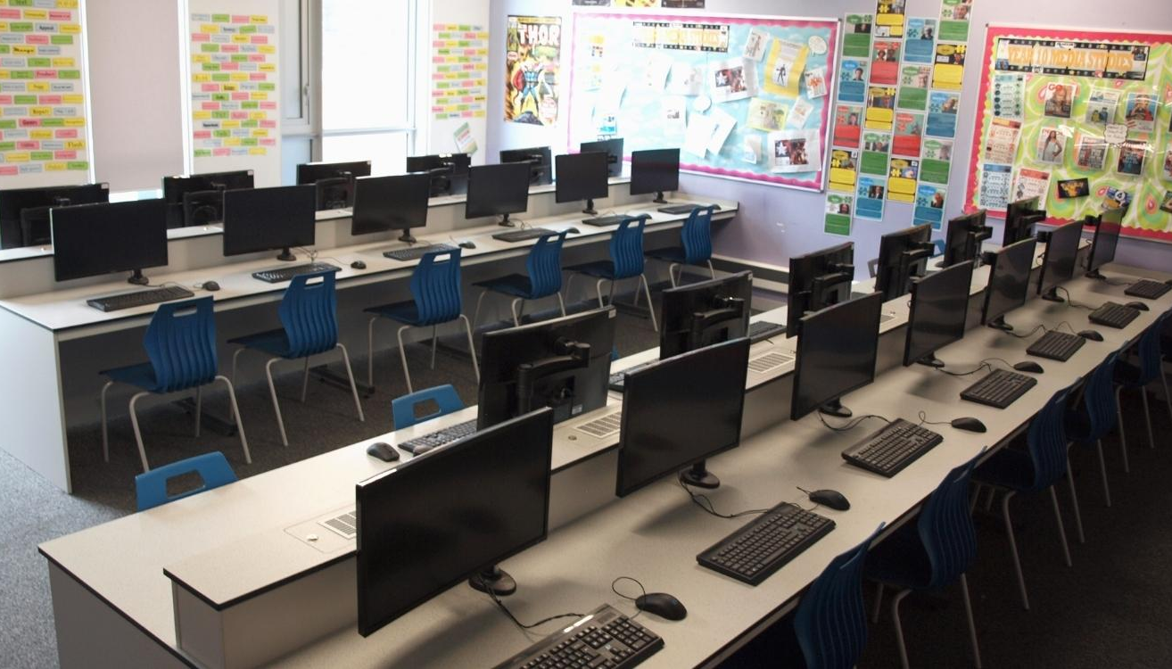
Sound file is in me!
1.
-3
2.
+6
3.
4.
Change points
+4

Slide 37
LIBRARY
LIBRARY
CLASS 5A
CLASS 5A
CLASS 5B
Go to the music room.
CLASS 4A
CLASS 4B
CLASS 4B
ART ROOM
?
MUSIC ROOM
COMPUTER ROOM
MUSIC ROOM
CLASS 3B
?
You're here
Notes:
2 presentatives ask and answer:
A: Could you tell me the way to ......, please?
B: ............... .

Slide 38
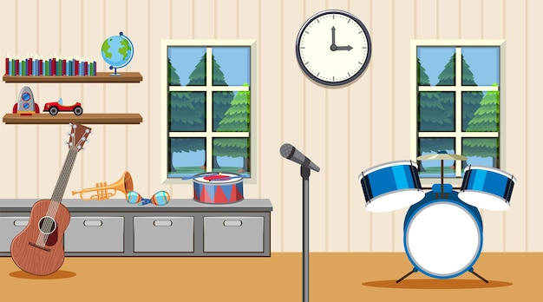

Sound file is in me!
1.
2.
+7
+1
3.
4.
+1
+1

Slide 39
LIBRARY
LIBRARY
CLASS 5A
CLASS 5A
CLASS 5B
Go to the library.
CLASS 4A
CLASS 4B
CLASS 4B
ART ROOM
?
MUSIC ROOM
CLASS 3B
COMPUTER ROOM
?
You're here
Notes:
2 presentatives ask and answer:
A: Could you tell me the way to ......, please?
B: ............... .

Slide 40

Sound file is in me!
1.
+6
2.
+1
3.
4.
Change points
+6

Slide 41
LIBRARY
CLASS 5A
CLASS 5A
CLASS 5B
Go to
Class 4B.
You're here
CLASS 4A
CLASS 4B
ART ROOM
CLASS 4B
?
MUSIC ROOM
CLASS 3B
COMPUTER ROOM
?
Notes:
2 presentatives ask and answer:
A: Could you tell me the way to ......, please?
B: ............... .

Slide 42


Sound file is in me!
1.
2.
+7
+1
3.
4.
+1
+10

Slide 43
Website: hoclieu.vn
Fanpage: https://www.facebook.com/tienganhglobalsuccess.vn/

