Slide 2

Our school rooms
Lesson 1 - Period 1

Slide 3



Table of contents
01
02
03
Warm-up & Review
04
Let's talk.
05
Look, listen and repeat.
Fun corner & Wrap-up
Listen, point and say.

Slide 4

01
Warm-up & Review

Slide 5

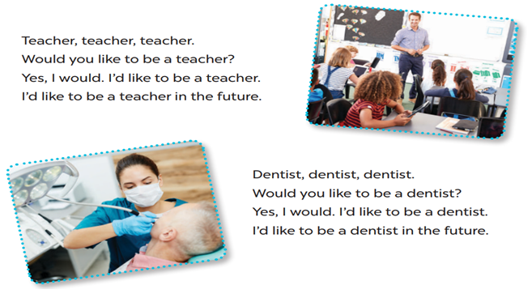


LET’S SING!
Teacher, teacher, teacher.
Would you like to be a teacher?
Yes, I would. I’d like to be a teacher.
I’d like to be a teacher in the future.
Dentist, dentist, dentist.
Would you like to be a dentist?
Yes, I would. I’d like to be a dentist.
I’d like to be a dentist in the future.

Slide 6
02
Look, listen and repeat.

Slide 7
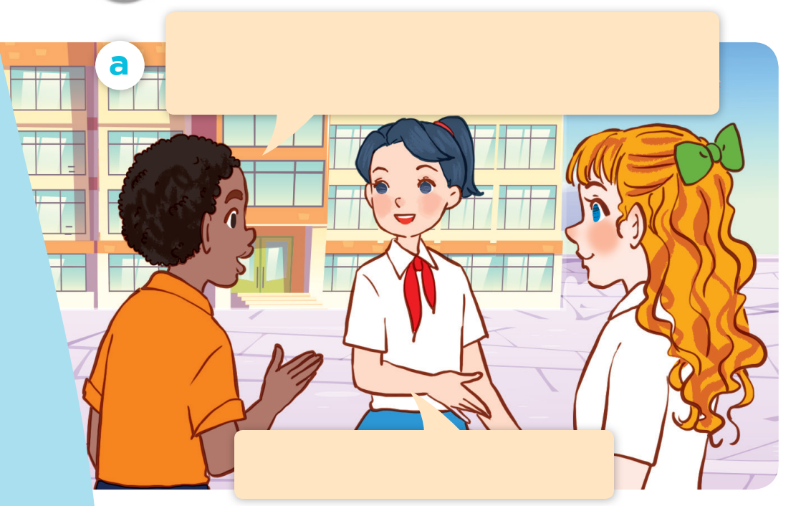
What are they doing?
Where are they?
Who are they?
Listen and repeat.
Good morning. Could you show us around your school?
Yes, of course. Let’s go!

Slide 8
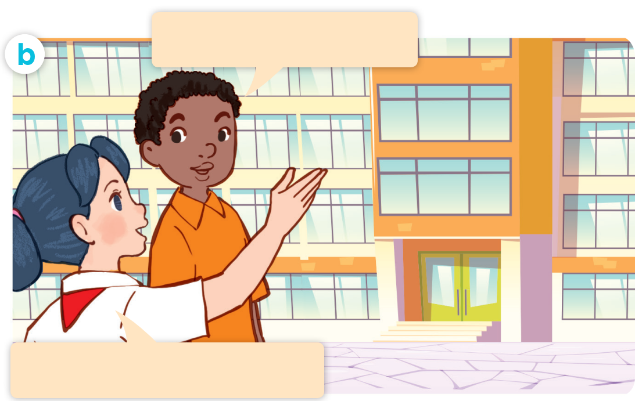
Listen and repeat.
Act it out.
Where’s the library?
It’s on the second floor.

Slide 9


Where’s the library?
It’s on the second floor.

Slide 10
03
Listen, point and say.

Slide 11
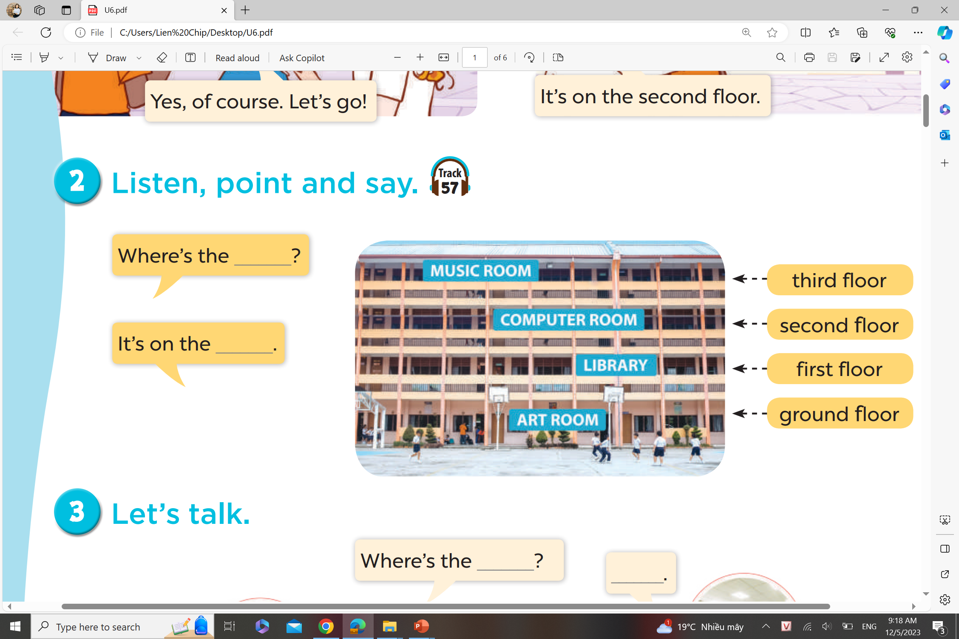
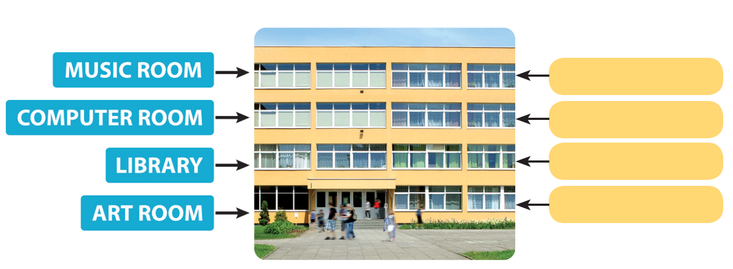
Listen, point and say.
Where’s the ____?
It’s on the ___.
third floor
second floor
first floor
ground floor

Slide 12
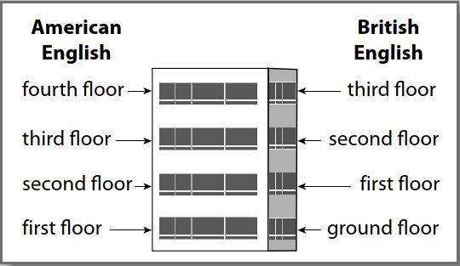
NOTE!

Slide 13
04
Let’s talk.

Slide 14
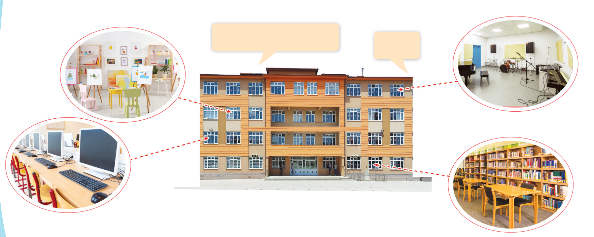
Let’s talk.
Where’s the _____?
_____.

Slide 15
05
Fun corner & Wrap-up

Slide 16








Slide 25



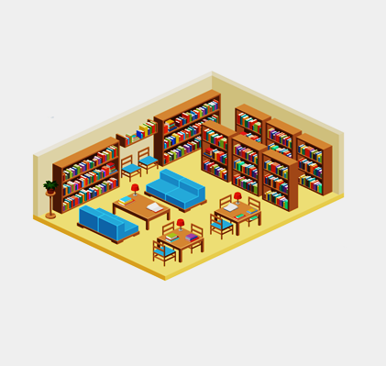


Where is the library?
It’s on the ground floor.

Slide 26
Unscramble
e
o
l
o
s_c_nd f_o_r

Slide 27


Unscramble
a
i
y
l_br_r_

Slide 28


Slide 29

Unscramble
m
u
i
o
o
_ _s_c r_ _m

Slide 30

- 3 stars

Slide 31

Where is the computer room?
It’s on the third floor.

Slide 32
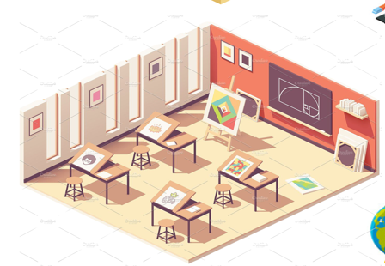
Where is the art room?
It’s on the first floor.

Slide 33
Website: hoclieu.vn
Fanpage: https://www.facebook.com/tienganhglobalsuccess.vn/

