Slide 2






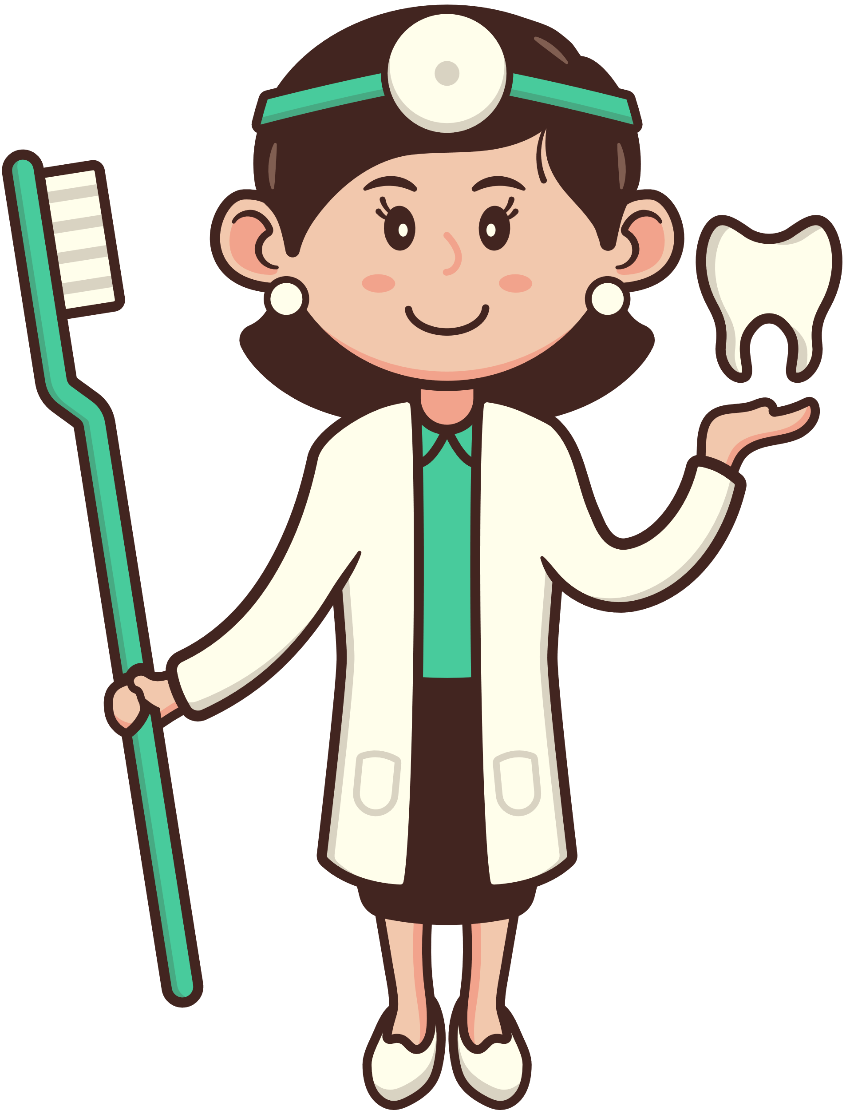


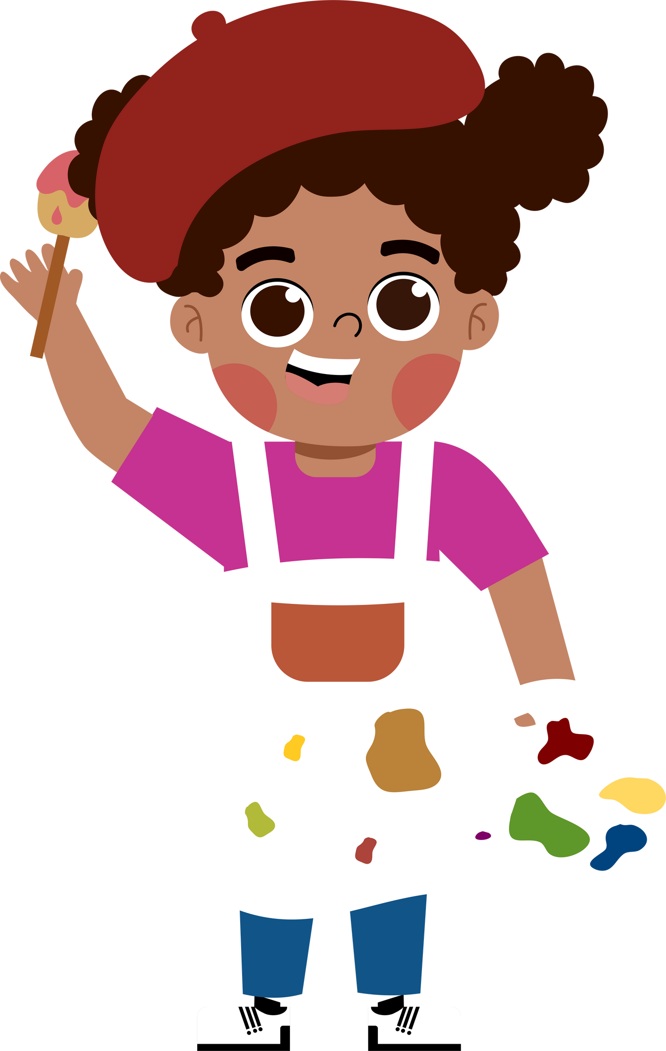
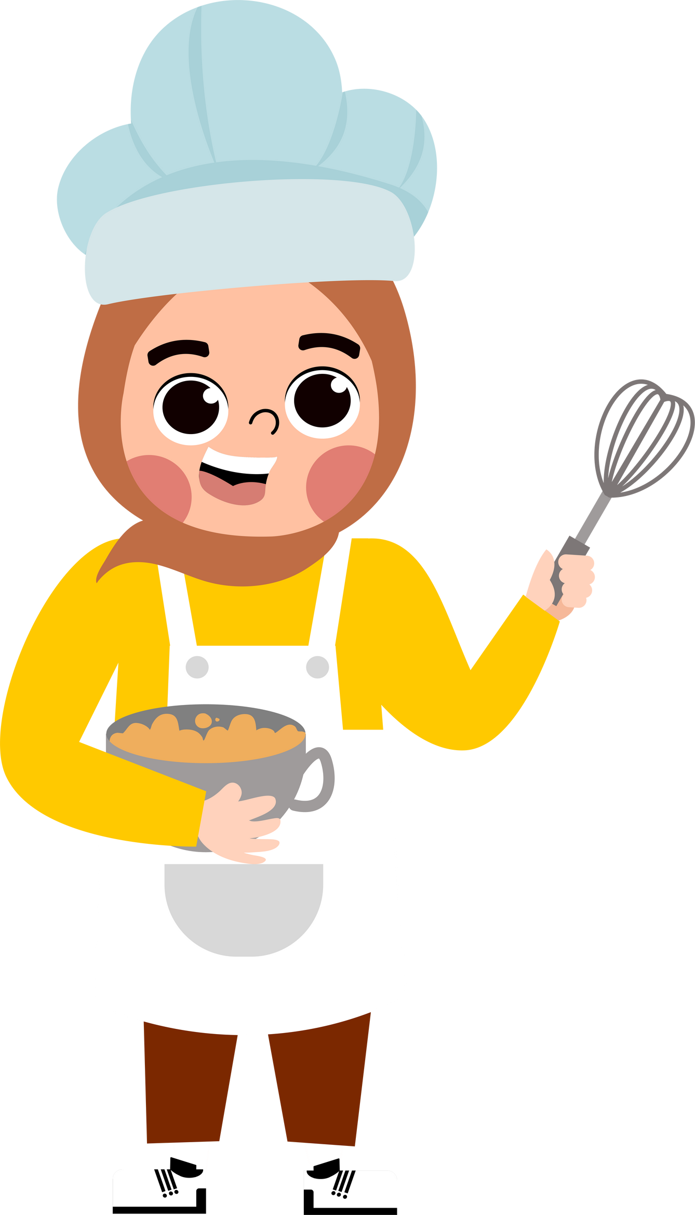
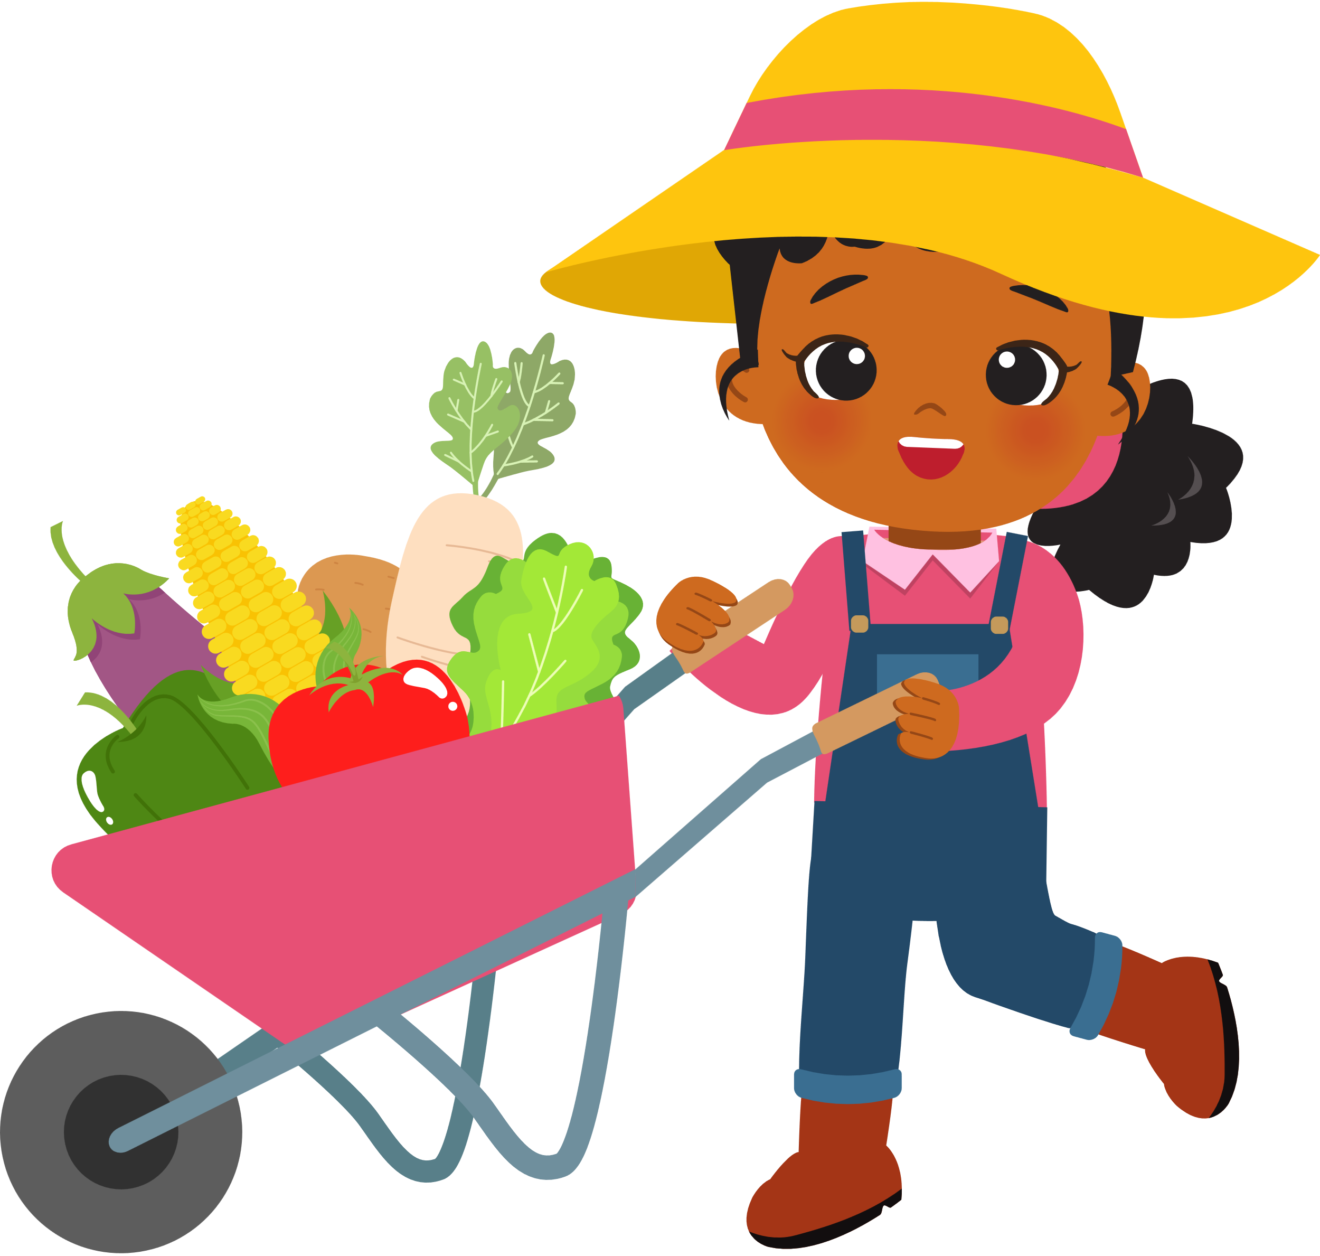

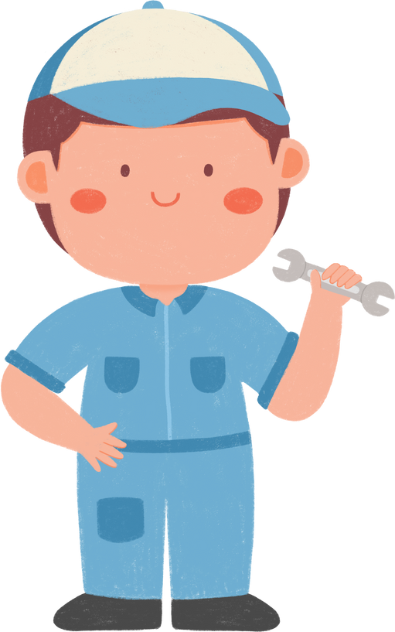
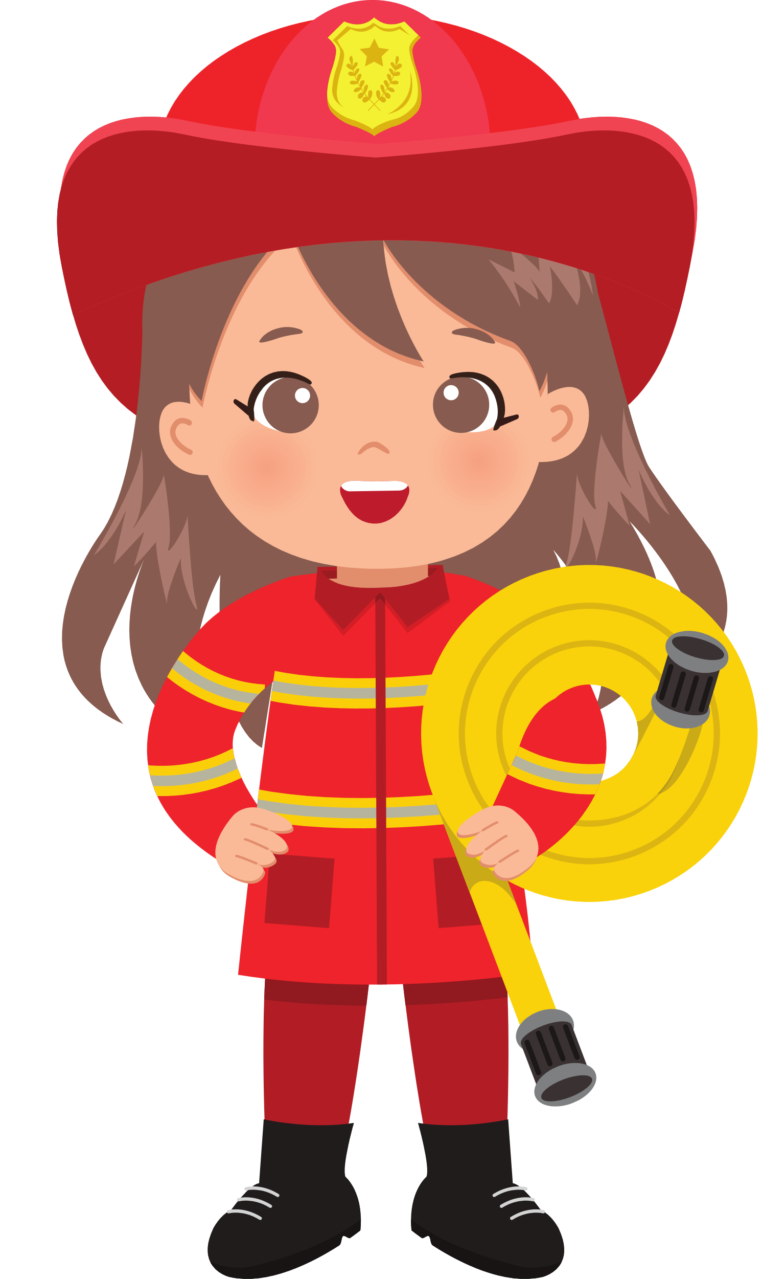
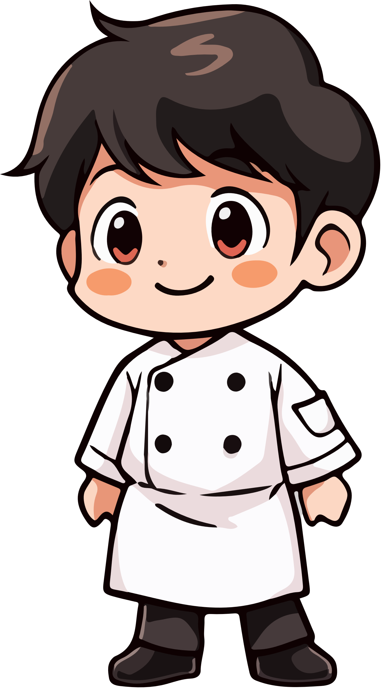


5
My future job
Lesson 3

Slide 3
I. OBJECTIVES.
By the end of the lesson, pupils will be able to:
1. Language.
- Correctly pronounce the two-syllable words with the stress on the first syllable as in ꞌteacher and ꞌdentist in isolation and as in the sentences My mother’s a ꞌteacher. and My father’s a ꞌdentist.;
- Identify the stress on some two-syllable words and circle the word with a different stress pattern from the other two words;
- Say the chant with the correct pronunciation, word stress and rhythm.
- Read an email and complete three gapped sentences about future jobs;
- Complete a gapped letter about people’s future jobs;
- Conduct a report about the future jobs that the class members would like to do in the future and use it to practise talking in the class during Project time.
2. Core competencies.
- Communication and collaboration: work in pairs and groups to complete the learning tasks.
- Self-control & independent learning: perform reading and writing tasks.
3. General competencies.
- Listening: listen and number
- Critical thinking: read and match
- Oral communication: let’s play
- Self-control & independent learning: perform listening tasks
- Communication and collaboration: work in pairs or groups
- Sociability: talk to each other, say good words to others.
4. Attributes.
- Kindness: help partners to complete learning tasks
- Diligence: complete learning tasks
- Honesty: tell the truth about feelings and emotions.
- Show their interests in their future jobs.

Slide 4




Warm-up

Slide 5


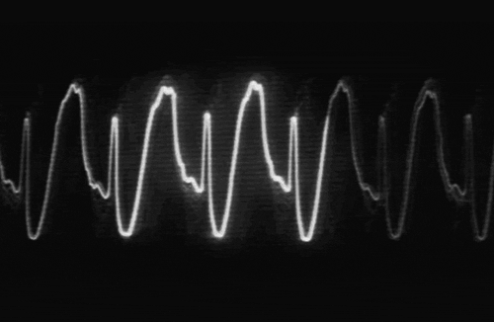


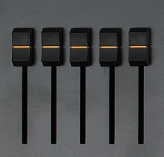


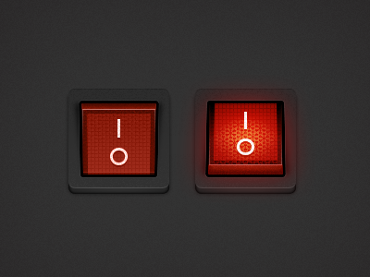

T R D C O O
DOCTOR
Notes:
Click on the red button to reveal the answer.

Slide 6
T I E R W R
WRITER
Notes:
Click on the red button to reveal the answer.

Slide 7
C H T R E A E
TEACHER
Notes:
Click on the red button to reveal the answer.

Slide 8
I S N T E D T
DENTIST
Notes:
Click on the red button to reveal the answer.

Slide 9
R I F E G T R E F H I
FIREFIGHTER
Notes:
Click on the red button to reveal the answer.

Slide 10
N E R D E R G A
GARDENER
Notes:
Click on the red button to reveal the answer.

Slide 11
R O R P E R E T
REPORTER
Notes:
Click on the red button to reveal the answer.

Slide 12




More jobs
Guess the job.

Slide 13
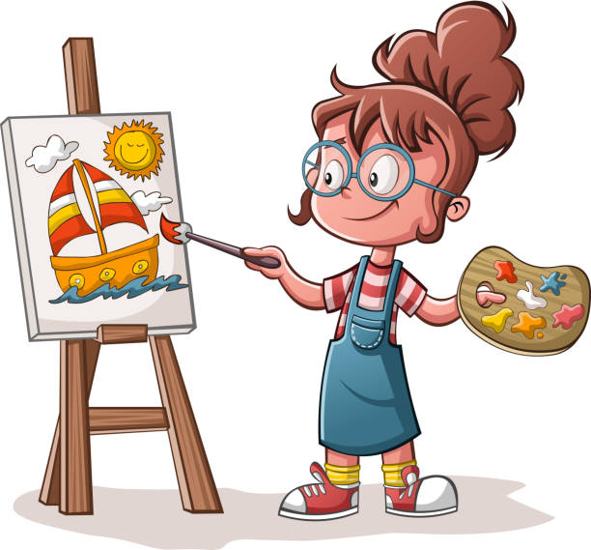
artist

Slide 14
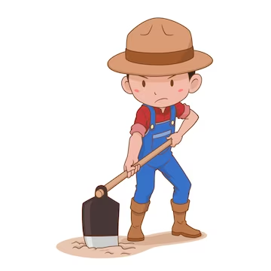
farmer

Slide 15
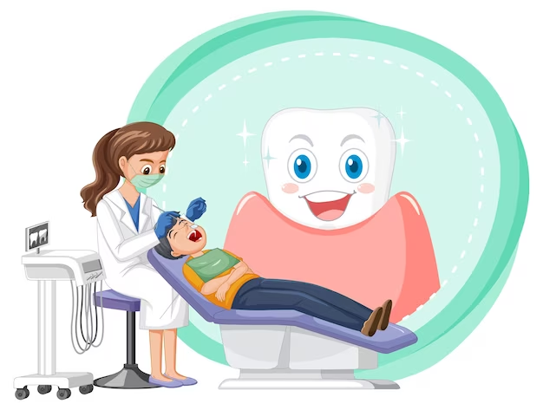
dentist

Slide 16
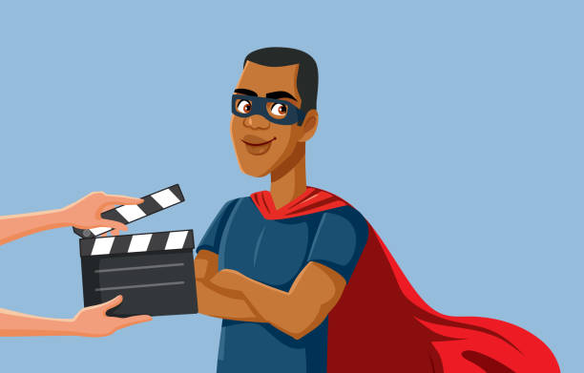
actor

Slide 17

pilot

Slide 18
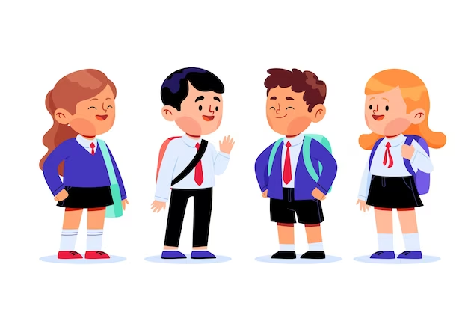
student

Slide 19
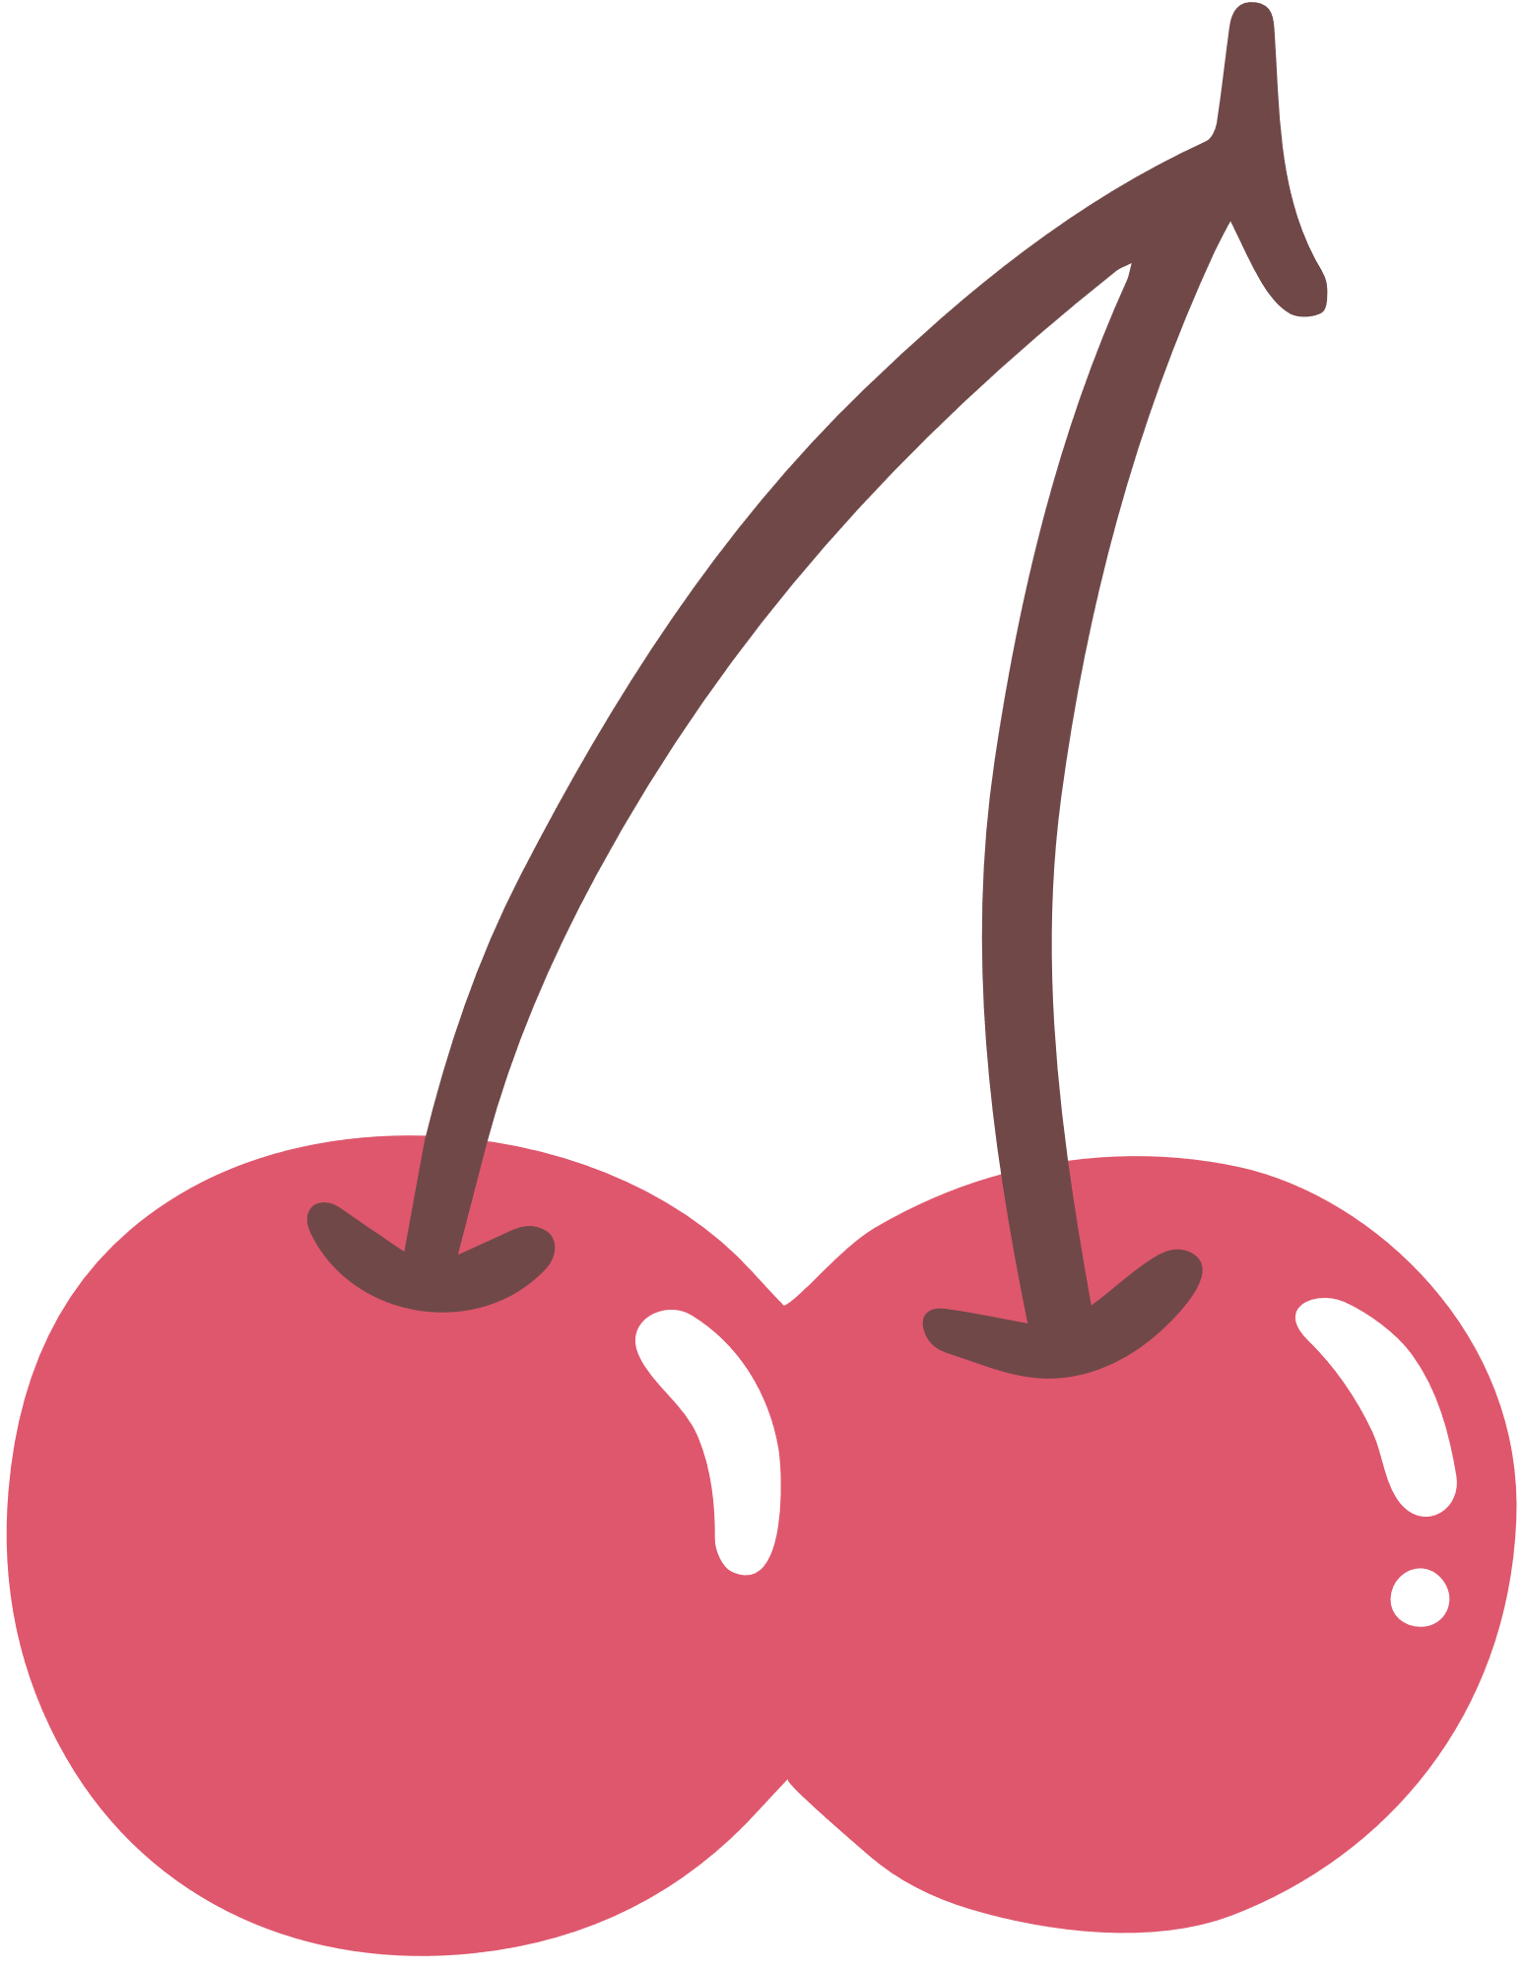



NOUNS
How many syllables?
artist
teacher
writer
gardener
pilot
dentist
actor
firefighter
doctor
student
farmer
reporter

Slide 20
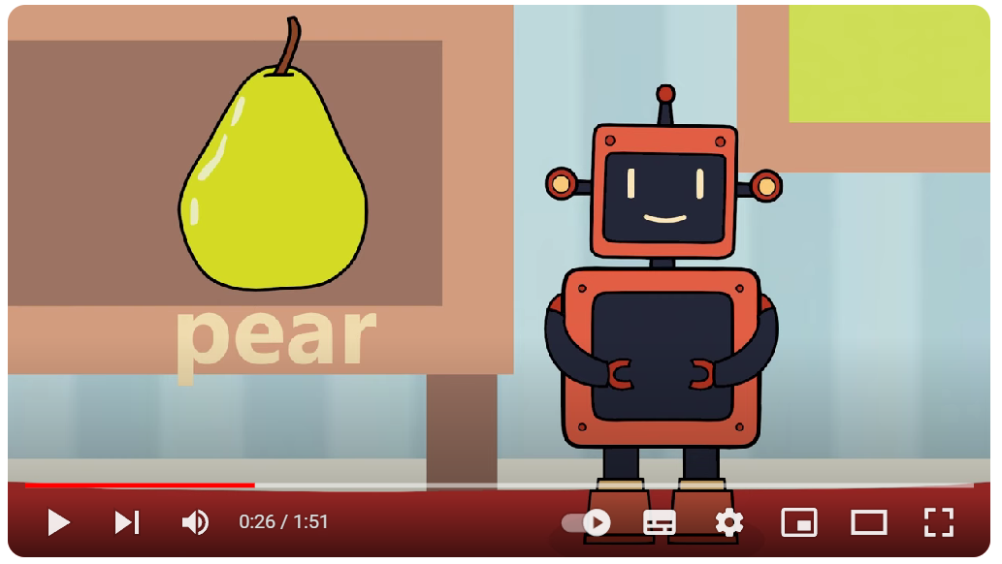
https://www.youtube.com/watch?v=UWaomqRcHuw

Slide 21
2syllables
3syllables
artist
teacher
writer
gardener
pilot
dentist
actor
firefighter
doctor
student
farmer
reporter

Slide 22
2syllables noun
stressed on 1st syllable
artist
teacher
writer
artist
teacher
writer
pilot
dentist
actor
pilot
dentist
actor
doctor
student
farmer
doctor
student
farmer

Slide 23
1. Listen and repeat.

Slide 24

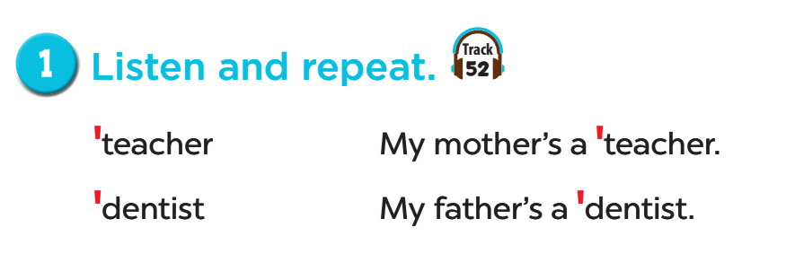

Slide 25
2. Circle, listen and check.

Slide 26
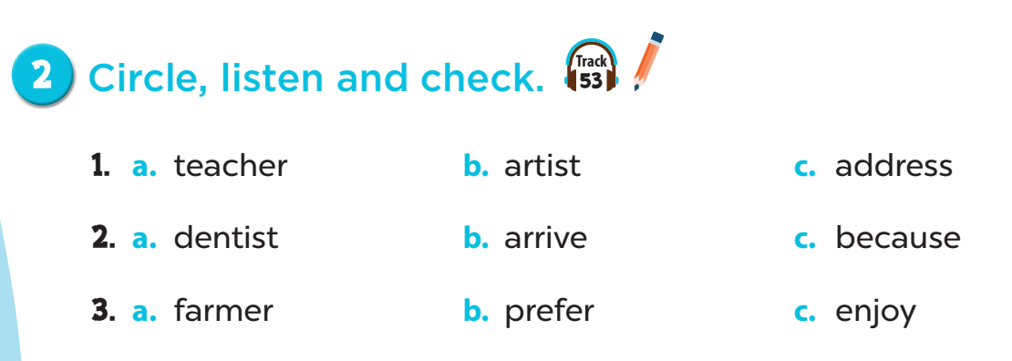

Slide 27
4. Read and circle.

Slide 28

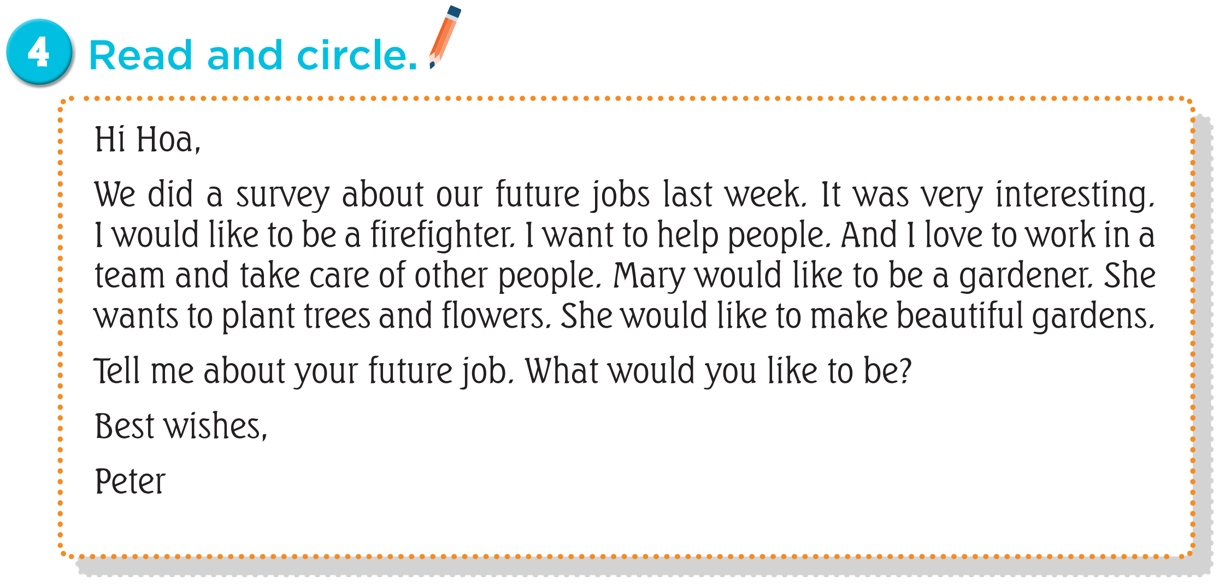


Read the email.

Slide 29
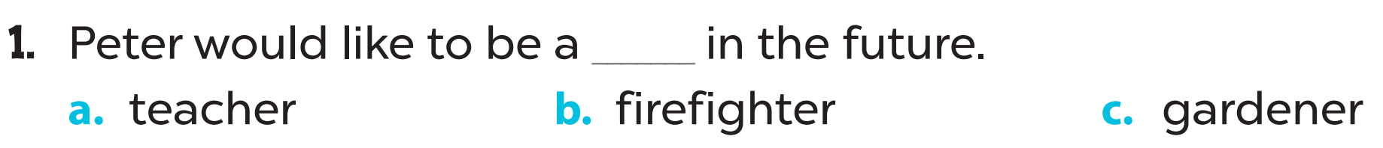

Slide 31
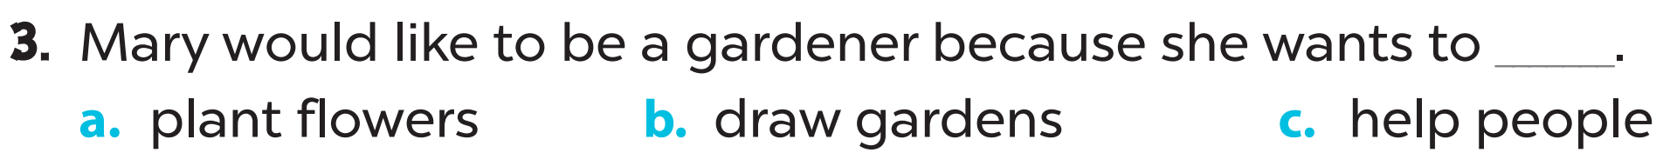

Slide 32
5. Let’s write.

Slide 33
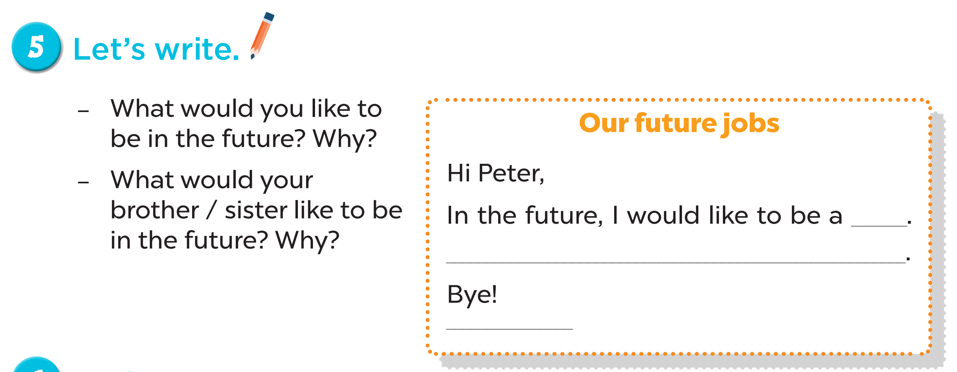

Slide 34
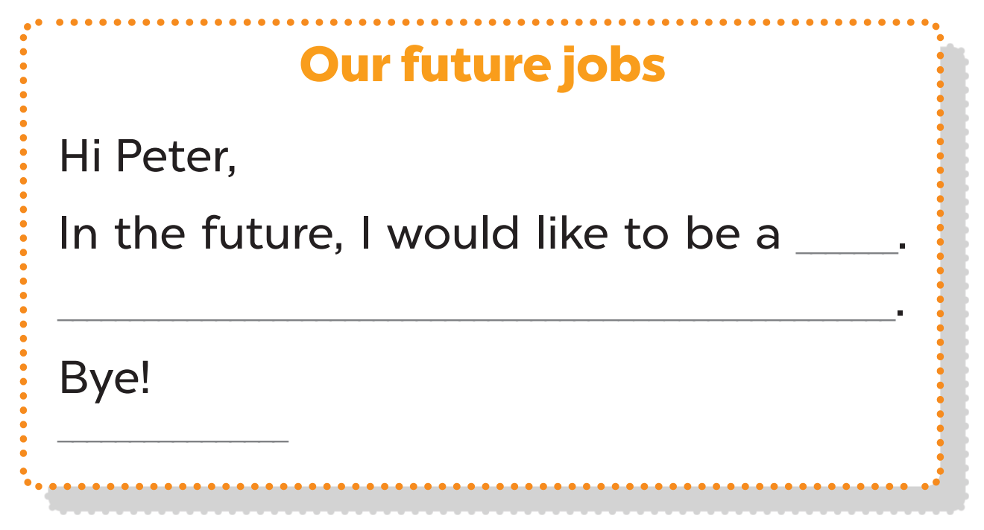

Slide 35
Fun corner and wrap-up

Slide 36

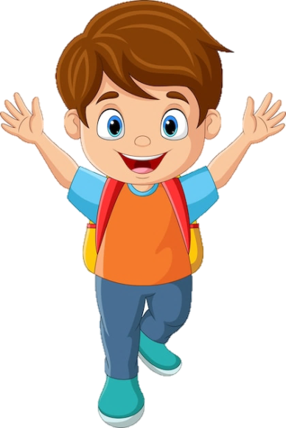
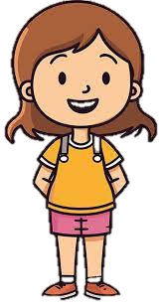
What would you like to be in the future?
I’d like to be a dentist.
Notes:
If the answer is correct, click “check” icon to get points.
If not, click “cross” icon (x) to move back to slide 16

Slide 37

What would you like to be in the future?
I’d like to be a firefighter.
Notes:
If the answer is correct, click “check” icon to get points.
If not, click “cross” icon (x) to move back to slide 16

Slide 38

What would you like to be in the future?
I’d like to be a doctor.
Notes:
If the answer is correct, click “check” icon to get points.
If not, click “cross” icon (x) to move back to slide 16

Slide 39
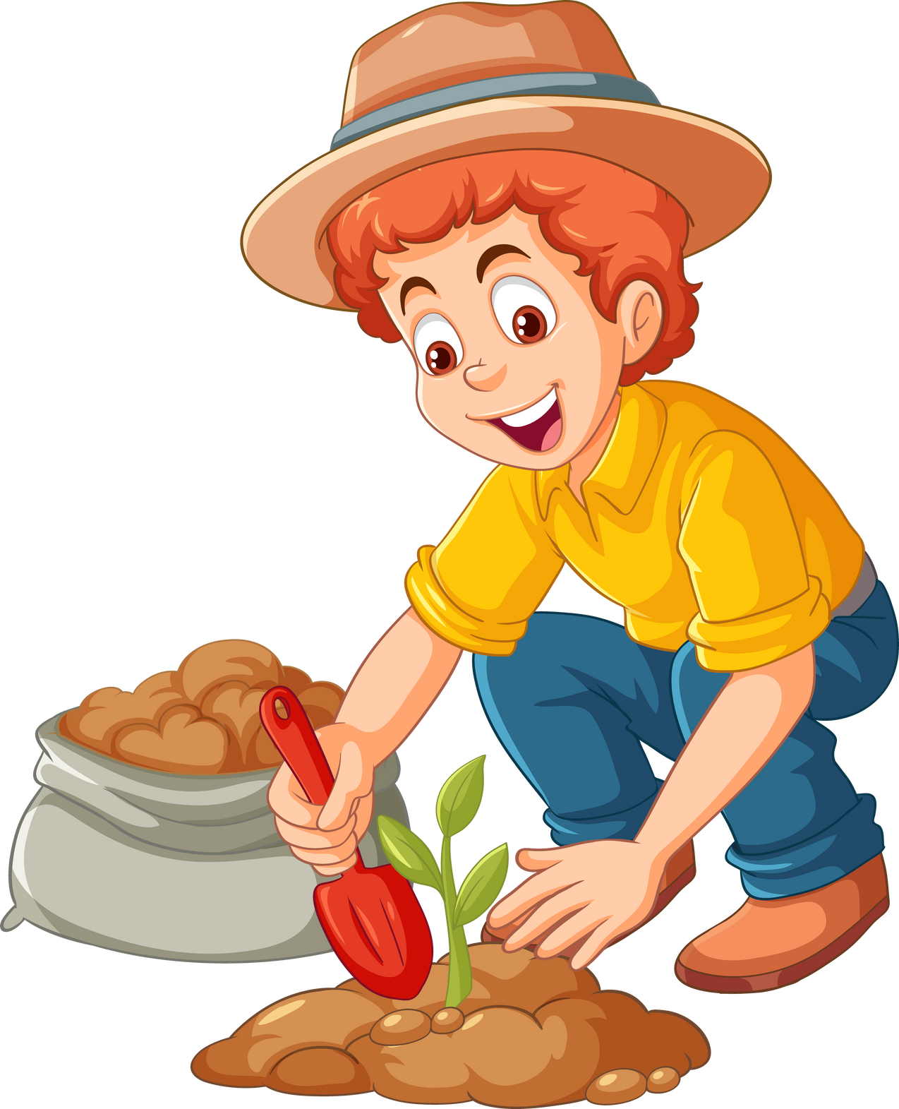
Why would you like to be a gardener?
Because I’d like to grow flowers.
Notes:
If the answer is correct, click “check” icon to get points.
If not, click “cross” icon (x) to move back to slide 16

Slide 40

Why would you like to be a writer?
Because I’d like to write stories.
Notes:
If the answer is correct, click “check” icon to get points.
If not, click “cross” icon (x) to move back to slide 16

Slide 41
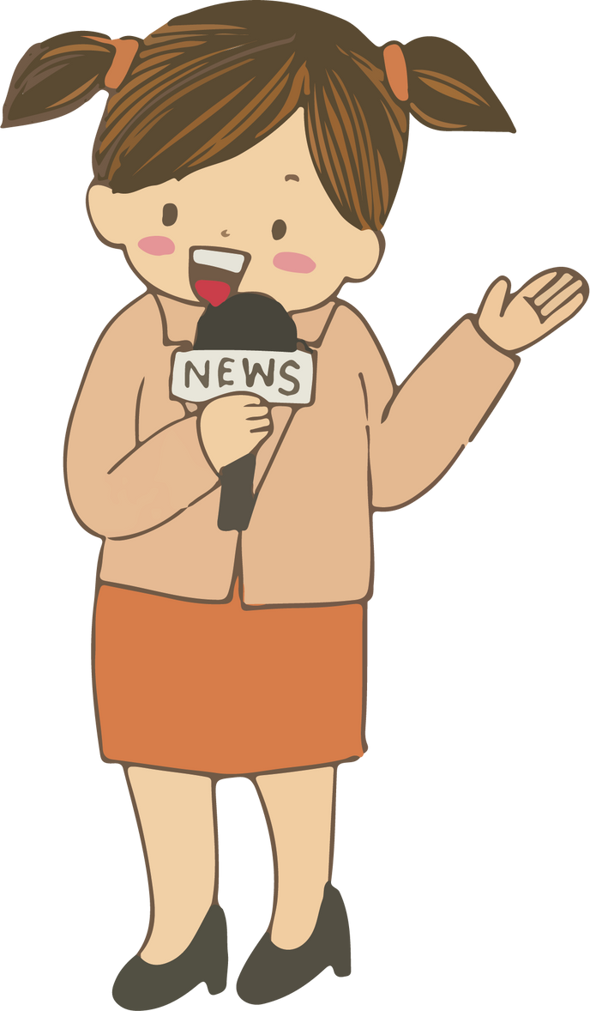
Why would you like to be a reporter?
Because I’d like to report the news.
Notes:
If the answer is correct, click “check” icon to get points.
If not, click “cross” icon (x) to move back to slide 16

Slide 42
Why would you like to be a teacher?
Because I’d like to teach children.
Notes:
If the answer is correct, click “check” icon to get points.
If not, click “cross” icon (x) to move back to slide 16

Slide 43

Would you like to be an artist?
Yes, I would.
Notes:
If the answer is correct, click “check” icon to get points.
If not, click “cross” icon (x) to move back to slide 16

Slide 44
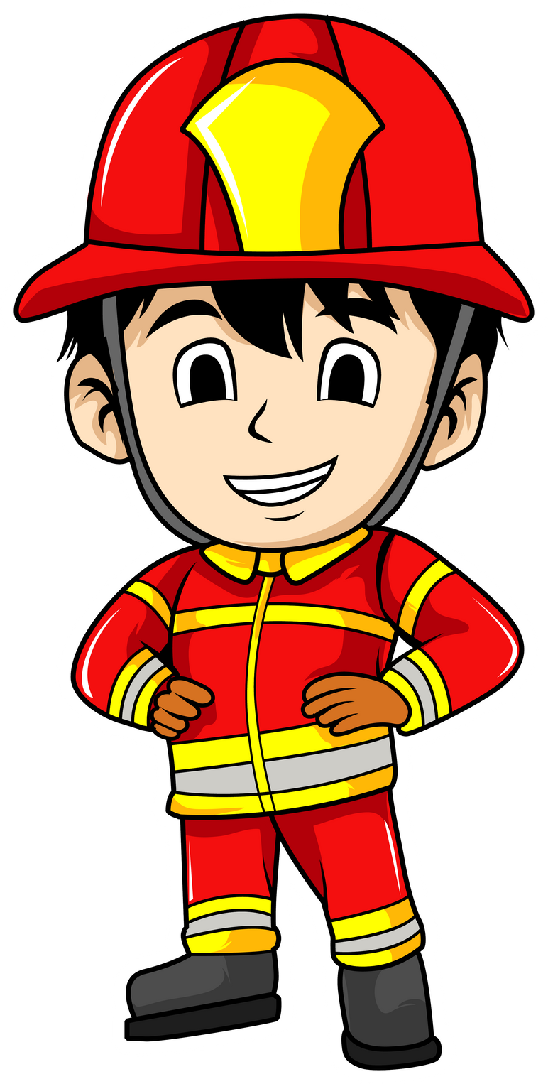

Would you like to be a firefighter?
No, I wouldn’t.
Notes:
If the answer is correct, click “check” icon to get points.
If not, click “cross” icon (x) to move back to slide 16

Slide 45
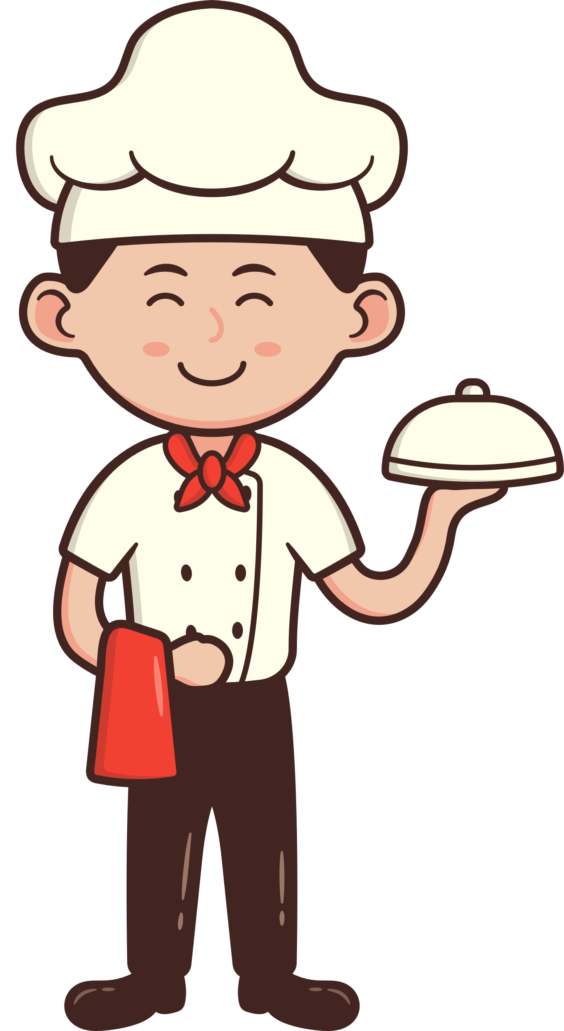
Would you like to be a cook?
No, I wouldn’t.
Notes:
If the answer is correct, click “check” icon to get points.
If not, click “cross” icon (x) to move back to slide 16

