Slide 2









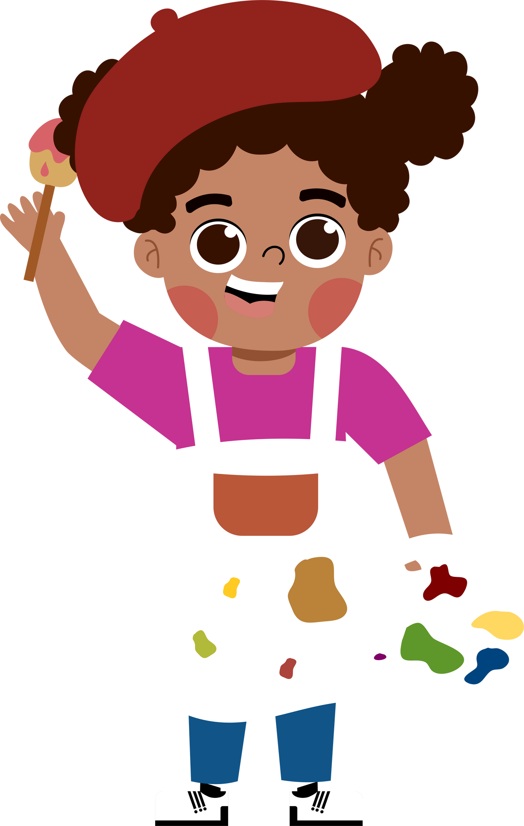
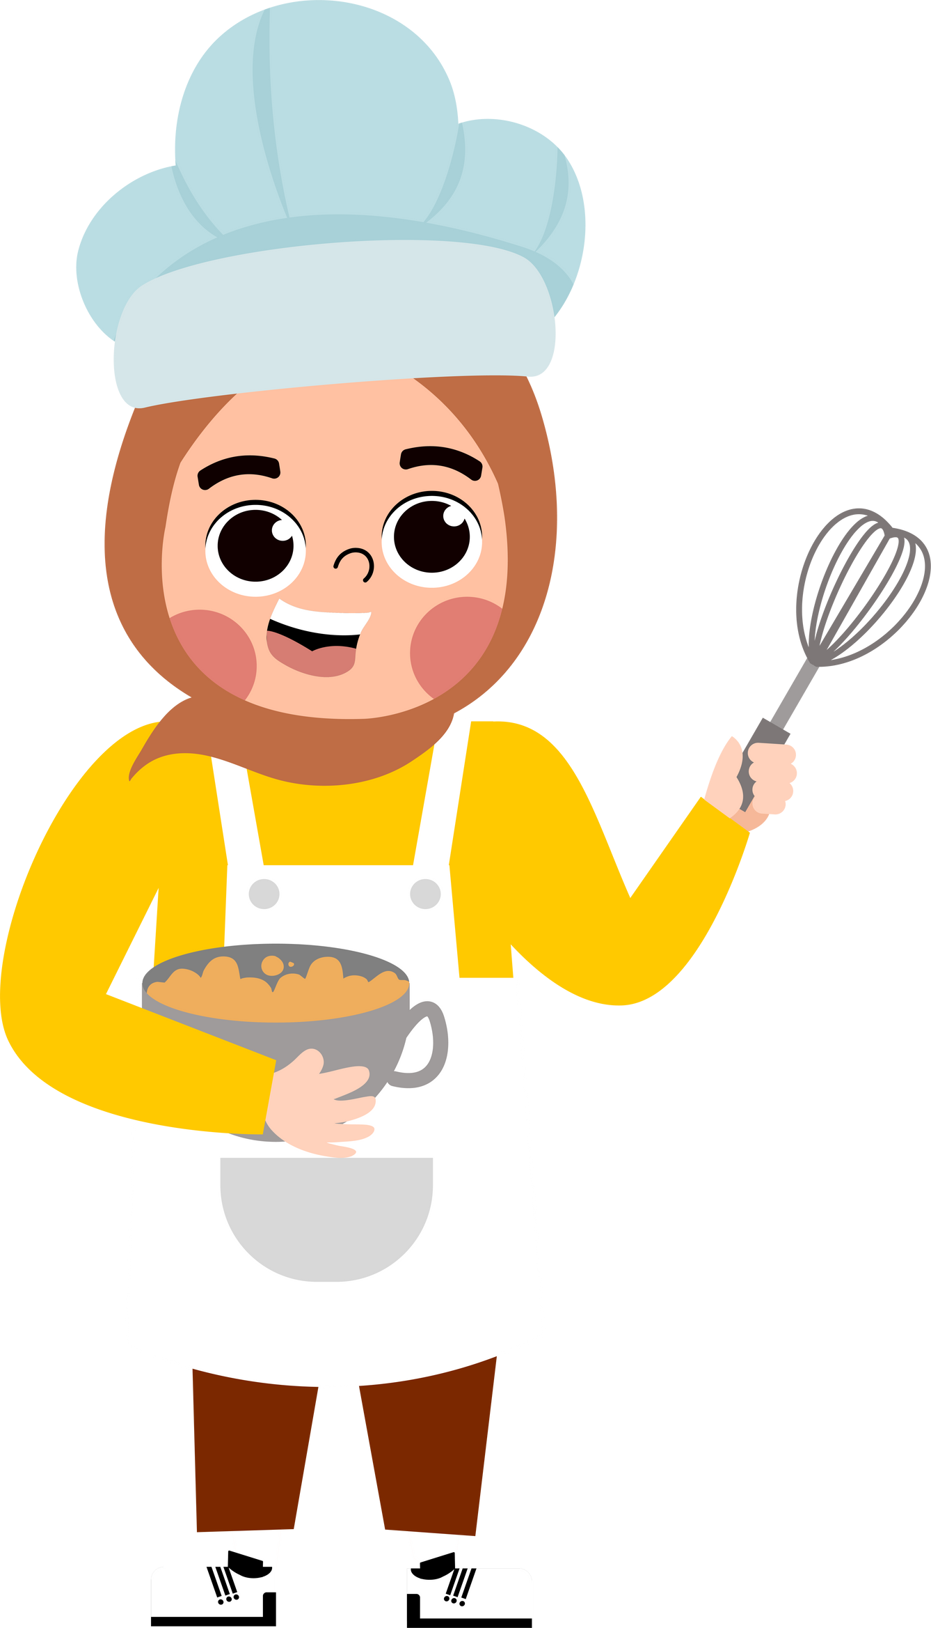
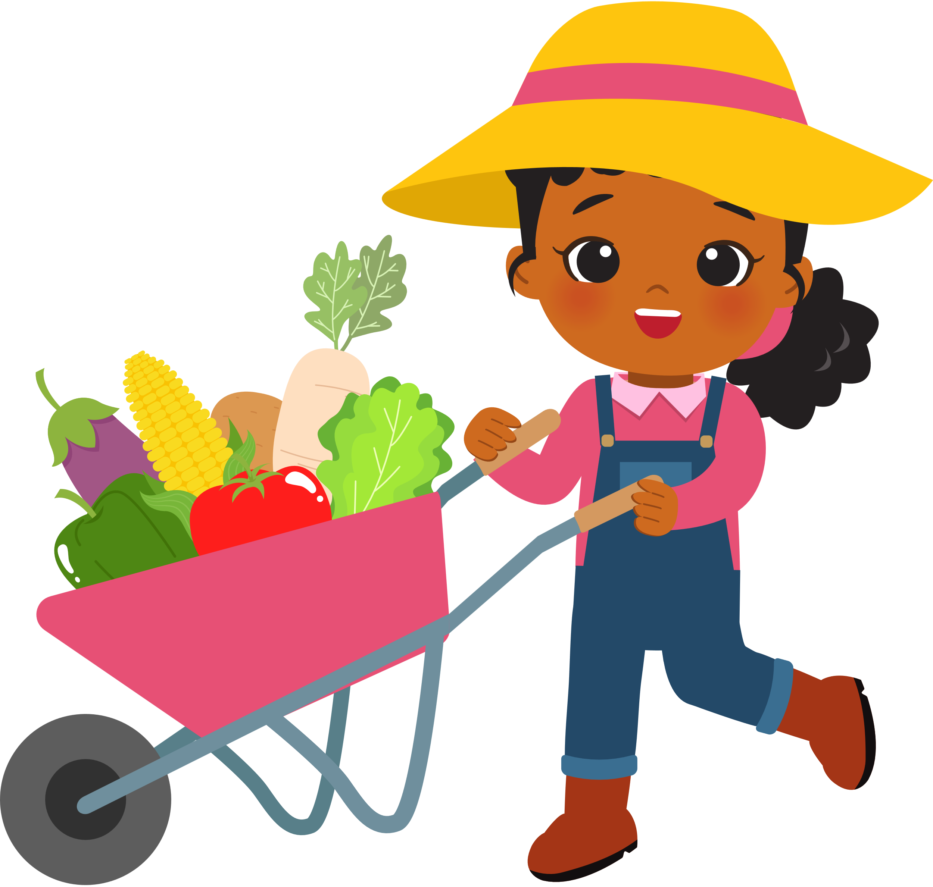

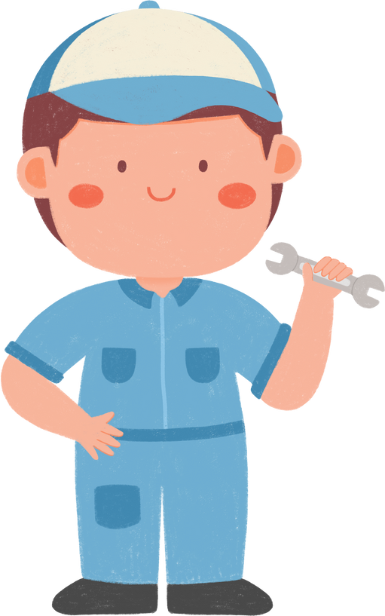
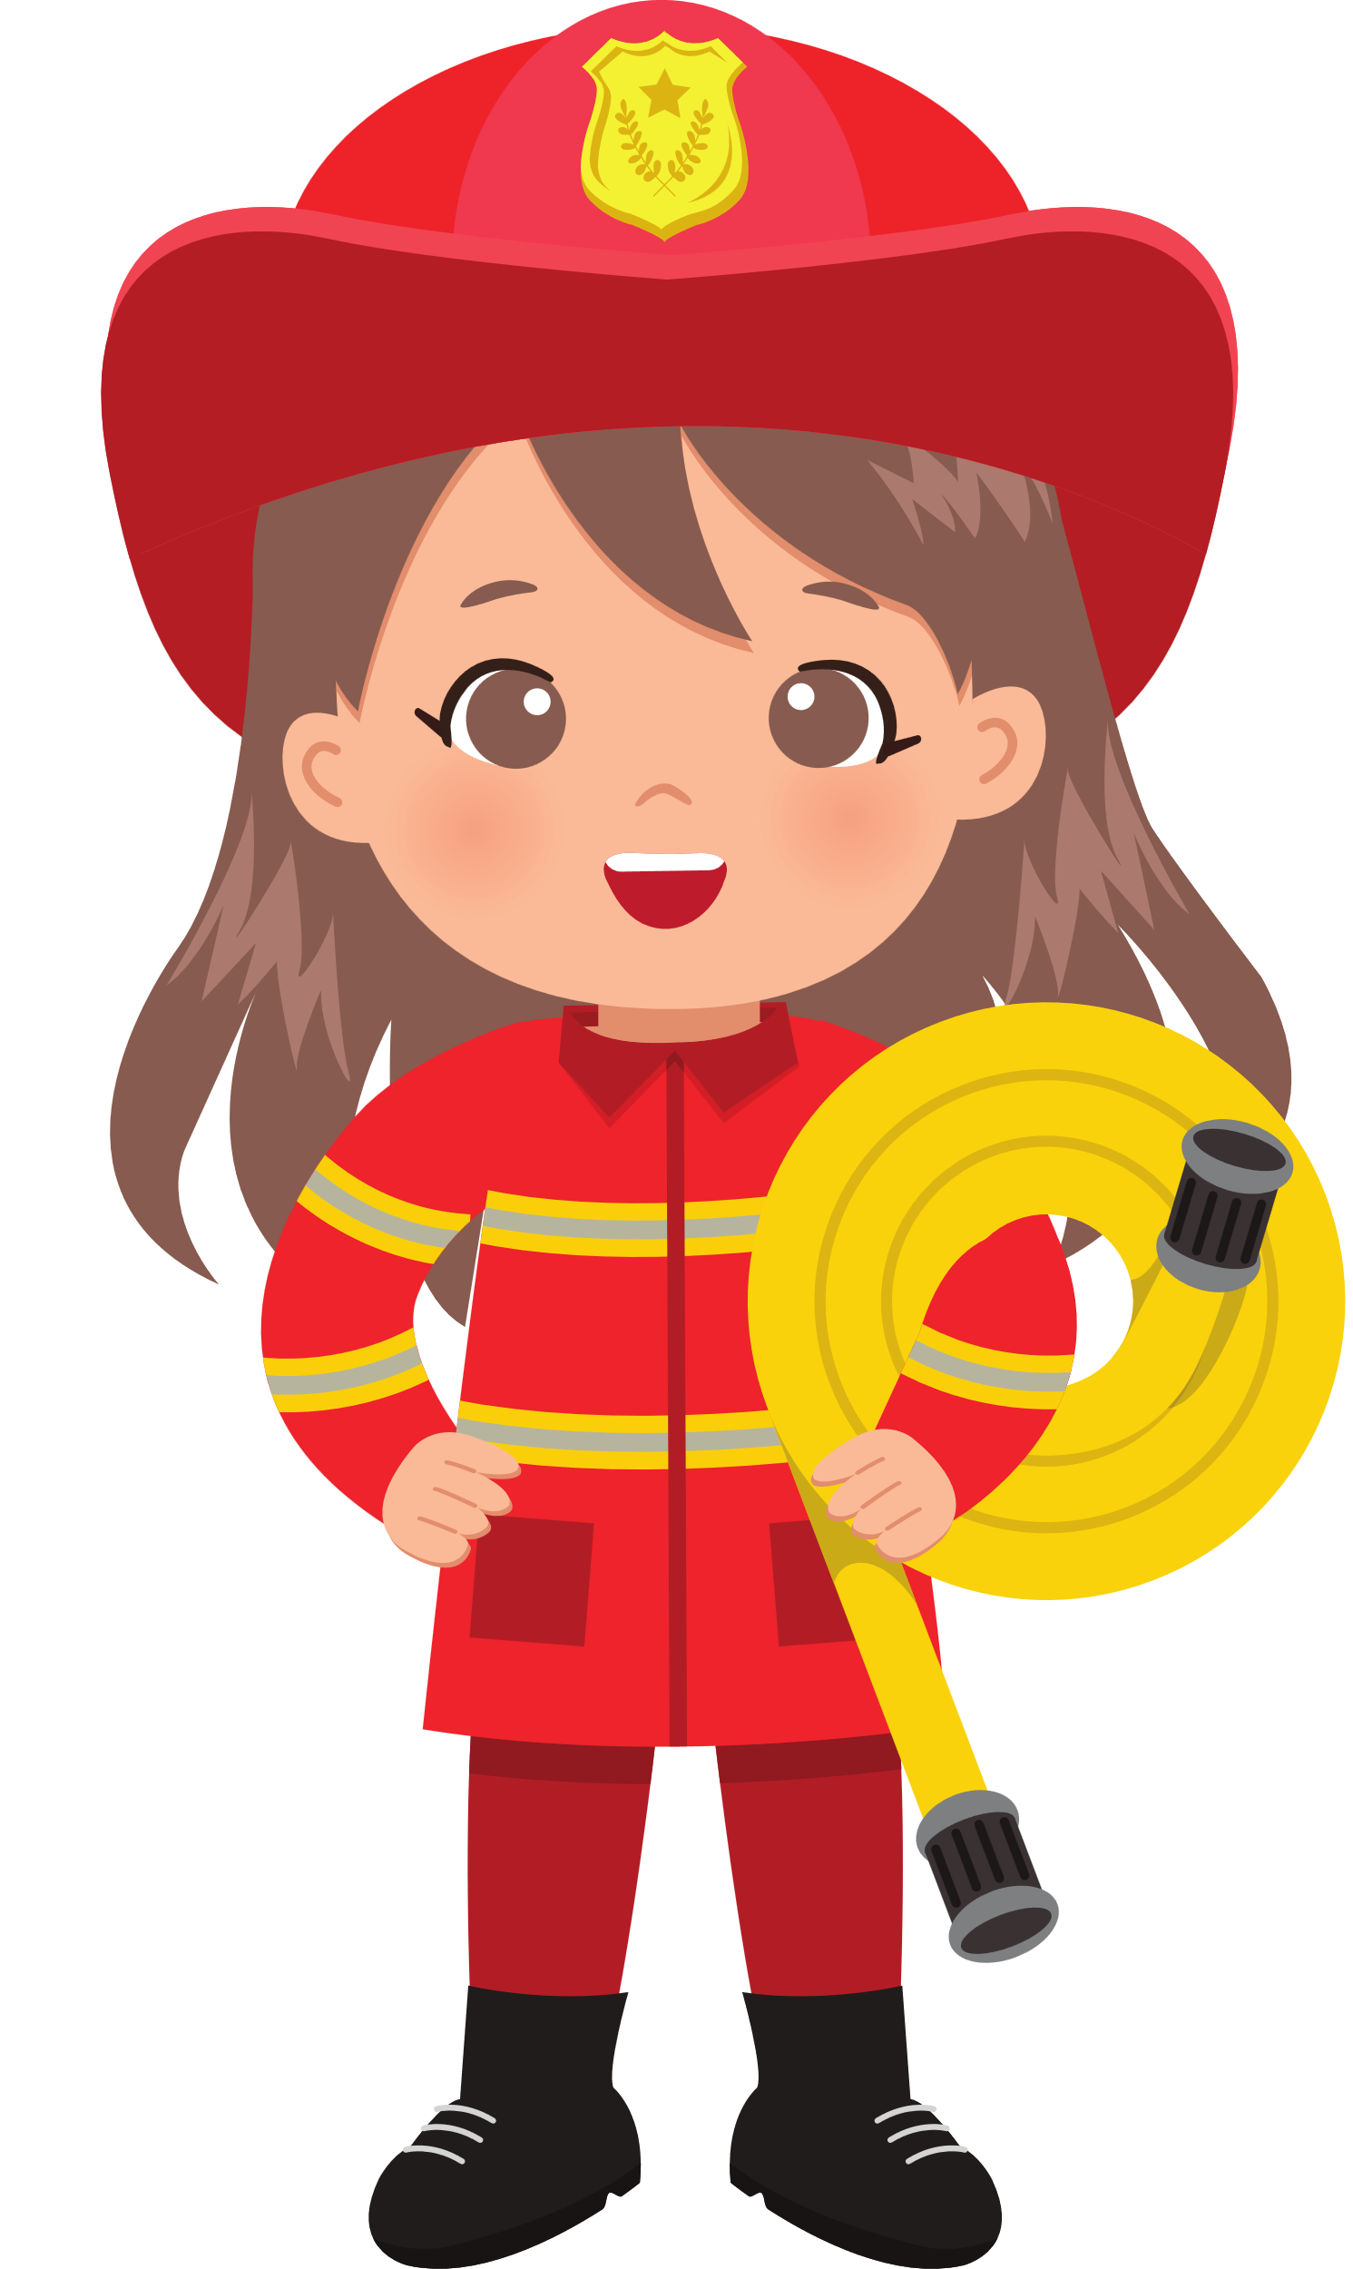
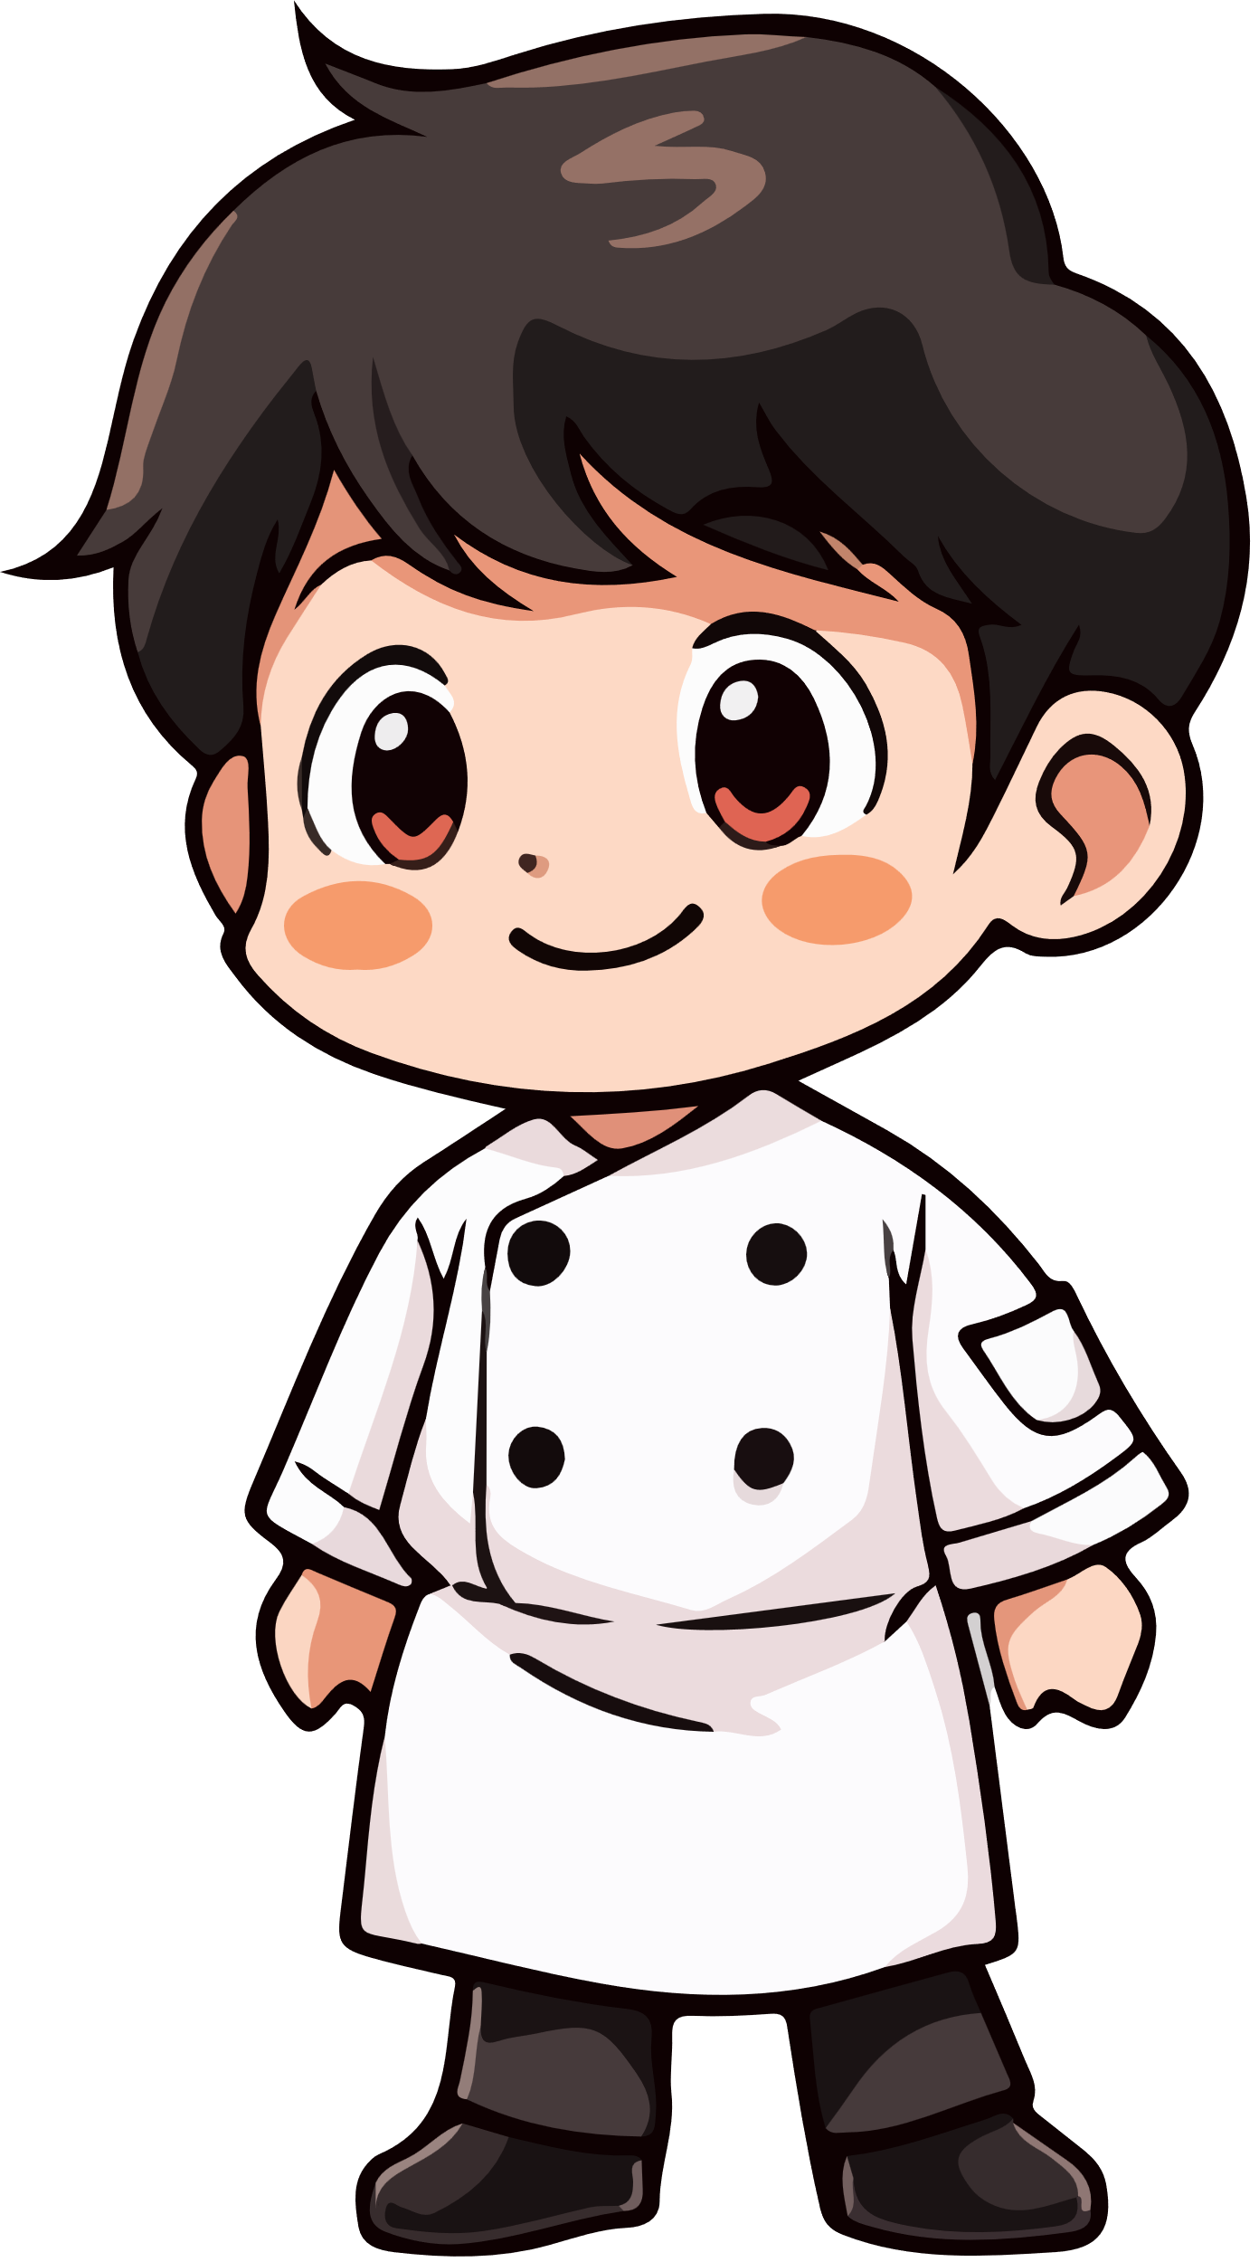


5
My future job
Lesson 2

Slide 3
I. OBJECTIVES.
By the end of this lesson, pupils will be able to:
1. Knowledge and skills.
- Understand and correctly repeat the sentences in two communicative contexts focusing on asking and answering questions about jobs and someone’s future job;
- Use the words firefighter, reporter, gardener and writer and the sentence patterns What would you like to be in the future? and I’d like to be a ________. to ask and answer questions about someone’s future job;
- Use What would you like to be in the future? – I’d like to be a ____. in a freer context.
- Listen to and understand four communicative contexts in which speakers ask and answer questions about people’s future jobs and number the pictures;
2. Competences.
- Critical thinking and creativity: learn how to ask and answer questions about someone’s future jobs correctly and fluently.
- Communication and collaboration: work in pairs and groups to complete the learning tasks.
- Self-control & independent learning: perform pronunciation and speaking tasks.
3. Attributes.
- Show their love and interest in a certain job in the future.

Slide 4




Warm-up

Slide 5


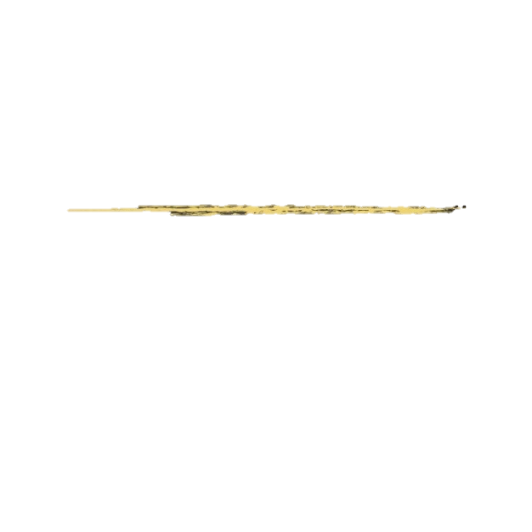

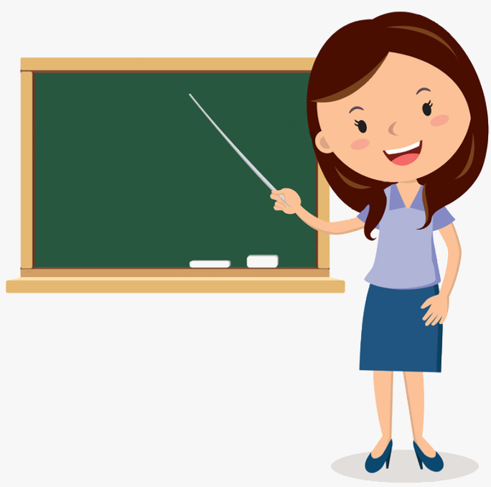



_ _ a c _ e_
t
e
h
r

Slide 6

c
a
_ o l _ _ e m _ n
p
i

Slide 7
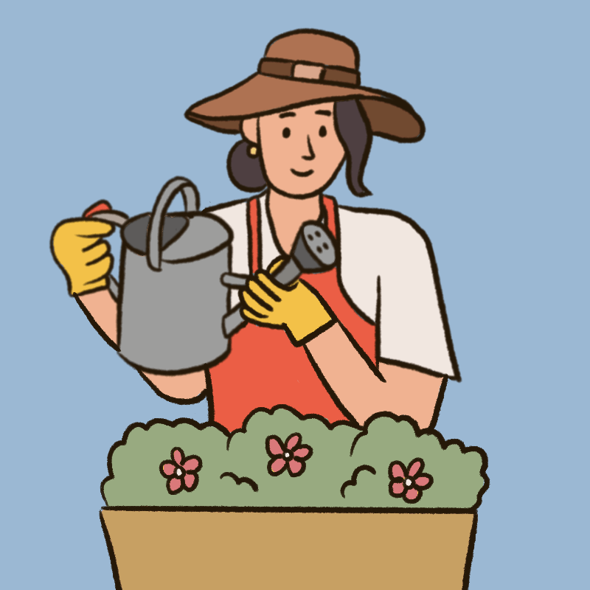
a
e
r
g _ r d_ n e _

Slide 8
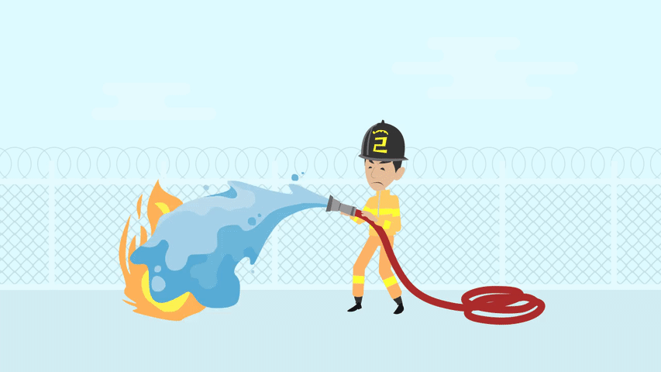
_ i r _ f i _ h t _ _
e
g
e
r
f

Slide 9
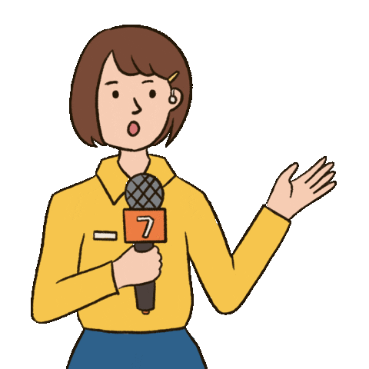
e
_ e p _ _ t _ r
r
o
r

Slide 10
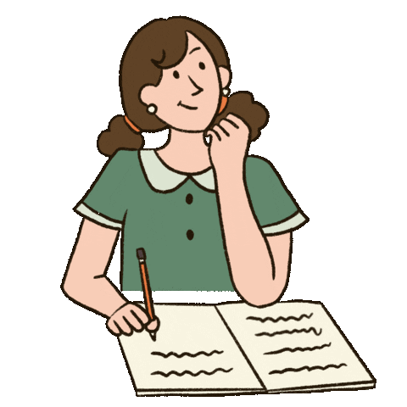
w
_ r _ _ e r
i
t

Slide 11

d
c
_ o _ t o _
r

Slide 12
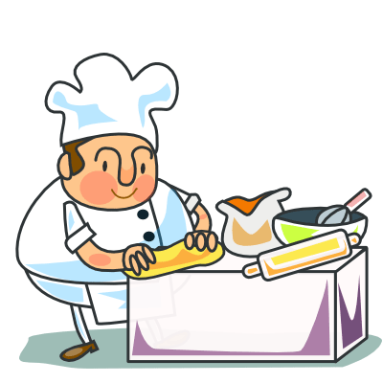
c
o
k
_ _ o _

Slide 13
New words
Look, listen and repeat.

Slide 14



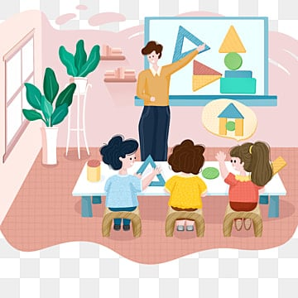


teach children

Slide 15

report the news

Slide 16
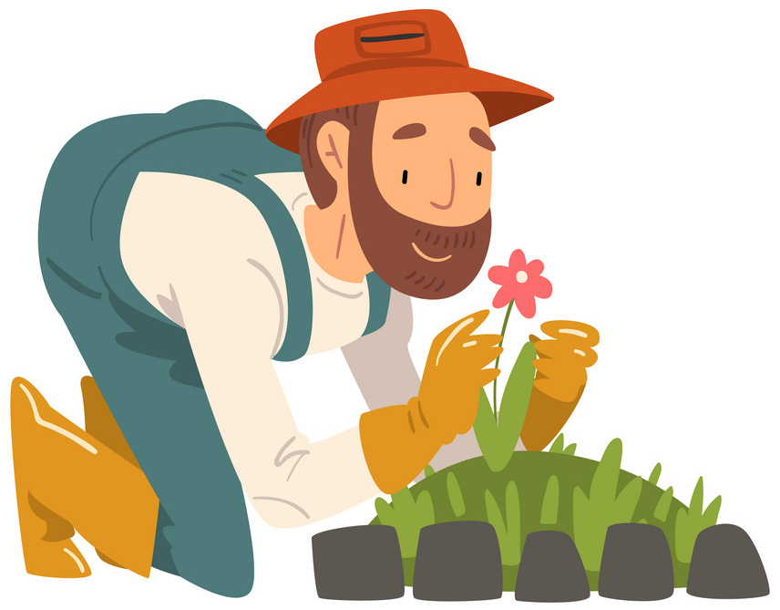
grow flowers

Slide 17

write stories

Slide 18
report the news
teach children
grow flowers
write stories

Slide 19
1. Look, listen and repeat.

Slide 20

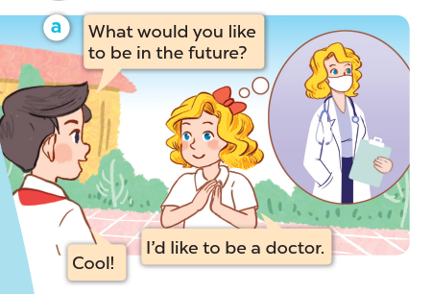



Slide 21
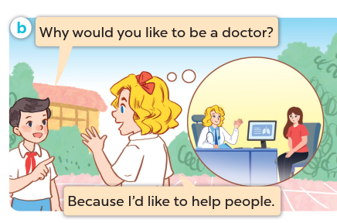

Slide 22
2. Listen, point and say.

Slide 23
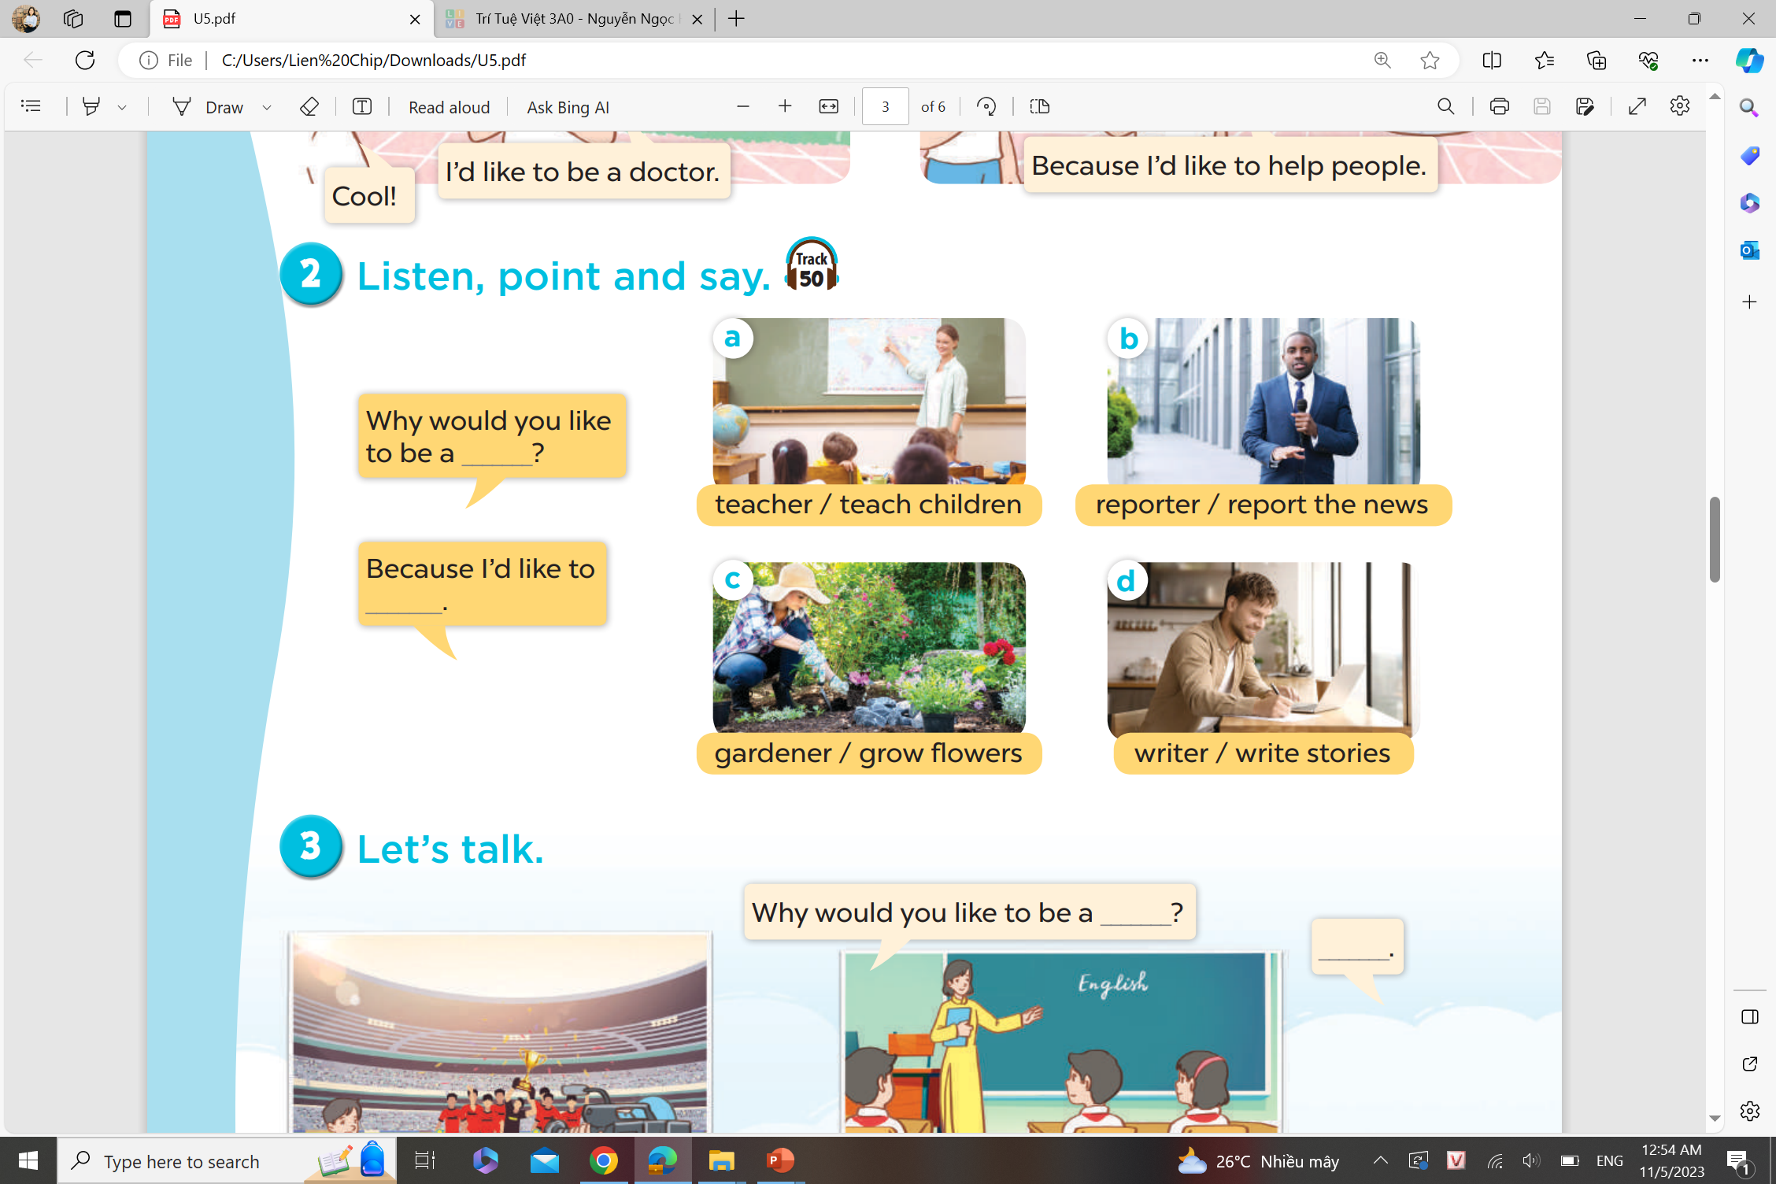

Slide 24
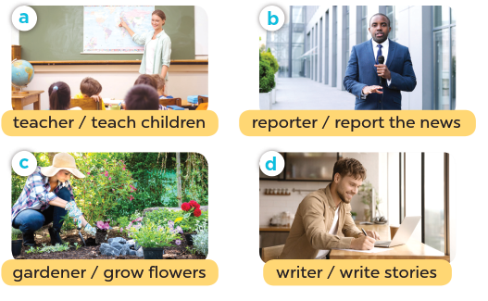

Slide 25


Slide 26
4. Listen and tick

Slide 27
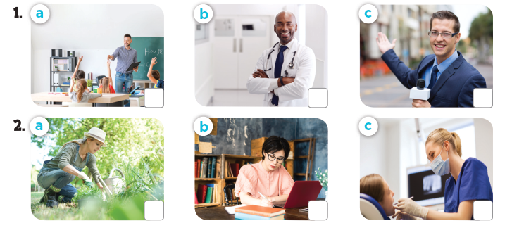


Slide 28
Fun corner and wrap-up

Slide 29


What
.................. would you like to be
in the future?
A. Why
B. What
C. Because

Slide 30
Why would you like to be a gardener?
- ................... I like to grow flowers.
Because
A. What
B. When
C. Because

Slide 31
Why would you like to
be a ......................?
reporter
A. reporter
B. gardener
C. doctor

Slide 32
Why would you like to be a teacher?
- Because I ................... to teach children.
like
A. to like
B. likes
C. like

Slide 33
writer
Why would you like to be a ......................?
- Because I like to write new stories.
A. writer
B. cook
C. farmer

Slide 34
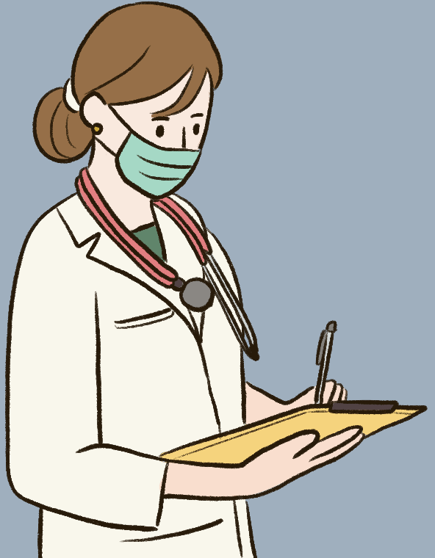
Why would you like to be a doctor?
- Because I like to ...............................
help sick people
A. teach children
B. help sick people
C. play football

Slide 35
Why would you like to be a.....................?
- Because I like to cook.
cook
A. farmer
B. cook
C. dancer

Slide 36
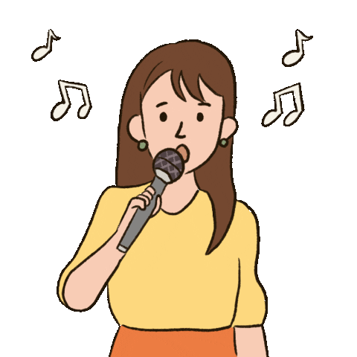
Why would you like to be a singer?
- Because I like to ....................
sing
A. help people
B. write stories
C. sing

