Slide 2









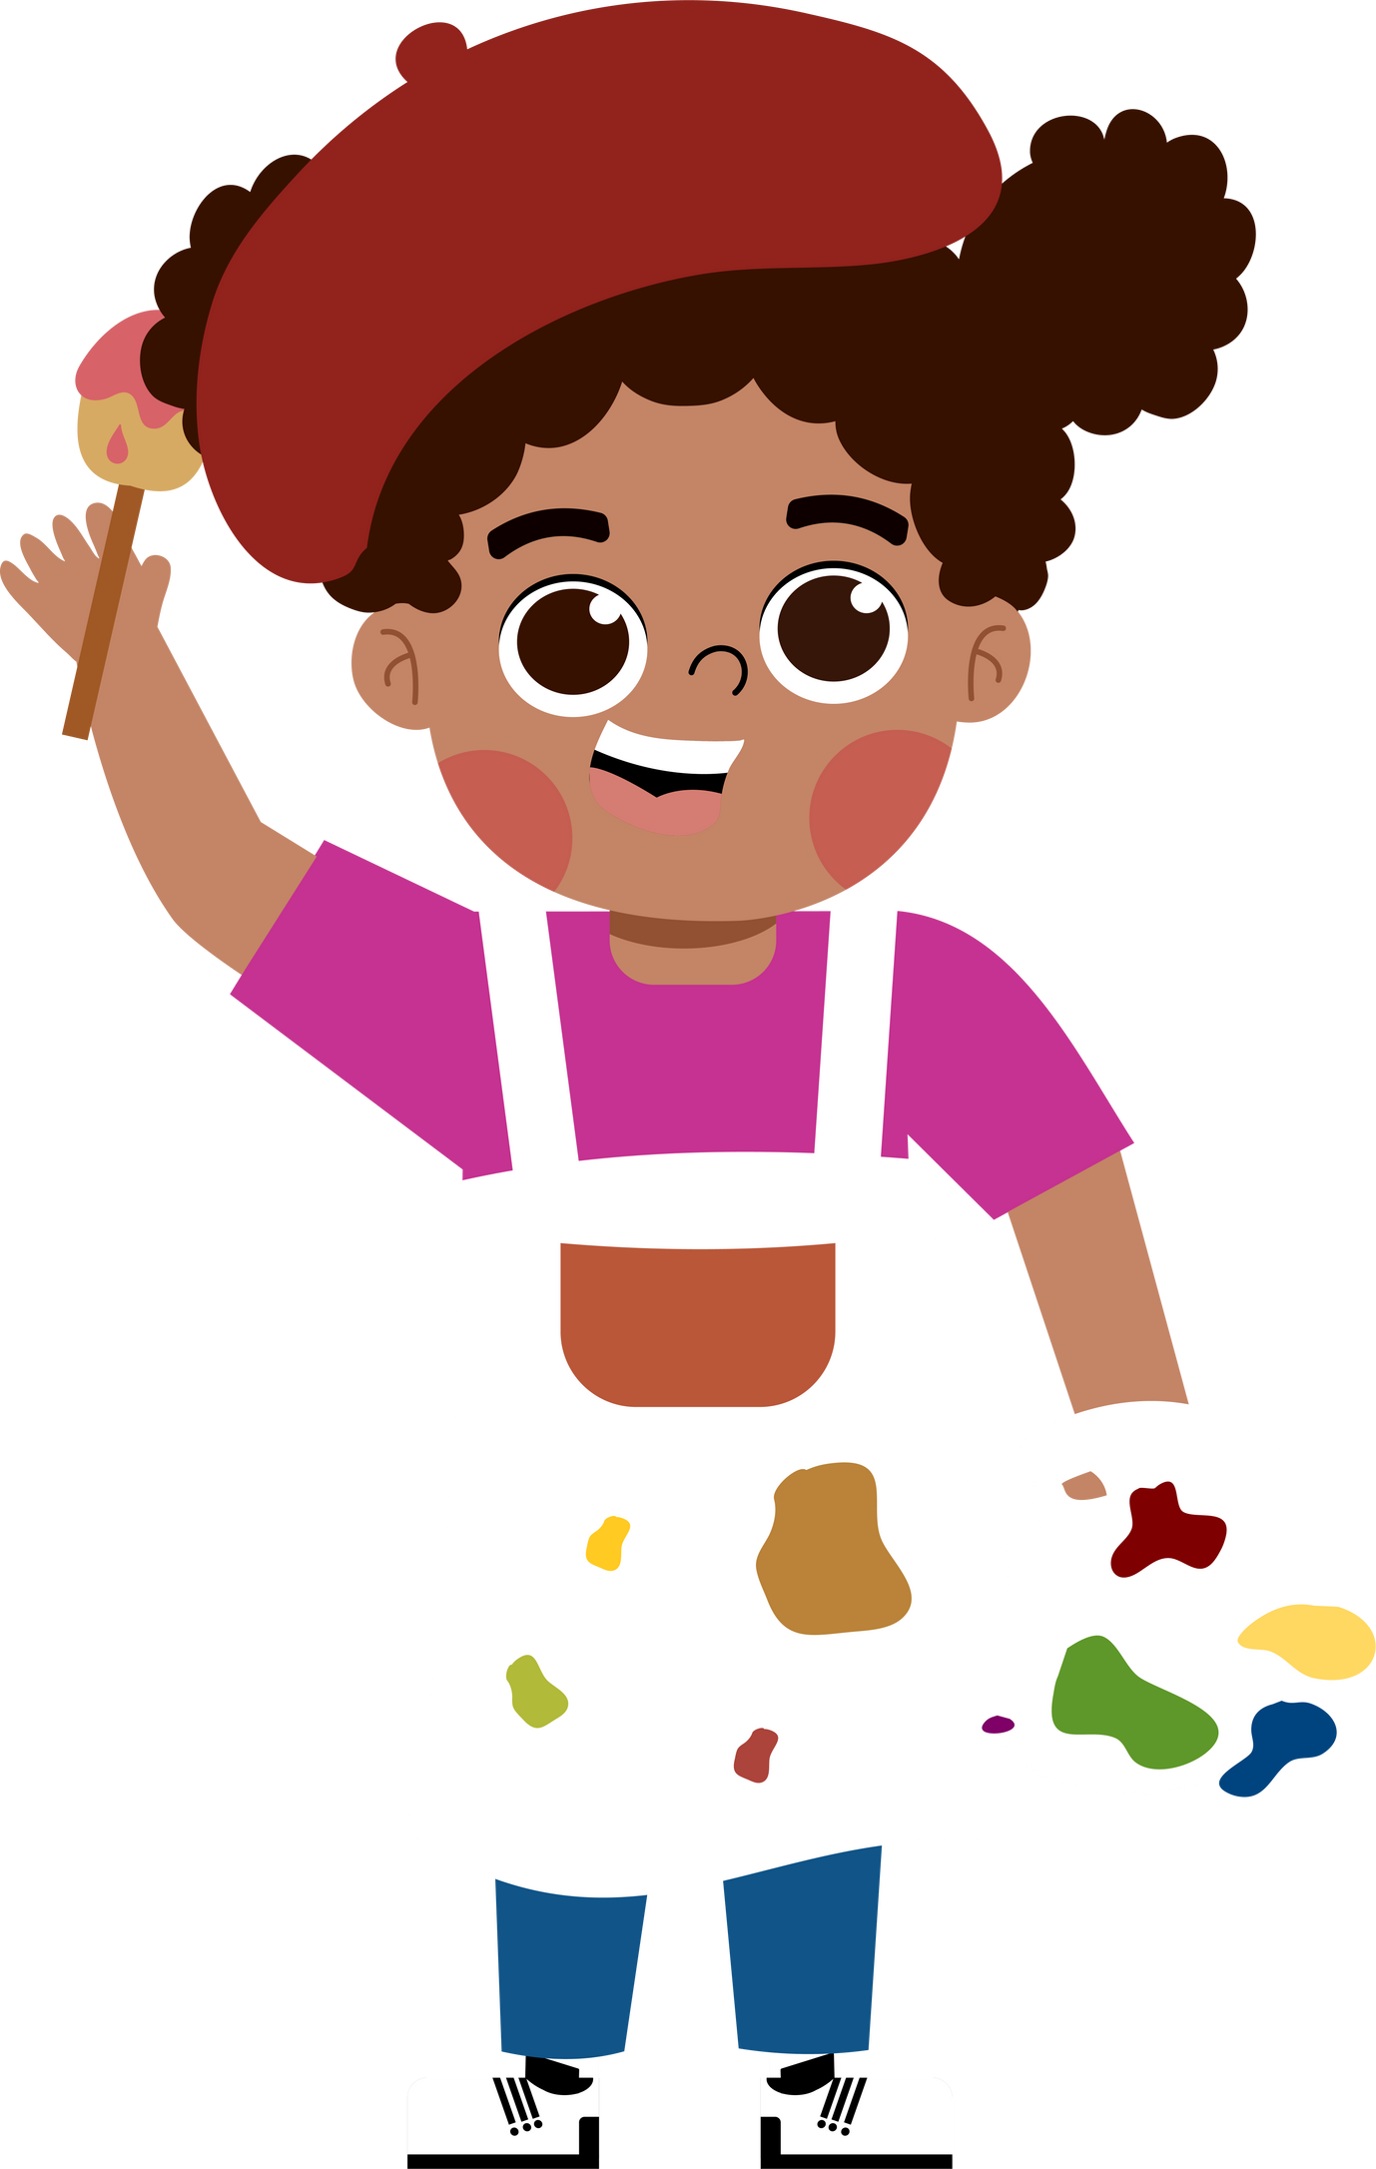
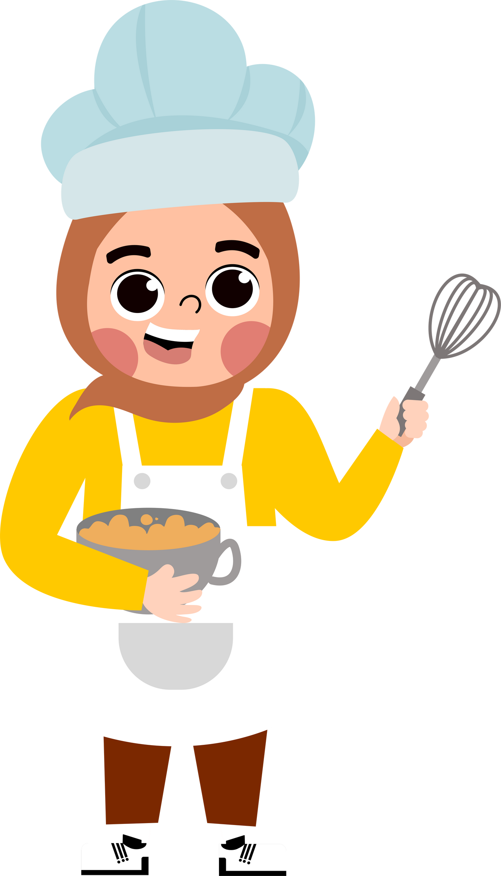
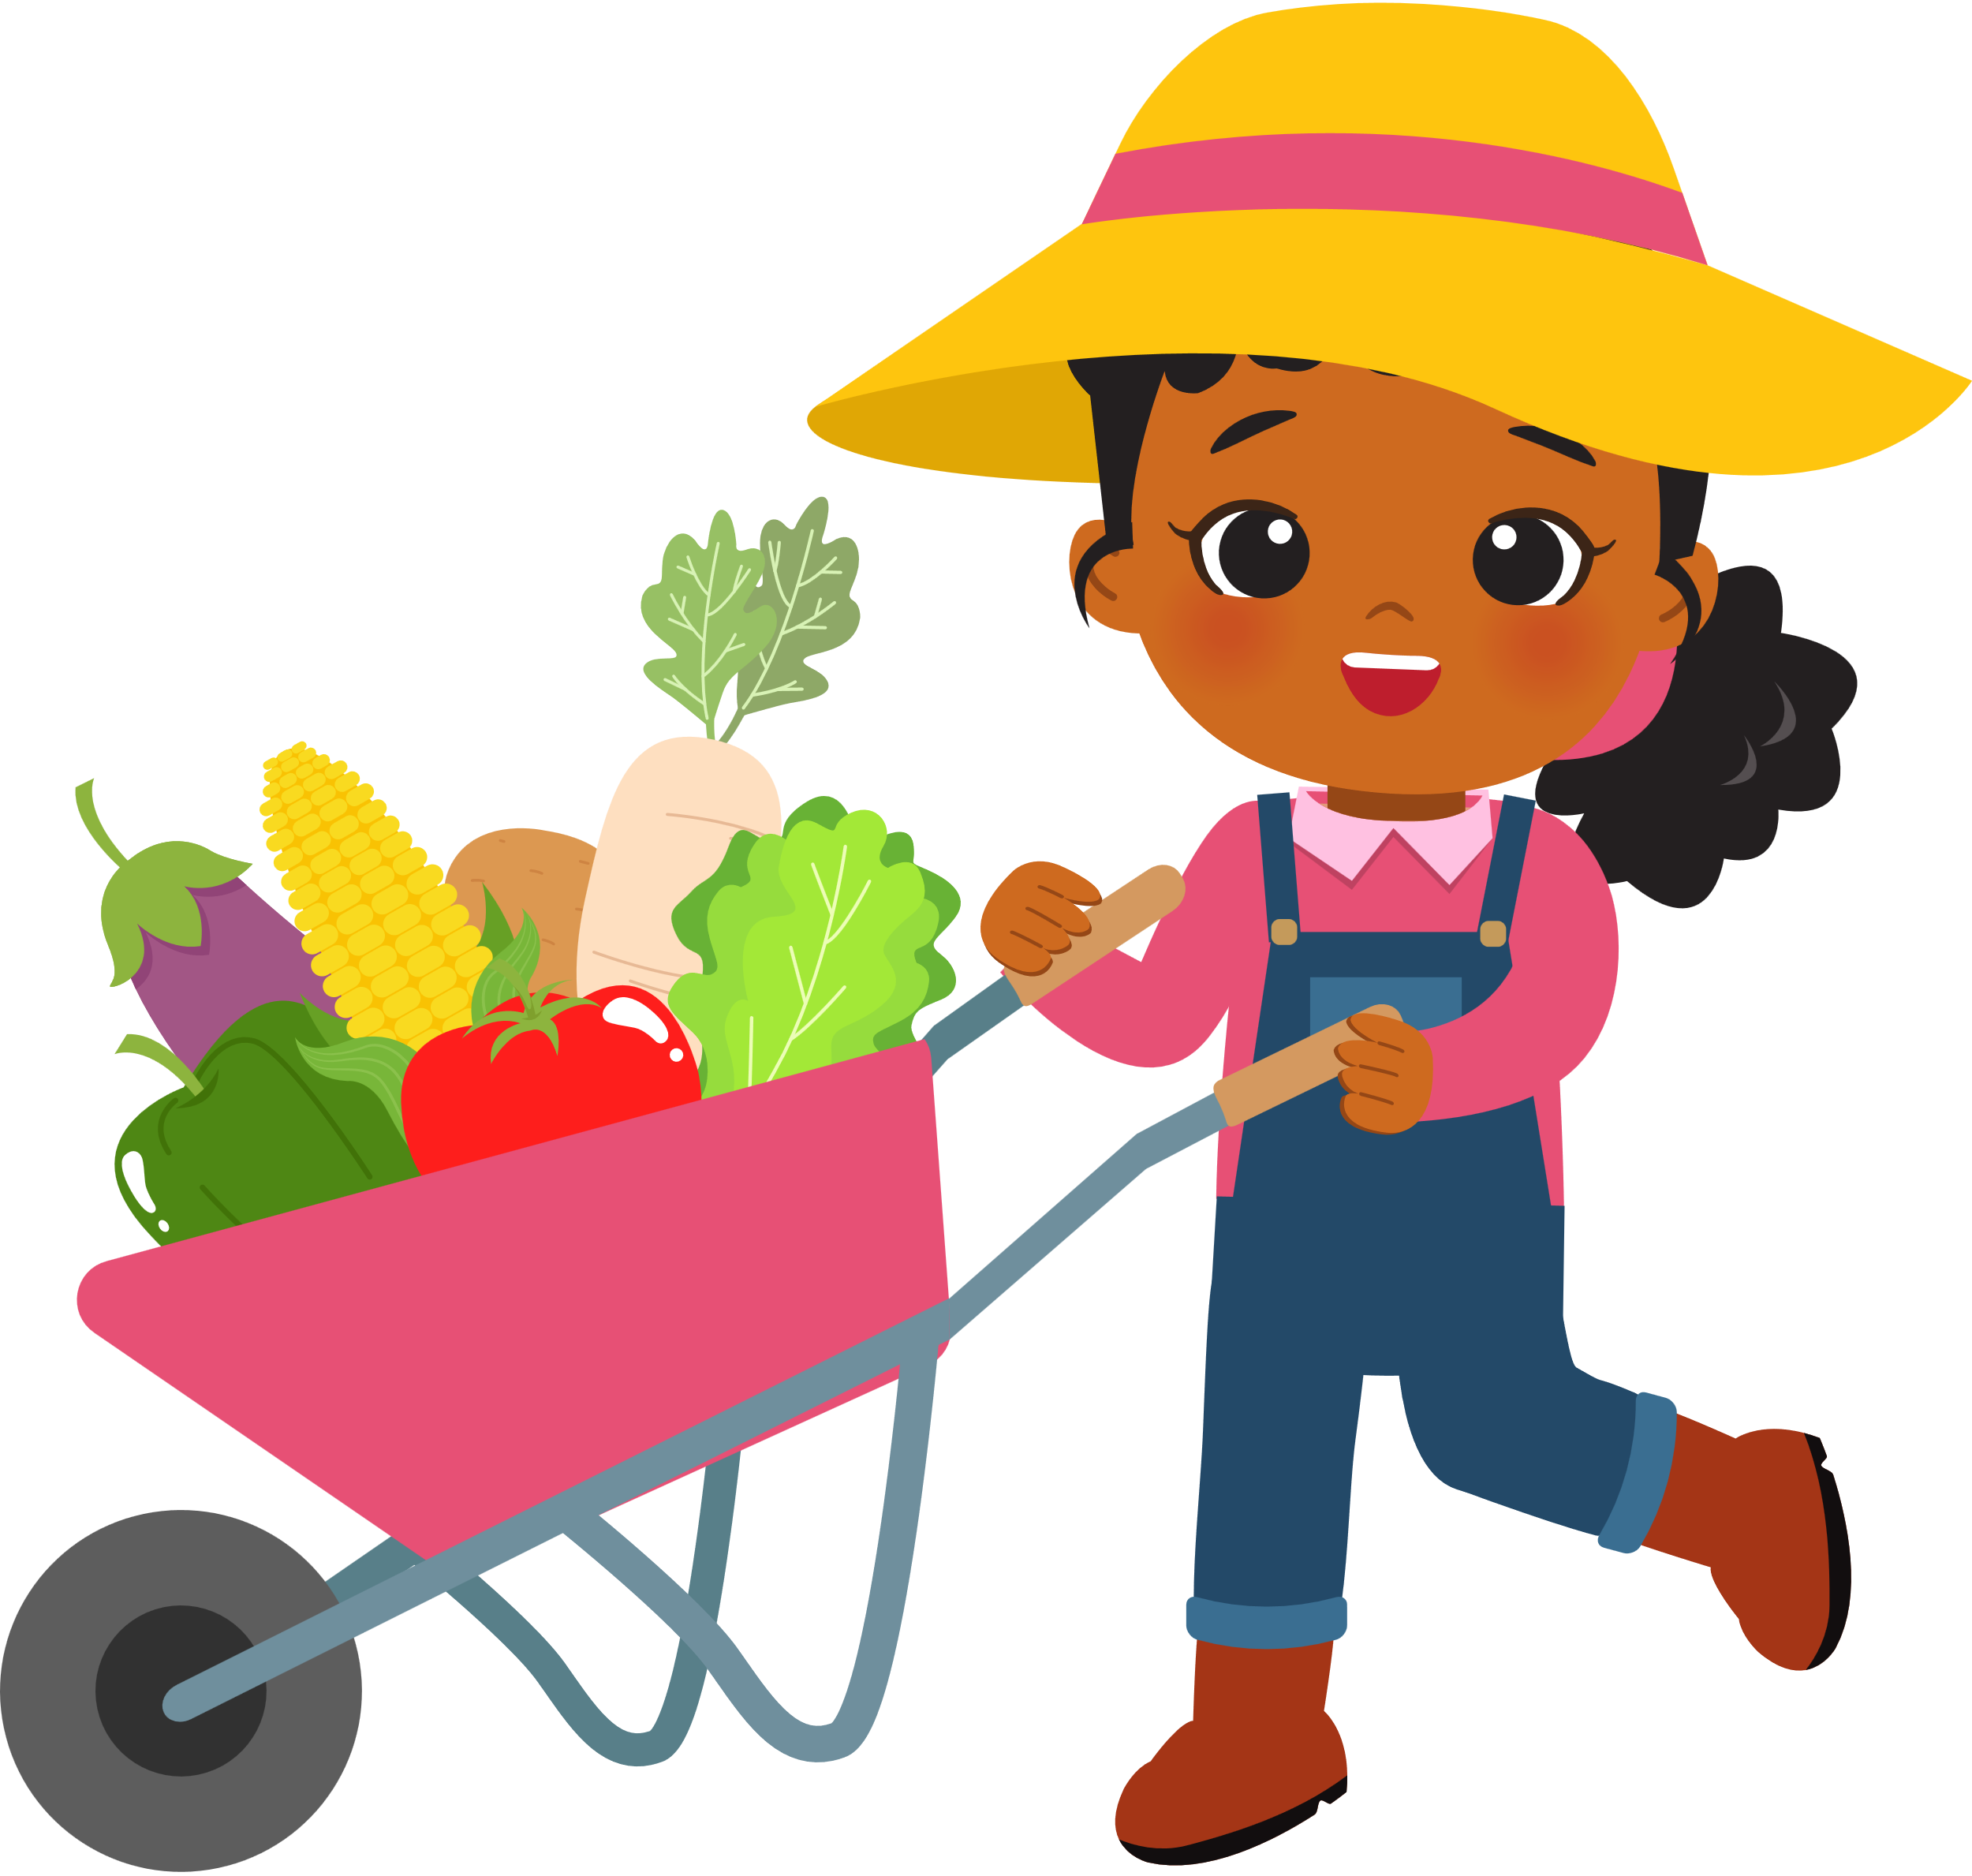

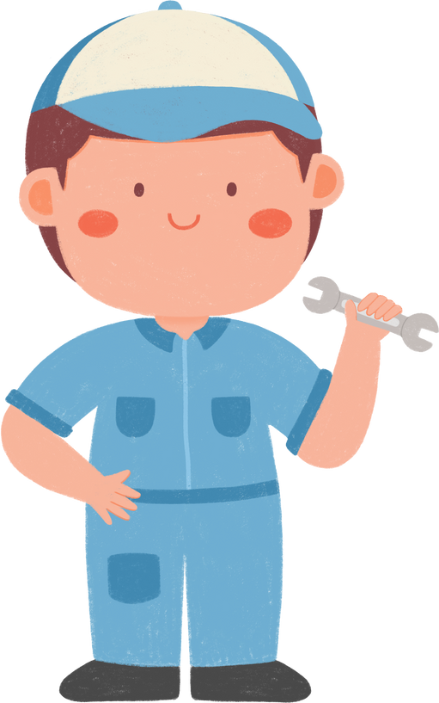
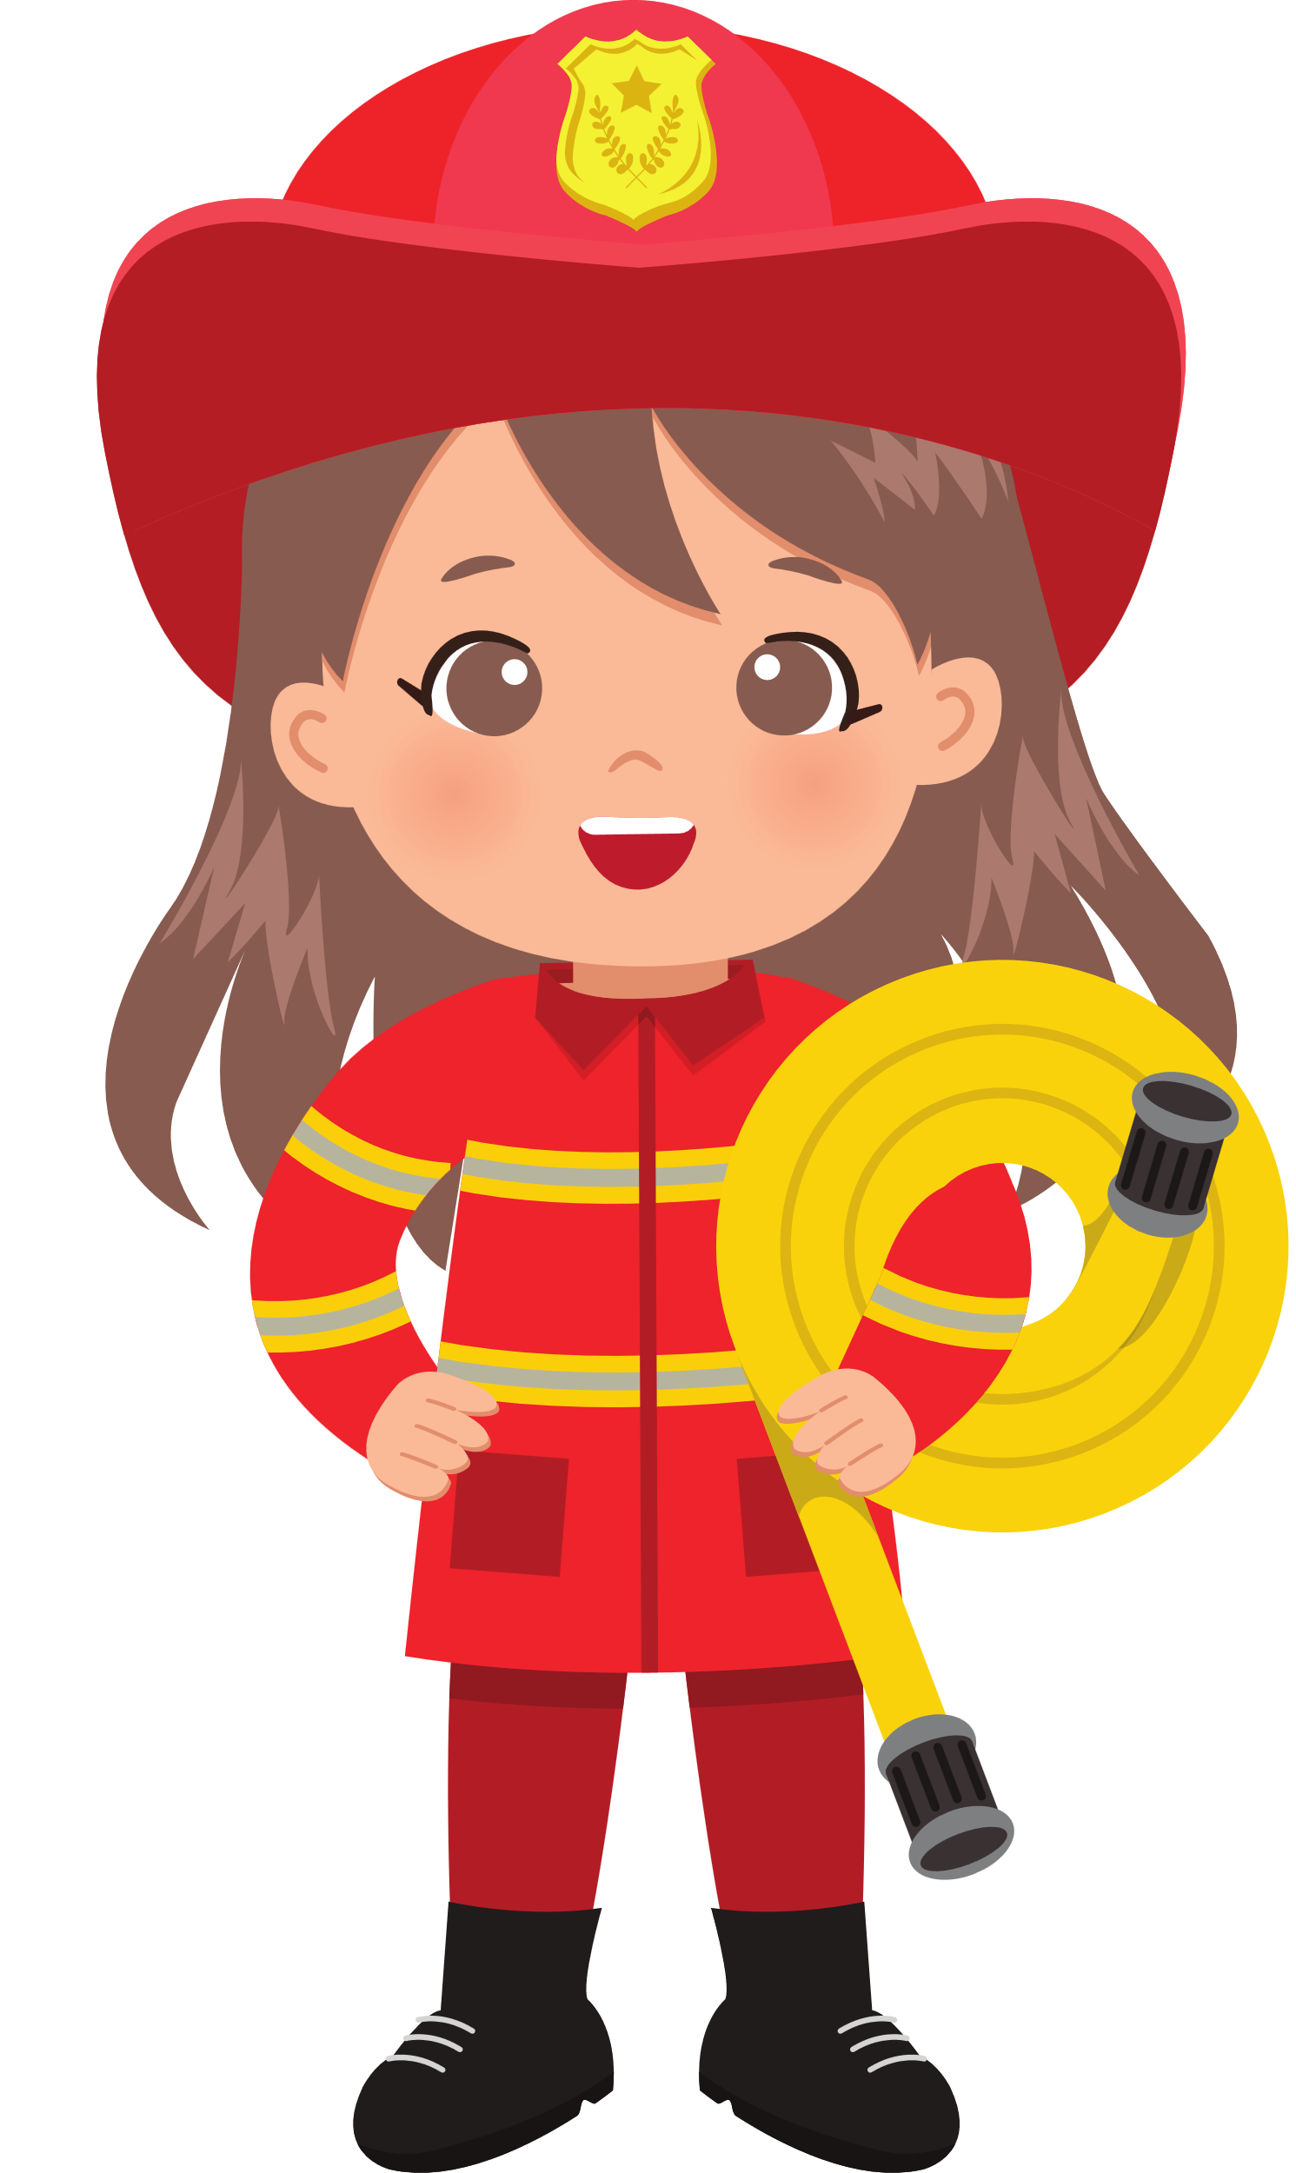
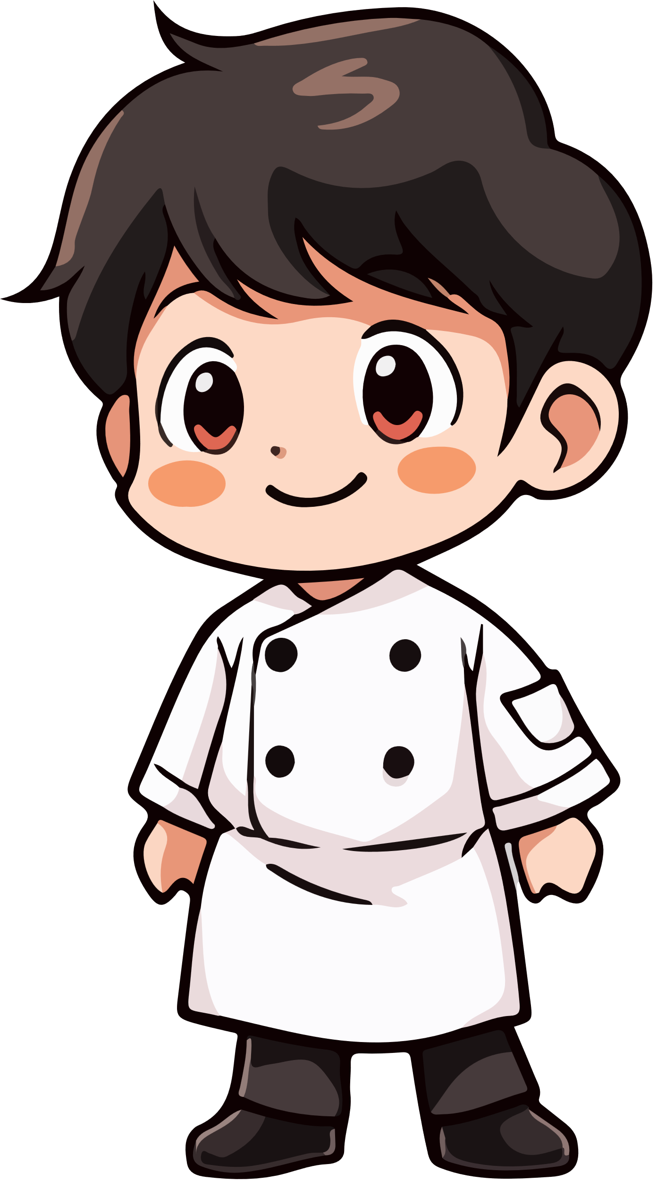


5
My future job
Lesson 1 + lesson 2

Slide 3
I. OBJECTIVES.
By the end of the lesson, pupils will be able to:
1. Language.
- Complete the target sentence patterns about future jobs with the help of picture cues;
- Listen to and complete the song What would you like to be in the future? and to sing it with the correct pronunciation, rhythm and melody.
- Use listen to and understand two communicative contexts in which speakers ask and answer questions about future jobs and tick the correct pictures;
- Complete two conversations with the help of the picture cues;
2. Core competencies.
- Communication and collaboration: work in pairs and groups to complete the learning tasks.
- Self-control & independent learning: perform listening, reading and writing tasks.
3. General competencies.
- Listening: listen and number
- Critical thinking: read and match
- Oral communication: let’s play
- Self-control & independent learning: perform listening tasks
- Communication and collaboration: work in pairs or groups
- Sociability: talk to each other, say good words to others.
4. Attributes.
- Kindness: help partners to complete learning tasks
- Diligence: complete learning tasks
- Honesty: tell the truth about feelings and emotions. - Show their interest in a certain job in the future

Slide 4




Warm-up

Slide 5
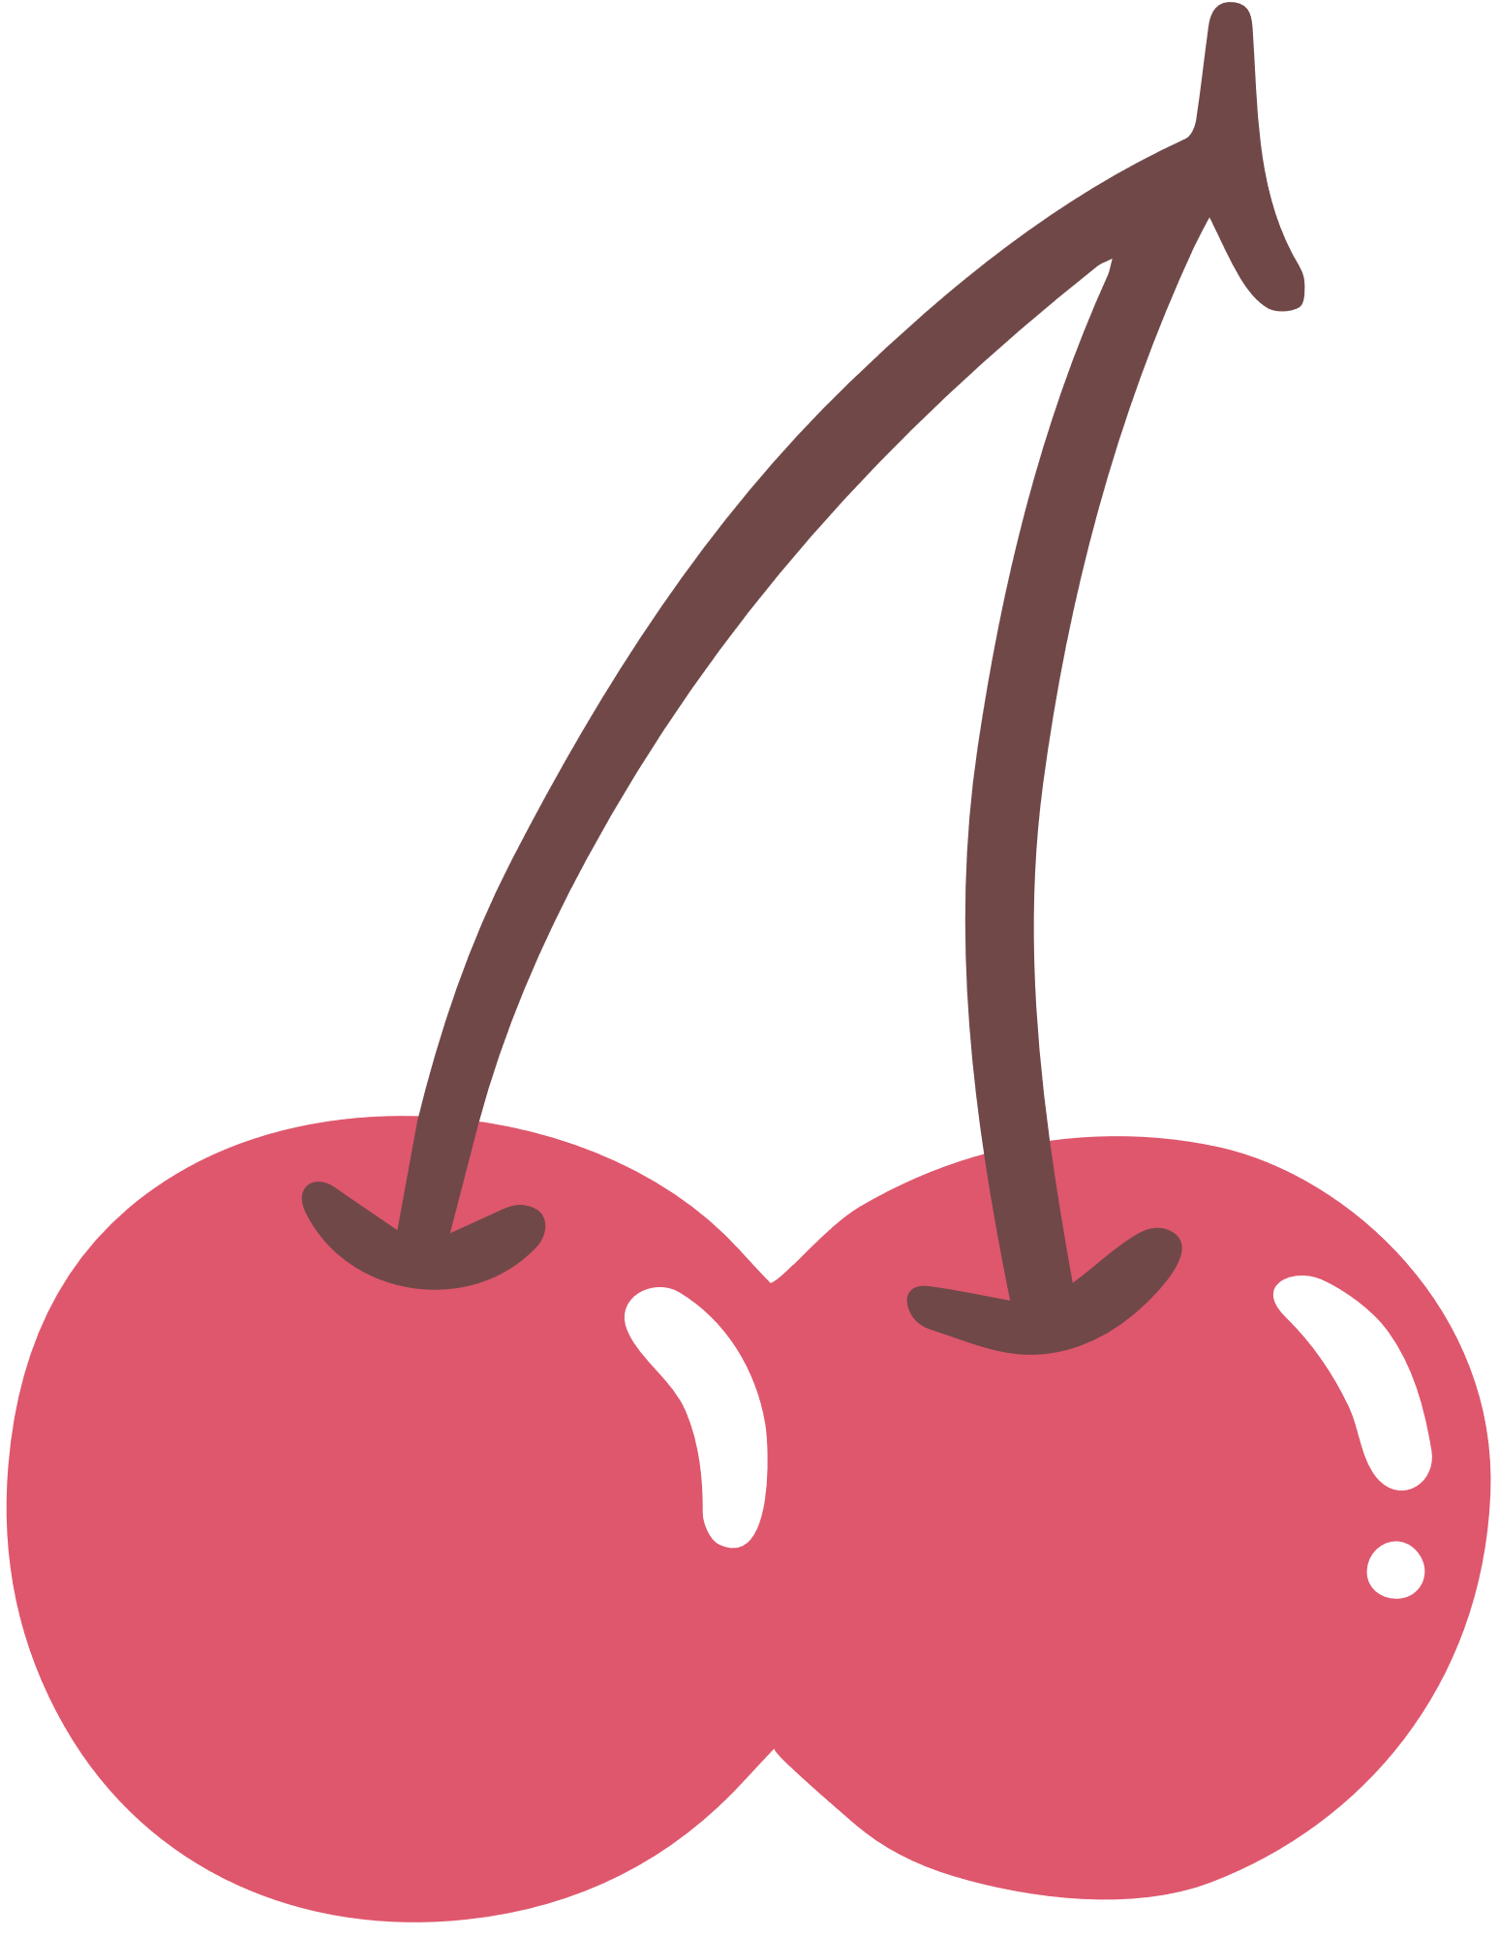










Slide 6

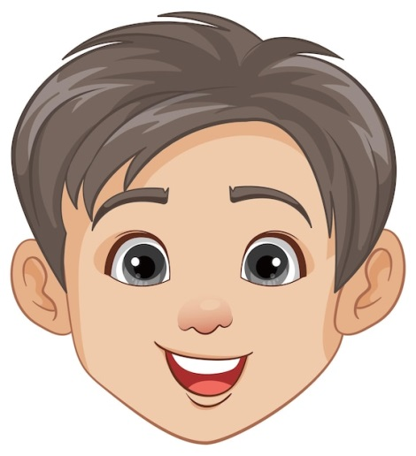




Why would you like to be a teacher?
Because I’d like to …………………………………….
teach children
report the news

Slide 7

Why would you like to be a writer?
Because I’d like to …………………………………….
help sick people
write stories

Slide 8
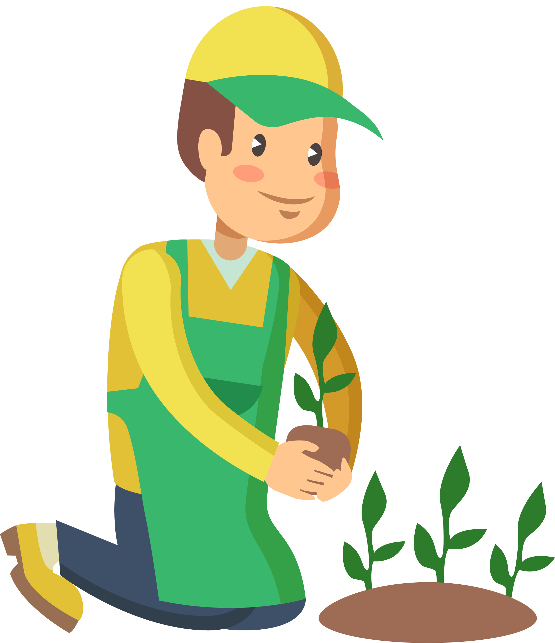
Why would you like to be a gardener?
Because I’d like to …………………………………….
grow flowers
put out fire

Slide 9

Why would you like to be a doctor?
Because I’d like to …………………………………….
help sick people
grow flowers

Slide 10
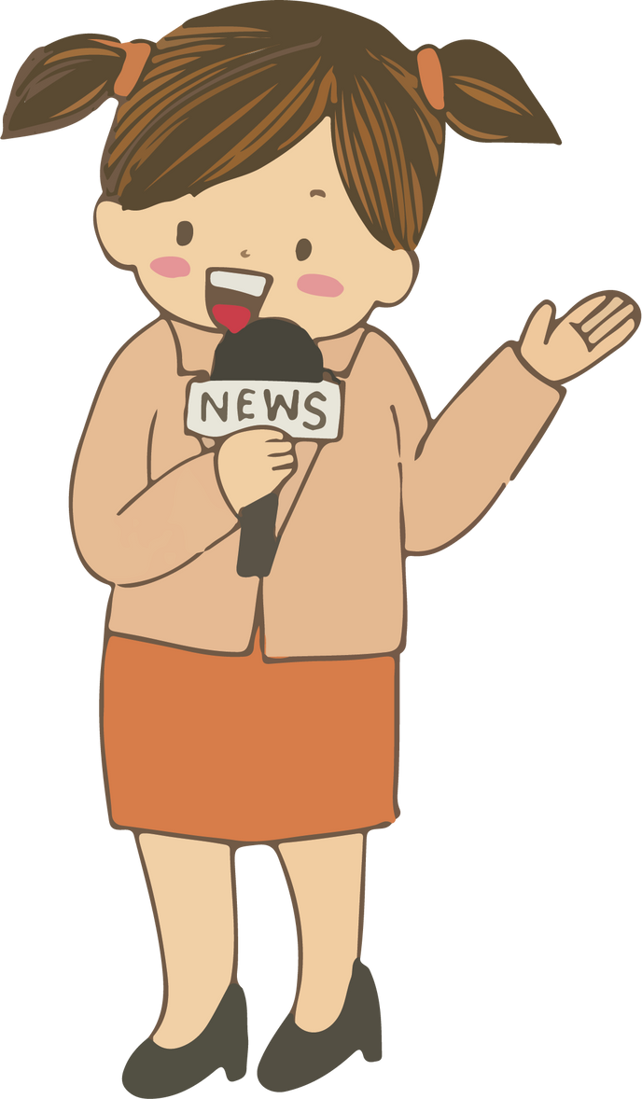
Why would you like to be a reporter?
Because I’d like to …………………………………….
write stories
report the news

Slide 11
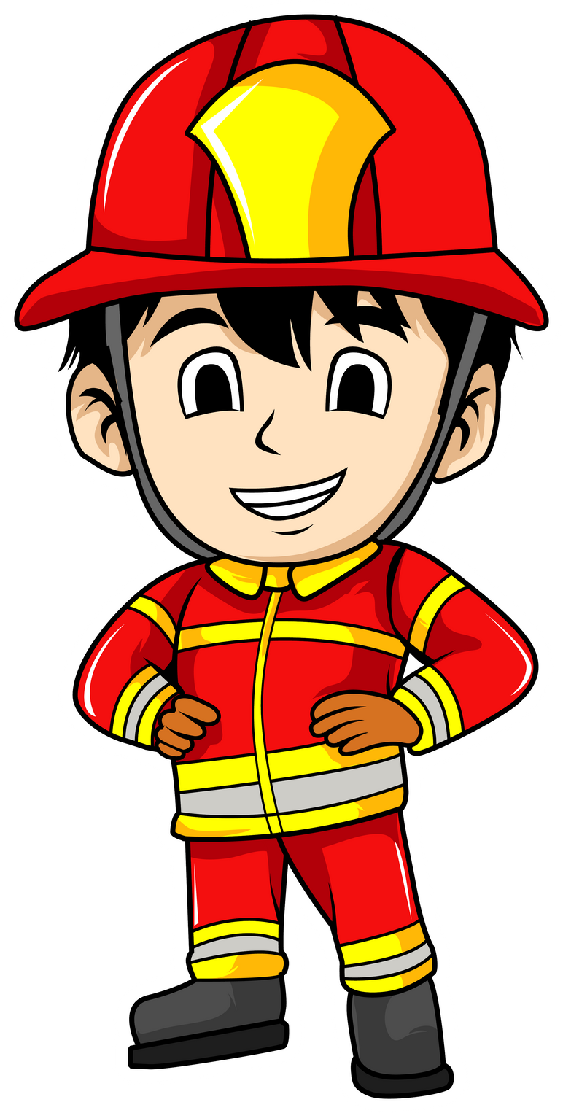
Why would you like to be a firefighter?
Because I’d like to …………………………………….
teacher children
put out fire

Slide 12
5. Read and complete.

Slide 13
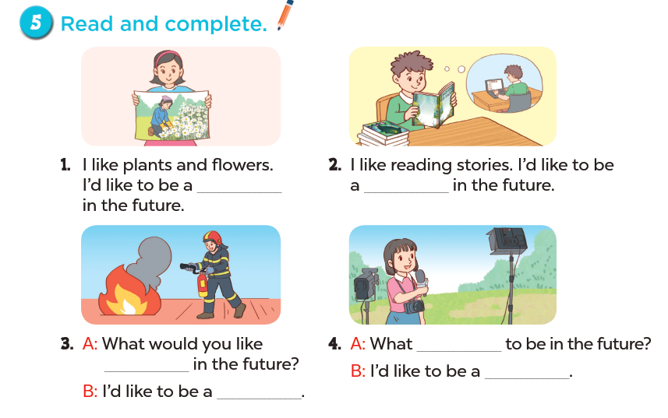

Slide 14
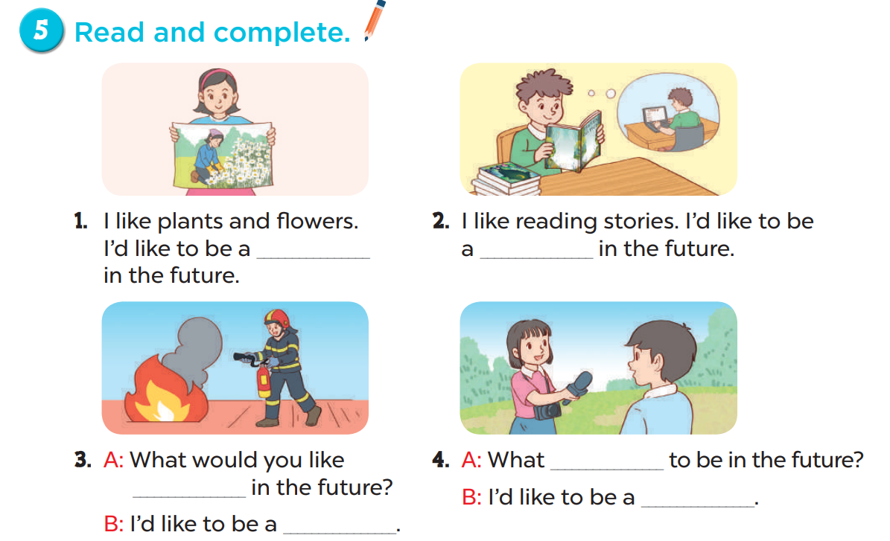
Look and say.
Read and complete.
gardener
writer
would
to be
reporter
firefighter

Slide 15
5. Read and complete.

Slide 16
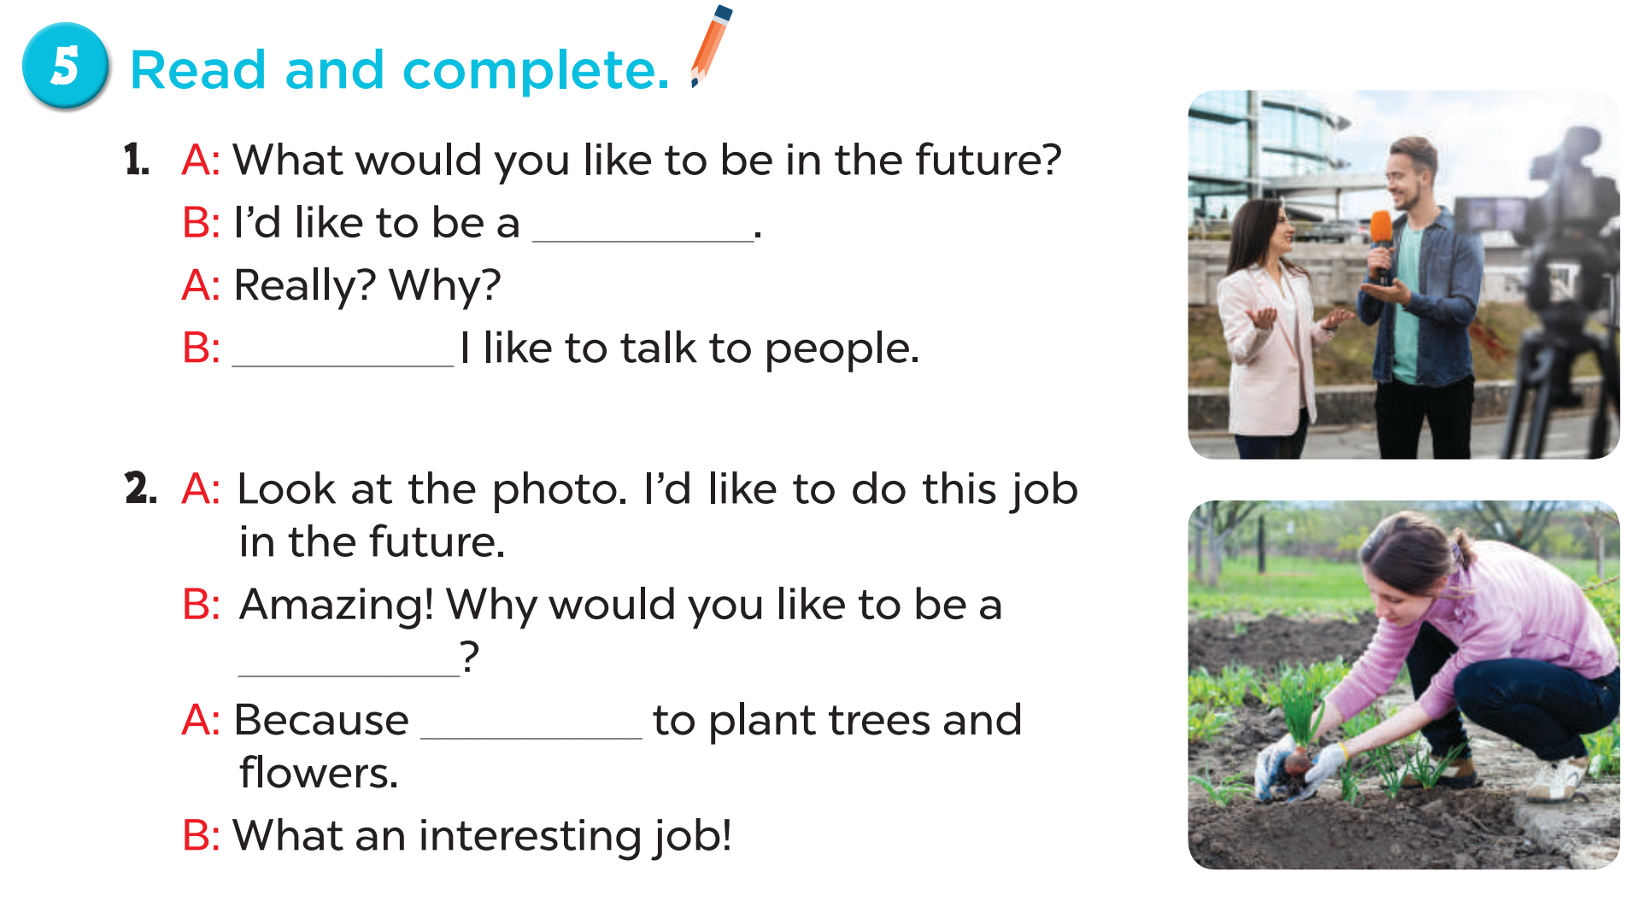
reporter
Because
gardener
I’d like

Slide 17
Fun corner and wrap-up

Slide 18
What would you like to be in the future?
doctor
gardener
teacher
reporter
firefighter
writer

Slide 19
I’d like to grow flowers.
doctor
firefighter
reporter
writer
teacher
gardener

Slide 20
I’d like to report the news.
doctor
firefighter
reporter
writer
teacher
gardener

Slide 21
I’d like to write stories.
doctor
firefighter
reporter
writer
teacher
gardener

Slide 22
I’d like to teach children.
doctor
firefighter
reporter
writer
teacher
gardener

Slide 23
I’d like to help sick people.
doctor
firefighter
reporter
writer
teacher
gardener

Slide 24
I’d like to put out the fire.
doctor
firefighter
reporter
writer
teacher
gardener

