Slide 2









Our Home
Lesson 2

Slide 3
Lesson 2

Slide 4

I. OBJECTIVES.
By the end of this lesson, pupils will be able to:
Knowledge and skills.
- understand and correctly repeat the sentences in two communicative contexts focusing on asking and answering questions about someone’s home and address;
- listen to and understand two communicative contexts in which speakers ask and answer questions about their addresses and circle the correct pictures
- correctly say the words and use
What’s your address?
It’s ____.
to ask and answer questions about someone’s address.
- use What’s your address?
It’s __________. to ask and answer questions about someone’s address.
- use
Do you live in ___? Yes, / No, ___. and What’s your address? – It’s ____. in a freer context.
2. Competences.
- Critical thinking and creativity: learn how to ask and answer questions about someone’s favourite things correctly and fluently.
- Communication and collaboration: work in pairs and groups to complete the learning tasks.
- Self-control & independent learning: perform pronunciation and speaking tasks.
3. Attributes.
- Show their pride in their personal information and where they live.
Notes:
- T numbers SS in each team
- T call out a number, ss with that number stand up and say the answee
- SS who have the fastest and correct answer will get 2 points, the slower correct answer will get 1 point

Slide 5

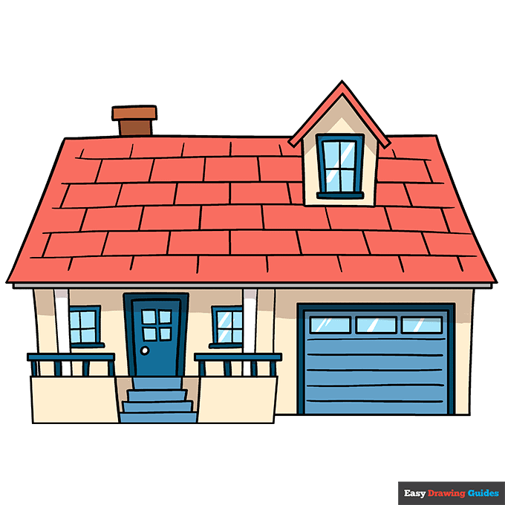
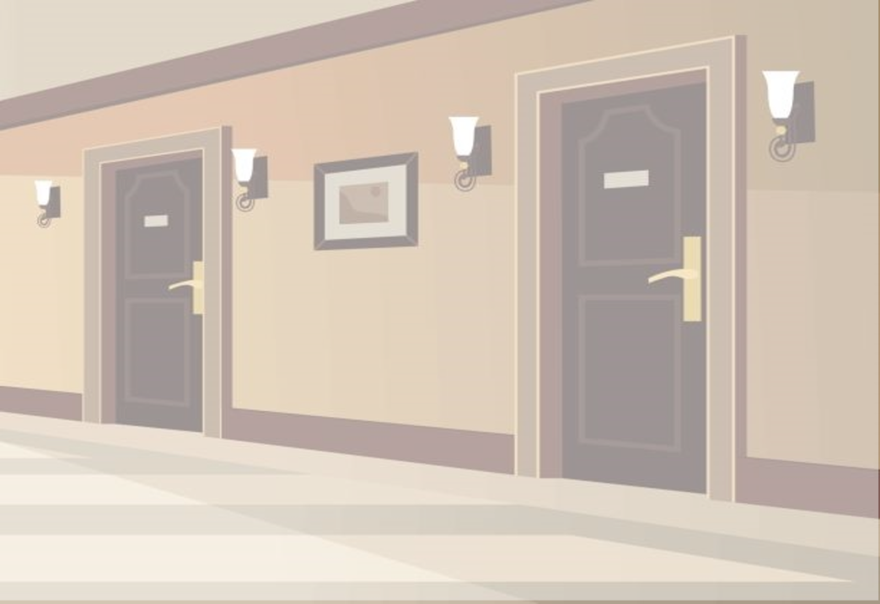
I live in a tower.
z
A
B
C

Slide 6



I live in a building.
z
A
B
C

Slide 7
I live in a flat.
z
A
B
C

Slide 8
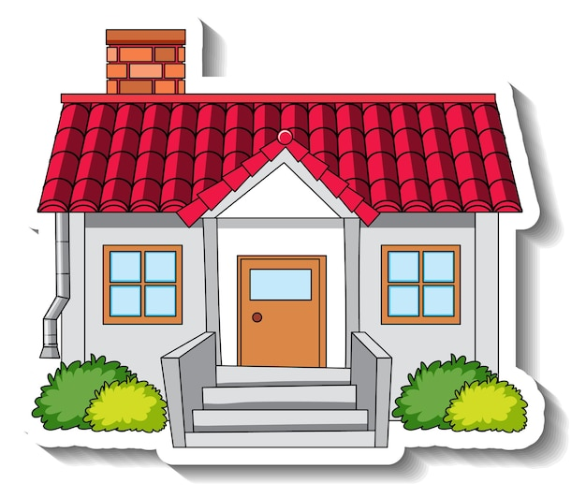
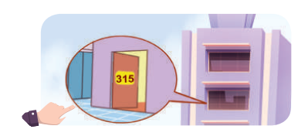
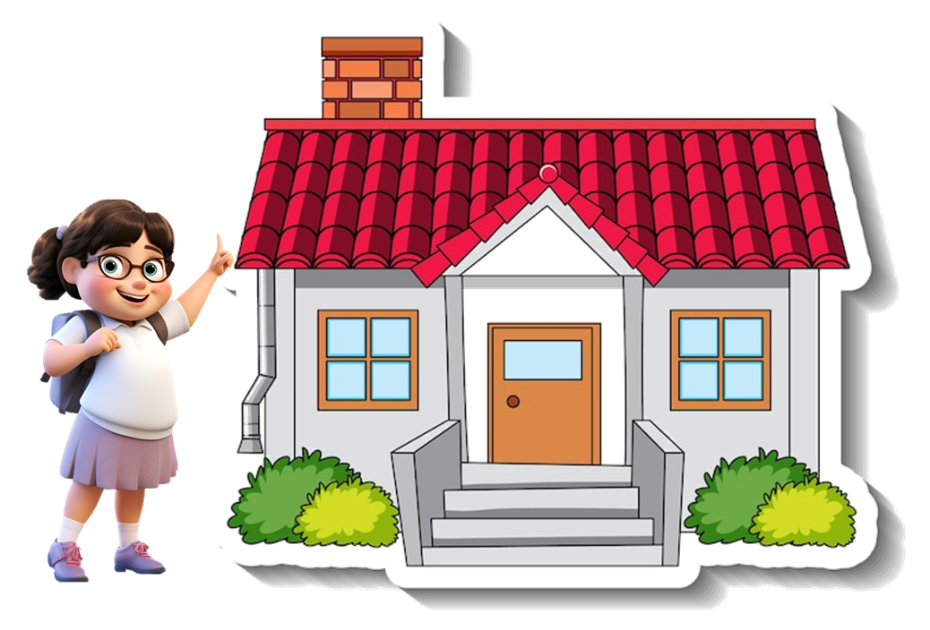
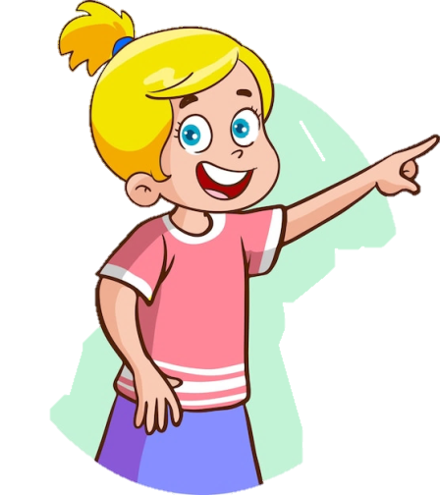

I live in that house.
A
B
C

Slide 9
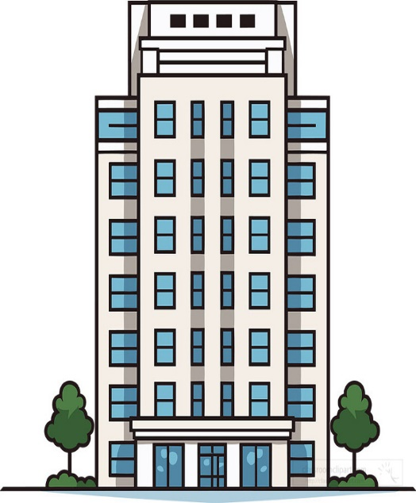
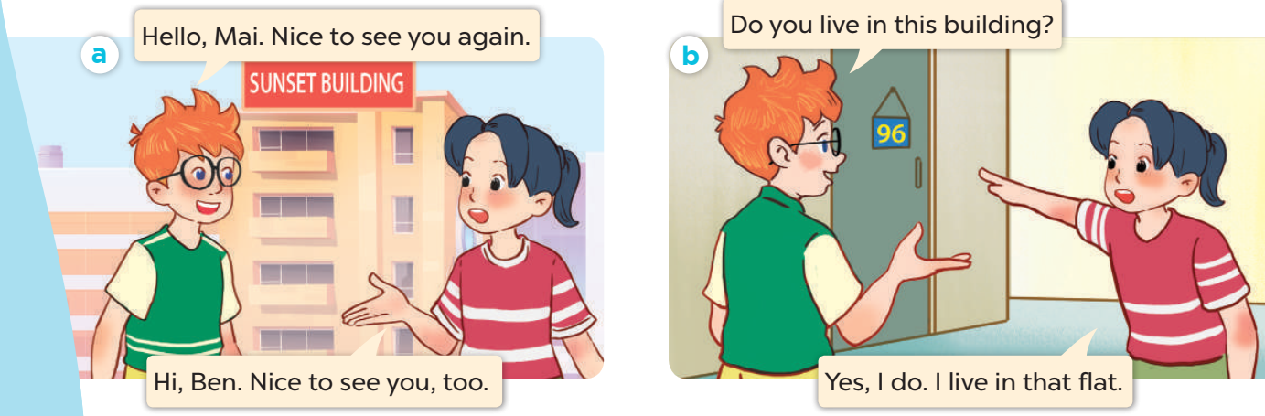
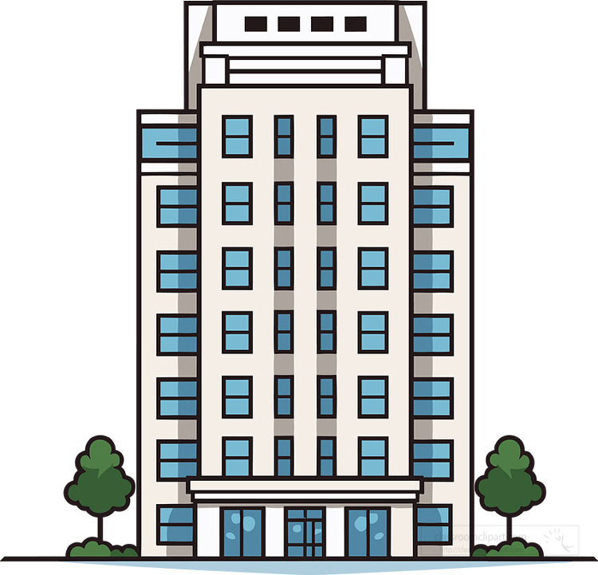
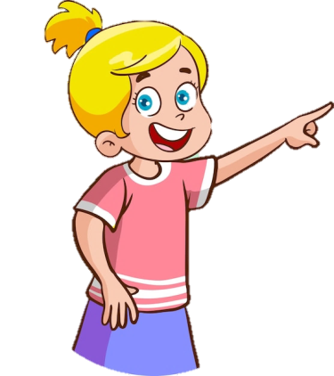
I live in this building.
A
B
C

Slide 10
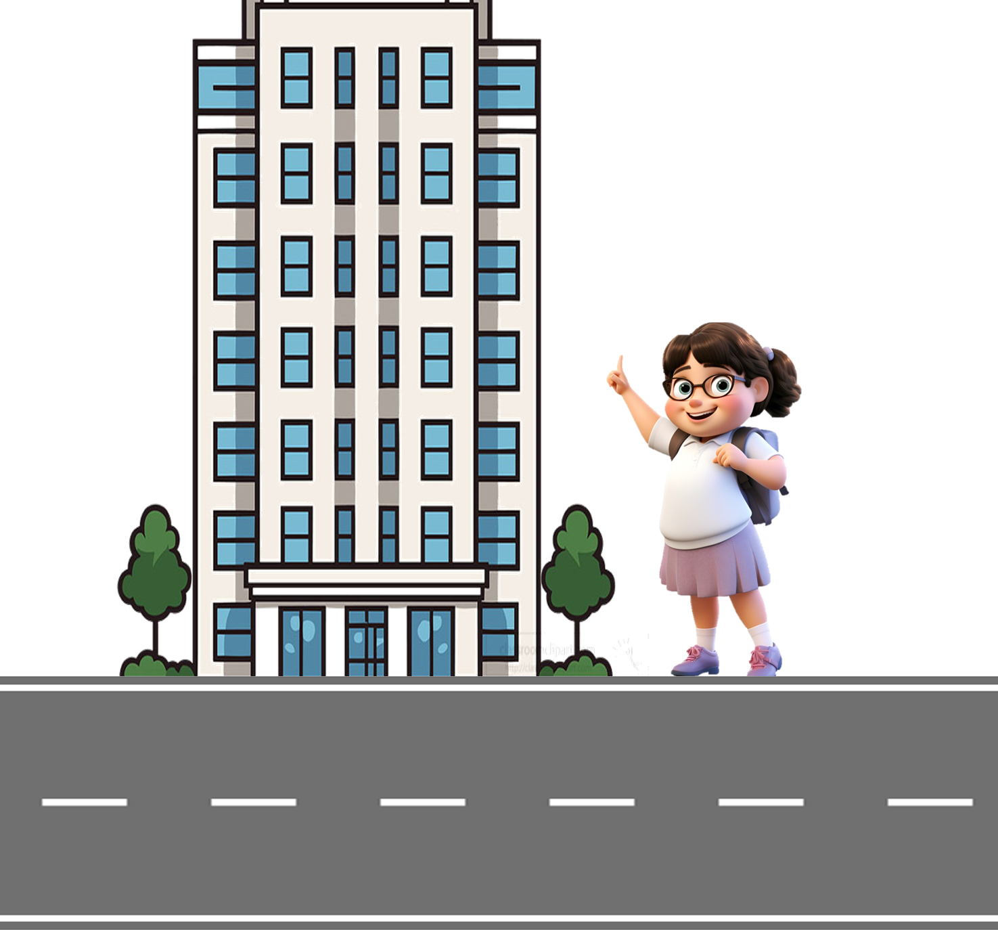
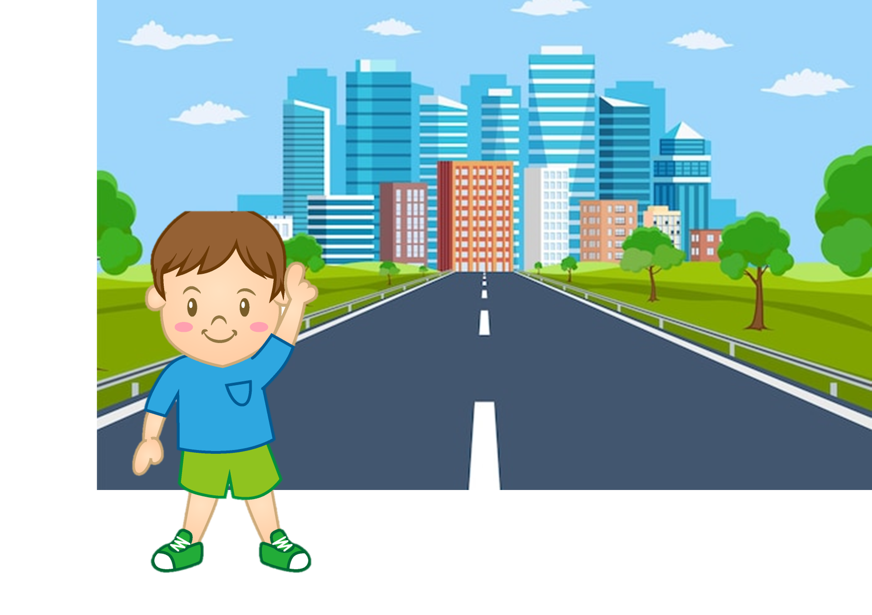
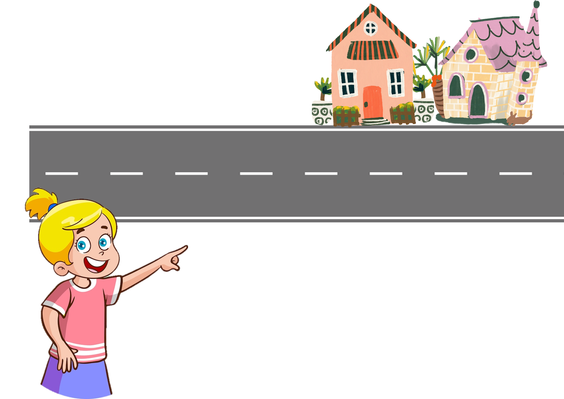
I live in that tower.
z
A
B
C

Slide 11
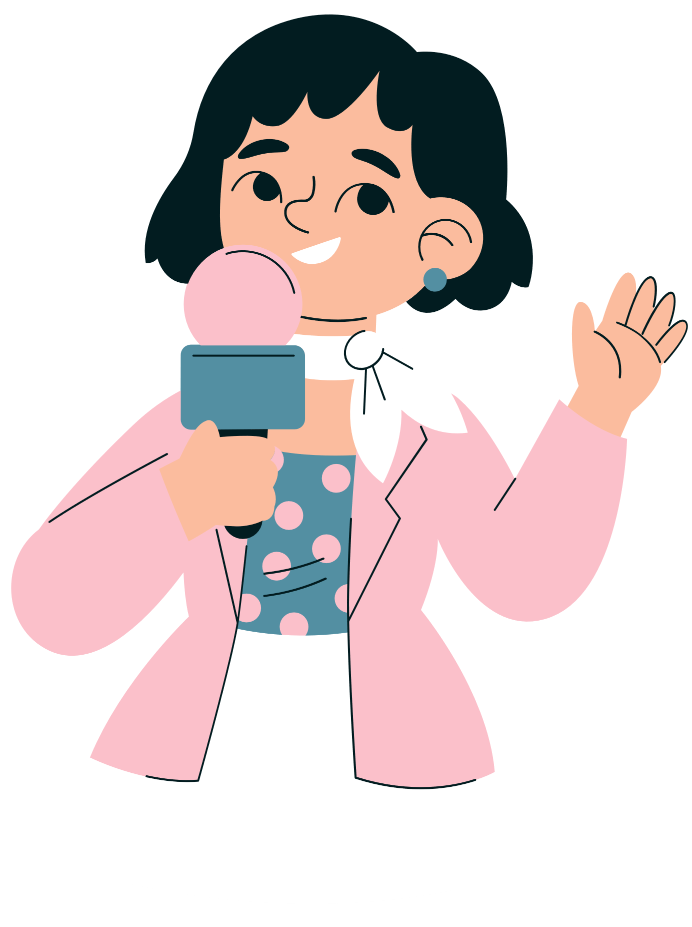
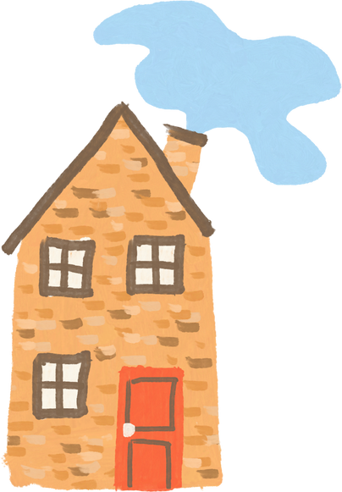
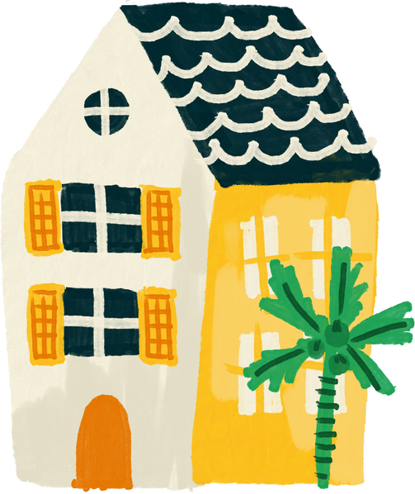
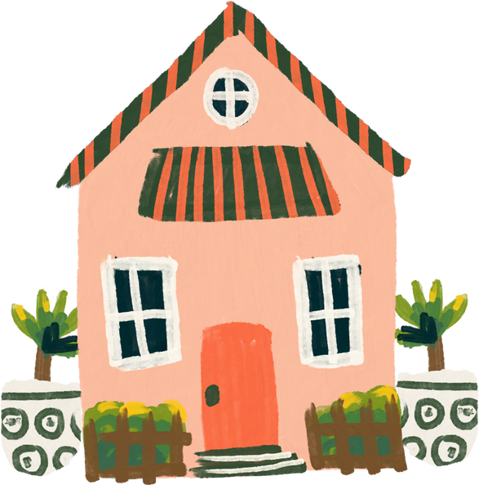
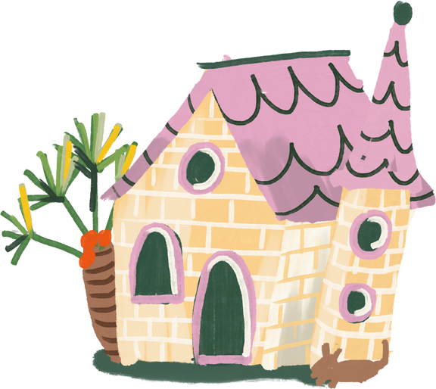
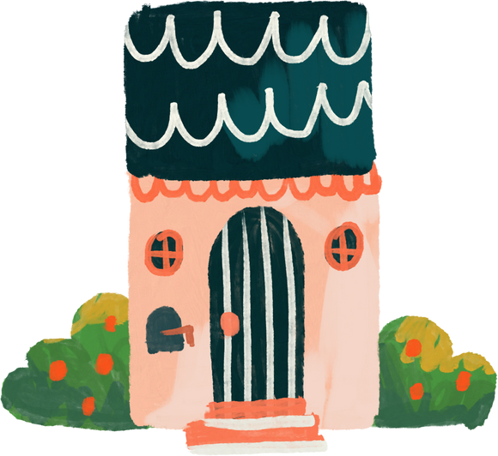
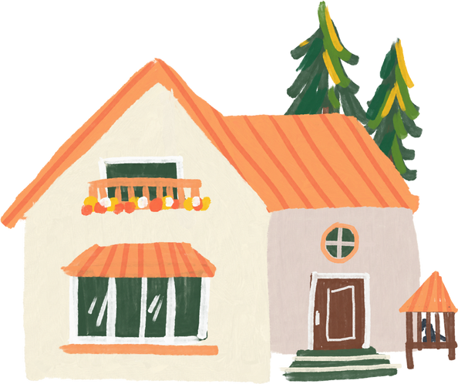
Review
Numbers 1 - 100

Slide 12

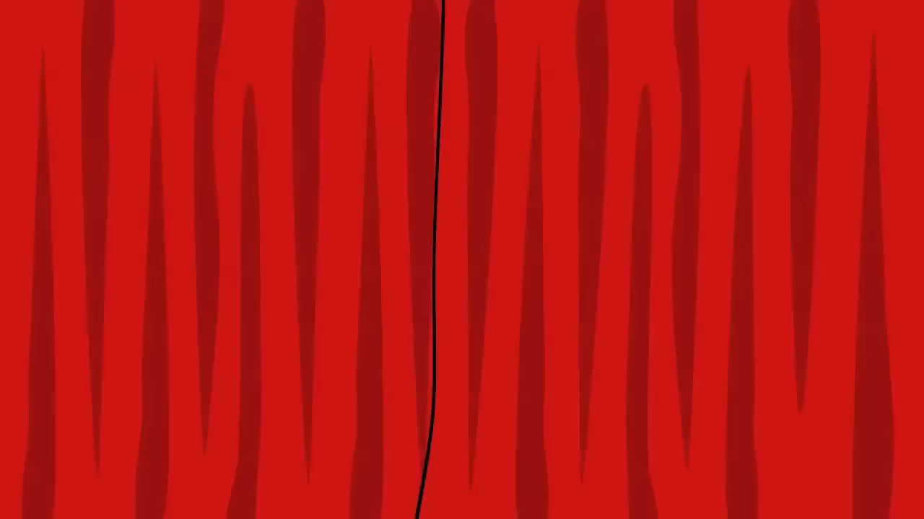
Numbers 1-20

Slide 13
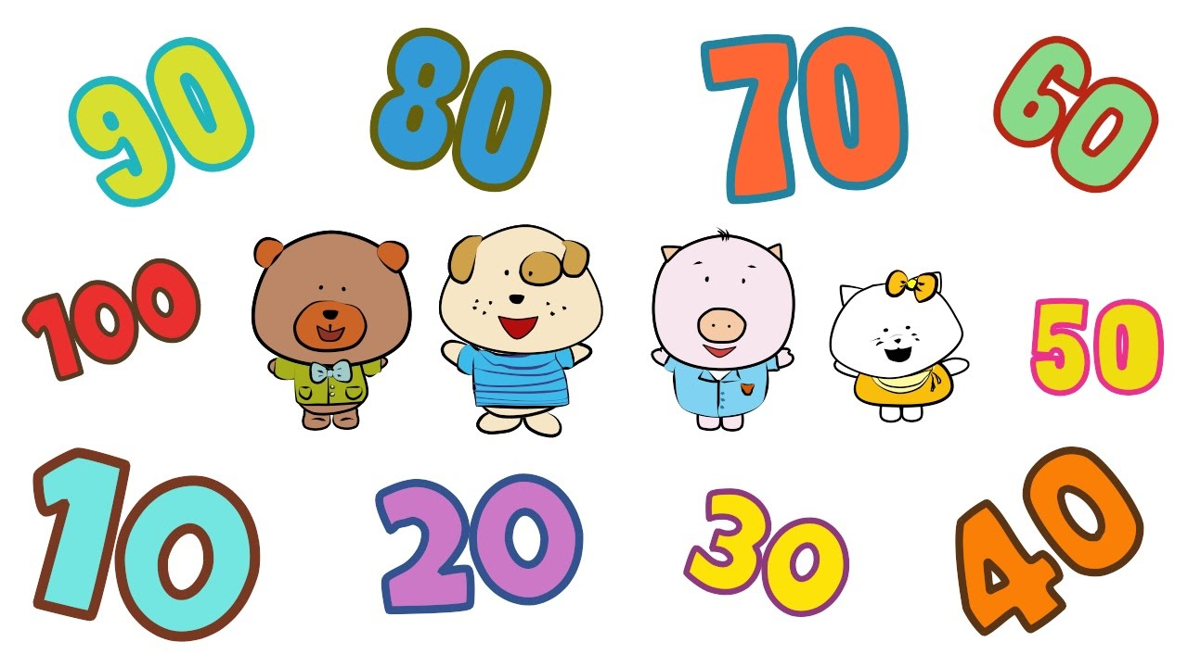

Count by tens to 100

Slide 14

How to say a number?
= 60 and 5
sixty-five

Slide 15

How to say a number >100
= one-one-six

Slide 16
Let's say the numbers!
74
55
37
91
42
245
126
168
29
383

Slide 17
1
Look, listen and repeat.
Notes:
- T numbers SS in each team
- T call out a number, ss with that number stand up and say the answee
- SS who have the fastest and correct answer will get 2 points, the slower correct answer will get 1 point

Slide 18
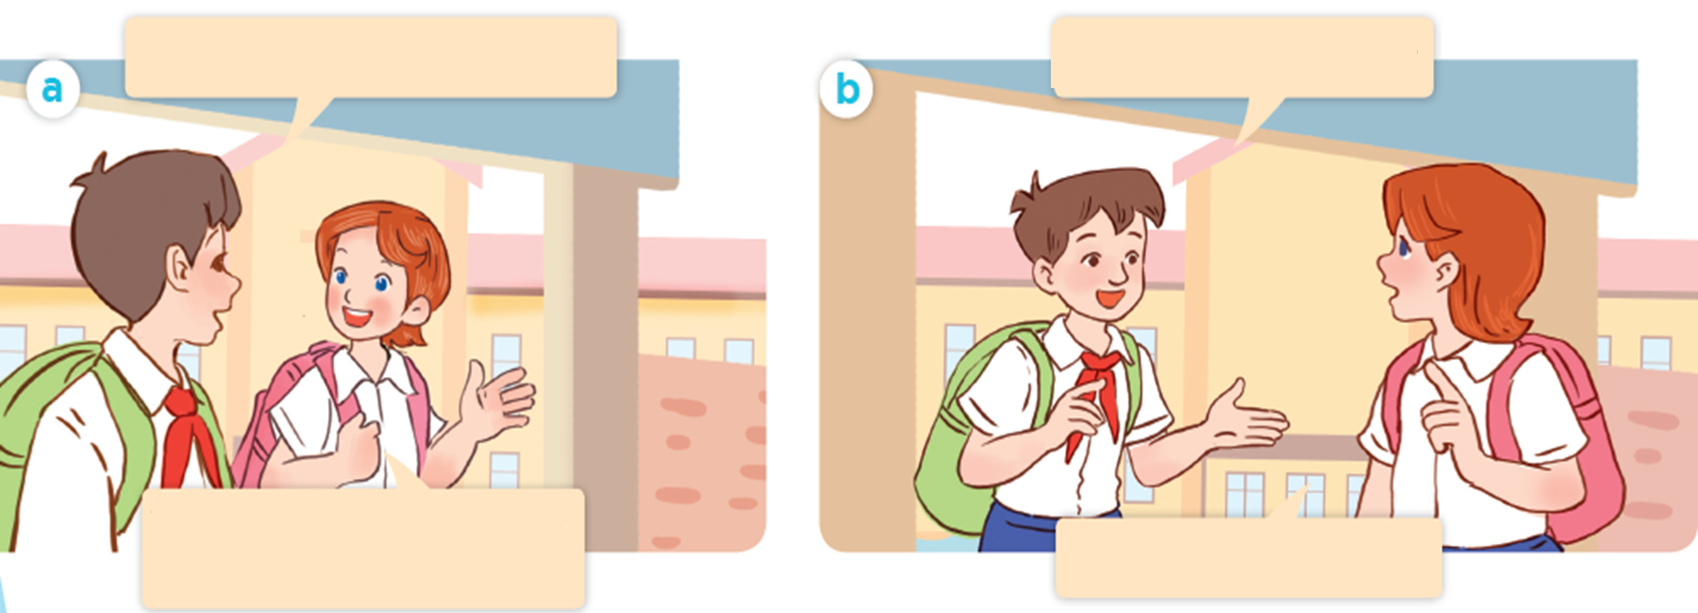
Where are they going?
Look! Where are they?

Slide 19


Look, listen and repeat.
Do you live near the school?
Yes, I do. I live about one
kilometre from here.

Slide 20
Look, listen and repeat
What's your address?
It's 45 Ba Trieu Street.

Slide 21
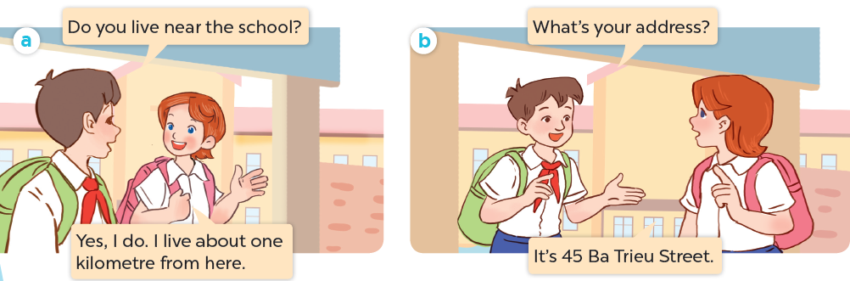
Look, listen and repeat

Slide 22
What's your address?
It's 45 Ba Trieu Street.

Slide 23
Vocabulary
Notes:
- T numbers SS in each team
- T call out a number, ss with that number stand up and say the answee
- SS who have the fastest and correct answer will get 2 points, the slower correct answer will get 1 point

Slide 24
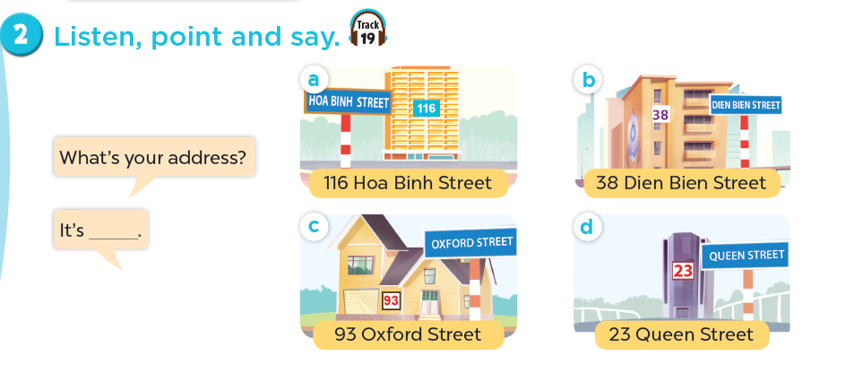

Slide 25
116 Hoa Binh Street

Slide 26
38 Dien Bien Street

Slide 27
93 0xford Street

Slide 28
23 Queen Street

Slide 29
2
Listen, point and say.
Notes:
- T numbers SS in each team
- T call out a number, ss with that number stand up and say the answee
- SS who have the fastest and correct answer will get 2 points, the slower correct answer will get 1 point

Slide 30
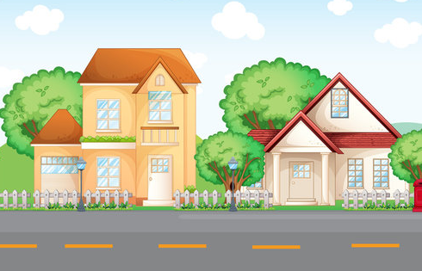

What's your address?
Ba Trieu
45
It's 45 Ba Trieu street.

Slide 31

What's your address?
Queen
134
It's 134 Queen street.

Slide 32
What's your address?
It's _______ street.

Slide 33
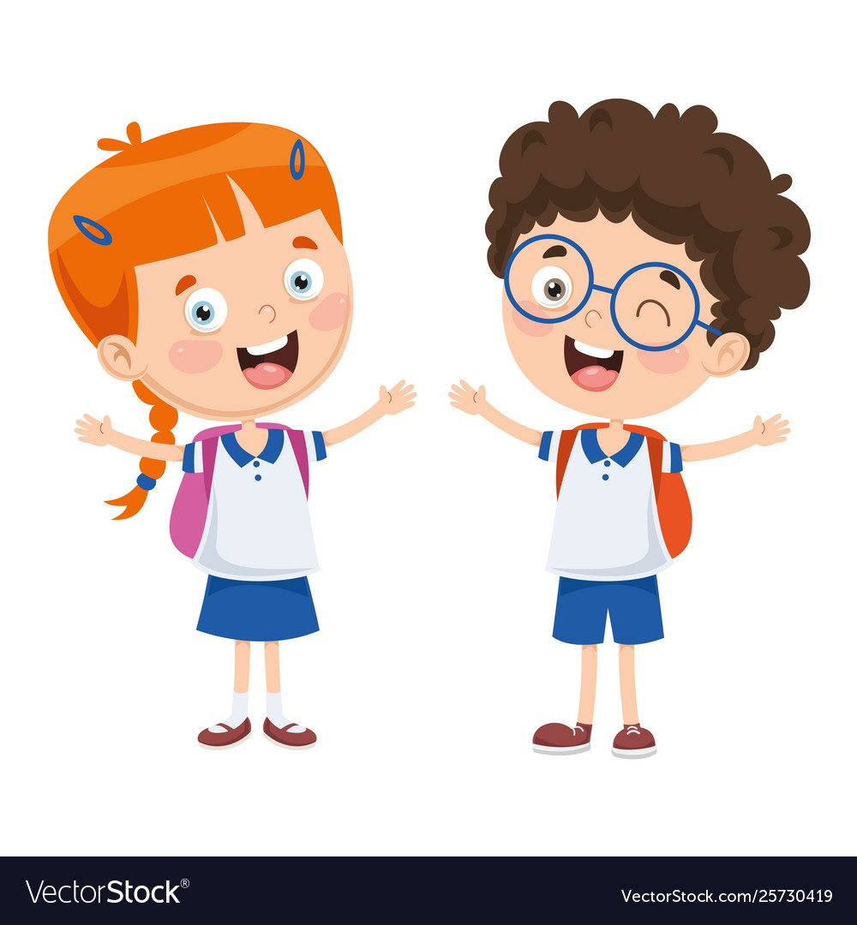
Listen, point and say.
What's your address?
It's 116 Hoa Binh Street.
116 Hoa Binh Street

Slide 34
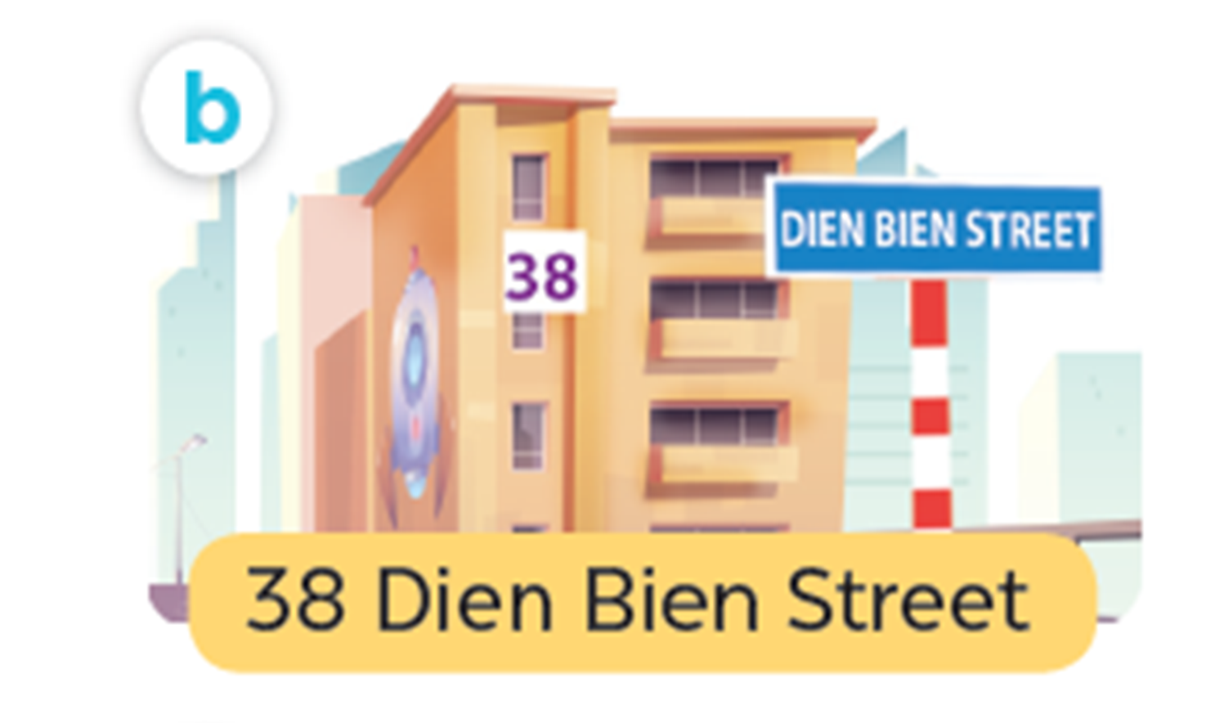
Listen, point and say.
What's your address?
It's 38 Dien Bien Street.
38 Dien Bien Street

Slide 35
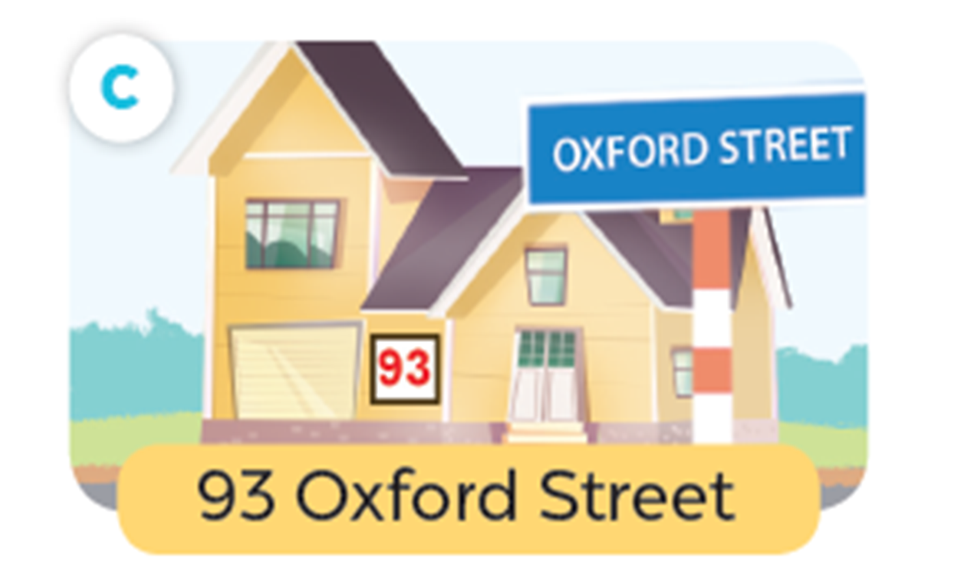
Listen, point and say.
What's your address?
It's 93 Oxford Street.
93 0xford Street

Slide 36
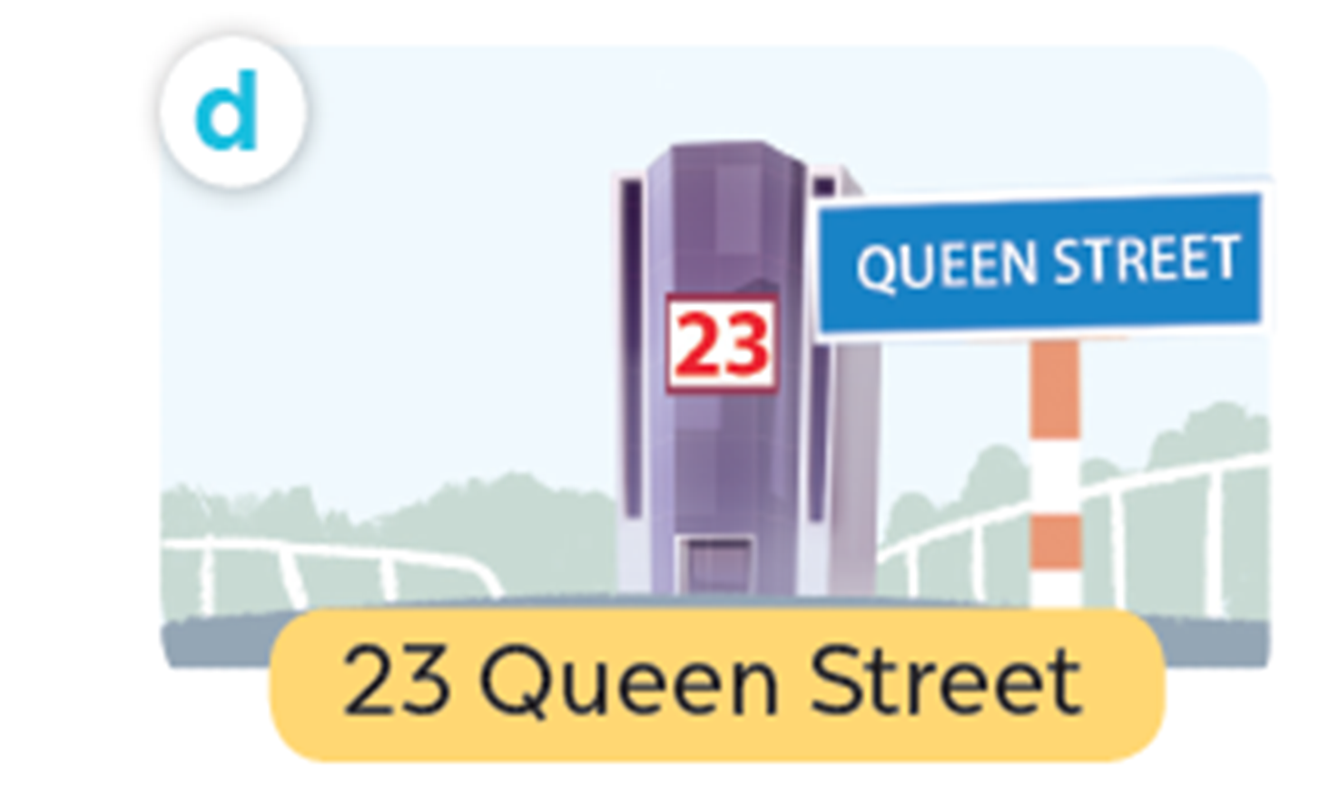
Listen, point and say.
What's your address?
It's 23 Queen Street.
23 Queen Street

Slide 37
Work in pairs. Practise.
What’s your address ?
116 Hoa Binh Street
38 Dien Bien Street
It’s ______ .
93 Oxford Street
23 Queen Street

Slide 38
4
Listen and circle.

Slide 39
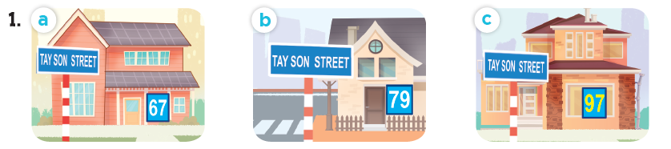
Look and say the number.
sixty-seven
seventy-nine
ninety-seven

Slide 40
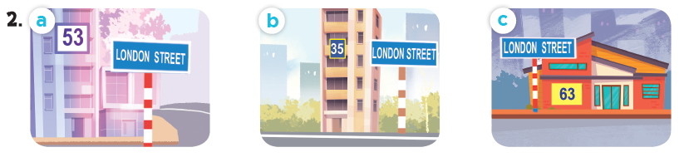
Look and say the number.
fifty-three
thirty-five
sixty-three

Slide 41
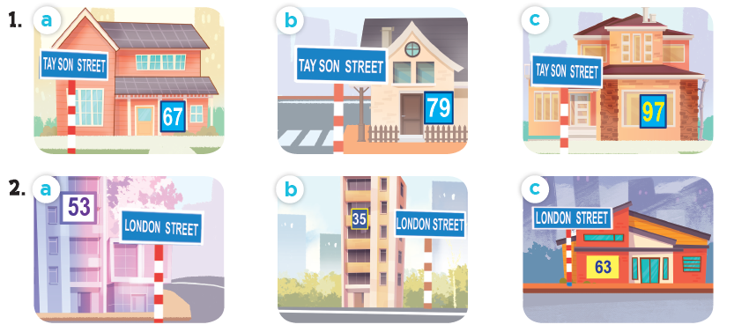
Listen and circle.

Slide 42
Fun corner and wrap-up
Notes:
- T numbers SS in each team
- T call out a number, ss with that number stand up and say the answee
- SS who have the fastest and correct answer will get 2 points, the slower correct answer will get 1 point

Slide 43


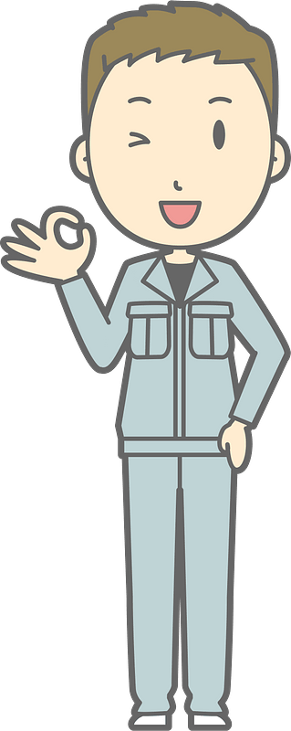
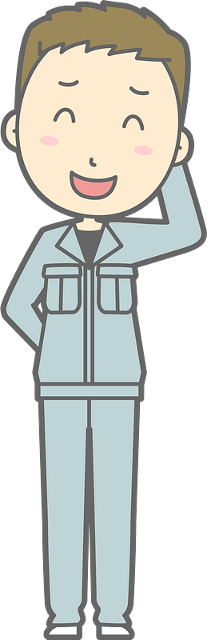

Bad
Luck
Billy
Notes:
This template is for educational, non-commercial purposes only. For more free game templates like this one, visit https://www.taysteachingtoolkit.com

Slide 44




This is Billy.
He has bad luck.

Slide 45

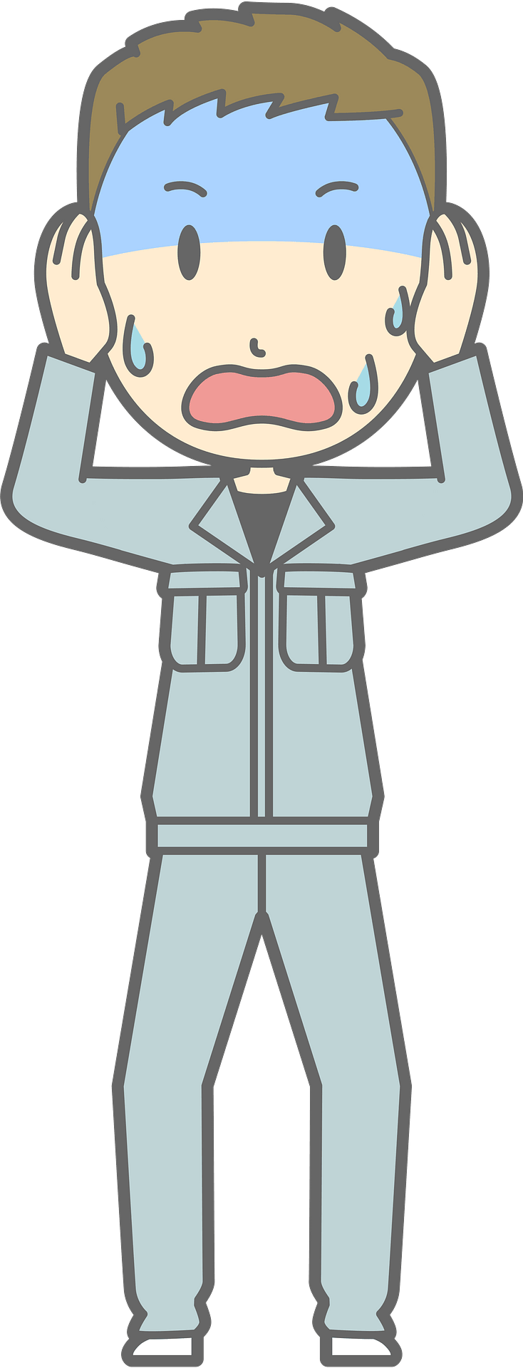
Dark clouds like to follow him…

Slide 46


…and strike him with lightning!
Notes:
Skeleton image designed by creazilla.com

Slide 47
Don’t worry,
Billy is okay…

Slide 48
…but, don’t have
bad luck like Billy.

Slide 49

How to play:
Everyone stands up.
One person reads the question on the screen.
Then, the next person goes.
If Billy is struck by lightning when you’re reading, you’re out (sit down).
The last person standing is the winner!
Notes:
TEACHER NOTES:
When I say ”Then, the next person goes.” I mean the next person reads the same word/sentence on the screen. The order of students reading is up to you and what makes the most sense for your class.
Feel free to adjust the instructions as needed for your class.
Skeleton image designed by creazilla.com

Slide 50
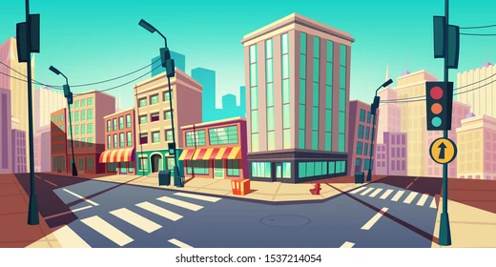

What's your address?
Ready?
67
Notes:
TEACHER NOTES:
Replace the text in the box with your key vocabulary/sentences.
OR if you want to make it into a speaking activity, delete the text and put an image in the box.
When playing the game, click/press the spacebar to send in the dark clouds.
Students start reading the text in the box after the dark cloud music stops.
Lightning will strike automatically after the dark clouds appear, no need to click again. The time when it strikes is different on each slide (view the animation pane to view or change the timing).
After the lightning strikes Billy and the student reading sits down, click/press the spacebar to go to the next slide.
Currently, there are 30 game slides in total (meant for 31 students). However, feel free to add or delete slides as needed for the number of students in your class.
If you want to adjust the time of when the lightning strikes, go to the “Animations” tab and open the ”Animation Pane.” Then, click on the “Lightning Strike” animation and adjust the delay time in the timing window.
If using the game more than once with the same class and are worried students will remember the lightning strike timing on each slide, no need to adjust the times of each lightning strike animation, just reorder the slides to save time and make the game feel fresh.
Skeleton image designed by creazilla.com

Slide 51


What's your address?
Ready?
108
Oxford
Notes:
TEACHER NOTES:
Replace the text in the box with your key vocabulary/sentences.
OR if you want to make it into a speaking activity, delete the text and put an image in the box.
When playing the game, click/press the spacebar to send in the dark clouds.
Students start reading the text in the box after the dark cloud music stops.
Lightning will strike automatically after the dark clouds appear, no need to click again. The time when it strikes is different on each slide (view the animation pane to view or change the timing).
After the lightning strikes Billy and the student reading sits down, click/press the spacebar to go to the next slide.
Currently, there are 30 game slides in total (meant for 31 students). However, feel free to add or delete slides as needed for the number of students in your class.
If you want to adjust the time of when the lightning strikes, go to the “Animations” tab and open the ”Animation Pane.” Then, click on the “Lightning Strike” animation and adjust the delay time in the timing window.
If using the game more than once with the same class and are worried students will remember the lightning strike timing on each slide, no need to adjust the times of each lightning strike animation, just reorder the slides to save time and make the game feel fresh.
Skeleton image designed by creazilla.com

Slide 52
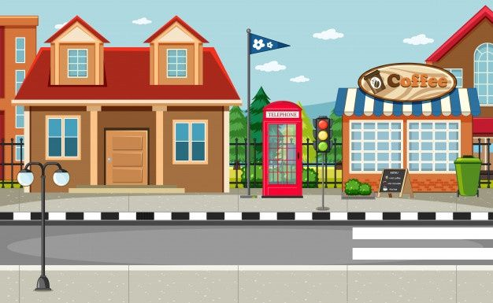
What's your address?
Ready?
76
Hung Vuong
Notes:
TEACHER NOTES:
Replace the text in the box with your key vocabulary/sentences.
OR if you want to make it into a speaking activity, delete the text and put an image in the box.
When playing the game, click/press the spacebar to send in the dark clouds.
Students start reading the text in the box after the dark cloud music stops.
Lightning will strike automatically after the dark clouds appear, no need to click again. The time when it strikes is different on each slide (view the animation pane to view or change the timing).
After the lightning strikes Billy and the student reading sits down, click/press the spacebar to go to the next slide.
Currently, there are 30 game slides in total (meant for 31 students). However, feel free to add or delete slides as needed for the number of students in your class.
If you want to adjust the time of when the lightning strikes, go to the “Animations” tab and open the ”Animation Pane.” Then, click on the “Lightning Strike” animation and adjust the delay time in the timing window.
If using the game more than once with the same class and are worried students will remember the lightning strike timing on each slide, no need to adjust the times of each lightning strike animation, just reorder the slides to save time and make the game feel fresh.
Skeleton image designed by creazilla.com

Slide 53
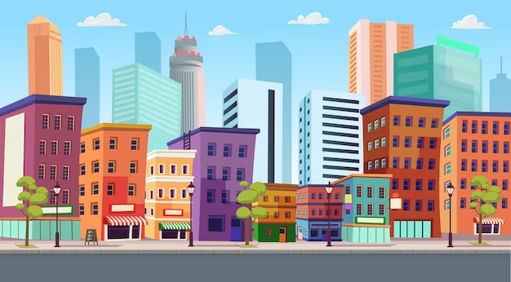
What's your address?
Ready?
25
Power
Notes:
TEACHER NOTES:
Replace the text in the box with your key vocabulary/sentences.
OR if you want to make it into a speaking activity, delete the text and put an image in the box.
When playing the game, click/press the spacebar to send in the dark clouds.
Students start reading the text in the box after the dark cloud music stops.
Lightning will strike automatically after the dark clouds appear, no need to click again. The time when it strikes is different on each slide (view the animation pane to view or change the timing).
After the lightning strikes Billy and the student reading sits down, click/press the spacebar to go to the next slide.
Currently, there are 30 game slides in total (meant for 31 students). However, feel free to add or delete slides as needed for the number of students in your class.
If you want to adjust the time of when the lightning strikes, go to the “Animations” tab and open the ”Animation Pane.” Then, click on the “Lightning Strike” animation and adjust the delay time in the timing window.
If using the game more than once with the same class and are worried students will remember the lightning strike timing on each slide, no need to adjust the times of each lightning strike animation, just reorder the slides to save time and make the game feel fresh.
Skeleton image designed by creazilla.com

Slide 54
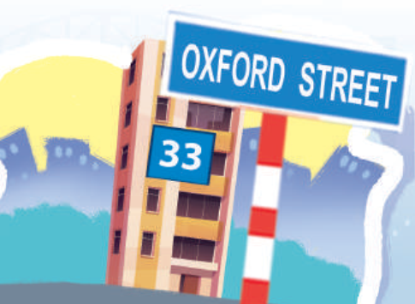
_____________?
It's 33 Oxford street.
Ready?
Notes:
TEACHER NOTES:
Replace the text in the box with your key vocabulary/sentences.
OR if you want to make it into a speaking activity, delete the text and put an image in the box.
When playing the game, click/press the spacebar to send in the dark clouds.
Students start reading the text in the box after the dark cloud music stops.
Lightning will strike automatically after the dark clouds appear, no need to click again. The time when it strikes is different on each slide (view the animation pane to view or change the timing).
After the lightning strikes Billy and the student reading sits down, click/press the spacebar to go to the next slide.
Currently, there are 30 game slides in total (meant for 31 students). However, feel free to add or delete slides as needed for the number of students in your class.
If you want to adjust the time of when the lightning strikes, go to the “Animations” tab and open the ”Animation Pane.” Then, click on the “Lightning Strike” animation and adjust the delay time in the timing window.
If using the game more than once with the same class and are worried students will remember the lightning strike timing on each slide, no need to adjust the times of each lightning strike animation, just reorder the slides to save time and make the game feel fresh.
Skeleton image designed by creazilla.com

Slide 55
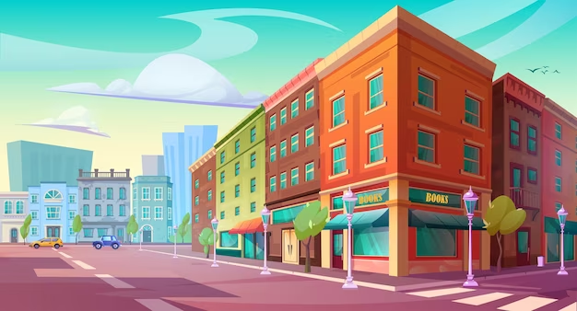
What's your address?
Ready?
246
Cau Giay
Notes:
TEACHER NOTES:
Replace the text in the box with your key vocabulary/sentences.
OR if you want to make it into a speaking activity, delete the text and put an image in the box.
When playing the game, click/press the spacebar to send in the dark clouds.
Students start reading the text in the box after the dark cloud music stops.
Lightning will strike automatically after the dark clouds appear, no need to click again. The time when it strikes is different on each slide (view the animation pane to view or change the timing).
After the lightning strikes Billy and the student reading sits down, click/press the spacebar to go to the next slide.
Currently, there are 30 game slides in total (meant for 31 students). However, feel free to add or delete slides as needed for the number of students in your class.
If you want to adjust the time of when the lightning strikes, go to the “Animations” tab and open the ”Animation Pane.” Then, click on the “Lightning Strike” animation and adjust the delay time in the timing window.
If using the game more than once with the same class and are worried students will remember the lightning strike timing on each slide, no need to adjust the times of each lightning strike animation, just reorder the slides to save time and make the game feel fresh.
Skeleton image designed by creazilla.com

