Slide 1
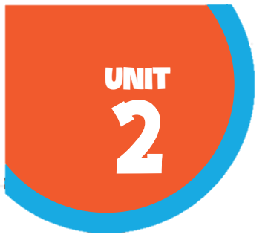








Our home
Lesson 1
(P.16, 17)

Slide 2
I. OBJECTIVES
By the end of this lesson, pupils will be able to:
1. Knowledge and skills
- use the words building, flat, house, tower and the numbers 23, 38, 93, and 116 in relation to the topic “Our homes”;
- correctly say the words and use
Do you live in this / that ?
Yes, I do.
No, I don’t
to ask and answer questions about someone’s home.
- use Do you live in ____? – Yes, / No, ____. in a freer context.
- listen to and understand four communicative contexts in which speakers ask and answer questions about their homes and number the pictures;
2. Competences
- Critical thinking and creativity: learn how to ask and answer questions about personal information correctly and fluently.
- Communication and collaboration: work in pairs and groups to complete the learning tasks.
- Self-control & independent learning: perform pronunciation and speaking tasks.
3. Attributes
- bShow their pride in their personal information and where they live.
- Show their pride in their personal home and address.

Slide 3

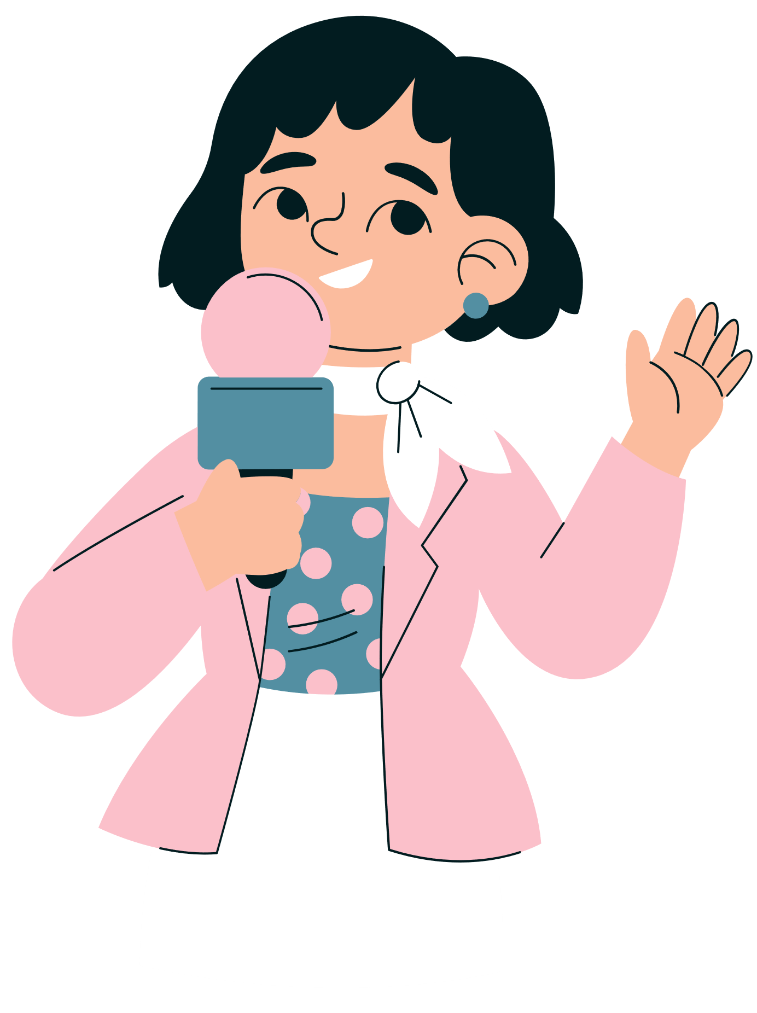
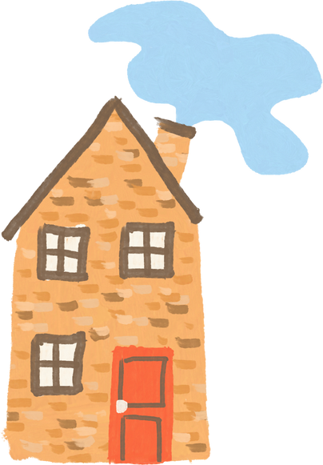
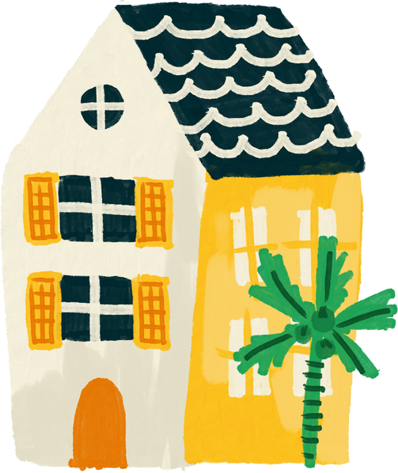
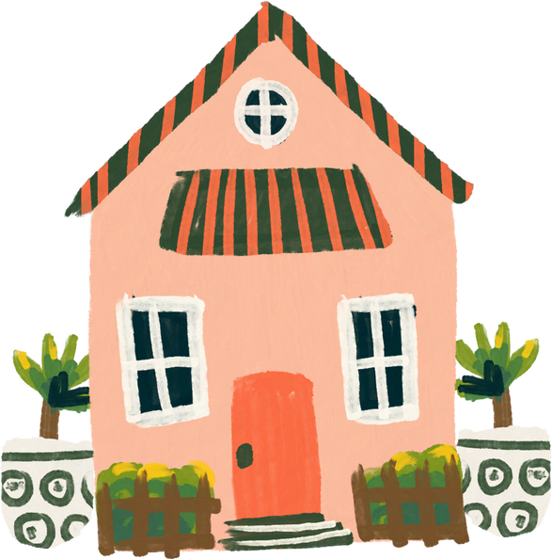
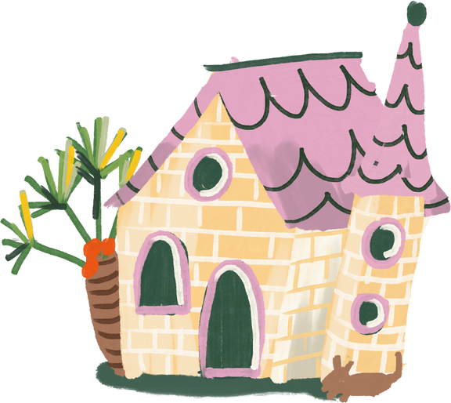
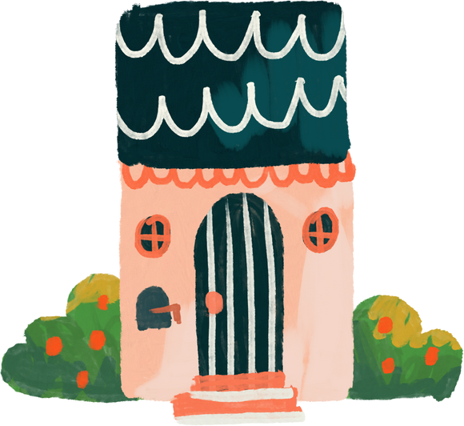
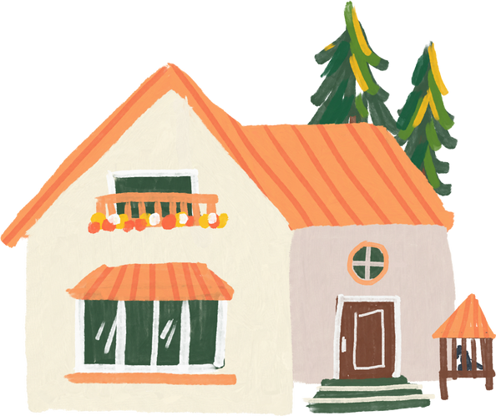
Warm-up and review

Slide 4



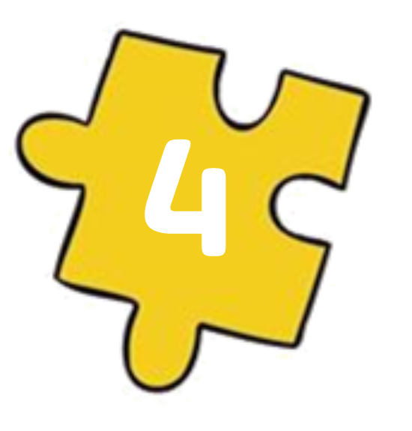
Guess the key word
Collect the letters.
E
O
HOME
M
H
Next Activity

Slide 5
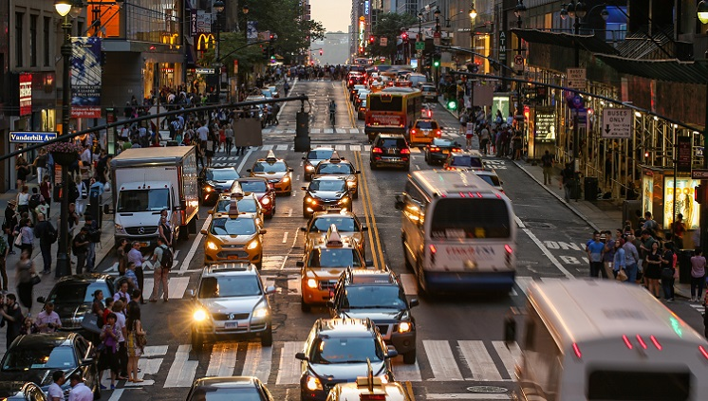
It's a busy .
st_ _e_
street

Slide 6
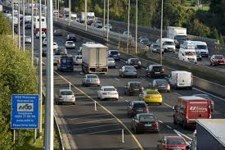
It's a noisy .
r_ _ _
road

Slide 7
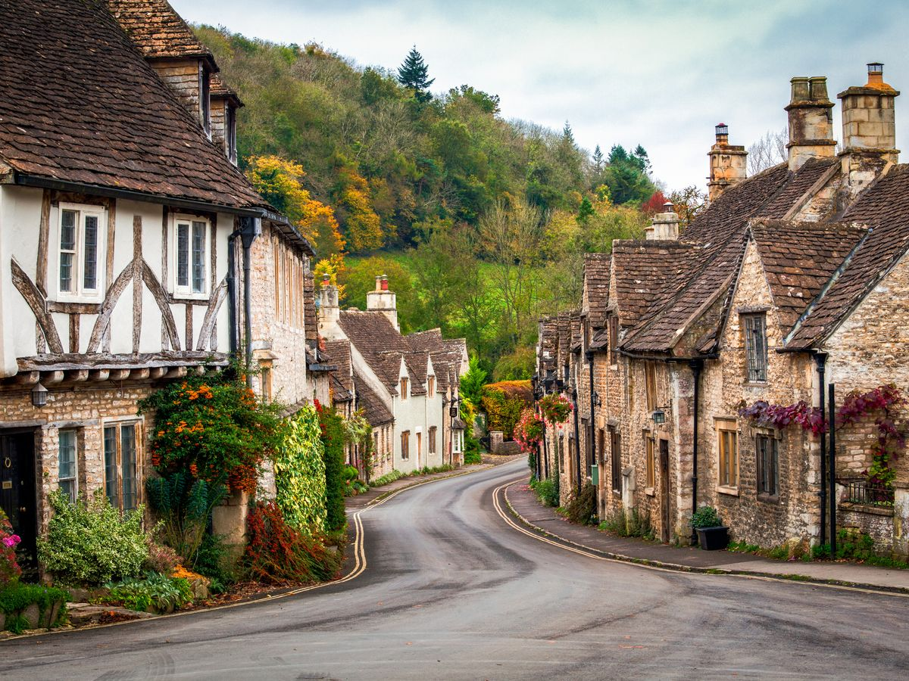
It's a quiet .
village
v_l_ag_

Slide 8

It's a big ..
c_ _y
city

Slide 9
01
Look, listen and repeat.

Slide 10
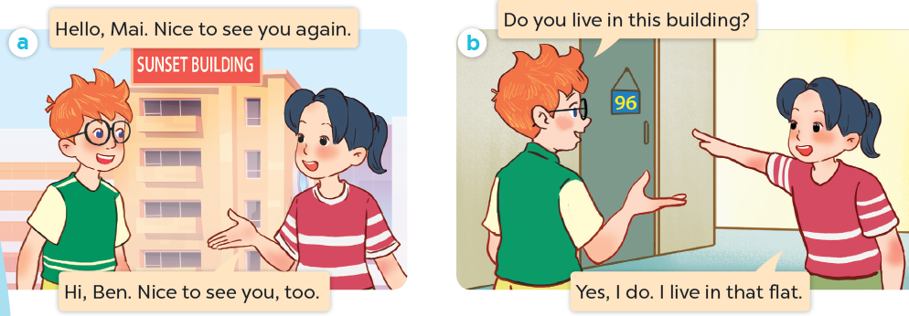
What are they talking about?
Where are they?
Who are they?

Slide 11

Look, listen and repeat.

Slide 12
Look, listen and repeat.

Slide 13
Look, listen and repeat.

Slide 14
02
Listen, point and say.

Slide 15
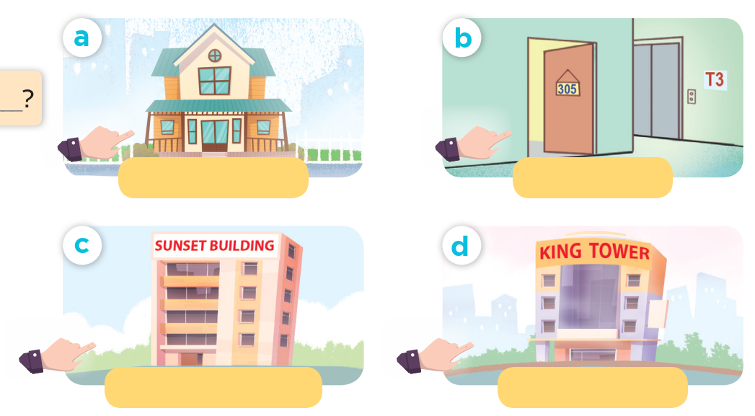

Slide 16
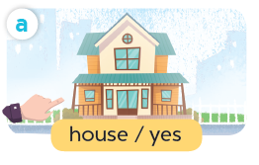
Listen, point and say.
house / yes

Slide 17
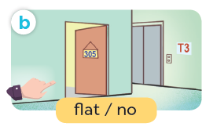
Listen, point and say.
flat / no

Slide 18
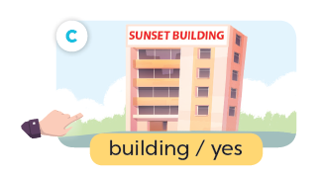
Listen, point and say.
building / yes

Slide 19
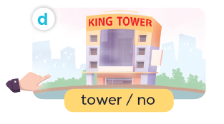
Listen, point and say.
tower / no

Slide 20
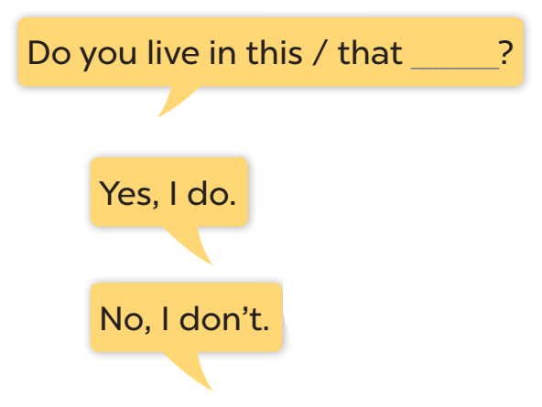




Slide 21
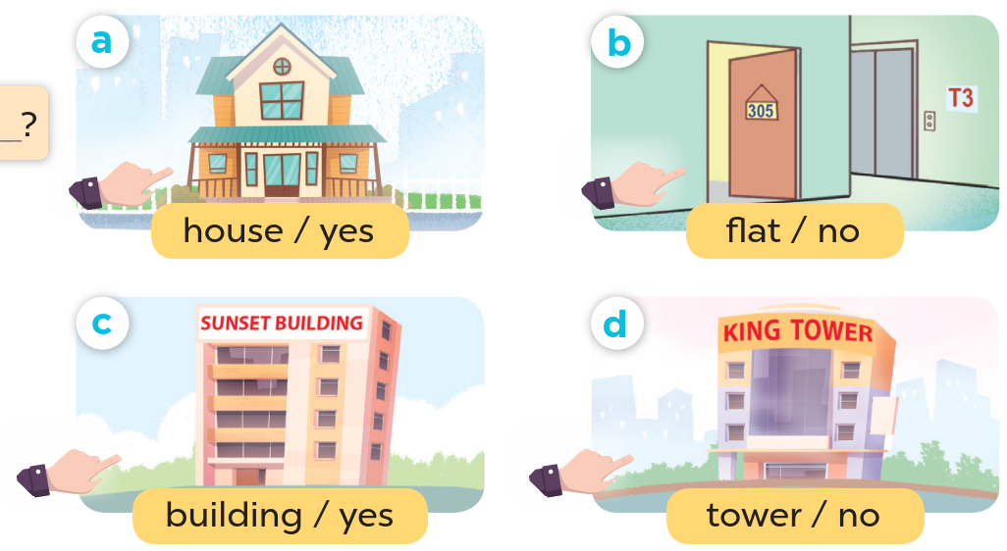
Look at the hands.

Slide 22
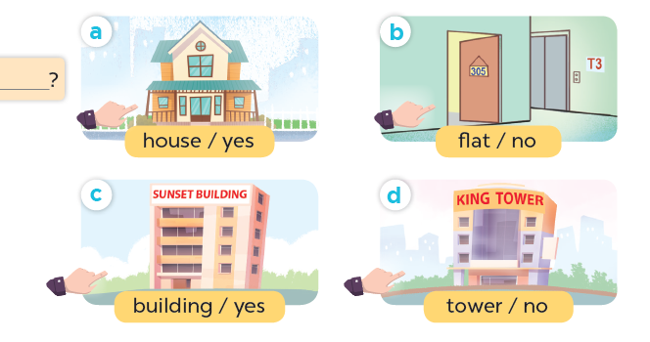
Listen, point and say.
Do you live in this house?
Yes, I do.
house / yes

Slide 23
Listen, point and say.
Do you live in this flat?
No, I don't.
flat / no

Slide 24
Listen, point and say.
Do you live in that building?
Yes, I do.
building / yes

Slide 25
Listen, point and say.
Do you live in that tower?
No, I don't.
tower / no

Slide 26
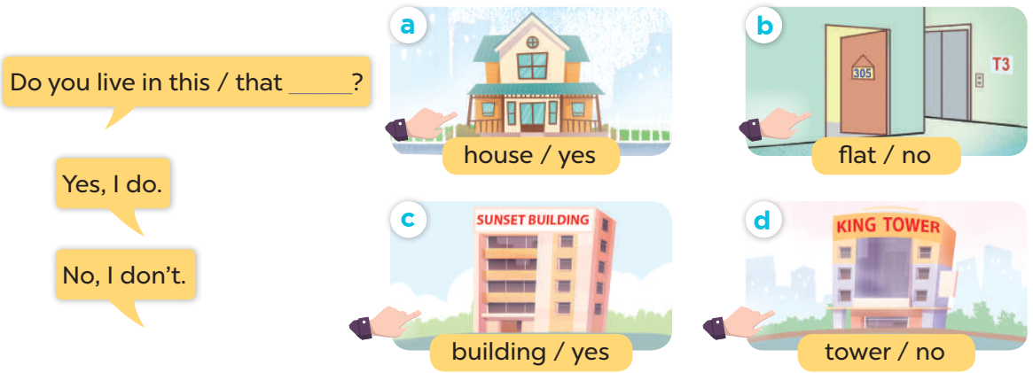
Work in pairs. Ask and answer.

Slide 27
04
Listen and number.

Slide 28
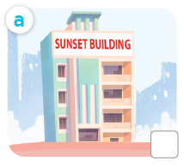
What is it?
building

Slide 29
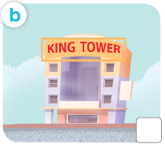
What is it?
tower

Slide 30
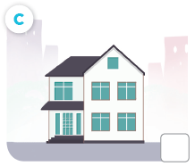
What is it?
house

Slide 31
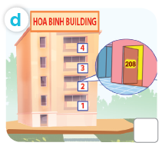
What is it?
flat

Slide 32
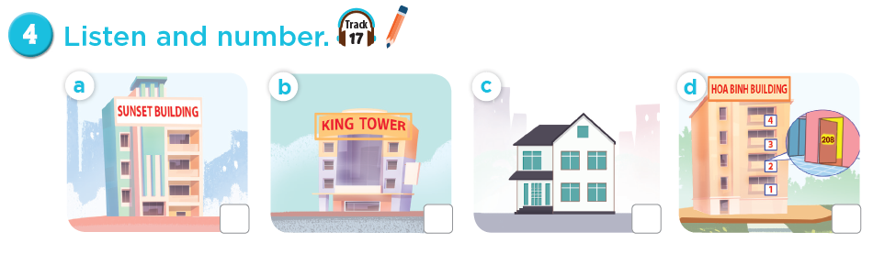
Listen and number.
4
3
1
2

Slide 33
Game
Lucky letter

Slide 34

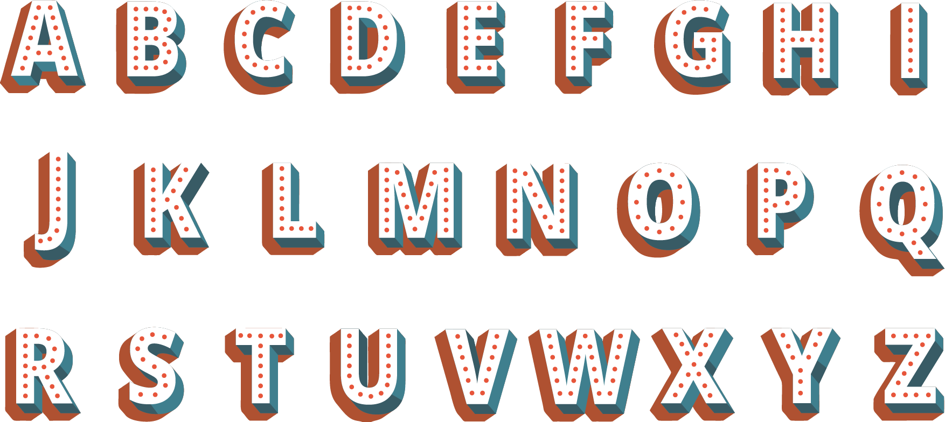
1
2
1
1
3
1
1
2

Slide 35
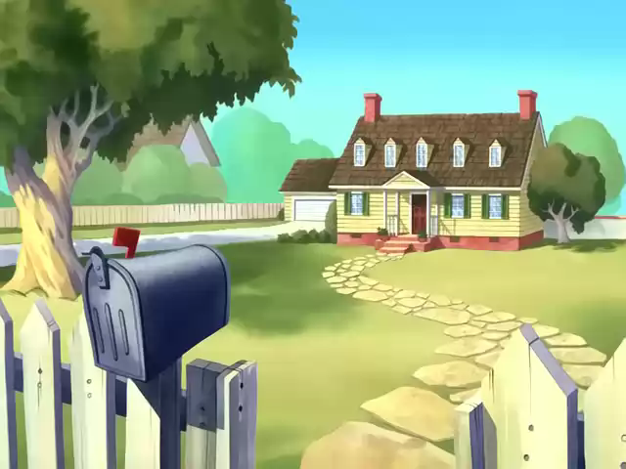

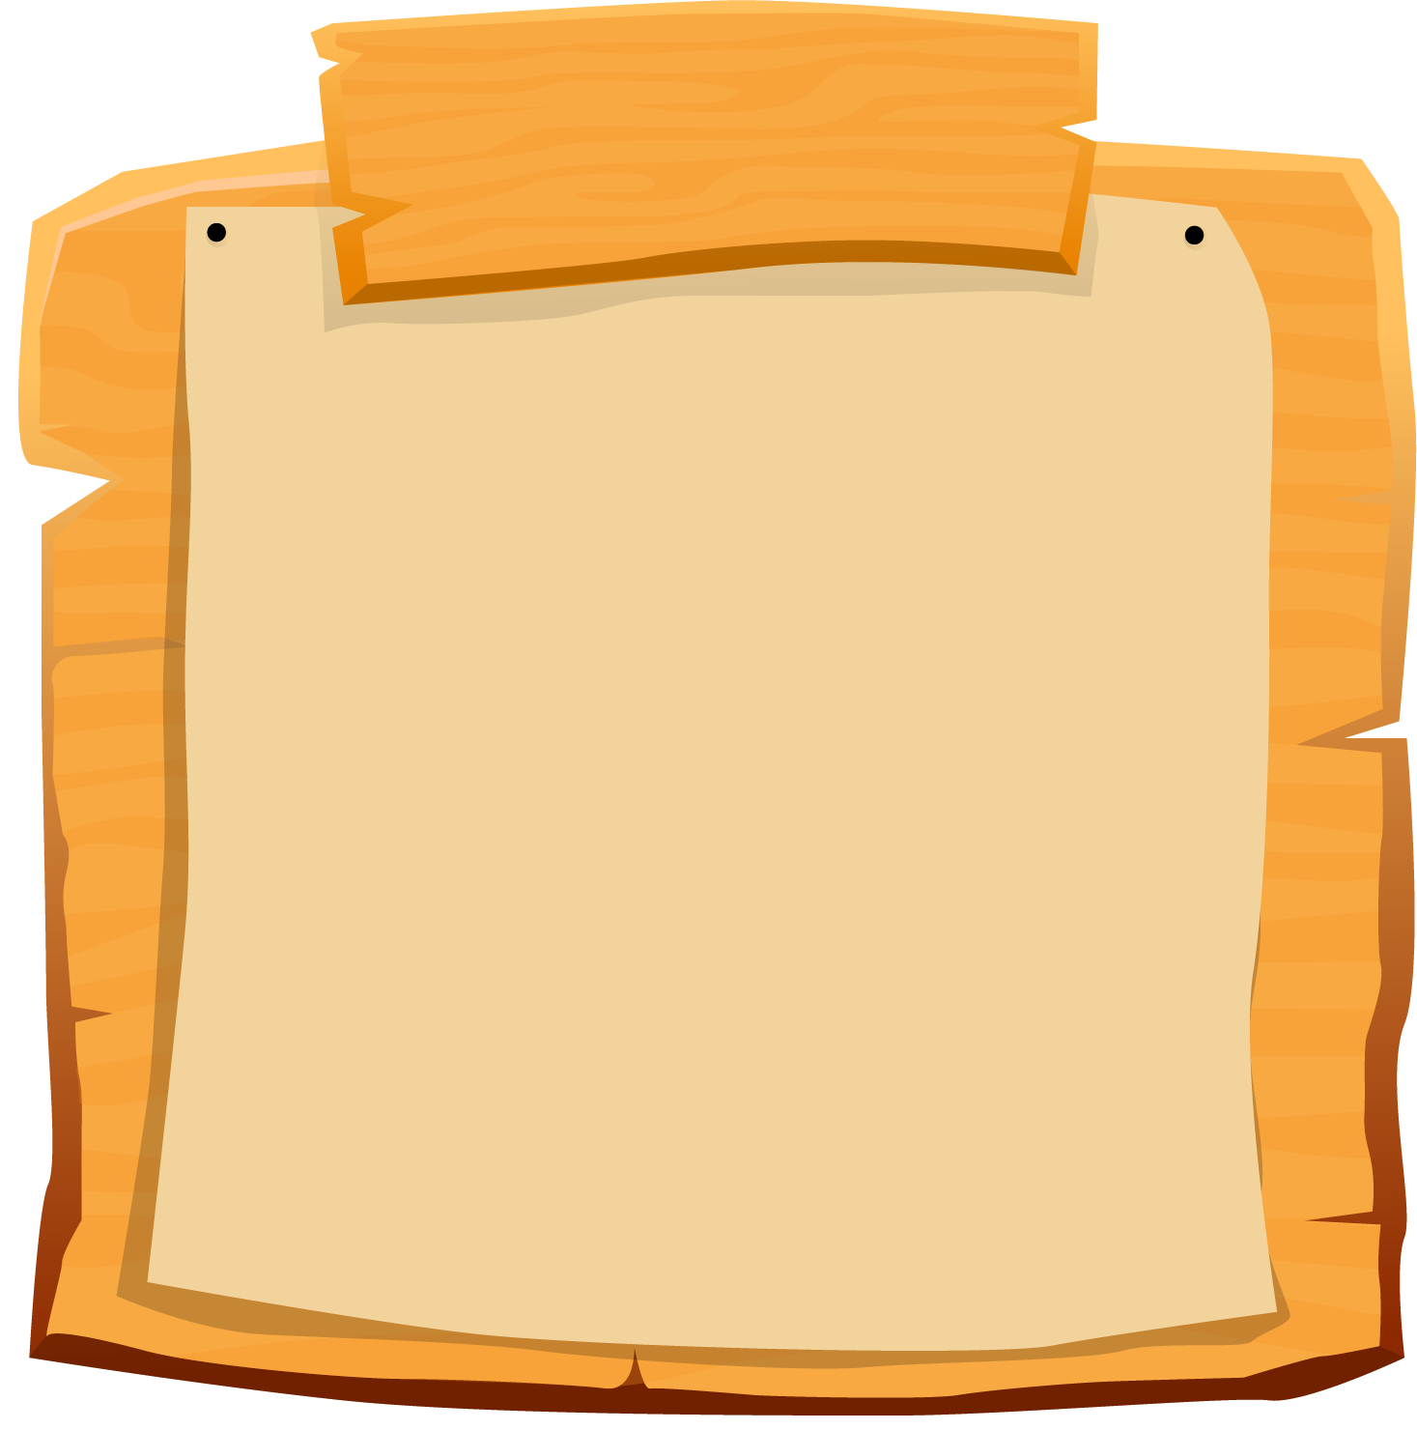

SCOREBOARD
Boys
Girls
0
1
2
3
4
5
6
7
8
9
0
1
2
3
4
5
6
7
8
9
Questions
Notes:
- Teacher clicks on each team's score board to add up on the score.
- Teacher click on the Questions sign to get back to the questions slide

Slide 36
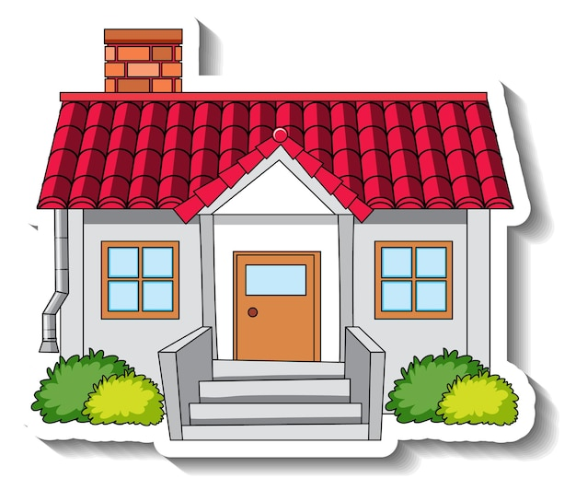

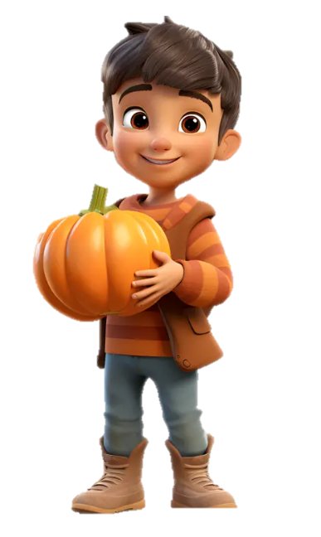

Do you live in this house?
Yes, I do.

Slide 37




Do you live in that house?
Yes, I do.

Slide 38
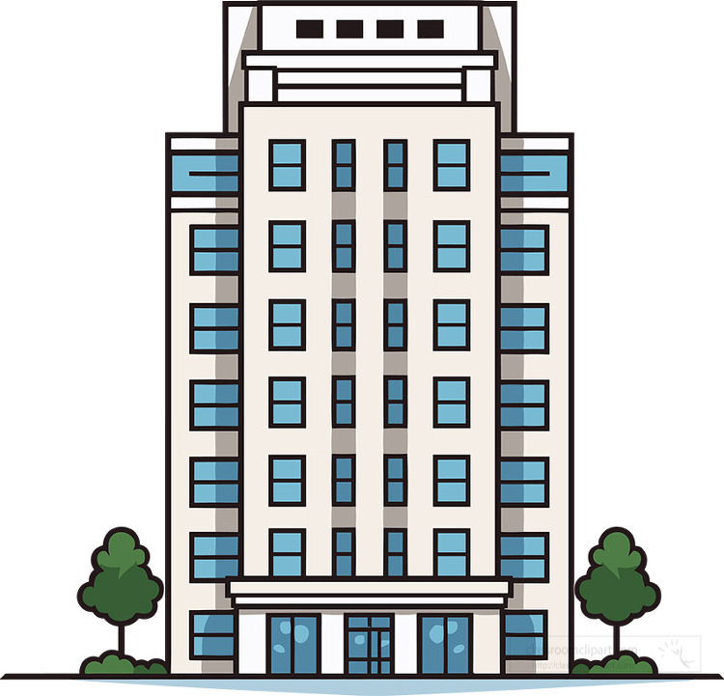
Moon Building
Do you live in this building?
No, I don't.

Slide 39
Moon Building
Do you live in that building?
No, I don't.

Slide 40

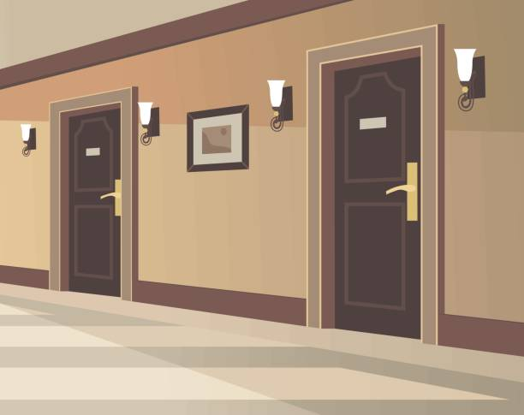

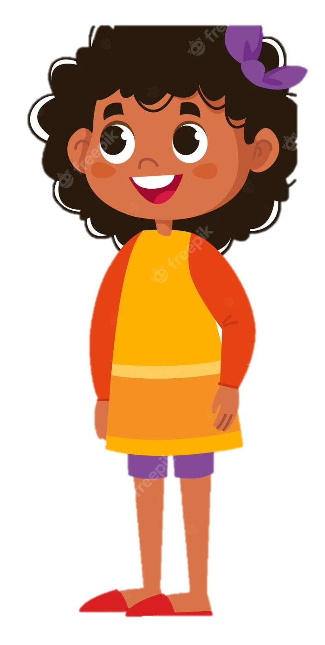
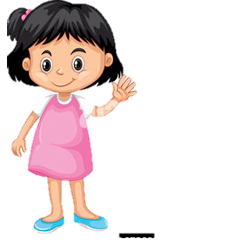
Do you live in this flat?
No, I don't.

Slide 41

Do you live in that flat?
Yes, I do.

Slide 42

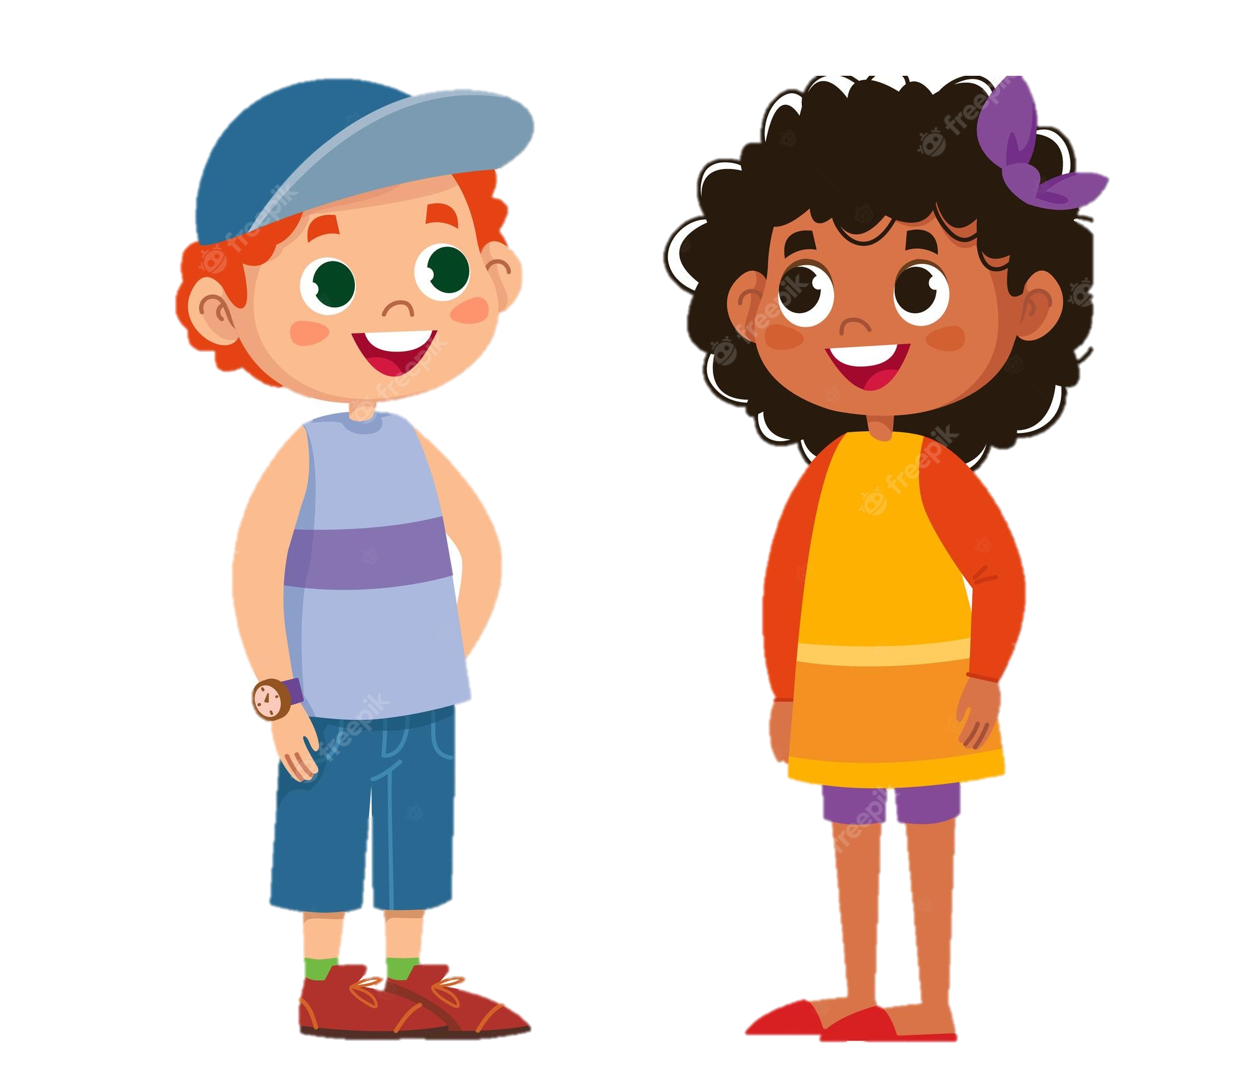
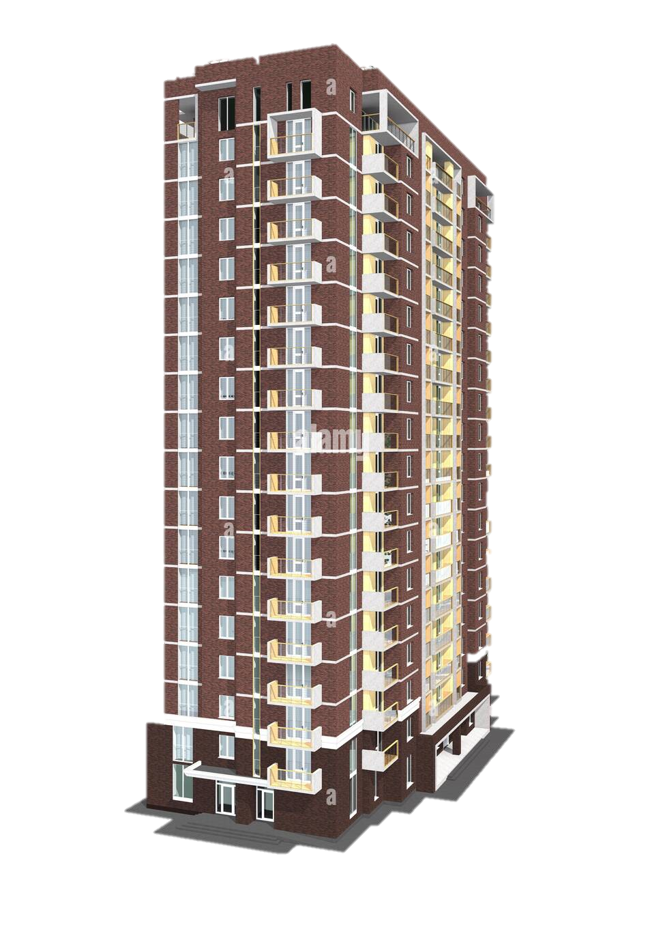
Do you live in this tower?
Yes, I do.
Queen Tower

Slide 43



Prince Tower
Do you live in that tower?
No, I don't.

