Slide 2

Unit 1. All about me!
Lesson 1

Slide 3


Warm-up and review

Slide 4
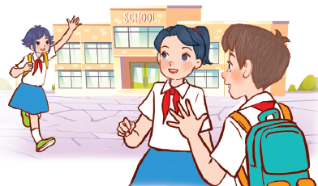
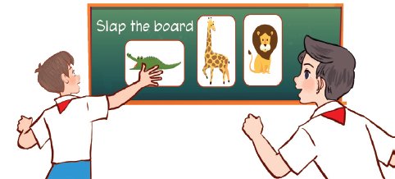
Let’s sing.
Back to school
Back to school.
Happy to see my friends!
Back to school.
Learning and playing are really cool!
Back to school.
Happy to see my teachers!
Back to school.
Learning and playing are really cool!

Slide 5

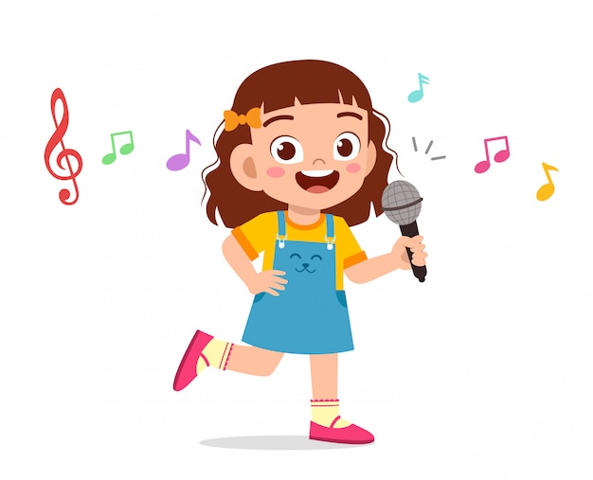
Perform

Slide 6
1
Look, listen and repeat.

Slide 7

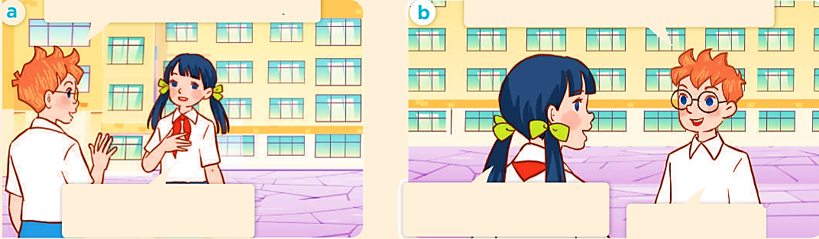
Look, listen and repeat.
a
b

Slide 8
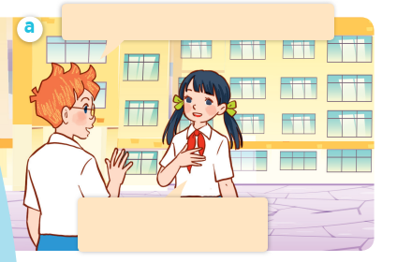
Look, listen and repeat.
Hello. I’m Ben. Nice to meet you.
Hello, Ben. I’m Lan.
Nice to meet you, too.
Notes:
Nháy vào hội thoại để nghe lại âm thanh từng câu.

Slide 9
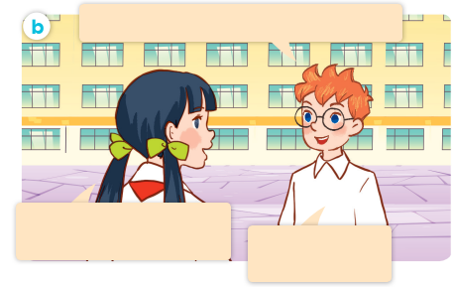
Look, listen and repeat.
Can you tell me about yourself, Lan?
Well, I’m in Class 5C.
I live in the countryside.
I’m in Class 5B.
I live in the city.
Notes:
Nháy vào hội thoại để nghe lại âm thanh từng câu.

Slide 10
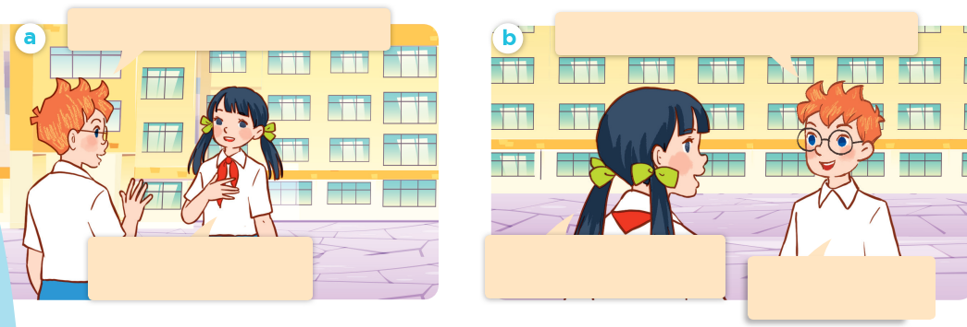
Look, listen and repeat.
Hello. I’m Ben. Nice to meet you.
Can you tell me about yourself, Lan?
Hello, Ben. I’m Lan.
Nice to meet you, too.
Well, I’m in Class 5C.
I live in the countryside.
I’m in Class 5B.
I live in the city.

Slide 11
Can you tell me about yourself, Lan?
Well, I’m in Class 5C. I live in the countryside.

Slide 12
2
Listen, point and say.

Slide 13
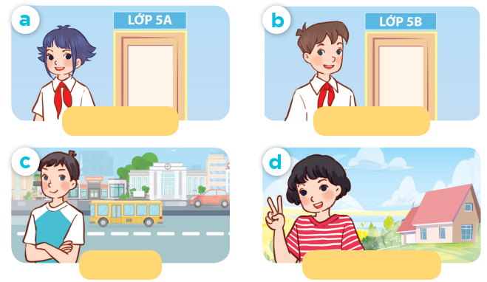
Listen, point and say.
Class 5A
Class 5B
city
countryside

Slide 14
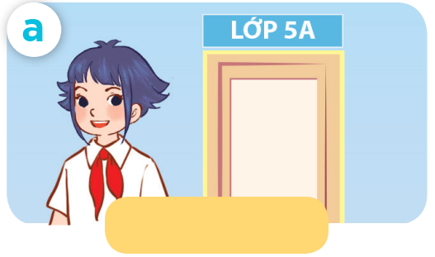
Listen, point and say.
Class 5A

Slide 15
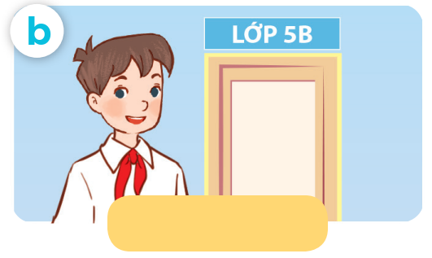
Listen, point and say.
Class 5B

Slide 16
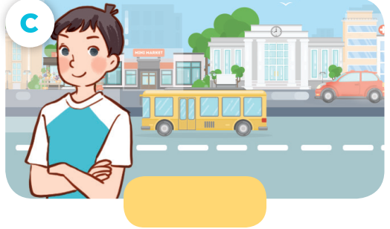
Listen, point and say.
city

Slide 17

Listen, point and say.
countryside

Slide 18

Can you tell me about yourself?
I’m in ____ .
I live in the ___.

Slide 19
Listen, point and say.
Can you tell me about yourself?
I’m in Class 5A .
Class 5A

Slide 20
Listen, point and say.
Can you tell me about yourself?
I’m in Class 5B.
Class 5B

Slide 21
Listen, point and say.
Can you tell me about yourself?
I live in the city.
city

Slide 22
Listen, point and say.
Can you tell me about yourself?
I live in the countryside.
countryside

Slide 23
Can you tell me about yourself?
Class 5A
Class 5B
I’m in ____.
I live in the __.
city
countryside

Slide 24
Can you tell me about yourself?
I’m in ____.
I live in the ___.

Slide 25
4
Listen and tick.

Slide 26
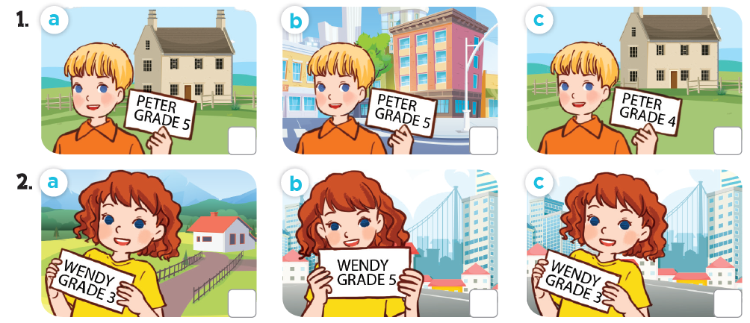
Listen and tick.

Slide 27
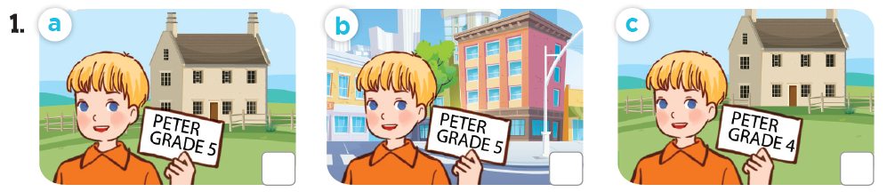
Listen and tick.
✓

Slide 28
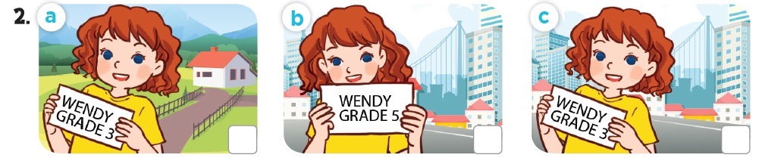
Listen and tick.
✓

Slide 29
Listen and tick.
✓
✓

Slide 30
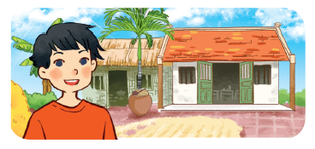
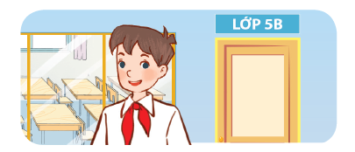


Read and complete.

Slide 31
Read and complete.
1. A: Can you tell me about yourself?
B: Sure. My name’s Ba. I live in the _____.
village

Slide 32
Read and complete.
2. A: Can you tell me about yourself?
B: Well, I’m Minh. I’m in _______.
Class 5B

Slide 33
Read and complete.
3. A: Can you ____ me about yourself?
B: Sure. I’m Phong. I live in the_________.
tell
city / town

Slide 34
Read and complete.
4. A: Can you tell me about _______?
B: Well, I’m Andy. I live in the ________________.
yourself
countryside / village

Slide 35
Read and complete.
1. A: Can you tell me about yourself?
B: Sure. My name’s Ba. I live the _____.
2. A: Can you tell me about yourself?
B: Well, I’m Minh. I’m in _______.
village
Class 5B
tell
yourself
3. A: Can you ____ me about yourself?
B: Sure. I’m Phong. I live in the _________.
4. A: Can you tell me about ________?
B: Well, I’m Andy. I live in the ________________.
city / town
countryside / village

Slide 36
06p11
Let’s sing.

Slide 37

All about me!
I’m Lisa.
I’m in Grade 3.
I live in the countryside.
Where do you live?
I’m Alan.
I’m in Grade 5.
I live in the city.
Where do you live?

Slide 38
Fun corner and wrap-up

Slide 39


Slide 40

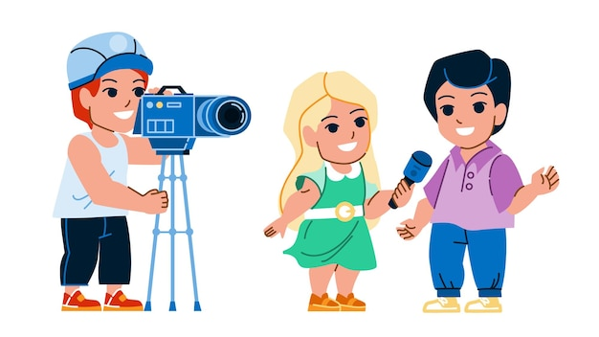
Can you tell me about yourself?
____.

