Slide 1






















Unit 1:
At my birthday party
Lesson 1

Slide 2
I. OBJECTIVES
By the end of this lesson, pupils will be able to:
1. Knowledge and skills
- correctly pronounce the name of the letter P/p (/piː/).
- correctly pronounce the sound of the letter P/p (/p/) in isolation and in the words pasta, popcorn and pizza.
2. Competences
- Communication and collaboration: work in pairs or groups to complete the learning tasks.
- Self-control and independent learning: perform pronunciation tasks.
3. Attributes
- Show their love and interest in food.
- Show their knowledge about choosing healthy food.
- Be willing to help friends.

Slide 3
WELCOME
TO OUR CLASS

Slide 4

01
Warm-up
Notes:
https://www.youtube.com/watch?v=CrPVTFCF074

Slide 5
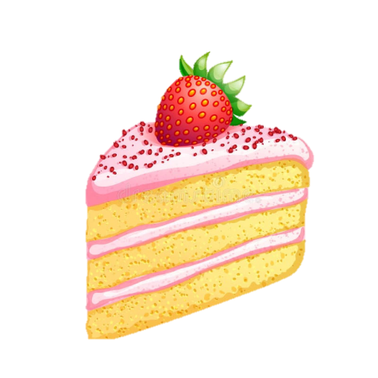
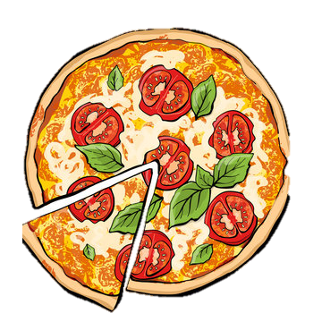
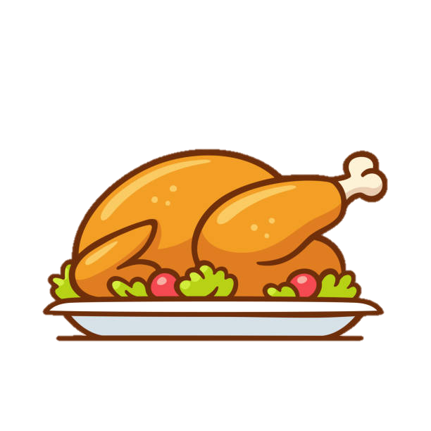


Look and Say

Slide 6
02
Activity 1
Listen and repeat.
Notes:
https://www.youtube.com/watch?v=CrPVTFCF074

Slide 7
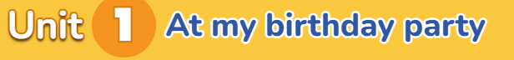
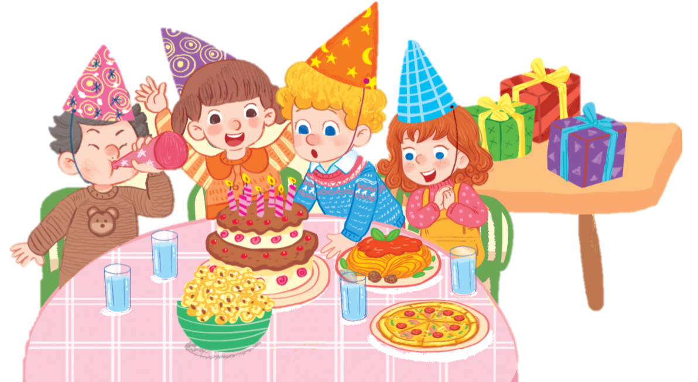

a party

Slide 8
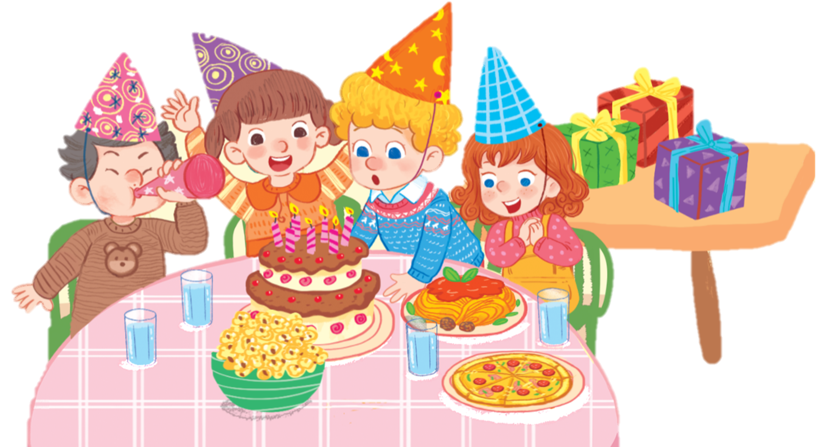
Pp

Slide 9
Pp
pasta

Slide 10
Pp
pasta
pizza

Slide 11

1. Listen and repeat.
Pp
pasta
popcorn
pizza

Slide 12
03
Activity 2
Point and say.
Notes:
https://www.youtube.com/watch?v=CrPVTFCF074

Slide 13
Pp
pasta
popcorn
pizza

Slide 14





Work in pairs.

Slide 15


Look and say aloud.
popcorn

Slide 16
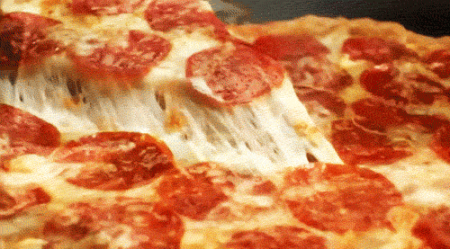
Look and say aloud.
pizza

Slide 17
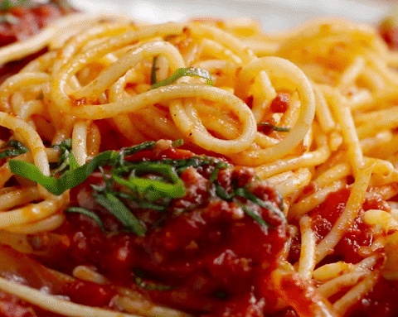
Look and say aloud.
pasta

Slide 18
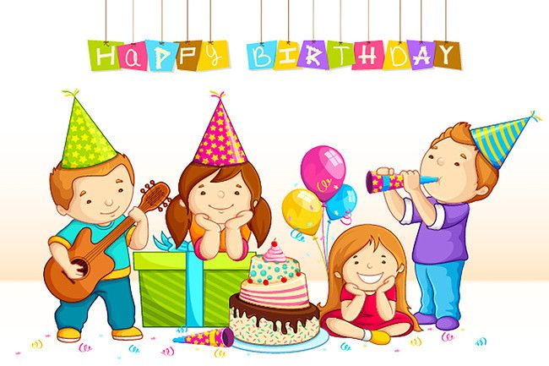
Look and say aloud.
party

Slide 19
04
Fun corner/Wrap-up
Notes:
https://www.youtube.com/watch?v=CrPVTFCF074

Slide 20
KIM’S GAME

Slide 21


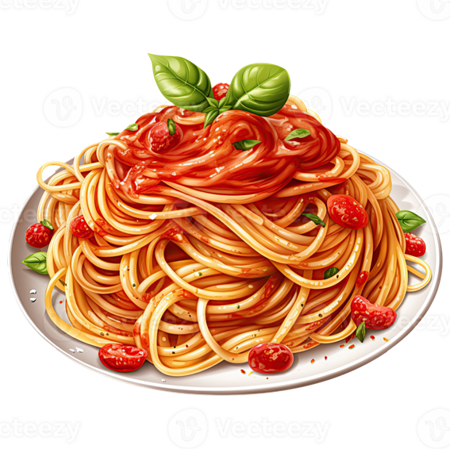

KIM’S GAME
(Turn 1)
Time’s up!

Slide 22



KIM’S GAME
(Turn 1)
pizza
popcorn
pasta

Slide 23

KIM’S GAME
(Turn 2)
Time’s up!

Slide 24



KIM’S GAME
(Turn 2)
popcorn
pasta
pizza

Slide 25

KIM’S GAME
(Turn 3)
popcorn
pizza
pasta
Time’s up!

Slide 26



KIM’S GAME
(Turn 3)
pizza
pasta
popcorn

Slide 27


Slide 28
Goodbye

