Slide 2
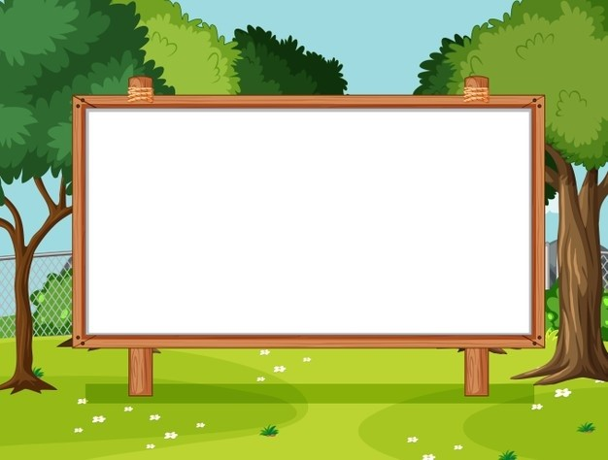
Unit 1. All about me!
Lesson 3.
(P.14, 15)

Slide 3
I. OBJECTIVES
By the end of this lesson, pupils will be able to:
1. Knowledge and skills
- correctly pronounce the two-syllable words with the stress on the first syllable as ‘dolphin and ‘tennis in isolation and as in the sentences I like ‘dolphins. and He plays ‘tennis on Sundays.
- read two paragraphs and circle the correct options.
- make Questions & Answers about personal information and favourite things.
- revise the target language by making a poster and presenting it to the class.
2. Competences
- Communication and collaboration: work in pairs and groups to complete the learning tasks.
- Self-control & independent learning: perform reading and writing tasks.
3. Attributes
- Show their love and interest in sports, colours, animals and food.

Slide 4


Warm-up and review

Slide 5
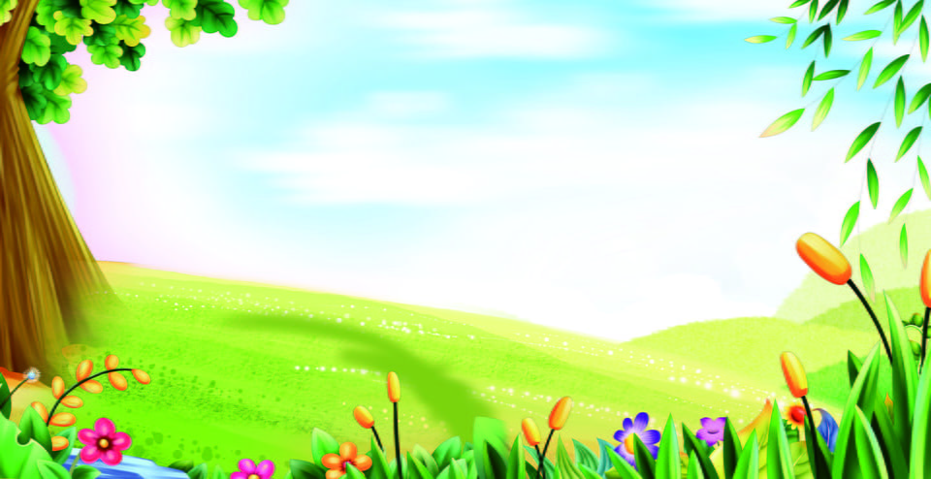
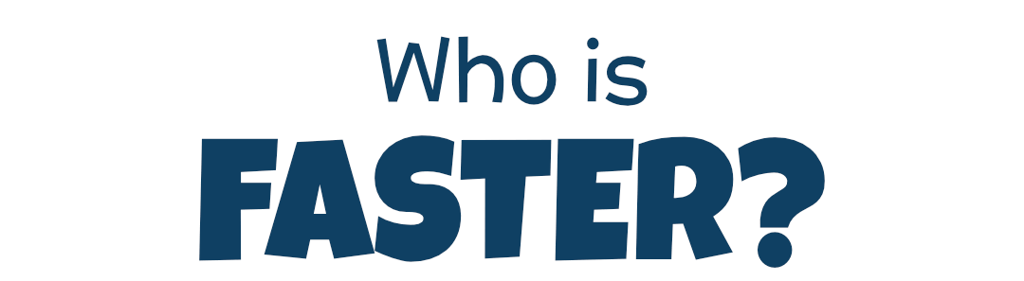
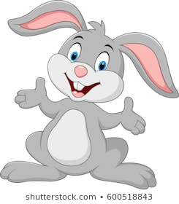
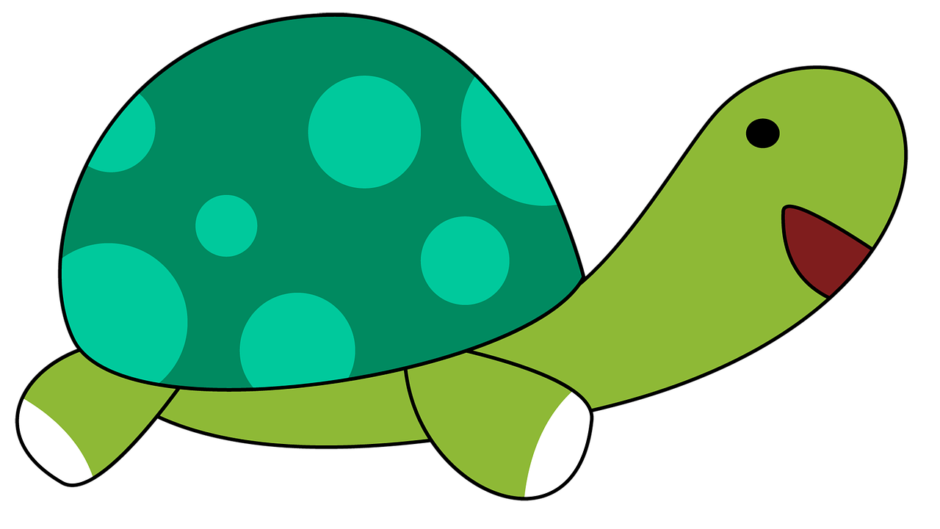
Team Turtle
Team Rabbit

Slide 6
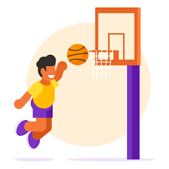
Choose the correct answer a,b or c.
A: What’s your favourite _______?
B: It’s basketball.
a
b
c
food
animal
sport

Slide 7
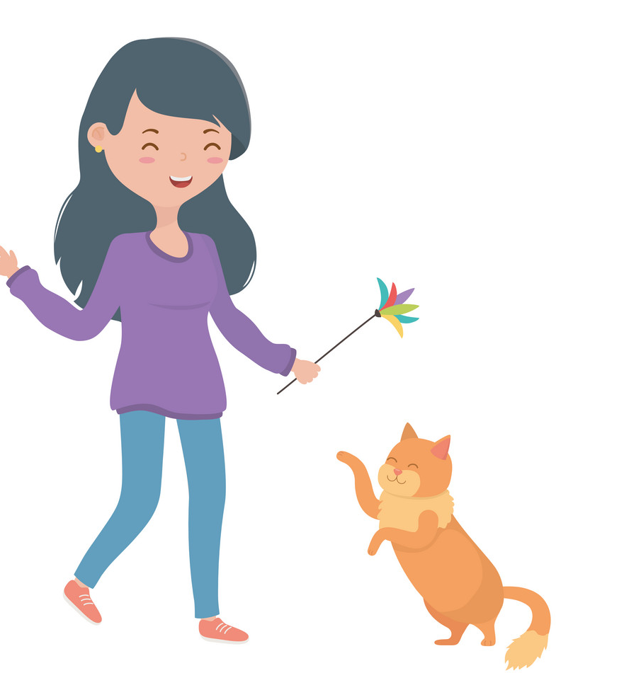
Choose the correct answer a,b or c.
A: What’s your favourite animal?
B: It’s _____.
a
b
c
cat
a cat
a dog

Slide 8

Choose the correct answer a,b or c.
A: What’s your favourite colour?
B: ___ red.
a
b
c
It
A
It’s

Slide 9
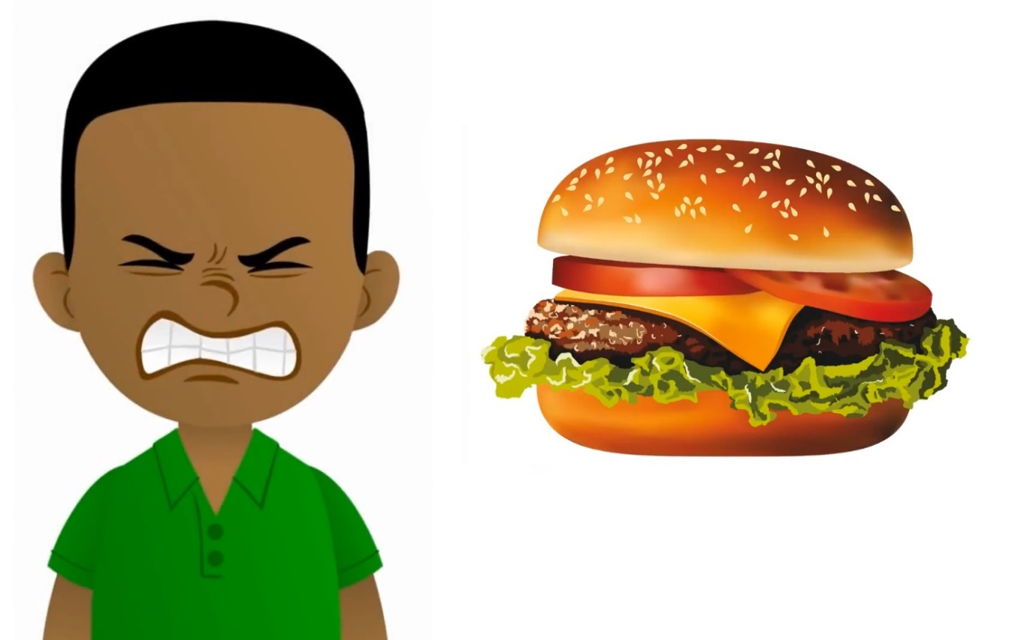
Choose the correct answer a,b or c.
A: My favourite food is hamburger.
Do you like hamburger, too?
B: No, I ____.
a
b
c
don’t
do
am

Slide 10

Summary
Notes:
GV nháy vào biểu tượng của đội chơi để tính điểm cho các đội. Mỗi lần nháy 1 ngôi sao xuất hiện.

Slide 11
01
Listen and repeat.

Slide 12

Listen and repeat.
'
I like dolphins.
dolphin
'

Slide 13
Listen and repeat.
'
'
tennis
He plays tennis on Sundays.

Slide 14
Listen and repeat.
'
'
dolphin
I like dolphins.
'
'
tennis
He plays tennis on Sundays.

Slide 15
02
Circle, listen and check.

Slide 16
Circle, listen and check.
1.
a. dolphin
b. giraffe
c. behind
2.
a. Japan
b. July
c. England
3.
a. tennis
b. hello
c. goodbye

Slide 17
Circle, listen and check.
1.
a. dolphin
b. giraffe
c. behind

Slide 18
Circle, listen and check.
2.
a. Japan
b. July
c. England

Slide 19
Circle, listen and check.
3.
a. tennis
b. hello
c. goodbye

Slide 20
Circle, listen and check.
1.
a. dolphin
b. giraffe
c. behind
2.
a. Japan
b. July
c. England
3.
a. tennis
b. hello
c. goodbye

Slide 21
Fun corner and wrap-up

Slide 22

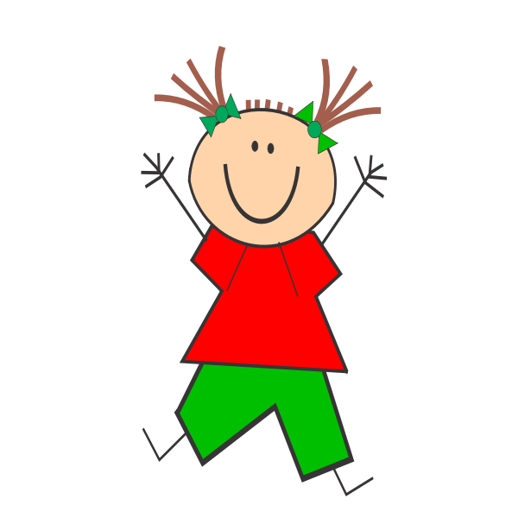
Jumping Games

Slide 23

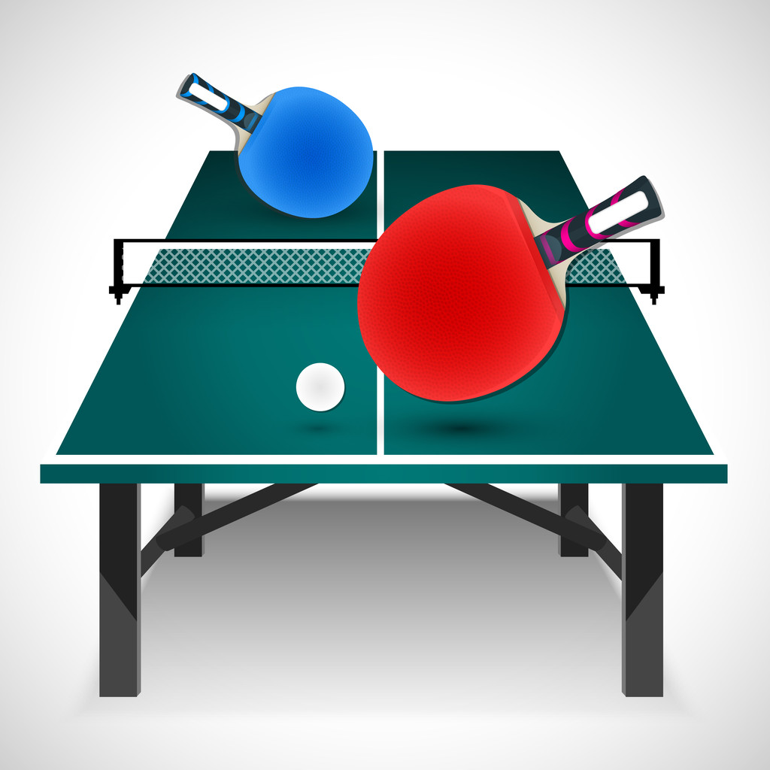
table tennis

Slide 24
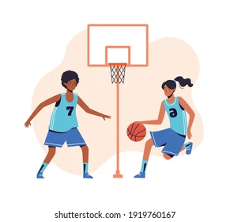
football

Slide 25

Japan

Slide 26
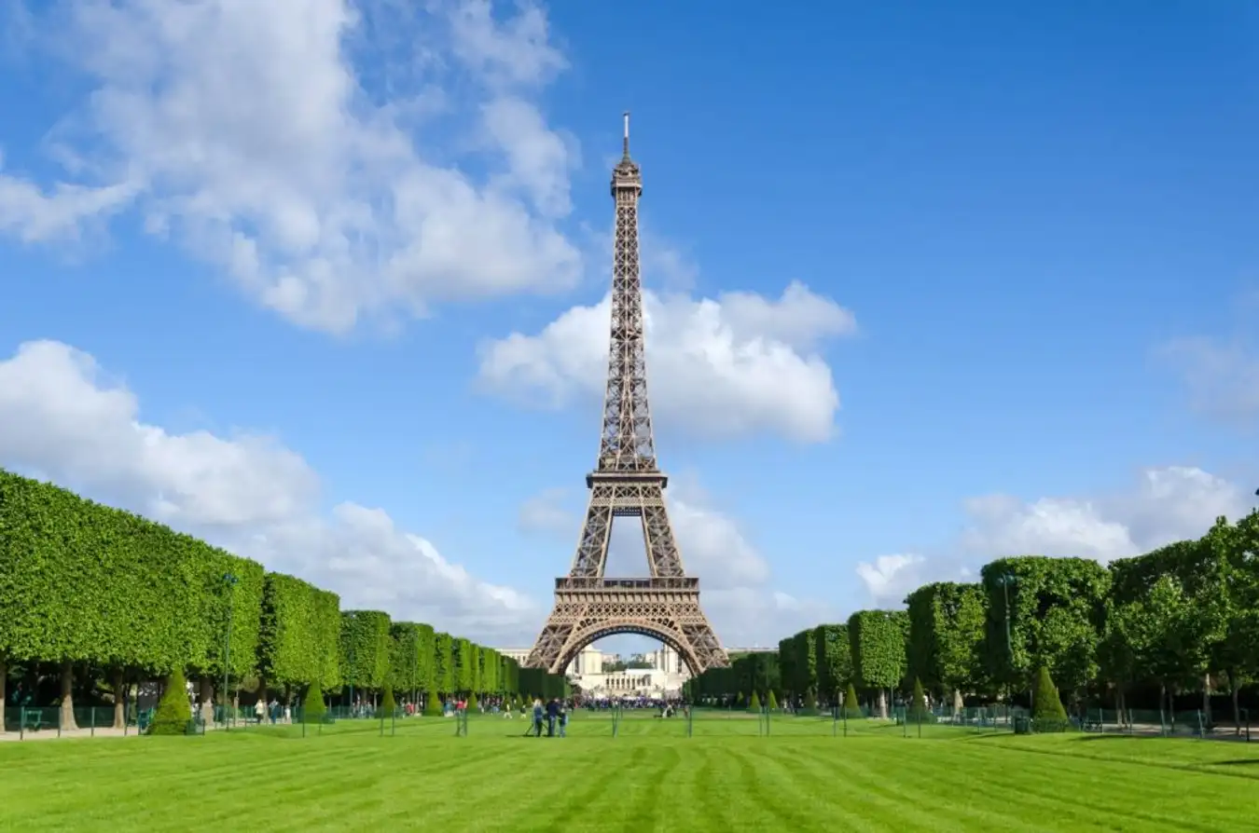
England

Slide 27
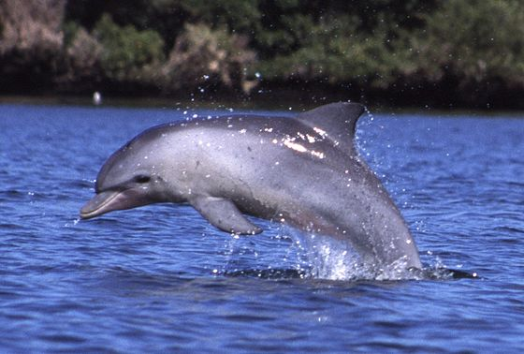
dolphin

Slide 28
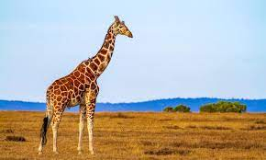
giraffe

Slide 29
04
Read and circle.

Slide 30
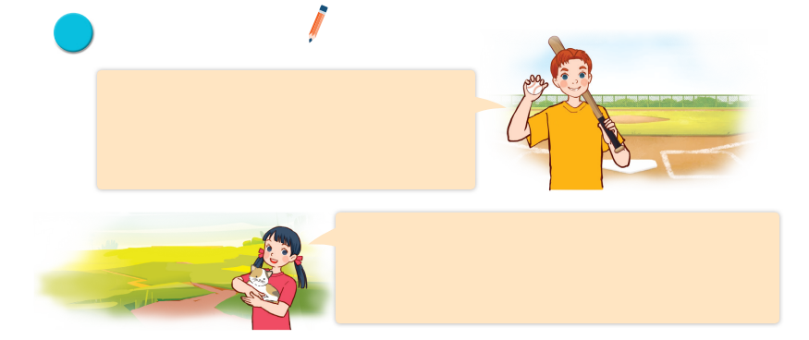
Read and circle.
Hi, all. Let me tell you a little bit about myself. My name’s Tom. I’m in Grade 5. I live in a big city. My favourite subject is maths. My favourite food is fish and chips. I’m a big fan of baseball.
It’s really fun.
Hello, everyone. Let me introduce myself. My full name’s Le Mai Lan. You can call me Lan. I’m in Class 5C. I live in the countryside. I love pets. I have two kittens and a rabbit. My favourite colour is pink. My favourite food is chicken pho. Yum!

Slide 31
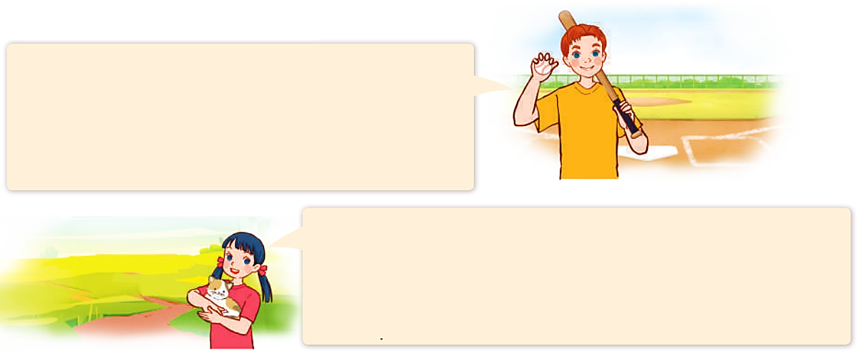
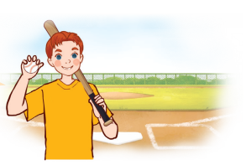
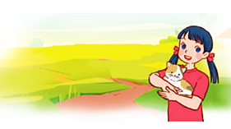
Read and circle.
Hi, all. Let me tell you a little bit about myself. My name’s Tom. I’m in Grade 5. I live in a big city. My favourite subject is maths. My favourite food is fish and chips. I’m a big fan of baseball.
It’s really fun.
Hello, everyone. Let me introduce myself. My full name’s Le Mai Lan. You can call me Lan. I’m in Class 5C. I live in the countryside. I love pets. I have two kittens and a rabbit. My favourite colour is pink. My favourite food is chicken pho. Yum!
1. Tom lives in _______.
a. a big village b. a big city c. a big town

Slide 32
Read and circle.
Hi, all. Let me tell you a little bit about myself. My name’s Tom. I’m in Grade 5. I live in a big city. My favourite subject is maths. My favourite food is fish and chips. I’m a big fan of baseball.
It’s really fun.
Hello, everyone. Let me introduce myself. My full name’s Le Mai Lan. You can call me Lan. I’m in Class 5C. I live in the countryside. I love pets. I have two kittens and a rabbit. My favourite colour is pink. My favourite food is chicken pho. Yum!
2. He likes _______.
a. fish and rice b. chicken and chips c. fish and chip

Slide 33
Read and circle.
Hi, all. Let me tell you a little bit about myself. My name’s Tom. I’m in Grade 5. I live in a big city. My favourite subject is maths. My favourite food is fish and chips. I’m a big fan of baseball.
It’s really fun.
Hello, everyone. Let me introduce myself. My full name’s Le Mai Lan. You can call me Lan. I’m in Class 5C. I live in the countryside. I love pets. I have two kittens and a rabbit. My favourite colour is pink. My favourite food is chicken pho. Yum!
3. Lan is in _______.
a. Class 4C b. Class 5C c. Class 3C

Slide 34
Read and circle.
Hi, all. Let me tell you a little bit about myself. My name’s Tom. I’m in Grade 5. I live in a big city. My favourite subject is maths. My favourite food is fish and chips. I’m a big fan of baseball.
It’s really fun.
Hello, everyone. Let me introduce myself. My full name’s Le Mai Lan. You can call me Lan. I’m in Class 5C. I live in the countryside. I love pets. I have two kittens and a rabbit. My favourite colour is pink. My favourite food is chicken pho. Yum!
4. Her favourite colour is _______.
a. pink b. green c. blue

Slide 35
Read and circle.
Hi, all. Let me tell you a little bit about myself. My name’s Tom. I’m in Grade 5. I live in a big city. My favourite subject is maths. My favourite food is fish and chips. I’m a big fan of baseball.
It’s really fun.
Hello, everyone. Let me introduce myself. My full name’s Le Mai Lan. You can call me Lan. I’m in Class 5C. I live in the countryside. I love pets. I have two kittens and a rabbit. My favourite colour is pink. My favourite food is chicken pho. Yum!
4. Her favourite colour is _______.
a. pink b. green c. blue

Slide 36
Read and circle.
Hi, all. Let me tell you a little bit about myself. My name’s Tom. I’m in Grade 5. I live in a big city. My favourite subject is maths. My favourite food is fish and chips. I’m a big fan of baseball.
It’s really fun.
Hello, everyone. Let me introduce myself. My full name’s Le Mai Lan. You can call me Lan. I’m in Class 5C. I live in the countryside. I love pets. I have two kittens and a rabbit. My favourite colour is pink. My favourite food is chicken pho. Yum!
1. Tom lives in _______.
a. a big village b. a big city c. a big town
2. He likes _______.
a. fish and rice b. chicken and chips c. fish and chips
3. Lan is in _______.
a. Class 4C b. Class 5C c. Class 3C
4. Her favourite colour is _______.
a. pink b. green c. blue

Slide 37
05
Let’s write.

Slide 38
Let’s write.
My name is _________. I live in the __________________. I am in Class _______. My favourite sport is ____________. My favourite food is ___________________. My favourite colour is ___________________. My favourite animal is ___________________.
What about you? What are your favourite things?

