Slide 2

Unit 1. All about me!
Lesson 2

Slide 3
I. OBJECTIVES.
By the end of this lesson, pupils will be able to:
1. Knowledge and skills:
- understand and correctly repeat the sentences in two communicative contexts focusing on asking and answering questions about someone’s favourite things. correctly say the words and use
What’s your favourite ___?
It’s ____.
to ask and answer questions about someone’s favourite things. use
What’s your favourite ___?
It’s ____. in freer contexts.
- use the words dolphin, pink, sandwich and table tennis in relation to the topic “All about me!”.
2. Competences:
- Critical thinking and creativity: learn how to ask and answer questions about someone’s favourite things correctly and fluently.
- Communication and collaboration: work in pairs and groups to complete the learning tasks.
- Self-control & independent learning: perform pronunciation and speaking tasks.
3. Attributes:
- Show their love and interest in sports, colours, animals and food.

Slide 4


Warm-up and review

Slide 5

Game

Slide 6
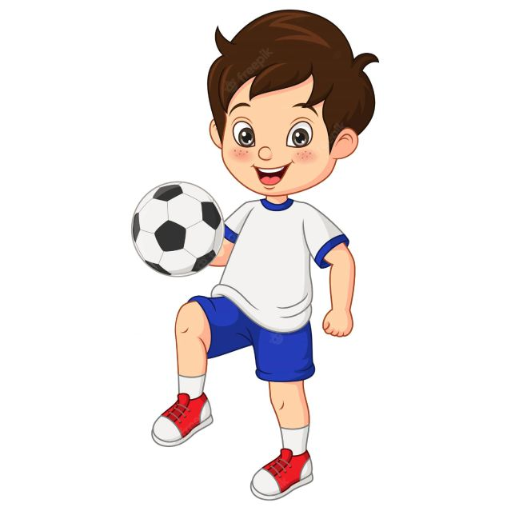

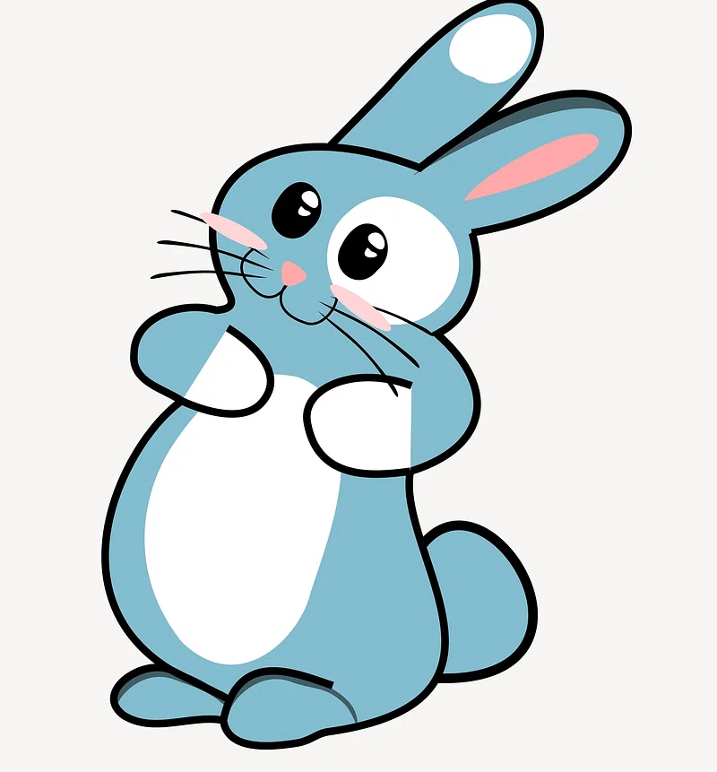

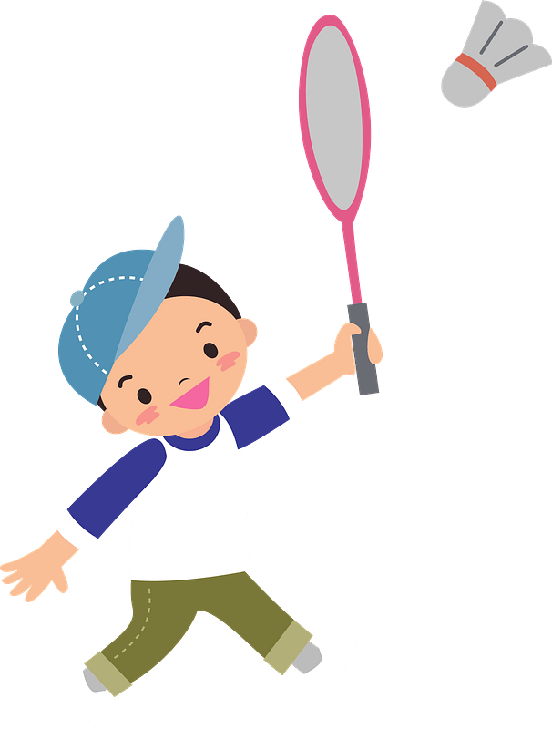
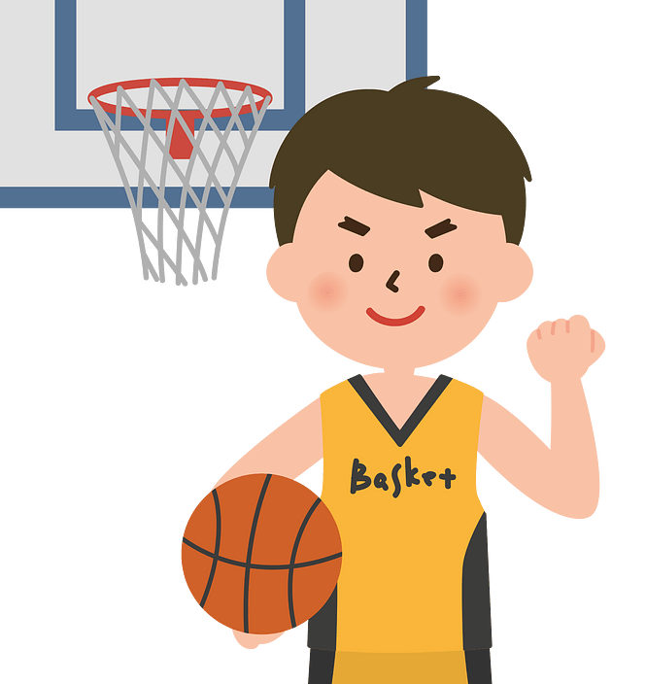
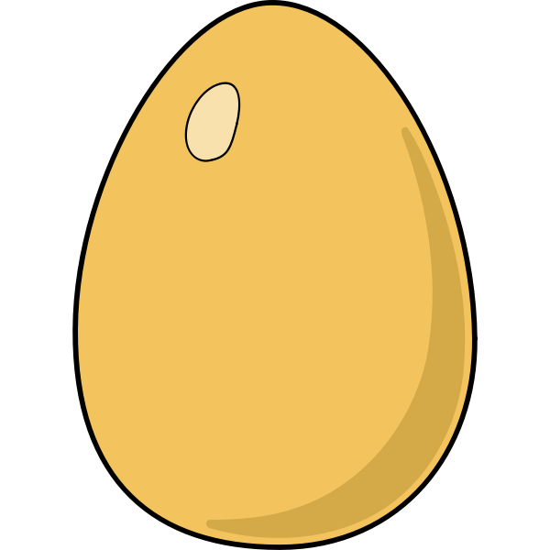

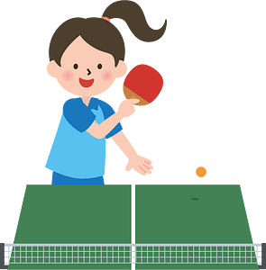
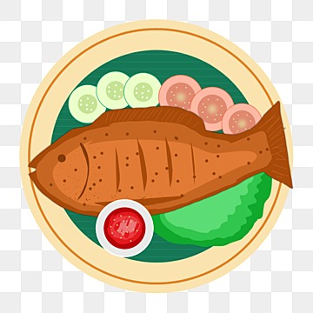
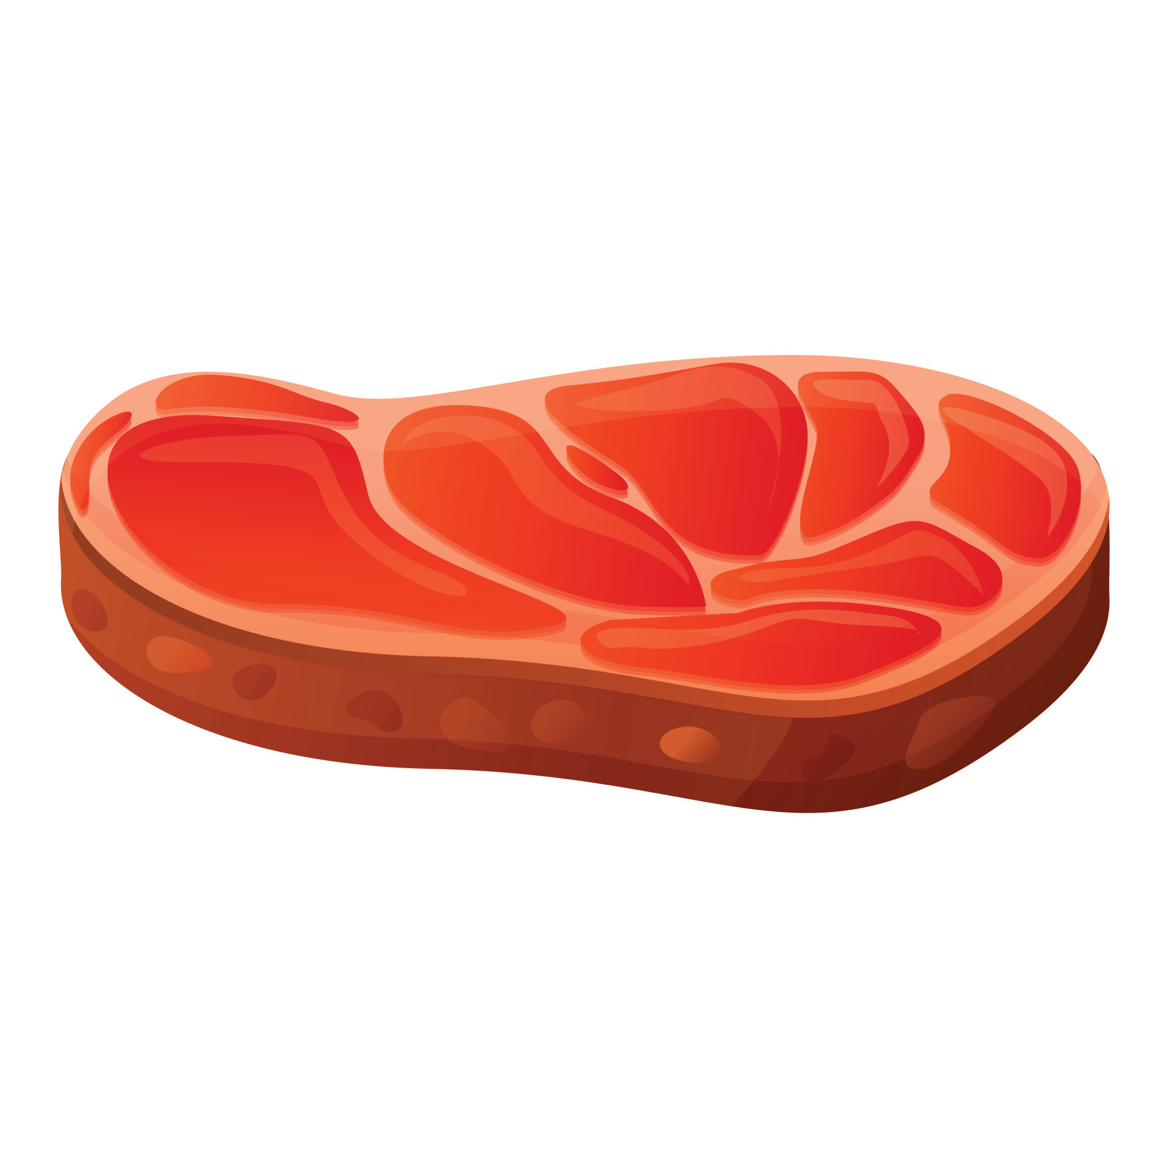
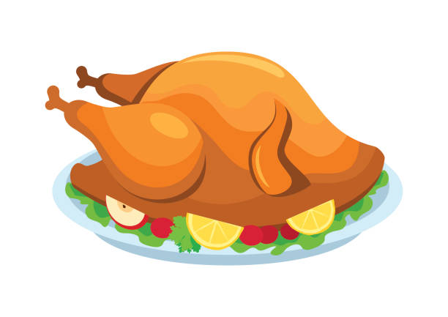




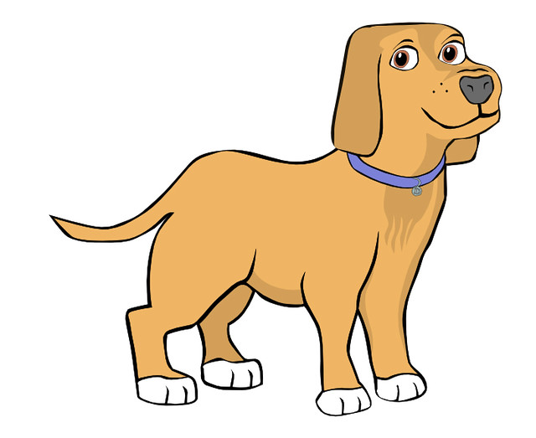
swim
Notes:
Nháy chuột để biến mất hình ảnh và xuất hiện hình ảnh tiếp theo

Slide 7



Slide 8
1
Look, listen and repeat.

Slide 9

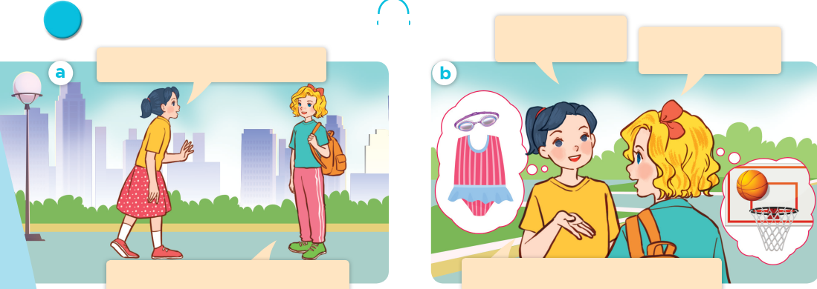
Look, listen and repeat.

Slide 10
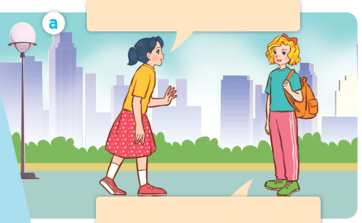
Look, listen and repeat.
Look, listen and repeat.
Where are you going, Mary?
I’m going to the sports centre.
Notes:
Nháy vào hội thoại để nghe lại âm thanh từng câu.

Slide 11
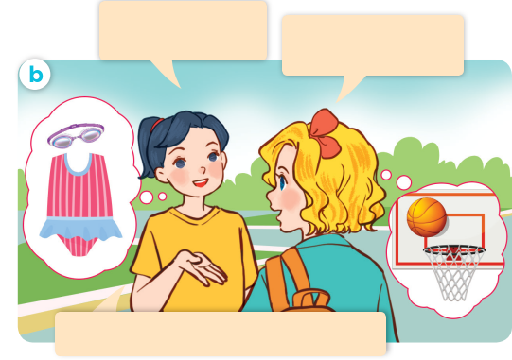
I’m going to the sports centre.
I’m going to the sports centre.
Look, listen and repeat.
Look, listen and repeat.
What’s your favourite sport?
It’s basketball. What about you?
My favourite sport is swimming.
Notes:
Nháy vào hội thoại để nghe lại âm thanh từng câu.

Slide 12
Look, listen and repeat.
Look, listen and repeat.
What’s your favourite sport?
It’s basketball. What about you?
Where are you going, Mary?
I’m going to the sports centre.
My favourite sport is swimming.

Slide 13

What’s your favourite sport?
It’s basketball.

Slide 14
2
Listen, point and say.

Slide 15
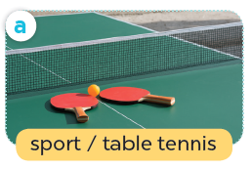
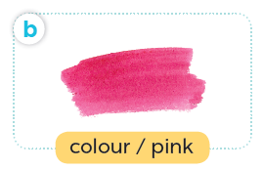
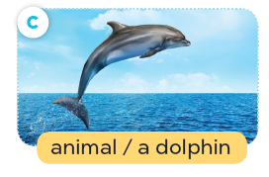
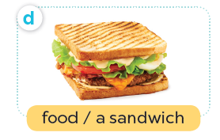
Listen, point and say.

Slide 16
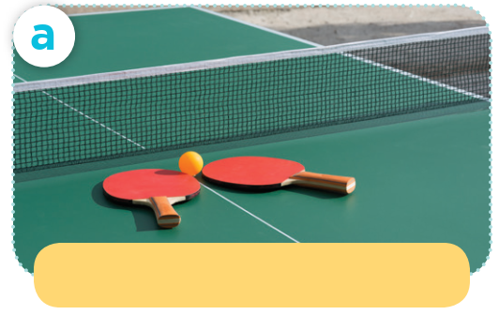
Listen, point and say.
sport / table tennis

Slide 17
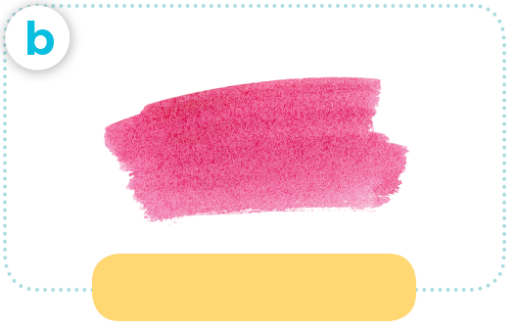
Listen, point and say.
colour / pink

Slide 18
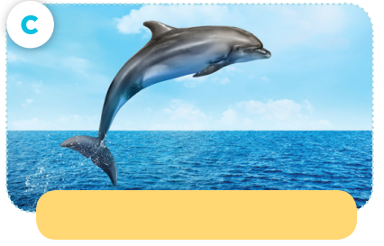
Listen, point and say.
animal / a dolphin

Slide 19
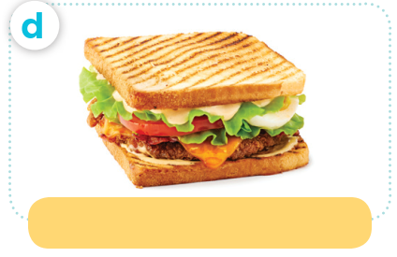
Listen, point and say.
food / a sandwich

Slide 20
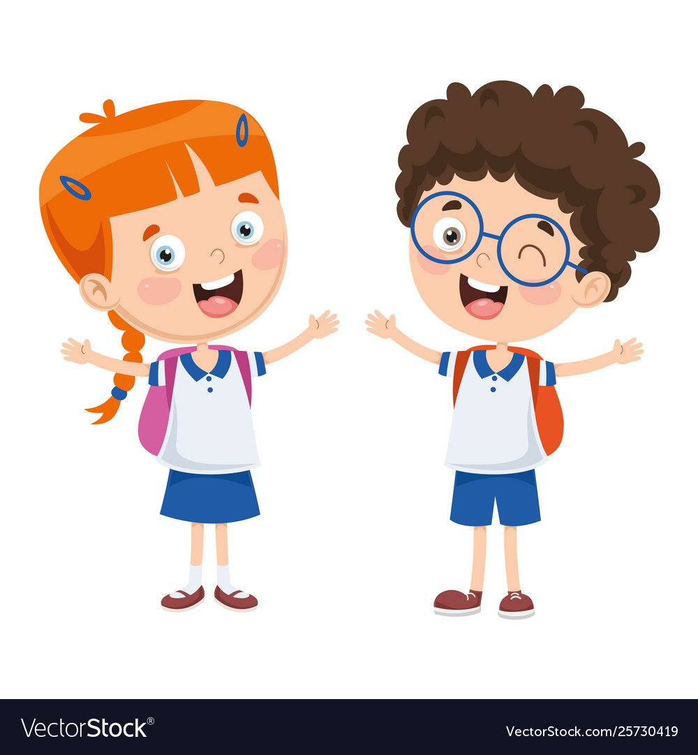
What’s your favourite ____?
It’s ____.

Slide 21
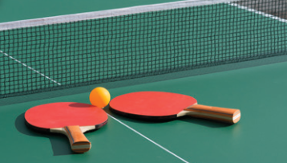
Listen, point and say.
What’s your favourite sport?
It’s table tennis.

Slide 22

Listen, point and say.
What’s your favourite colour?
It’s pink.

Slide 23
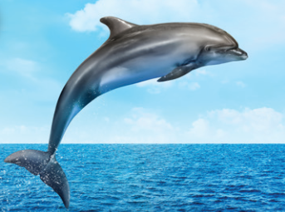
Listen, point and say.
What’s your favourite animal?
It’s a dolphin.

Slide 24
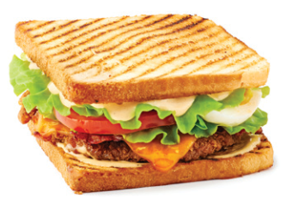
Listen, point and say.
What’s your favourite food?
It’s a sandwich.

Slide 25
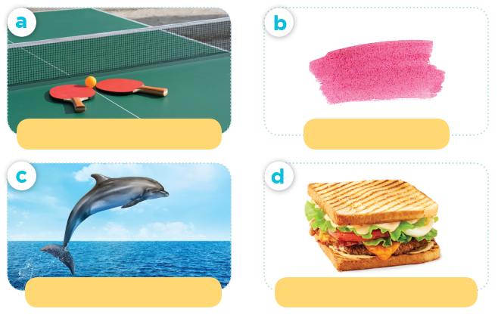
What’s your favourite ____?
sport / table tennis
colour / pink
It’s ____.
animal / a dolphin
food / a sandwich

Slide 26
4
Listen and match

Slide 27
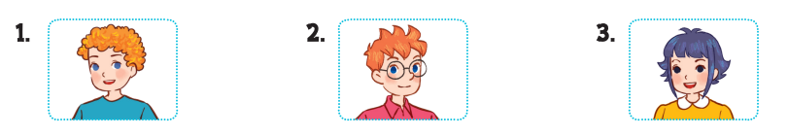
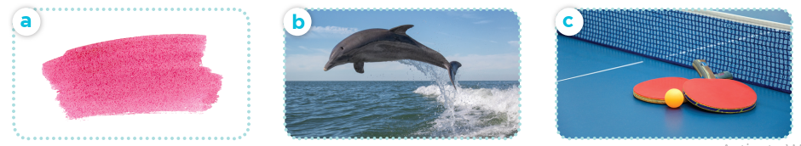
Listen and match.

Slide 28
Fun corner and wrap-up

Slide 29

Flash card passing
Game

