Slide 1
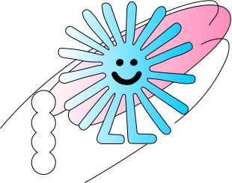
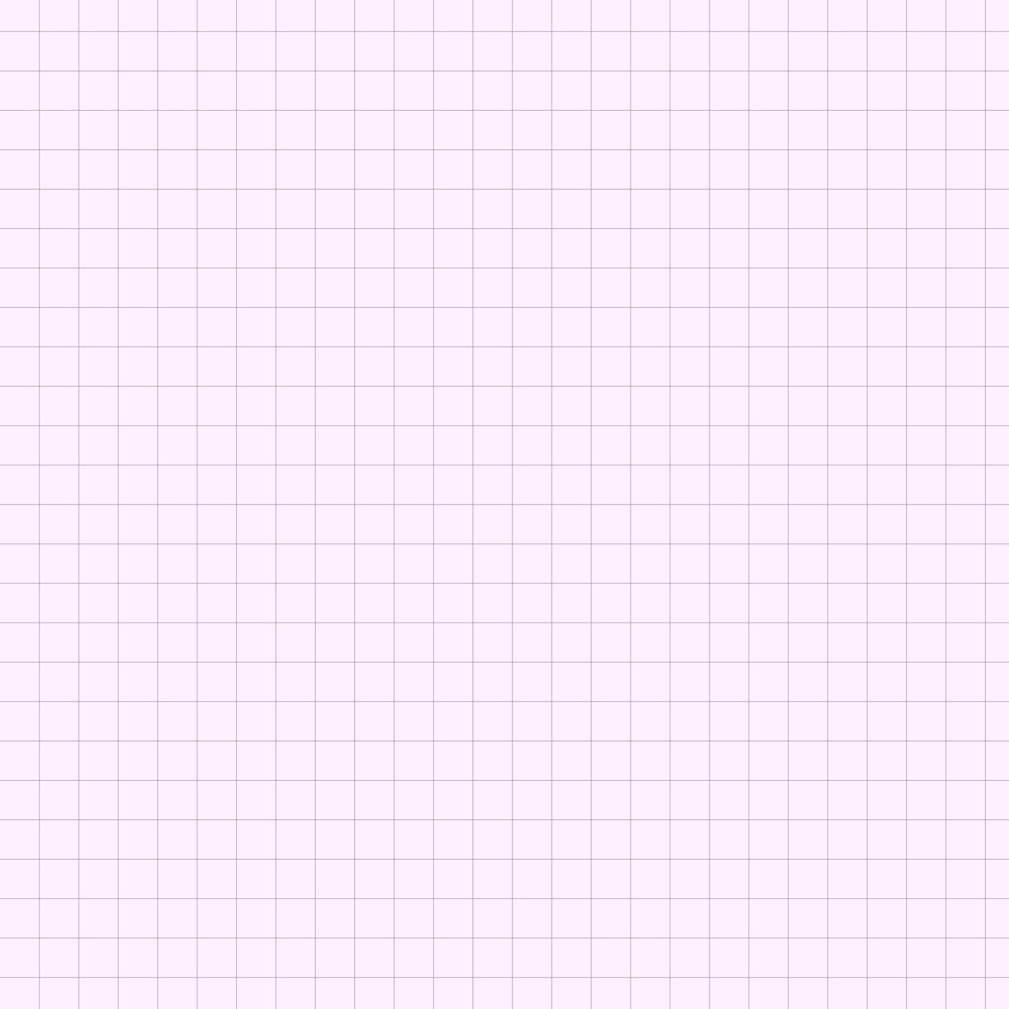
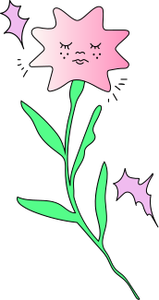

Wednesday, November 6th, 2024
REVIEW
1
LET'S START!

Slide 2
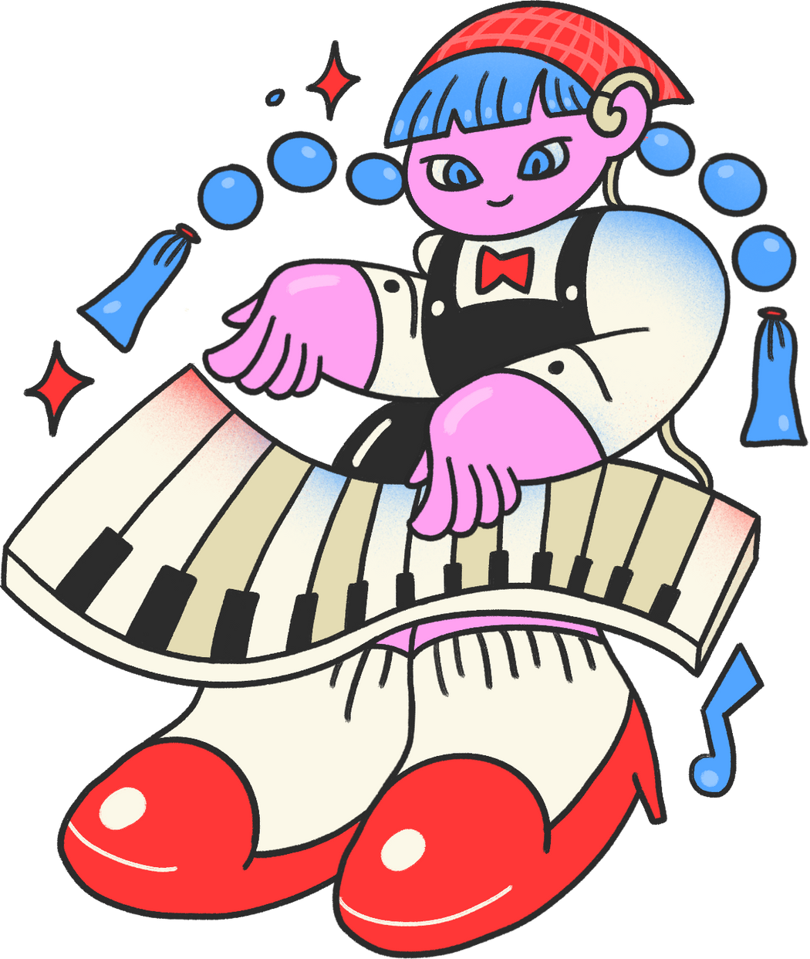
Liceria & Co.
GAME NIGHT
LET'S PLAY!

Slide 3

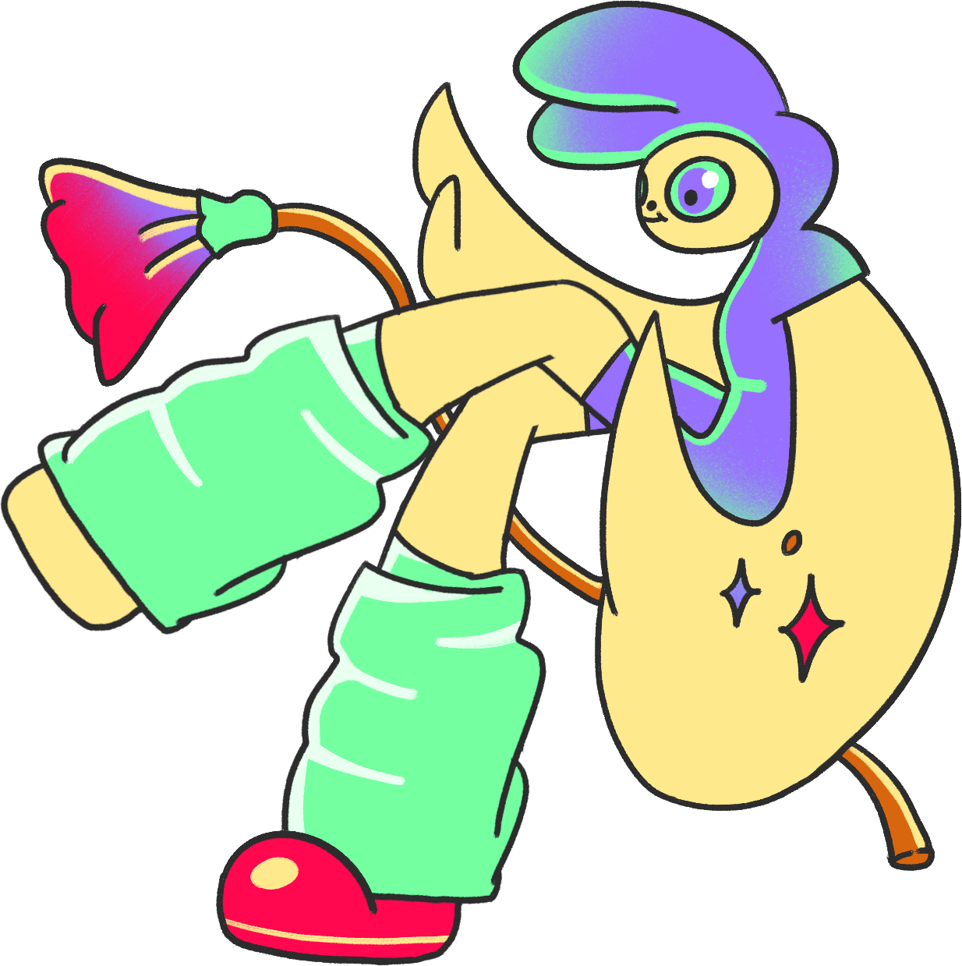
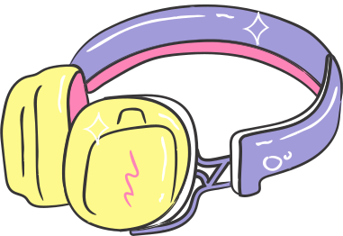
HOW TO PLAY
Guess the words!

Slide 4
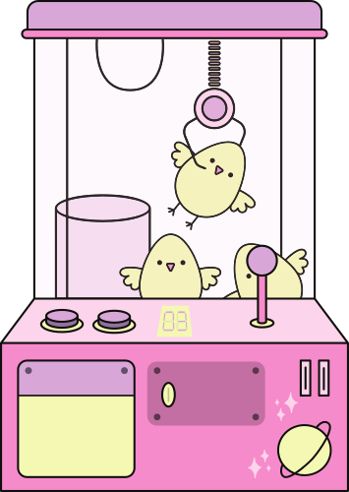
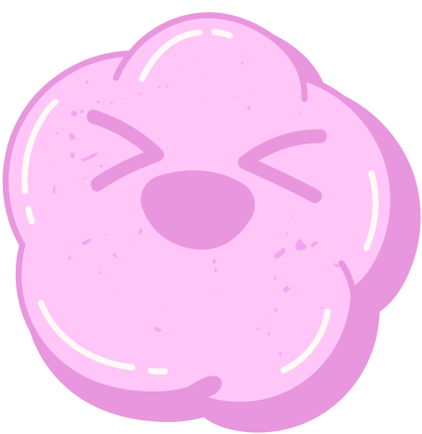
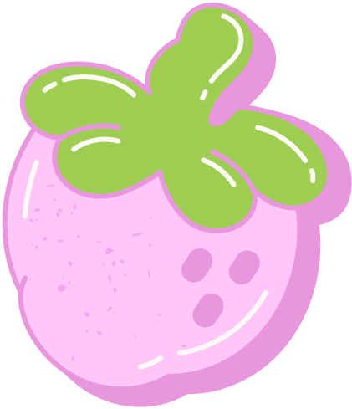

ARE YOU READY?

Slide 5
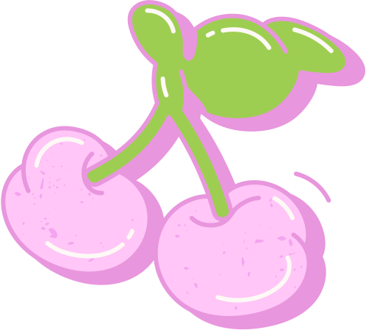
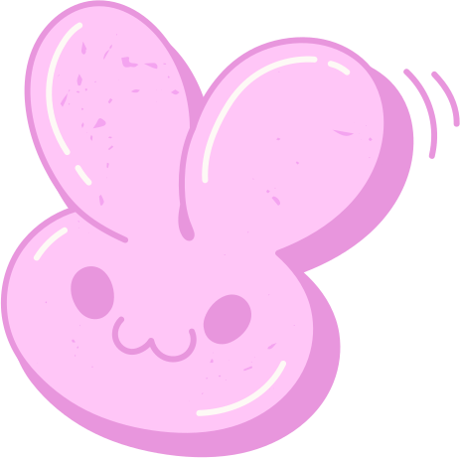
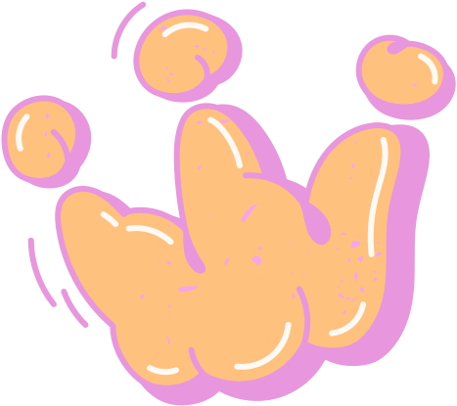

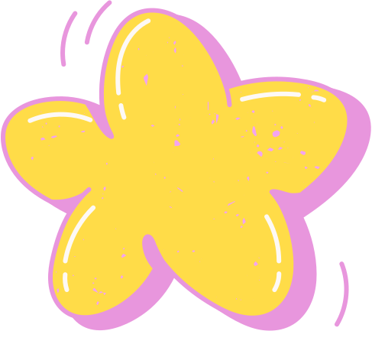
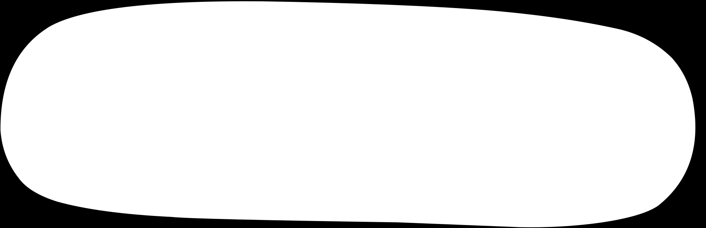
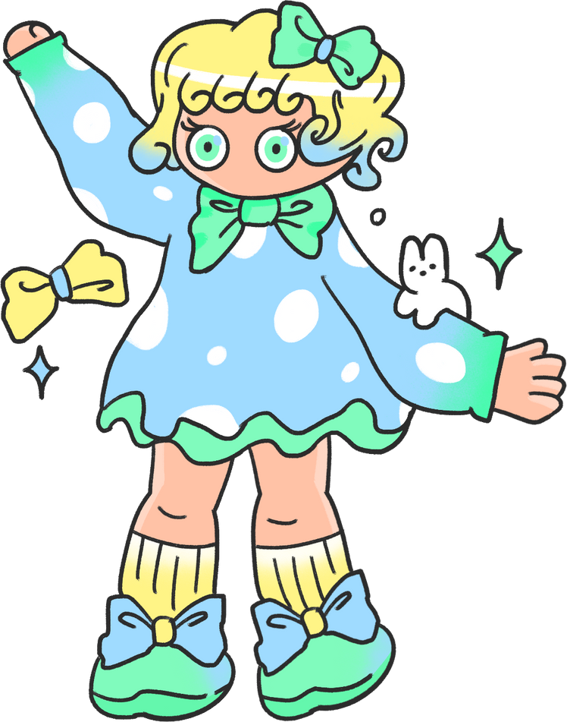
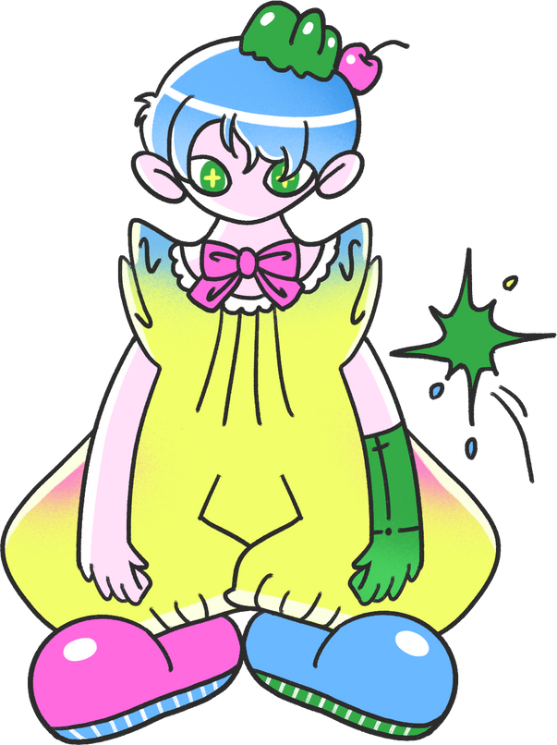
M_L_YS_A
Hint : Country

Slide 6

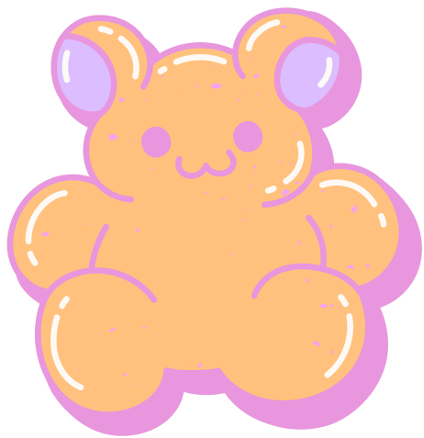
ANSWER
MALAYSIA

Slide 7
G_RD_RN_R
Hint : Job

Slide 8
ANSWER
GARDERNER

Slide 9
T_BL_ T_NN_S
Hint : Sport

Slide 10
ANSWER
TABLE TENNIS

Slide 11
B_IL_IN_
Hint : Place

Slide 12
ANSWER
BUILDING

Slide 13
S_R_ TH_ INT_RN_T
Hint : free-time activity

Slide 14
ANSWER
SURF THE INTERNET

Slide 15
THANK YOU
FOR PLAYING

Slide 16
3. Read and match
  Can you tell me about yourself?
a. Because I'd like to report th news.
2. Do you live in this tower?
b. I'm Andy. I'm in Grade 5.
3. Why would you like to be a reporter?
c. He's Malaysian.
4. What do you like doing in your free time?
d. No, I don't.
5. What nationality is he?
e. I like going for a walk.

Slide 17
4. Read and match
My name is Henry. I am Australian. I live in a small town in the south of Australia. My address is 72 Greenwood Street. I think my town is fantastic. It is always clean and beautiful. The people are friendly and helpful. I am a pupil in Grade 5 at Superstar Primary School. My favourite subject at school is science. I have quite good marks in science lessons. In my free time, I like surfing the Internet and planting flowers. I also enjoy going for a walk with my younger sister, Lily. My dream is to become a doctor in the future.

Slide 18
4. Read and match
All about me
Name: Herry.
Grade: (1) ________________________
Nationality: (2) ________________________
Address: (3) ________________________ Greenwood Street
Favourite subject: science
Free-time activities: (4) ________________________ , planting flowers, going for a walk with Lily
Future job: (5)________________________ .
5
Australian
72
surfing the Internet
doctor

Slide 19
5. Let's write:
Write about yourself.
– Your name
– Your address
– Your free-time activities
– Your future job

Slide 20
5. Let's write:
Example:
My name is Binh. My address is 12 Hoa Mai Street. I like surfing the Internet. I would like to be a writer because I want to write interesting stories.

Slide 21
Homework:
  Do Activity Book at page 34,35
  Prepare Unit 6 lesson 1

Slide 22
THANK YOU

