Slide 2





REVIEW 1
Period 1

Slide 3
I. OBJECTIVES.
By the end of the lesson, pupils will be able to:
1. Language.
- listen to five questions and circle the correct answer a, b or c.
- Ask and answer questions using picture cues.
2. Core competencies.
- Critical thinking and creativity: learn how to ask and answer questions using picture cues correctly and fluently.
- Communication and collaboration: work in pairs and teams to complete the learning tasks.
- Self-control & independent learning: perform listening and speaking tasks.
3. General competencies.
- Listening: listen and number
- Critical thinking: read and match
- Oral communication: let’s play
- Self-control & independent learning: perform listening tasks
- Communication and collaboration: work in pairs or groups
- Sociability: talk to each other, say good words to others.
4. Attributes.
- Study hard to review the vocabulary and sentence patterns they have learnt.
- Be honest in the learning tasks.

Slide 4





Warm-up and Review

Slide 5












Let's Play
The Memory Game

Slide 6

Round 1
Let's Go!

Slide 7



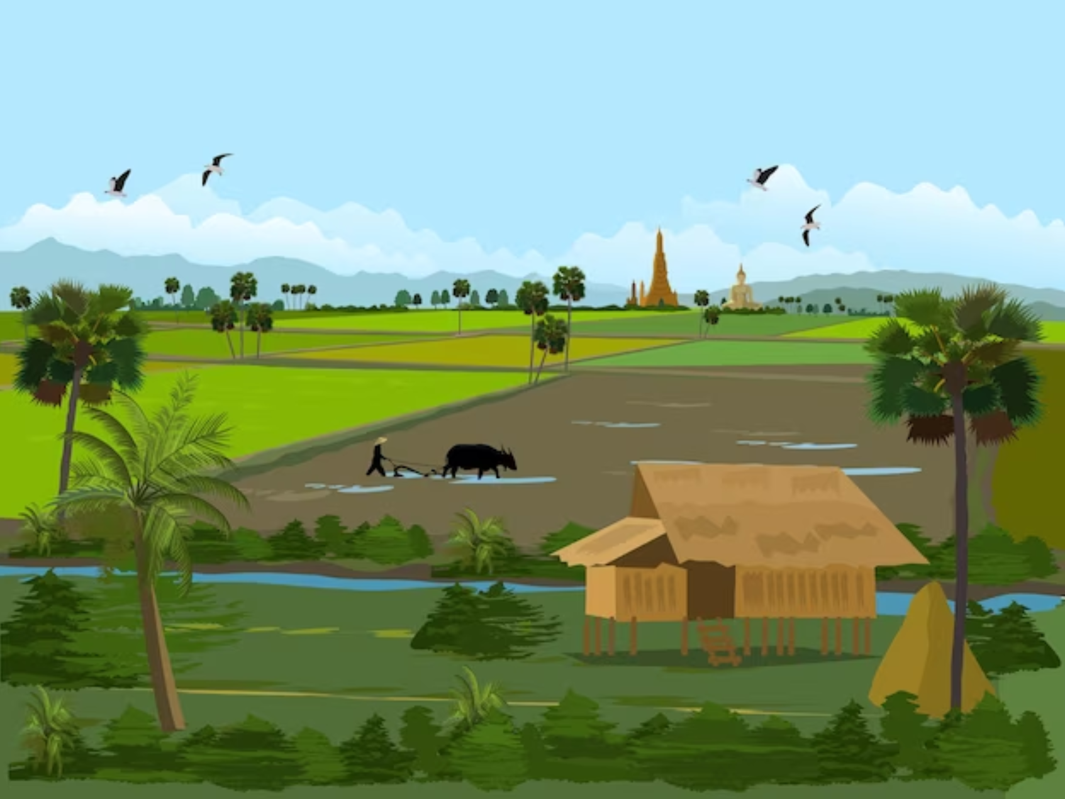
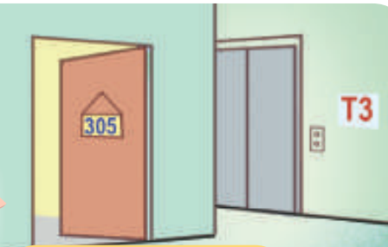
A
B
C
D
E
F
G
H
house
flat
countryside
city

Slide 8

Round 1 Score Board
Use this to keep track of the points! Copy and paste the token for every point a player receives.
Player 1
Player 2
Player 3
Notes:
Copy and paste the token for every point a player receives.

Slide 9
Round 2
You got this!

Slide 10


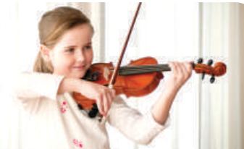



A
B
C
D
E
surf
the
Internet
water
the
flowers
play
the violin
I
F
G
H
J
Malaysia
Australia

Slide 11
Round 2 Score Board
Use this to keep track of the points! Copy and paste the token for every point a player receives.
Player 1
Player 2
Player 3

Slide 12

Thank you for playing!
See you next time!

Slide 13


1. Listen and circle a, b, or c.

Slide 14



Look and read.
a. I have a dolphin.
b. It’s a dolphin.
c. I can see a dolphin.
Notes:
Step 1: Draw pupils’ attention to the first set of suggested answers. Have them read the answer options. Check comprehension.

Slide 15


Look and read.
a. Yes, I can.
b. Yes, I do.
c. Yes, I am.
Notes:
Step 1: Draw pupils’ attention to the first set of suggested answers. Have them read the answer options. Check comprehension.

Slide 16

Look and read.
a. I’d like to write stories for children.
b. I’m a writer.
c. I’d like to be a writer.
Notes:
Step 1: Draw pupils’ attention to the first set of suggested answers. Have them read the answer options. Check comprehension.

Slide 17

Look and read.
a. He’s in the computer room.
b. He likes playing football.
c. He’s active.
Notes:
Step 1: Draw pupils’ attention to the first set of suggested answers. Have them read the answer options. Check comprehension.

Slide 18

Look and read.
a. I like watering flowers.
b. I’m watering flowers.
c. I like flowers.
Notes:
Step 1: Draw pupils’ attention to the first set of suggested answers. Have them read the answer options. Check comprehension.

Slide 19


Listen and circle a, b or c.
a. I have a dolphin.
b. It’s a dolphin.
c. I can see a dolphin.
Notes:
Step 2: Play the recording for Question 1. Play the recording again for pupils to do the task. Play the recording a third time for pupils to check their answers.

Slide 20


Listen and circle a, b or c.
a. I’d like to write stories
for children.
b. I’m a write.
c. I’d like to be a writer.
a. I have a dolphin.
b. It’s a dolphin.
c. I can see a dolphin.
a. Yes, I can.
b. Yes, I do.
c. Yes, I am.
a. He’s in the computer room.
b. He likes playing football.
c. He’s active.
a. I like watering flowers.
b. I’m watering flowers.
c. I like flowers.
Notes:
Step 3: Repeat Steps 1 and 2 for the rest of the questions.

Slide 21

YOUR ANSWERS
b
______
______
______
______
______
Notes:
Step 4: Get pupils to swap books with a partner, then check answers as a class. Write the correct answers on the board.
Step 5: Play the recording for pupils to double-check their answers.

Slide 22
Let’s check!
a. Yes, I can.
b. Yes, I do.
c. Yes, I am.
Notes:
* Key: 1. b, 2. b, 3. c, 4. c, 5. a

Slide 23
Let’s check!
a. I’d like to write stories for children.
b. I’m a writer.
c. I’d like to be a writer.
Notes:
* Key: 1. b, 2. b, 3. c, 4. c, 5. a

Slide 24
Let’s check!
a. He’s in the computer room.
b. He likes playing football.
c. He’s active.
Notes:
* Key: 1. b, 2. b, 3. c, 4. c, 5. a

Slide 25
Let’s check!
a. I like watering flowers.
b. I’m watering flowers.
c. I like flowers.
Notes:
* Key: 1. b, 2. b, 3. c, 4. c, 5. a

Slide 26
2. Ask and answer.

Slide 27

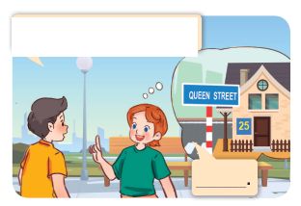


What’s your address?
Lucy
Nick
It’s 25 Queen Street.
Notes:
Step 1: Draw pupils’ attention to the first picture. Get them to look at the bubble to identify the activity shown in it. Check pupils’ comprehension.
Step 2: Draw pupils’ attention to Question 1. Have pupils look at the bubble over Lucy’s head to answer the question.

Slide 28

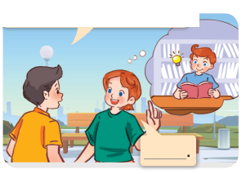
What’s your brother like?
He’s clever.
Notes:
Step 3: Repeat Step 1 and 2 with the rest of the questions.

Slide 29

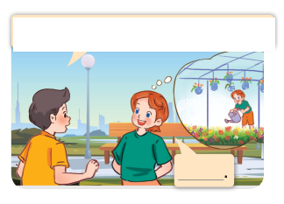
What do you do at the weekend?
I water flowers.
Notes:
Step 3: Repeat Step 1 and 2 with the rest of the questions.

Slide 30

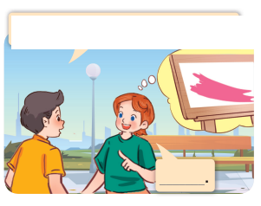
What’s your favourite color?
It’s pink.
Notes:
Step 3: Repeat Step 1 and 2 with the rest of the questions.

Slide 31

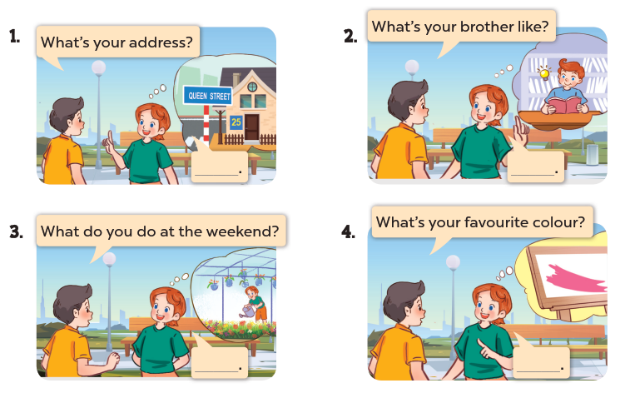
Notes:
Step 4: Have pupils work in pairs to role-play the four exchanges. Go around the classroom to monitor the activity.

Slide 32
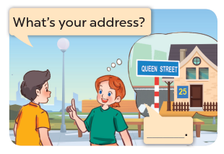
Game: PASS THE BALLS!
Notes:
Extension: Invite pairs of pupils to stand up and take it in turns to role-play the target exchanges.
Game: Pass the balls!
Pupils pass the two balls; one is red and the other is blue. Listen to music and they pass the balls. When the music stops, the pupils with the red ball will make a question and the one with the blue ball will give the answer.

Slide 33
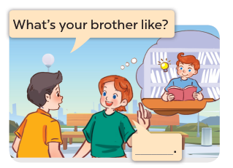
Game: PASS THE BALLS!
Notes:
Extension: Invite pairs of pupils to stand up and take it in turns to role-play the target exchanges.
Game: Pass the balls!
Pupils pass the two balls; one is red and the other is blue. Listen to music and they pass the balls. When the music stops, the pupils with the red ball will make a question and the one with the blue ball will give the answer.

Slide 34
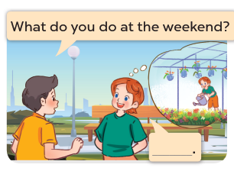
Game: PASS THE BALLS!
Notes:
Extension: Invite pairs of pupils to stand up and take it in turns to role-play the target exchanges.
Game: Pass the balls!
Pupils pass the two balls; one is red and the other is blue. Listen to music and they pass the balls. When the music stops, the pupils with the red ball will make a question and the one with the blue ball will give the answer.

Slide 35
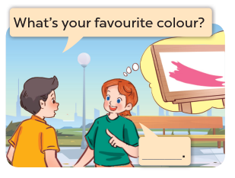
Game: PASS THE BALLS!
Notes:
Extension: Invite pairs of pupils to stand up and take it in turns to role-play the target exchanges.
Game: Pass the balls!
Pupils pass the two balls; one is red and the other is blue. Listen to music and they pass the balls. When the music stops, the pupils with the red ball will make a question and the one with the blue ball will give the answer.

Slide 36
3. Read and match.

Slide 37




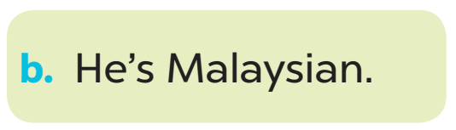
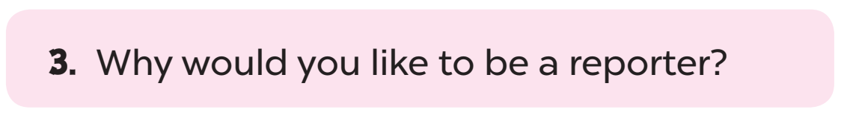
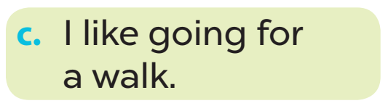
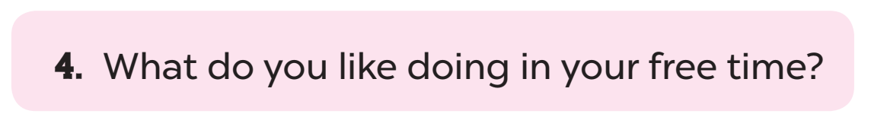
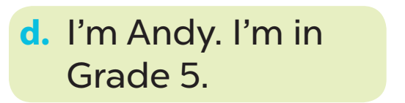

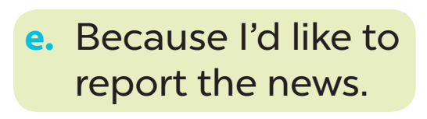
Look and read.
Notes:
Step 2: Give pupils time to do the task. Go around the classroom to offer support.

Slide 38
Let’s check.
Notes:
Step 2: Give pupils time to do the task. Go around the classroom to offer support.

Slide 39
Fun corner and Wrap-up.

Slide 40





Let's Play
TIC TAC TOE

Slide 41











Team 1
blue
pink
clever
31
Nguyen
Hue
street
17
Hoa Binh
street
go for
a walk
Team 2
surf the Internet
active
orange
Notes:
GV kết hợp cách cho điểm ở bảng đen.

Slide 42



Score Board
Team 1
Team 2
Notes:
Copy and paste the token for every point a team receives.

Slide 43

THANK YOU
for
PLAYING!

