Slide 1


Slide 2


Our sports day
9
Lesson 3

Slide 3
I. OBJECTIVES.
By the end of the lesson, pupils will be able to:
1.Language knowledge & skills.
- Correctly repeat the sounds of the letter y in isolation, in the word February (/i/) as in the sentence Our sports day is in February, and the word July (/aɪ/), as in the My birthday is in July.
- Identify the target words July and January while listening.
- Read and show understanding of a text by deciding if the statements are true or false.
- Read, understand and complete the gapped text about a sports day.
2. Competences.
- Communication and collaboration: work in pairs and groups to complete the learning tasks
- Self-control & independent learning: perform learning tasks
3. Attributes.
- Develop their interests in sports and show their responsibility by raising awareness of the months of the year.

Slide 4
Review

Slide 5
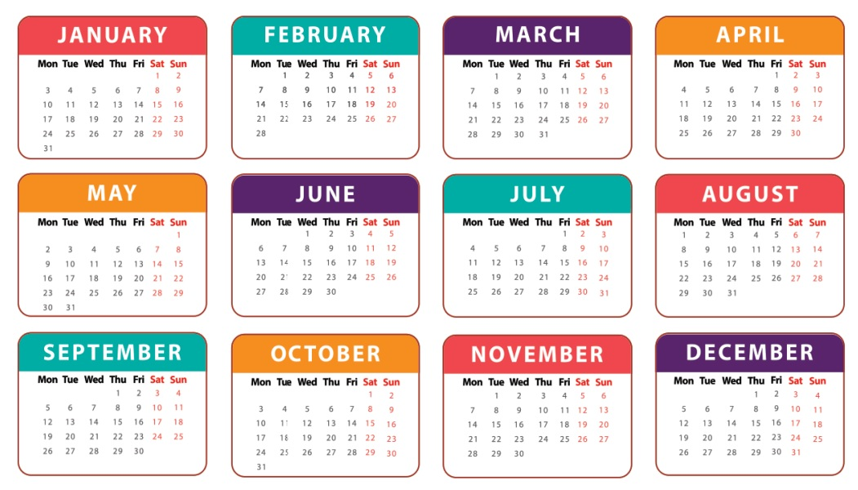

When’s your sports day?
It’s in June.

Slide 6
Is your sports day in February?
Yes, it is.

Slide 7
Is your sports day in July?
No, it isn’t.

Slide 8
When’s your sports day?
It’s in December.

Slide 9
When’s your birthday?
It’s in April.

Slide 10
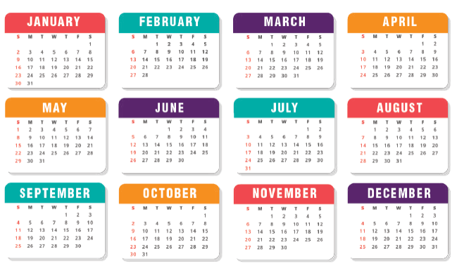
Is your sports day in October?
Yes, it is.

Slide 11
When’s your birthday?
It’s in May.

Slide 12
Is your sports day in January?
No, it isn’t.

Slide 13
1. Listen and repeat.

Slide 14
letter y
/i/
/aɪ/
February
July

Slide 15

1
Listen and repeat.
y February
Our sports day is in February.
y July
My birthday is in July.

Slide 16
2. Listen and circle.

Slide 17
2
Listen and circle.
1. Is your sports day in ___?
a. July b. February c. January
2. I like ___.
a. July b. January c. cycling

Slide 18
4. Read and tick True or False.

Slide 19
Read the passage.
Our sports day is in November. It is in the school playground. There are many pupils and teachers. We play different sports and games. The boys play badminton. The girls play football. The teachers play basketball. It is a lot of fun!

Slide 20

True or False.
 | True | False
1. The sports day is in November.
2. The sports day is in the school gym.
3. The boys play badminton.
4. The girls play basketball.

Slide 21
5. Let’s write.

Slide 22
5
Let’s write.
Our school sports day is in ________. We play sports and games in the school playground. The girls _________. The boys __________. The teachers _________. We all love our sports day.
October
play chess
play football
play volleyball

Slide 23
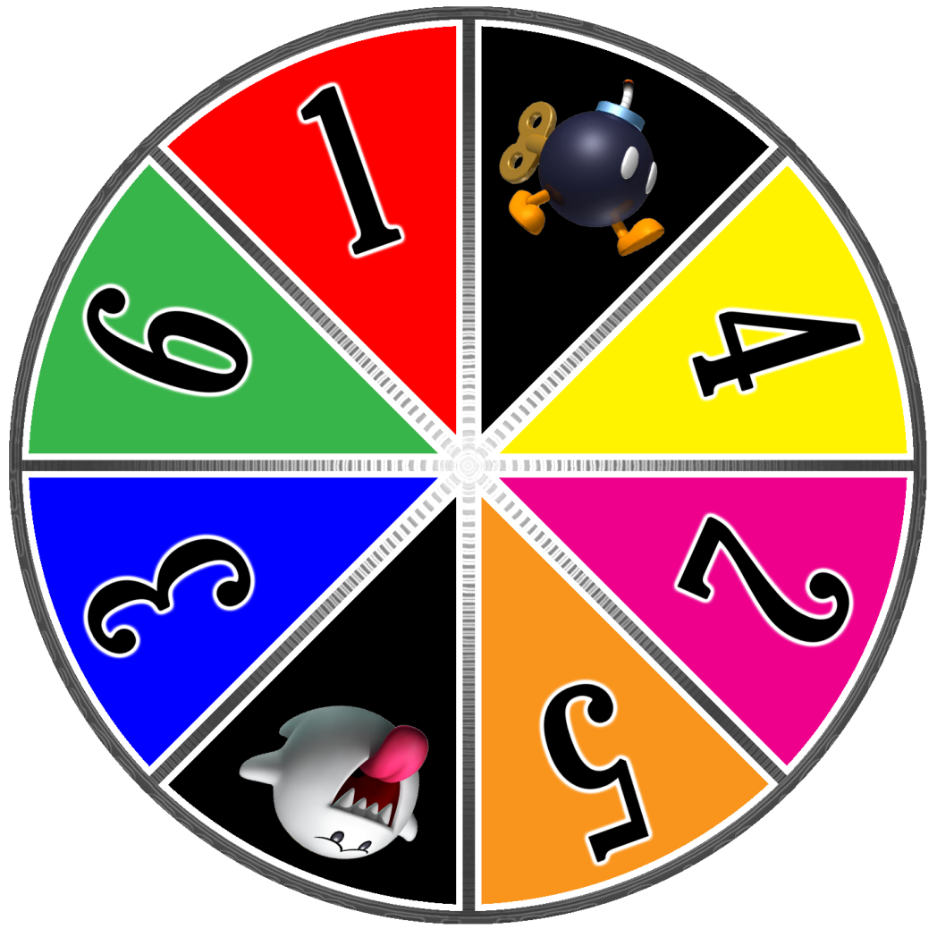




Slide 24
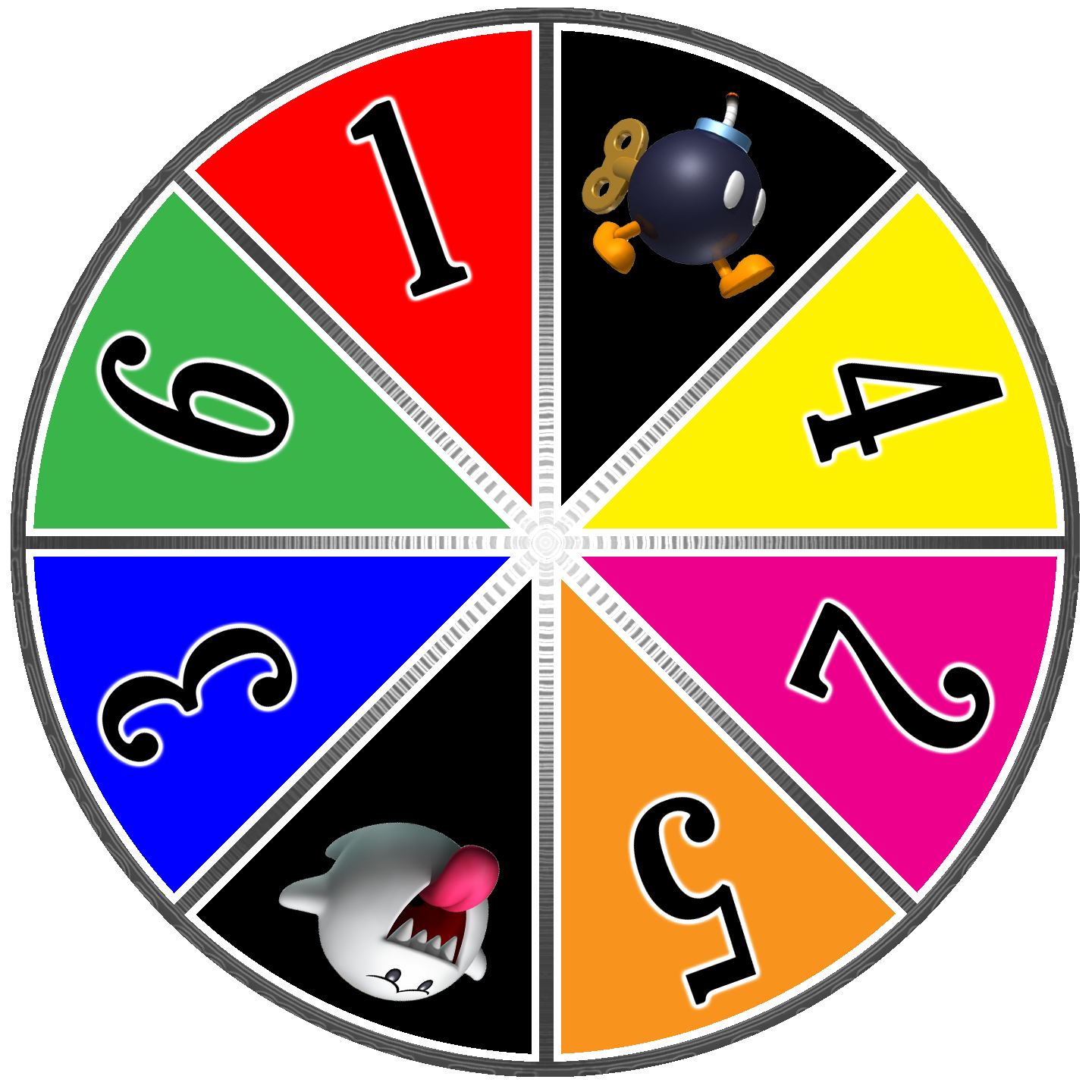

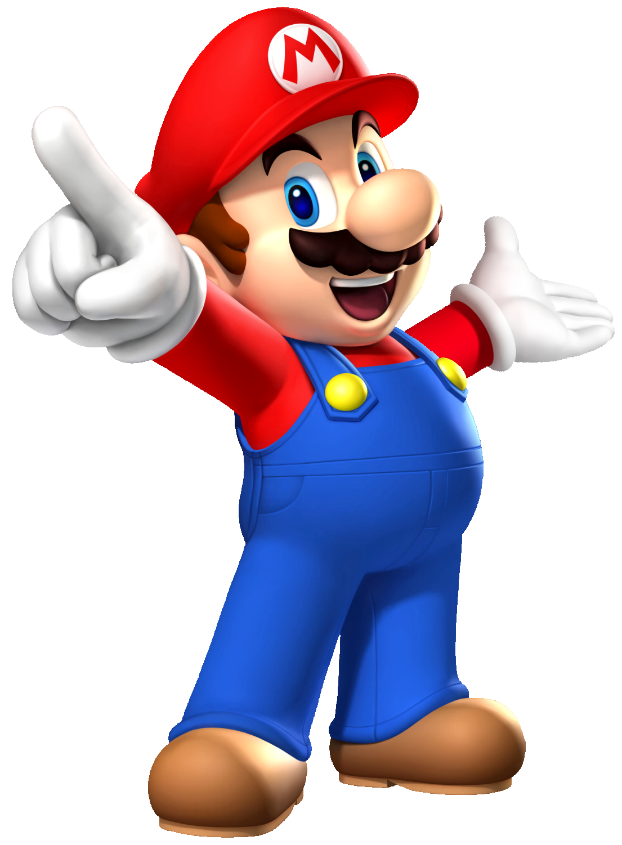


Slide 25

When’s your sports day?
It’s in August.

Slide 26
When’s your sports day?
It’s in September.

Slide 27
Is your sports day in June?
No, it isn’t. It’s in May.

Slide 28
When’s your sports day?
It’s in November.

Slide 29
Our …………..…… is in July.
sport days
sports day
Notes:
Students fill in the blank

Slide 30
My …………..…… is in December.
birth day
birthday
Notes:
Students fill in the blank

Slide 31
When’s your sports day?
It’s in April.

Slide 32
When’s your birthday?
It’s in …….
Notes:
Students fill in the blank

Slide 33
Our sports day is ……… March.
in
on

Slide 34
Our sports day is in November.
True
False

Slide 35
Our sports day is in ………...
July
August
Notes:
Students fill in the blank

Slide 36
Our sports day is in February.
True
False

