Slide 1


Slide 2


Our Sports Day
9
Lesson 2

Slide 3
I. OBJECTIVES.
By the end of the lesson, pupils will be able to:
1. Language knowledge & skills.
- Understand and correctly repeat the sentences in two communicative contexts focusing on asking and answering questions about when a sports day is.
- Correctly say the words and use When's your sports day? – It's in ______. to ask and answer questions about when a sports day is.
- Enhance the correct use of When's your sports day? – It's in ______. to ask and answer questions about when a sports day is in a freer context.
- Listen to and understand two communicative contexts in which pupils ask and answer questions about when a sports day is and tick the correct pictures.
2. Competences.
- Communication and collaboration: work in pairs and groups to complete the learning tasks
- Self-control & independent learning: perform listening tasks
3. Attributes.
- DDevelop their interests in sports and show their responsibility by raising awareness of the months of the year.

Slide 4
Warm-up

Slide 5

Notes:
Link: https://youtu.be/SSl-SbVz2oA

Slide 6
Unscramble the letters
Notes:
- Divide pupils into teams.
- Show the scrambled letters. Have pupils think and whisper the answer to their friend.
- Teacher calls out the representatives to race to the board and write the answer.
- Teacher gives stars/ points to the team with correct answer. Give extra stars/ points to the fast team(s).

Slide 7





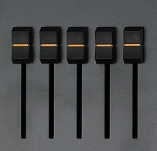




E U R Y A F B R
FEBRUARY
Notes:
Click on the red button to reveal the answer.

Slide 8
R A I P L
APRIL
Notes:
Click on the red button to reveal the answer.

Slide 9
Y J U A R A N
JANUARY
Notes:
Click on the red button to reveal the answer.

Slide 10
U S A T U G
AUGUST
Notes:
Click on the red button to reveal the answer.

Slide 11
C R A H M
MARCH
Notes:
Click on the red button to reveal the answer.

Slide 12
YLUJ
JULY
Notes:
Click on the red button to reveal the answer.

Slide 13
1. Look, listen and repeat.

Slide 14
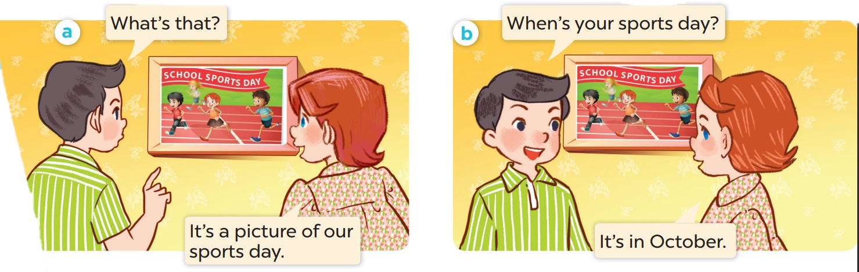
Who is the girl? Who is the boy?

Slide 15

Look, listen and repeat.

Slide 16
Work in pairs. Practise.

Slide 17
2. Listen, point and say.

Slide 18
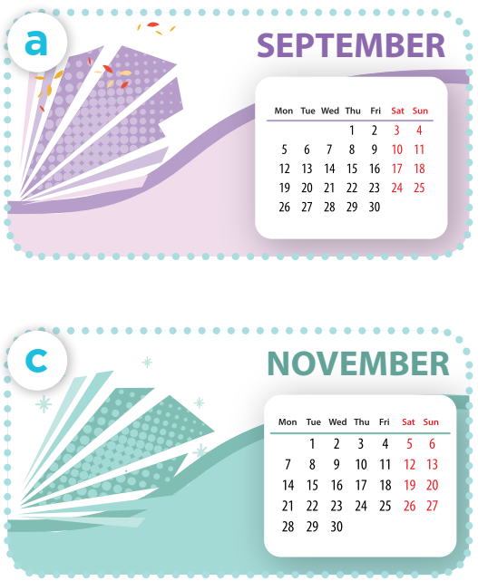
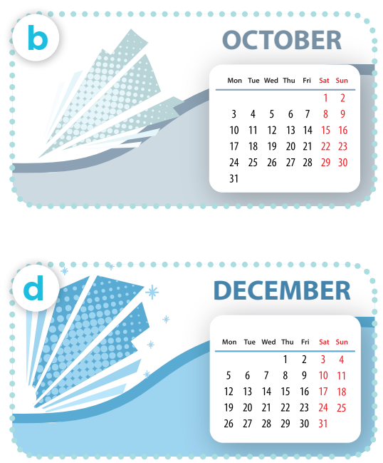
Listen, point and say.
Work in pairs. Practise.
When’s your sports day?
It’s in ___.
Notes:
Click on the Speaker Icon to play the audio.

Slide 19


When's your sports day?
It's in December.

Slide 20


When's your sports day?
NOVEMBER
It's in November.

Slide 21
When's your sports day?
It's in _____.

Slide 22
2. Listen and tick.

Slide 23
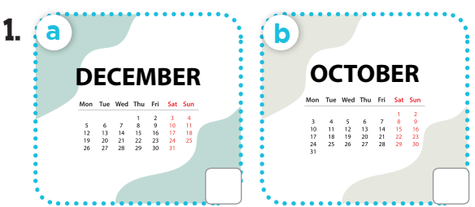
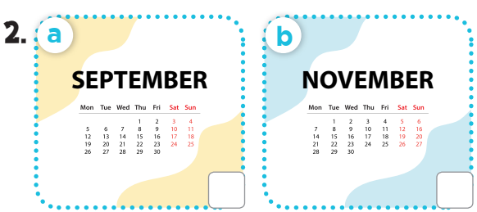
Look and say the months.

Slide 24
Listen and tick.
v
v

