Slide 1


Slide 2


Our sports day
9
Lesson 1

Slide 3
I. OBJECTIVES.
By the end of the lesson, pupils will be able to:
1. Language knowledge & skills.
- Understand and correctly repeat the sentences in two communicative contexts focusing on asking and answering questions about a sports day.
- Correctly say the words and use :
Is your sports day in ______?
- Yes, it is.
- No, it isn’t. It’s in ______. to ask and answer questions about a sports day.
- Enhance the correct use of Is your sports day in ______? – Yes, it is. / No, it isn’t. It’s in ______. to ask and answer questions about a sports day.
2. Competences.
- Communication and collaboration: work in pairs and groups to complete the learning tasks
- Self-control & independent learning: perform listening tasks
3. Attributes.
- Develop their interests in sports and show their responsibility by raising awareness of months in the year.

Slide 4
Warm-up

Slide 5

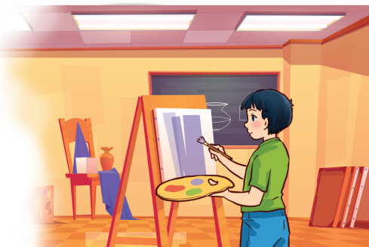
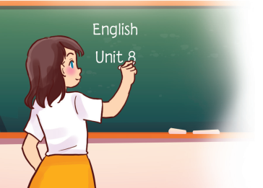
Art, art.
My favourite subject is art. Why do you like it?
Because I want to be a painter.
English, English.
My favourite subject is English. Why do you like it?
Because I want to be an English teacher.

Slide 6
1. Look, listen and repeat.

Slide 7
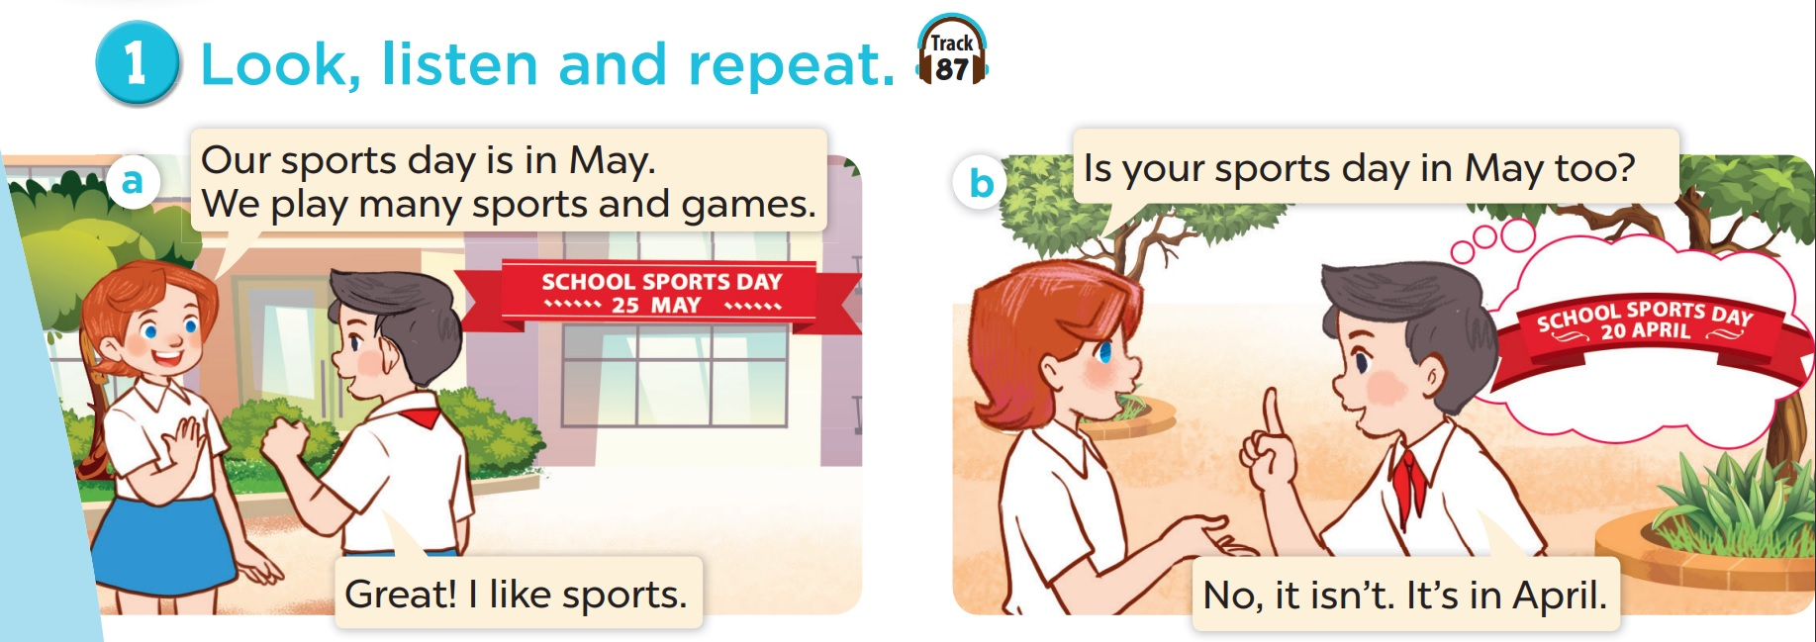
Who is the girl? Who is the boy?

Slide 8
When is the girl's school sports day?
When is the boy's school sports day?

Slide 9
Look, listen and repeat.

Slide 10
2. Listen, point and say.

Slide 11
Vocabulary

Slide 12
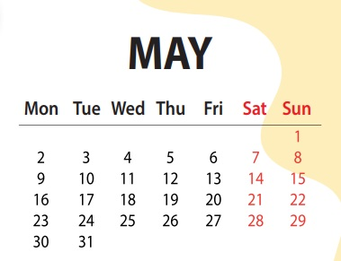

Slide 13
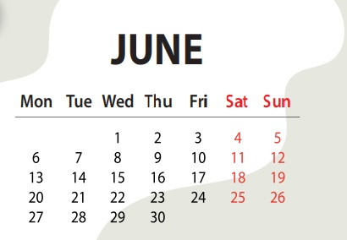

Slide 14
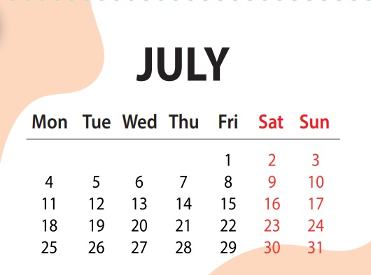

Slide 15
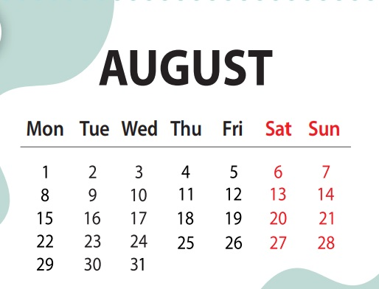

Slide 16
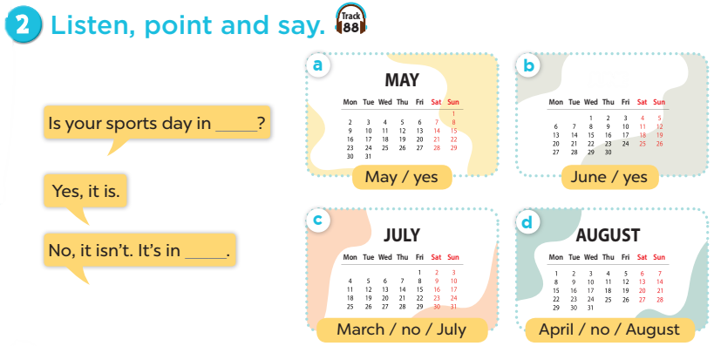
Notes:
Click on the Speaker Icon to play the audio.

Slide 17
4. Listen and match.

Slide 18
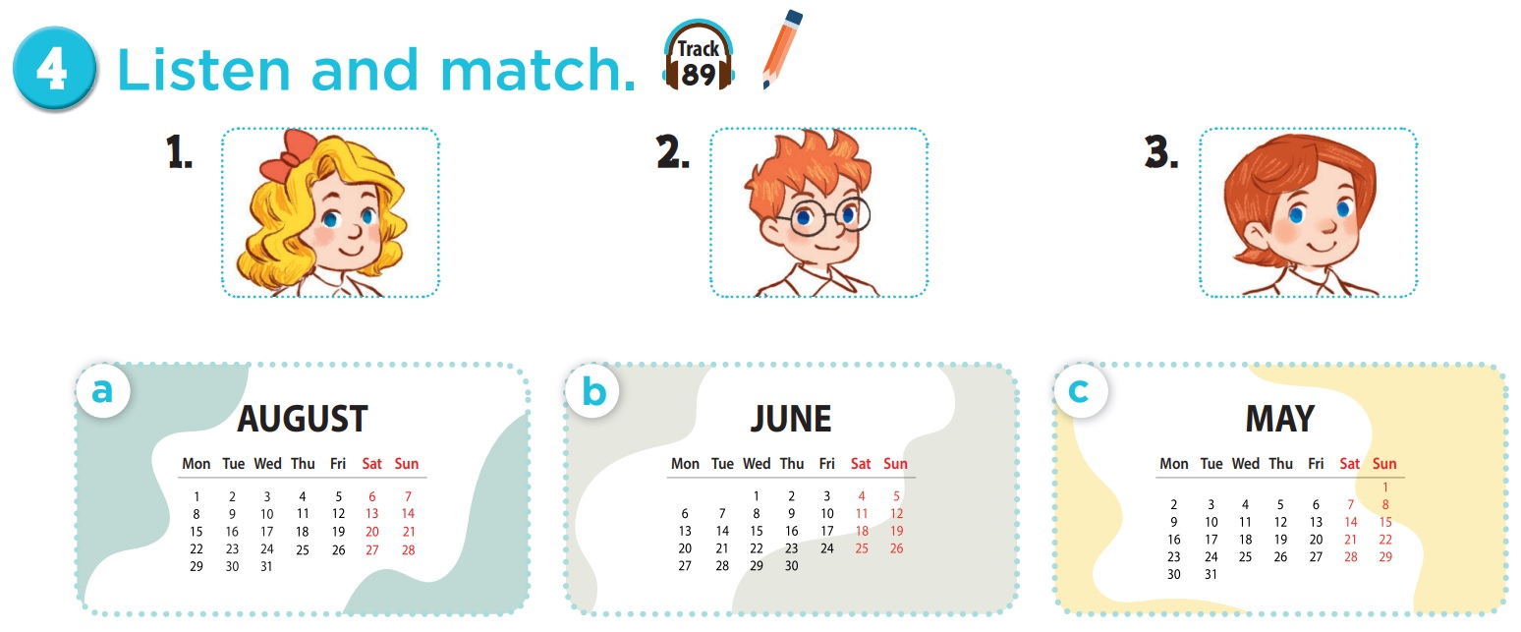

Who is she? Who is he?

Slide 19
Which month do you see?

Slide 20

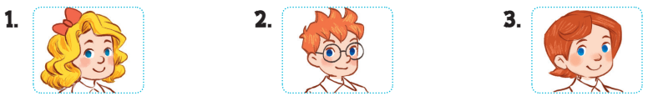
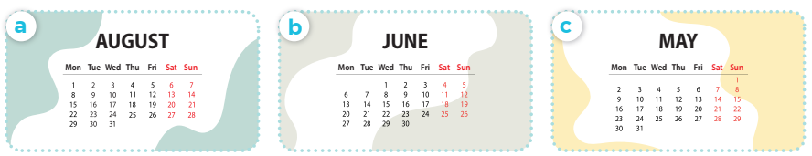

Slide 21
Game

Slide 22
0
0
0
O
O
O
X
X
X
1
2
3
X
X
X
0
0
0
O
O
O
X
X
X
4
5
6
X
X
X
0
0
0
O
O
O
X
X
X
7
8
9
X
X
X
Notes:
- Divide Ss into 2 teams: one team is X, one team is O.
- Students select a number on the grid, then 2 students from that team ask and answer based on the cue. If they answer correctly, teacher clicks on the home button to go back to the first slide, then click on X or O (depending on which team is answering).
- The first team to get three Xs or three Os in a row wins!

Slide 23

your sports day / May?
Is your sports day in May?
Yes, it is.

Slide 24
your sports day / June?
Is your sports day in June?
No, it isn't.
It's in May.

Slide 25


your sports day / July?
Is your sports day in July?
Yes, it is.

Slide 26

your sports day / July?
Is your sports day in July?
No, it isn't. It's in June.

Slide 27
your sports day / February?
Is your sports day in February?
No, it isn't. It's in June.

Slide 28
What's the 4th month of the year?
It's April.

Slide 29
What's the 5th month of the year?
It's May.

Slide 30
What's the 6th month of the year?
It's June.

Slide 31
What's the 7th month of the year?
It's July.

