Slide 1


Slide 2


Our sports day
9
Lesson 1 + Lesson 2

Slide 3
I. OBJECTIVES.
By the end of the lesson, pupils will be able to:
1. Language knowledge & skills.
- Complete four target sentence patterns in four exchanges with the help of picture cues.
- Sing the song Our sports day with the correct pronunciation, rhythm and melody.
- Complete two gapped dialogues with the help of picture cues.
2. Competences.
- Communication and collaboration: work in pairs and groups to complete the learning tasks
- Self-control & independent learning: perform listening tasks
3. Attributes.
- Develop their interests in sports and show their responsibility by raising awareness of months in the year.

Slide 4
Warm-up

Slide 5
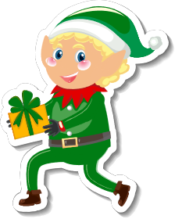
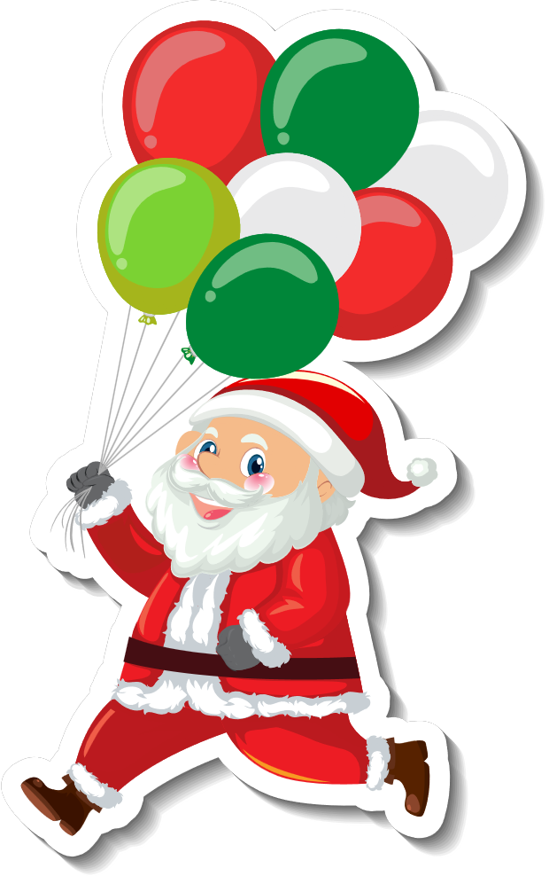


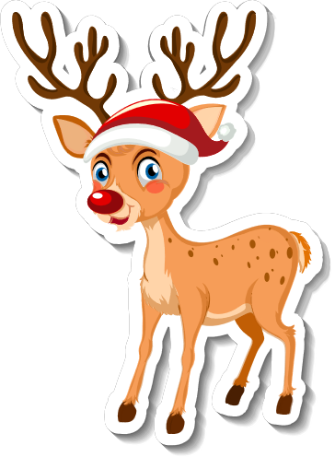

In which month can you see these?

Slide 6
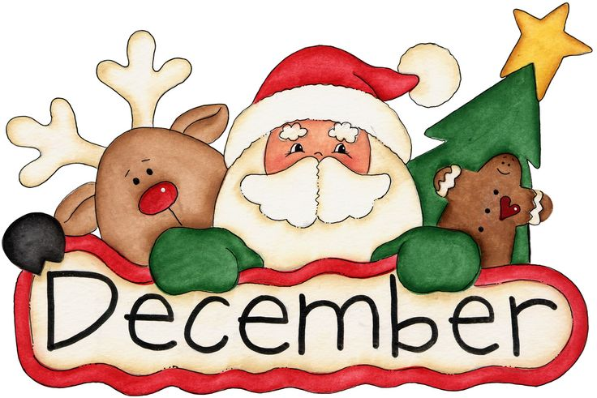
The 12th month of the year

Slide 7
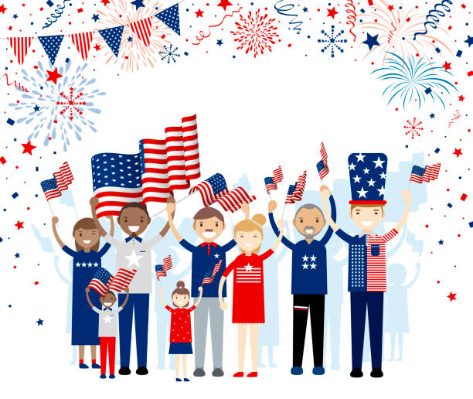

American Independence Day
Summer Holiday

Slide 8

The 7th month of the year

Slide 9

Summer holiday
starts

Slide 10
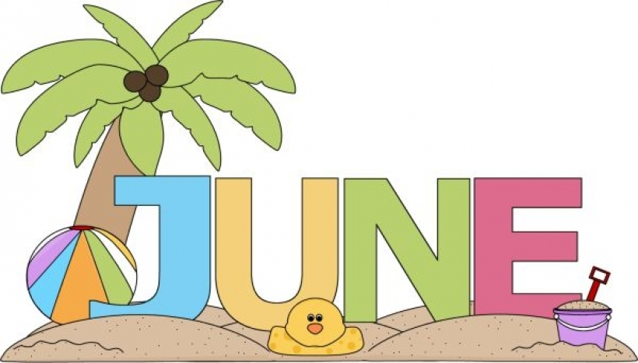
The 6th month of the year

Slide 11


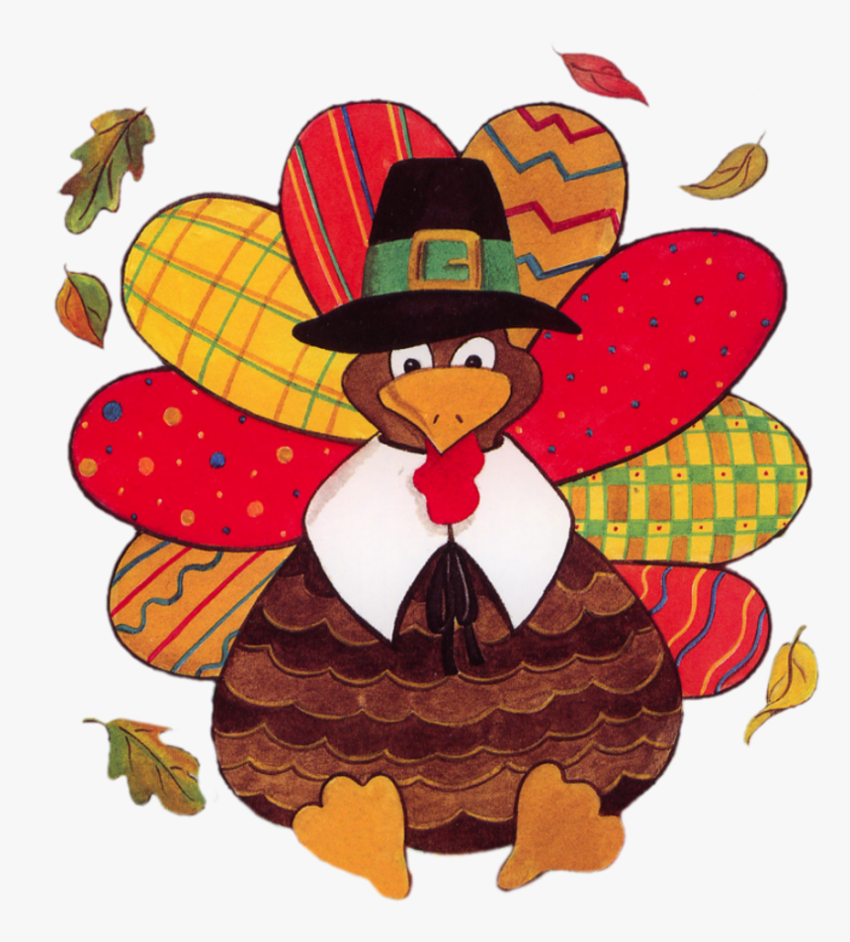

Slide 12

The 11th month of the year

Slide 13

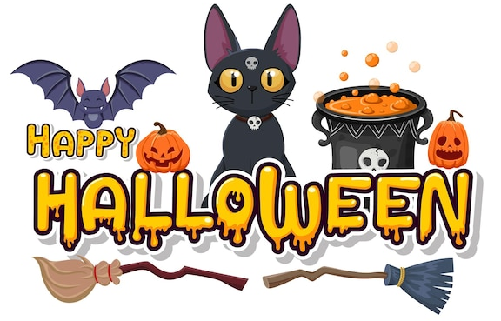

Slide 14
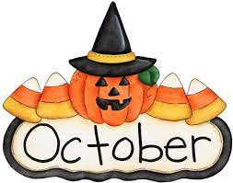
The 10th month of the year

Slide 15


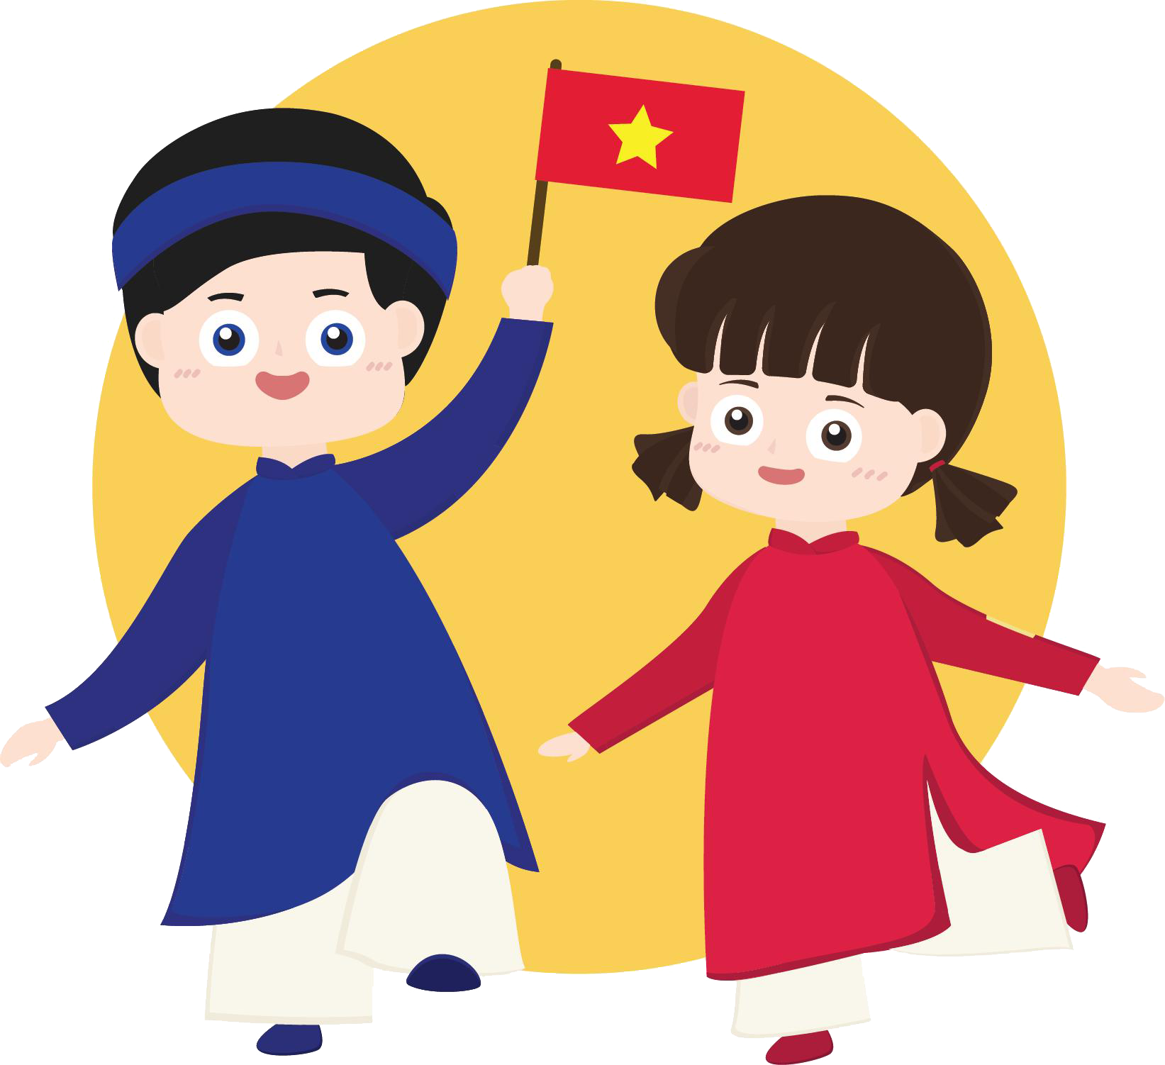

Slide 16
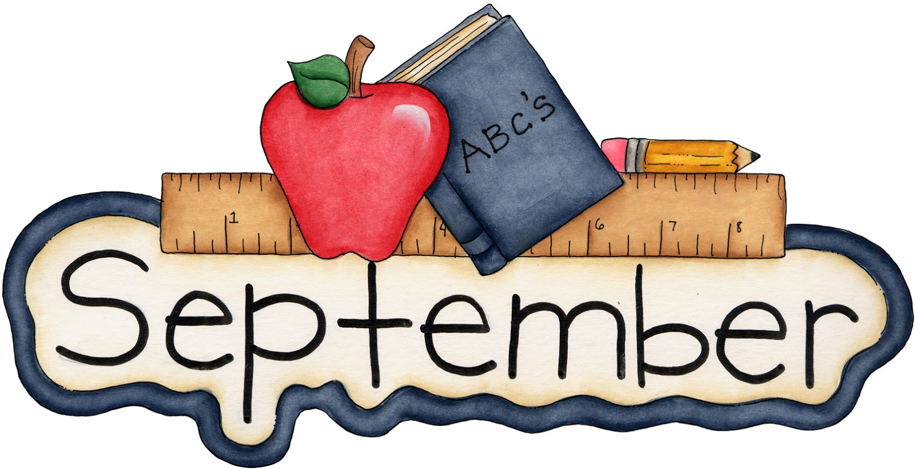
The 9th month of the year

Slide 17
5. Look, complete
and read.

Slide 18

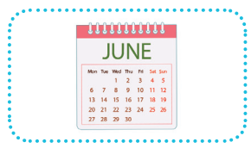
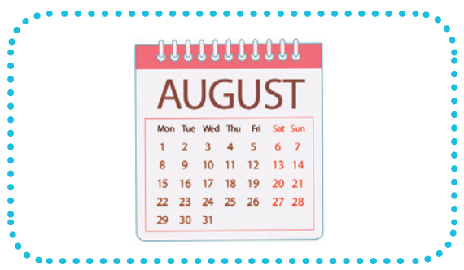
1.
A: Is your sports day in June?
B: Yes, ______.
2.
A: Is your sports day in ________?
B: Yes, it is.
it is
August

Slide 19
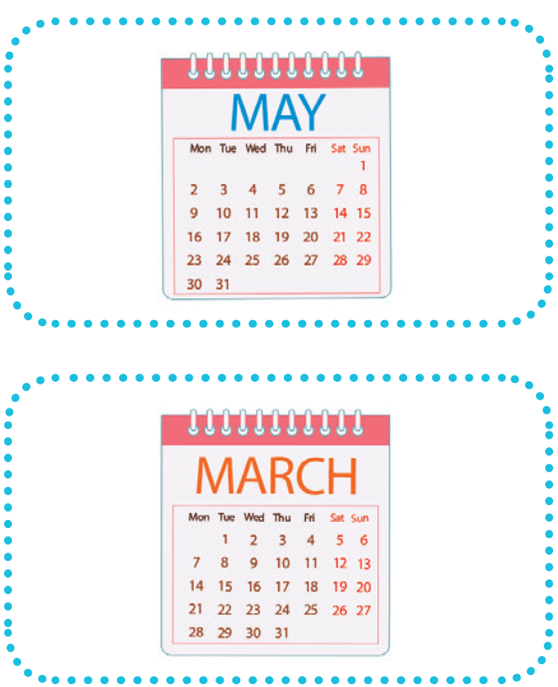
3.
A: _____ your sports day in February?
B: No, it isn’t. It’s in _____. 4.
A: Is your sports day ____ July?
B: _________. It’s in March.
Is
May
in
No, it isn’t

Slide 20
6. Let's sing.

Slide 21



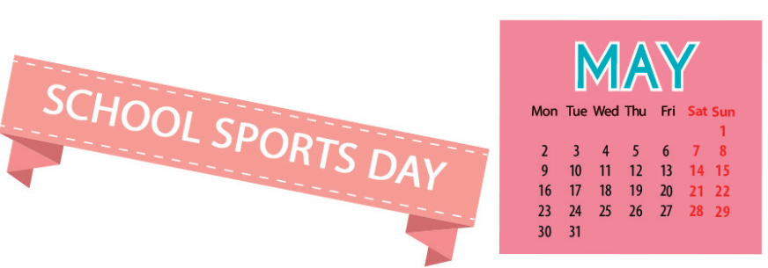
Our sports day
Sports day, sports day.
Is your sports day in May?
Yes, it is. Yes, it is.
It’s in May.
Sports day, sports day.
Is your sports day in June?
No, it isn’t. No, it isn’t.
It’s in July.

Slide 22
5.Look, complete and read.

Slide 23
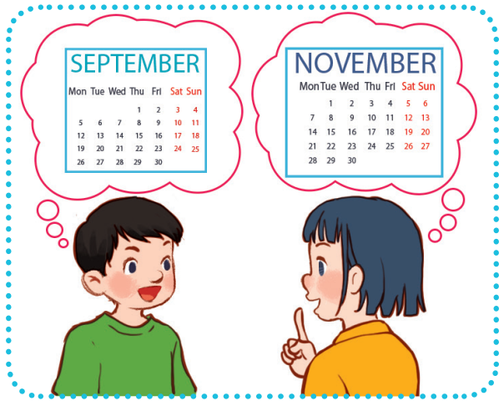
Look, complete and read.
5
1.
A: Is your sports day in September?
B: ______, it is. When’s your sports day?
A: It’s in __________.
Yes
November

Slide 24
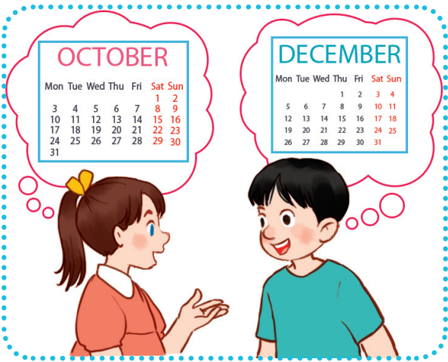
Look, complete and read.
5
2.
A: Our sports day is in October.
_____ your sports day in
October too?
B: No, it isn’t.
A: ________ your sports day?
B: It’s in __________.
Is
When’s
December

Slide 25
Game

Slide 26



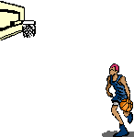

All-Star

Slide 27

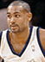
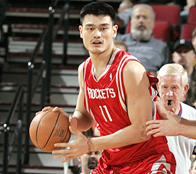

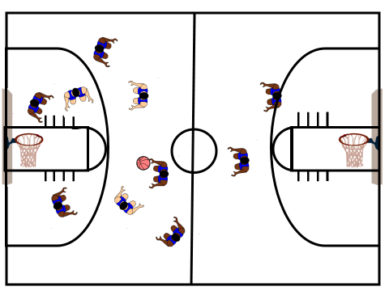
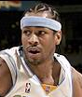
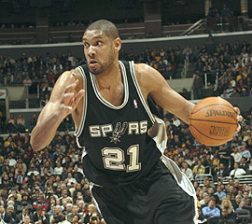

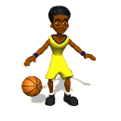
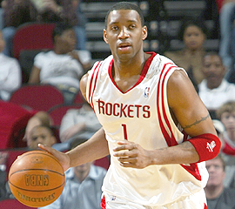

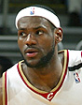

Scoreboard
Grant Hill
Yao Ming
Pippin
Tim Duncan
Allen
Michael Jordan
Grady
Nick
James

Slide 28
Is your sports day _____ June?
in
B
A. on
B. in
C. at
D. for

Slide 29


Slam Dunk
Slam Dunk

Slide 30
___ your sports day in May?
A
A. Is
B. It

Slide 31
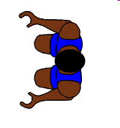
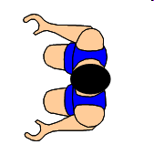

No point!

Slide 32
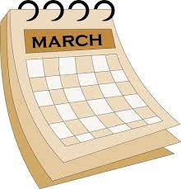
Is your sports day
in April?
B
A. Yes, it is.
B. No, it isn't.
Notes:
Encourage students to say "It's in March."

Slide 33

Slam Dunk
Slam Dunk

Slide 34

Is your sports day in July?
C
A. Yes, it isn't.
B. No, it isn't.
C. Yes, it is.
D. No, it is.

Slide 35

Slam Dunk
Slam Dunk

Slide 36

A: Is your sports day
in ___?
B: Yes, it is.
A
A. March
B. May

Slide 37
Slam Dunk
Slam Dunk

Slide 38
A: Is your sports day
in ___?
B: No, it isn't.
B
A. March
B. May

Slide 39
No point!

Slide 40
A: Is your sports day
in February?
B: Yes, _____.
A
A. it is
B. it isn't

Slide 41

Slam Dunk
Slam Dunk

Slide 42
A: Is your sports day in September? B: No, _____.
B
A. it is
B. it isn't

Slide 43

Slam Dunk
Slam Dunk

Slide 44
A: Is your sports day
in January?
B: _____. It's in March.
C
A. Yes, it isn't.
B. Yes, it is.
C.No, it isn't.
D. No, it is.

Slide 45
Slam Dunk
Slam Dunk

