Slide 1





Slide 2


Our school facilities
6
Lesson 1

Slide 3
I. OBJECTIVES.
By the end of the lesson, pupils will be able to.
1. Language.
- understand and correctly repeat the sentences in two communicative contexts focusing on asking and answering questions about the location of a school.
- correctly say the words and use Where’s your school? – It’s in the _____. to ask and answer questions about the location of a school.
- enhance the correct use of Where’s your school? – It’s in the ___. to ask and answer questions about the location of a school in a freer context.
2. Competences.
- Communication and collaboration: work in pairs and groups to complete the learning tasks
- Self-control & independent learning: perform listening tasks
3.Attributes.
- Show pride in where they’re from and respect to other people by using appropriate gestures and intonation when asking and answering about school locations.

Slide 4
Warm-up

Slide 5
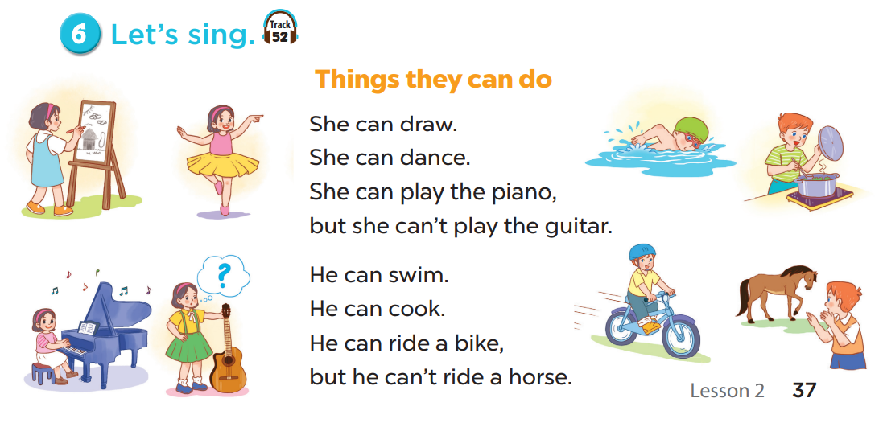


Slide 6
1. Look, listen and repeat.

Slide 7
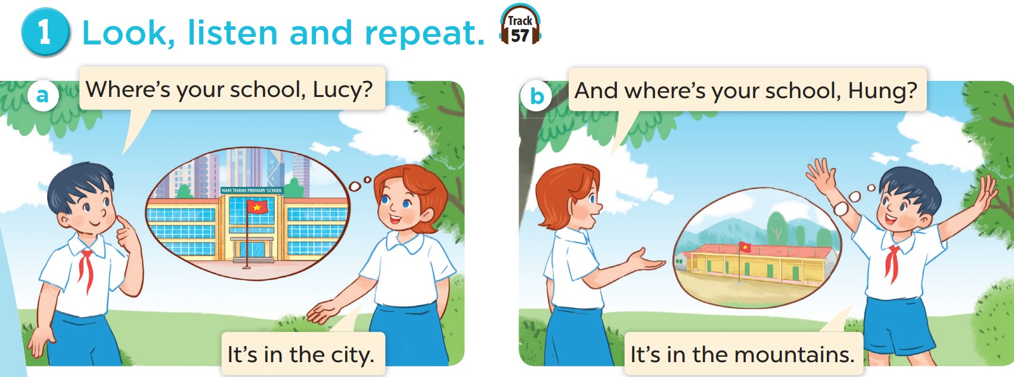

Slide 8
2. Listen, point and say.

Slide 9
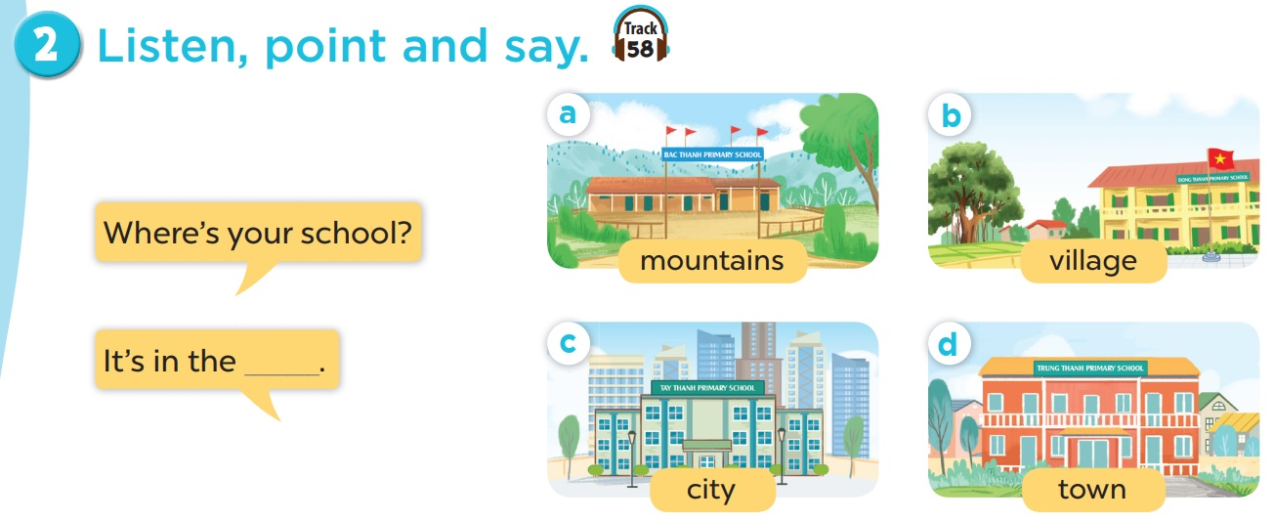

Slide 10
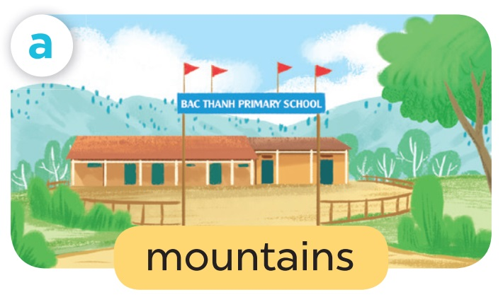
Where’s your school?
It’s in the mountains.

Slide 11
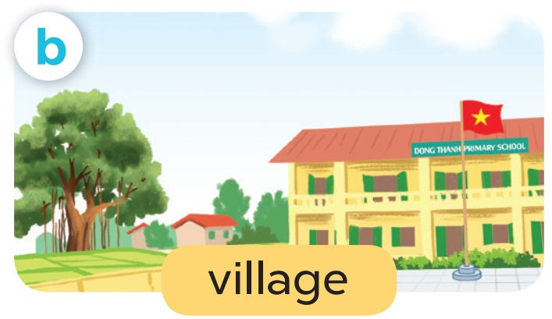
Where’s your school?
It’s in the village.

Slide 12
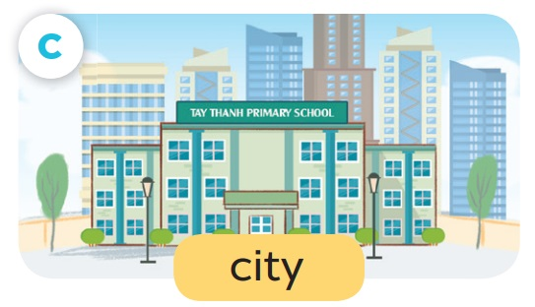
Where’s your school?
It’s in the city.

Slide 13

Where’s your school?
It’s in the town.

Slide 14
4. Listen and number.

Slide 15
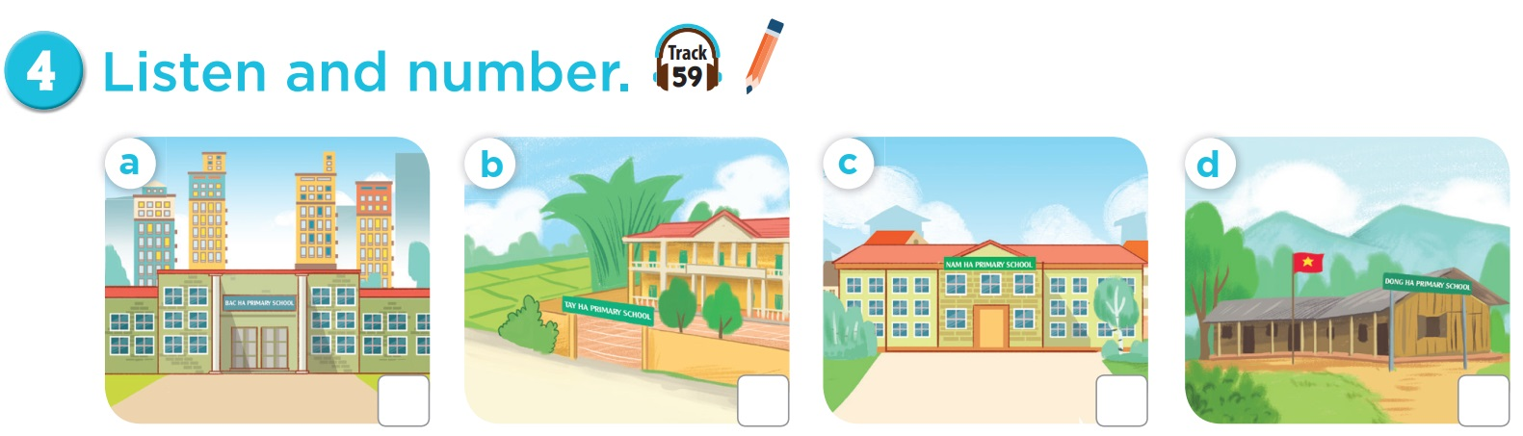
3
4
1
2

Slide 17

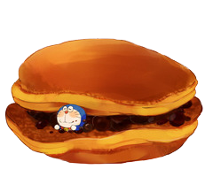
= Mystery
power-up
= points

Slide 18
O
P
Q
R
S
T
U
V
W
X
Y
Z
End game

Slide 19



- _____ is your school?
- It’s in the city.
Where

Slide 21
- Where is your school? - It’s in the ____.
city

Slide 23
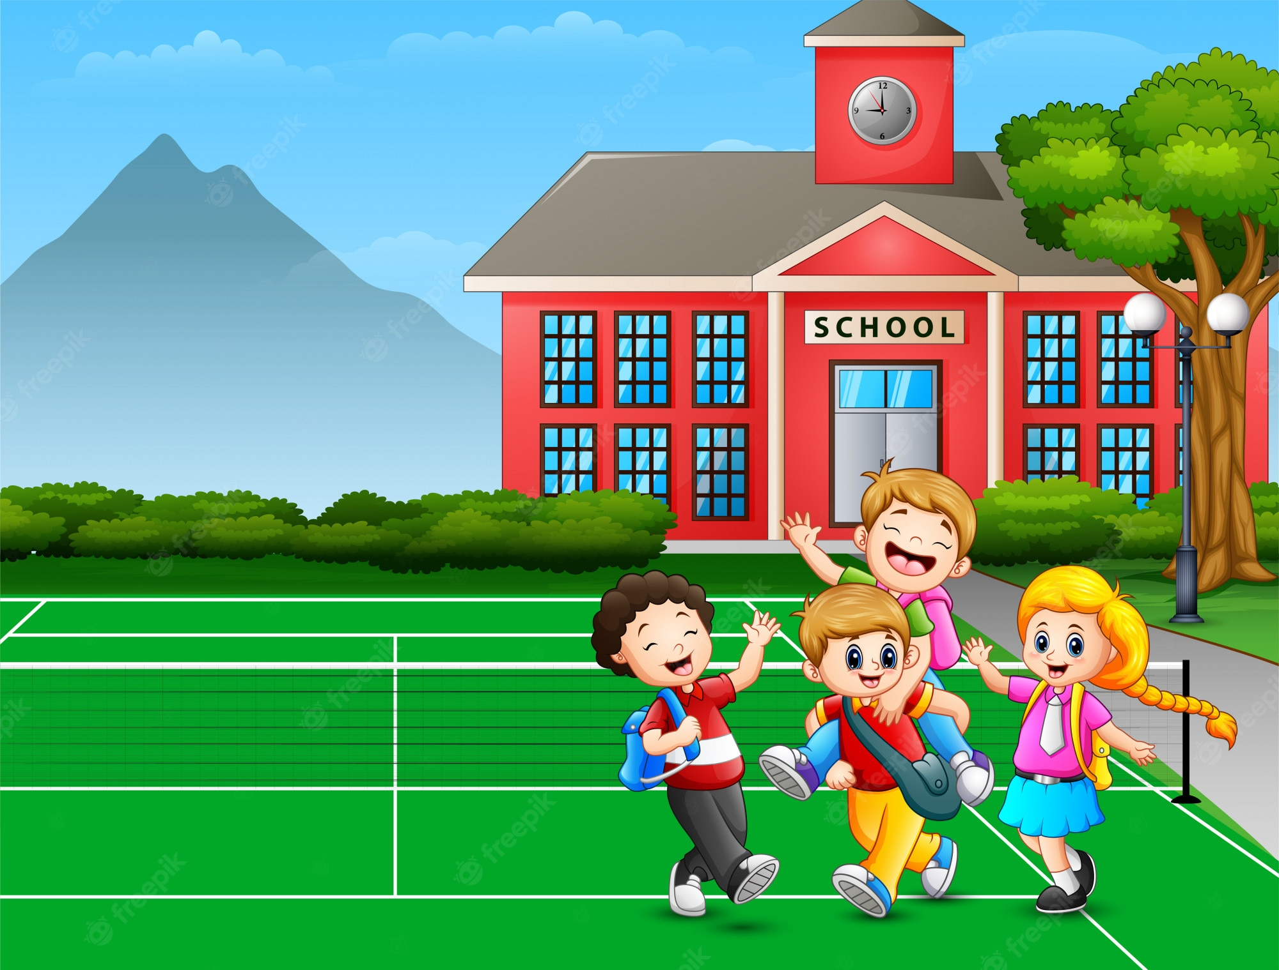
- Where’s your school?
- ______________.
It’s in the mountains.

Slide 25
Where are the children?
A. At home. B. At school.
B. At school.

Slide 27
How many children are there at the playground?
There are four.

Slide 29

- Is it a village?
- _________.
Yes, it is.

Slide 31

- Where is the Minion?
- _____________.
It’s in the village.

Slide 33

It’s a village.
A
B
A

Slide 35
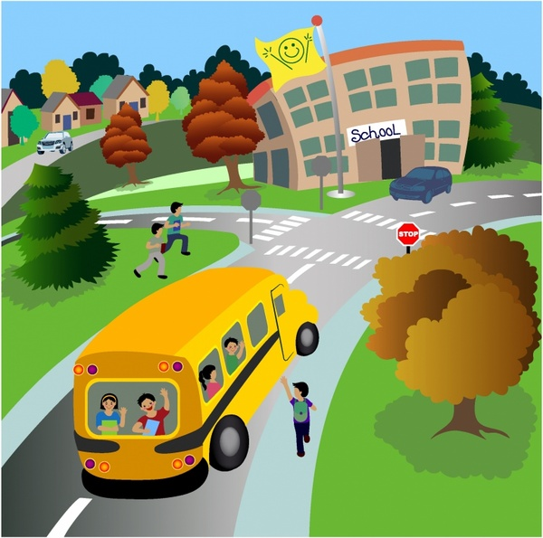
- Is it a city? - ______.
No, it isn’t. It’s a town.

Slide 37
My school is in the mountains.
A
B
B

Slide 38







Slide 39
Change points!

Slide 40
Steal 3 points!

Slide 41
7 points!

Slide 42
Where is the school?
It’s in the town.

Slide 43




Slide 44
Steal 3 points!

Slide 45




Slide 46
9 points!

Slide 47
town / the / in / school / is / My /.
My school is in the town.

Slide 48




Slide 49
10 points!

