Slide 1





Slide 2


Slide 3

Saturday December 10th , 202..
Competition Board
Team 1 |  | Team 2 | Team 2

Slide 4








Class rules
Sit nicely
Listen
3. Speak English.
4. Raise hands to talk.
5. Be happy.

Slide 5
01
Warm-up
Sing : I love my school

Slide 6

Video : Schools

Slide 7


Our school facilities
6
Lesson 1 ( 1,2,3)

Slide 8
02
Activity 1
Look, listen and repeat.

Slide 9
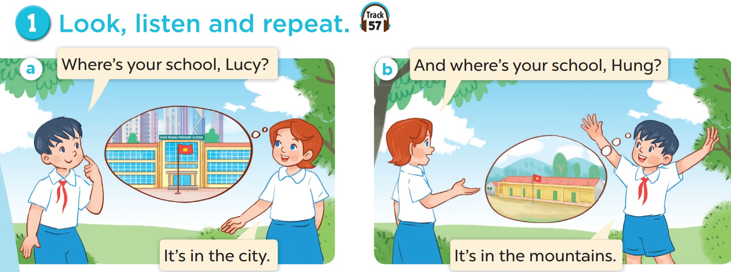

Slide 10
03
Activity 2
Listen, point and say.

Slide 11


Wednesday November 8th , 2023
Unit 6: School facilities
Lesson 1 ( 1,2,3)
2. Listen, point and say
*Vocabulary

Slide 12
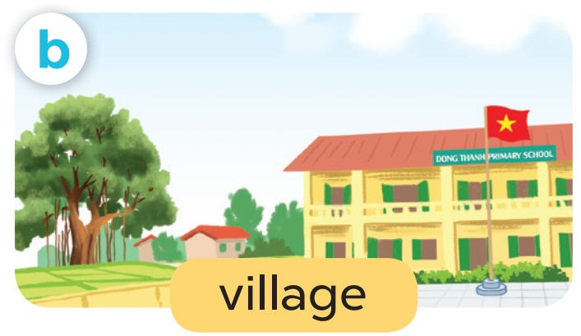
Wednesday November 8th , 2023
Unit 6: School facilities
Lesson 1 ( 1,2,3)
2. Listen, point and say
*Vocabulary

Slide 13

Wednesday November 8th , 2023
Unit 6: School facilities
Lesson 1 ( 1,2,3)
2. Listen, point and say
*Vocabulary

Slide 14

Wednesday November 10th , 2023
Unit 6: School facilities
Lesson 1 ( 1,2,3)
2. Listen, point and say
*Vocabulary

Slide 15
Wednesday November 8th , 2023
Unit 6: School facilities
Lesson 1 ( 1,2,3)
2. Listen, point and say
*Vocabulary

Slide 16
Game:
Guessing

Slide 17

mountains

Slide 18

village

Slide 19
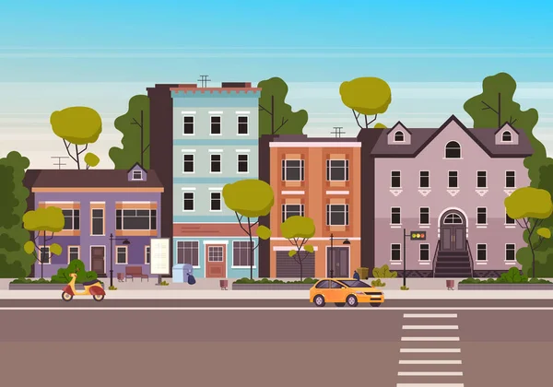
town

Slide 20

city

Slide 21




MATCHING
1
city
2
town
3
4
mountains
5
village

Slide 22
Huyền Trang
My
Linh
Phương
Trâm Anh
Chi
Đỗ Thảo
Ngọc Anh
Ngân
Bảo
Ng Châu
Tú
Hoàng Anh
Vũ Châu
Mai
sơn
Yến
Tín
Thu Thảo
Q.Anh

Slide 23
Where’s your school?
It’s in the mountains.

Slide 24
Where’s your school?
It’s in the village.

Slide 25
Where’s your school?
It’s in the city.

Slide 26
Where’s your school?
It’s in the town.

Slide 27
Wednesday November 8th , 2023
Unit 6: School facilities
Lesson 1 ( 1,2,3)
Sentence Patterns
* Cách hỏi – trả lời: Trường của bạn ở đâu
Where’s your school?
It’s in the
+ địa điểm.
city
vilage

Slide 28
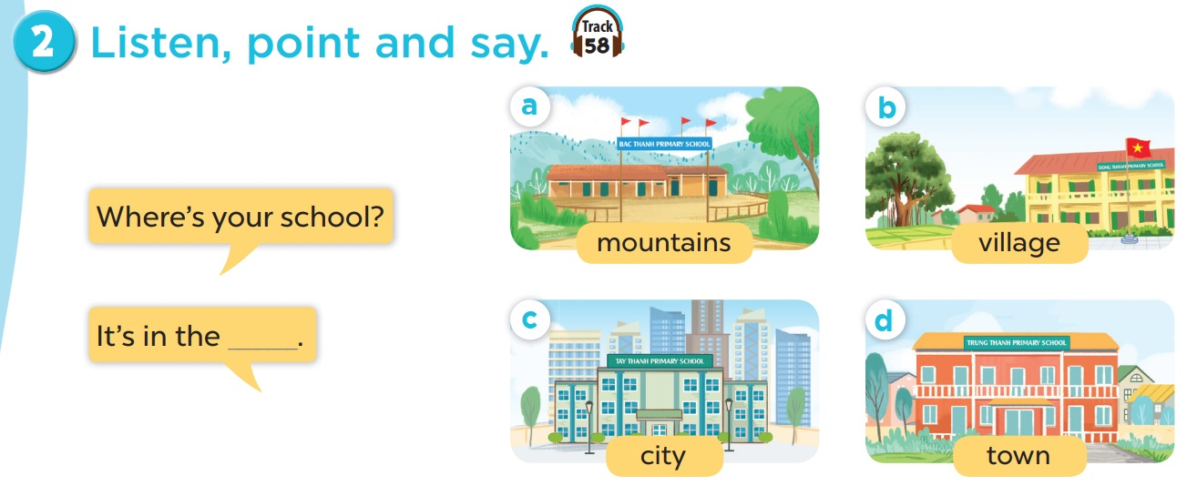

Slide 29
Game:

Slide 30
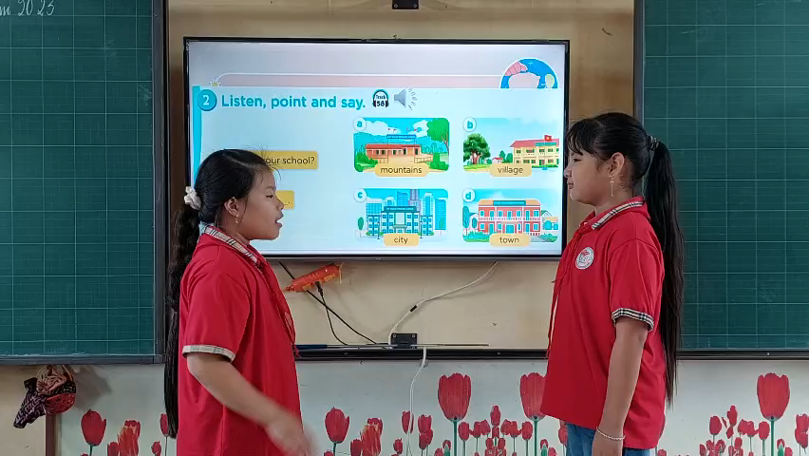

Slide 31
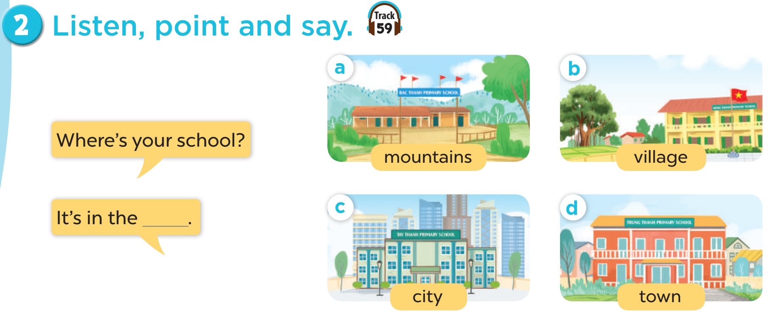
Listen and repeat.
Work in pairs. Play roles.

Slide 32
04
Activity 3
Let’s talk.

Slide 33
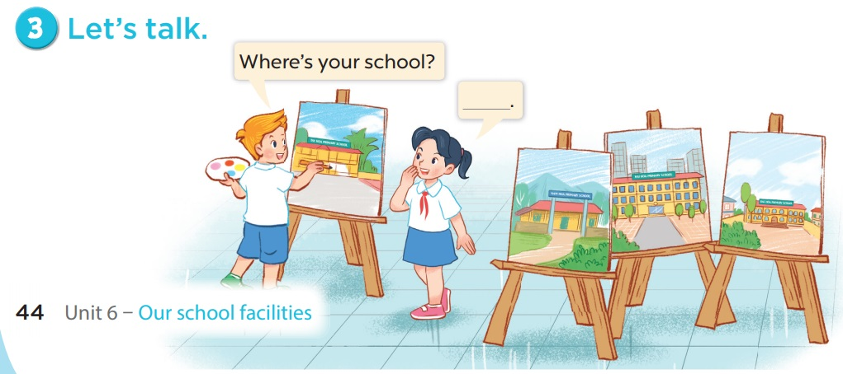

Slide 34
Game : Carousel hotpot
(Lẩu băng chuyền

Slide 35
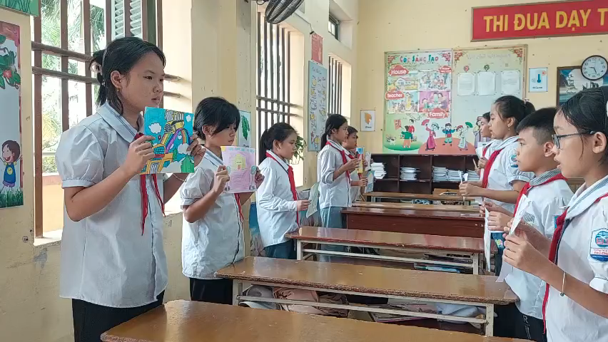
Game : carousel hotpot
(Lẩu băng chuỳn

Slide 36

Presentation

Slide 37
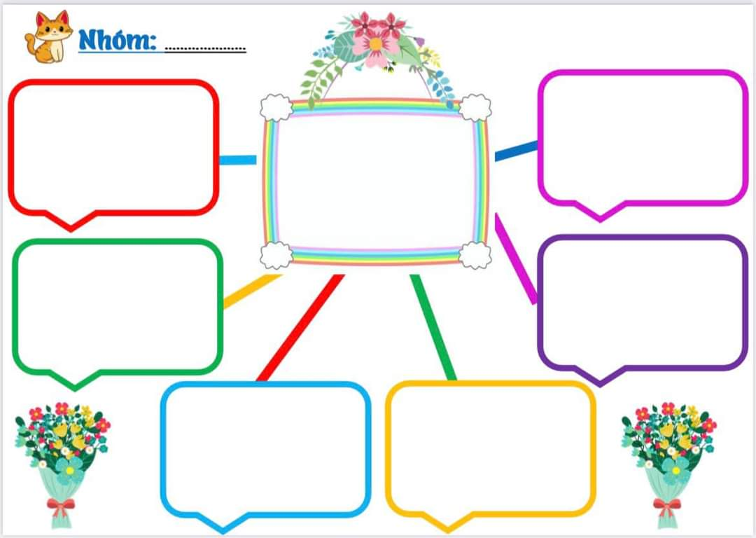

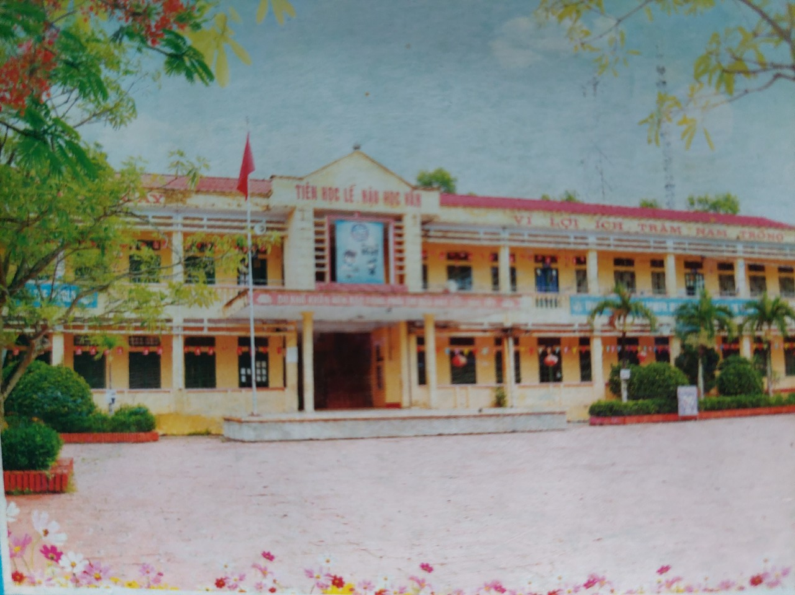
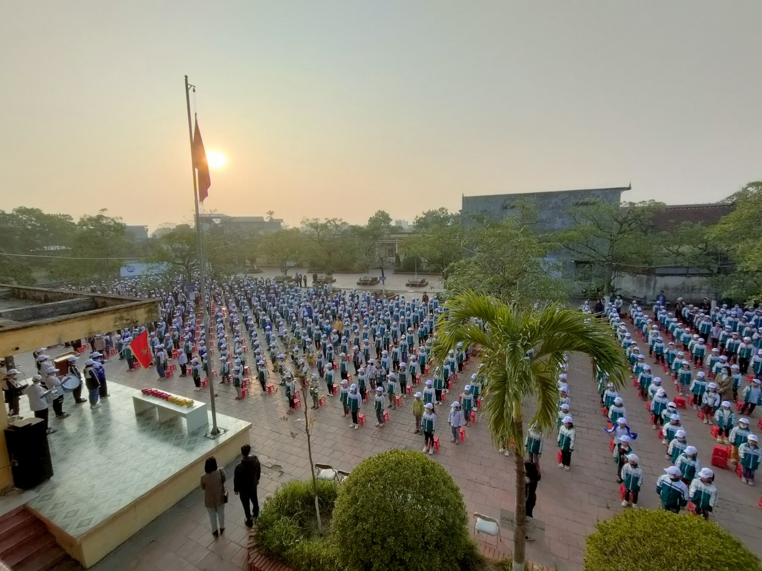
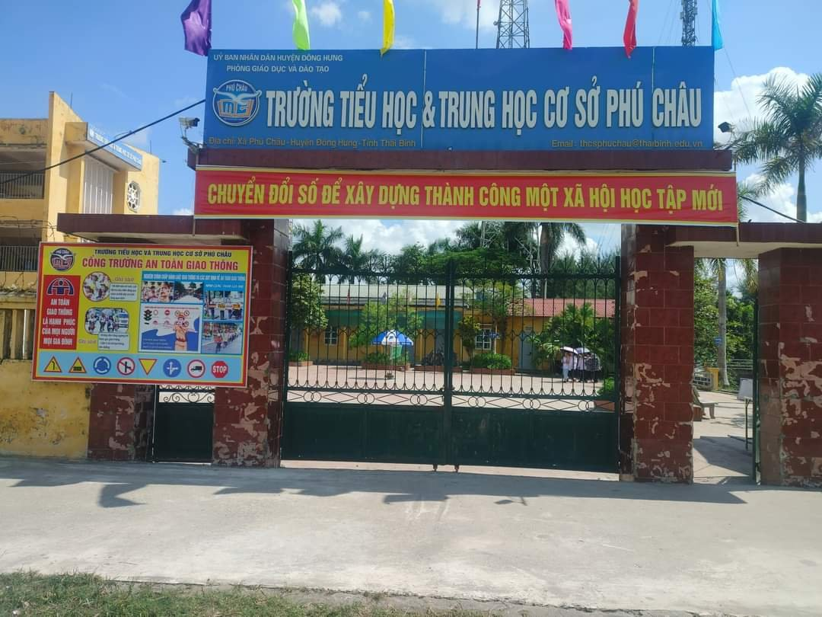
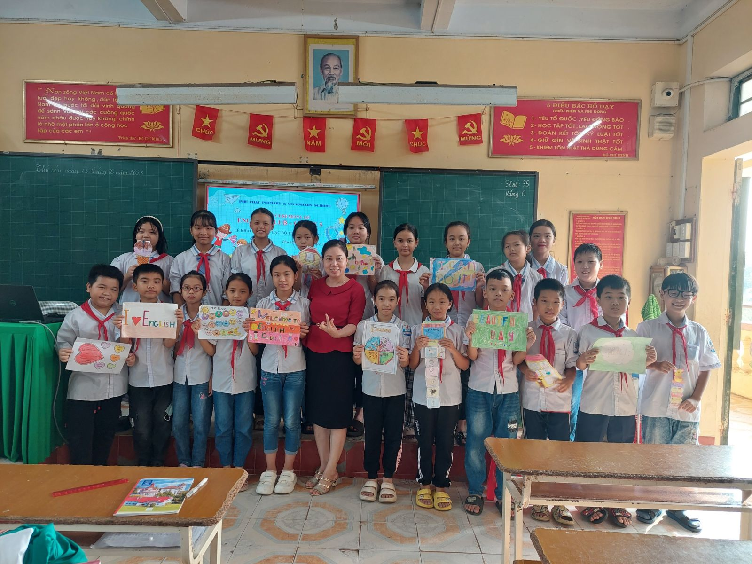
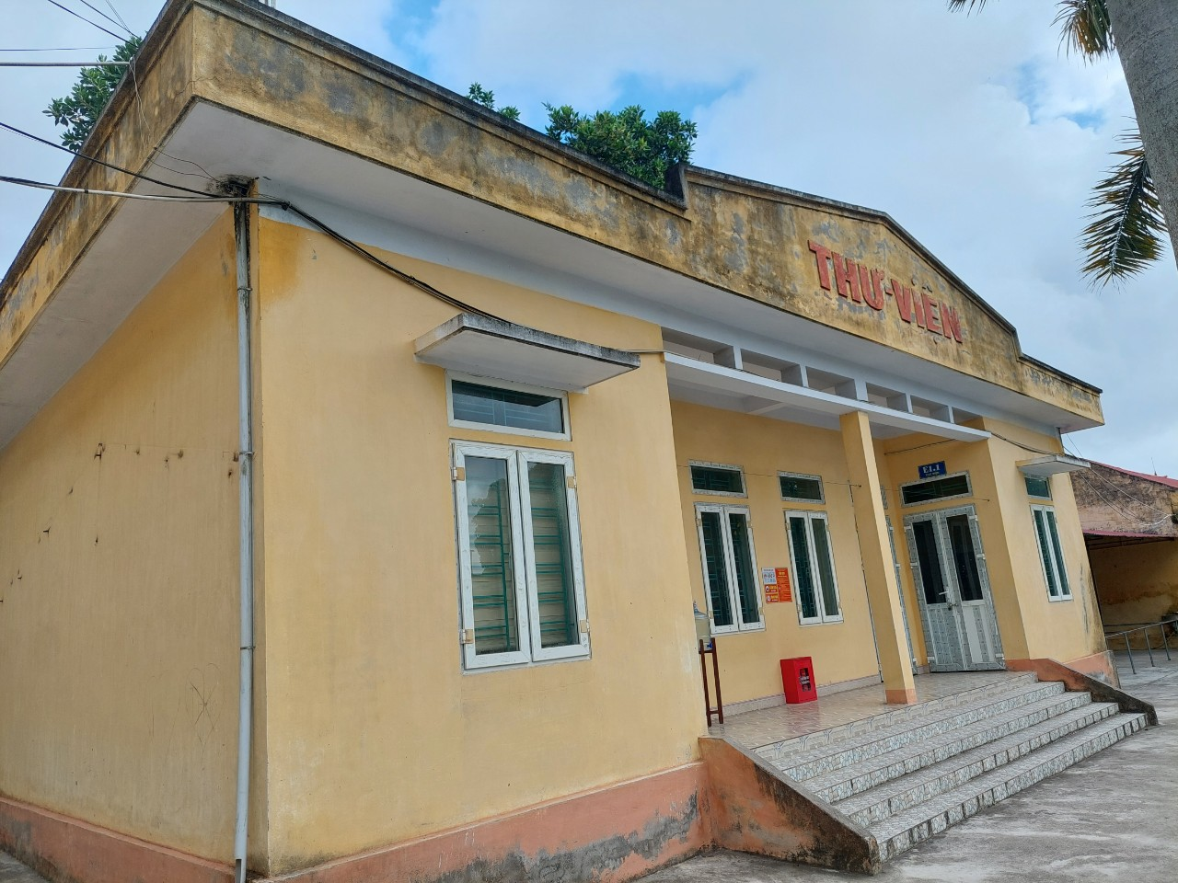
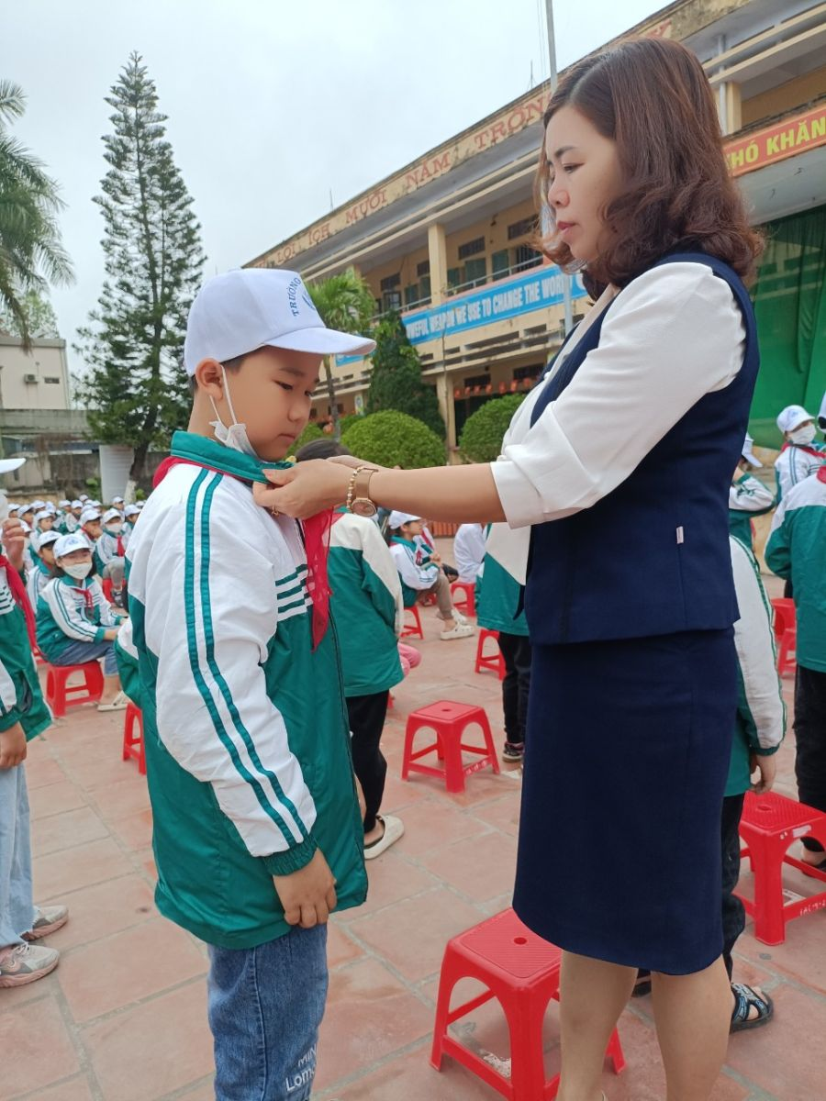
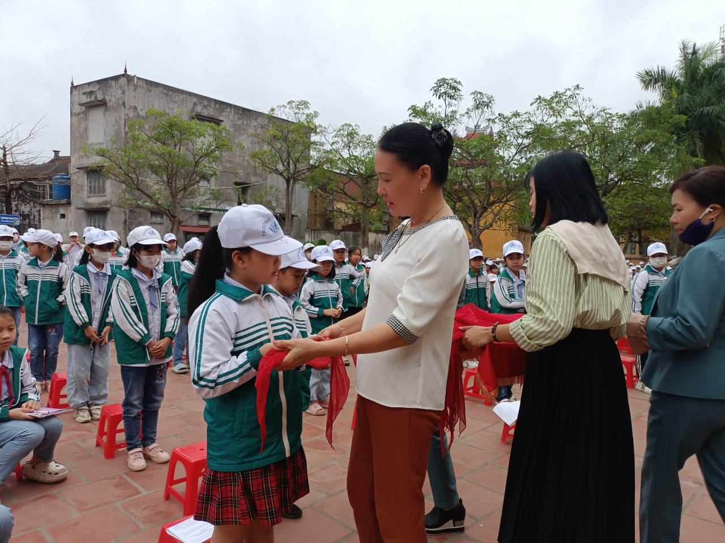
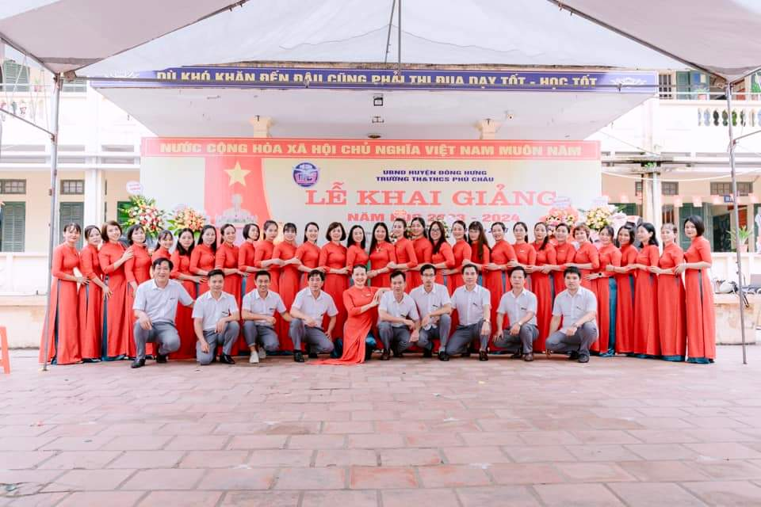
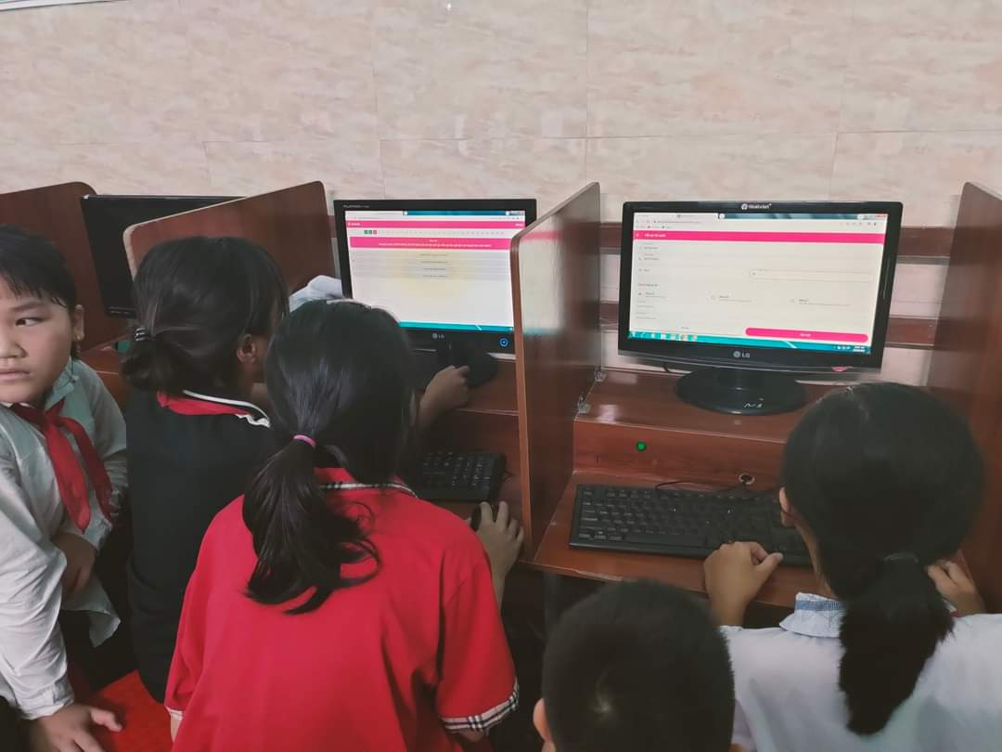

Slide 38
MATCHING
1
city
2
town
3
4
mountains
5
village

Slide 39
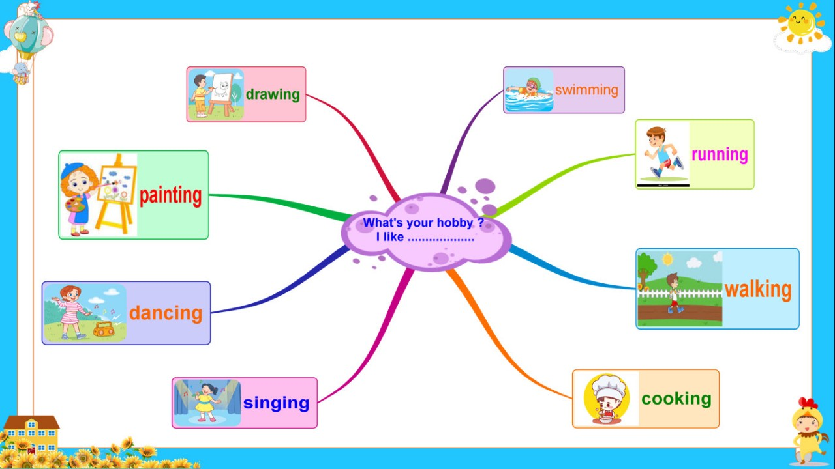
Where’s your school?
It’s in the……….

Slide 40


Slide 41

HOMELINK
1. Practise speaking more
2. Prepare the next lesson:
Unit 10: Lesson 2 (4,5,6)

