Slide 1





Slide 2



Things we can do
5
LESSON 3

Slide 3
I. OBJECTIVES.
By the end of the lesson, pupils will be able to:
1. Language.
- Say the chant with the correct pronunciation and rhythm.
- Complete a gapped text about the abilities and lack of abilities of Lucy, Ben and the pupils themselves;
- Carry out a school club survey, collect the information and present their friends’ abilities and lack of abilities to the class by using the target language.
2. Competences.
- Communication and collaboration: work in pairs and groups to complete the learning tasks
- Self-control & independent learning: perform listening tasks
- Problem solving
3. General competencies.
- Listening: listen and number
- Critical thinking: read and match
- Oral communication: let’s play
- Self-control & independent learning: perform listening tasks
- Communication and collaboration: work in pairs or groups
- Sociability: talk to each other, say good words to others.
4. Attributes.
- Show pride in what they can do and great respect for other people’s abilities by using appropriate gestures and intonation when asking and answering about abilities.

Slide 4
Warm-up

Slide 5
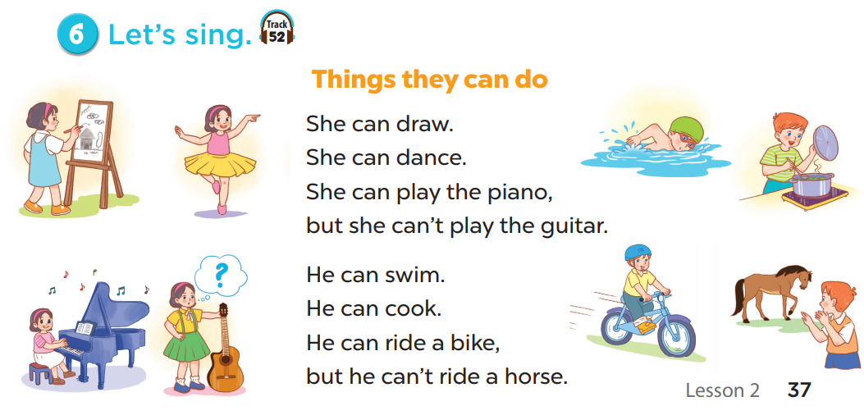

Things can we do

Slide 6
1. Listen and repeat.

Slide 7
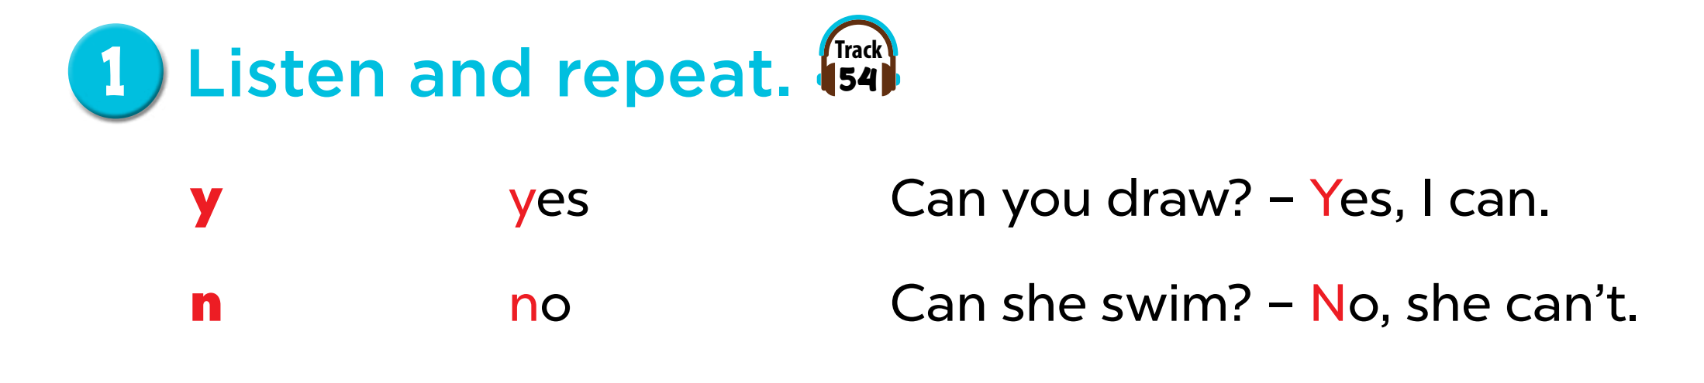
Notes:
Step 1: Draw pupils’ attention to the letter y, the word yes and the sentence Can you draw? – Yes, I can.
Play the recording and encourage pupils to point to the letter / word / sentence while listening.
Step 2: Play the recording again for pupils to listen and repeat. Do this several times until
pupils feel confident. Correct their pronunciation where necessary and praise them if their
pronunciation is good.
Step 3: Repeat Steps 1 and 2 for the letter n.

Slide 8
2. Listen and circle.

Slide 9

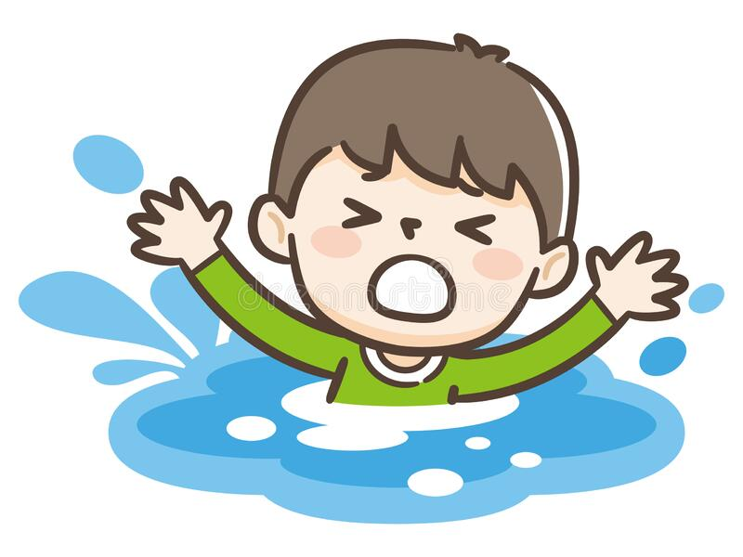
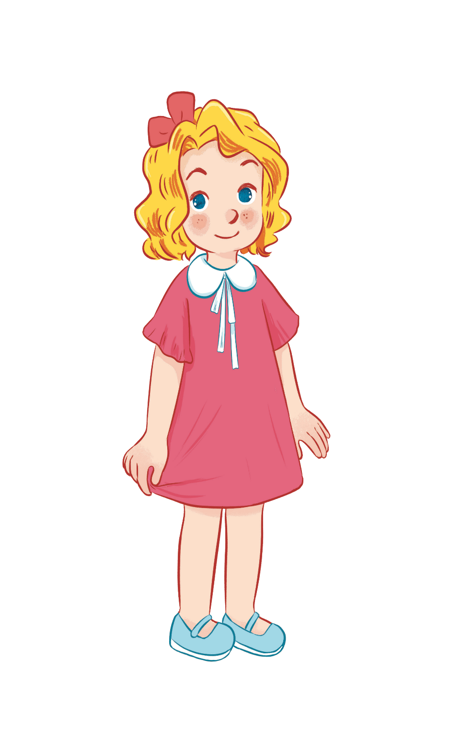
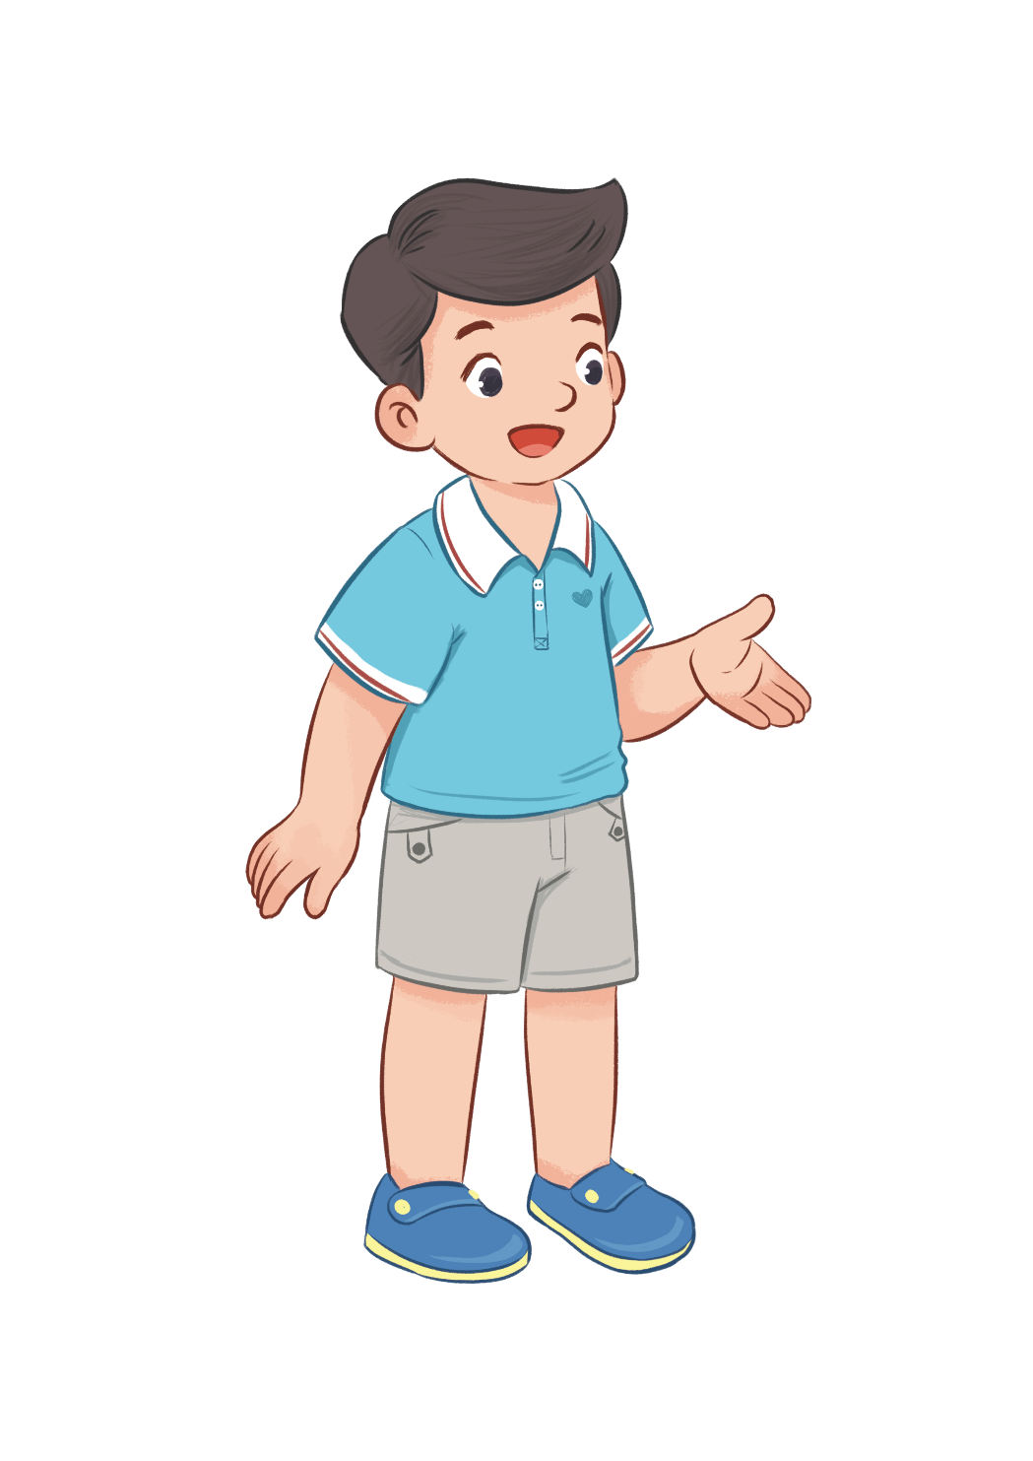


Can he swim?
No, he can’t.
Yes, he can.

Slide 10

Can they draw?
Yes, they can.
No, they can’t.

Slide 11
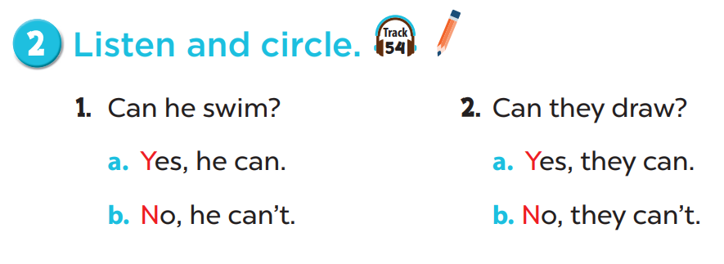

Slide 12
4.Read and tick.

Slide 13
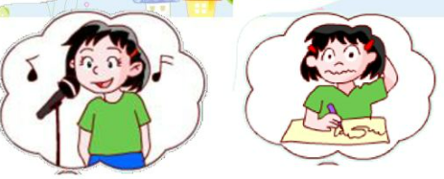


She can sing.
She can’t write.
She can sing but she can’t write.

Slide 14
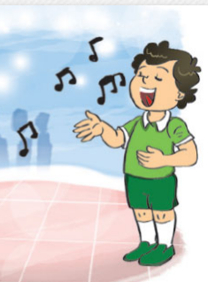
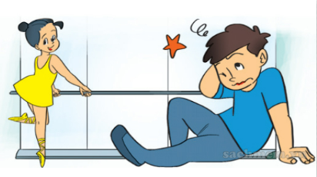
He can sing.
He can’t dance.
He can sing but he can’t dance.

Slide 15
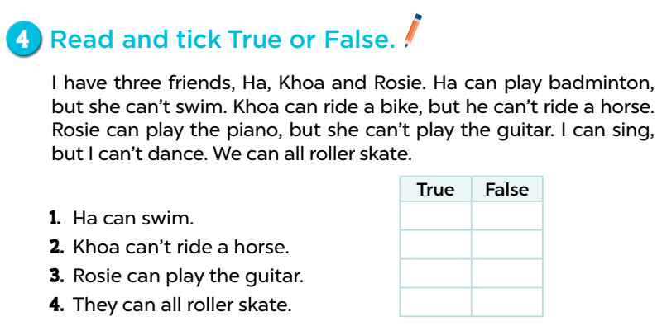








Slide 16
5. Let’s write.

Slide 17
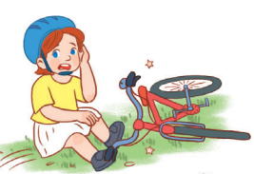

Lucy
Can Lucy ride a bike?
No, she can’t.
She can’t ride a bike.

Slide 18
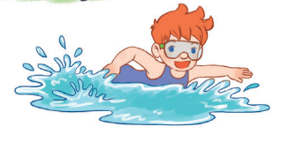
Ben
Can Ben swim?
Yes, he can.

Slide 19
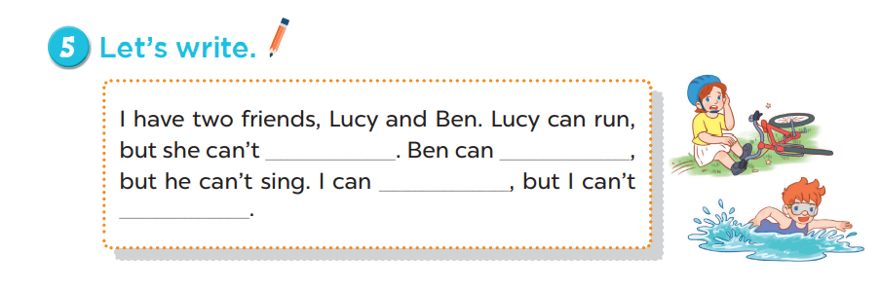
ride a bike
swim

Slide 20
Fun corner

Slide 21


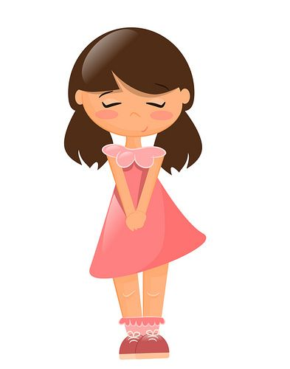
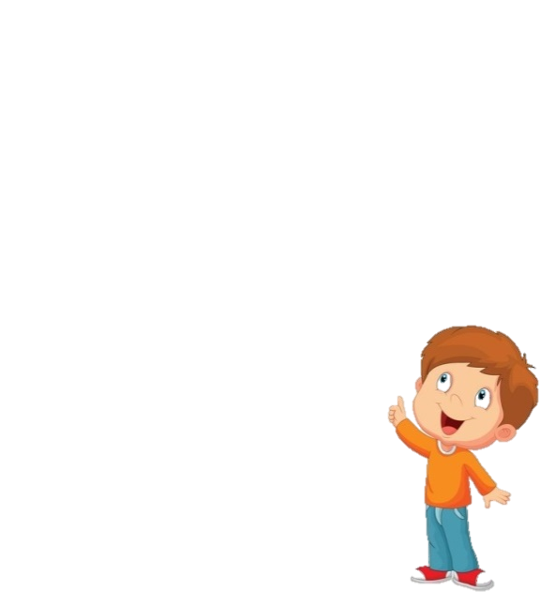








Notes:
Choose a number.
Read the quiz and say the answer.
Get points when balloon flies away.

Slide 22


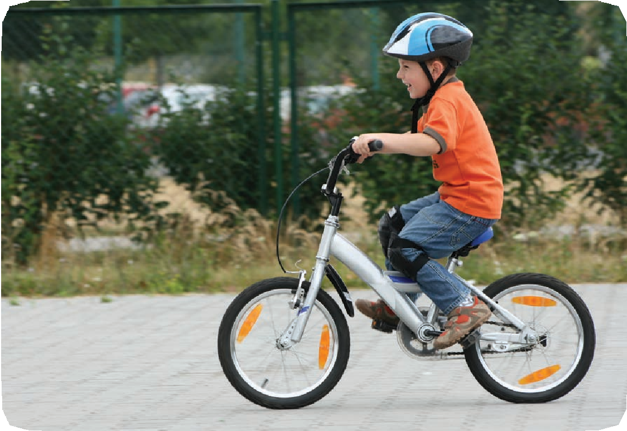
Can he ride a bike?
Yes, he can.

Slide 23

+ 5 POINTS

Slide 24
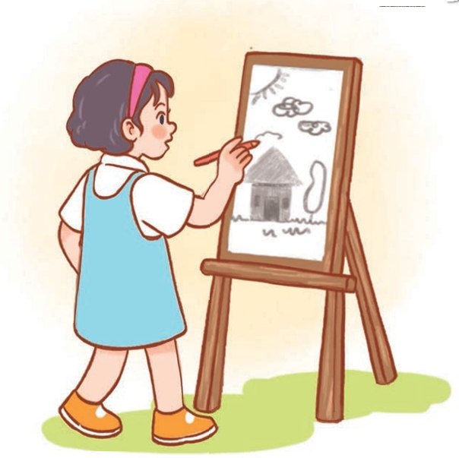
Can she draw?
Yes, she can.

Slide 25
- 2 POINTS

Slide 26
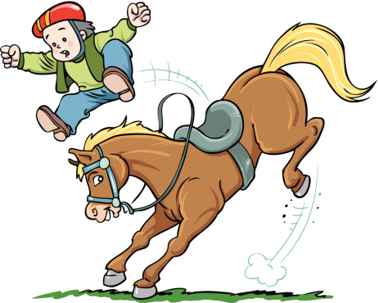
Can he ride a horse?
No, he can’t.

Slide 27
+ 3 POINTS

Slide 28
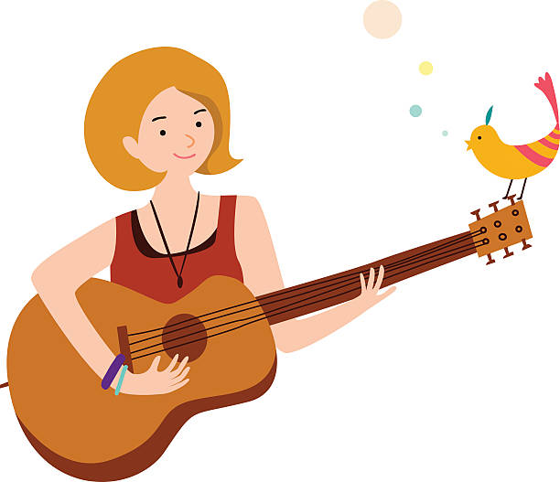
Can she play the guitar?
Yes, she can.

Slide 29
GIVE 3 POINTS

Slide 30
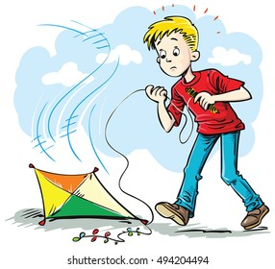
Can he fly a kite?
A. Yes, he can.
B. No, he can.
C. No, he can’t.

Slide 31
- 5 POINTS

Slide 32
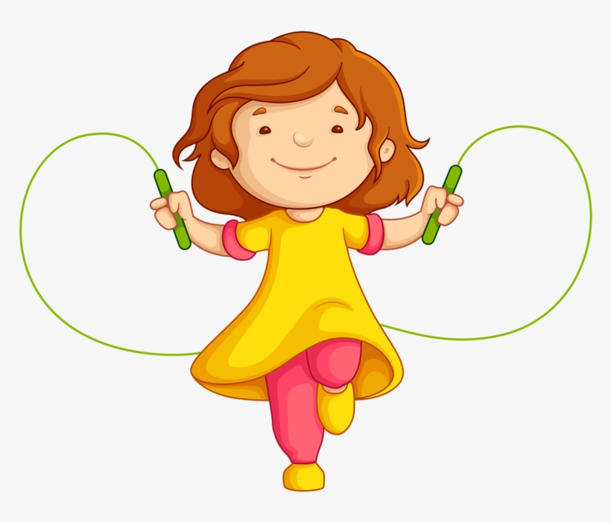
Can she skip?
A. Yes, she can’t.
B. Yes, she can.
C. No, she can’t.

Slide 33
+ 10 POINTS

Slide 34
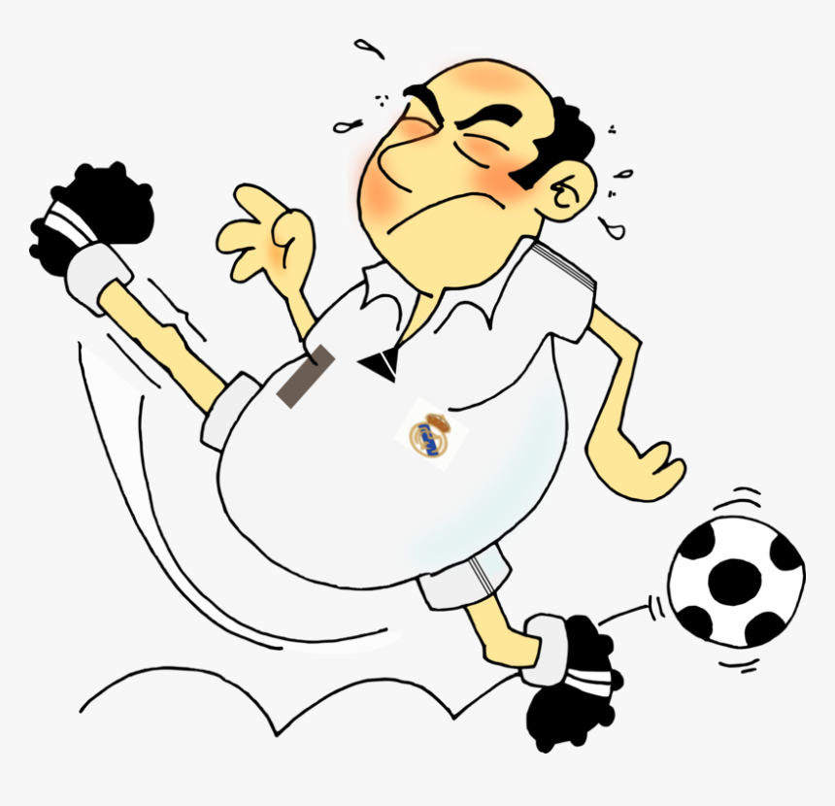
Can your father
play football?
A. No, he can’t.
B. No, he can.
C. Yes, he can.

Slide 35
STEAL
5 POINTS

Slide 36
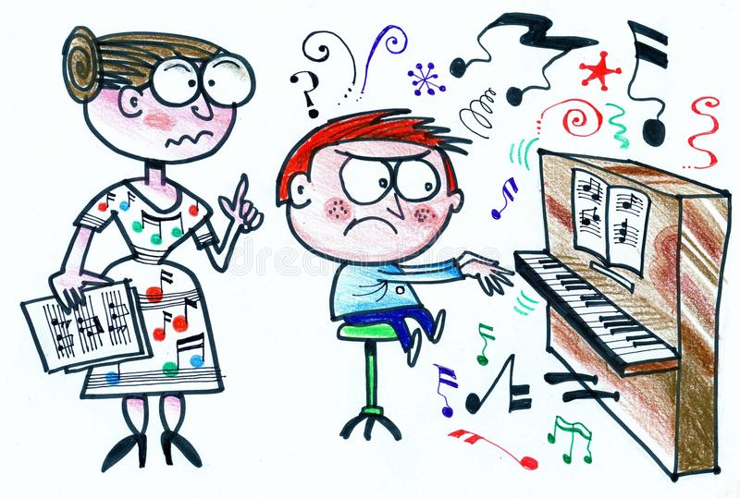
Can he play the piano?
No
…………, he can’t.

Slide 37
DOUBLE POINTS

Slide 38
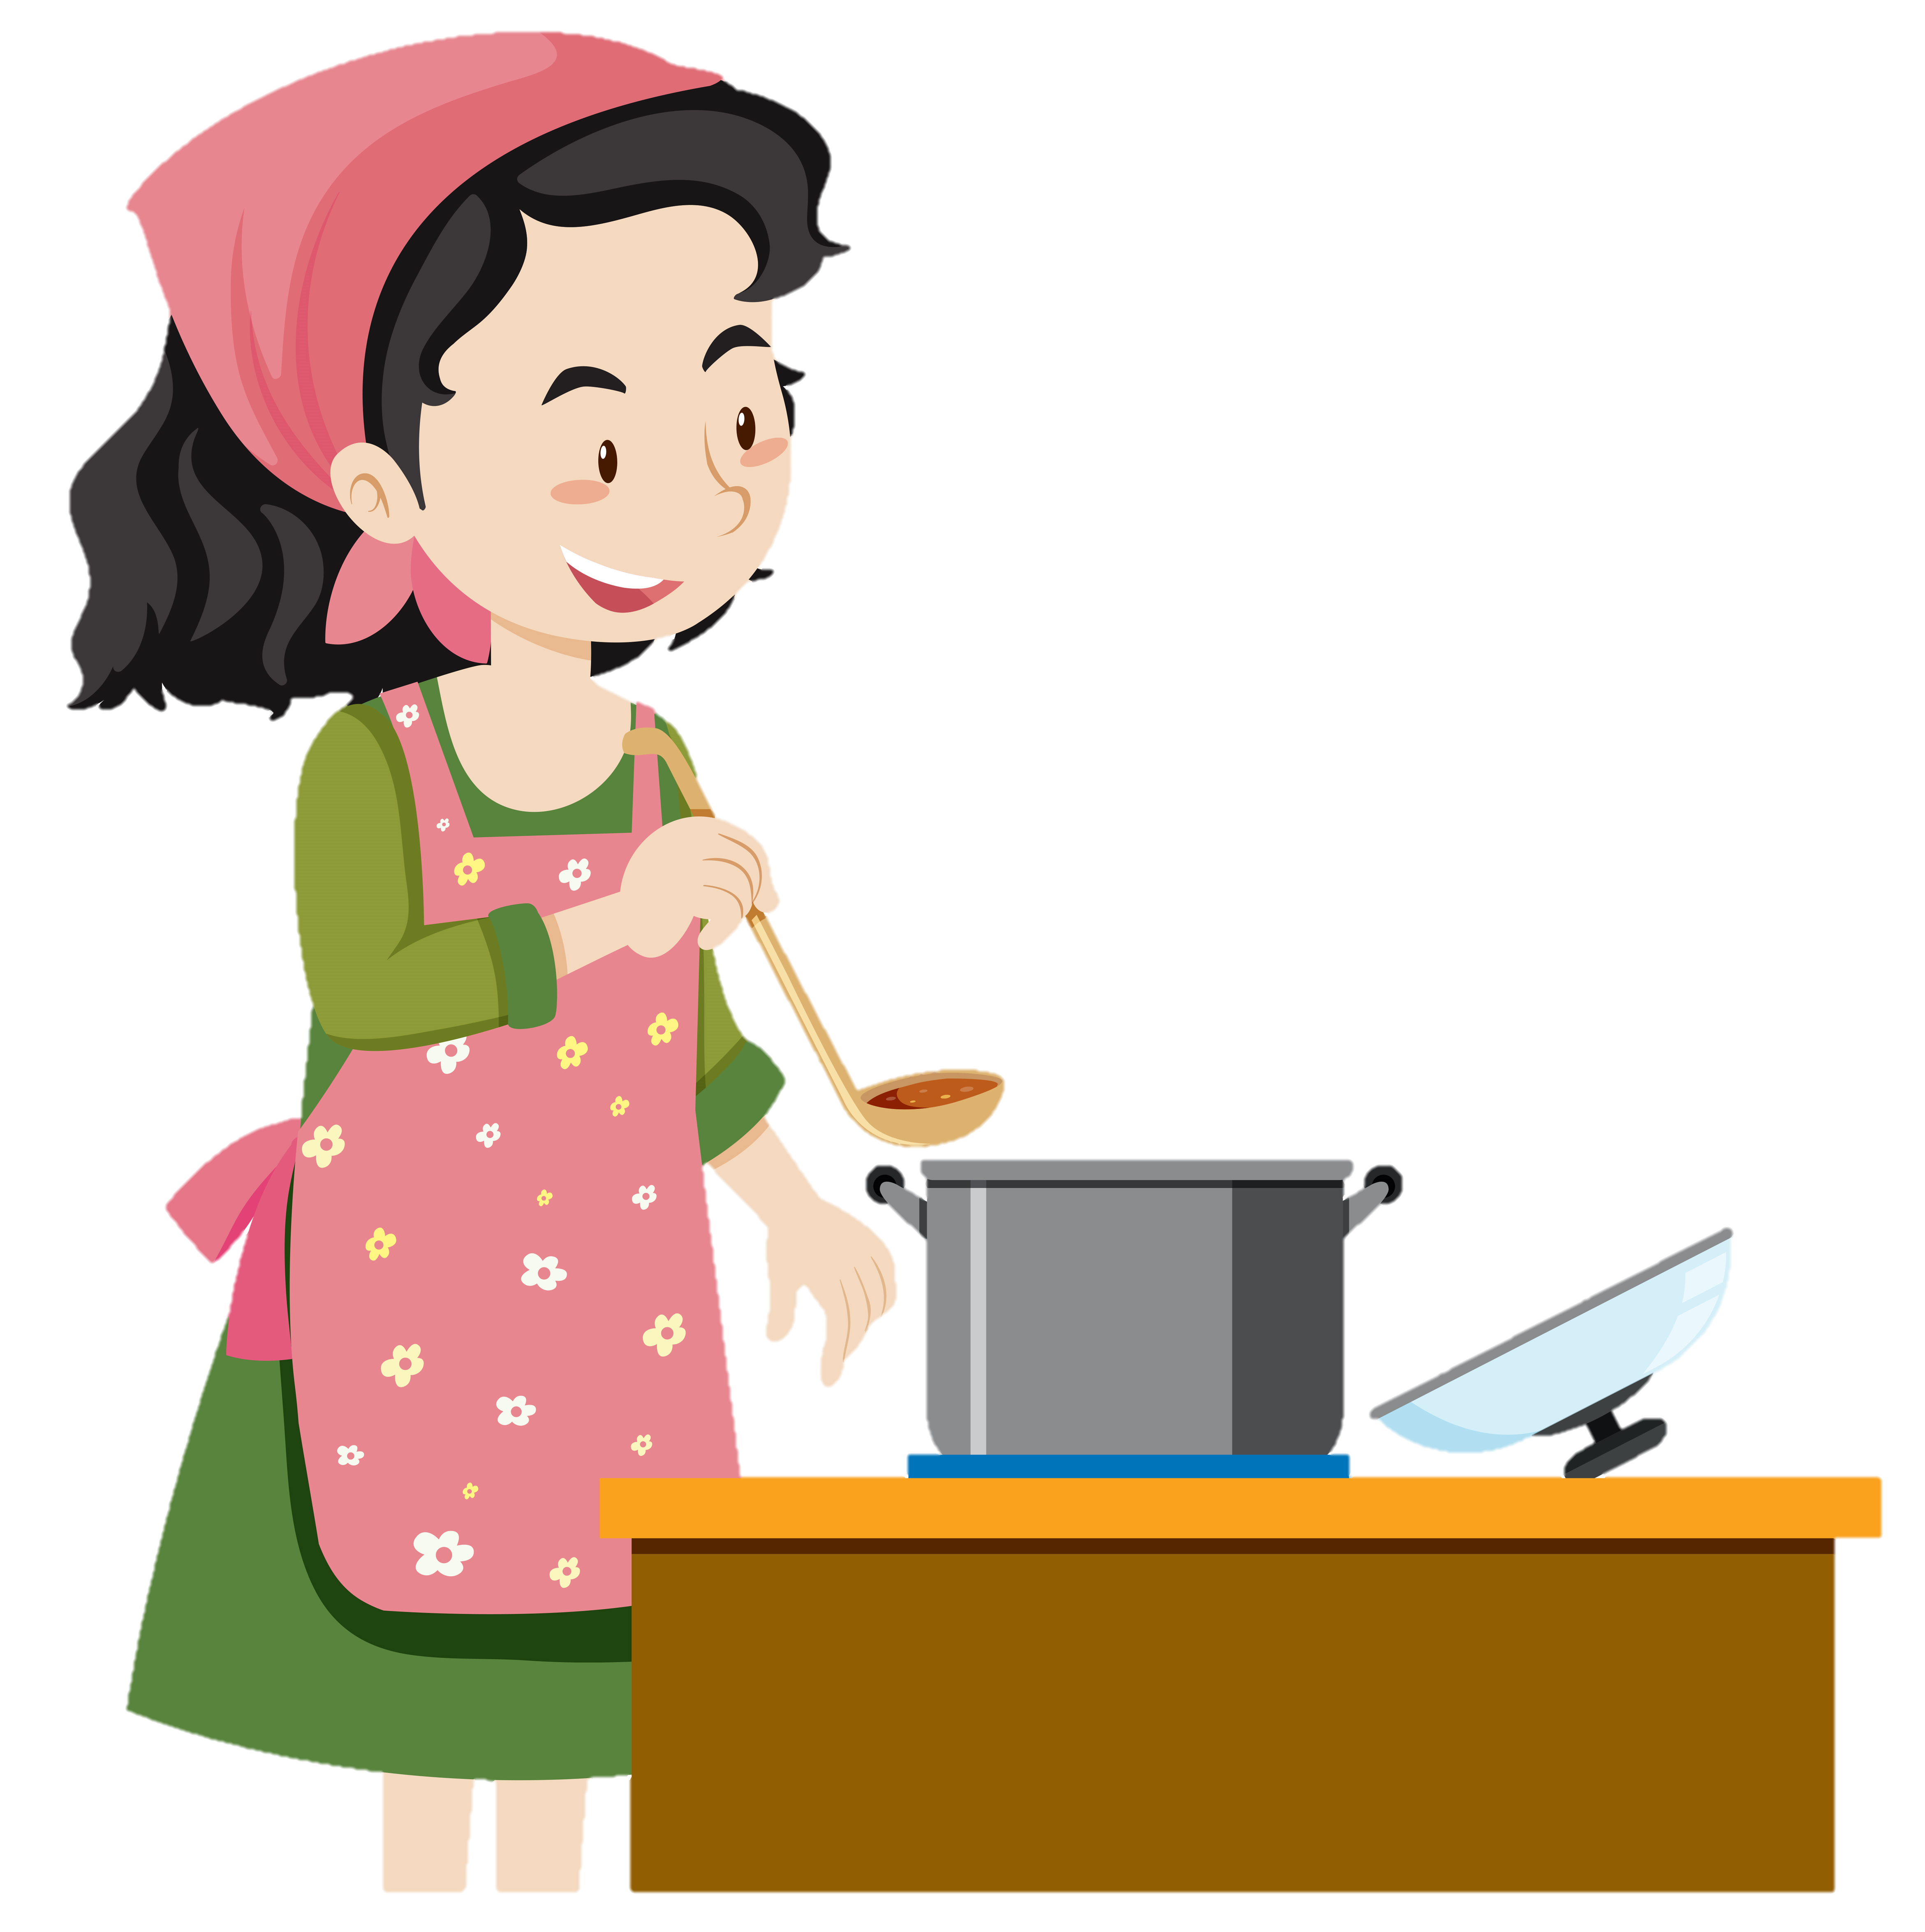
Can your mother cook?
Yes
…………, she can.

Slide 39
+ 1 POINTS

Slide 40
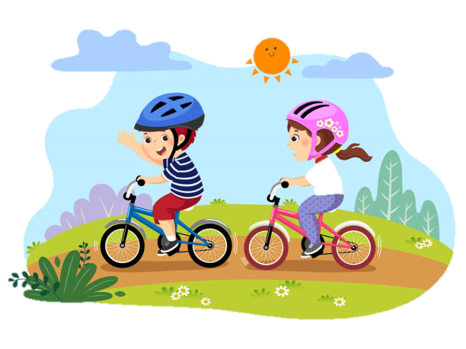
Can they ride a bike?
Yes
…………, they can.

Slide 41
- 5 POINTS

