Slide 1





Slide 2



Things we can do
5
LESSON 2

Slide 3
I. OBJECTIVES.
By the end of the lesson, pupils will be able to:
1. Language.
- Understand and correctly repeat the sentences in two communicative contexts (pictures) in which the characters talk about abilities and lack of abilities.
- Correctly say the words and use Can he / she _____? – Yes, he / she can. / No, he / she can’t, but he / she can _____. to talk about abilities and lack of abilities.
- Enhance the correct use of Can he / she _____? – Yes, _____. / No, _____, but _____. to talk about abilities and lack of abilities in a freer context.
2. Competences
- Communication and collaboration: work in pairs and groups to complete the learning tasks
- Self-control & independent learning: perform listening tasks
3. General competencies.
- Listening: listen and number
- Critical thinking: read and match
- Oral communication: let’s play
- Self-control & independent learning: perform listening tasks
- Communication and collaboration: work in pairs or groups
- Sociability: talk to each other, say good words to others.
4. Attributes.
- Show pride in what they can do and great respect for other people’s abilities by using appropriate gestures and intonation when asking and answering about abilities.

Slide 4
Warm-up

Slide 5
Look and guess.

Slide 6
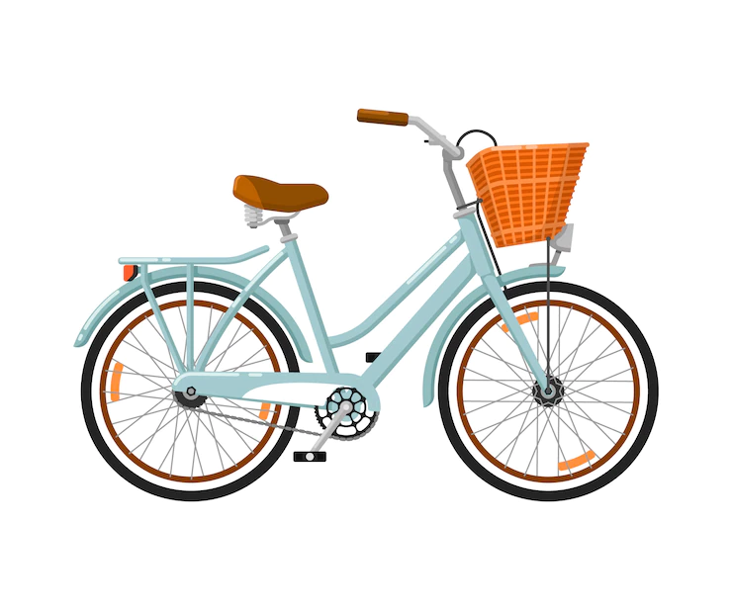
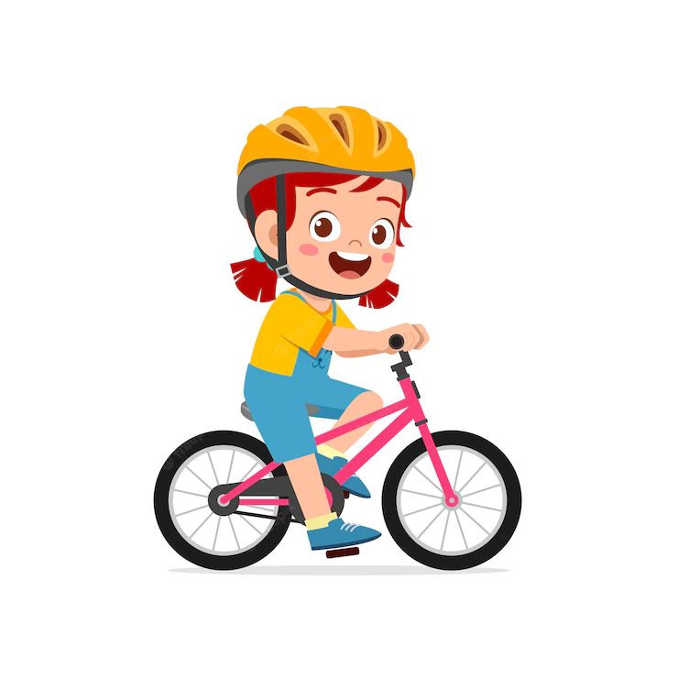
What can you do with this?
I can ride a bike.

Slide 7
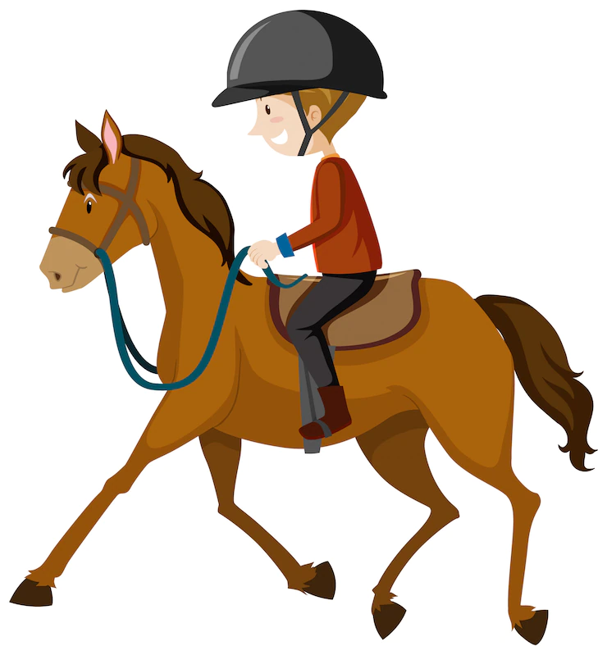

What can you do with this?
I can ride a horse.

Slide 8

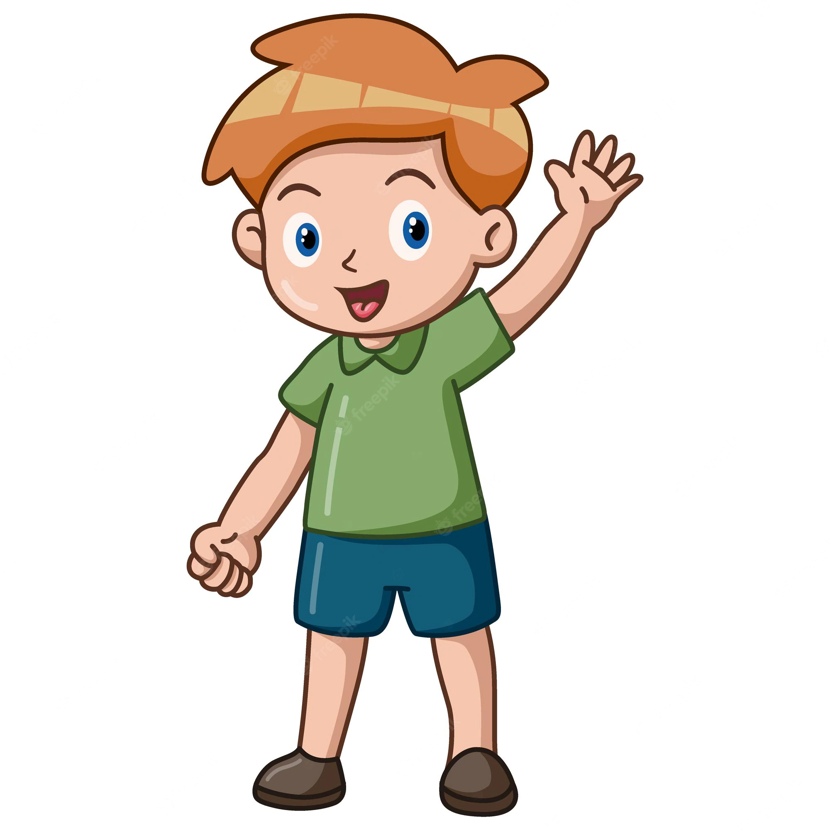
What can you do with this?
I can fly a kite.

Slide 9


What can you do with this?
I can play the piano.

Slide 10
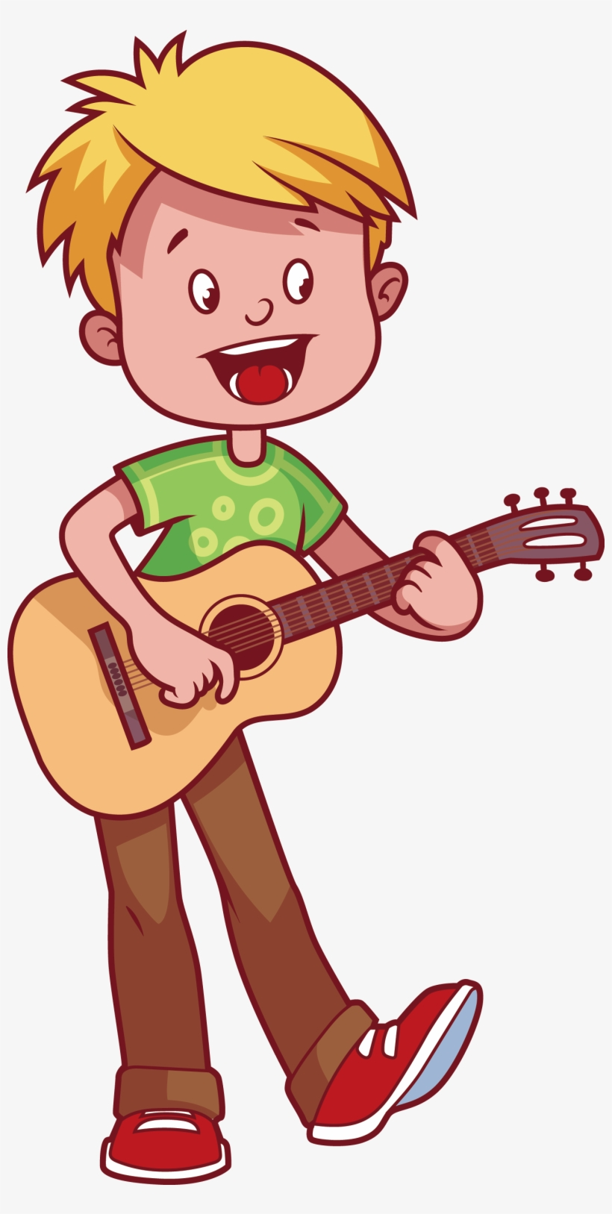

What can you do with this?
I can play the guitar.

Slide 11
1. Look, listen and repeat.

Slide 12
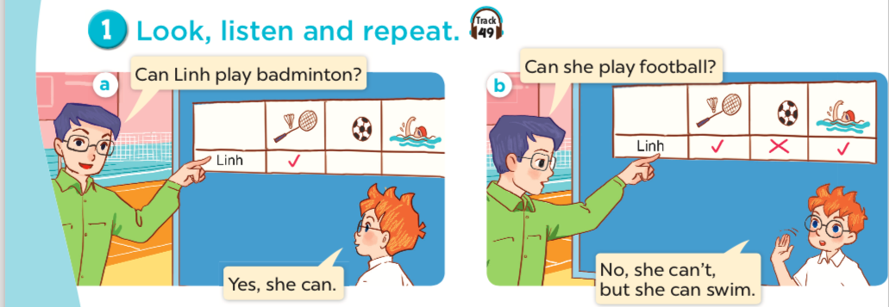

Slide 16
2.Listen, point and say.

Slide 17

play badminton

Slide 18
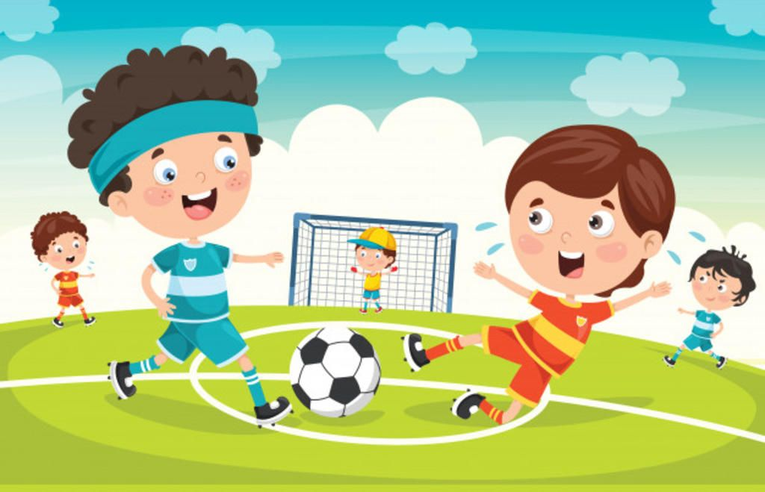
play football

Slide 19

cook

Slide 20

swim

Slide 21
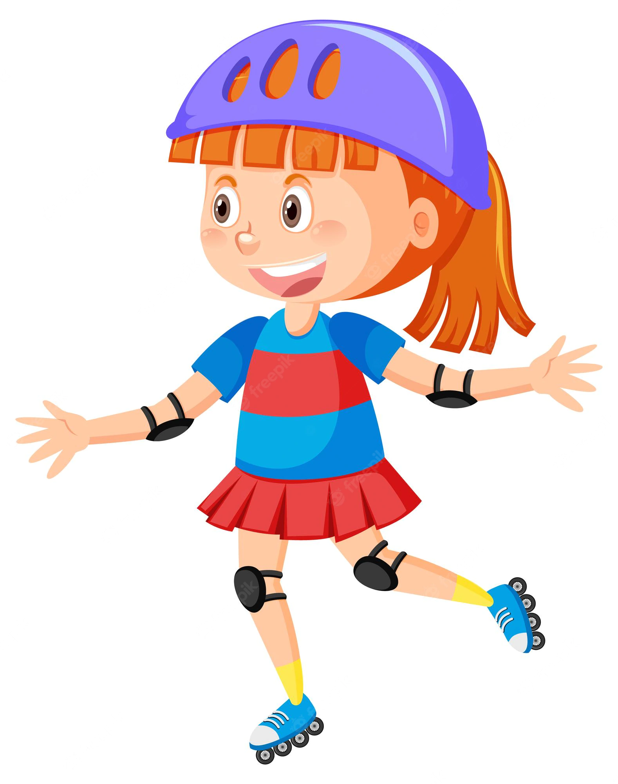
roller skate

Slide 22

draw

Slide 23
Matching game!

Slide 24


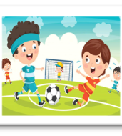

Let’s play
swim
play football
cook
Notes:
Click the card to show the words/picture. Click again to turn it face down.

Slide 25
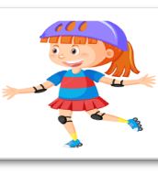
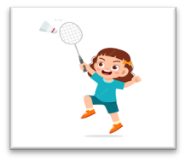
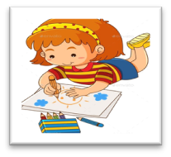
Let’s play.
draw
roller skate
play
badminton
Notes:
Click the card to show the words/ picture. Click again to turn it face down.

Slide 26

Can Mary cook?
she
Yes, she can.

Slide 27


Can she swim?
No, she can't, but she can cook.

Slide 28
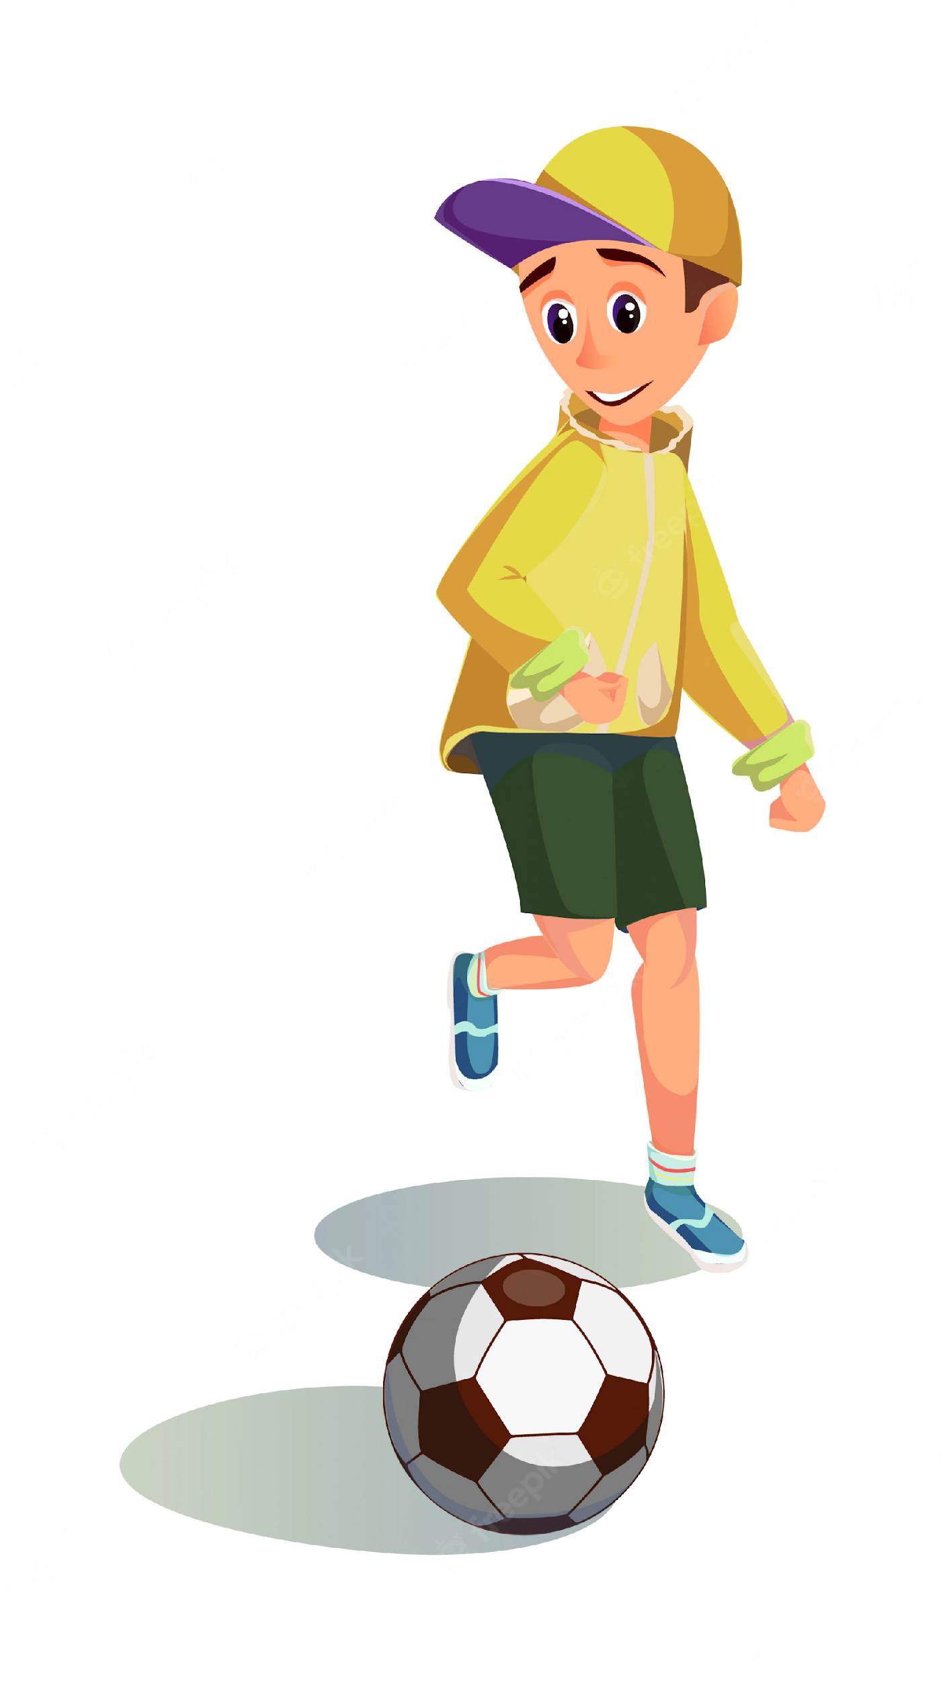
Can Ben play football?
he
Yes, he can.

Slide 29

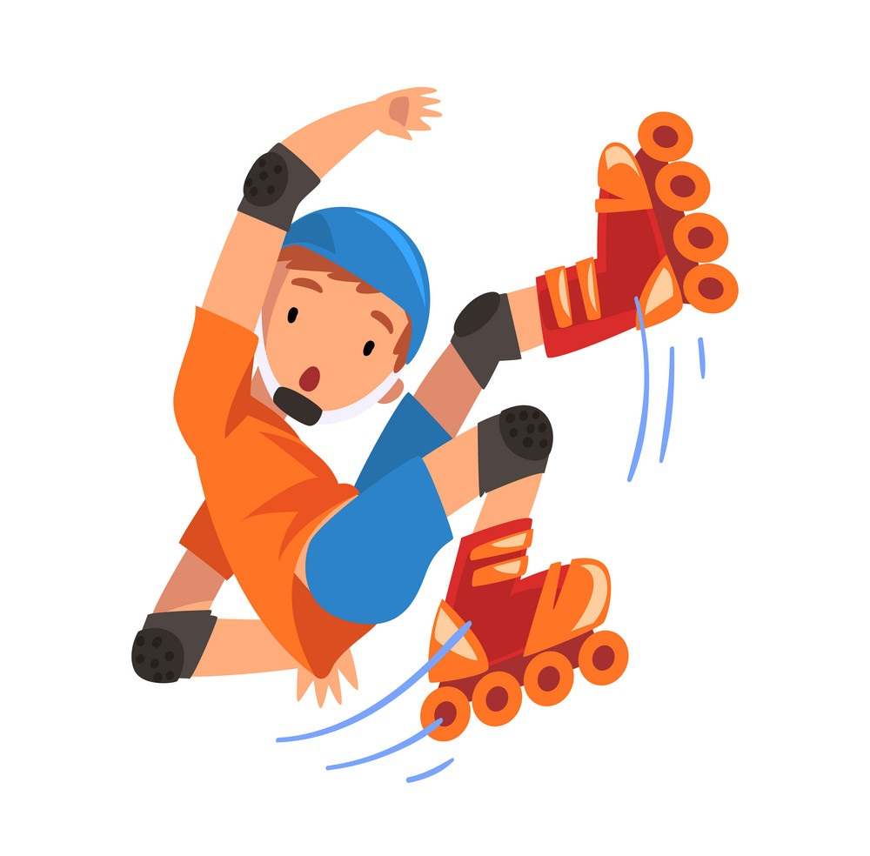
Can he roller skate?
No, he can't,
but he can play football.

Slide 30
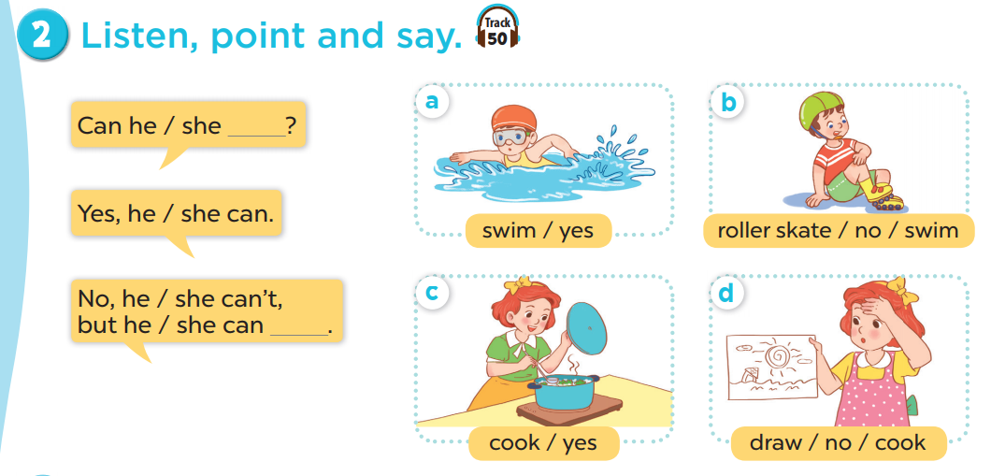

Slide 31


4.Listen and tick or cross.

Slide 32
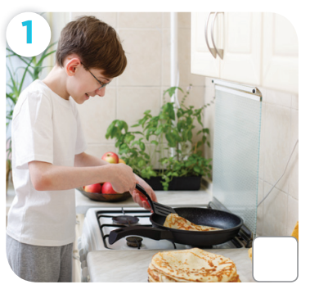
Can he cook?

Slide 33
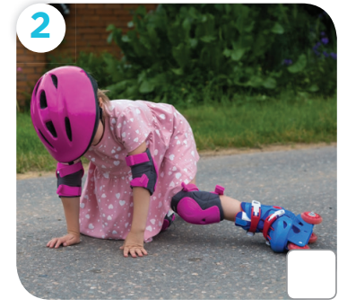
Can she roller skate?

Slide 34
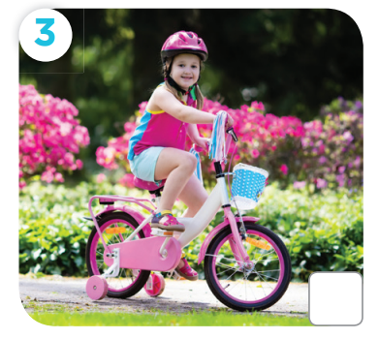
Can she ride a bike?

Slide 35
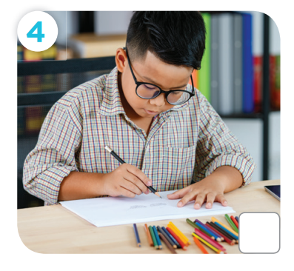
Can he draw a picture?

Slide 36
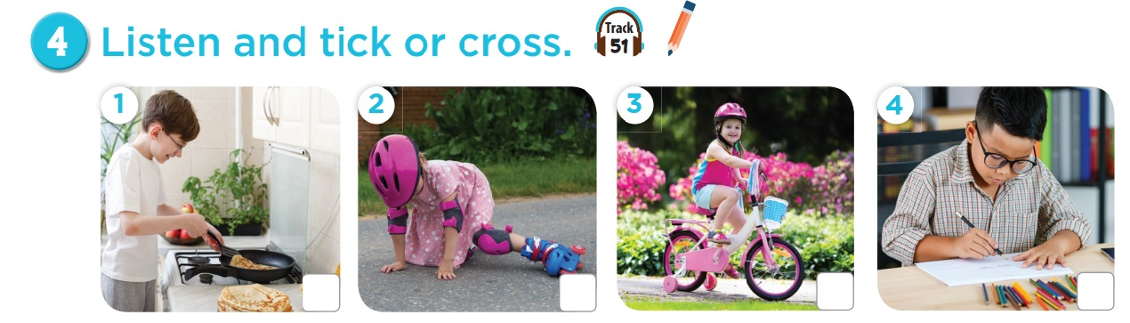



Slide 37
Games

Slide 38



Notes:
CLICK THE CLOUD – GO TO PART 4

Slide 39

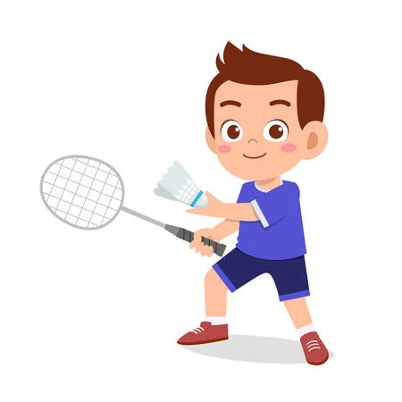

Can he _______________?
play badminton
____, he can.
Yes
Notes:
CLICK PINK AMONG US – GO TO THE POINTS

Slide 40
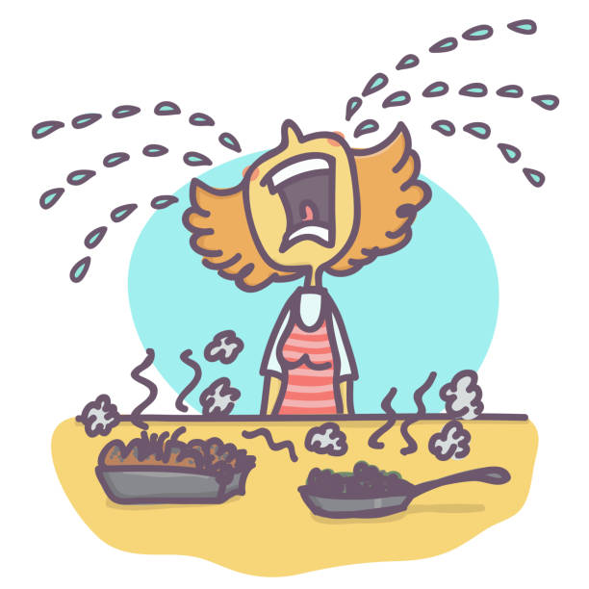
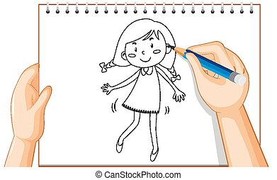
Can she cook?
No
____, she can't,
but she can _____.
draw
Notes:
CLICK PINK AMONG US – GO TO THE POINTS

Slide 41
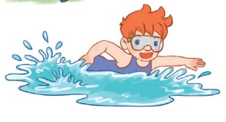
Can he ________?
swim
Yes, he _____.
can
Notes:
CLICK PINK AMONG US – GO TO THE POINTS

Slide 42
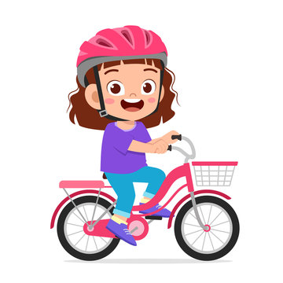
Can she ____________?
ride a bike
Yes, ________.
she can
Notes:
CLICK PINK AMONG US – GO TO THE POINTS

Slide 43
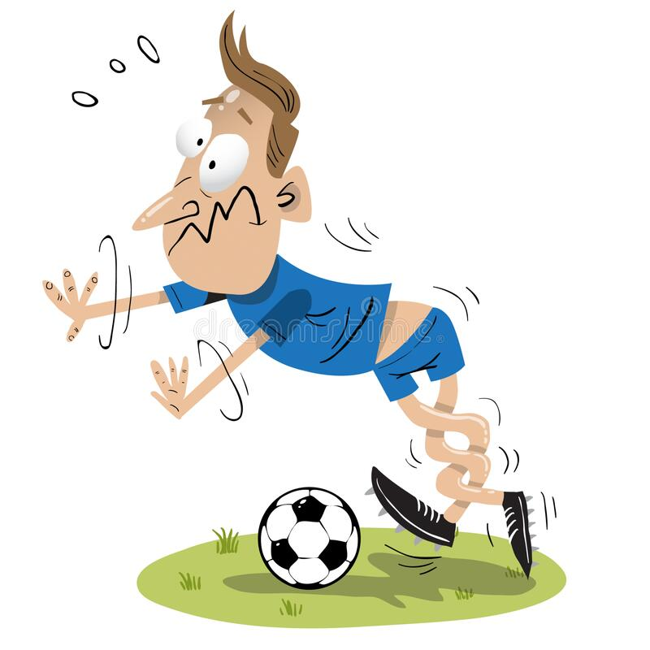
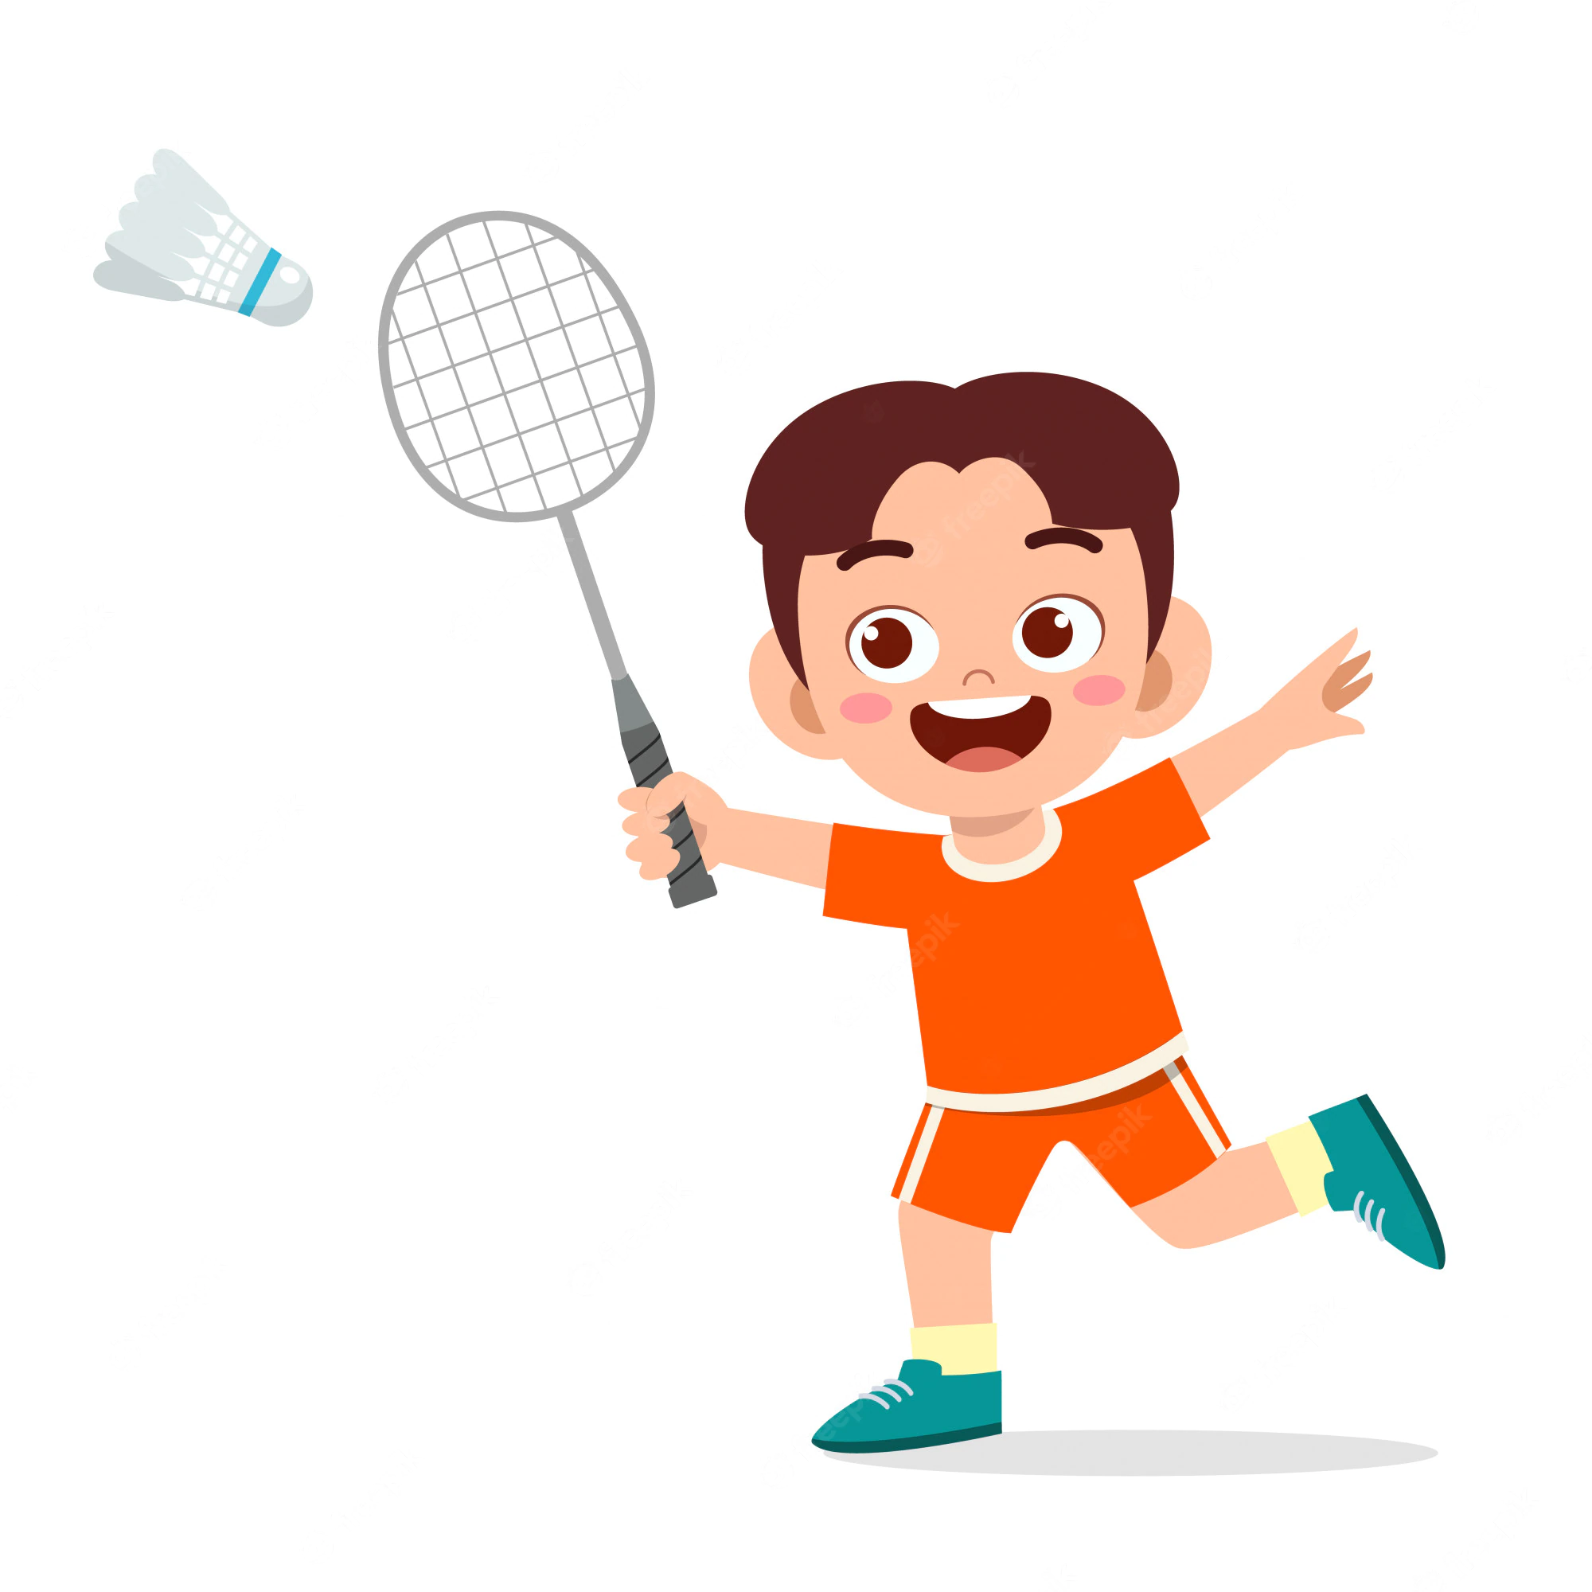
Can he play football ?
No
____, he can't,
but he can ______________.
play badminton
Notes:
CLICK PINK AMONG US – GO TO THE POINTS

Slide 44
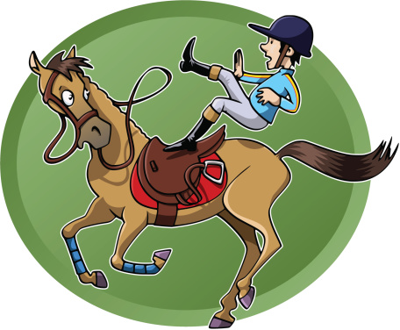
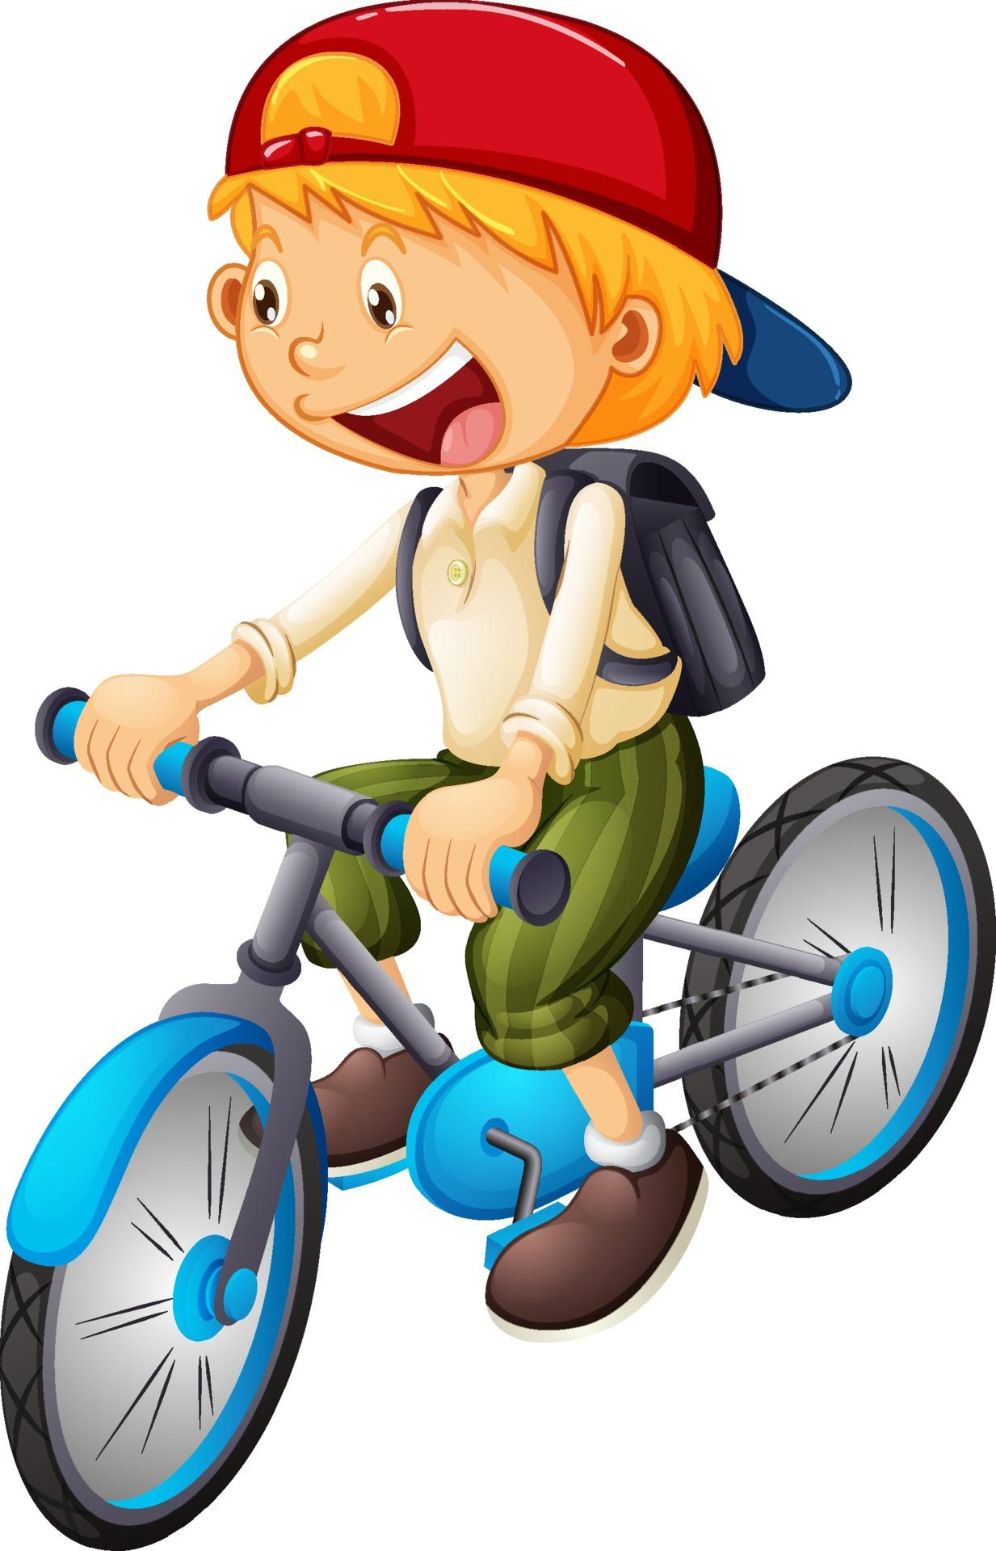
Can he ride a horse ?
can't
No, he ______,
but he _____ ride a bike.
can
Notes:
CLICK PINK AMONG US – GO TO THE POINTS

Slide 45

Can _____ play the piano?
she
Yes, _______.
she can
Notes:
CLICK PINK AMONG US – GO TO THE POINTS

Slide 46
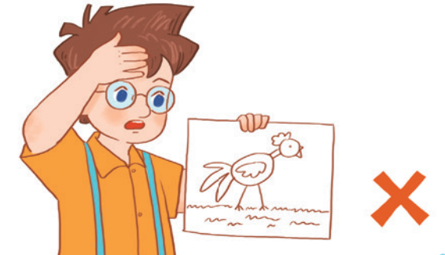
Can he ________?
draw
____, he _____.
No
can't
Notes:
CLICK PINK AMONG US – GO TO THE POINTS

Slide 47





Slide 48



Slide 49


Slide 50


Slide 51


Slide 52


Slide 53


Slide 54


