Slide 1





Slide 2



Things we can do
5
Lesson 1 + Lesson 2

Slide 3
I. OBJECTIVES.
By the end of the lesson, pupils will be able to:
1. Language.
- Complete four gapped exchanges with the help of picture cues.
- Practise the target vocabulary and sentence patterns by playing the game Can you ...?
- Complete four gapped exchanges with the help of picture cues.
- Sing the song Things they can do with the correct pronunciation, rhythm and melody.
2. Competences.
- Communication and collaboration: work in pairs and groups to complete the learning tasks
- Self-control & independent learning: perform listening tasks.
3. General competencies.
- Listening: listen and number
- Critical thinking: read and match
- Oral communication: let’s play
- Self-control & independent learning: perform listening tasks
- Communication and collaboration: work in pairs or groups
- Sociability: talk to each other, say good words to others.
4. Attributes.
- Show pride in what they can do and great respect for other people’s abilities by using appropriate gestures and intonation when asking and answering about abilities.

Slide 4
Warm-up Guessing game

Slide 5
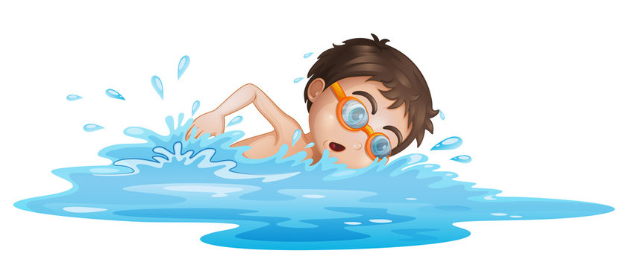

swim

Slide 6
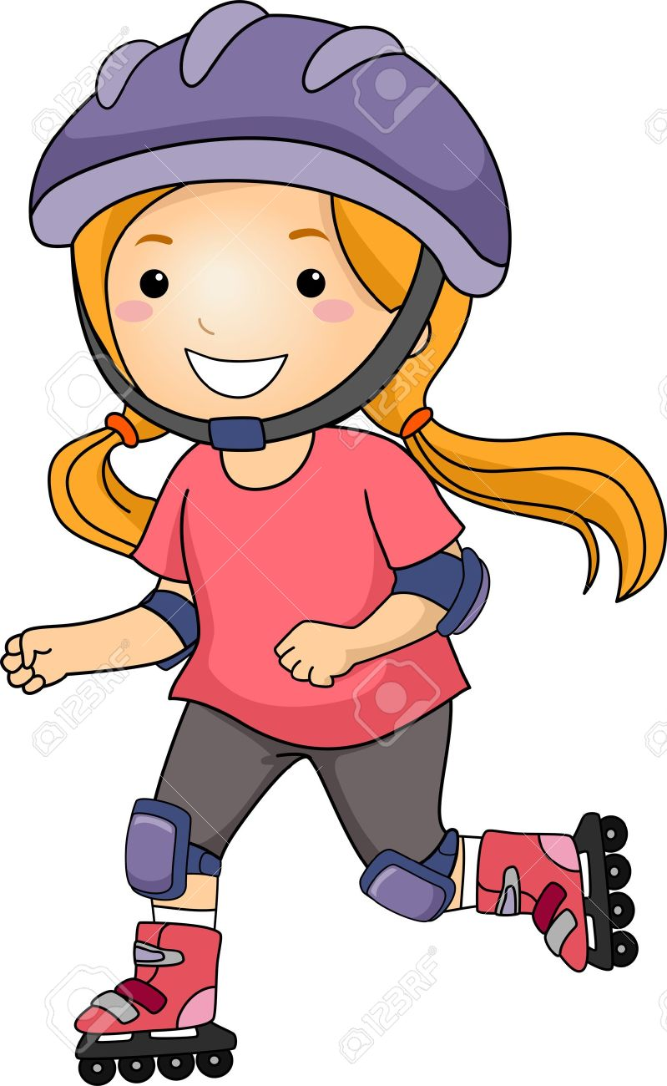
roller skate

Slide 7
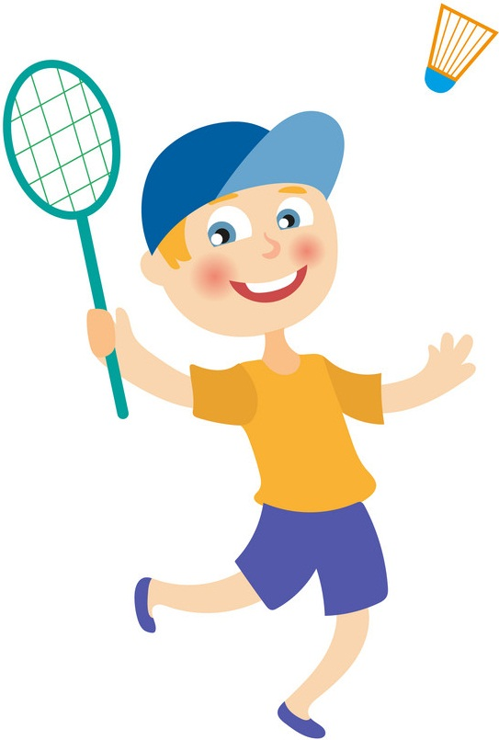
play badminton

Slide 8
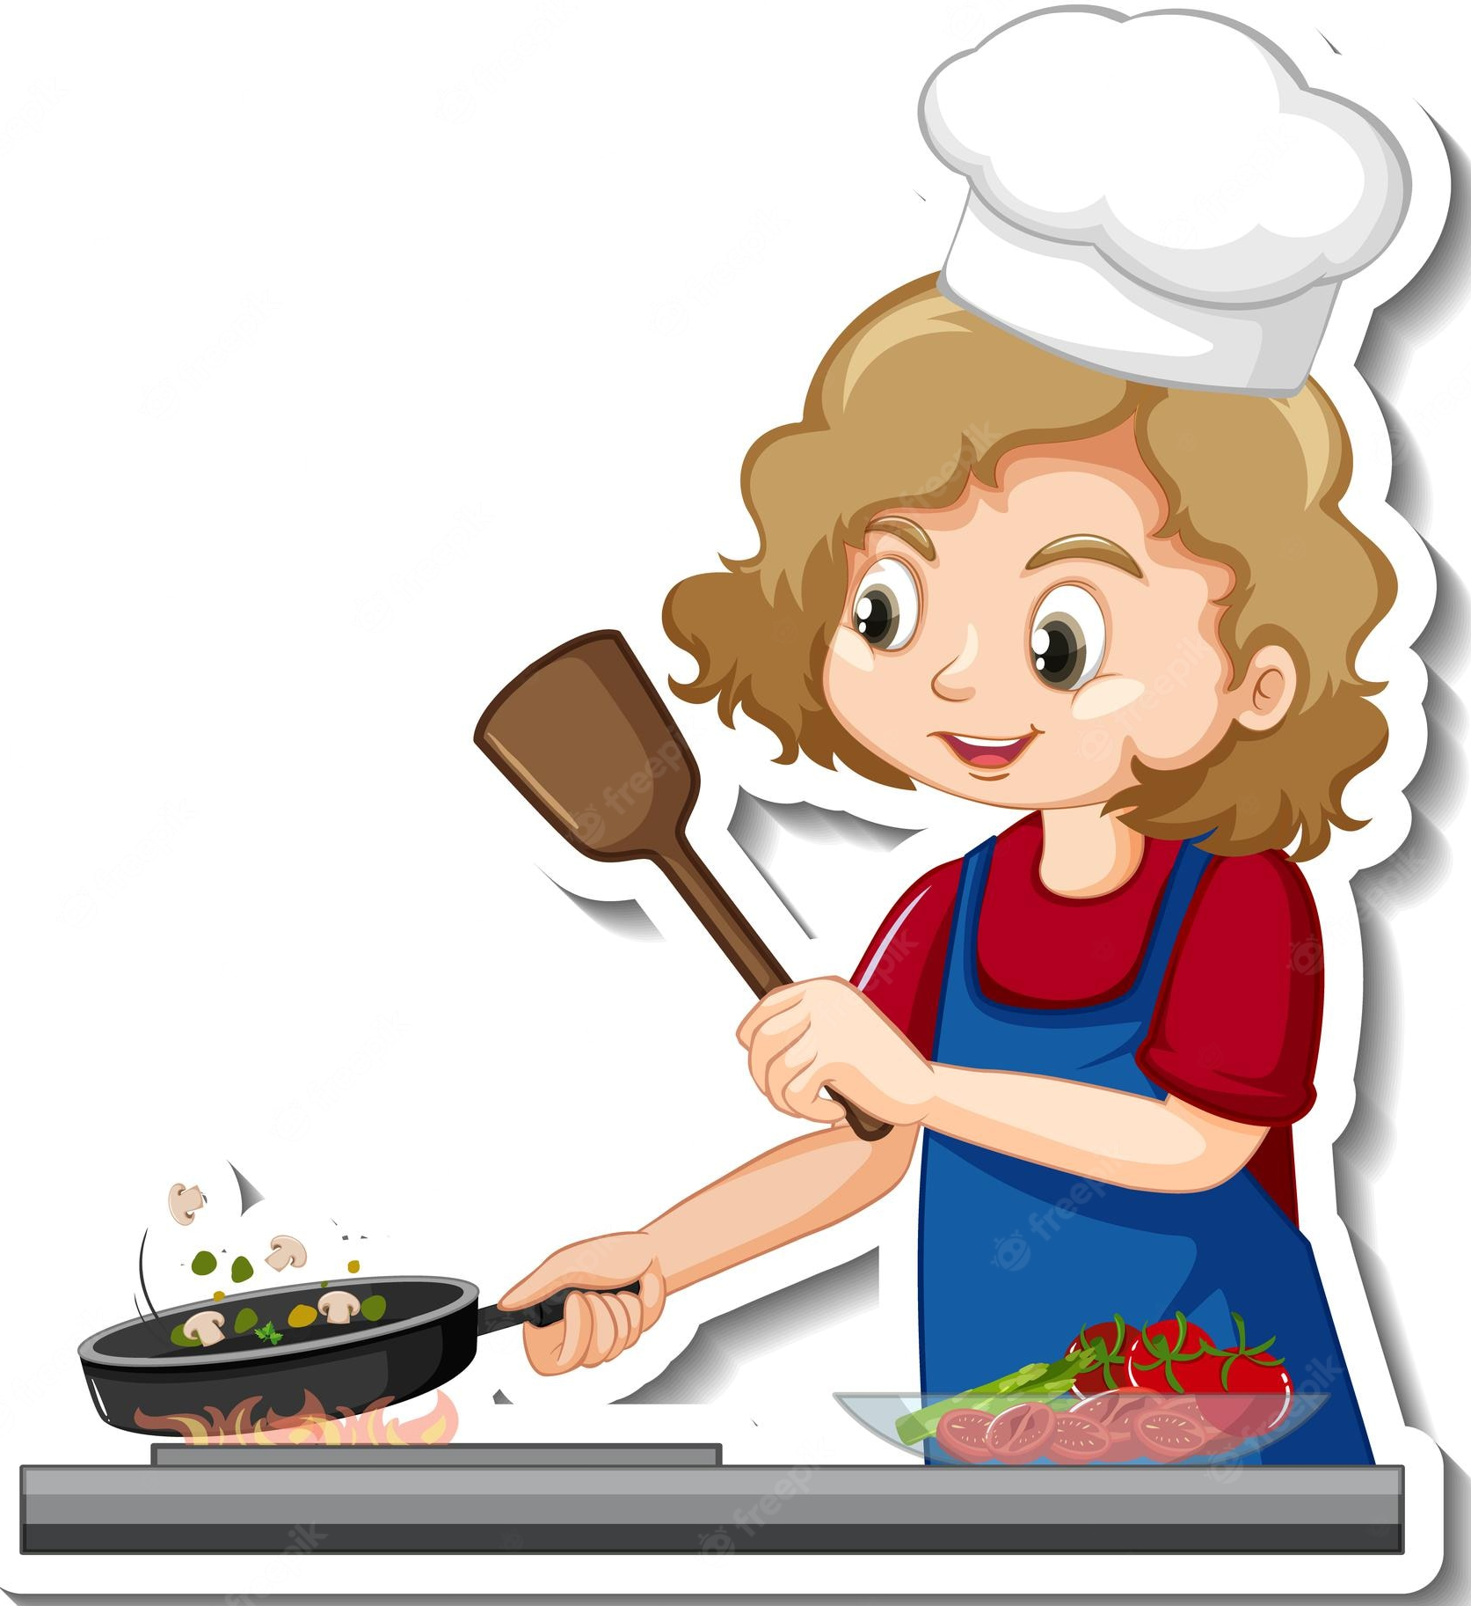
cook

Slide 9
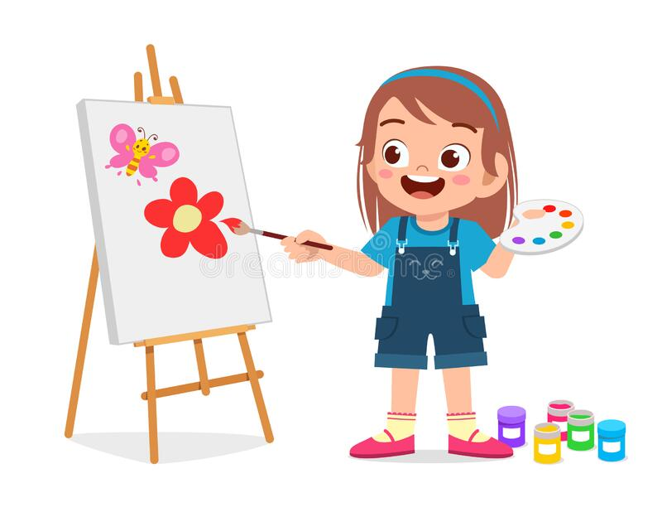
draw

Slide 10
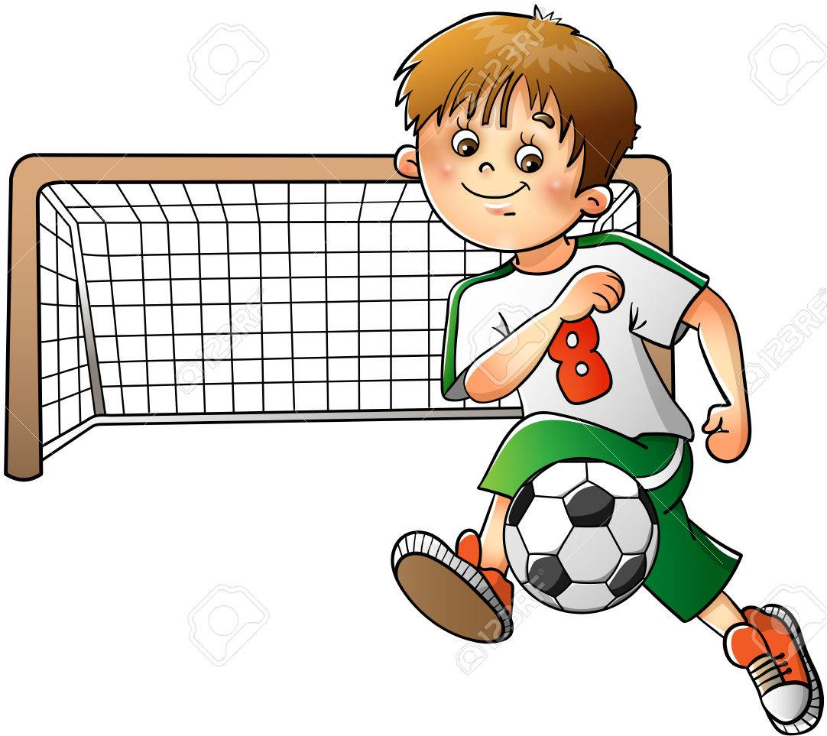
play football

Slide 11

play the piano

Slide 12
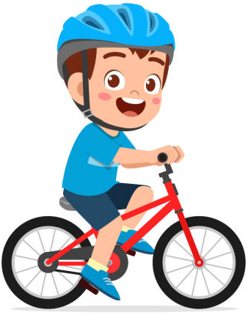
ride
a bike

Slide 13
Review

Slide 14
Let’s meet some
friends.
What can / can’t they do?

Slide 15
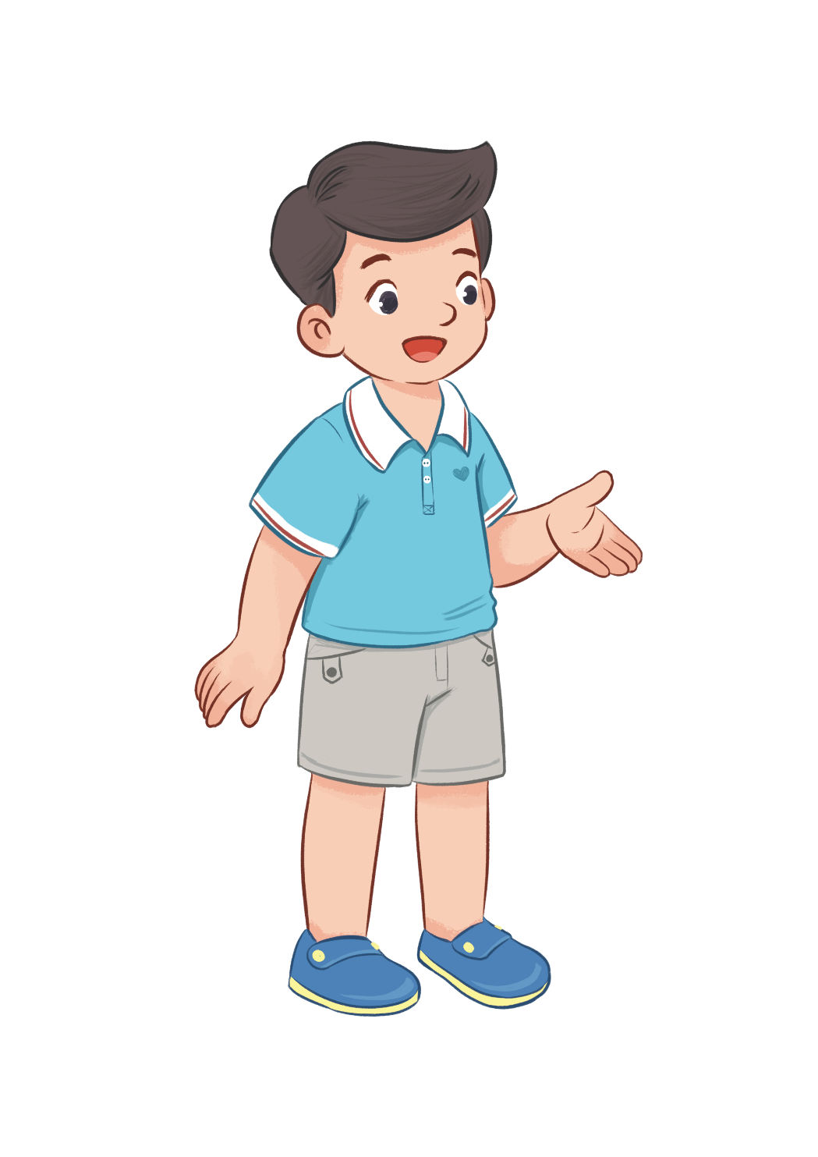
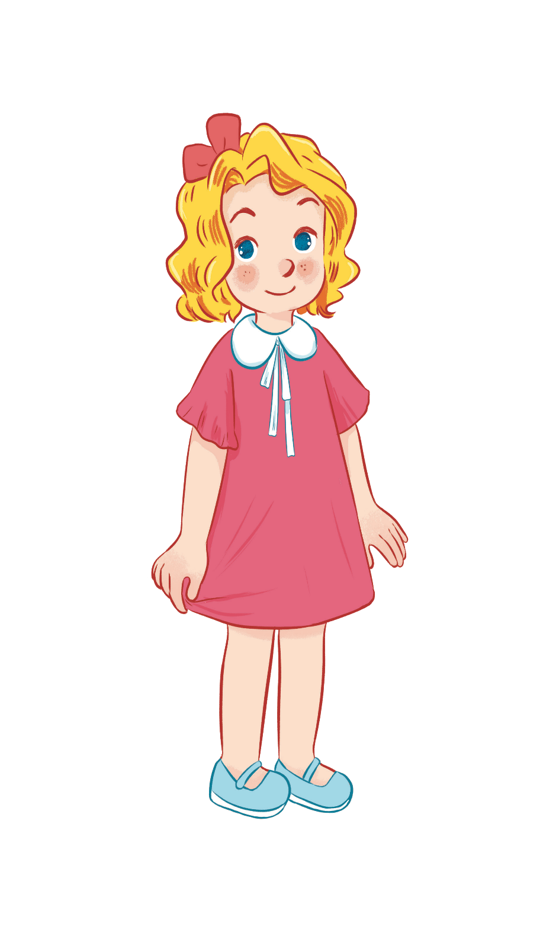



Can he play badminton?
No, he can’t.
Yes, he can.

Slide 16


Can she swim?
Yes, she can.
No, she can’t.

Slide 17
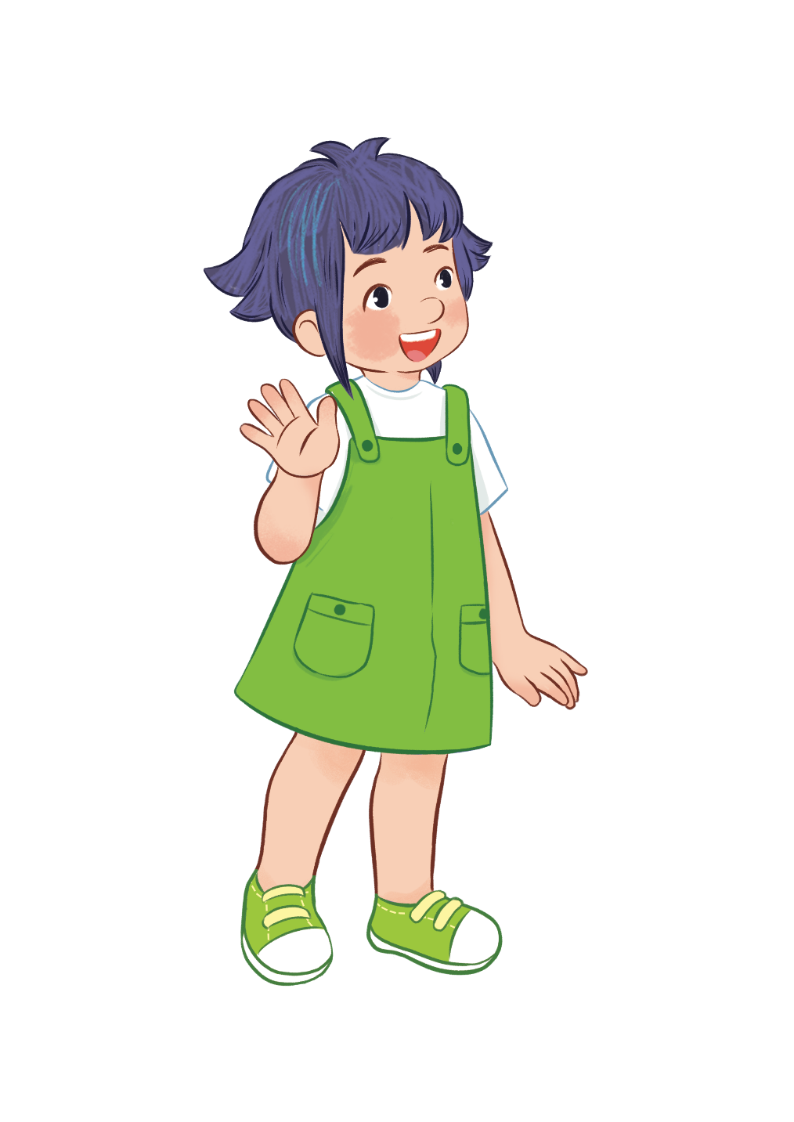
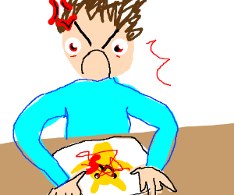

Can she draw?
Yes, she can.
No, she can’t.

Slide 18

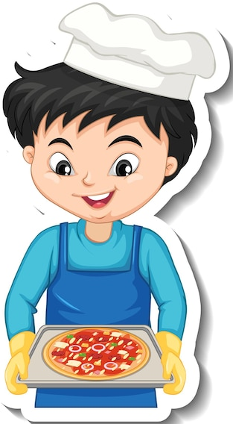
Can he cook?
Yes, he can.
No, he can’t.

Slide 19



can ...........
can’t ...........

Slide 20
5. Look, complete and read.

Slide 21
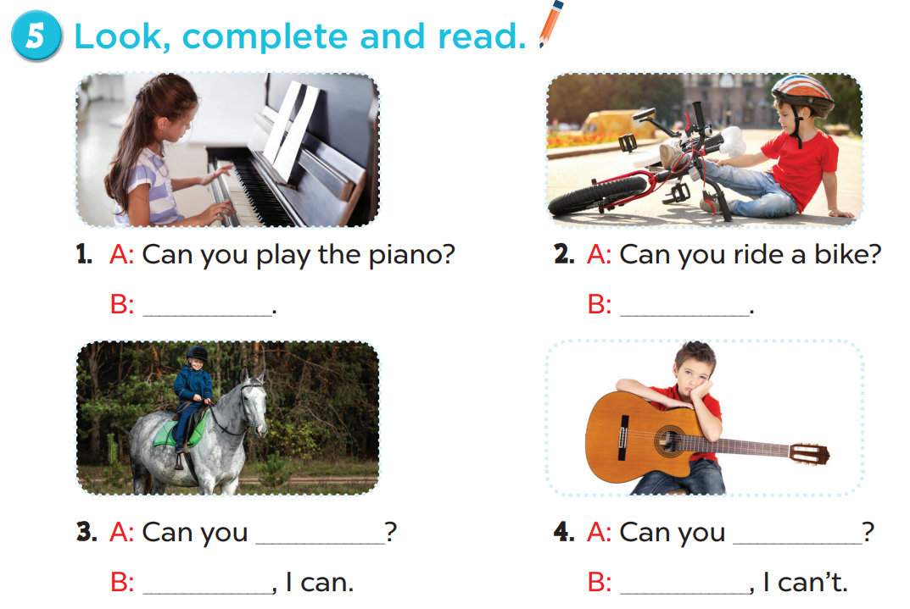
Yes, I can.
No, I can’t
play the guitar
ride a horse
Yes
No

Slide 22
5. Look, complete and read.

Slide 23
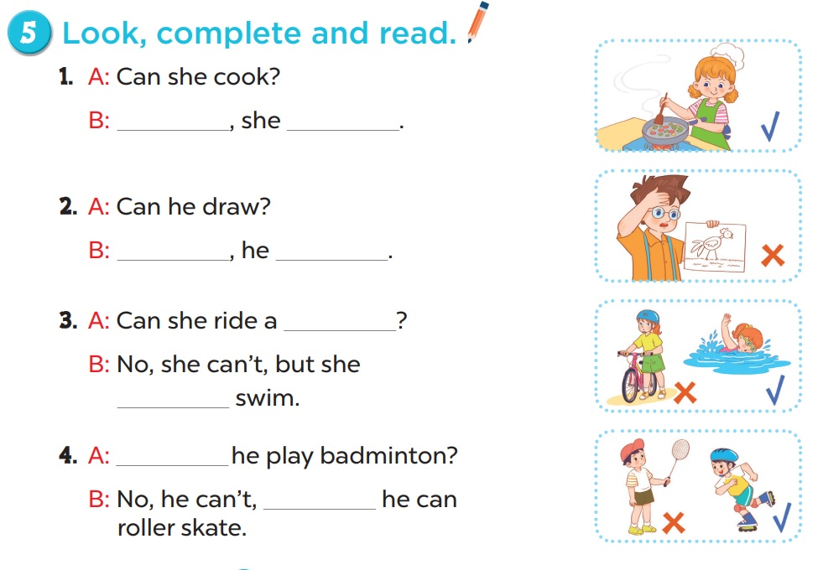
Yes
can
No
can’t
bike
can
Can
but

Slide 24
6. Let’s sing.

Slide 25
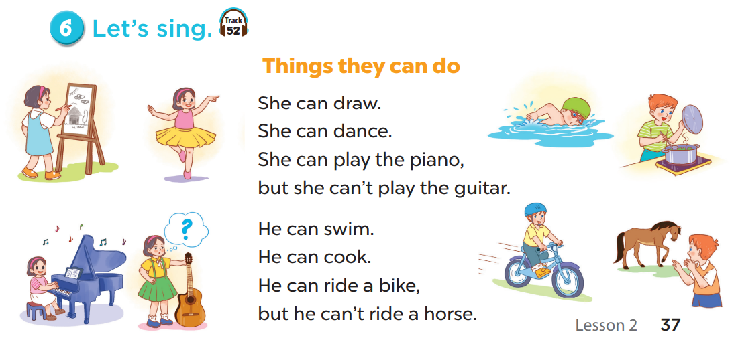


Slide 26
06
Fun corner

Slide 27


Slide 28

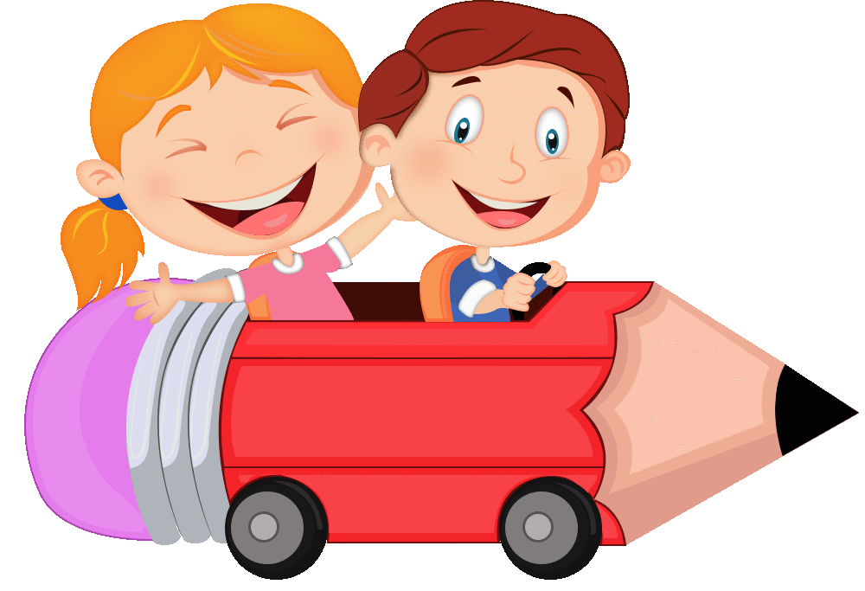

Slide 29




Slide 30
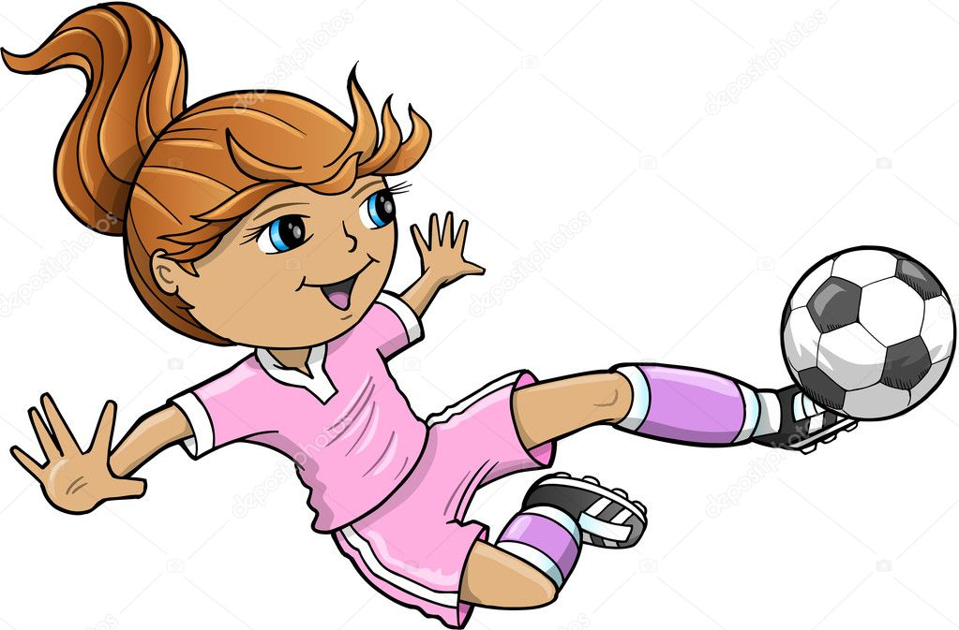



Can she play football?
No, she can’t.
Yes, she can.

Slide 31
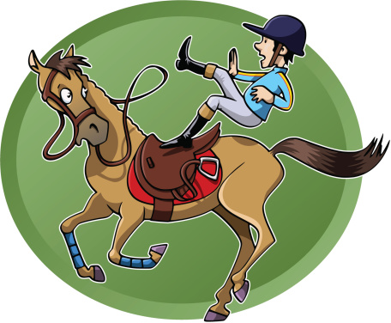



Can he ride a horse?
No, he can’t.
Yes, he can.

Slide 32



Can he ride a bike?
No, he can’t.
Yes, he can.

Slide 33
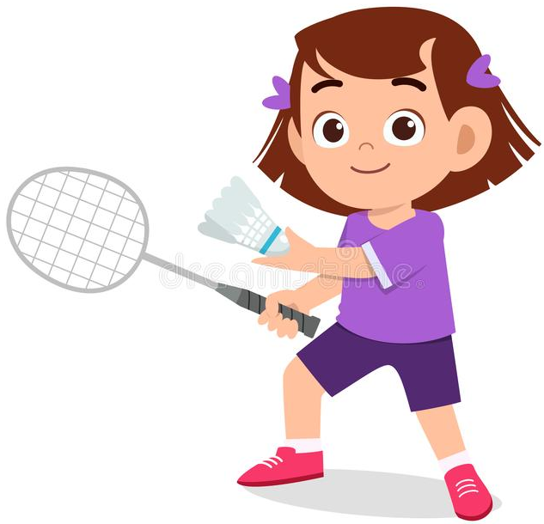
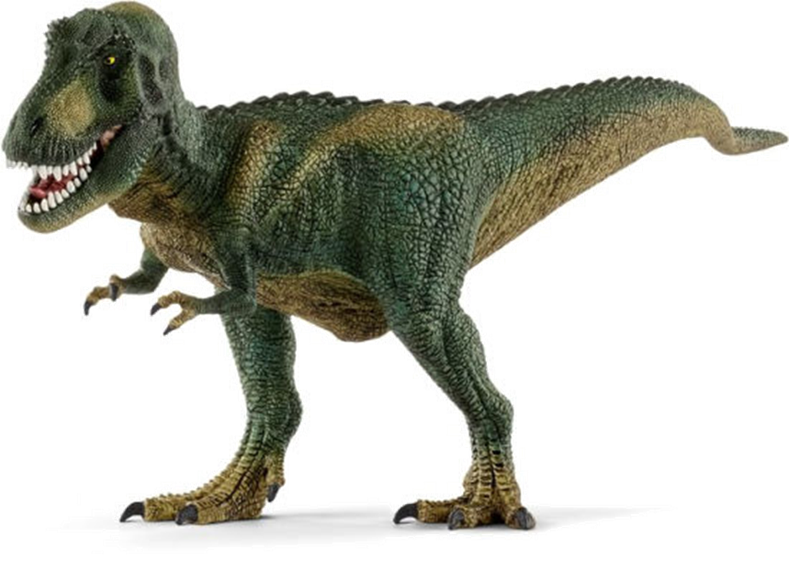

Can she play badminton?
Yes, she can.
No, she can’t.

Slide 34
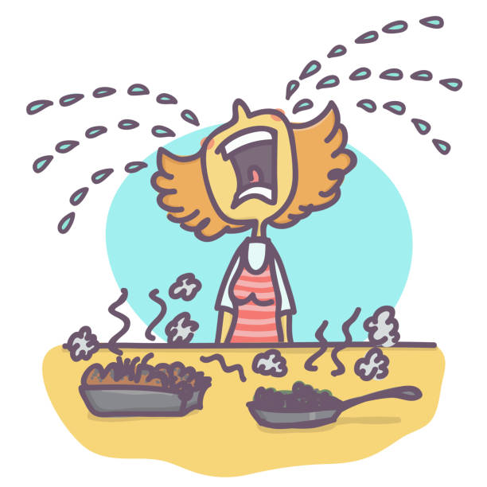
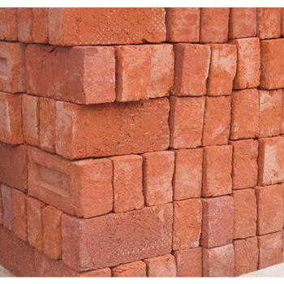


Can she cook?
Yes, she can.
No, she can’t.

Slide 35

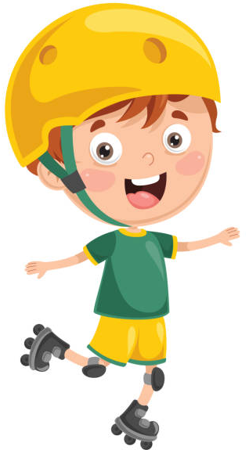
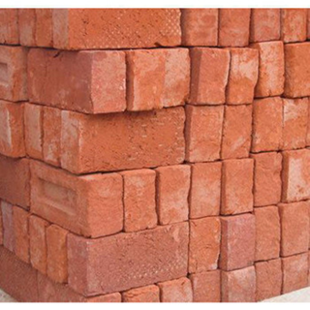

Can he roller skate?
No, he can’t.
Yes, he can.

