Slide 1
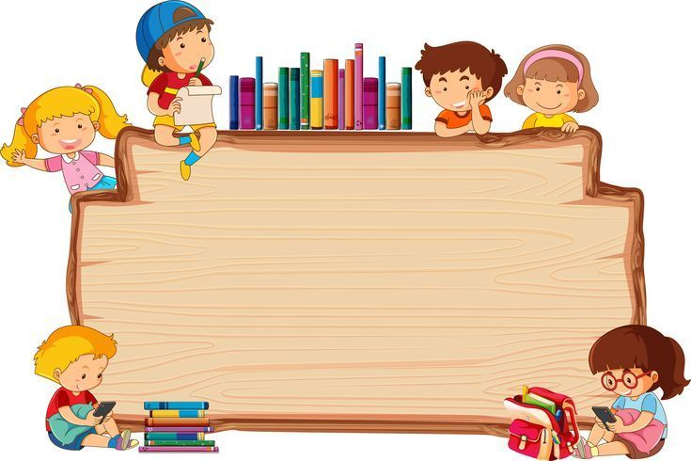
Welcome to our class!

Slide 2

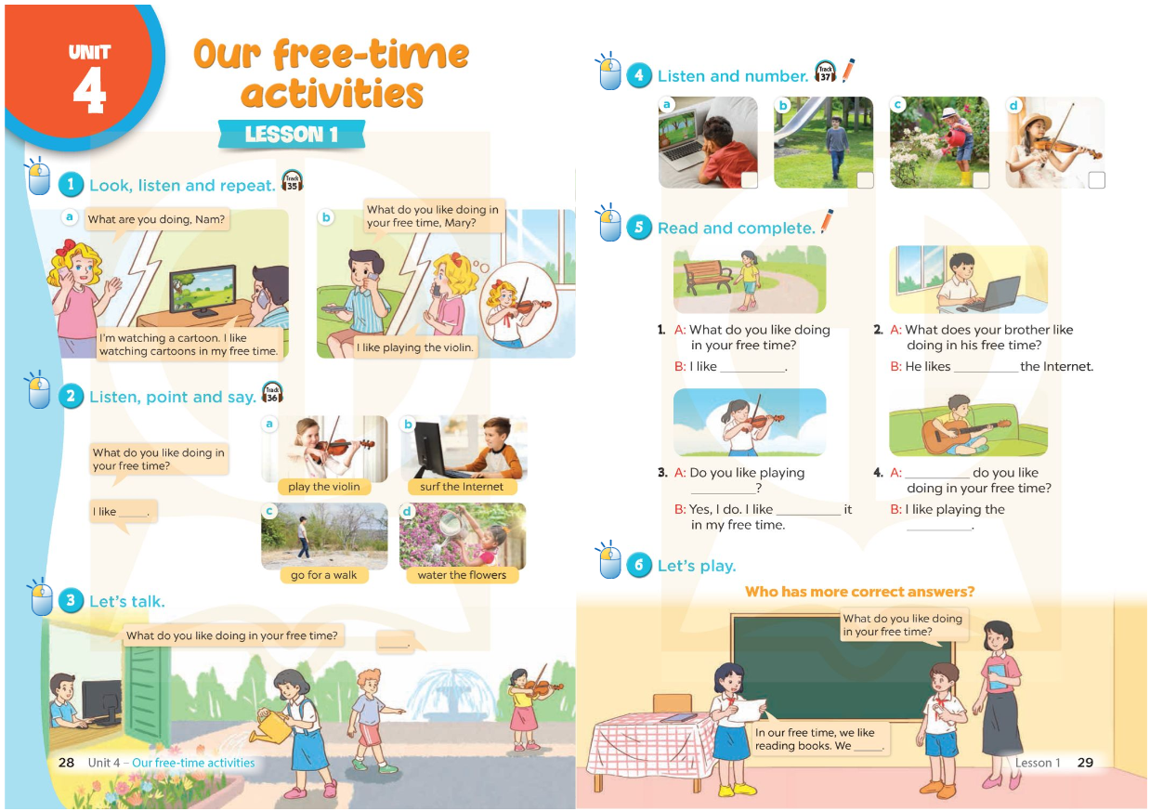

Slide 3
Unit 4: Our free-time activities
Lesson 1 (4-5-6)

Slide 4
Warm up
Let’s watch the video
and do the action

Slide 5
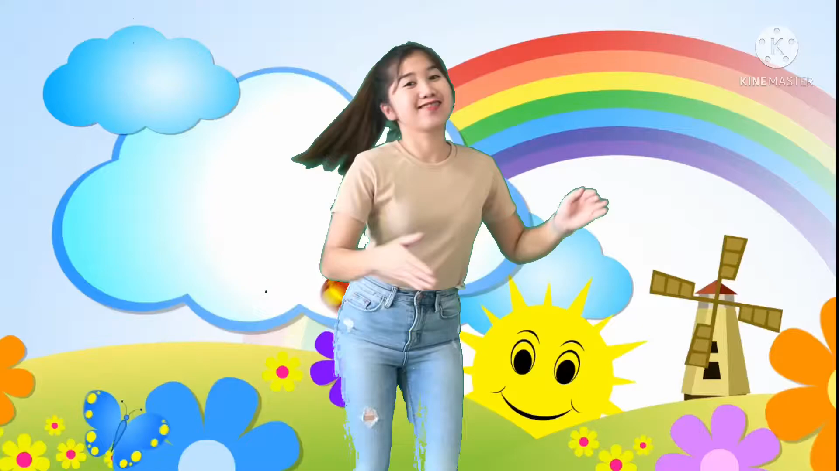

Slide 6
Review
Look at some pictures
and choose the correct answers
A, B, or C.

Slide 7
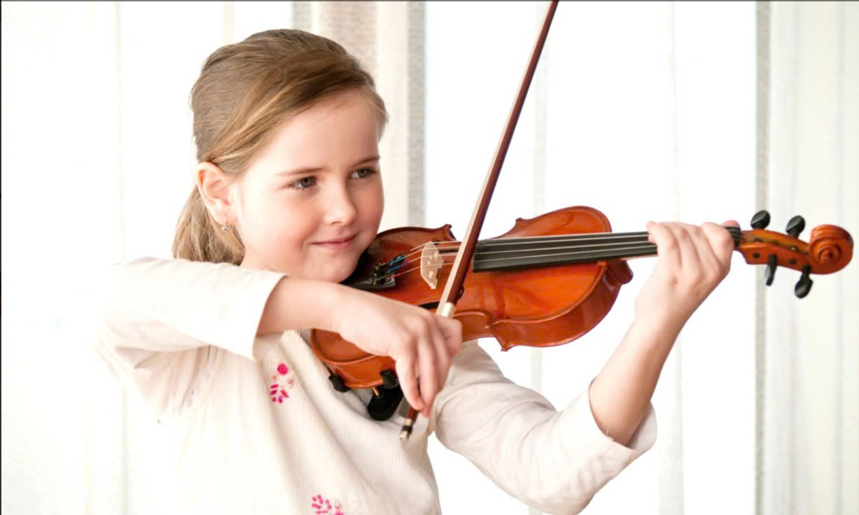
1
What do you like doing in your free time?
I like ___________________.
A. swimming
B. playing the violin
C. going for a walk

Slide 8
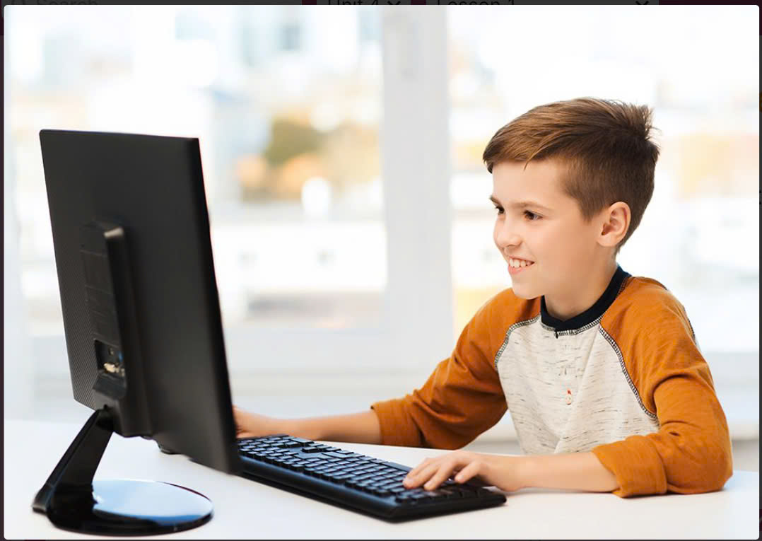
2
What do you like doing in your free time?
I like ___________________.
A. watering the flowers
B. playing the violin
C. surfing the Internet

Slide 9
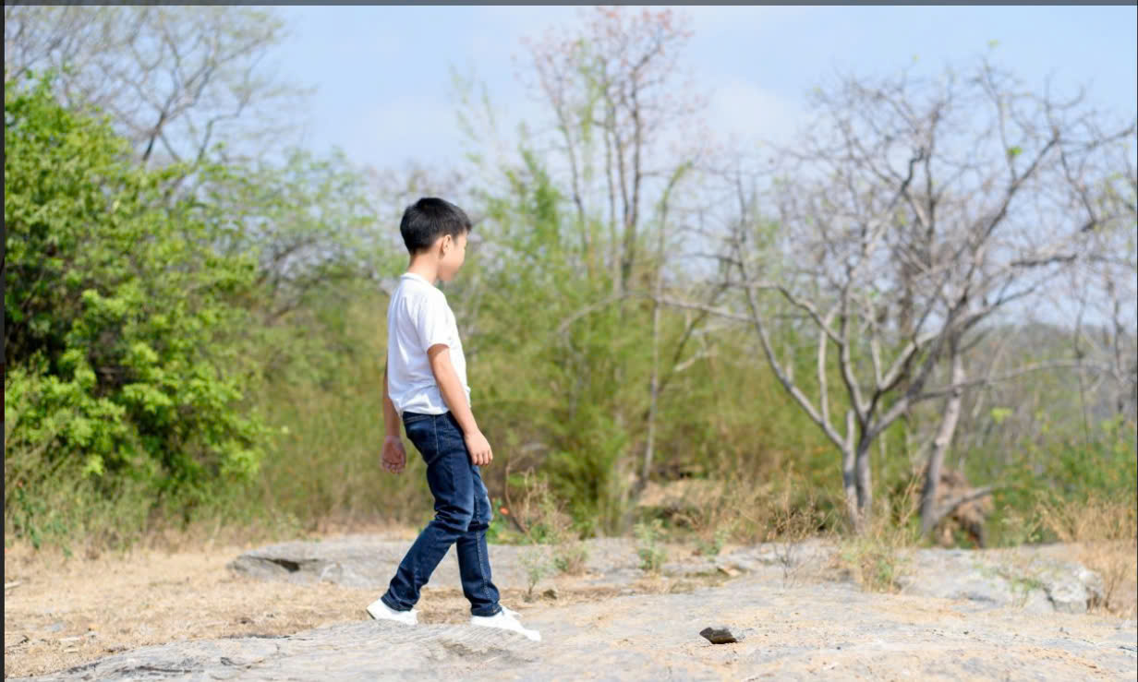
3
What do you like doing in your free time?
I like ___________________.
A. playing basketball
B. playing football
C. going for a walk

Slide 10
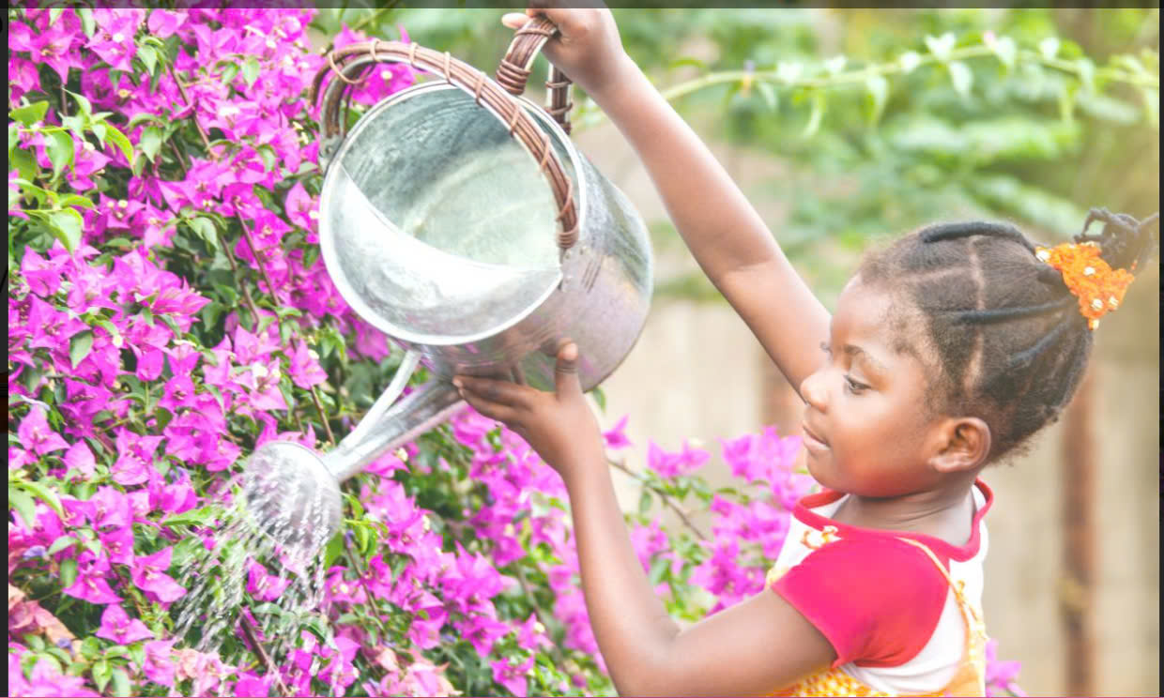
4
What do you like doing in your free time?
I like ___________________.
A. watering the flowers
B. playing the guitar
C. reading a book

Slide 11
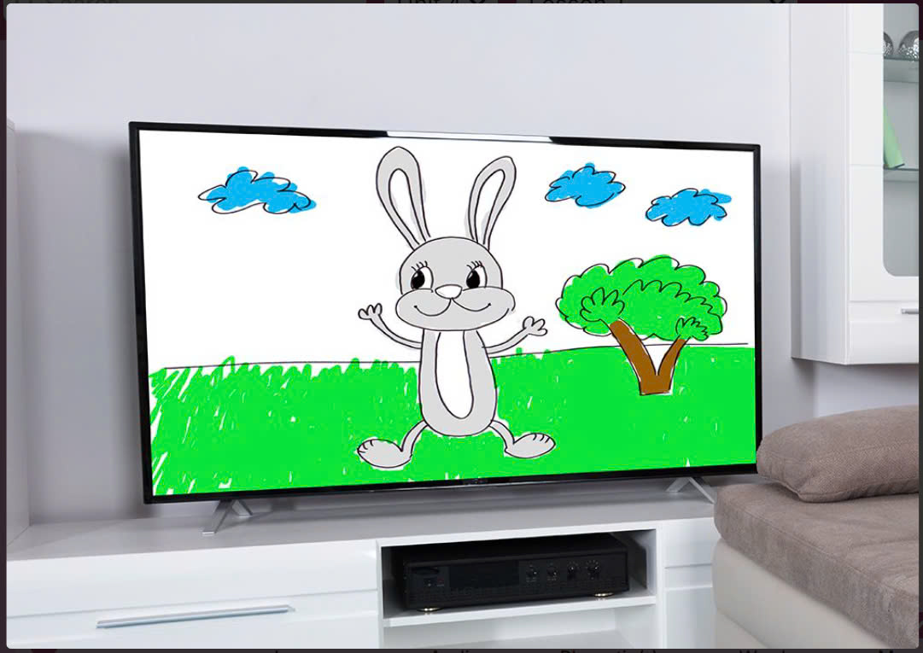
5
What do you like doing in your free time?
I like ___________________.
A. watching a cartoon
B. surf the Internet
C. going for a walk

Slide 12
What do you like doing in your free time?
I like ___________________.

Slide 13
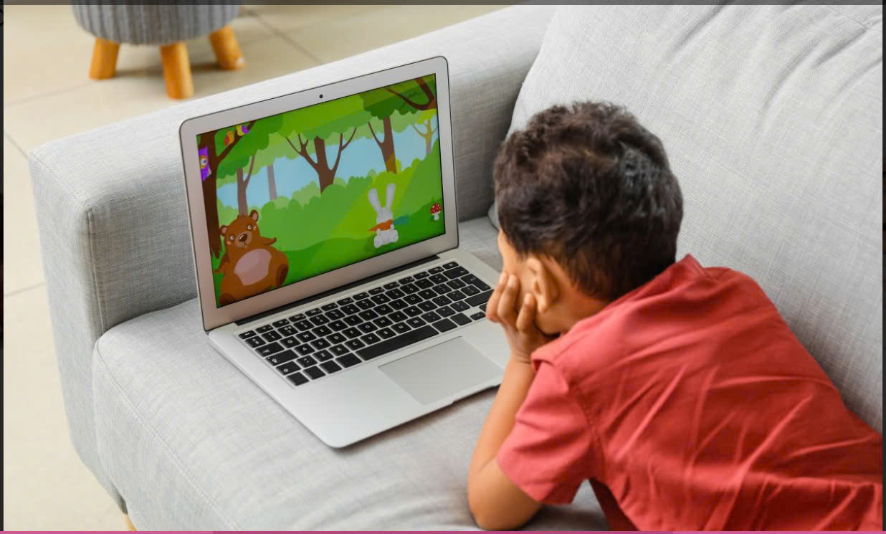
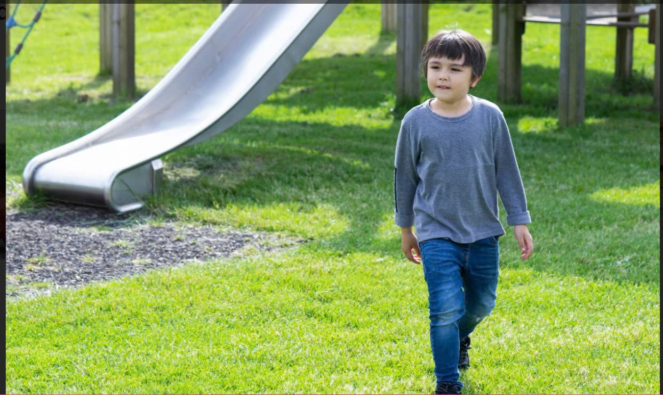
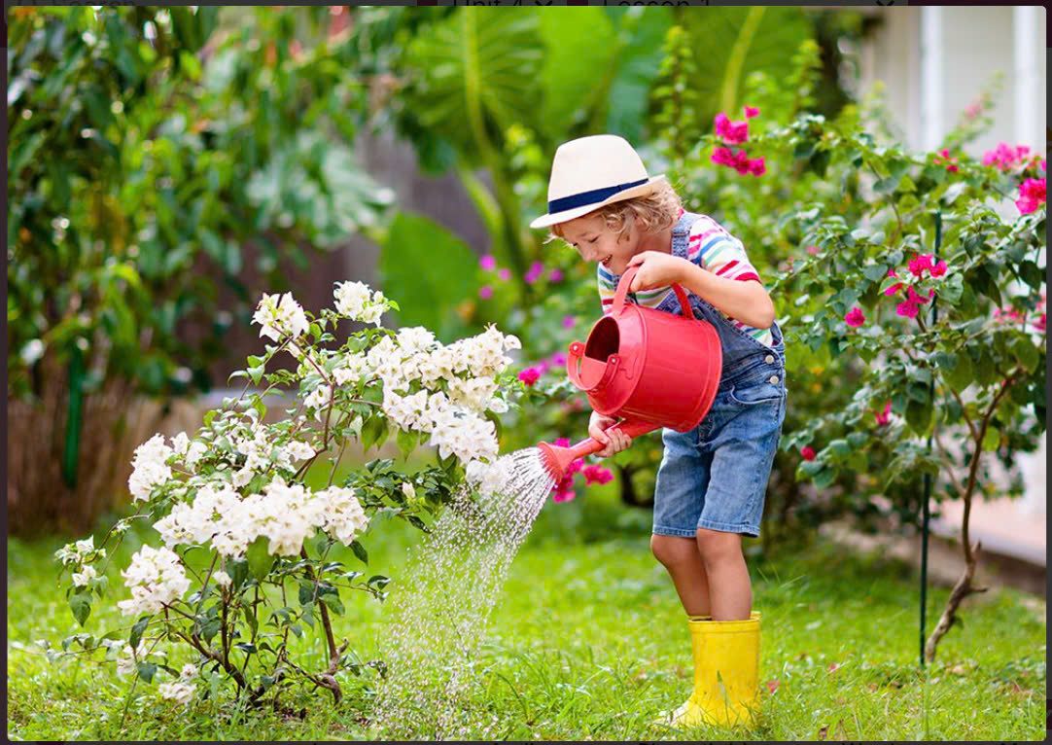
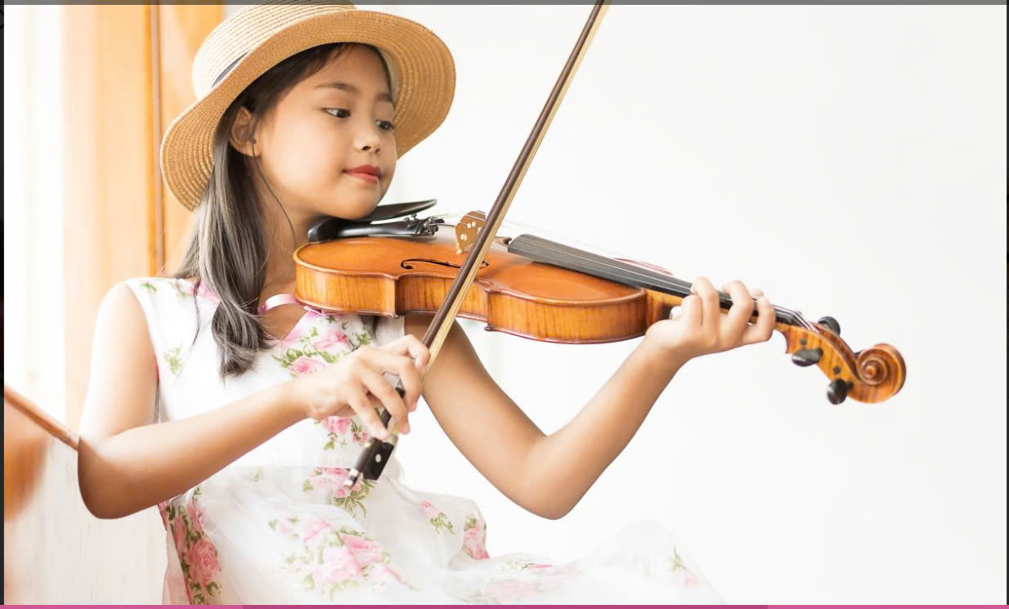
4. Listen and number
a
b
c
d

Slide 14
4. Listen and number
a
What’s the boy doing?
He’s watching a cartoon.
What does he like doing?
He likes watching cartoons.

Slide 15
4. Listen and number
b
What’s the boy doing?
He’s going for a walk.
What does he like doing?
He likes going for a walk.

Slide 16
4. Listen and number
c
What’s the girl doing?
She’s watering the flowers.
What does she like doing?
She likes watering the flowers.

Slide 17
4. Listen and number
d
What’s the girl doing?
She’s playing the violin.
What does she like doing?
She likes playing the violin.

Slide 18


4. Listen and number
a
b
c
d

Slide 19
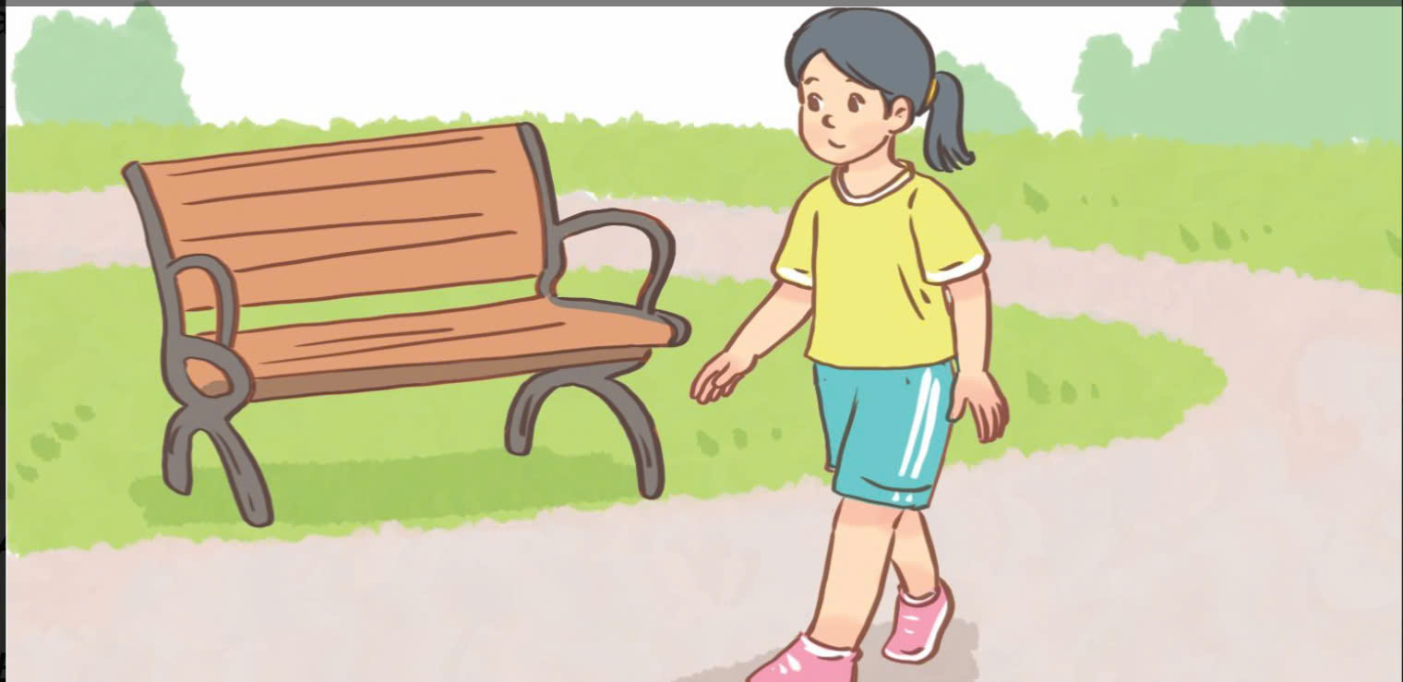
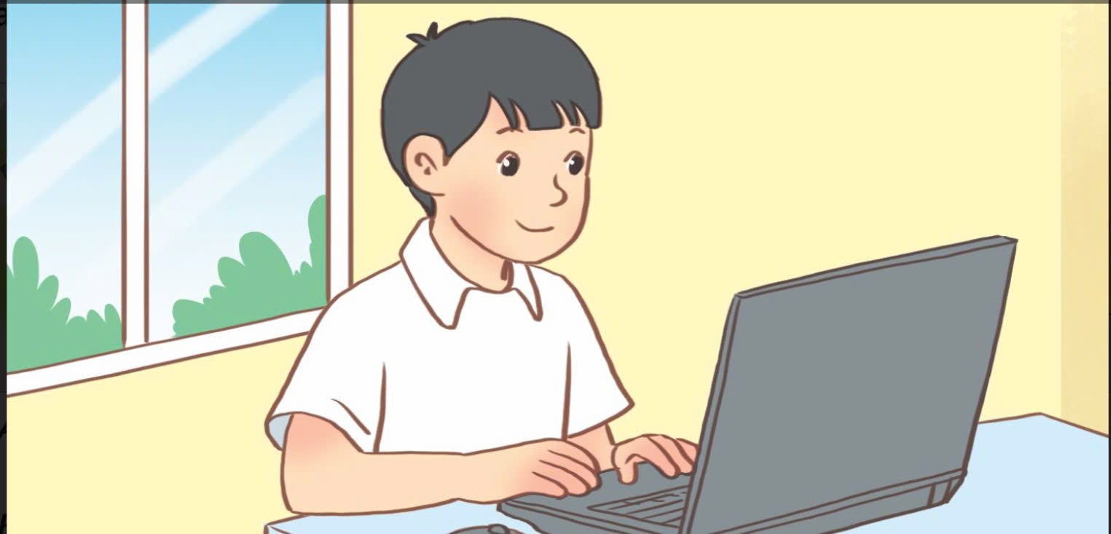
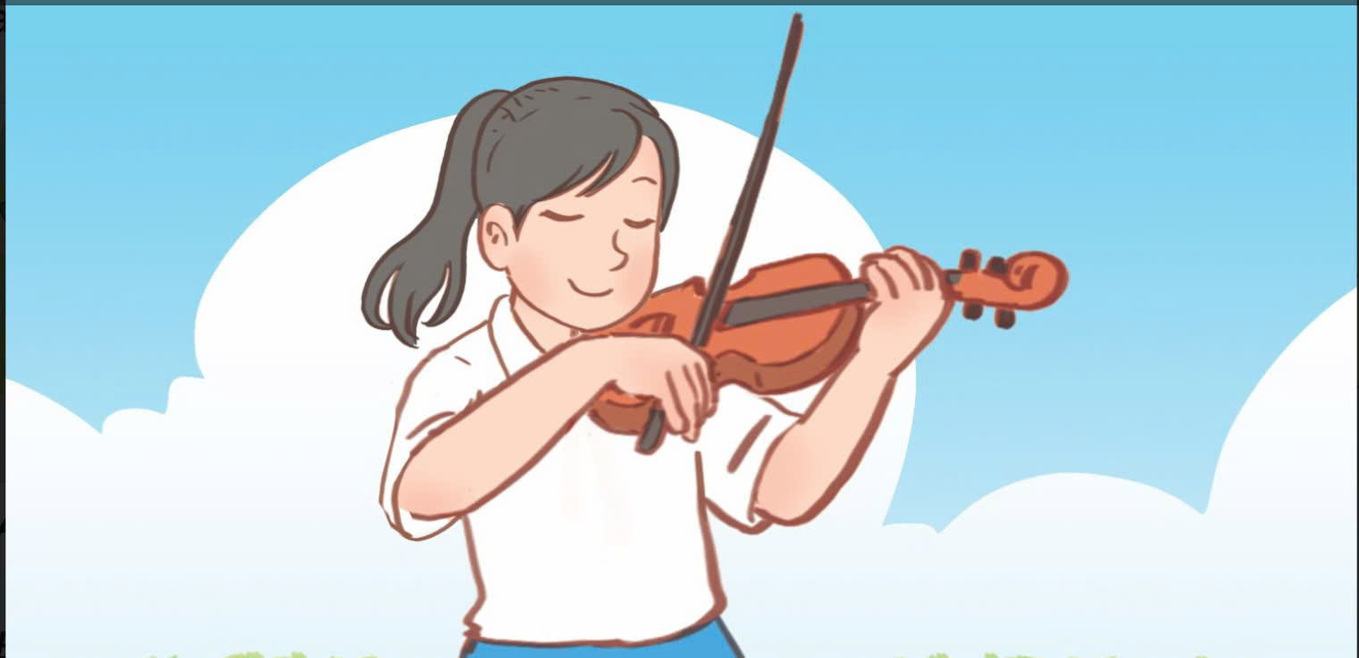
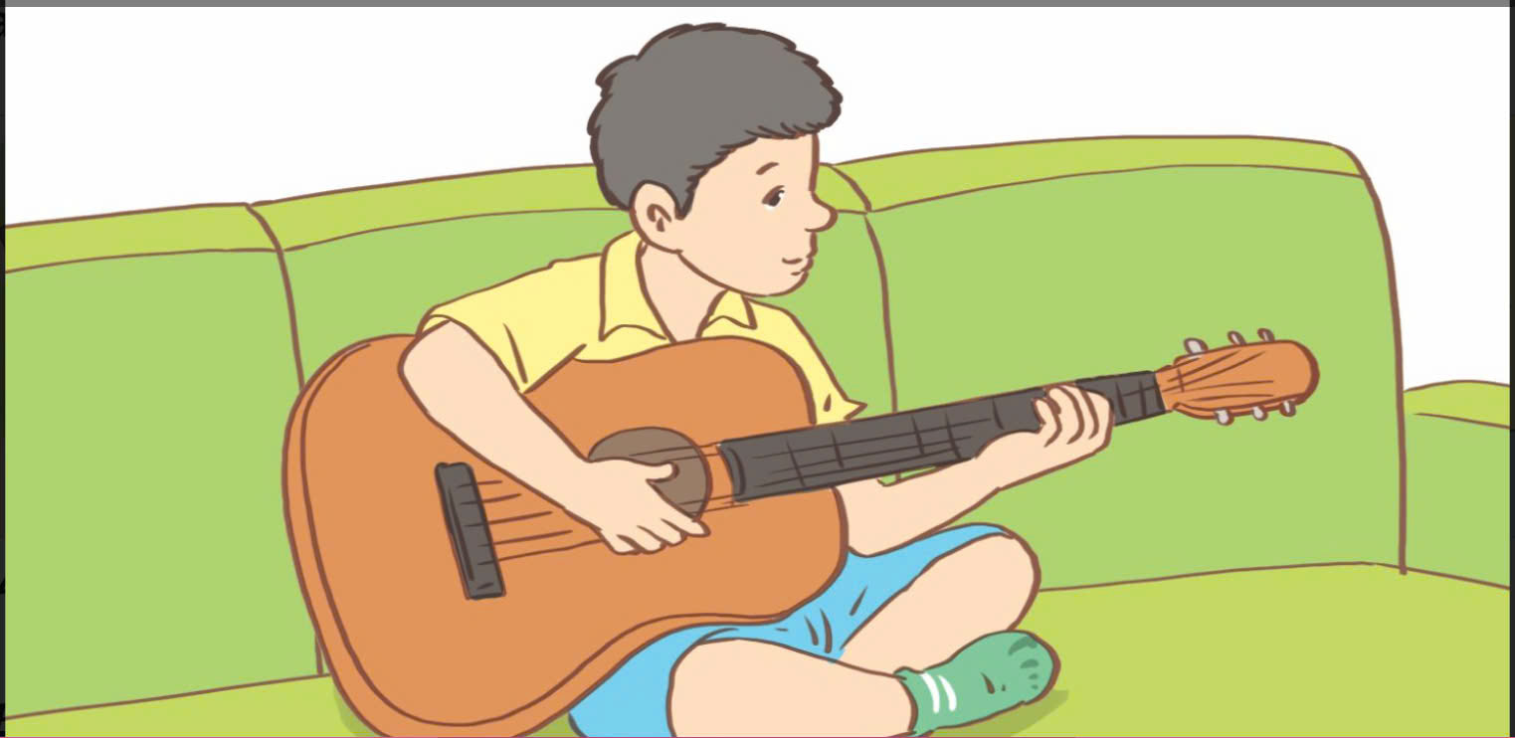
5. Read and complete
1.
A: What do you like doing
in your free time?
B: I like ______________.
2.
A: What does your brother like
doing in his free time?
B: He likes ___________ the Internet.
3.
A: Do you like playing ____________?
B: Yes, I do. I like ________ it
in my free time.
4.
A: _______ do you like doing
in your free time?
B: I like playing the ________.

Slide 20
5. Read and complete
1.
A: What do you like doing in your free time?
B: I like _____________________________________.

Slide 21
5. Read and complete
2.
A: What does your brother like doing in his free time?
B: He likes _______________ the Internet.

Slide 22
5. Read and complete
3.
A: Do you like playing ____________?
B: Yes, I do. I like __________ it in my free time.

Slide 23
5. Read and complete
4.
A: _______ do you like doing in your free time?
B: I like playing the ________.

Slide 24
5. Read and complete
1.
A: What do you like doing
in your free time?
B: I like ______________.
2.
A: What does your brother like
doing in his free time?
B: He likes ___________ the Internet.
3.
A: Do you like playing ____________?
B: Yes, I do. I like ________ it
in my free time.
4.
A: _______ do you like doing
in your free time?
B: I like playing the ________.

Slide 25
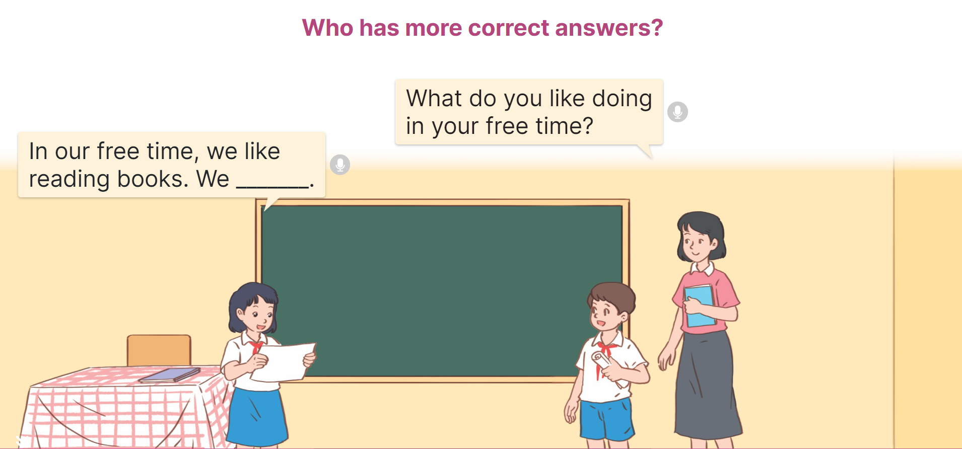
6. Let’s play.
Who has more correct answers?

Slide 26
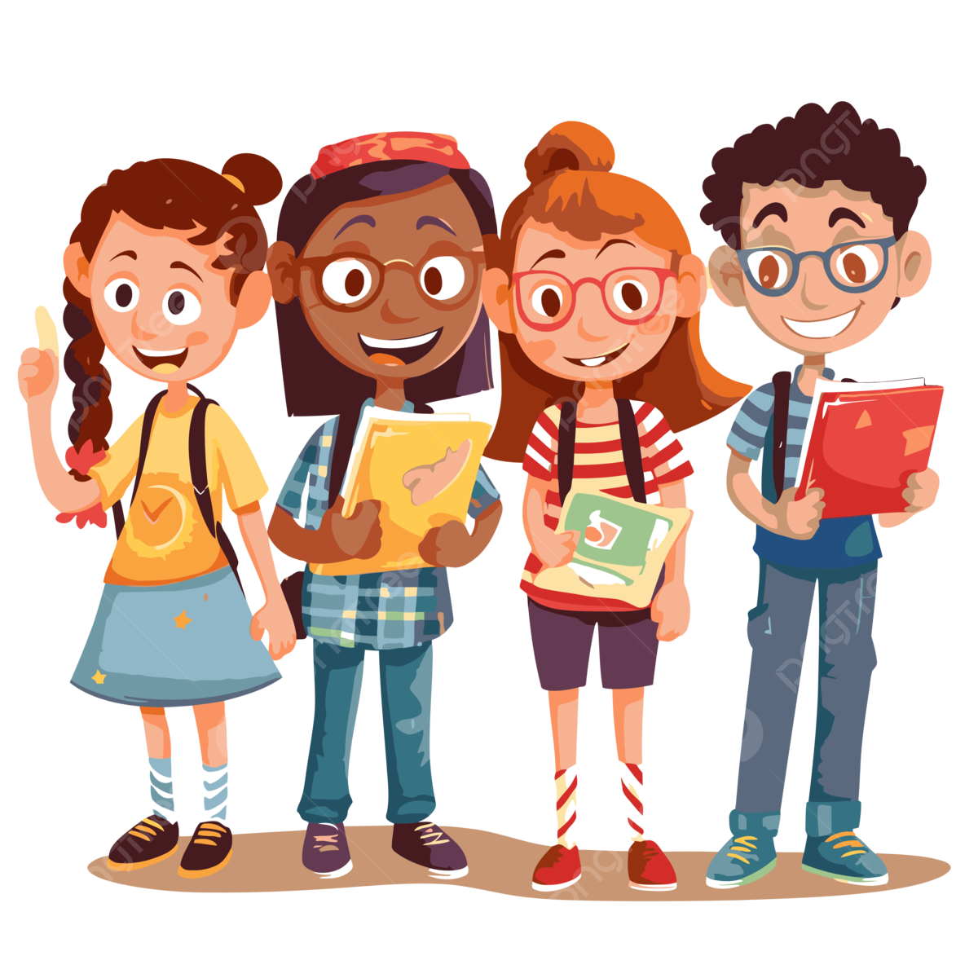
6. Let’s play.
Work in groups of four pupils
in 5 minutes

Slide 27
Group _____
What do you like doing in your free time?
I like _____________________________________.
I like _____________________________________.
I like _____________________________________.
I like _____________________________________.
I like _____________________________________.
In our free time, we like _________________.

Slide 28
Advice
Pupils, please:
memorize the vocabulary and practice the sentences at home.
prepare for the next lesson: Unit 4 – Lesson 2 (1-2-3) page 30.

Slide 30

Thank you
and
Goodbye

