Slide 1
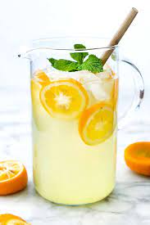
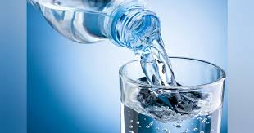
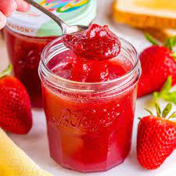
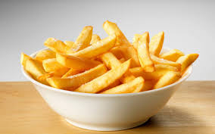
b
a
c
d
I want some water.

Slide 2
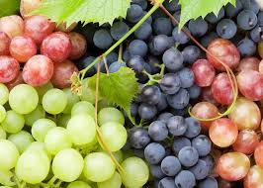
a
b
c
d
I want some lemonade.

Slide 3
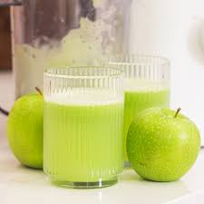
a
b
c
d
I want some grapes.

Slide 4

Ham Rong Primary school
Unit 4 My birthday party
(Lesson 3: 1,2,3)
Teacher: Le Thu Lan

Slide 5
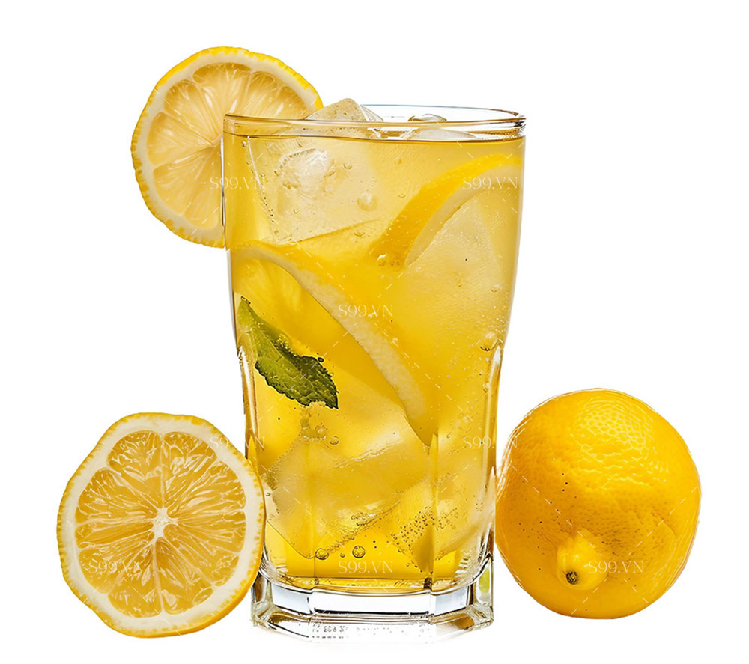
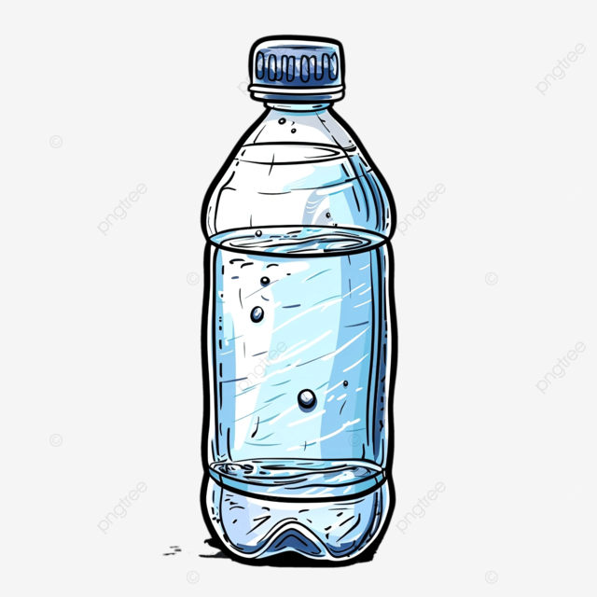
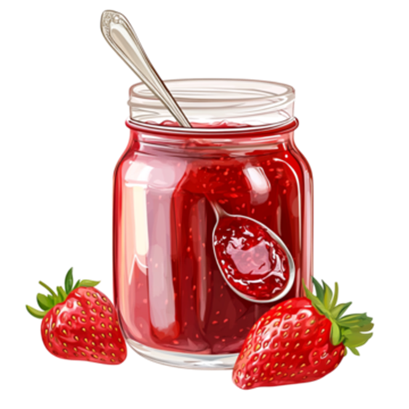
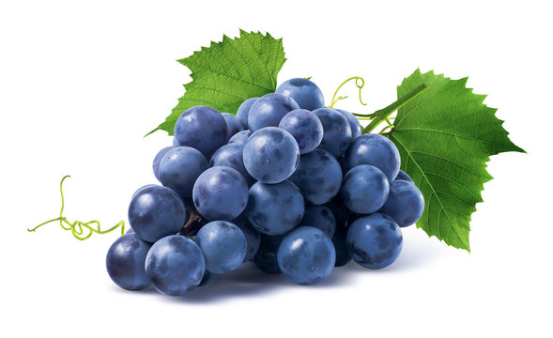
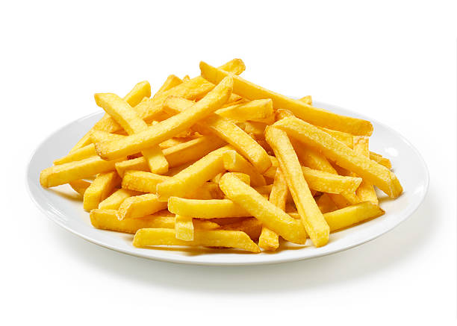
Keep silent/Repeat

Slide 6


1.Listen and repeat.
j jam I like jam.
w water I want some water.

Slide 7
I want some _________ .
chips
grapes
water
jam
lemonade

Slide 8
2.Listen and circle.
1. I want some _____.
a. jam b. water c. juice
b
2. There is some ___on the table.
a. juice b. water c. jam
c

Slide 9
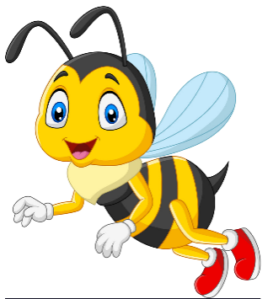
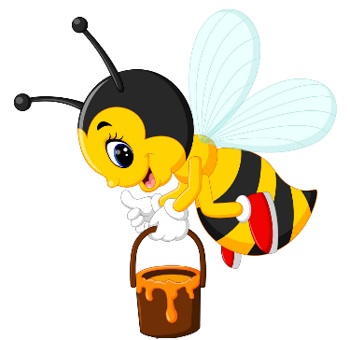



I want some_________.
Next
chips.
water.
jam.
Notes:
Ms Huyền Phạm - 0936.082.789 – YOUTUBE: MsPham. Facebook: Dạy và học cùng công nghệ.

Slide 10
There is some _________.
Next
Apple juice.
lemonade.
water.
Notes:
Ms Huyền Phạm - 0936.082.789 – YOUTUBE: MsPham. Facebook: Dạy và học cùng công nghệ.

Slide 11
There are some _________.
Next
chips.
grapes.
juice.
Notes:
Ms Huyền Phạm - 0936.082.789 – YOUTUBE: MsPham. Facebook: Dạy và học cùng công nghệ.

Slide 12
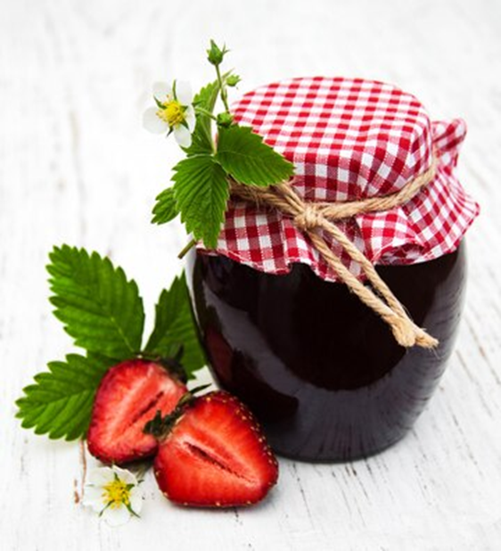
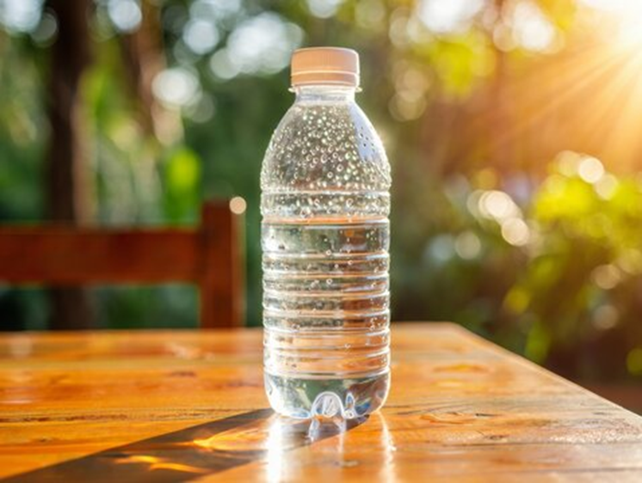
3.Let’s chant.
Jam, jam.
There’s jam on the table.
I want some jam.
Water, water.
There’s water on the table.
I want some water.

Slide 13
Jam, jam.
There’s jam on the table.
I want some jam.
Water, water.
There’s water on the table.
I want some water.

Slide 14
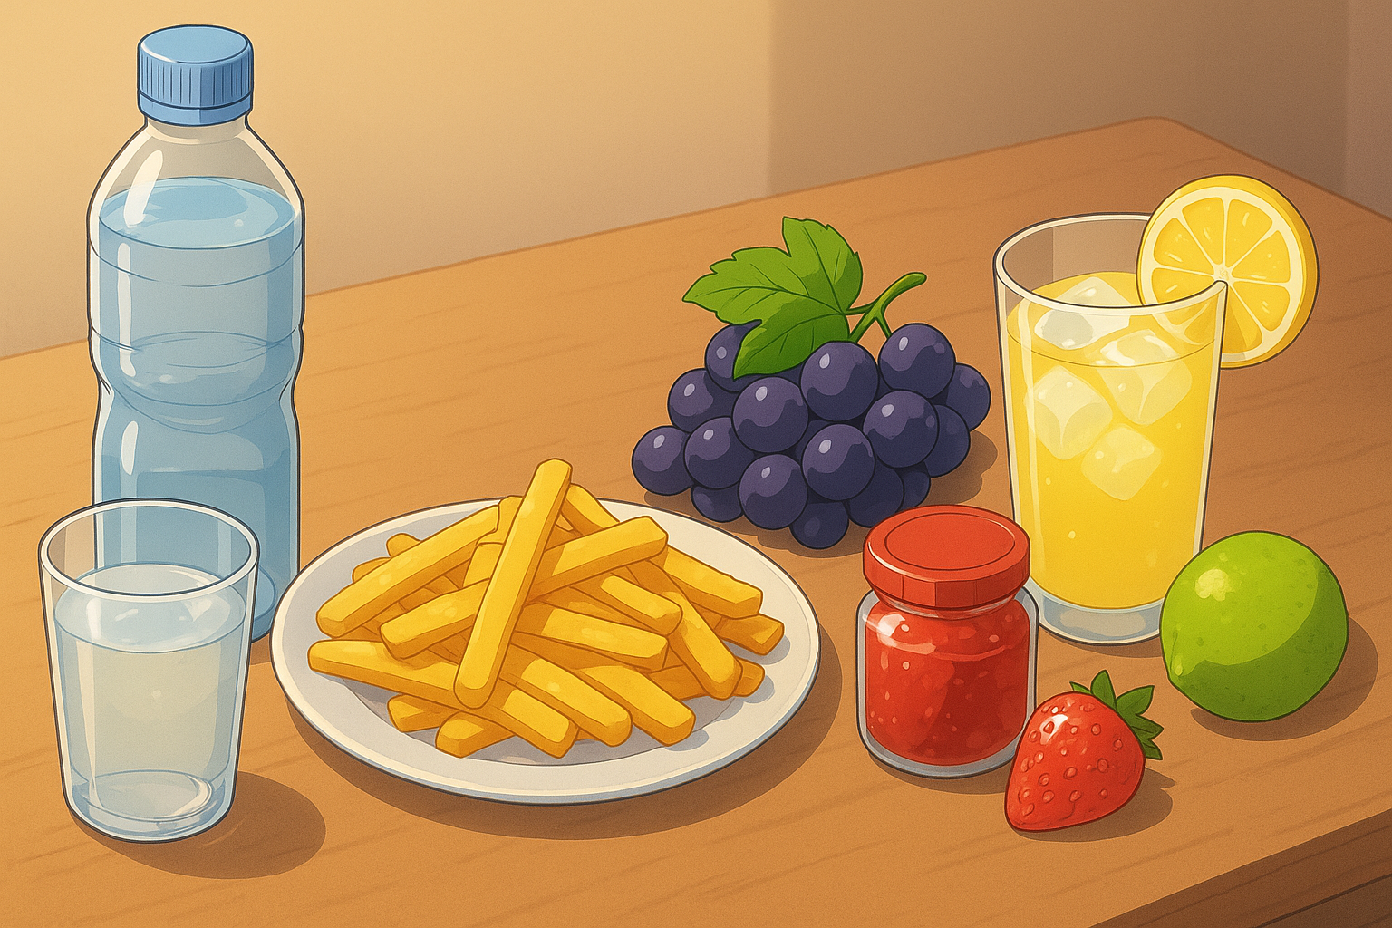
There’s some ________ on the table.
There are
There are
grapes
water
chips
lemonade
jam

Slide 15
What do you want to eat?
I want some chips.
I want some grapes.
I want some jam.

Slide 16
What do you want to drink?
I want some water.
I want some lemonade.

Slide 17

Thanks for your attention!

