Slide 1

Ham Rong Primary school
Unit 4 My birthday party
(Lesson 3: 1,2,3)
Teacher: Le Thu Lan

Slide 2
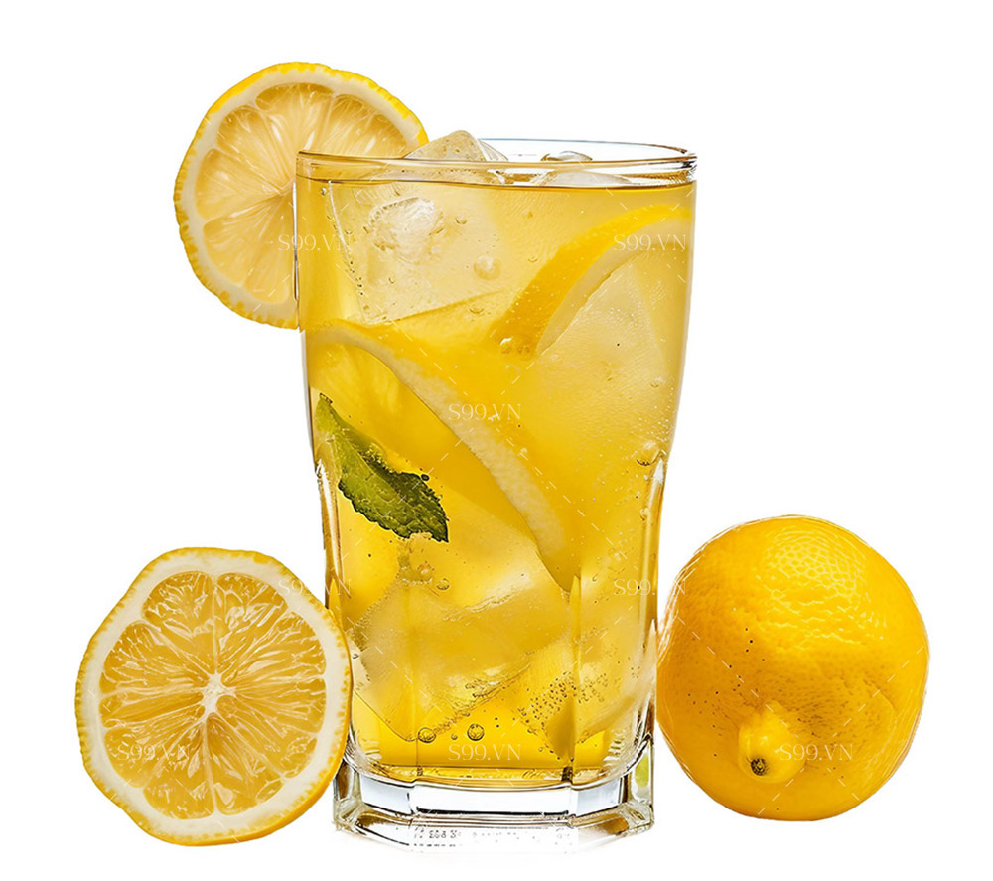
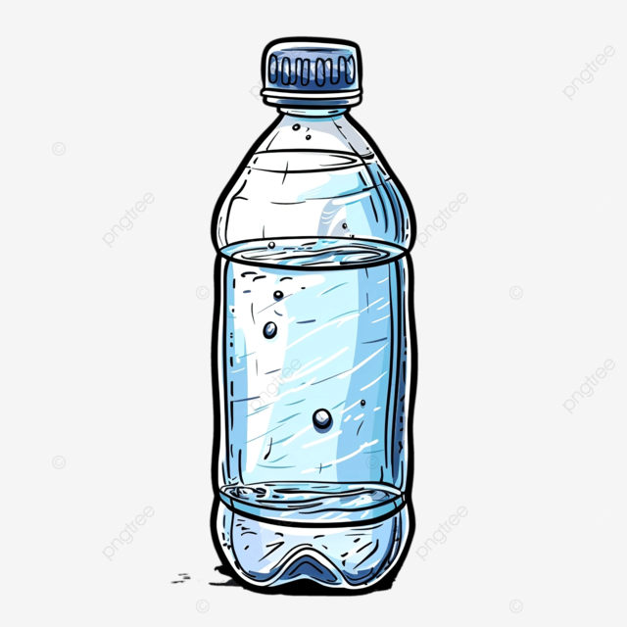
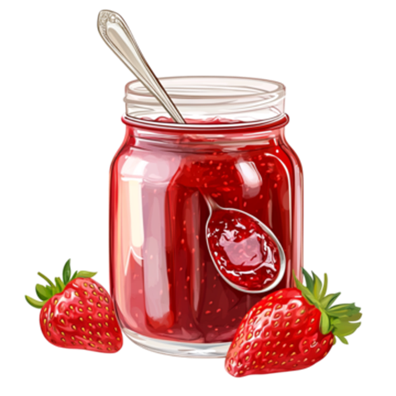
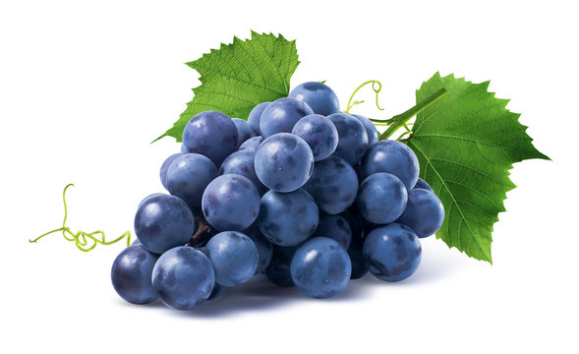
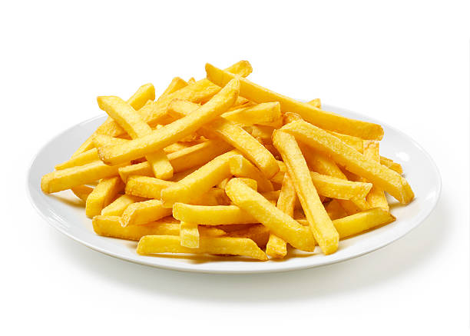
Keep quiet or Repeat.

Slide 3


1.Listen and repeat.
j jam I like jam.
w water I want some water.

Slide 4
I want some _________ .
chips
grapes
water
jam
lemonade

Slide 5
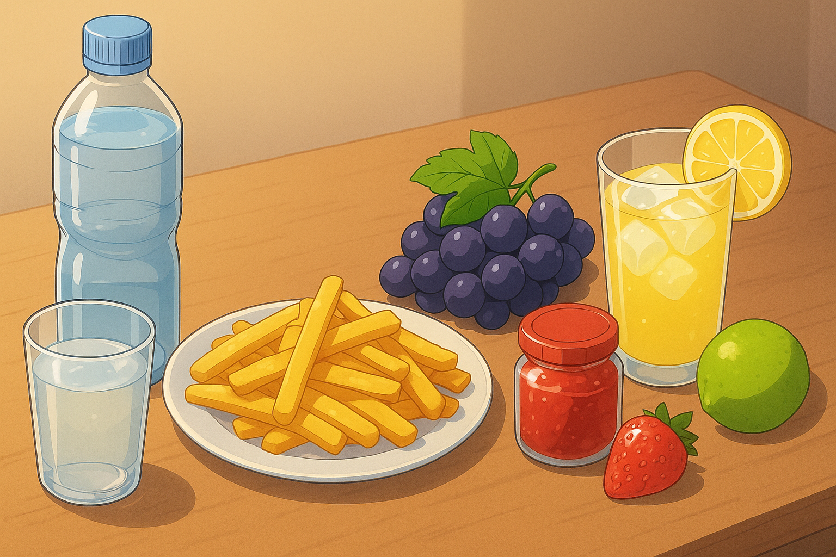
There’s some ________ on the table.
chips
There are
jam
water
grapes
lemonade

Slide 6
2.Listen and circle.
1. I want some _____.
a. jam b. water c. juice
2. There is some ___on the table..
a. juice b. water c. jam

Slide 7
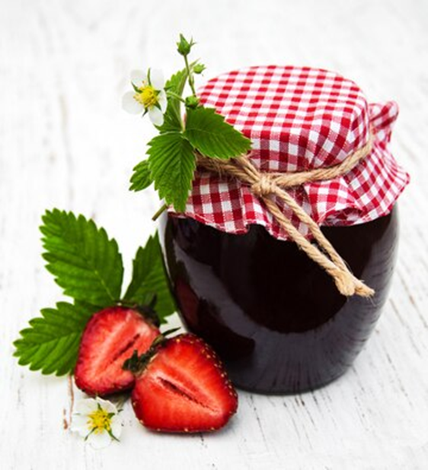
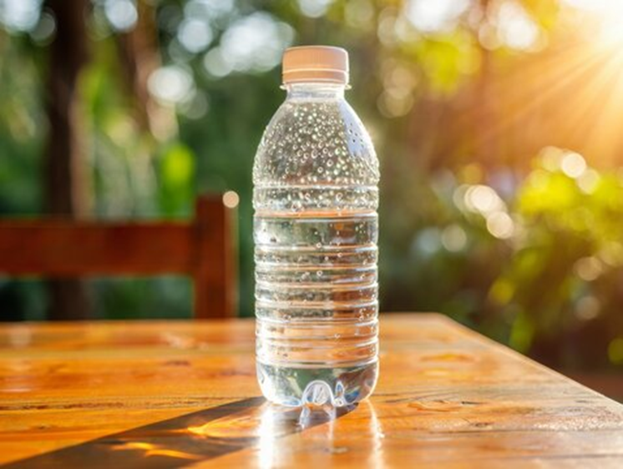
3.Let’s chant.
Jam, jam.
There’s jam on the table.
I want some jam.
Water, water.
There’s water on the table.
I want some water.

Slide 8
Jam, jam.
There’s jam on the table.
I want some jam.
Water, water.
There’s water on the table.
I want some water.

