Slide 1





Slide 2


Time and daily routines
2
Lesson 3

Slide 3
Warm-up & review

Slide 4
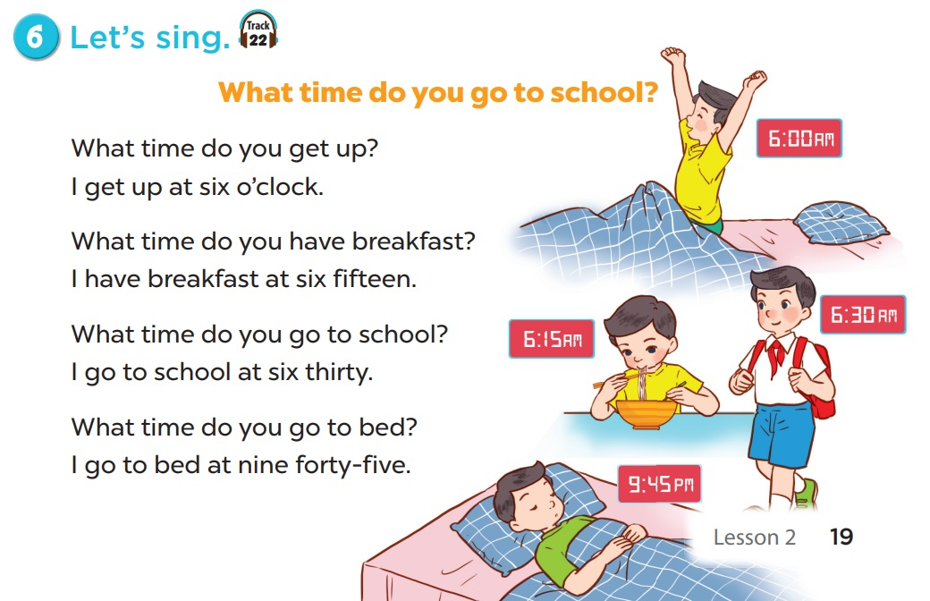


Slide 5
1
Listen and repeat.

Slide 6
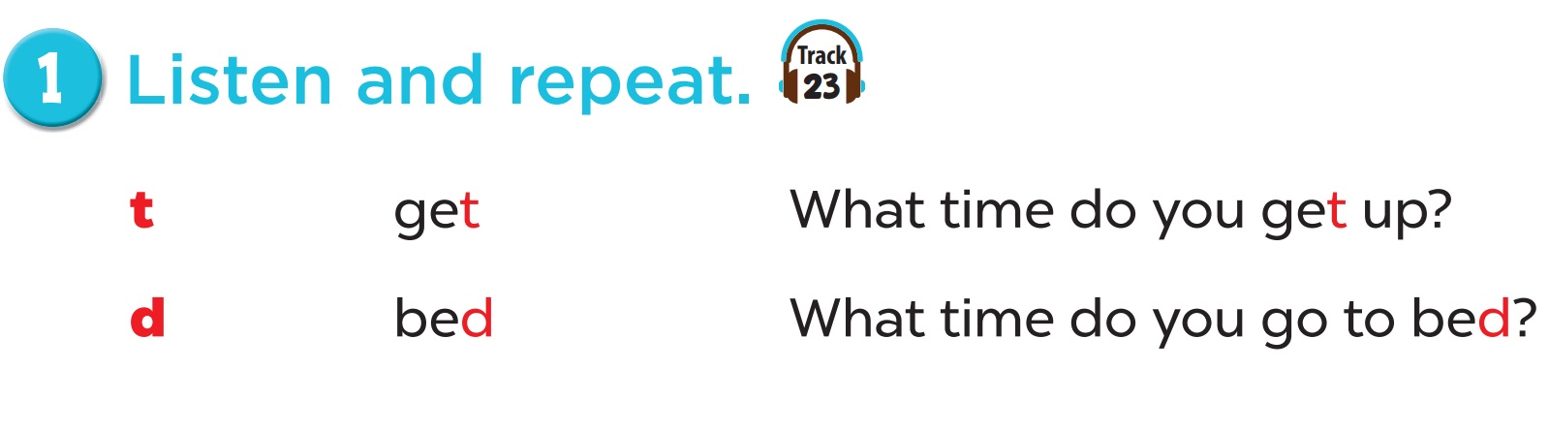

Slide 7
2
Listen and circle.

Slide 8
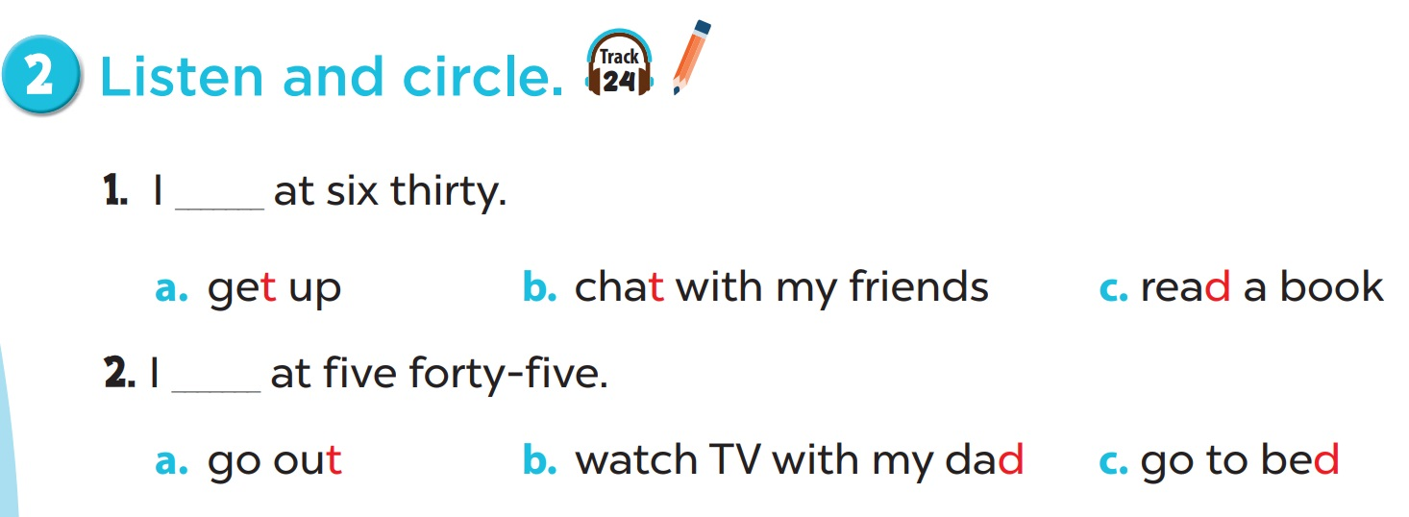

Slide 9
4
Read and match.

Slide 10
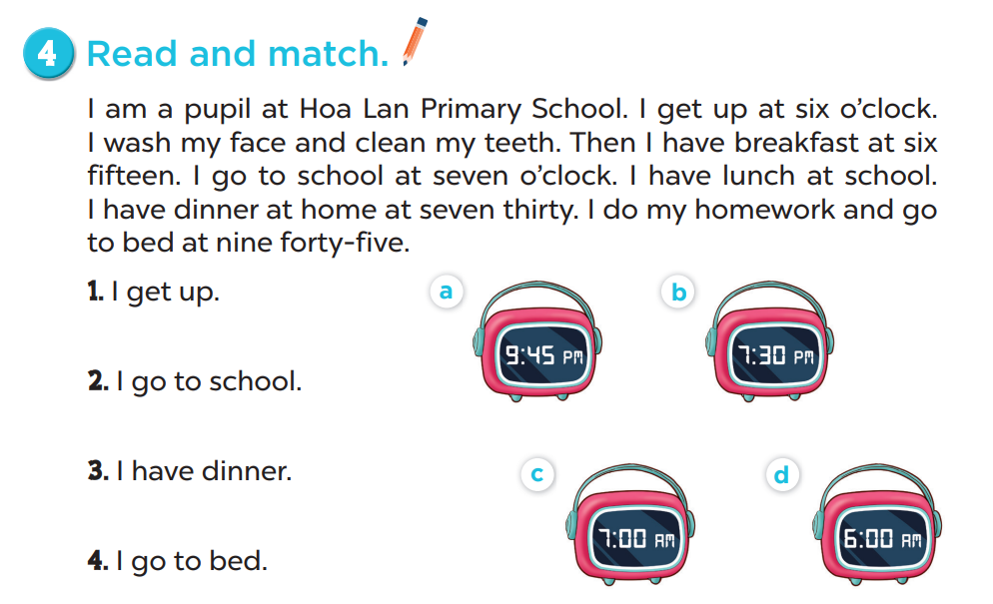

Slide 11
5
Let’s write.

Slide 12
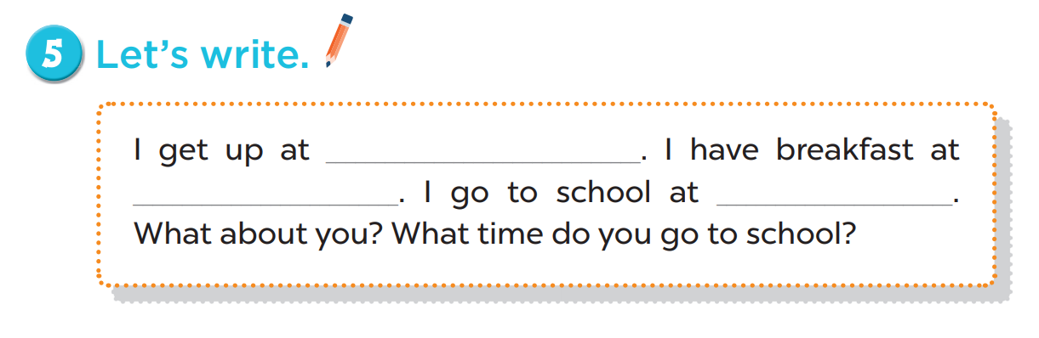
six o’clock
six thirty
seven o’clock

Slide 13
Fun corner & wrap-up

Slide 14
SPIN AND SAY
TIGER
DONKEY
TEACHER
DUCK
TUB
T
DUCK
D
DOG
GET
BED
TIGER
Click the needle to start and then again to stop the wheel. Then READ ALOUD.

Slide 15






Slide 16

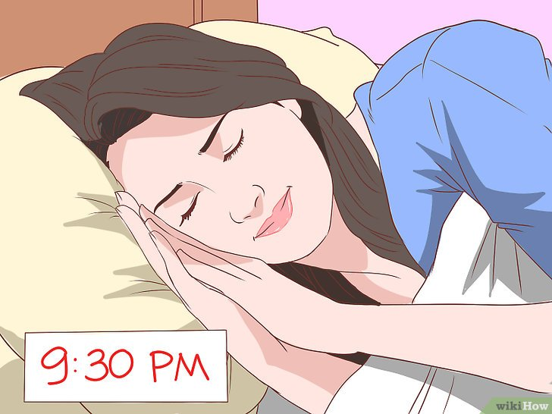



Câu hỏi 3
A. have breakfast
B. go to bed
+5
-1
-1
-1
C. go to school
D. get up

Slide 17
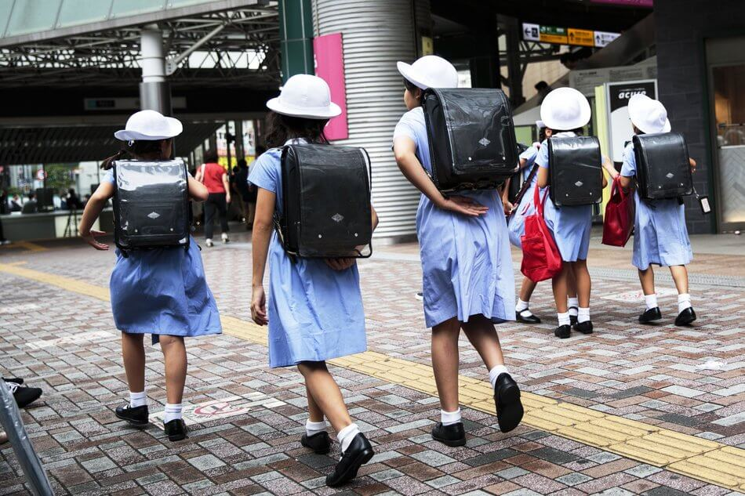

Câu hỏi 2
A. get up
B. have breakfast
+7
-1
-1
-1
C. go to school
D. go to bed

Slide 18
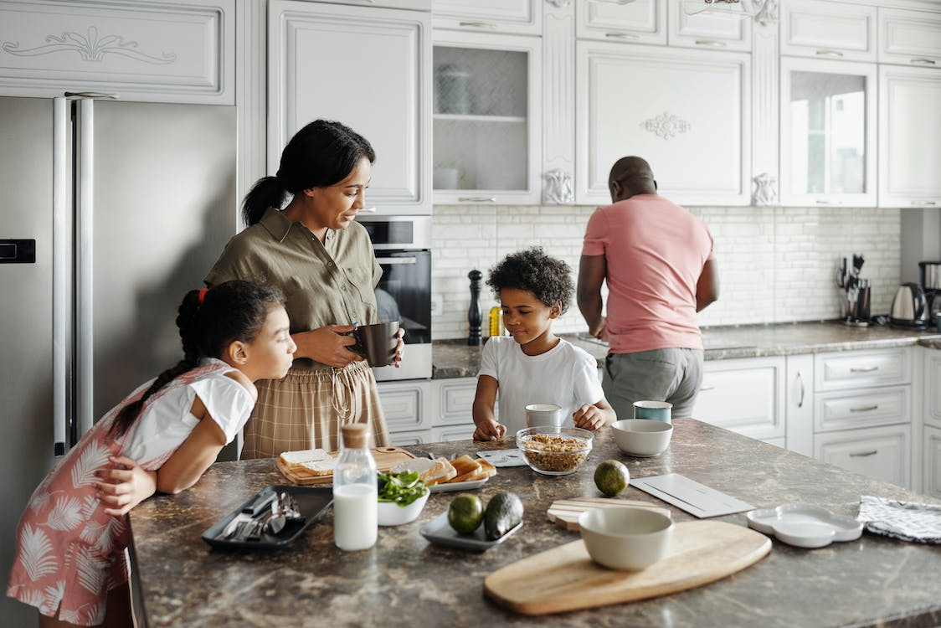
Câu hỏi 1
A. have breakfast
B. go to school
+5
-1
-1
-1
C. go to bed
D. get up

Slide 19
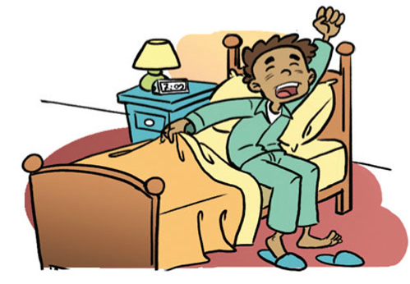
Câu hỏi 4
A. have breakfast
B. go to school
+6
-1
-1
-1
C. go to bed
D. get up

Slide 20

Câu hỏi 3
A. I go to school at seven fifteen.
B. I go to school at six
forty-five.
+8
-1
-1
-1
C. I go to school at seven forty-five.
D. I go to school at seven o’clock.

Slide 21
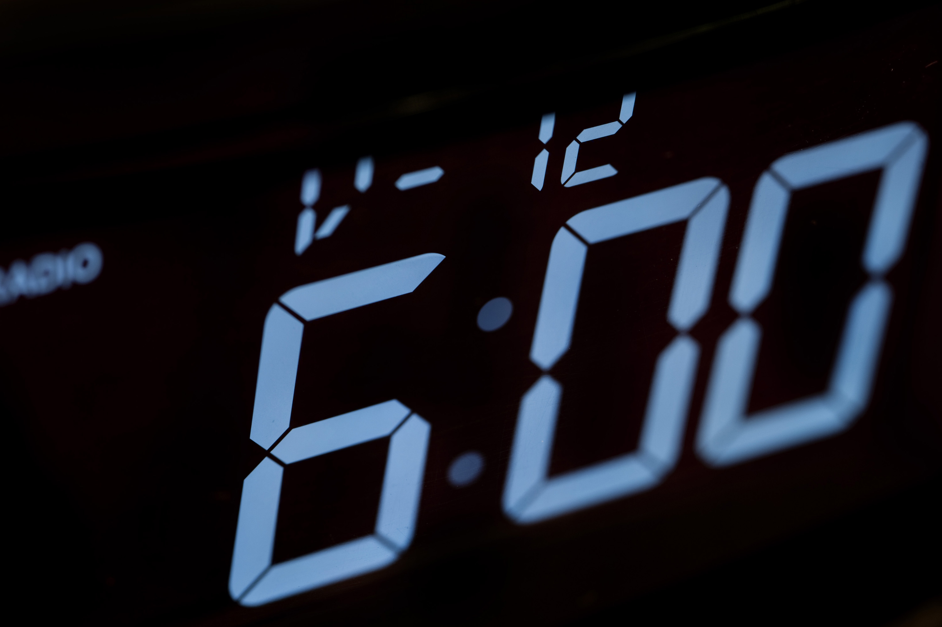
Câu hỏi 2
A. I get up at six fifteen.
B. I get up at six
forty-five.
+5
-1
-1
-1
C. I get up at six o’clock.
D. I get up at six thirty.

Slide 22


Great job!
Exit

