Slide 1


Time and daily routines
2
Lesson 1

Slide 2
I. OBJECTIVES.
By the end of the lesson, pupils will be able to
1. Language knowledge & skills.
- understand and correctly repeat the sentences in two communicative contexts focusing on asking and telling the time.
correctly say the phrases and use
What time is it?
It’s _____. to ask and tell the time.
- enhance the correct use of What time is it? –It’s _____. to ask and tell the time in a freer context
- listen to and understand two communicative contexts in which two pupils play a game asking and telling the time and tick the correct pictures
2. Competences.
Communication and collaboration: work in pairs and groups to complete the learning tasks
- Self-control & independent learning: perform learning tasks
3. Attributes
Show their responsibility by noticing the time and follow the timetable on time.

Slide 3
Warm-up & Review

Slide 4
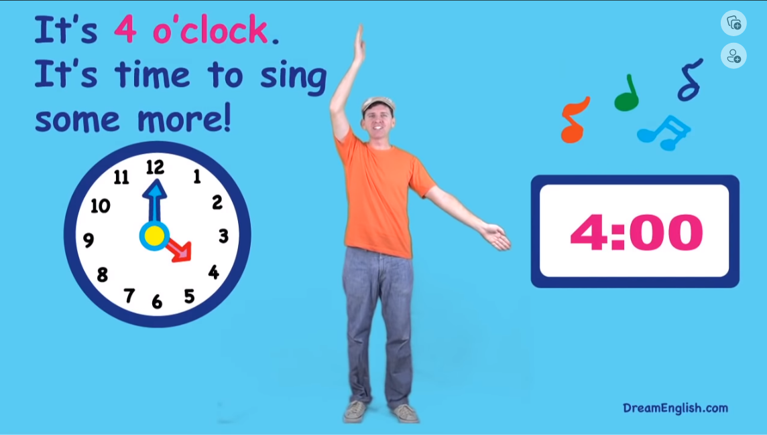
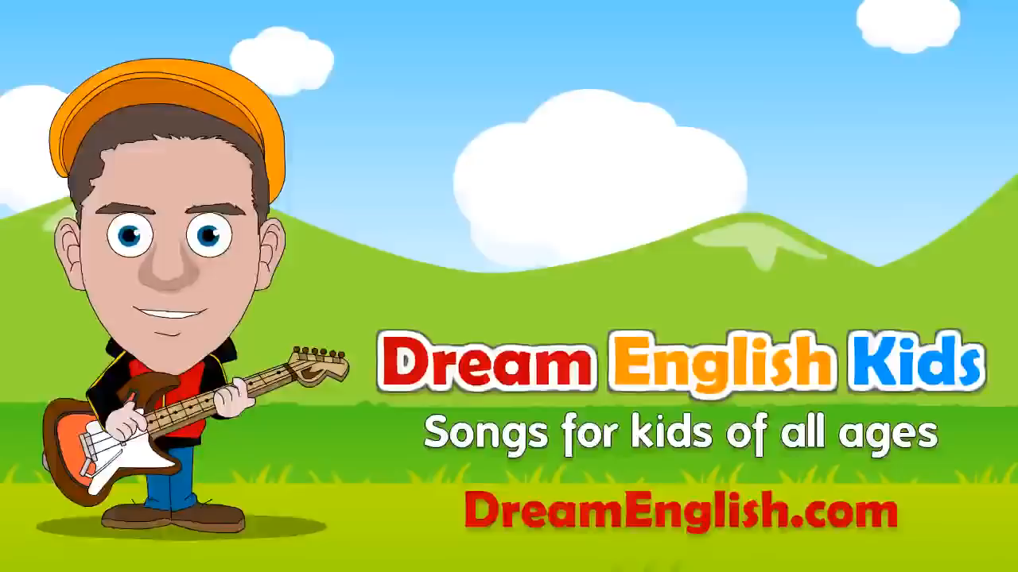
Sing the song.

Slide 5
01
Look, listen and repeat.

Slide 6
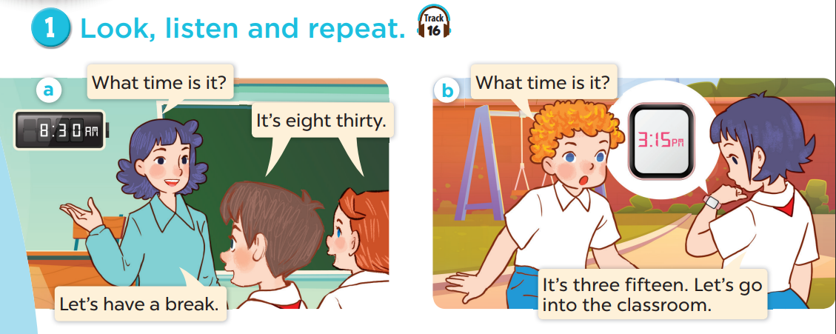


Slide 7
02
Listen, point and say.

Slide 8
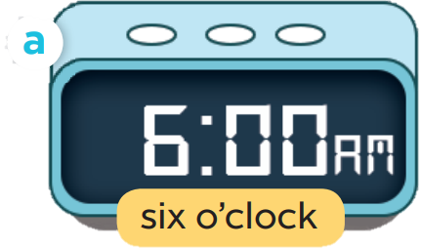
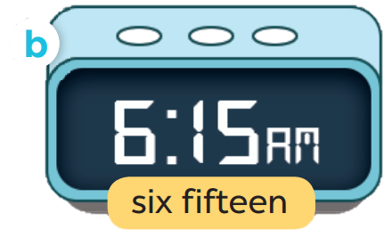
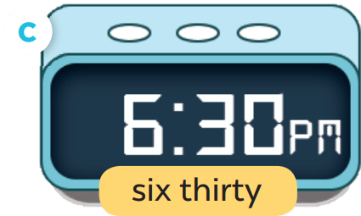
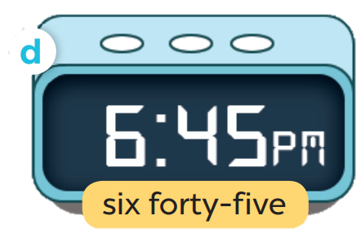

Slide 9
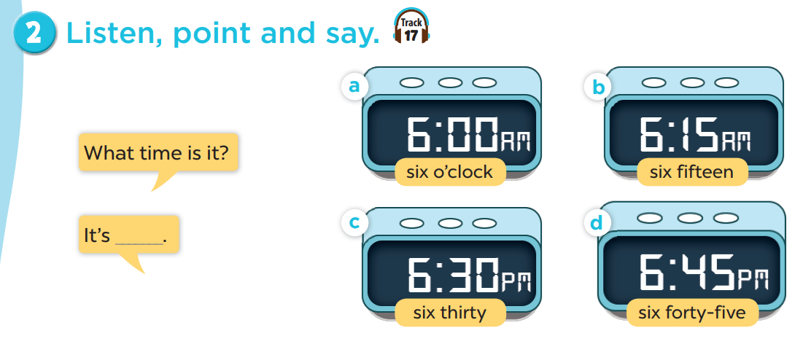

Slide 10

What time is it?
I six o’clock.

Slide 11
04
Listen and tick.

Slide 12
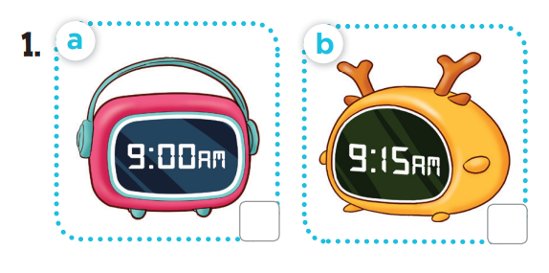
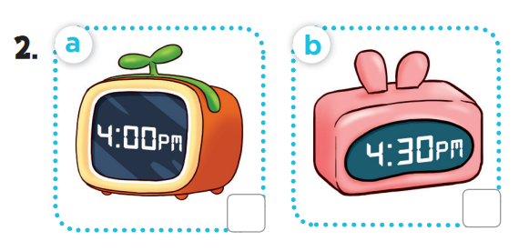

Slide 13
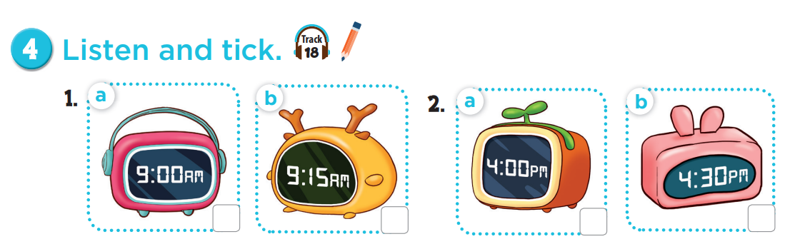


Slide 14
Fun corner & wrap-up

Slide 15



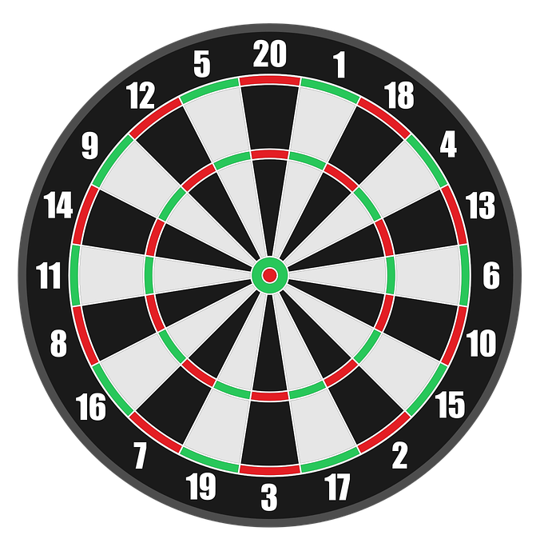

PLAY

Slide 16

A: What time is it?
B: It’s ___________.
+50
b. seven thirty
a. seven o’clock
c. six o’clock
Next

Slide 17
A: What time is it?
B: It’s ___________.
+50
b. eight fifteen
a. eight fifty
c. eight five
Next

Slide 18
A: What time is it?
B: It’s ___________.
+25
b. two three
a. two thirty
c. two thirteen
Next

Slide 19
A: What time is it?
B: It’s ____________.
+25
b. four fifteen
a. four forty
c. four forty-five
Next

Slide 20
WELL DONE!
EXIT

