Slide 1
Unit 1
My friends
Lesson 1 + Lesson 2
(P.11, 13)

Slide 2
I. OBJECTIVES
By the end of the lesson, pupils will be able to
1. Language knowledge & skills
- complete two gapped sentences and two gapped exchanges with the help of picture cues;
sing the song Where are you from? with the correct pronunciation, rhythm and melody.
- complete two gapped sentences and two gapped exchanges with the help of picture cues;
2. Competences
- Communication and collaboration: work in pairs and groups to complete the learning tasks
- Self-control & independent learning: perform listening tasks
3. Attributes
- Show pride in where they come from and great respect for where someone comes from by using appropriate gestures and intonation when asking and answering about nationality.

Slide 3
Warm-up

Slide 4

Where are you from?
I'm from Britain.
?
?

Slide 5

Where are you from?
I'm from Viet Nam.
?
?

Slide 6

Where are you from?
I'm from America.
?
?

Slide 7

Where are you from?
I'm from Australia.
?
?

Slide 8
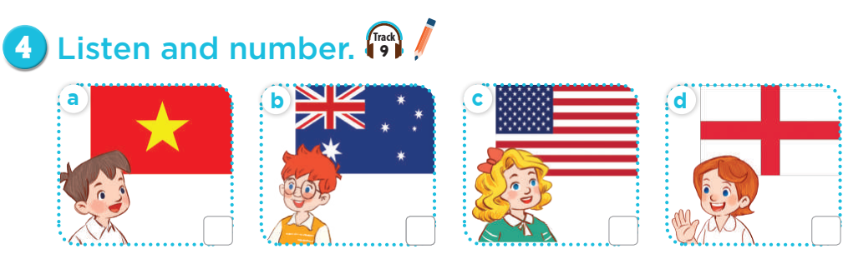
Where's he from?

Slide 9

Where's she from?

Slide 10
05
Look,complete and read.

Slide 11
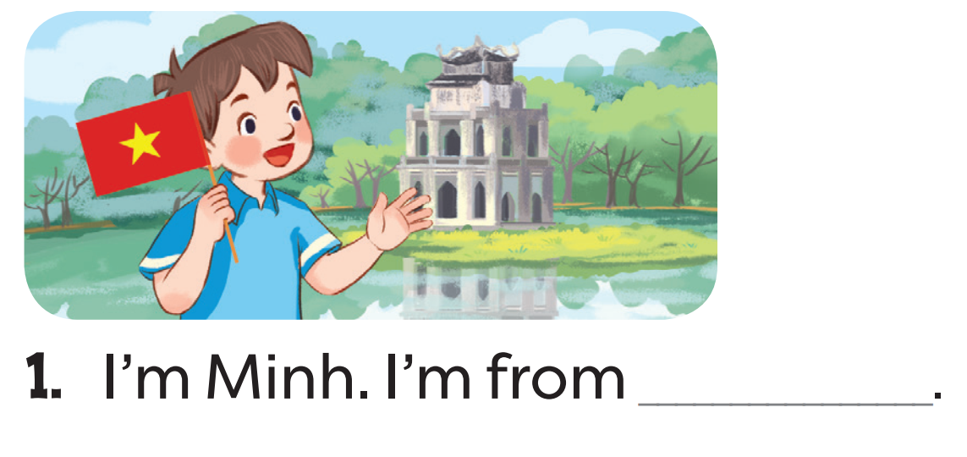
Read. What's the missing word?
Viet Nam

Slide 12
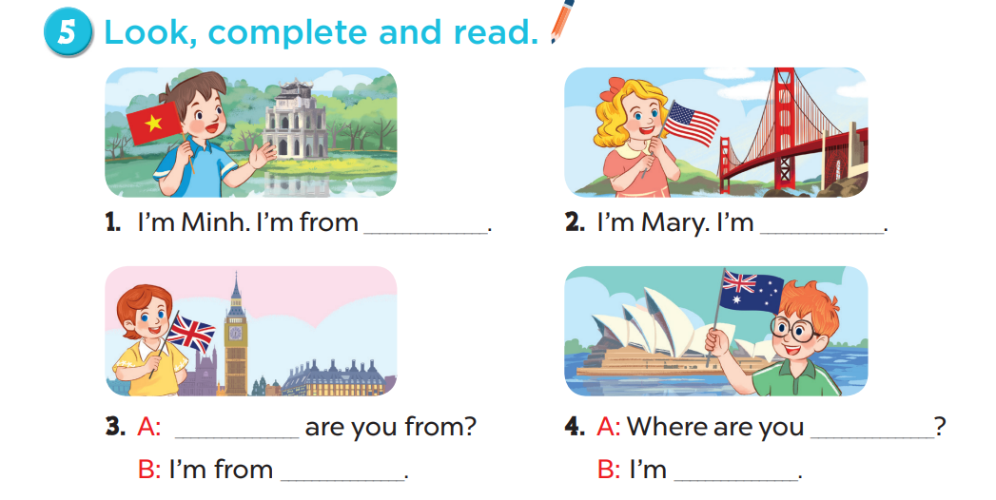
Viet Nam
from America
Where
from
Britain
from Australia

Slide 13
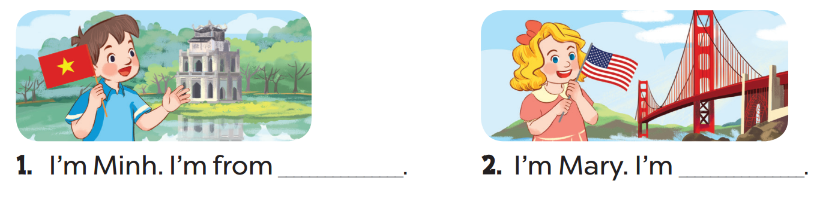
Viet Nam
from
America

Slide 14
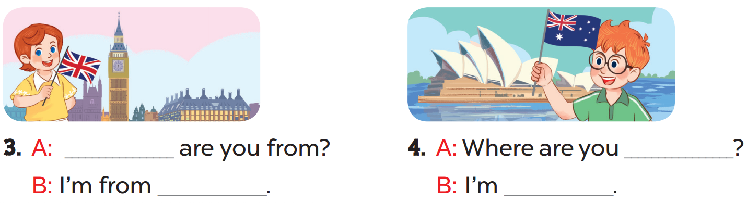
Where
from
Britain
from Australia

Slide 15
06
Let's sing.

Slide 16

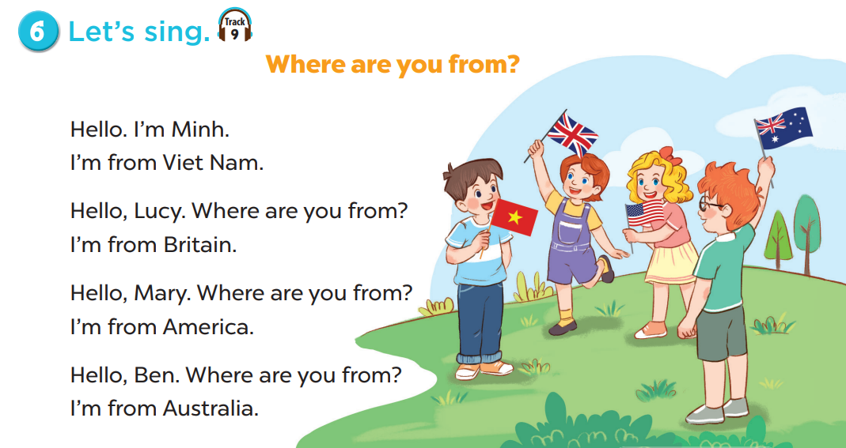
Read the lyrics.

Slide 17
Listen.
Practise line by line.
Sing the song.

Slide 18
05 P13
Look, complete and read.

Slide 19
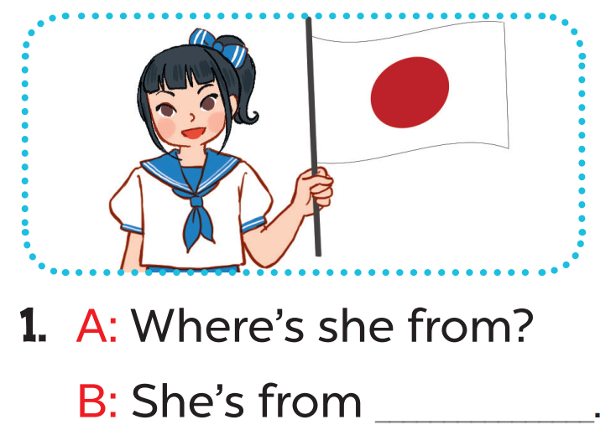
Read. What's the missing word?
Japan

Slide 20
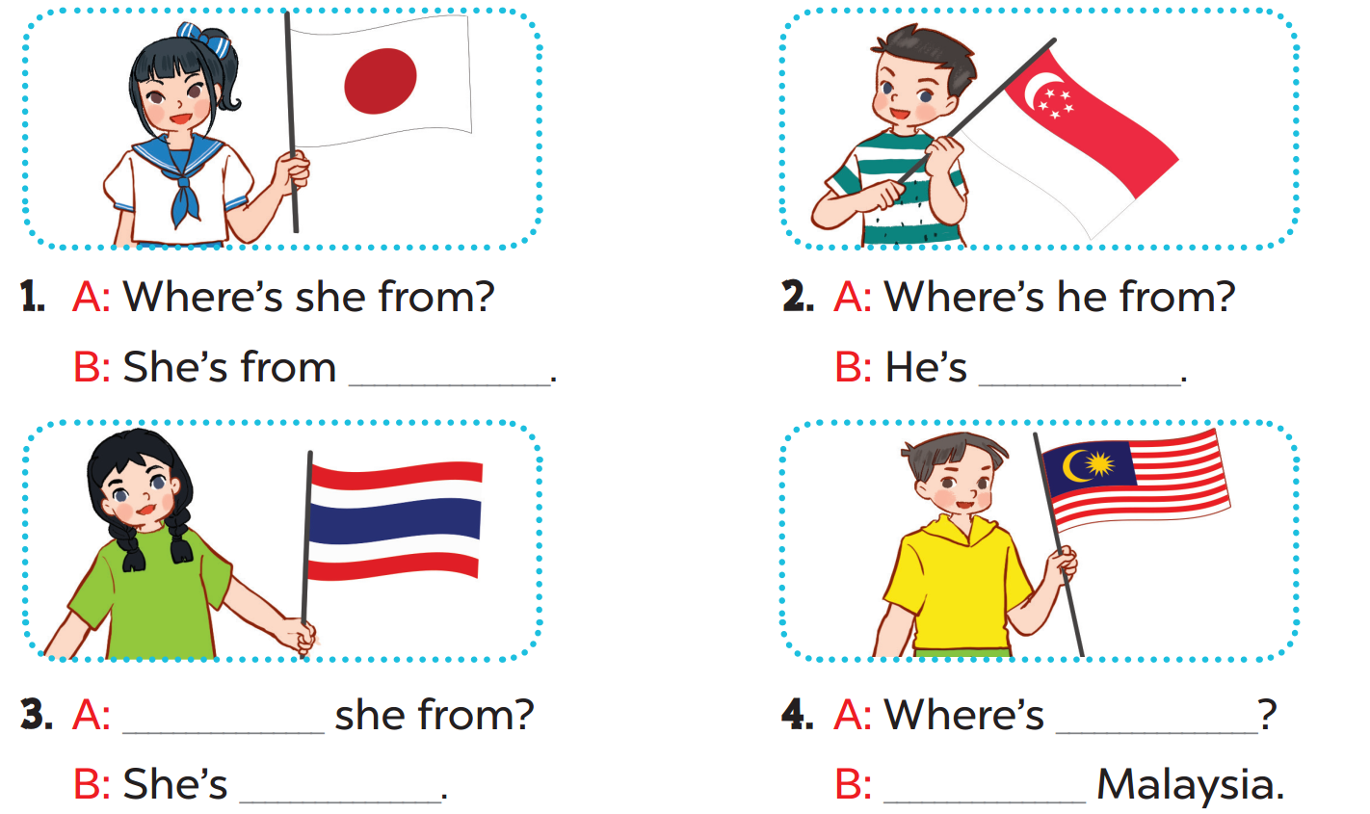
Japan
from Singapore
Where's
he from
from Thailand
He's from

Slide 21
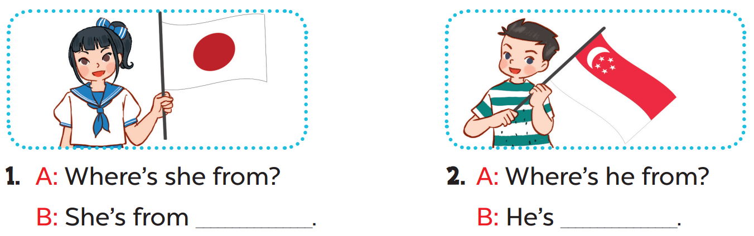
Read aloud.
Japan
from Singapore

Slide 22
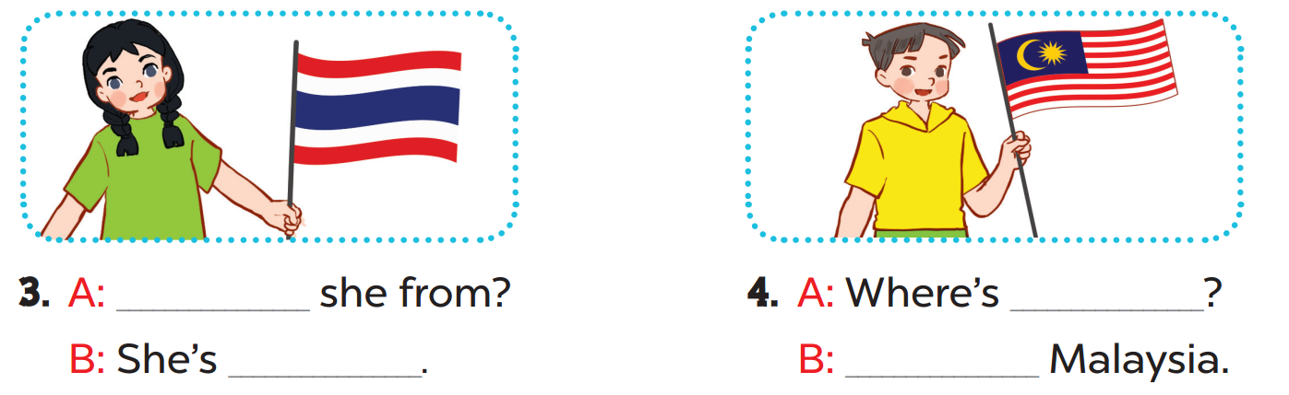
Act it out.
Where's
he from
Thailand
He's from

Slide 23
Fun time
What's the missing word?

Slide 24











Choose and answer.
Boys
Girls

Slide 25


Where are you ....... ?
from
A. from
B. form
C. for

Slide 26
......... are you from?
Where
A. How
B. I'm
C. Where

Slide 27


Hello. ........ Lan.
I'm
A. Where
B. I'm
Lan
C. I

Slide 28
Where ........ you from?
are
A. am
B. are
C. I'm

Slide 29


I'm .................. .
from America
A. from Australia
B. from America
C. America

Slide 30



I'm .................. .
from Britain
A. from Britain
B. Form Britain
C. from America

Slide 31


I'm from ........... .
Australia
A. From Britain
B. Australia
C. from Australia

Slide 32
....... from Viet Nam .
I'm
A. Im
B. I'm
C. I

