Slide 1





Slide 2
Starter
C. Outdoor activites

Slide 3
OBJECTIVES
By the end of the Starter unit, pupils will be able to:
Language knowledge & skills:
- practise the names of outdoor activities by playing Miming game.
- match the pupils with the pictures and say about their hobbies.
- read the chant aloud and act out with the help of the lyrics and picture cues.
Competences:
- Communication and collaboration: work in pairs and groups to complete the learning tasks
Self-control & independent learning: perform listening tasks
Attributes:
- show pride in what they can do and their hobbies by using appropriate gestures and intonation when talking about hobbies.

Slide 4
Warm-up & Review

Slide 5
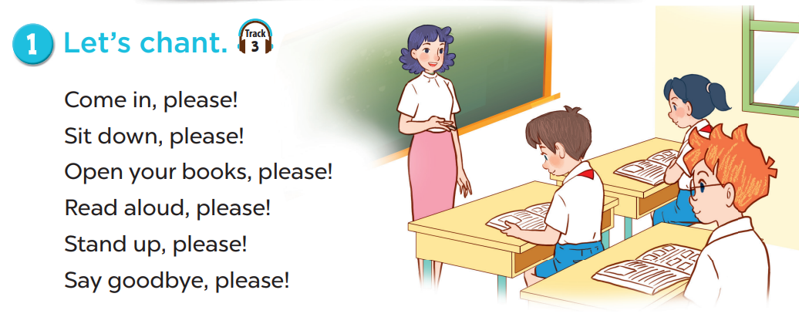



Slide 6

sing

Slide 7

swim

Slide 8
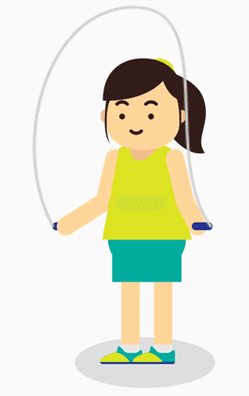
skip

Slide 9
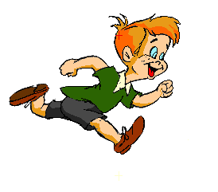
run

Slide 10
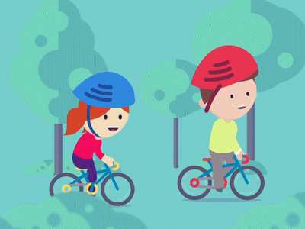
cycle

Slide 11
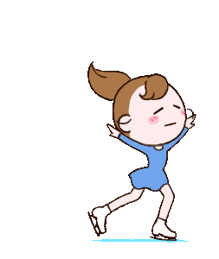
skate

Slide 12
Look
and guess.

Slide 13

skip

Slide 14
swim

Slide 15
run

Slide 16
skate

Slide 17
cycle

Slide 18
sing

Slide 19
01
Let’s play.

Slide 20
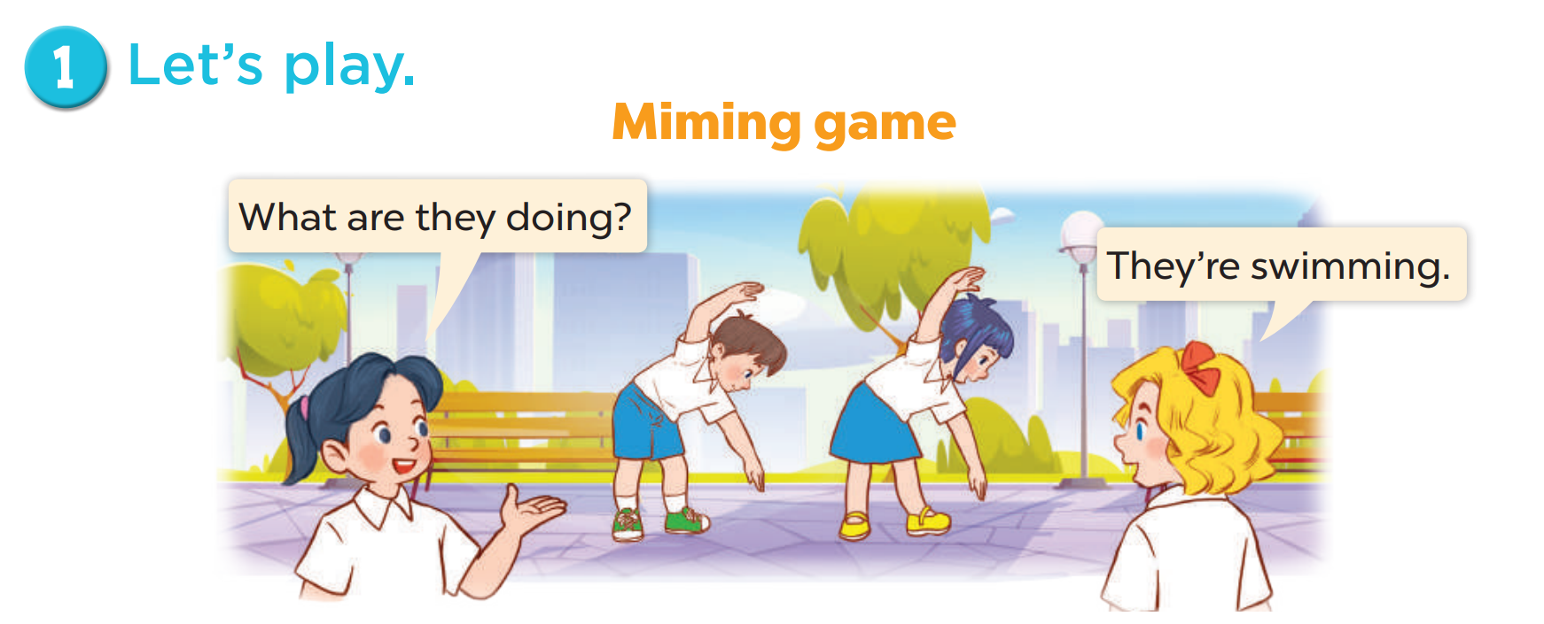
What are they doing?
Who are they?

Slide 21
02
Follow the lines and say.

Slide 22
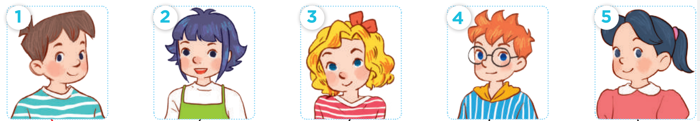
Who are they?
Minh
Linh
Mary
Ben
Mai

Slide 23
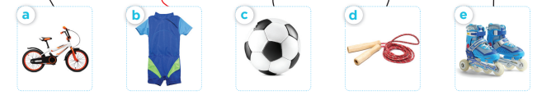
What are they?
a bike
a swimsuit
a football
a skipping
rope
a pair of
skates

Slide 24
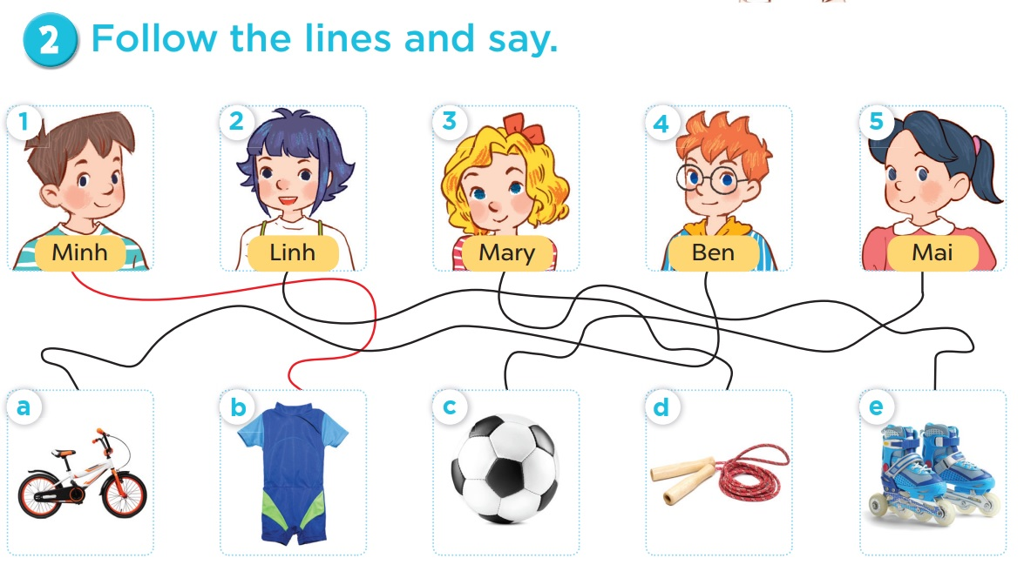
Follow the lines and say.

Slide 25
Follow the lines and say.
Look at Minh. His hobby is swimming.

Slide 26
Follow the lines and say.
Look at Linh. Her hobby is skipping.

Slide 27
Follow the lines and say.
Look at Mary. Her hobby is roller skating.

Slide 28
Follow the lines and say.
Look at Ben. His hobby is cycling.

Slide 29
Follow the lines and say.
Look at Mai. Her hobby is playing football.

Slide 30
03
Read and act out.

Slide 31
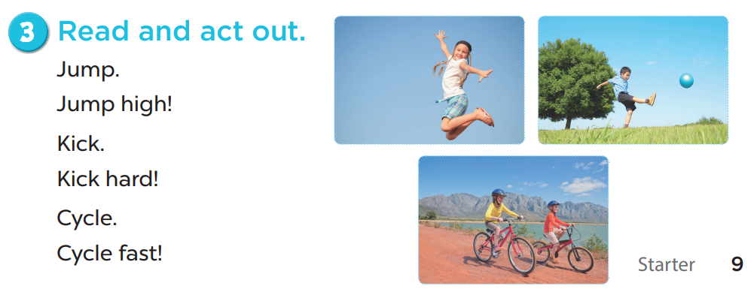

Slide 32
Fun time

Slide 33










1
3
2
4
5
6
7
8
- 5
+20
+3
+5
shoot 2
REFERENCES

Slide 34
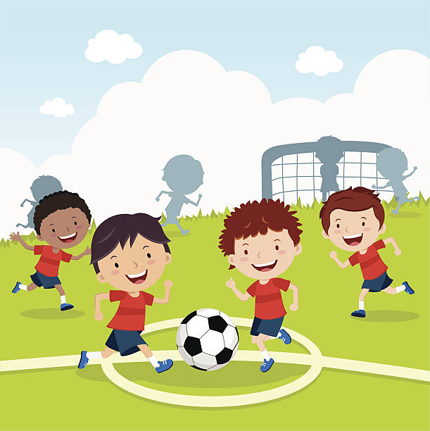
Look, read and choose.
A. We aren’t playing football.
B. We are playing football.
C. We are playing tennis.

Slide 35
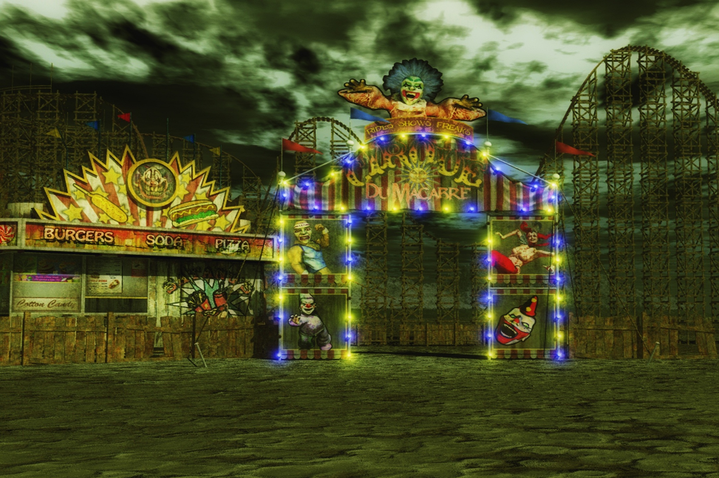




A
B
C
3
5
Notes:
DICE ROLL GAME

Slide 36
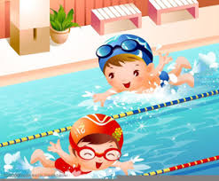
Look, read and choose.
A. They aren’t swimming.
B. They are swimming.
C. They are running.

Slide 37

A
B
C
2
7
Notes:
DICE ROLL GAME

Slide 38

Look, read and choose.
A. They are reading.
B. They are riding a horse.
C. They are drawing.

Slide 39
A
B
C
5
2
Notes:
DICE ROLL GAME

Slide 40
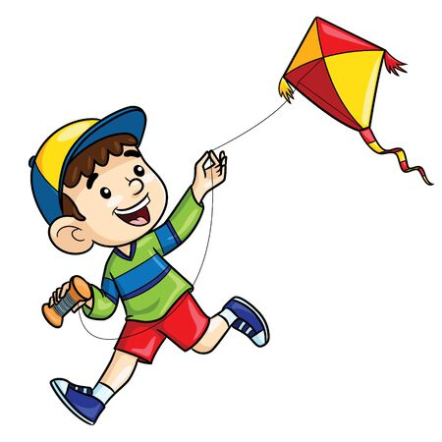
Look, read and choose.
A. He is flying a kite.
B. He isn’t flying a kite.
C. He is skating.

Slide 41
A
B
C
4
Notes:
DONE

Slide 42
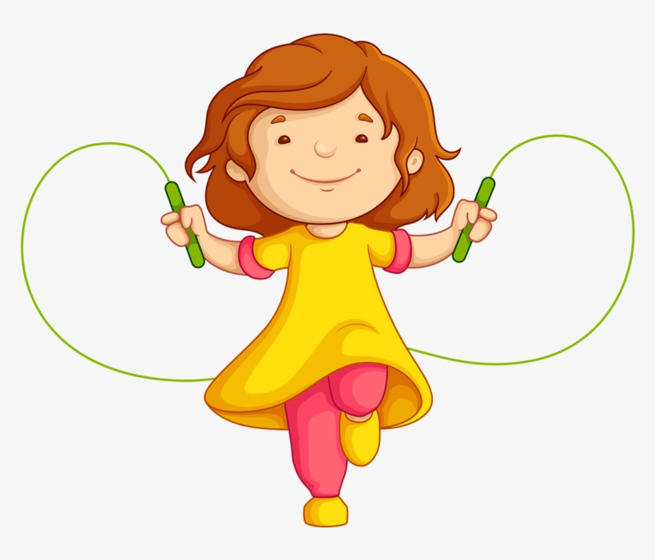
Look, read and choose.
A. Her hobby is running.
B. Her hobby is riding a bike.
C. Her hobby is skipping.

Slide 43
A
B
C
3
5
Notes:
DICE ROLL GAME

Slide 44

Look, read and choose.
A. Her hobby is cycling.
B. Her hobby is swimming.
C. Her hobby is watching TV.

Slide 45
A
B
C
10
Notes:
DONE

Slide 46
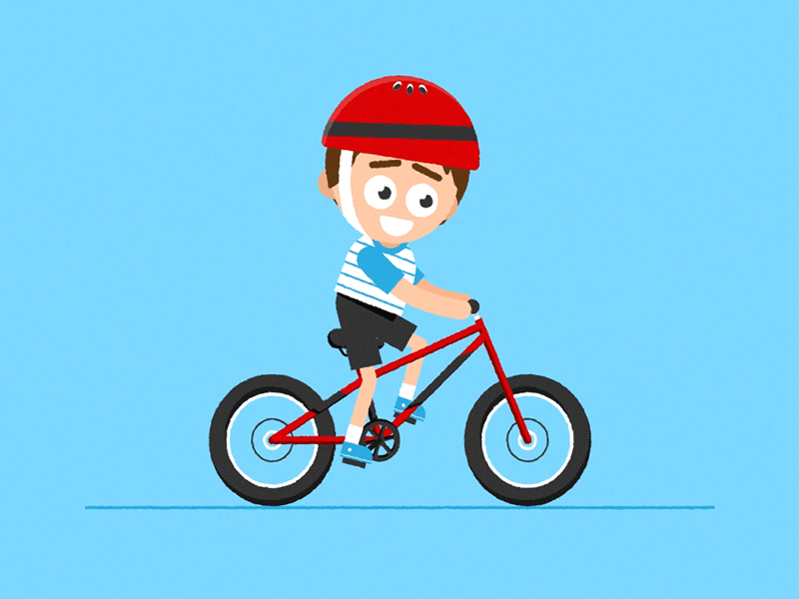
Look, read and choose.
A. His hobby is driving a car.
B. His hobby is running.
C. His hobby is cycling.

Slide 47
A
B
C
5
10
Notes:
DICE ROLL GAME

Slide 48
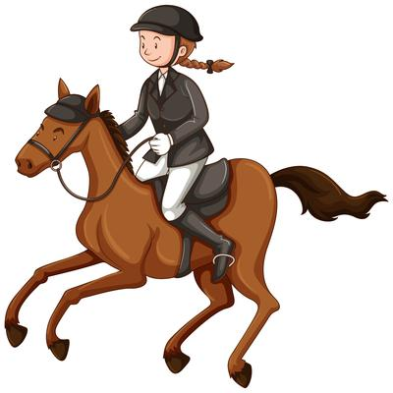
Look, read and choose.
A. Her hobby is riding a horse.
B. Her hobby is driving a car.
C. Her hobby is playing the piano.

Slide 49

A
B
C
Notes:
DONE

