Slide 1
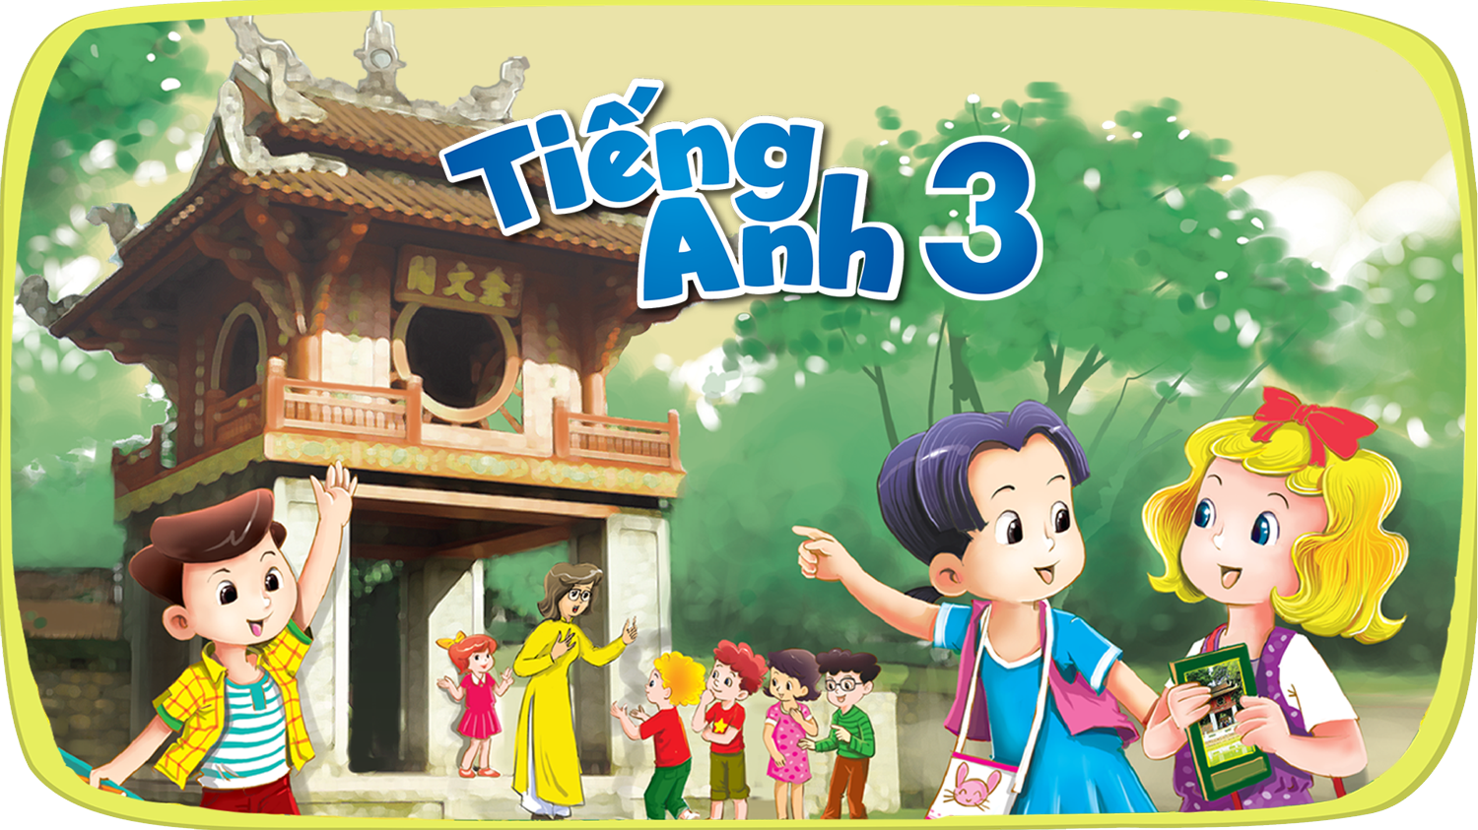




Slide 2
Starter
B. Classroom activites

Slide 3
OBJECTIVES.
By the end of the lesson, pupils will be able to:
Language knowledge & skills:
- say the chant with the correct rhythm and pronunciation.
- Listen to and understand four sentences describing what the characters are doing in the classroom at break time and number the correct pictures.
- listen to and understand a chant with seven sentences describing what the characters usually do in the classroom, and act out the chant.
Competences:
- Communication
- Self-control & independent learning: perform listening tasks

Slide 4
Warm-up & Review

Slide 5

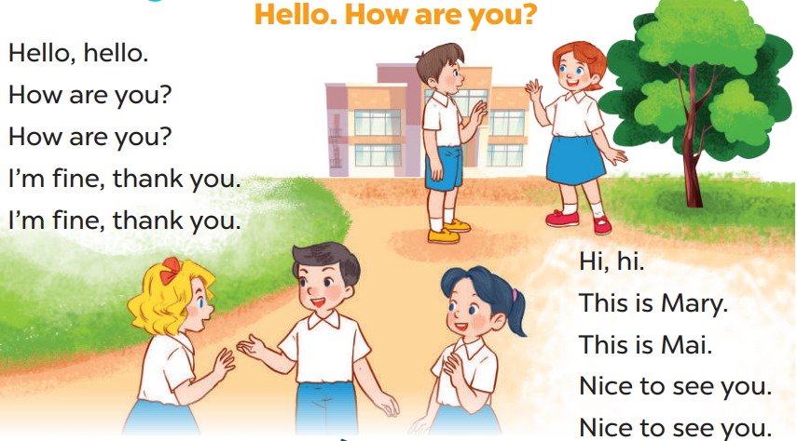
Let’s sing.

Slide 6
Look and guess.

Slide 7
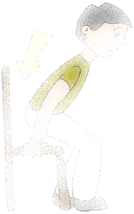
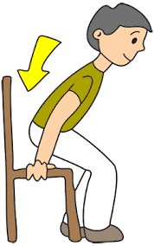
Sit down.

Slide 8

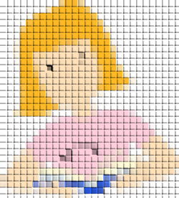
Open your book.

Slide 9


Read aloud.

Slide 10

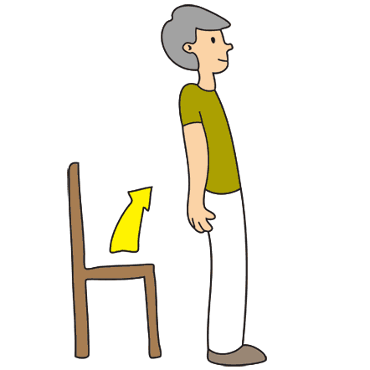
Stand up.

Slide 11
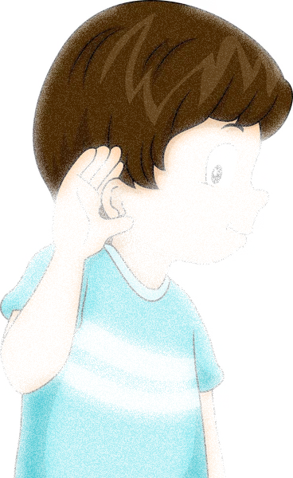
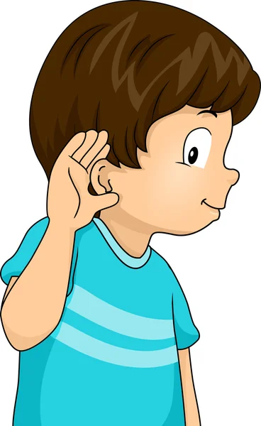
Listen.

Slide 12
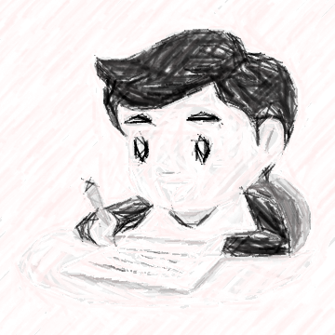

Write.

Slide 13
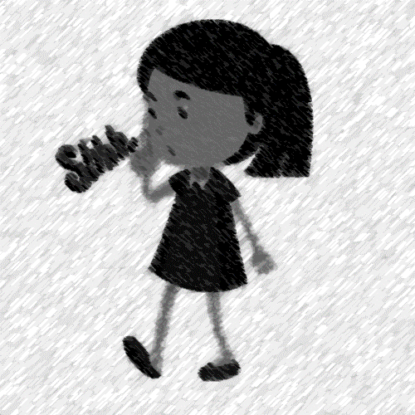

Be quiet.

Slide 14
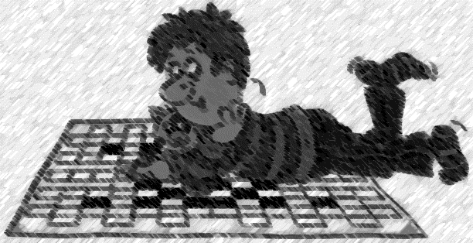
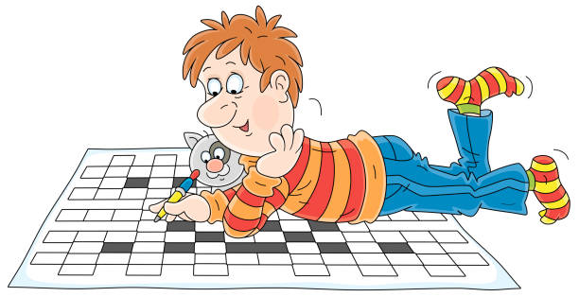
Do a puzzle.

Slide 15
Let’s chant.
01

Slide 16
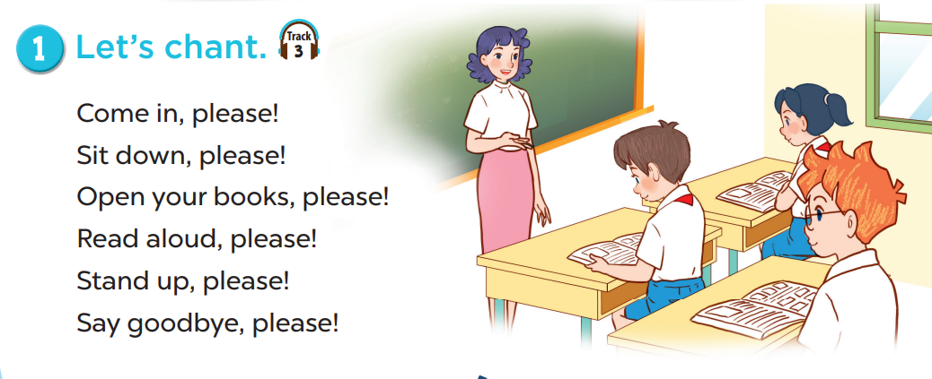
Listen and repeat.

Slide 17
Clap and chant.

Slide 18
Listen and number.
02

Slide 19
Look and say.

Slide 20

What is she doing?
Notes:
She’s reading ………….

Slide 21
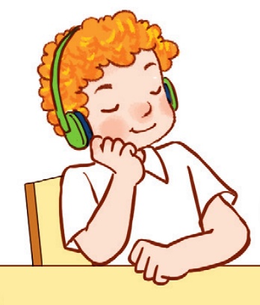
What is he doing?
Notes:
He’s listening to ……………

Slide 22
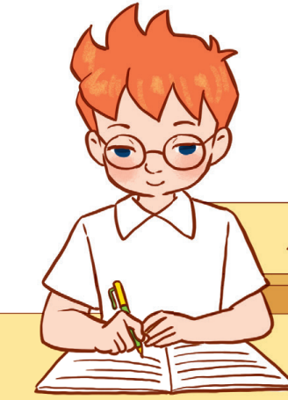
What is he doing?
Notes:
He’s is writing

Slide 23
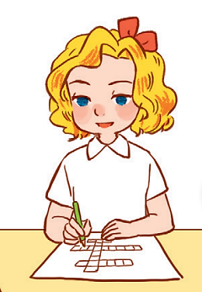
What is she doing?
Notes:
She’s doing a puzzle

Slide 24

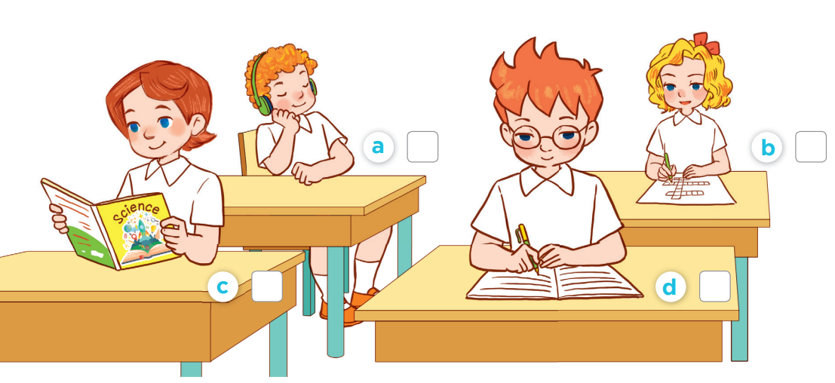
Listen and number.
1
4
2
3

Slide 25
Listen and act out.
03

Slide 26
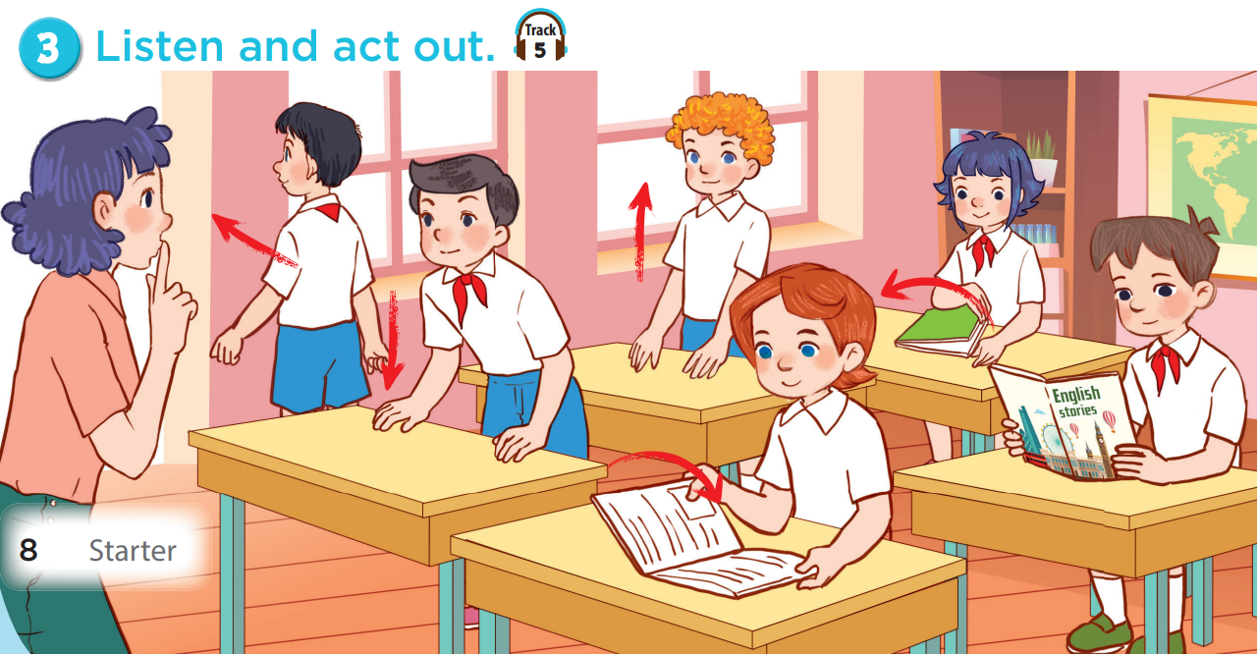

Slide 28
Games

Slide 29
Listen.
- 1*
Read.
- 5*
Team 1
Come in.
+ 5*
Open your book.
+4*
Team 2
Go out.
– 2*
SPIN
Say goodbye.
+2*
Team 3
Close your book.
+ 4*
Be quiet.
+1*
Sit down.
– 5*
Do a puzzle.
1 *
Stand up.
* 5*
Raise hands.
-2*

