Slide 1





Slide 2
Lesson 2
REVIEW
1

Slide 3
I. OBJECTIVES.
By the end of the lesson, pupils will be able to:
1. Language.
- Correctly use the following sentence patterns:
Where are you from? - I’m from ______.
Where’s he/she from? - He’s/ She’s from _______.
What time is it?
Can you ______? - Yes, I can. / No, I can’t.
Can he/she ______? - Yes, he/she can./ No, he/she can’t, but ____.
When’s your birthday? - It’s in _______.
What do you do on ______? - I ________.
What time do you ______? I _______ at ________.
What do you want to eat/drink? - I want _______.
2. Competencies.
- Communication and collaboration: work in pairs or groups
3. General competencies.
- Listening: listen and number
- Critical thinking: read and match
- Self-control & independent learning: perform listening tasks
- Communication and collaboration: work in pairs or groups
- Sociability: talk to each other, say good words to others.
4. Attributes.
- Work hard to consolidate what they have learnt and make good progress

Slide 4
Warm-up

Slide 5
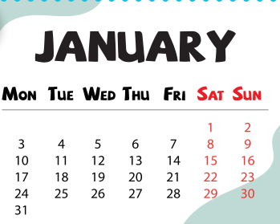
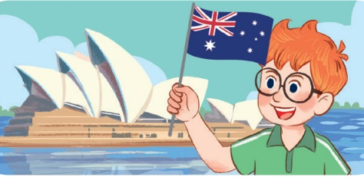

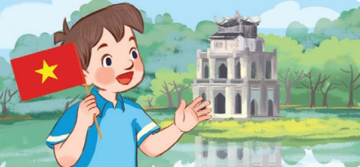
Choose the odd.

Slide 6

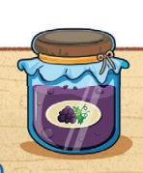
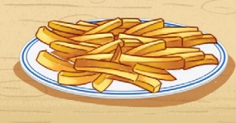
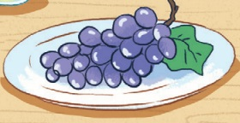
Choose the odd.

Slide 7
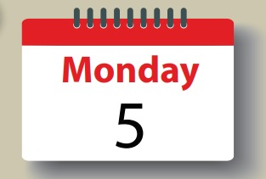
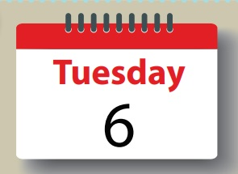
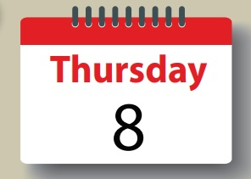

Choose the odd.

Slide 8
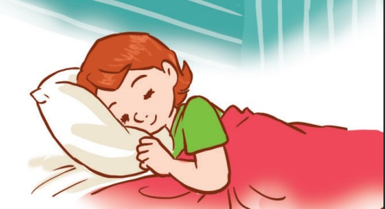


Choose the odd.

Slide 9
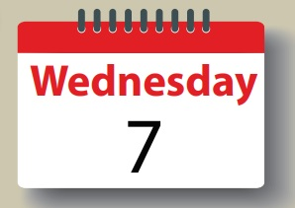

Choose the odd.

Slide 10
5. Read and
complete.

Slide 11
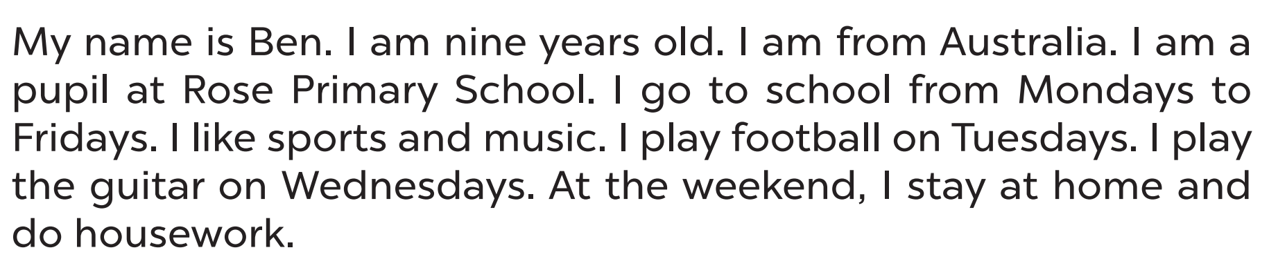
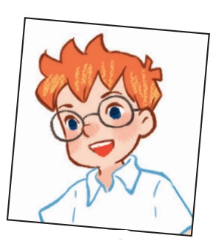
Read the text.

Slide 12
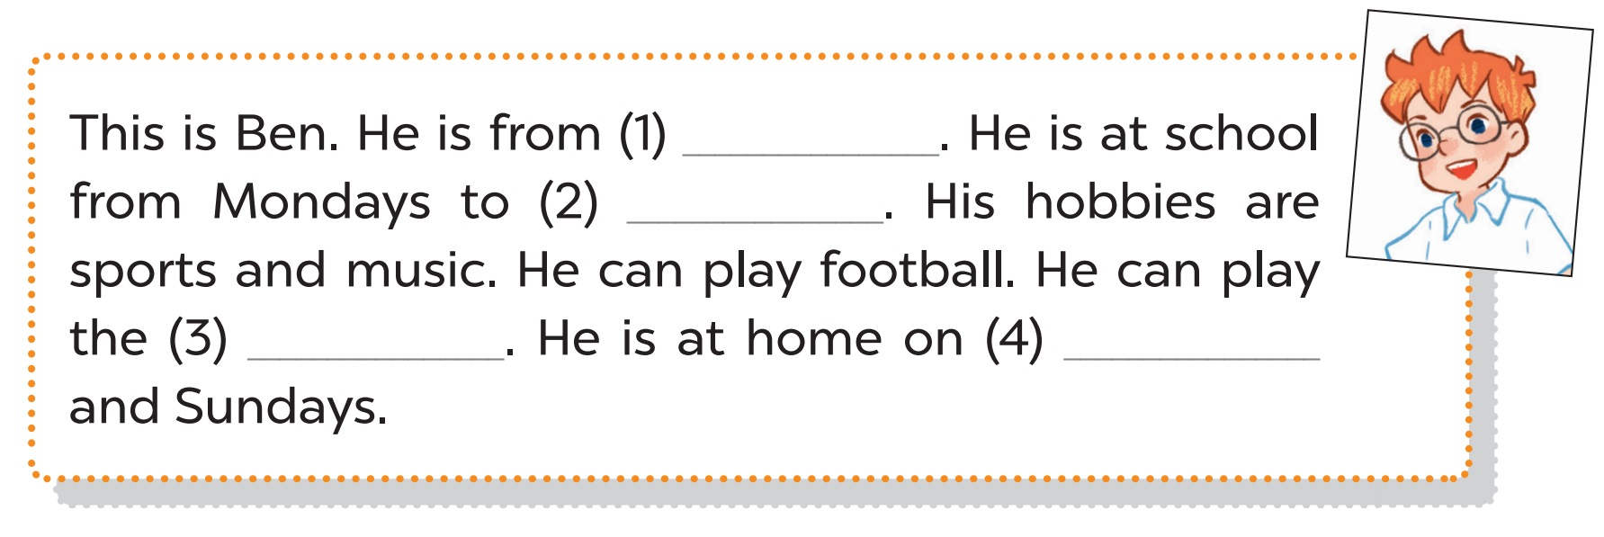
Let’s check.
Australia
Fridays
guitar
Saturdays

Slide 13
Reading comprehension

Slide 14

Where is Ben from?
He’s from Australia.

Slide 15
How many days does
Ben go to school?
Five days
(from Monday to Friday).

Slide 16

Can he play football?
Yes, he can.

Slide 17
Can he play the guitar?
Yes, he can.

Slide 18

Does he go to school on Saturdays?
No, he doesn’t.

Slide 19
5. Let’s write.

Slide 20
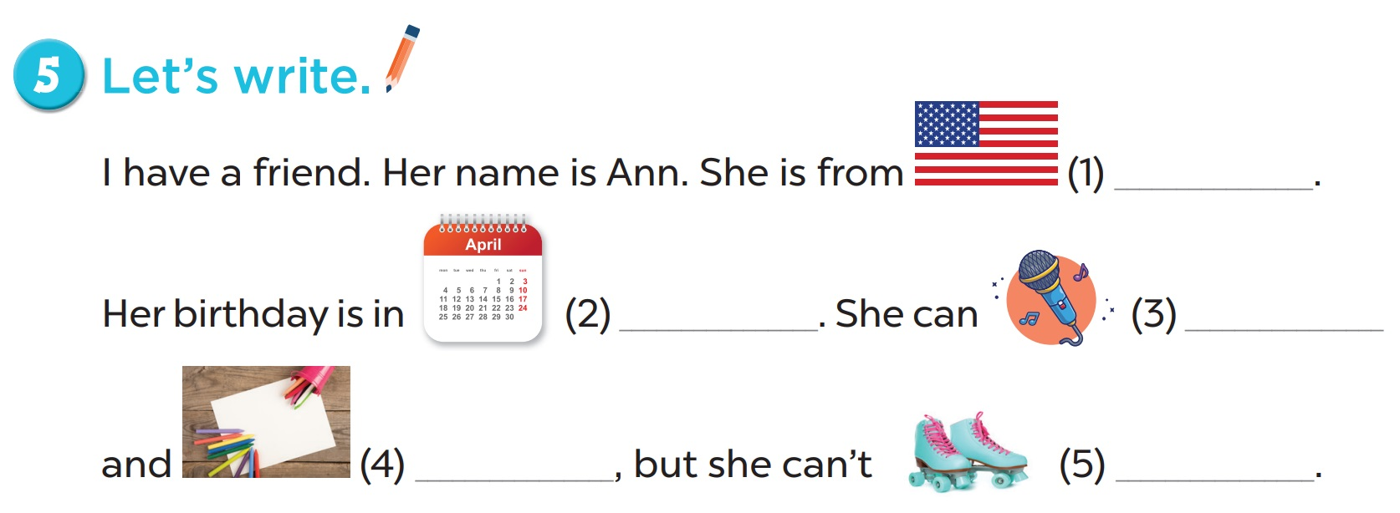
America
April
sing
draw
roller skate

Slide 21
Game

Slide 22
0
0
0
O
O
O
X
X
X
1
2
3
X
X
X
0
0
0
O
O
O
X
X
X
4
5
6
X
X
X
0
0
0
O
O
O
X
X
X
7
8
9
X
X
X

Slide 23

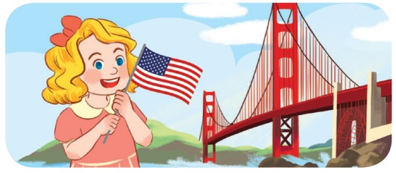
_m_r_c_
I’m Mary. I’m from ……………………. .
America

Slide 24

_rita_n
I’m Lucy. I’m from ……………………. .
Britain

Slide 25
W_dn_sd_y
Tuesday - …………………. - Thursday
Wednesday

Slide 26

l_m_n_d_
- What do you want to drink?
- I want some l……………………. .
lemonade

Slide 27

w_t_r
I want some w…………… .
water

Slide 28
F_br__r_
January - …………………. - March
February

Slide 29

………….. o’clock
I go to school at s_v_n _’cl_ck.
seven o’clock

Slide 30
j_m
There is j…………… on
the table.
jam

Slide 31
gr____
There are some gr……………
on the plate.
grapes

