Slide 1





Slide 2
Lesson 1
REVIEW
1

Slide 3
I. OBJECTIVES.
By the end of the lesson, pupils will be able to:
1. Language.
- correctly use the following sentence patterns:
Where are you from? - I’m from ______.
Can you ______? Yes, I can. / No, I can’t.
Can he/she ______? - Yes, he/she can./ No, he/she can’t, but ____.
When’s your birthday? - It’s in _______.
What do you do on ______? - I ________.
What time do you ______? I _______ at ________.
What do you want to eat/drink? - I want _______.
2. Competencies.
Self-control & independent learning: perform learning tasks
Communication and collaboration: work in pairs or groups
3. General competencies.
- Critical thinking: read and match
- Self-control & independent learning: perform listening tasks
- Communication and collaboration: work in pairs or groups
- Sociability: talk to each other, say good words to others.
4. Attributes.
- Kindness: help partners to complete learning tasks
- Diligence: complete learning tasks
- Honesty: tell the truth about feelings and emotions

Slide 4
Warm-up

Slide 5



1
2
3
4
5
6
7
8

Slide 6



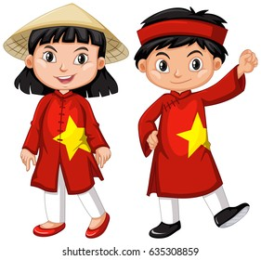






- Where are you from?
– I’m from
Viet Nam
Japan
Viet Nam
England

Slide 7

- What day is it today?
It’s
It’s Wednesday.
It’s Tuesday.

Slide 8

- What do you do on Mondays?
- We
go to school.
We go to school.
We do housework.
We listen
to music.

Slide 9

- When’s your birthday?
– It’s in .
April
March
May
April

Slide 10
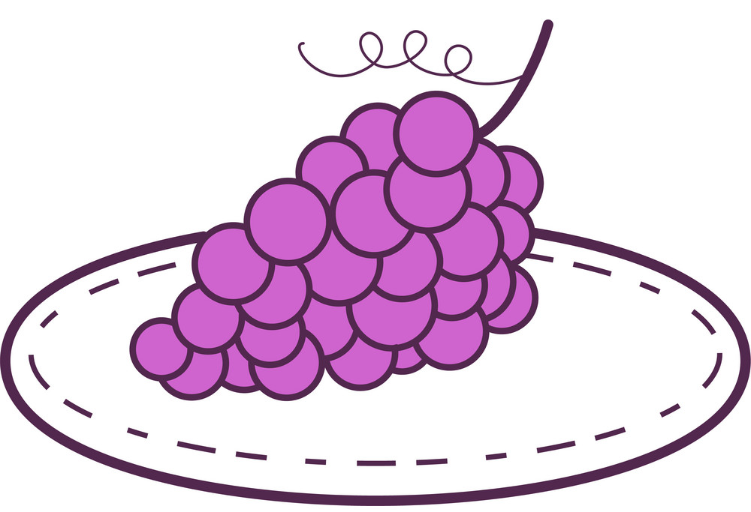
- What do you want to eat?
– I want some .
grapes
apples
grapes
chips

Slide 11

- What do you want to drink?
Juice
– I want some .
water
juice
milk

Slide 12

- What time is it?
- It’s
one fifteen
one fifteen
one thirty

Slide 13

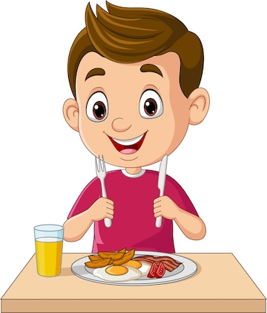
- What time do you have breakfast?
- I have breakfast at
six o’clock
six o’clock
five o’clock
eight o’clock

Slide 14

- When’s your birthday?
– It’s in
April
March
May
April

Slide 15
1. Listen and tick.

Slide 16
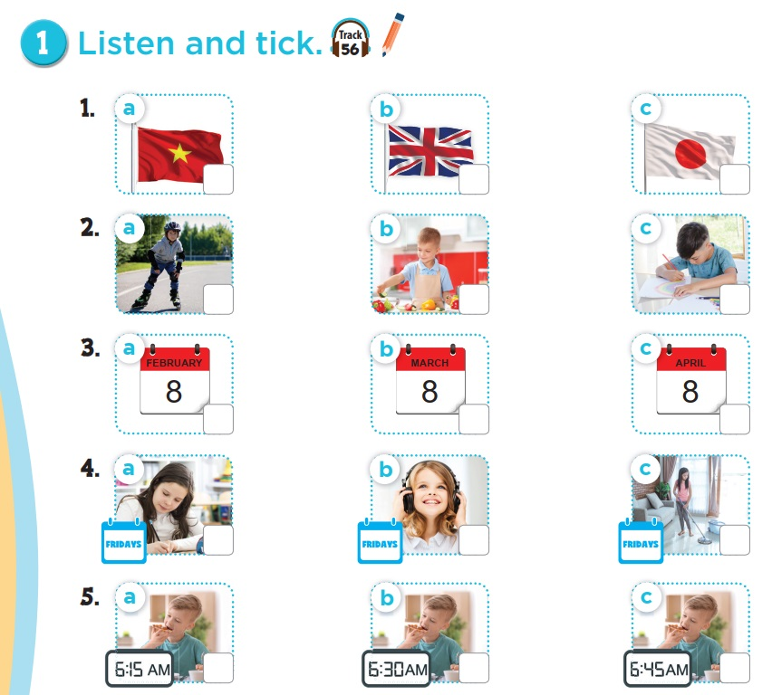



Slide 17
2. Ask and answer.

Slide 18
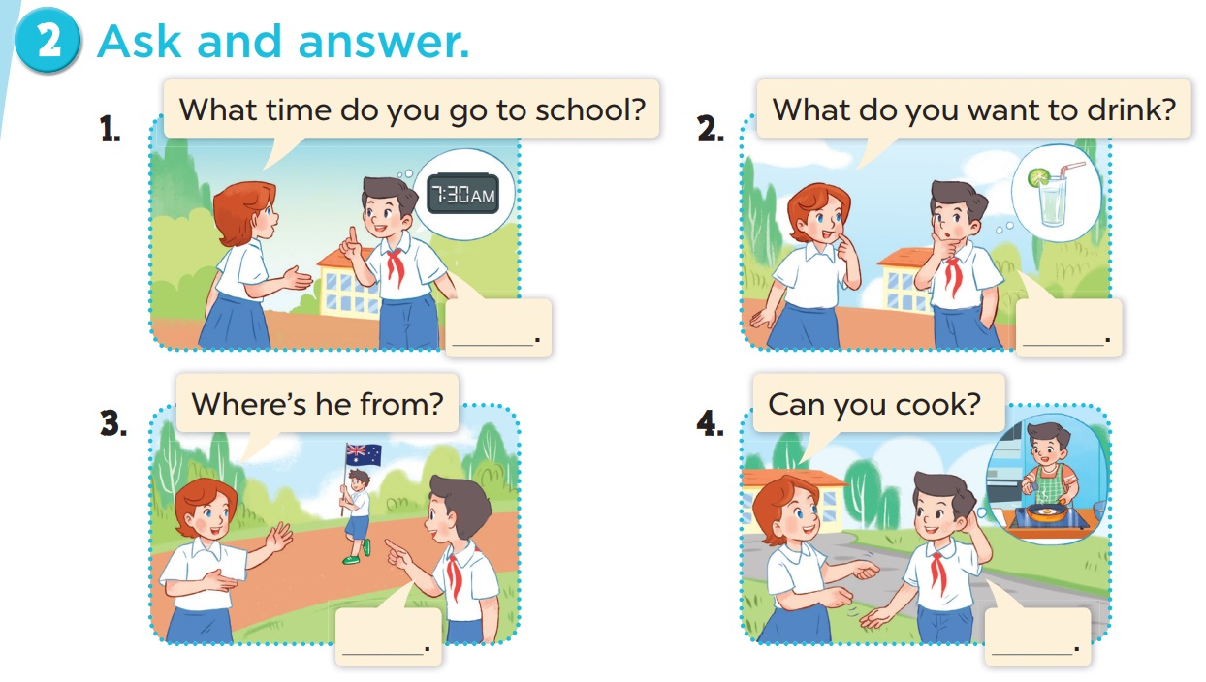

Slide 19
3. Read and match.

Slide 20
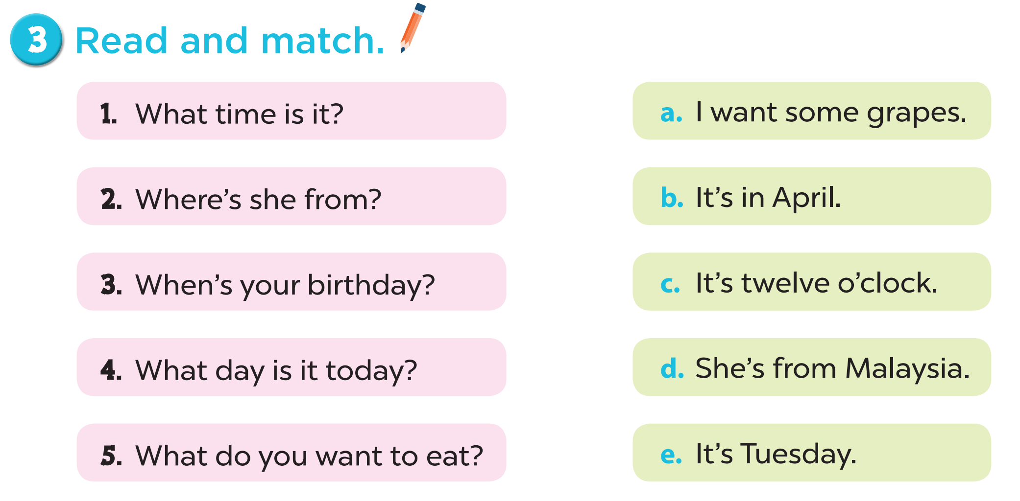
Notes:
Key: 1. c 2. d 3. b 4. e 5. a

Slide 21
Game

Slide 22


1 *
Can you …?
5 *
What time do you ….?
SPIN
3*
What do you want to drink?
2*
What do you want to eat?
10*
What do you do on …?
tekhnologic

