Slide 1


Slide 2
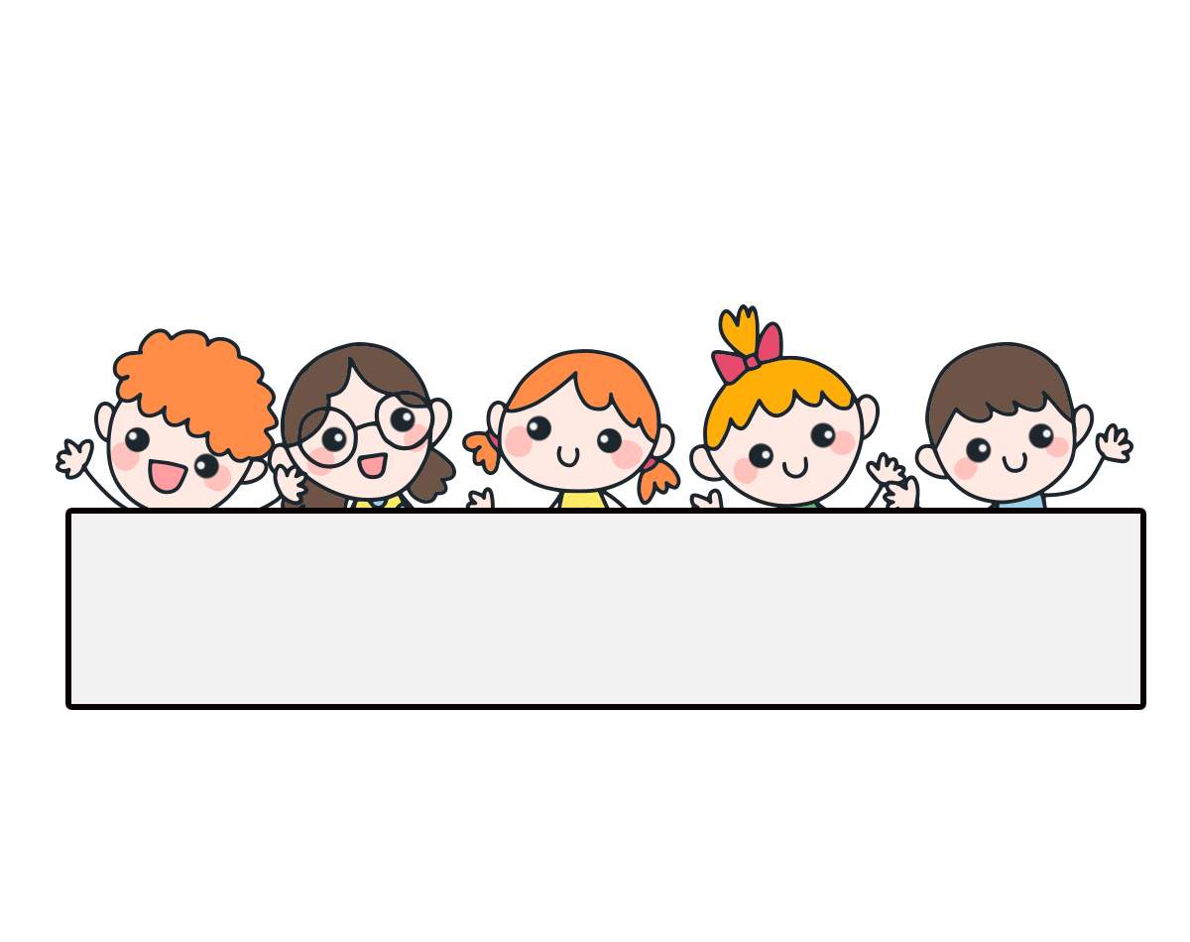
Warm-up

Slide 3
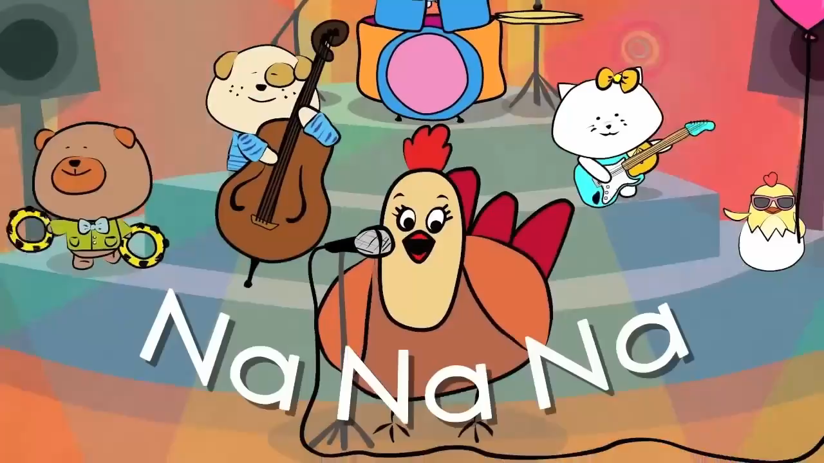

Slide 4


RING
THE GOLDEN BELL

Slide 5


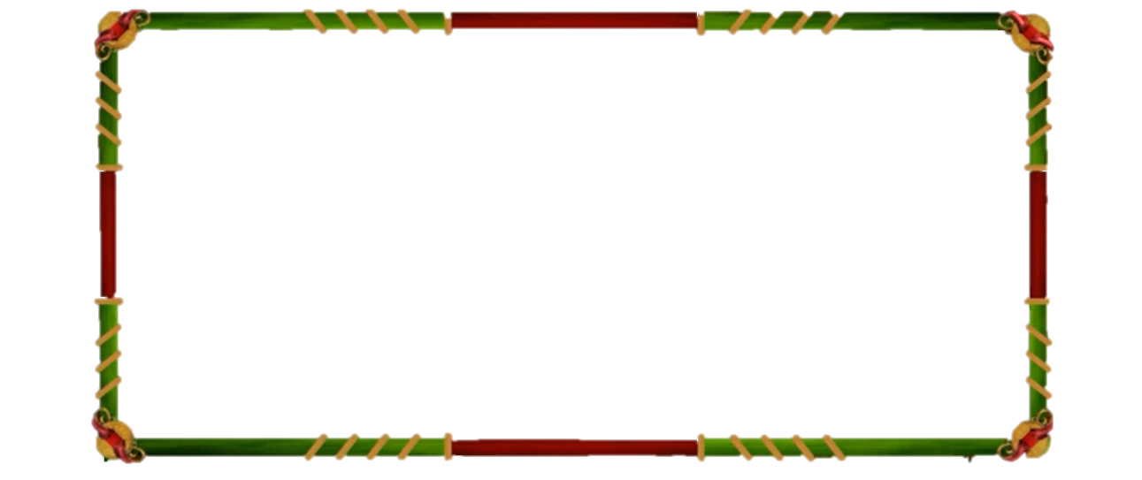

RING THE GOLDEN BELL
Các học sinh lần lượt trả lời 10 câu hỏi Học sinh trả lời vào bảng. Nếu trả lời đúng thì được giữ lại để trả lời câu tiếp theo. Nếu sai bị loại và úp bảng xuống bàn. Học sinh còn lại cuối cùng là người xuất sắc nhất. Người nào trả lời đúng câu hỏi cuối cùng là người chiến thắng, rung được chuông vàng.

Slide 6

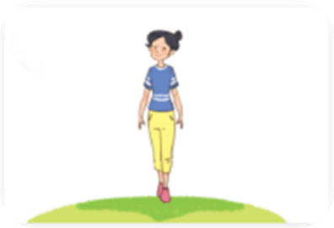
Question 1
Linh: What does she look like?
Mai: ____________.
A. She slim
B. She’s slim
10
9
8
7
6
5
4
3
2
1
0
C. She has slim
D. She does slim

Slide 7


Question 1
Linh: What does she look like?
Mai: ____________.
A. She slim
B. She’s slim
10
C. She has slim
D. She does slim

Slide 8

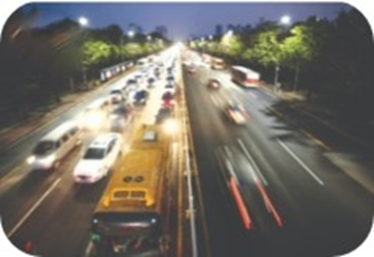
Question 2
What’s the ________ like?
A. village
B. big city
10
9
8
7
6
5
4
3
2
1
0
C. road
D. small street

Slide 9

Question 2
What’s the ________ like?
A. village
B. big city
10
C. road
D. small street

Slide 10
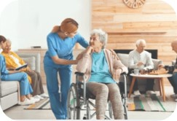
Question 3
Mary: __________________?
Bill: She works at a nursing home.
A. Where does your mother work?
B. Where does he work?
10
9
8
7
6
5
4
3
2
1
0
C. What does she do?
D. Where does he live?

Slide 11
Question 3
Mary: __________________?
Bill: She works at a nursing home.
A. Where does your mother work?
B. Where does he work?
10
C. What does she do?
D. Where does he live?

Slide 12
Question 4
Ben: What does he do on Sundays?
Nam: ____________.
A. He watch TV.
B. He watchs TV.
10
9
8
7
6
5
4
3
2
1
0
C. He cook meals.
D. He watches TV.

Slide 13
Question 4
Ben: What does he do on Sundays?
Nam: ____________.
A. He watch TV.
B. He watchs TV.
10
C. He cook meals.
D. He watches TV.

Slide 14
Question 5
Linh: Where do you live?
Mai: I live _____ Tran Hung Dao Street
A. in
B. at
10
9
8
7
6
5
4
3
2
1
0
C. a
D. an

Slide 15
Question 5
Linh: Where do you live?
Mai: I live _____ Tran Hung Dao Street.
A. in
B. at
10
C. a
D. an

Slide 16
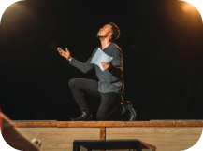
Question 6
Lucy: What does he do?
Nam: He’s ________.
A. a actor
B. a policeman
10
9
8
7
6
5
4
3
2
1
0
C. an actor
D. a farmer

Slide 17
Question 6
Lucy: What does he do?
Nam: He’s ________.
A. a actor
B. a policeman
10
C. an actor
D. a farmer

Slide 18
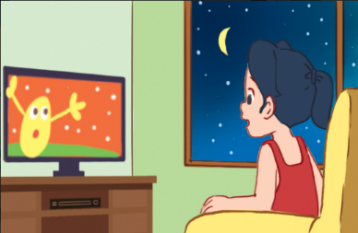
Question 7
Bill: When do you watch TV?
Linh: I watch TV ________.
A. in the morning
B. at noon
10
9
8
7
6
5
4
3
2
1
0
C. in the afternoon
D. in the evening
nguyenngocduong.vn

Slide 19
Question 7
Bill: When do you watch TV?
Linh: I watch TV ________.
A. in the morning
B. at noon
C. in the afternoon
D. in the evening

Slide 20
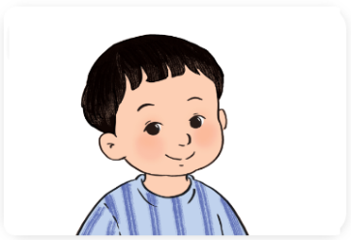
Question 8
Ben: What does your brother look like?
Nam: He________.
A. have short hair
B. has a round face
10
9
8
7
6
5
4
3
2
1
0
C. is short hair
D. haves a round face
nguyenngocduong.vn

Slide 21
Question 8
Ben: What does your brother look like?
Nam: He________.
A. have short hair
B. has a round face
10
C. is short hair
D. haves a round face
nguyenngocduong.vn

Slide 22
Question 9
Mary: ______ does he go on Saturdays?
Bill: He goes to the sport centre.
A. what
B. who
10
9
8
7
6
5
4
3
2
1
0
C. When
D. Where
nguyenngocduong.vn

Slide 23
Question 9
Mary: ______ does he go on Saturdays?
Bill: He goes to the sport centre.
A. what
B. who
10
C. When
D. Where
nguyenngocduong.vn

Slide 24
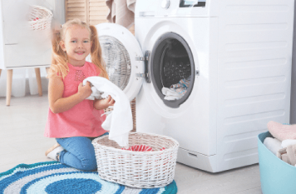
Question 10
Mai: What do you do in the morning?
Hoa: I ________.
A. clean the floor
B.wash the clothes
10
9
8
7
6
5
4
3
2
1
0
C. help with the cooking
D. wash the dishes
nguyenngocduong.vn

Slide 25
Question 10
Mai: What do you do in the morning?
Hoa: I ________.
A. clean the floor
B. wash the clothes
10
C. help with the cooking
D. wash the dishes
nguyenngocduong.vn

Slide 26

CONGRATULATION

Slide 27
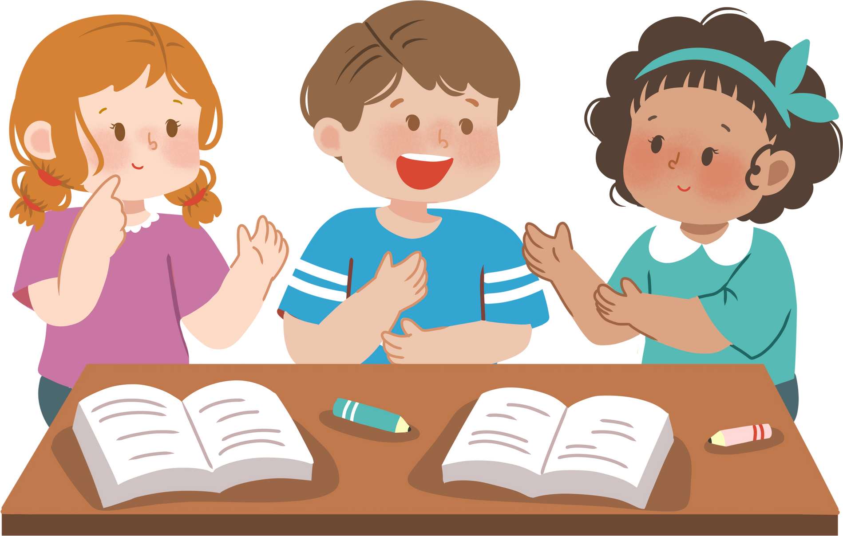
Friday, March 14th 2025
Review 3 (1+2)

Slide 28


Contents
Listen and number.
Ask and answer.

Slide 29

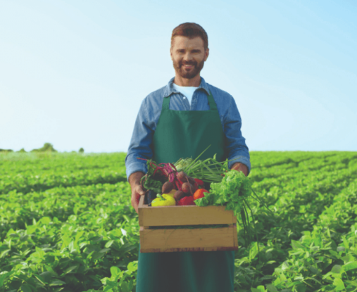
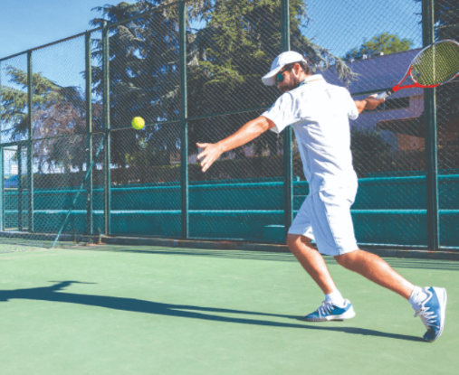
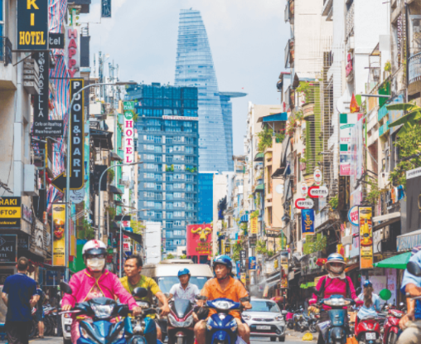
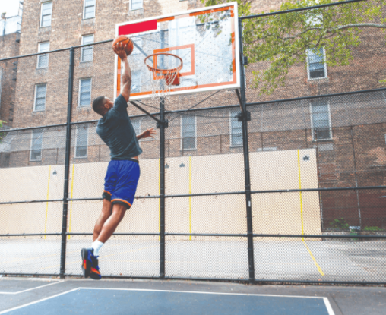




1. Listen and number.
a
b
2
4
c
d
1
3

Slide 30
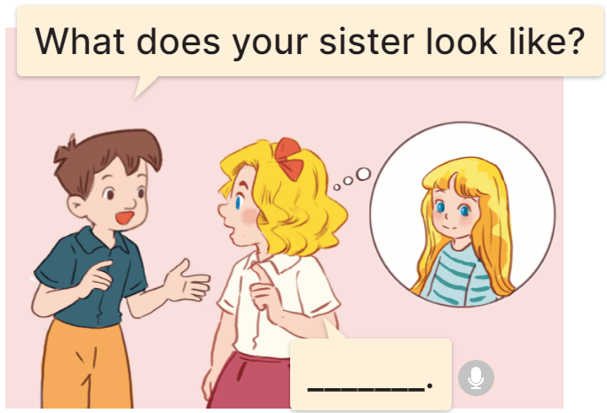
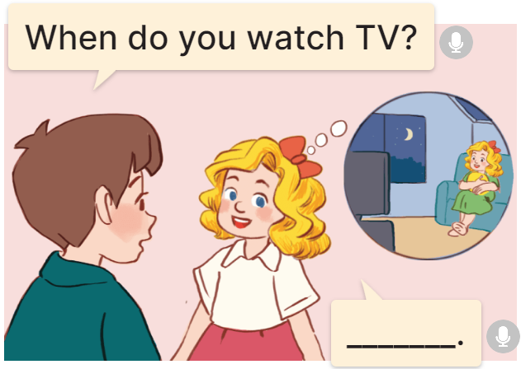
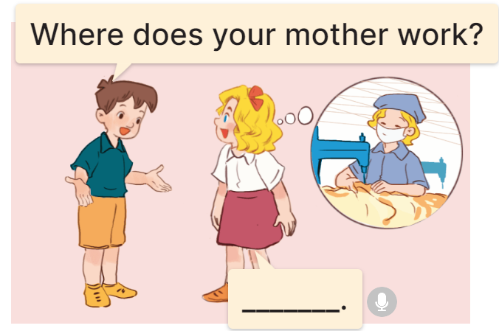
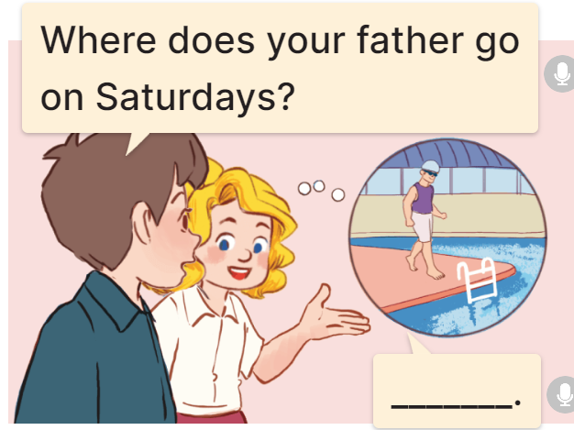
2. Ask and answer.
1.
2.
When do you watch TV?
What does your sister look like?
________________________.
_______________.
I watch TV in the evening
She has long hair
3.
4.
Where does your mother work?
Where does your father go on Saturdays?
______________________.
She works at a factory
____________________________.
He goes to the swimming pool

Slide 31
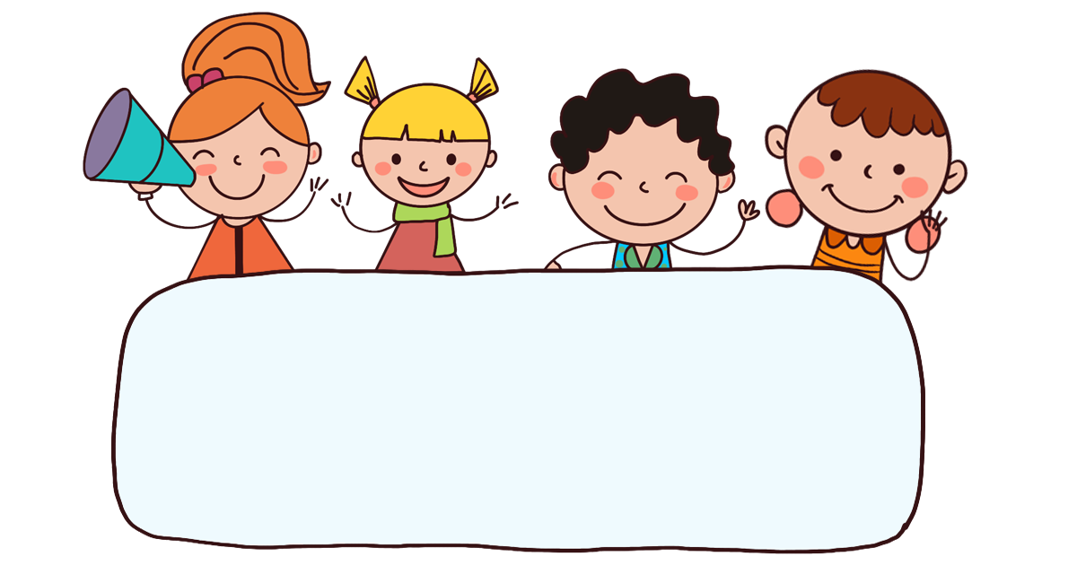
Fun corner
& wrap - up

Slide 32
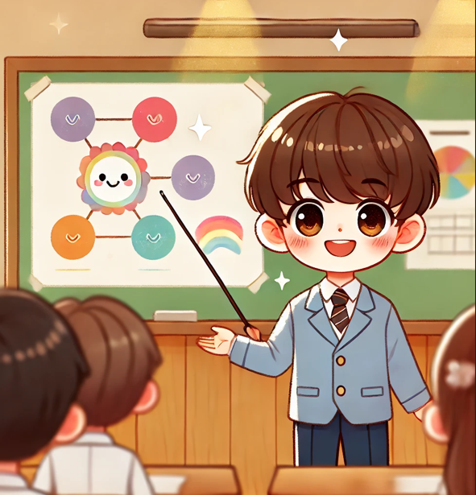
Draw a picture of a family member and talk about them.

Slide 33
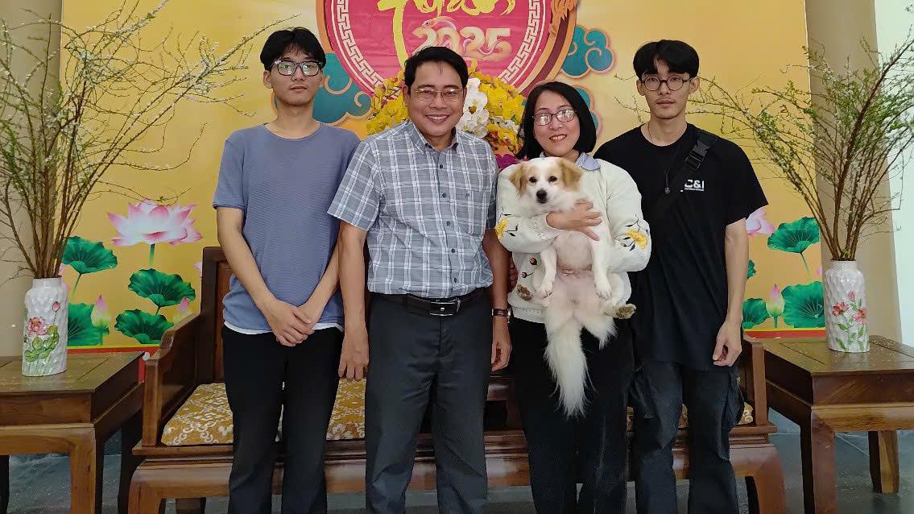

Slide 34
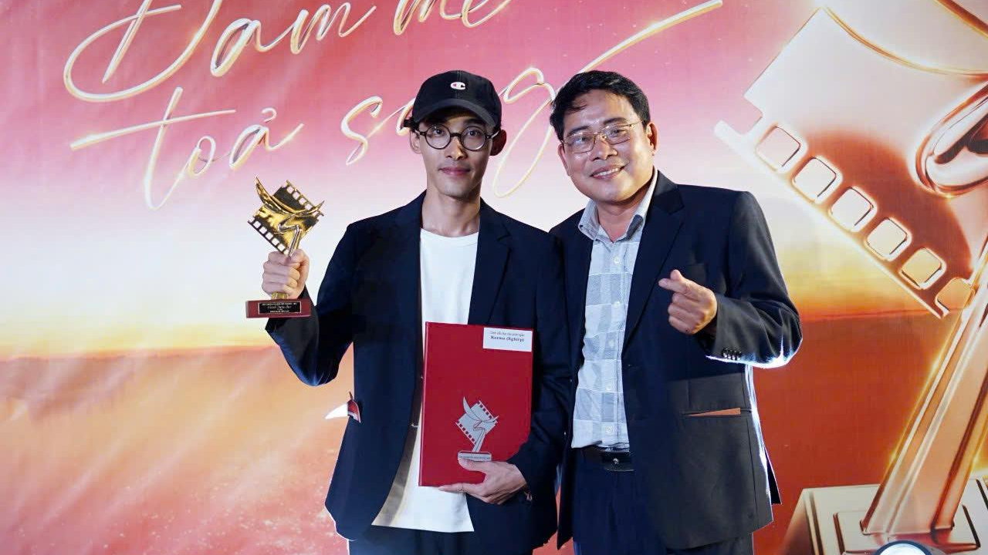

Slide 35
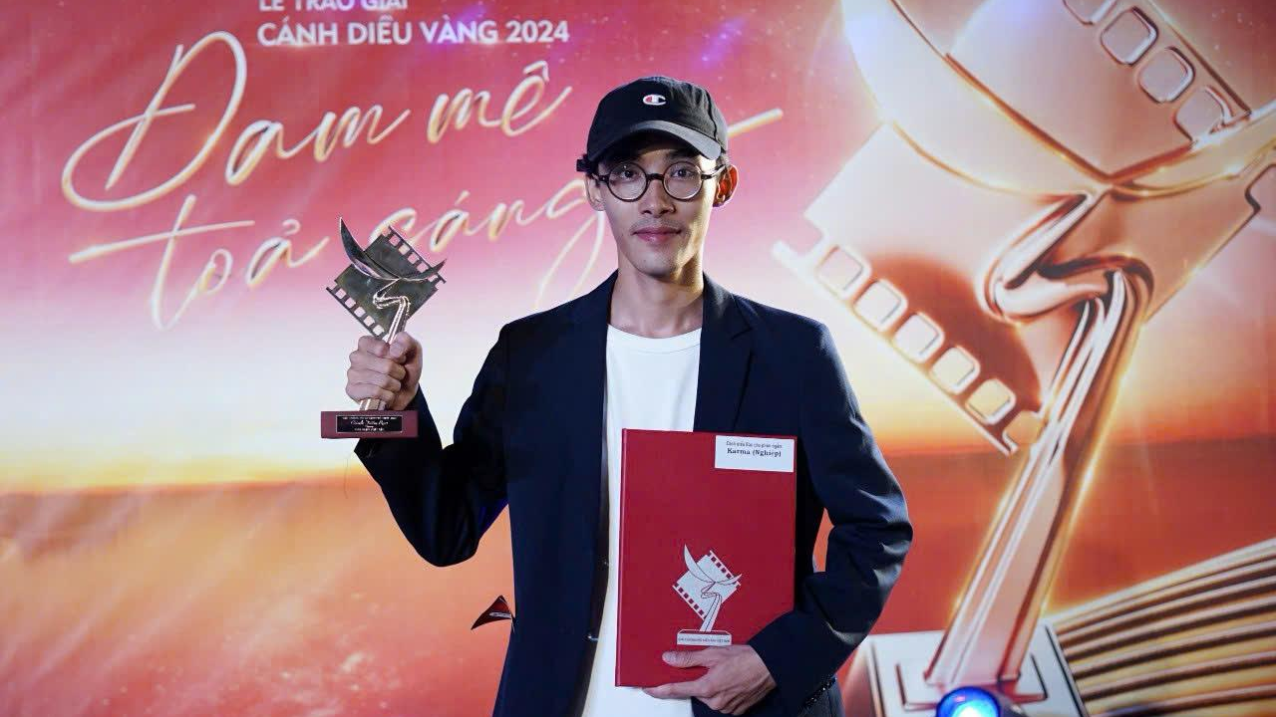

Slide 36

Thank you!

