Slide 1
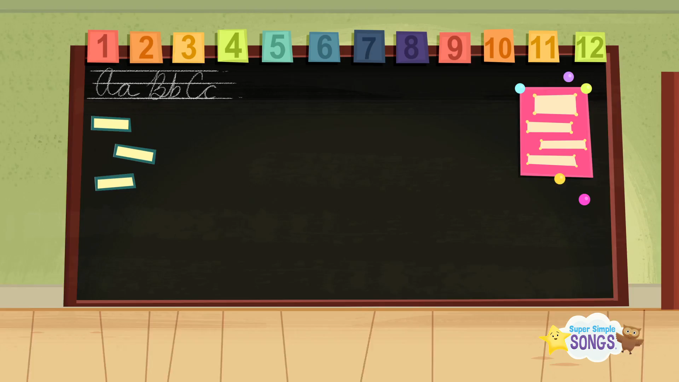

Slide 2

Wednesday, 8th May 2024
UNIT 19.THE ANIMAL WORLD
LESSON 3: 123
1. Listen and repeat.
‘loudly
These animals are roaring ‘loudly.
‘quickly
Those animals are running ‘quickly.

Slide 3
Wednesday, 8th May 2024
UNIT 19.THE ANIMAL WORLD
LESSON 3: 123
2. Listen and circle.
These giraffes are moving…………….
A. quickly B. loudly
2.Those lions are roaring………………… .
A. loudly B. quickly

Slide 4
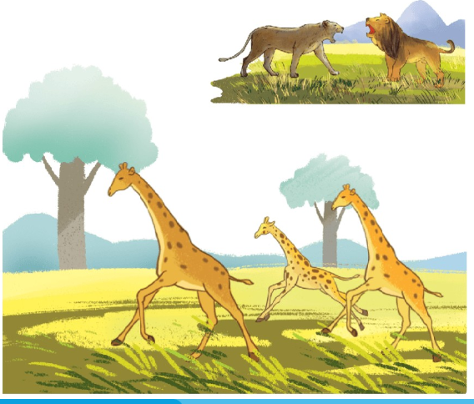
Wednesday, 8th May 2024
UNIT 19.THE ANIMAL WORLD
LESSON 3: 123
3. Let’s chant.
Loudly, loudly.
These lions are roaring loudly.
They are roaring loudly.
Quickly, quickly.
Those giraffes are running quickly.
They are running quickly.

Slide 5
Wednesday, 8th May 2024
Unit 19 THE ANIMAL WORLD
LESSON 3:123
Game
1. This animal has a long neck and legs
FFEGIRA
This animal is grey, big and has got short legs.
GIRAFFE
OPPIH
HIPPO
2.This animal roars loudly.
ONLI
LION

Slide 6
Wednesday, 8th May 2024
UNIT 19.THE ANIMAL WORLD
LESSON 3: 123
3.This animal likes bananas.
KEYMON
MONKEY
4.This animal dances beautifully.
KCOPEAC
PEACOCK

